Slide 1
Introduction to CesrTA
David Rubin
September 11, 2012

Slide 2
Questions
Consider the positron storage ring:
What is the threshold beam current for emittance dilution and instability due to the electron cloud ?
What are the most effective techniques for mitigating the growth of the electron cloud ?
What are the relevant material properties of the mitigations?
How do we extrapolate our findings to other machines ?

Slide 3
Program: Question 1
To address the first question (emittance dilution threshold ?)
Create low emittance (both horizontal and vertical) CESR configuration so that we can explore the beam physics in the appropriate regime =>
Superconducting damping wigglers to reduce emittance
Instrumentation for beam based measurement and optics correction, to minimize residual coupling and dispersion
Instrumentation for measuring emittance
Develop techniques for generating an electron cloud of arbitrary (ring averaged) density
Instrumentation to measure emittance growth and instabilities as a function of the cloud density

Slide 4
Program Questions 2-3
To address the second (effectiveness of mitigations ?)
Detectors for measuring local electron cloud density in a controlled environment including:
Flux of synchrotron radiation
External magnetic field (dipole, quadrupole, wiggler, drift)
Vacuum chamber geometry and surface treatment
Beam energy, current and bunch configuration
(Retarding field analyzers, shielded pickups, TE wave)
And the third (material properties ?)
Detectors that can provide temporal information about the growth and decay of the cloud
( Shielded pickups and time resolving RFAs)

Slide 5
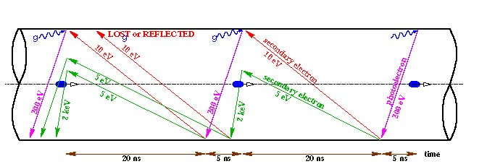
Question 4 – Extrapolation
Electron Cloud
Synchrotron radiation photons strike chamber walls emitting photo-electrons.
Electrons are accelerated by the circulating positron bunches into the opposite wall, producing secondaries
Interaction of the positron beam with the accumulating cloud generates instabilities and dilutes vertical emittance

Slide 6
4 – Extrapolation to Other Machines
Physics of the electron cloud is incorporated into models
The “Complete” model includes
Emission of photons from circulating positrons
Tracking of photons to the vacuum chamber. Generation of a photoelectron, or a reflection. If reflected continue tracking.
Simulation of the emission of photoelectrons at the photon-wall absorption point.
Evaluation of forces that act on the electrons (from the beam, space-charge and external fields).
Application of forces to the electrons and propagation of electron trajectories.
Simulation of secondary emission as the electrons hit the walls of the chamber.
Many details are parameterized in the model:
Dependence of photon scattering angle on chamber surface (roughness). (Experimental program to verify reflectivity model is underway – Reflectivity collaboration)
Quantum efficiency, angular and energy distribution of photo-electrons depends on photon energy and chamber surface properties
Secondary emission depends on primary energy and incident angle as well as surface chemistry
Measurements inform the models and constrain the parameters
The models are the basis of the simulations that predict storage ring performance

Slide 7
CESR Conversion

Slide 8
CESR Conversion
Reconfigure CESR layout for low emittance operation
Develop/install instrumentation for measuring electron cloud
Retarding field analyzers, - measurement of local density, spatial and energy distribution of the cloud
Shielded pickups – local measurement of time evolution of the cloud
TE-wave – semi-local measurement of density
Bunch dependent tune shifts (global measure of cloud density)
Develop/install instrumentation for tuning low emittance (correcting β-phase, coupling, dispersion) and measuring effect of cloud on the beam
High bandwidth/high precision beam position monitors
Turn by turn/bunch by bunch x-ray beam size monitor (to measure vertical emittance)
Deploy survey reference grid for routine magnet alignment
Develop/install instrument for direct measurement of SEY of materials in storage ring environment

Slide 9
CESR Conversion - constraint
Preserve compatibility with CHESS x-ray operation.
Transition from CesrTA low emittance single beam optics, to CHESS electron/positron configuration must be routine (1-2 hours)
Gate valves suitably deployed to minimize effect on CESR vacuum and CHESS operation when swapping test chambers

Slide 10
Low Emittance
Machine Layout, Optics and Instrumentation for Low Emittance operation

Slide 11
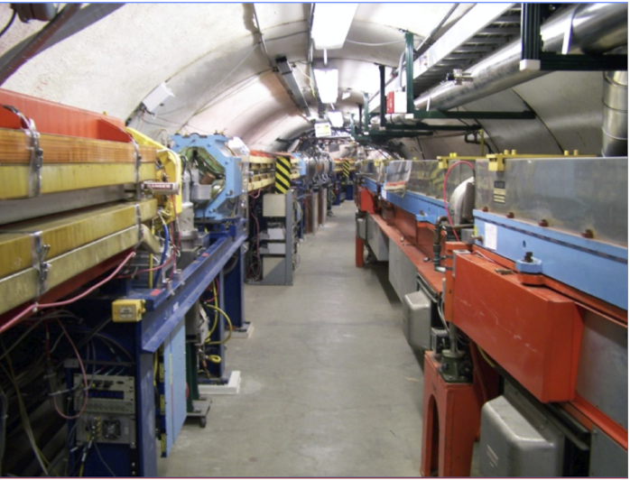
CESR Conversion – Low Emittance Optics
CESR lattice has long dipoles and a relatively low density of quadrupoles
=> relatively high emittance
To attain low emittance we rely on damping wigglers
At 2GeV, the 12, 1.3m long, 1.9T superconducting wigglers, decrease radiation damping time by 10 from 0.5 secs to 50 msec.
=> 4 fold reduction in horizontal emittance providing we can eliminate dispersion
To that end we re-locate 6 wigglers from arc to L0 straight.
And design optics with the appropriate constraints

Slide 12
Low emittance lattice functions
Flexible magnetic optics
All 100 quadrupoles and 78 sextupoles are independently powered
E = 2.1 GeV
ε_{x} =3 nm-rad
More than a dozen distinct lattice configurations for operation at energies from 1.8 - 5.3 GeV have been implemented and used for various studies

Slide 13
CESR Conversion
L3 Instrumentation
RFAs, dipole chicane, Time Resolving RFA, in-situ SEY, vBSM, TE-wave
Installed 2009-2012
Wigglers relocated to
L0, summer 2008
Wigglers moved from 15E/W to L0. Mitigations tested in L0 wigglers
Available space at 15E/W used to test mitigations in field free region
with SPU, RFA, TE-wave – dipole RFA

Slide 14
Damping wigglers
Damping wigglers redeployed to zero dispersion straight
Wigglers instrumented with mitigations and RFAs

Slide 15
Precision beam position monitors
Turn by turn/bunch by bunch
~10 micron single pass precision
Routine tuning
for low emittance is essential to the experimental program.
Beam based characterization of machine optics depends on high bandwidth/high precision beam position monitors.
Upgrade to digital readout electronics completed 2010

Slide 16
Xray beam size monitor
Xray beam size monitor
- Measure vertical beam size to ~ 10 microns => vertical emittance
- Turn by turn/bunch by bunch to 4 ns => bunch dependent emittance
xBSM Commissioning – Positrons 2009-2010, Electrons 2011

Slide 17
Visible light beam size monitor
Visible light beam size monitor
- Double slit interferometer => horizontal beam size (emittance and energy spread)
- Streak camera => bunch length
e+
e⁻
Streak camera - 2009
Horizontal beam size monitor - 2011

Slide 18
Visible light beam size monitor
Schematic of visible light optics
Optical path length 17m from source at B48 to camera

Slide 19
Low emittance configuration
Wigglers relocated to zero dispersion straight. (L0)
Survey reference system established, and magnet alignment completed
Instrumention deployed for tuning low emittance with capability to measure
Turn by turn position
Width, height, length of single bunch
And turn by turn and bunch by bunch measure of vertical size

Slide 20
Electron cloud instrumentation
Instrumentation for measuring electron cloud and characterizing mitigations

Slide 21
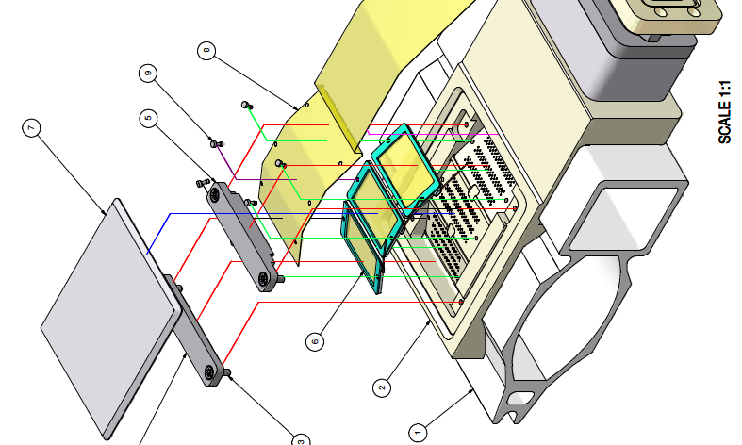
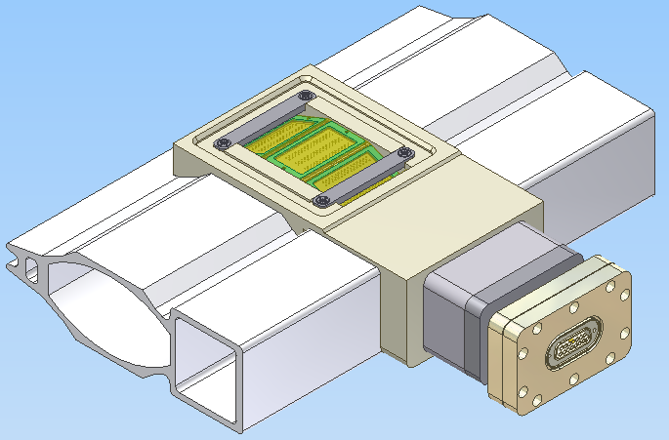
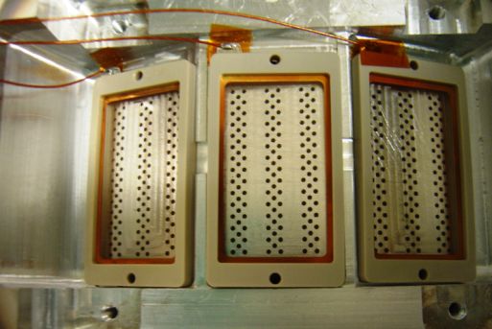
Retarding field analyzers
Local measurement of time averaged flux of
electrons into wall of chamber
Measures the energy spectrum of the time-average cloud current which impacts the chamber wall.
Most devices are segmented, so that some position information is also available.
Placed in drifts, dipoles, quadrupoles, and wigglers.
In chambers with mitigations, RFAs measure their effectiveness

Slide 22
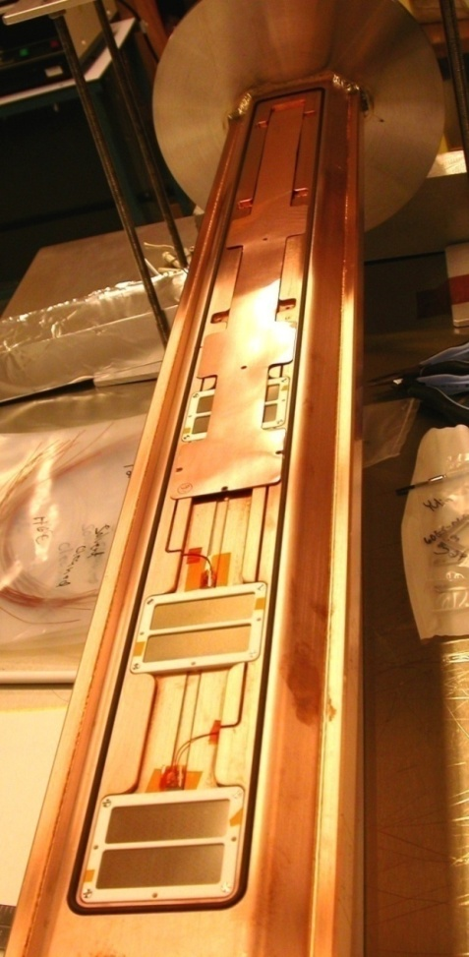
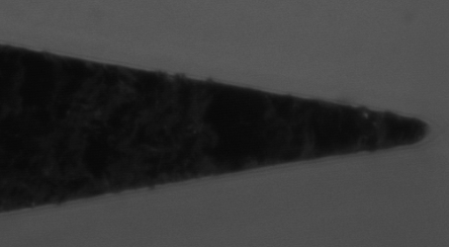
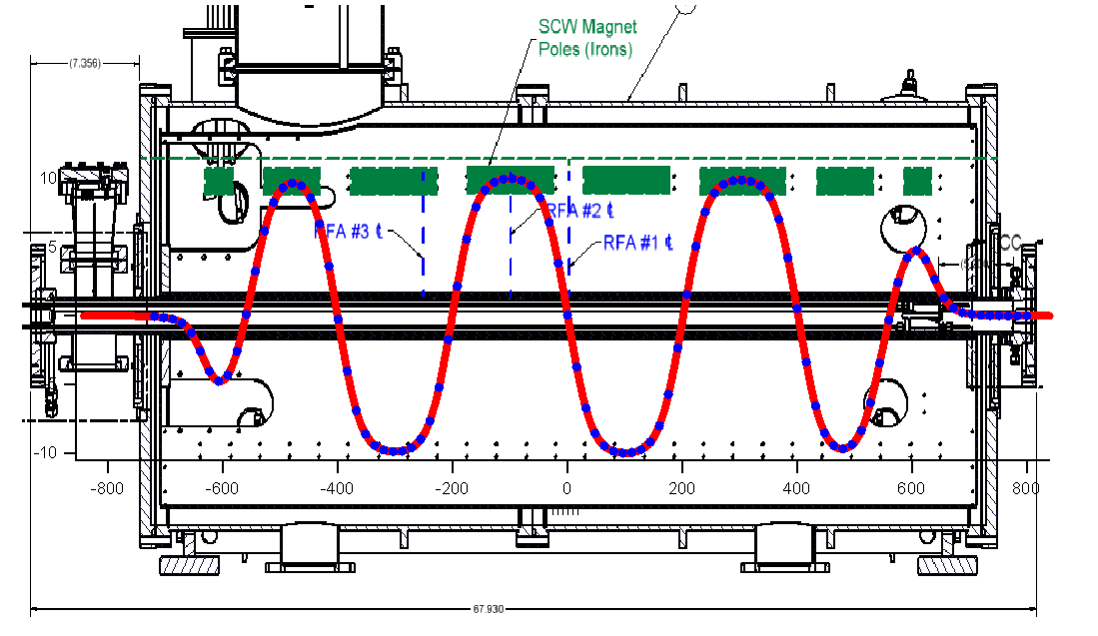
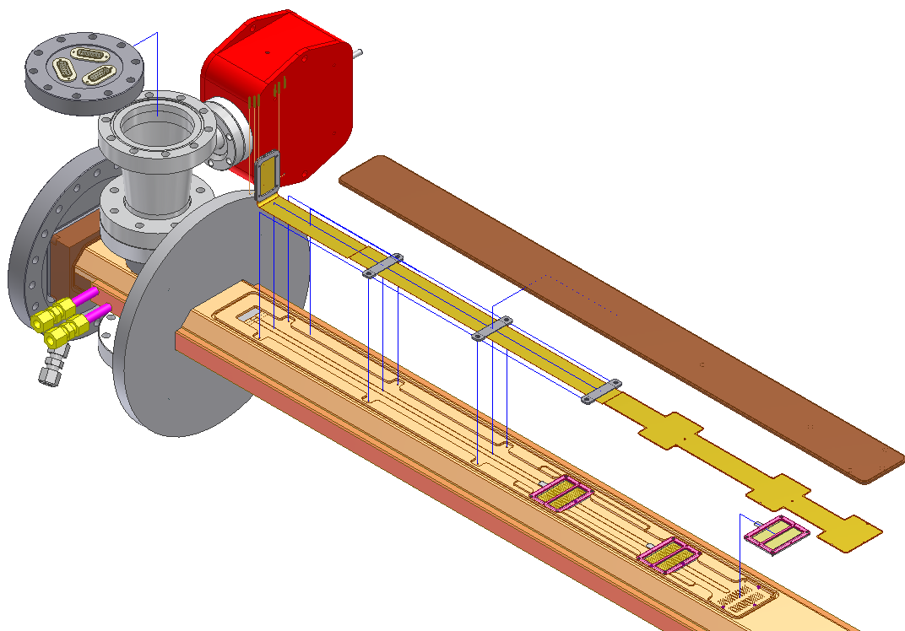
Retarding field analyzers
Four wigglers are instrumented with RFAs
Bare Cu
TiN coated
Grooves
Clearing electrode
Each wiggler has three RFAs
Groove tips/valley radius < 0.002” !!

Slide 23
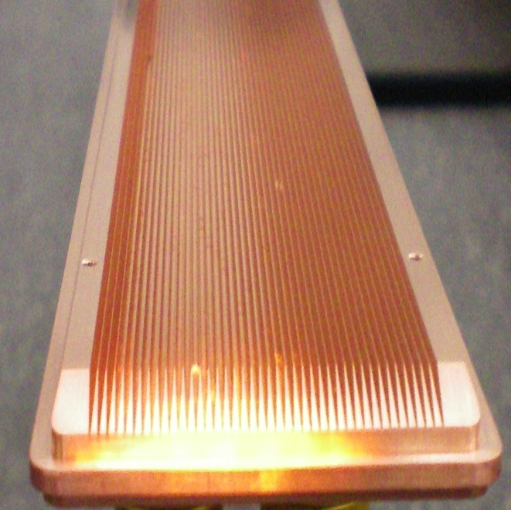
Wiggler mitigations
Clearing electrode
Grooved copper insert

Slide 24
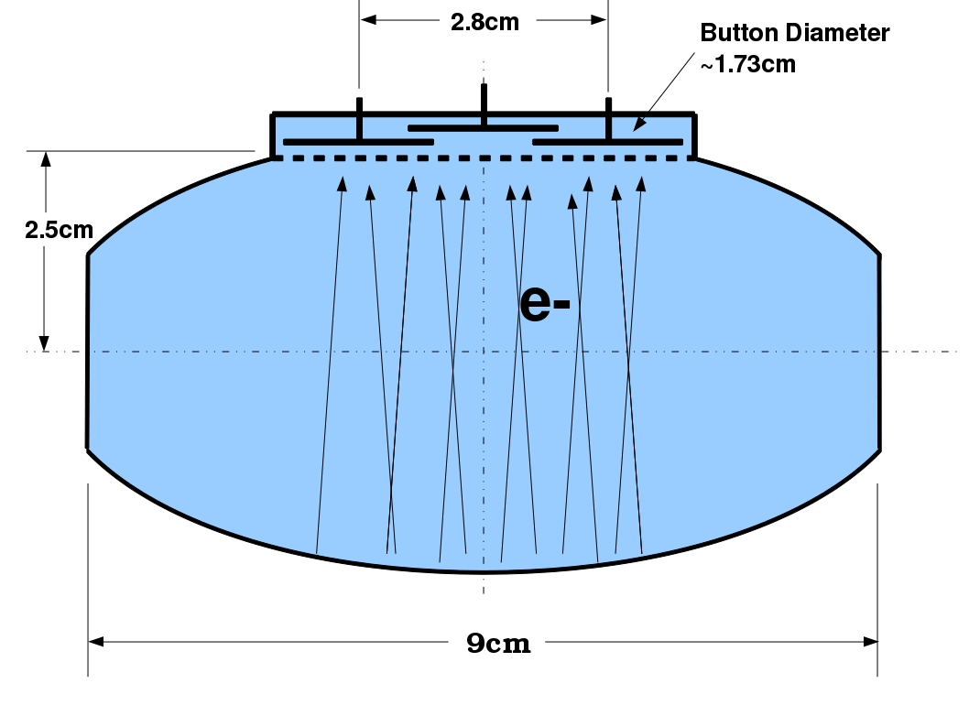
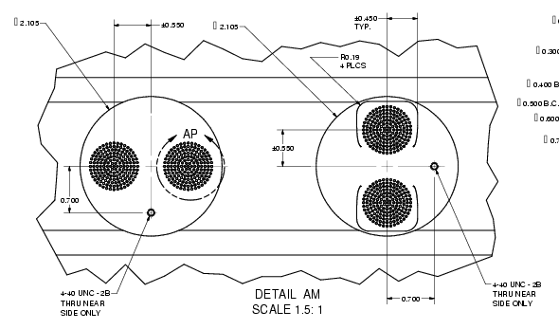
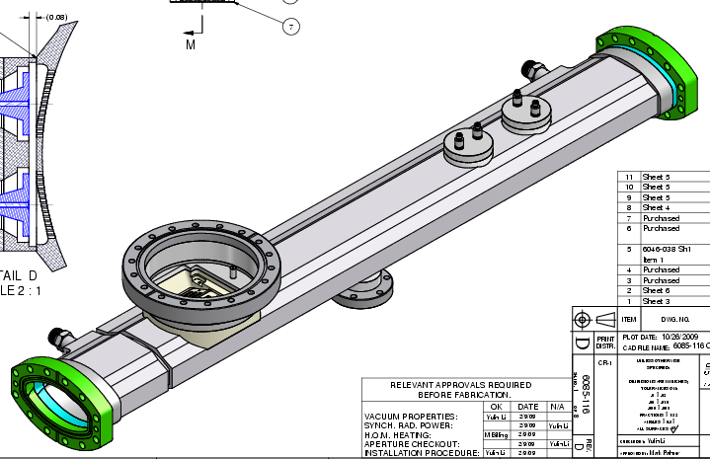

Shielded pickup
Shielded pickups have nanosecond temporal resolution and inform time development and decay of cloud

Slide 25
Experimental region 15W
Chambers with various mitigations are tested in 15W and 15E regions
=> providing comparison in standardized synchrotron radiation environment

Slide 26
Electron Cloud Instrumentation
L3 Instrumentation
RFAs, dipole chicane, Time Resolving RFA, in-situ SEY, vBSM, TE-wave
Installed 2009-2012
Wigglers relocated to
L0, summer 2008
Wigglers moved from 15E/W to L0. Mitigations tested in L0 wigglers
Available space at 15E/W used to test mitigations in field free region
with SPU, RFA, TE-wave – dipole RFA

Slide 27
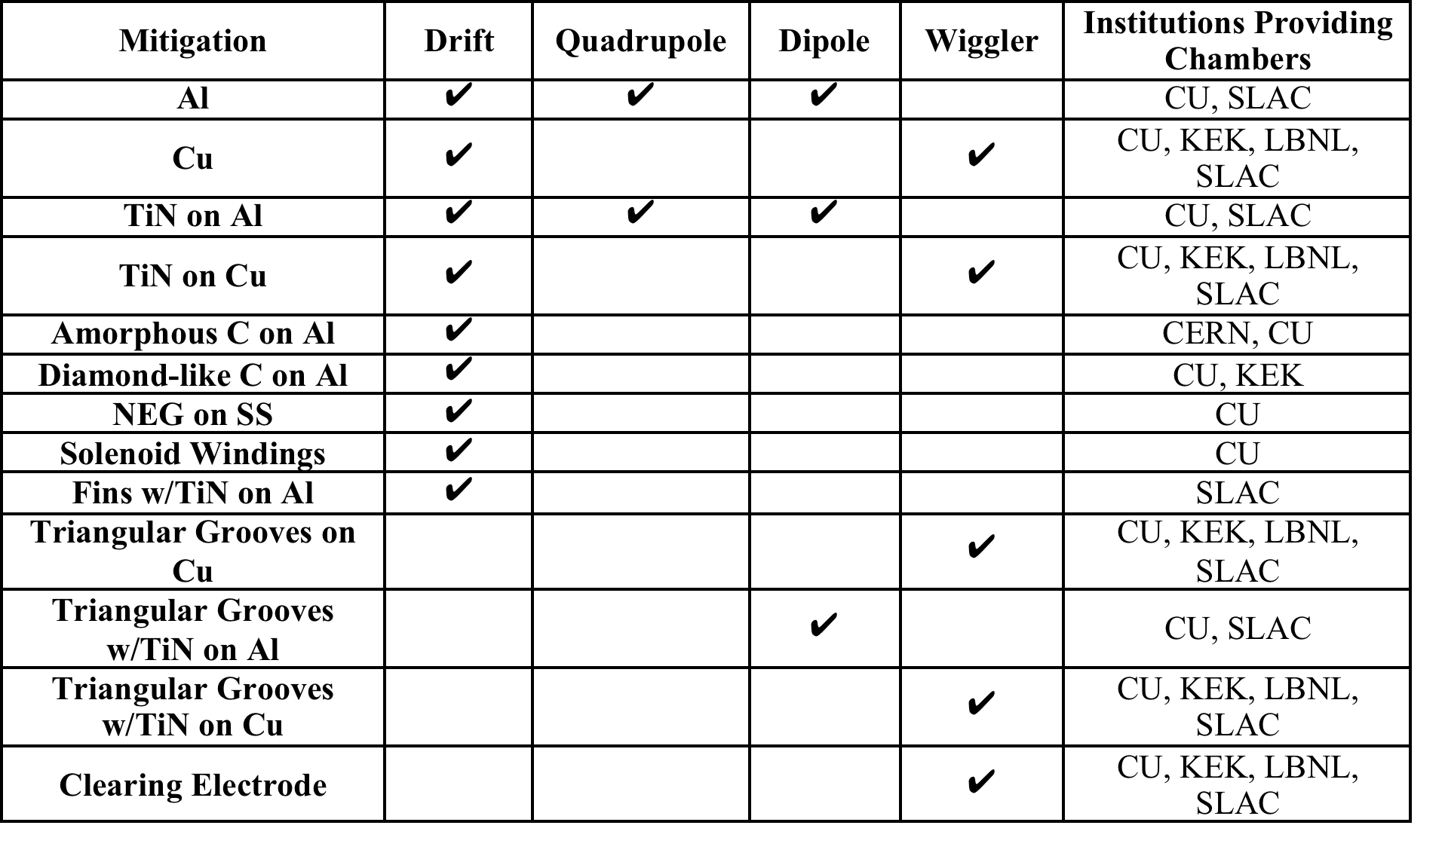
Tested Mitigations
2009-2012

Slide 28
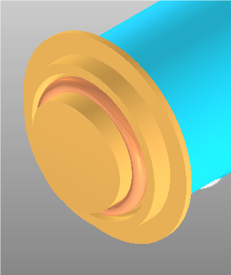
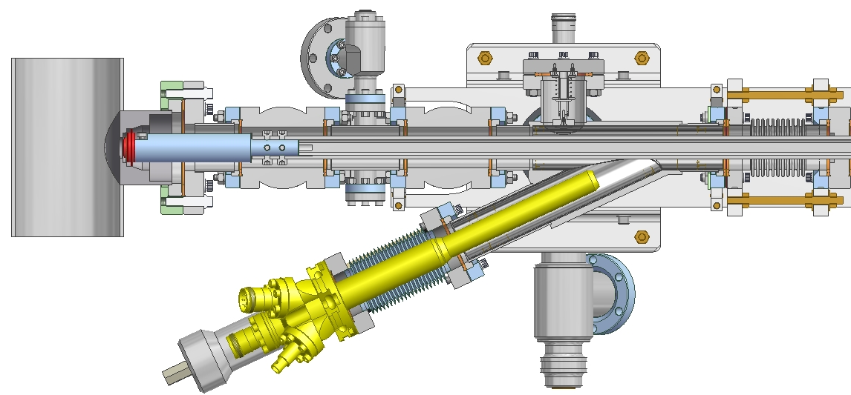
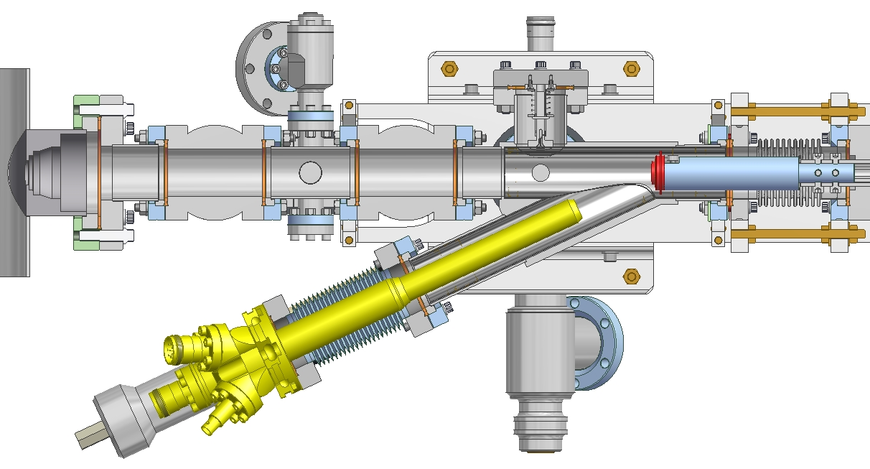
Ecloud model – SEY measurement
Direct measurement of secondary
emission yield, including angular and energy dependence and
the effect of beam processing
Positron beam
Electron gun

Slide 29
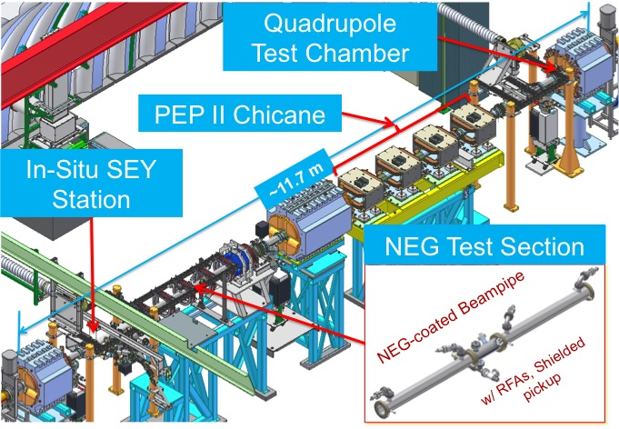
L3 instrumentation

Slide 30
ILC positron damping ring
Contributions to ILC DR design - 2012
Specification of vacuum chamber and mitigations for the ILC damping ring, based on CesrTA measurements
Electron cloud simulation codes
Developed in parallel to CesrTA experimental program,
Benchmarked against CesrTA data
That demonstrate that with the recommended
mitigations, the electron cloud density will be well
below threshold for emittance blowup
Emittance tuning methodology developed for CesrTA is used to establish damping ring alignment and instrumentation specifications

Slide 31
Beyond electron cloud
Intra-beam scattering
Tuning techniques routinely yield ~ 10-15 pm-rad vertical emittance
Instrumentation for measuring multi-bunch size and spectra is well suited to investigate collective effects (not just electron cloud)
In low emittance CesrTA, 2GeV optics, intra-beam scattering makes significant (measurable) contribution to equilibrium beam size
Measurements with both particle species allow us to distinguish electron cloud, ion, “other” effects
And we have investigated IBS in some detail (2011-2012)

Slide 32
Machine Studies TIme
Nearly 240 days of dedicated studies time (2008 – 2012)
Approximately one dozen lattice configurations implemented, tuned, tested
With many dozens of “knobs” to adjust coupling, dispersion, horizontal & vertical emittance, beta …
Experiments at 1.8, 2.1, 2.3, 3.0, 4.0, 5.3 GeV
with both electrons and positrons
Extensive measurements of ecloud, and low emittance beam physics

Slide 33
Today’s Agenda
Instrumentation – John Sikora
SEY and RFA studies – Walter Hartung
Shielded Pickup studies – Jim Crittenden
Electron cloud beam dynamics studies – Gerry Dugan
Emittance tuning – Jim Shanks
Intra-beam scattering – Mike Ehrlichman
CesrTA Collaboration – Mike Billing
Super KEK-B ecloud mitigation and instrumentation - John Flanagan
Future plans – D. Rubin

Slide 34
End
Thank you for your attention

Slide 35
Low Emittance Optics
Exploit damping wigglers to reduce emitttance
At 2.0 GeV, 12-1.3m long 1.9T superconducting wigglers increase radiation damping rate 2/sec to 20/second.
If the wigglers are in a zero dispersion straight, there is an (almost) corresponding decrease in horizontal emittance.
Not quite because the wigglers themselves generate dispersion internally.
=>2.5 - 3 nm-rad

Slide 36
CesrTA Program Goals
Electron cloud
Mitigation
Material properties: SEY, QE, beam processing, durability
Modeling
Cloud growth and beam-cloud interactions
Dynamics
Cloud induced tune shift, emittance dilution, instability
To answer the question: For a given vacuum chamber design, what is the threshold current for emittance dilution and instability from the electron cloud?
Emittance tuning
To determine sensitivity of low emittance beams to electron cloud effects, in a variety of lattice configurations (beam energy, horizontal emittance etc) we need set of beam based measurements and correction techniques for routine application
Requires precision bpm to measure residual coupling and vertical dispersion, and beam size monitors for measuring emittance and a good understanding of systematic measurement errors
Collective effects
While the electron cloud has been the principle focus of the effort, CesrTA is now well instrumented for exploring other collective effects including intr-beam scattering, fast ion instability, and limits to ultra-low emittance operation

Slide 37
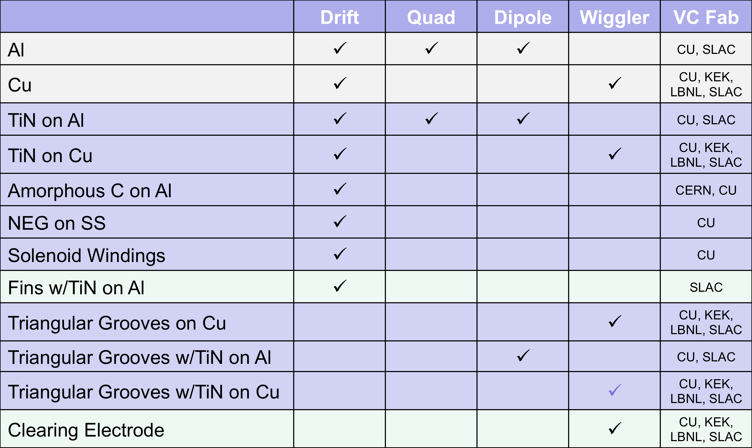

Slide 39
Introduction
Goals of the CesrTA R&D program
Emittance tuning
Electron cloud research
Intra-beam scattering
ILC positron damping ring
CESR conversion
Summary and plan for the day

