Slide 1
Phase space matching through injection channel
D. Rubin
April 11, 2013

Slide 3
Z[cm]

Slide 4
Z[cm]

Slide 5
Z[cm]

Slide 6
inflector
Track through iron, cyrostat, inflector
Construct transfer matrix about trajectory
~ 0.86 deg

Slide 7
Transfer matrix through iron, cryostat, inflector
Total length = 4.39m
Transfer Matrix : Kick [Matrix symplectic error: 1.185E-02]
1.61951 5.68287 -0.10265 -0.12099 0.00032 0.02890 : -2.820E-02
0.29750 1.65985 -0.03583 -0.05500 0.00025 0.00047 : -1.318E-02
-0.08510 -0.05582 0.44649 3.19115 -0.00014 0.00884 : -9.206E-03
-0.02370 -0.04136 -0.25378 0.40416 -0.00010 -0.00031 : -5.138E-03
0.00776 0.04529 -0.00296 0.00323 1.00000 0.00046 : -4.947E-13
0.00000 0.00000 0.00000 0.00000 0.00000 1.00000 : 0.000E+00
The 6X6 transfer matrix propagates the 6-d phase space vector

Slide 8
E 821

Slide 9
40 mm-mrad beam clears inflector if at exit
β_{x}=2.45, α_{x}= -0.41, β_{y}=19.1, α_{y}= 0.045
σ_{E}/E = 0.15% clears inflector if at exit
η= 7.96, η’=0.057
Quadrupoles optimized to minimize
α,η, η’ at entrance to beam line and with “reasonable” β
Beam travels right to left
Propagate backwards from downstream end of inflector through backleg iron and through beam line quadrupoles

Slide 10
Beam travels left to right
Propagate forward through beam line quadrupoles, backleg iron, inflector and into ring

Slide 11
σ = [βε + (ηδ)²]^{1/2}
ε = 40 mm-mrad, δ = 0.5%
Q1 requires large aperture
Q1
Propagate forward through beam line quadrupoles, backleg iron, inflector and into ring

Slide 12
How do twiss parameters propagate through iron, cryostat, inflector into ring

Slide 14
63.9 deg
Effective gradient G ≈ (1+cos(63.9))/2 (ΔB_{y}/ΔR)

Slide 15
Twiss parameters (A-matrix) is chosen to be single valued in ring

Slide 16
β,α at s=0 are chosen so that 40mm-mrad beam fits through inflector aperture.
Quads upstream of iron (F-quads and D-quads) optimized to achieve reasonable values at 120m
Second turn
First turn
(Energy aperture has not been optimized)
Hole through iron

Slide 17
Conclusion
There will significant horizontal defocusing in dipole fringe
Better estimate of effective gradient will be determined from OPERA calculation of B-field along injection channel
Place focusing quadrupole in the injection line as close to the iron as possible in order to most effectively compensate fringe defocusing

Slide 18
Suppose we choose β_{x} β_{y} at upstream end of inflector so that 40 mm-mrad
so that most of the beam fits through the inflector aperture
(Assuming ideal inflector: zero field, opened ends)
⬅

Slide 20
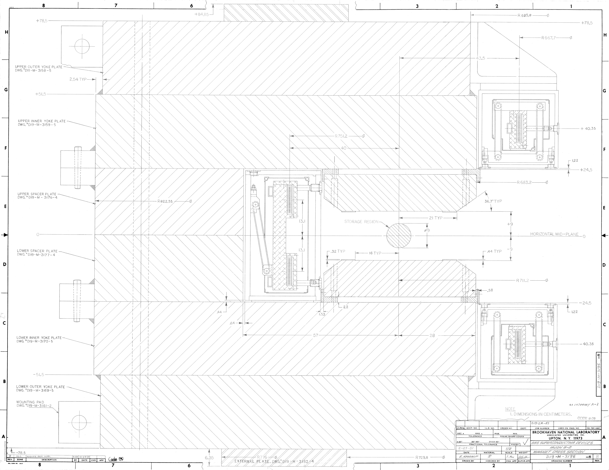

Slide 21
Propagate backwards once around ring (cc) and then through fringe with gradient 3.625 T/m
The effective focusing is very strong

Slide 22
In the other direction:
Use the same β_{x} β_{y} that got beam through ideal inflector but this time include focusing of fringe.

