Slide 1
Dependence of Momentum Acceptance on Offset and Angle at the Inflector
David Rubin
Cornell University
July 31, 2022

Slide 2
How is kick temporal width included?
Inequality that defines momentum bite is generalized to include kicks on multiple turns with the replacement

Slide 3
Momentum Acceptance
No x,x’ correlation

Slide 6
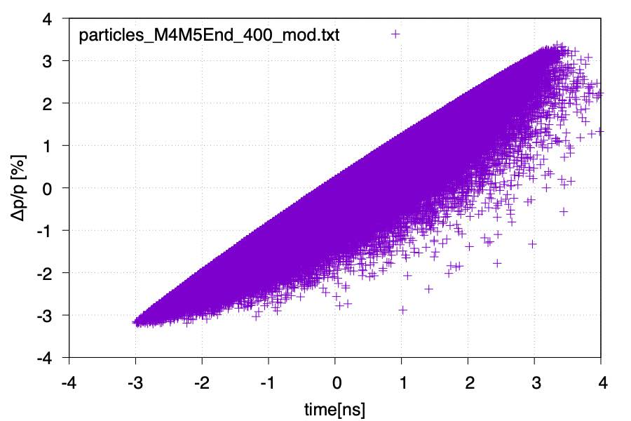

Slide 8
The kickers have a finite aperture
Magic momentum muon enters kicker #1 displaced ~ 22 mm from magnet axis
inflector
s
kicker
Muons with high momentum and/or angle will miss part or all of kicker #1.
inflector
s
kicker

