Slide 1
Spin-phase space correlations and differential decay
D. Rubin, R. Fatemi
Cornell University
February 8, 2023

Slide 2
Pion decay kinematics => correlations of spin phase with phase space coordinates x, x’
Injection into g-2 ring => correlation of x,x’ with momentum acceptance
Differential decay => correlation of average momentum in stored beam with time

Slide 3
p_{μ}
μ⁺
μ⁺
s'
s
φ
P’_{μ}
x₀'
z
π⁺
Boost to lab frame
π⁺
ν_{μ}
lab frame
Pion rest frame
(Combley and Picasso)
Since a_{μ} << 1, ∼ constant as muon propagates along beam line

Slide 4
If pions all decay at a single point
b
a
x_{b}'
x_{a}'
π_{a ,}
π_{b}
θ_{β}
Perfect correlation
At the decay point (θ_{β} = 0),
At θ_{β} =π/2
At θ_{β} =π,
The sign of dφ/dx and dφ/dx’ in the distribution will change every half betatron wavelength

Slide 5
b
a
x_{b}'
x_{a}'
π_{a ,}
x_{c}’
π_{b}
π_{c,} π_{d}
x_{d}’
θ_{β}
c
d
Beyond θ_{β} =π,
If pions decay uniformly over an integral number of betatron wavelengths, there will be no correlation of x, or x’ with φ
The correlation results from a nonuniform decay and/or over fractional betatron wavelengths
The sign of dφ/δx and dφ/dx’ in the distribution will change every half betatron wavelength

Slide 6
Correlation with invariant amplitude
p_{μ}
μ⁺
μ⁺
s'
s
φ
P’_{μ}
x₀'
z
π⁺
Boost to lab frame
π⁺
ν_{μ}
lab frame
Pion rest frame
Since a_{μ} << 1, ∼ constant as muon propagates along beam line
Suppose pion beam (lab frame) has zero emittance, so that at muon’s birth, x=0, x’=x’₀
A spin angle – transverse phase space correlation can be given in terms of the invariant amplitude
=>
where α,β,γ are twiss parameters and β₀ is β-function at pion decay point

Slide 7
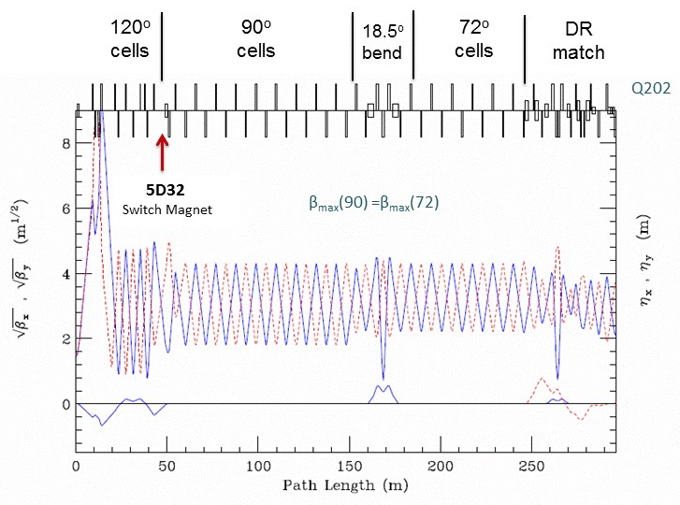
With 4 turns around the Delivery Ring φ for all muons regresses by 4ν_{s} independent of amplitude a
With knowledge of β₀, we can compute the invariant amplitude a and φ for all the muons in the distribution
M2-M3
β_{min} =1m
β_{max} = 81m
<β> = 9m

Slide 8
At the end of M5, (β = 52.39 m , γ= 4.19/m, α = 1.48)
β₀=1m
β₀=9m
β₀=81m
φ
β₀=81m
β₀=1m
β₀=9m
Assumptions: emittance of pion beam is zero, p_{π} = constant
What about y?

Slide 9
φ(x)
π⁺ decay kinematics
φ(x’)
x’(δ)
injection
x(δ)
differential decay
Nonlinear

Slide 10
x’(δ)
x(δ)
Since x and x’ are nonlinear functions of δ, and <δ> is a function of time, is also a function of time

Slide 12
Δω_{a} increases with time
Time averaged <Δω_{a}> also increases with time

Slide 13
Fractional change in ω_{α} due to spin-coordinate correlation
Raw
ΔB/B_{inf} =-1%
ΔB/B_{inf} =+1%
Run 2 kick-early
Run 3b kick-early
Run 3b kick – timed
Run 3b kick- timed (Diktys)
Gm2ringsim Run 2

Slide 15
BMAD
GM2RINGSIM

Slide 16
Correlation of spin phase with displacement (x), angle (x’) and momentum (δ=Δp/p) in distribution at the end of M5
Origin: Energy dependence of spin tune in delivery ring
Origin: π⁺ decay kinematics
EndofM5_Valetov_withInit.dat doc-db 17800

Slide 17
x_{b}'
x_{a}'

Slide 18
1 264G-210ns-Raw
2 Inf-1%
3 Inf+1%
4 224G-180ns
5 264G-180ns
6 264G-210ns
7 264G-210ns-Diktys
8 gm2rinsim-Run_2
9 gm2rinsim-Run_3a
10 gm2rinsim-Run_3b
11 gm2rinsim-Raw

Slide 19
At the end of M5, (β = 52.39 m , γ= 4.19/m, α = 1.48)
β₀=1m
β₀=9m
φ
β₀=81m
β₀=81m
β₀=1m
β₀=9m
Assumptions: emittance of pion beam is zero,

