Slide 1
Dependence of Momentum Acceptance on Displacement of Injected Muons, and the Crnkovic Differential Decay Effect
D. Rubin
Cornell University
September 14, 2022

Slide 2
Correlation between muon spin and momentum in muon rest frame
Spin angle lags for muon x’ > 0
Spin angle leads for muon x’ < 0
Doc-db 3841 Crnkovic, et al.
Doc-db 27609 Morse

Slide 3
Crnkovic et al. doc db 3477 and 3841 show that spin angle and muon phase space coordinates x, x’, are correlated in muons propagated to end of M5
Extrapolation to inflector exit
=>
If x, x’ are correlated with momentum acceptance, we expect early to late effect
doc db 3841

Slide 4
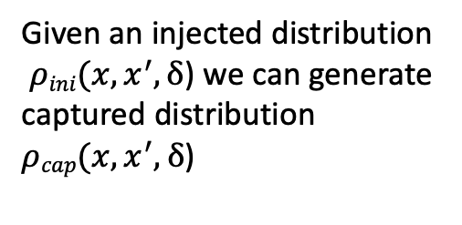
Injection Acceptance Model
Momentum acceptance in terms of initial conditions and the kick
is the collimator aperture
doc-db 27471-v1 & 26243-v2
Phase space at inflector exit
Given an injected distribution
$ρini(x,x^{′},δ$) we can generate captured distribution $ρcap(x,x^{′},δ$)
For our initial distribution assume
gaussian distributed over the range
Momentum (δ), independent of

Slide 5
Assume uniform distribution of momenta in injected beam
Scan x_{inf} over inflector width (from 0.068m to 0.086m)
Use
Use measured kick pulse shape to get
Weight by measured pulse intensity and assume x is gaussian distributed

Slide 6
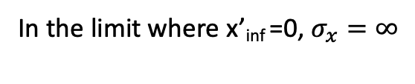
Simplest Case
In the limit where x’_{inf} =0, $σ_{x}=∞$
Momentum acceptance as a function of kick angle for x_{inf} = 77 mm, x’_{inf} =0
Momentum acceptance as a function of x_{inf} for θ_{k} = 10.2 mrad, x’_{inf} =0

Slide 7

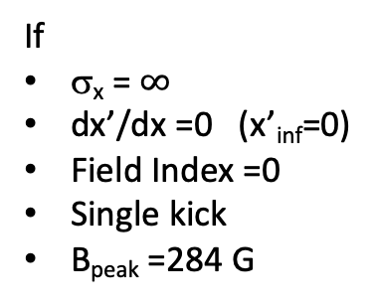
If
σ_{x} = $∞$
dx’/dx =0 (x’_{inf}=0)
Field Index =0
Single kick
B_{peak} =284 G
$$⟨δ〉=m_{x} x_{inf}+b$$

Slide 8
We have
But what we want is

Slide 9
Momentum acceptance as a function of x_{inf} for θ_{k} = 10.2 mrad, x’_{inf} =0
The momentum δ in the slice is independent of x_{inf}

Slide 10
Same data
Axis swapped
Note that
is independent of δ, for

Slide 11
Evidently
Is the appropriate measure of the dependence of
Recalling that we find that
is independent of δ, for

Slide 12
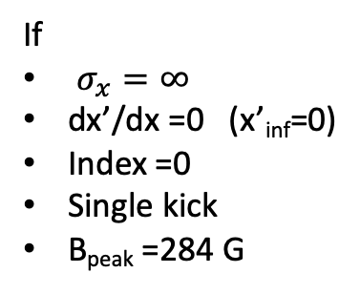

If
$σ_{x}=∞$
dx’/dx =0 (x’_{inf}=0)
Index =0
Single kick
B_{peak} =284 G
$\frac{Δω}{ω}=0.6$ ppb

Slide 13
Re-cap
Assume uniform distribution of momenta in injected beam
Scan x_{inf} over inflector width (from 0.068m to 0.086m)
Use
Use measured kick pulse shape to get
Weight by measured pulse intensity and assume x is gaussian distributed
Run I
Time dependence of kicker field and injected pulse

Slide 14
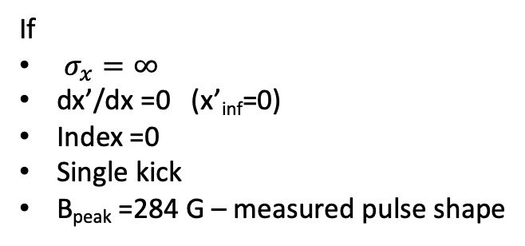

If
$σ_{x}=∞$
dx’/dx =0 (x’_{inf}=0)
Index =0
Single kick
B_{peak} =284 G – measured pulse shape
$\frac{Δω}{ω}=0.4$ ppb

Slide 15
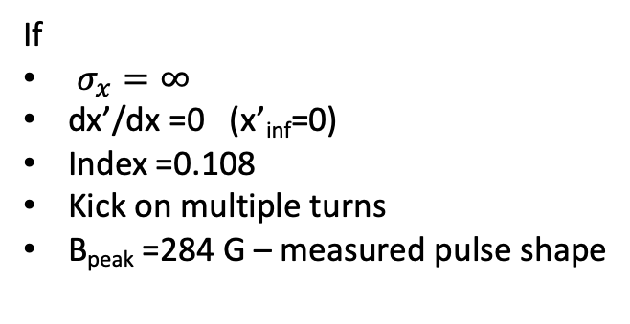

If
$σ_{x}=∞$
dx’/dx =0 (x’_{inf}=0)
Index =0.108
Kick on multiple turns
B_{peak} =284 G – measured pulse shape
$\frac{Δω}{ω}=0.7$ ppb

Slide 16
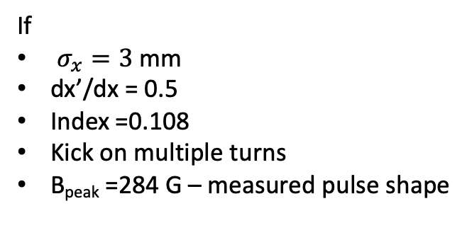

If
$σ_{x}=3$ mm
dx’/dx = 0.5
Index =0.108
Kick on multiple turns
B_{peak} =284 G – measured pulse shape
$\frac{Δω}{ω}=0.2$ ppb

Slide 17
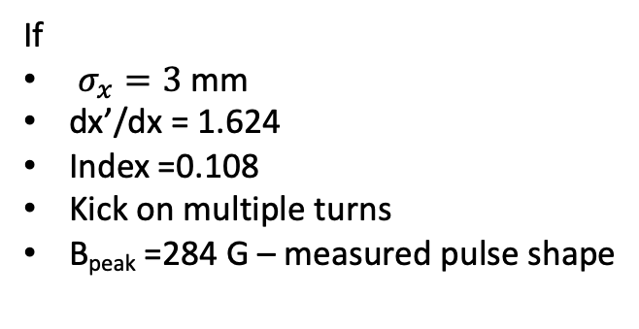

If
$σ_{x}=3$ mm
dx’/dx = 1.624
Index =0.108
Kick on multiple turns
B_{peak} =284 G – measured pulse shape
$\frac{Δω}{ω}=0.001$ ppb

Slide 18

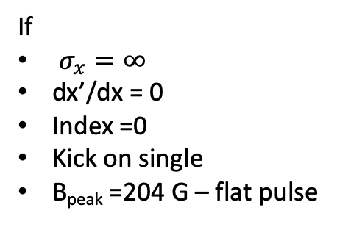
If
$σ_{x}=∞$
dx’/dx = 0
Index =0
Kick on single
B_{peak} =204 G – flat pulse
$\frac{Δω}{ω}=0.588$ ppb

Slide 19

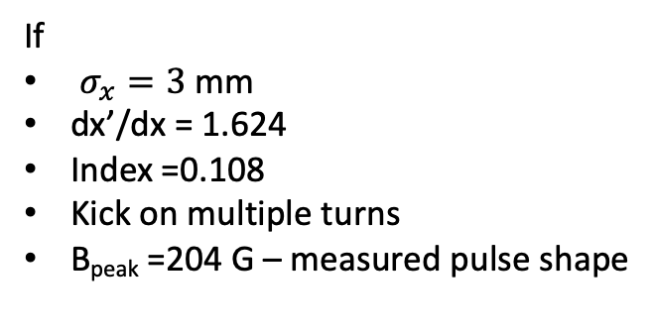
If
$σ_{x}=3$ mm
dx’/dx = 1.624
Index =0.108
Kick on multiple turns
B_{peak} =204 G – measured pulse shape
$\frac{Δω}{ω}=−0.008$ ppb

Slide 20

Track particles with temporal distribution as per measured T0 through the injection channel and into the ring
Peak kicker field is 204 G
Measured kicker pulse shape
For particles that survive at least 4 us, plot
  Offset at inflector (x_{inf}) vs fractional momentum offset (δ)
  Angle at inflector (x_{inf}) vs fractional momentum offset (δ)
Compute and
$\frac{Δω}{ω}∼0.2$ ppb

Slide 21
Conclusion:
Momentum acceptance
=>
for any plausible injected distribution

Slide 22
Details of the final calculation
Use BMAD to propagate from the end of M5 to inflector exit
to get
Then
Next and from doc-db 3477
=>

Slide 23
Propagate from the end of M5 to inflector exit

Slide 24
From doc-db 3477 for E821

Slide 25
Momentum acceptance in terms of initial conditions and the kick
is the collimator aperture
Average
If x’_{inf} =0

Slide 26
Possible explanations
Extracting x-x’ correlation from spin phase vs x,x’ is flawed
Spin phase vs x,x’ plots are for some place other than the end of M5 (our assumption when propagating to the inflector exit)
Neglecting the width of the x’ distribution is a poor assumption
Phase space at inflector exit
BMAD
Extrapolation from docdb 3841

