Slide 2
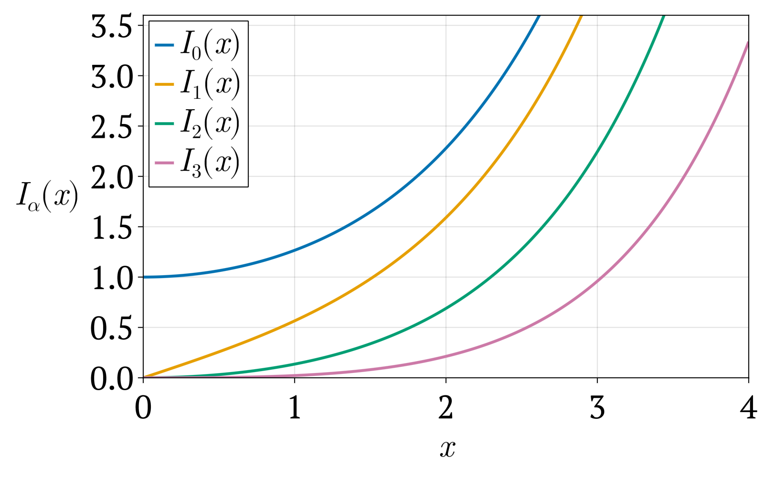
General solution to Laplacian in cylindrical coordinates
In a region free of sources
Approximate boundary conditions
On the pole faces,
=18cm, Is the magnet gap

