Slide 1
thyratron
August 3, 2017

Slide 2
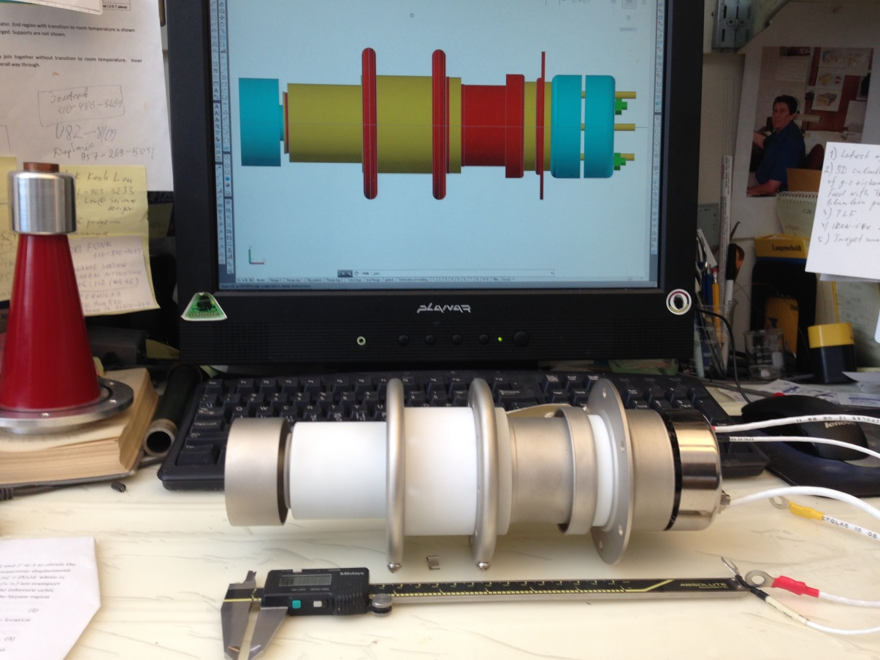
New thyratron CX1725X
Arrived Feb 28 2014

Slide 3
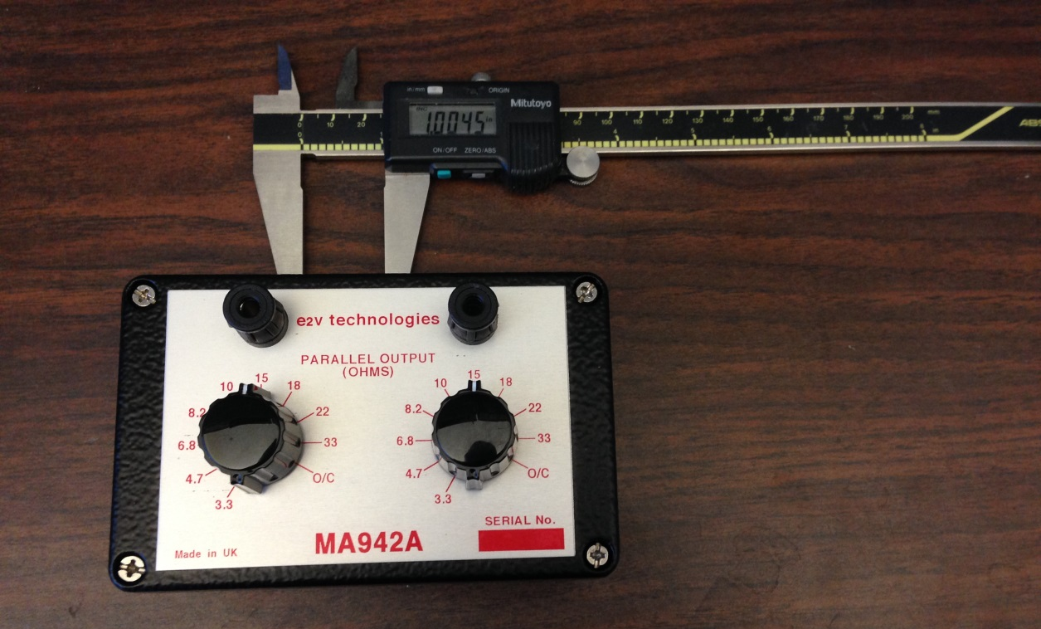
HARDWARE
Resistor block serving for precise regulation of heating
Arrived Feb 14 2014

Slide 4
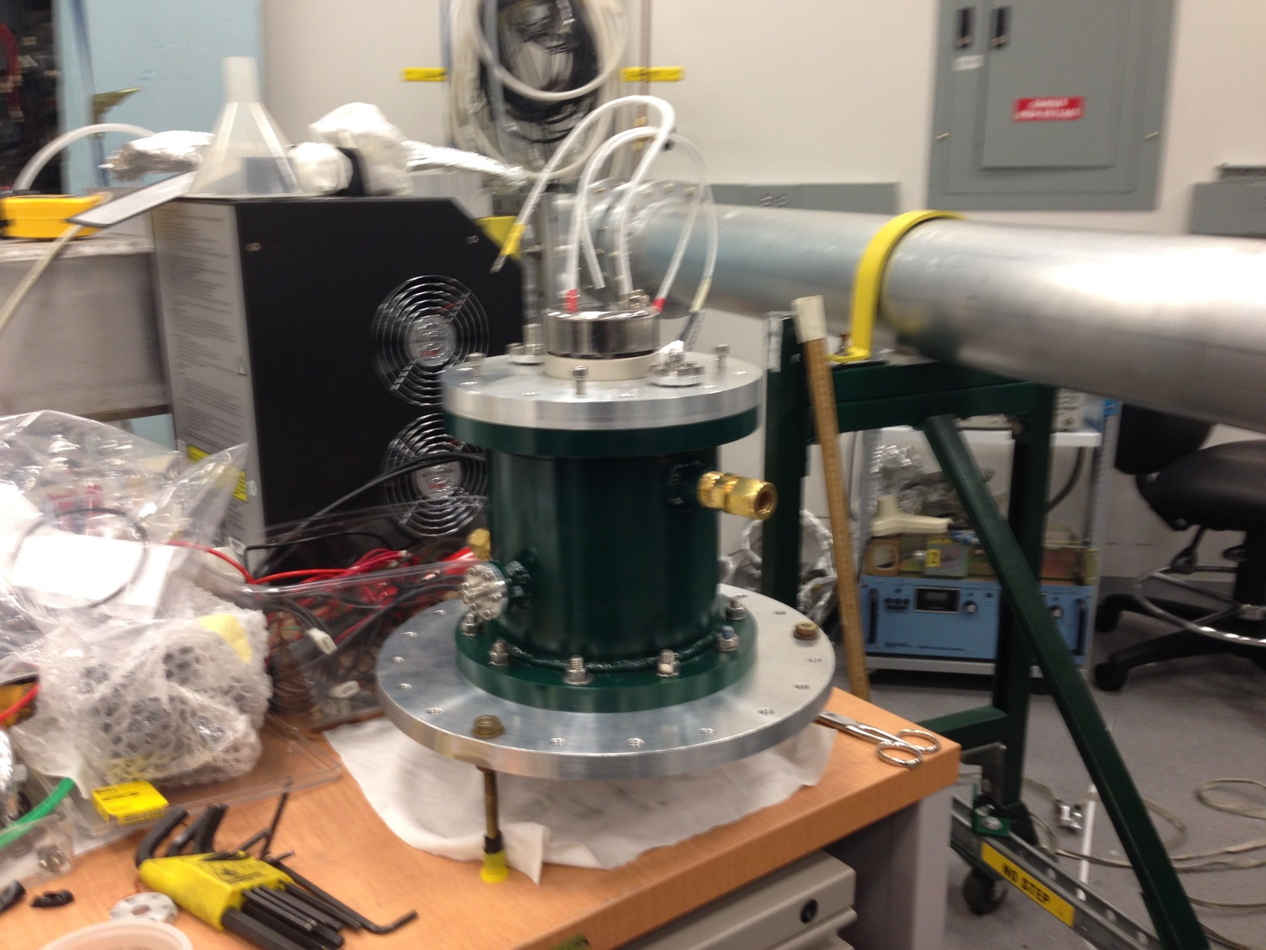
New thyratron in housing. Transition flange (large one at the bottom )allows easy joint with existing triaxial Blumlein tubing.

Slide 5
New thyratron CX1725X

Slide 6
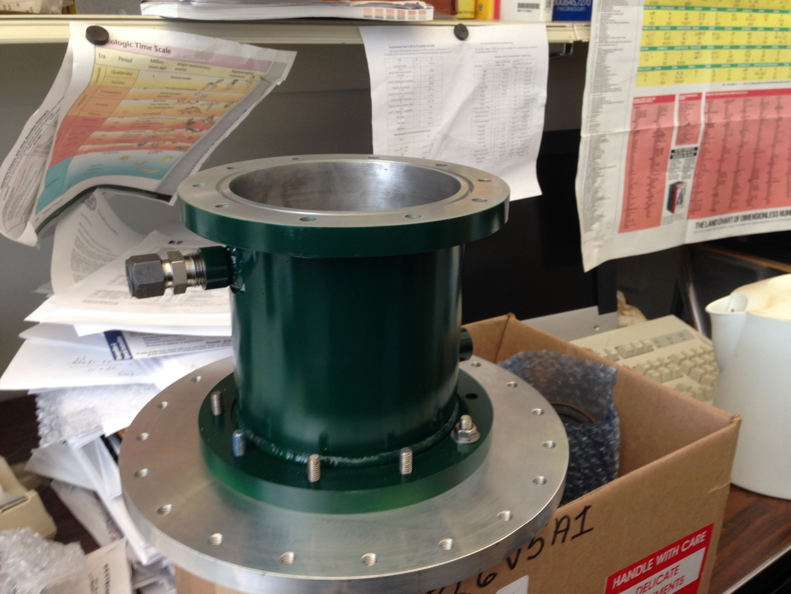
Housing for new thyratron with transition flange for testing in existing triaxial line
This housing will be used in a final design

Slide 7
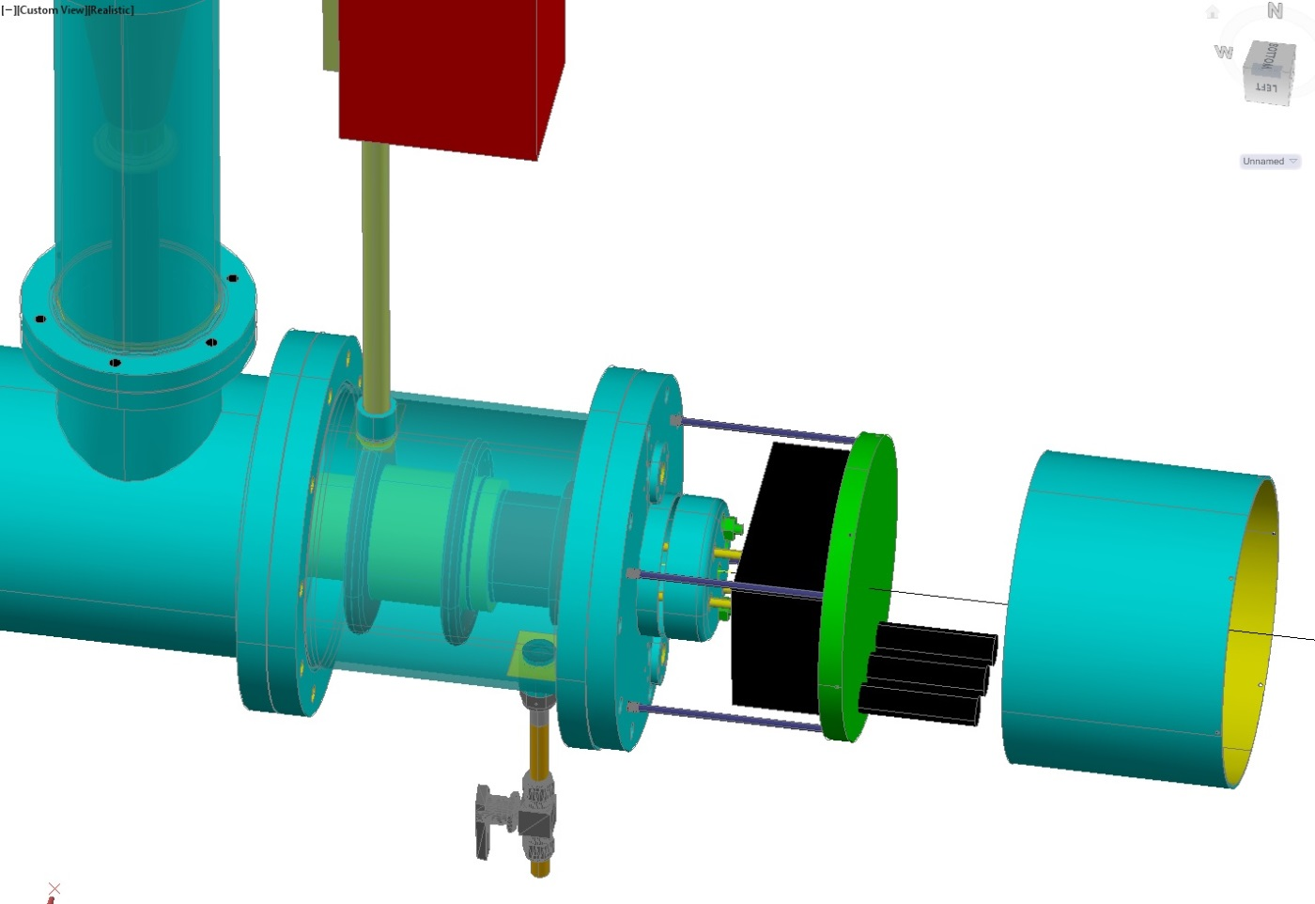
Resistor regulator for reservoir (from slide 12)
Triaxial line
Thyratron
Cover
Housing

Slide 8
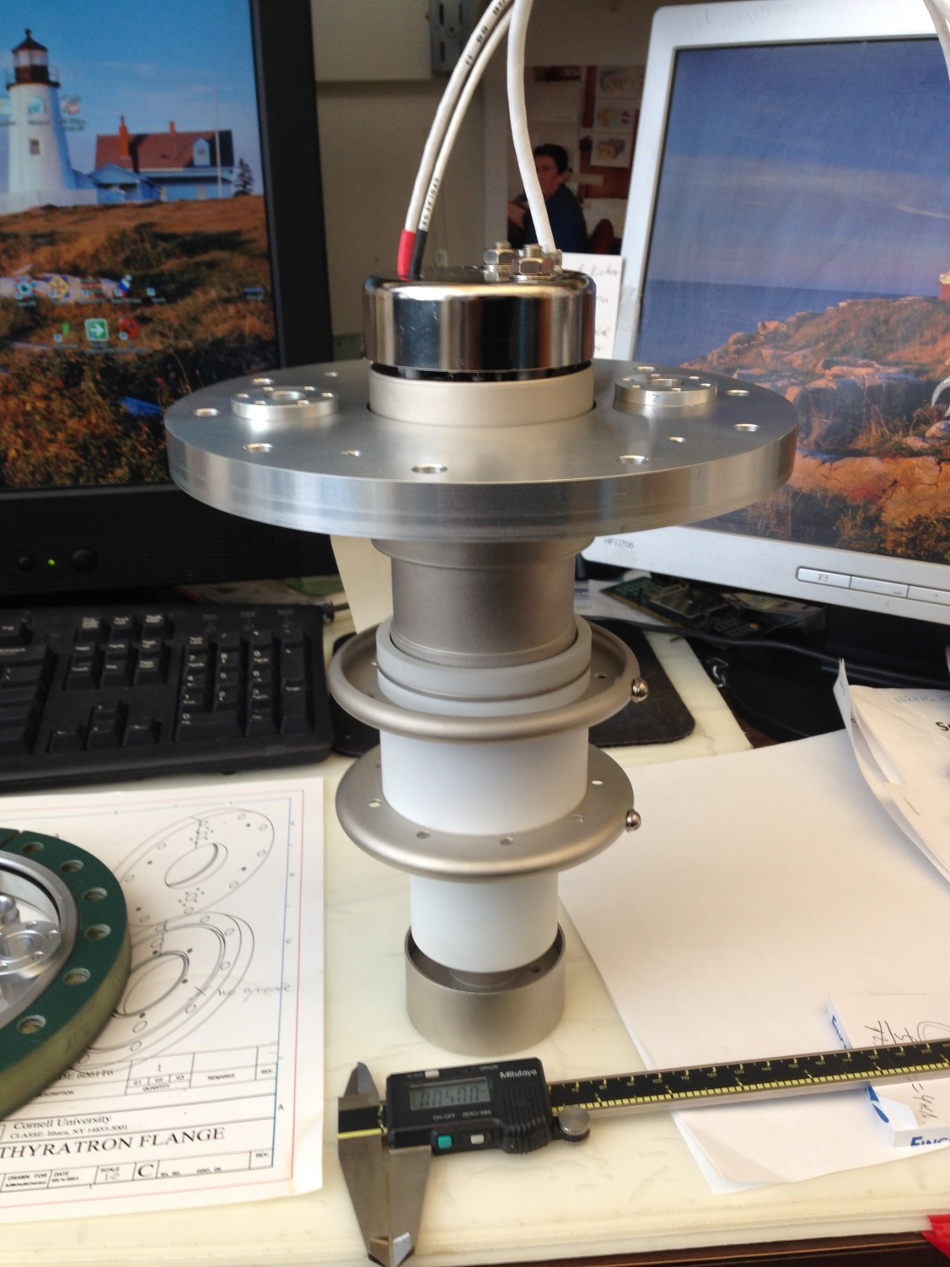
CX1725X on mounting flange

