Slide 1
Kicker Status
Collaboration Meeting
November 19, 2015
David Rubin for
Alexander Mikhailichenko & SeungCheon Kim & Andre Frankenthal

Slide 2
Kicker Status
Blumlein pulse forming network
Kicker plates and trolley rails
Power Supply
Controls
Pulse characteristics

Slide 3
Storage Ring Kicker Requirements
Kickers steer injected muons onto the closed orbit of the storage ring
Requirements:
Kick angle ~ 10.8 to 12.8 mrad
Kicker B-field ~ 285 to 336 Gauss
Integrated B-field ~ 1.11 to 1.31 kG-m
Pulse width(τ_{wid})
120ns < τ_{wid} < 149ns
Repetition rate
~100Hz peak, 12Hz average
3 – 1.3m kickers
τ_{rev} = 149 ns
d = 77 mm, R=7112 mm
kick angle θ = d/R = 10.8 mrad

Slide 4
Blumlein Pulse Forming Network
Direction of kick
9m
blumlein
insulator
thyratron
D = 9m
= 4.7 (Castor oil)
=> τ = 120ns

Slide 5
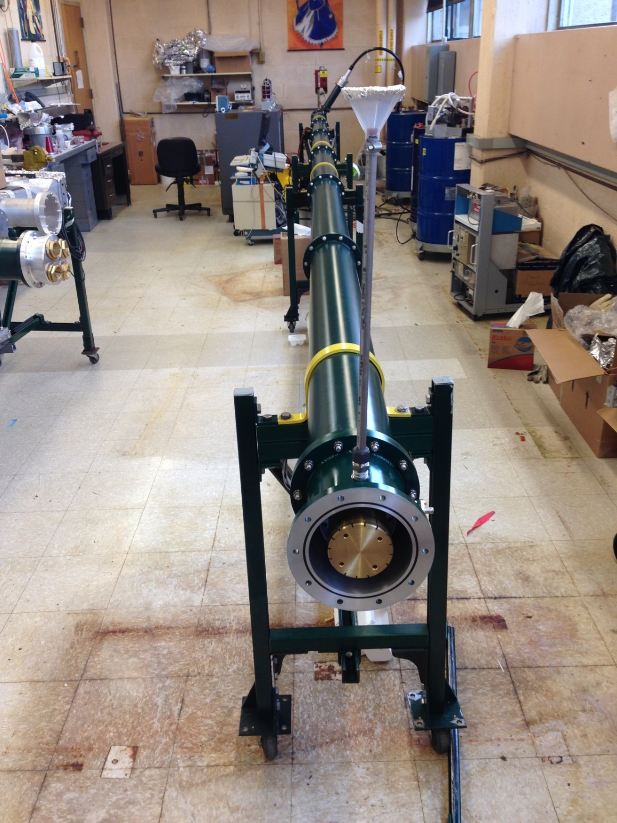
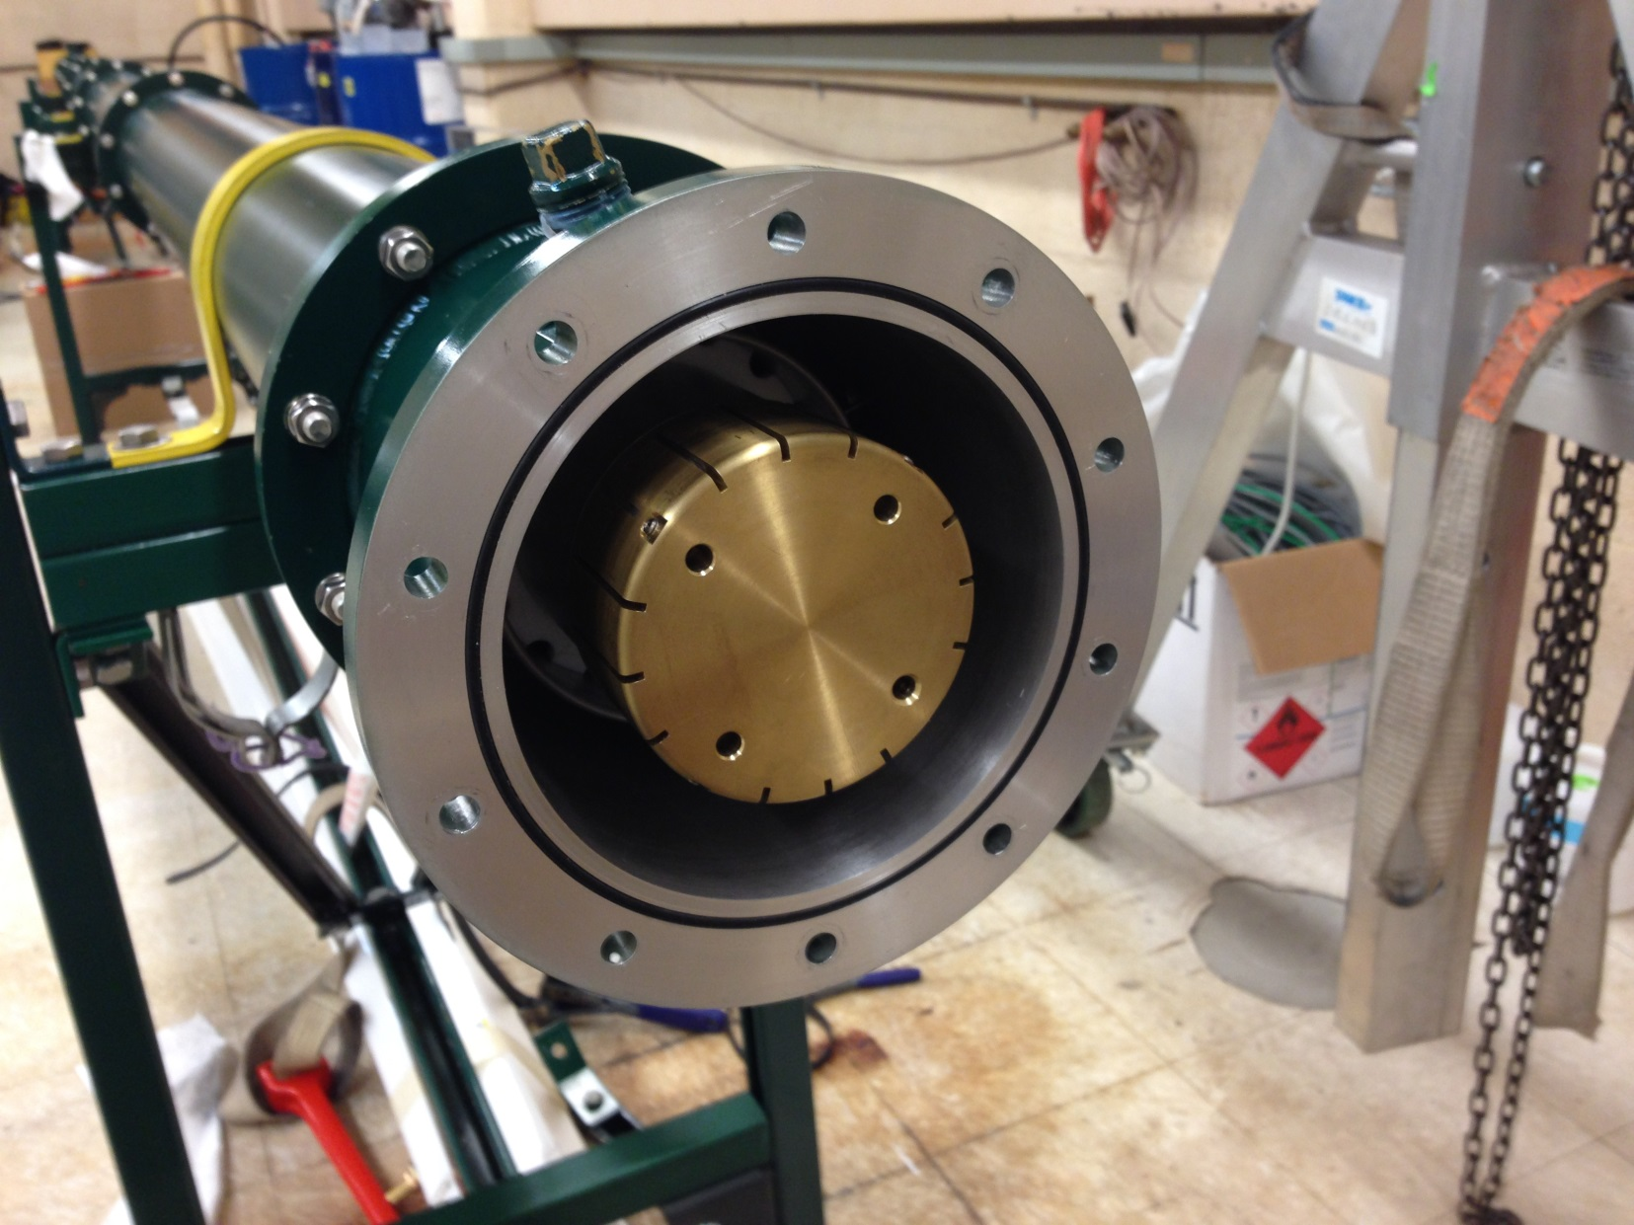
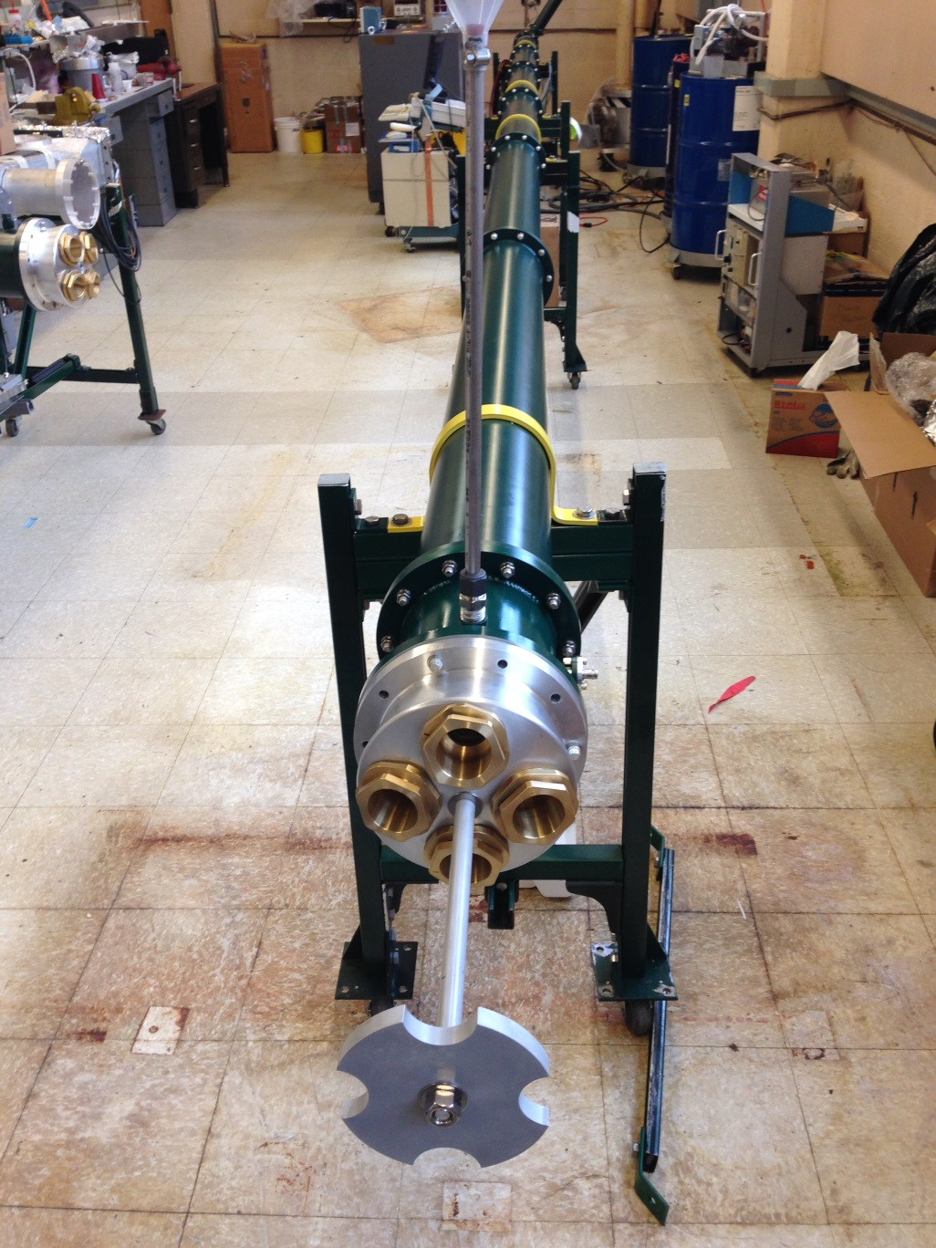
Blumlein
3- 9m long triaxial tubes
thyratron
Coupling to 4 50Ω coax
Central conductor

Slide 6
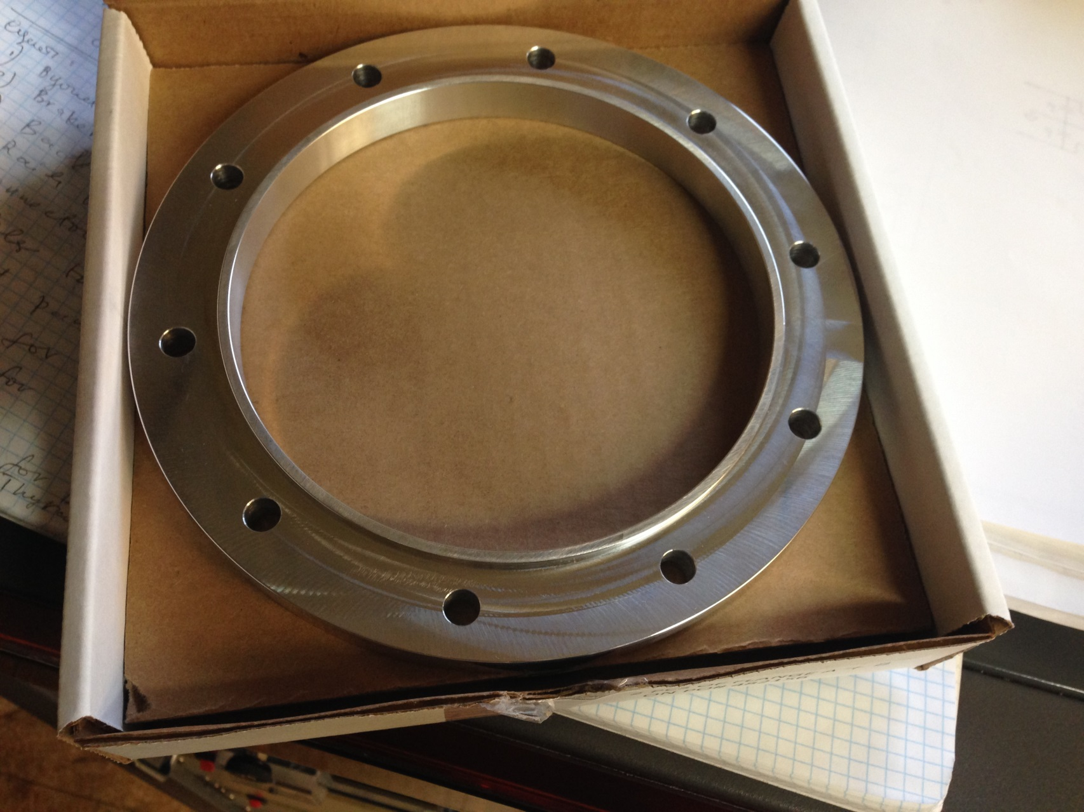
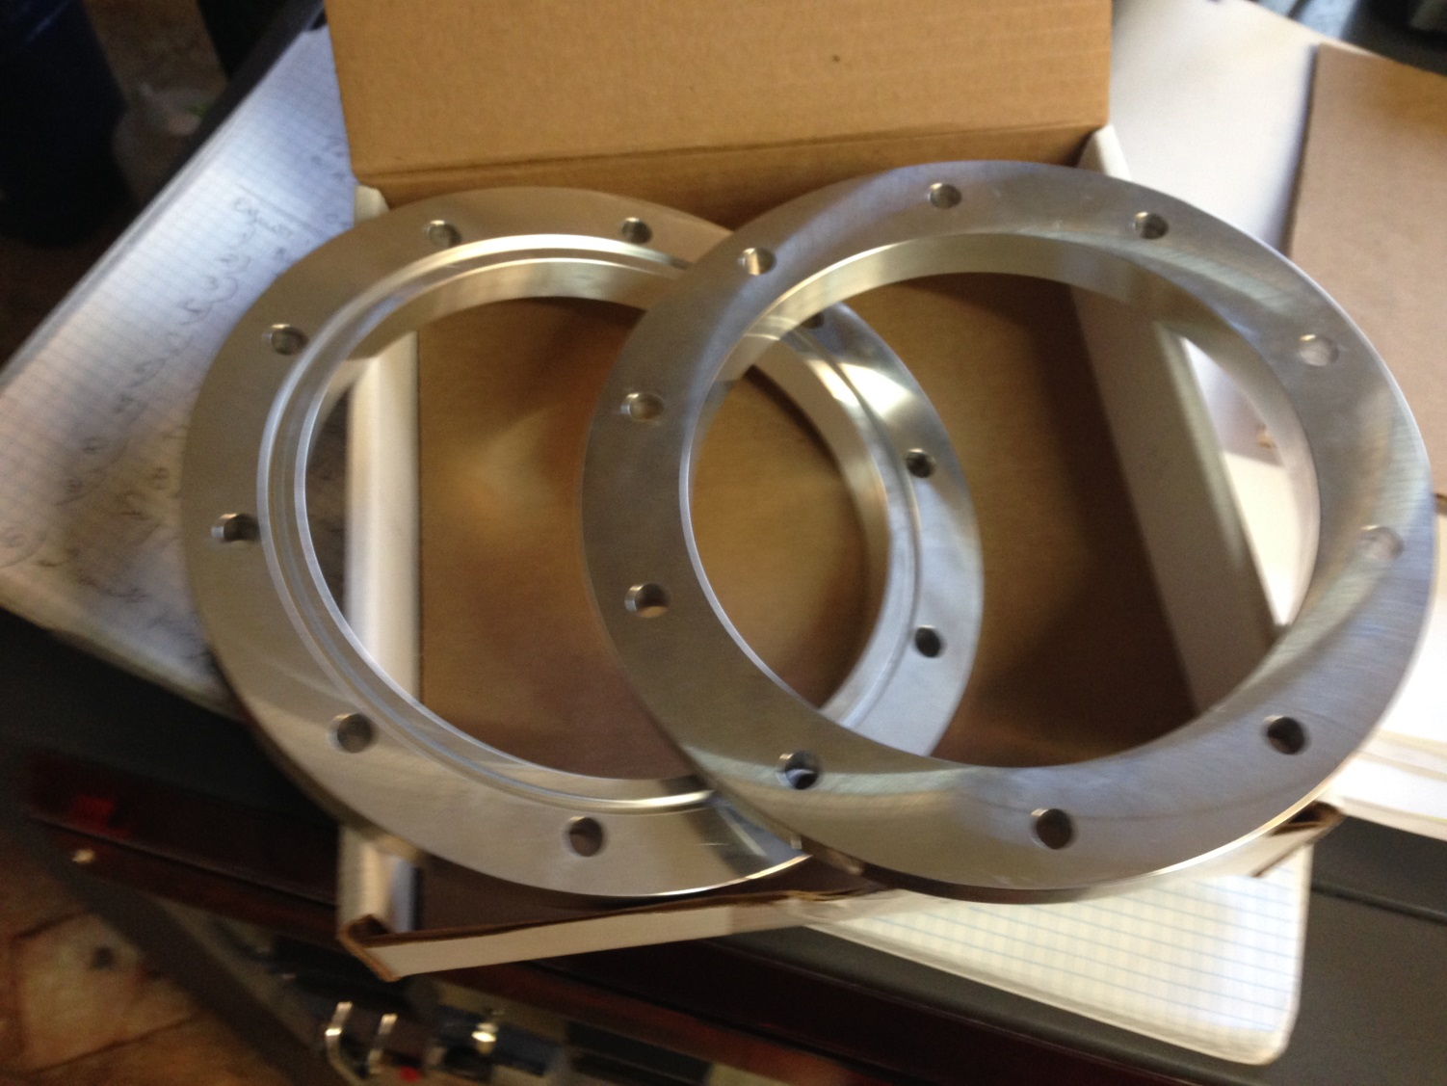
Blumlein implementation
68 flanges manufactured by Hancock Precision Inc. received
Plan to place order for tubes in December
With radii fine tuned to improve impedance match

Slide 7
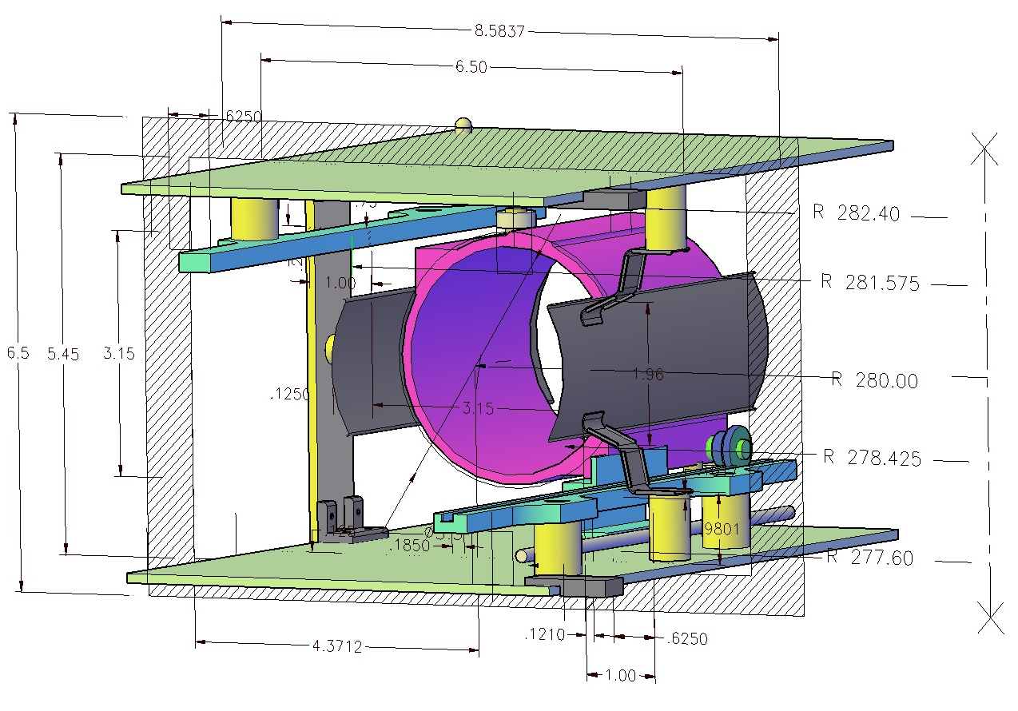
Kicker Cage – Plates - Rails
New cage for kicker plates (127 cm long)

Slide 8
Kicker plates – rails - trolley

Slide 9
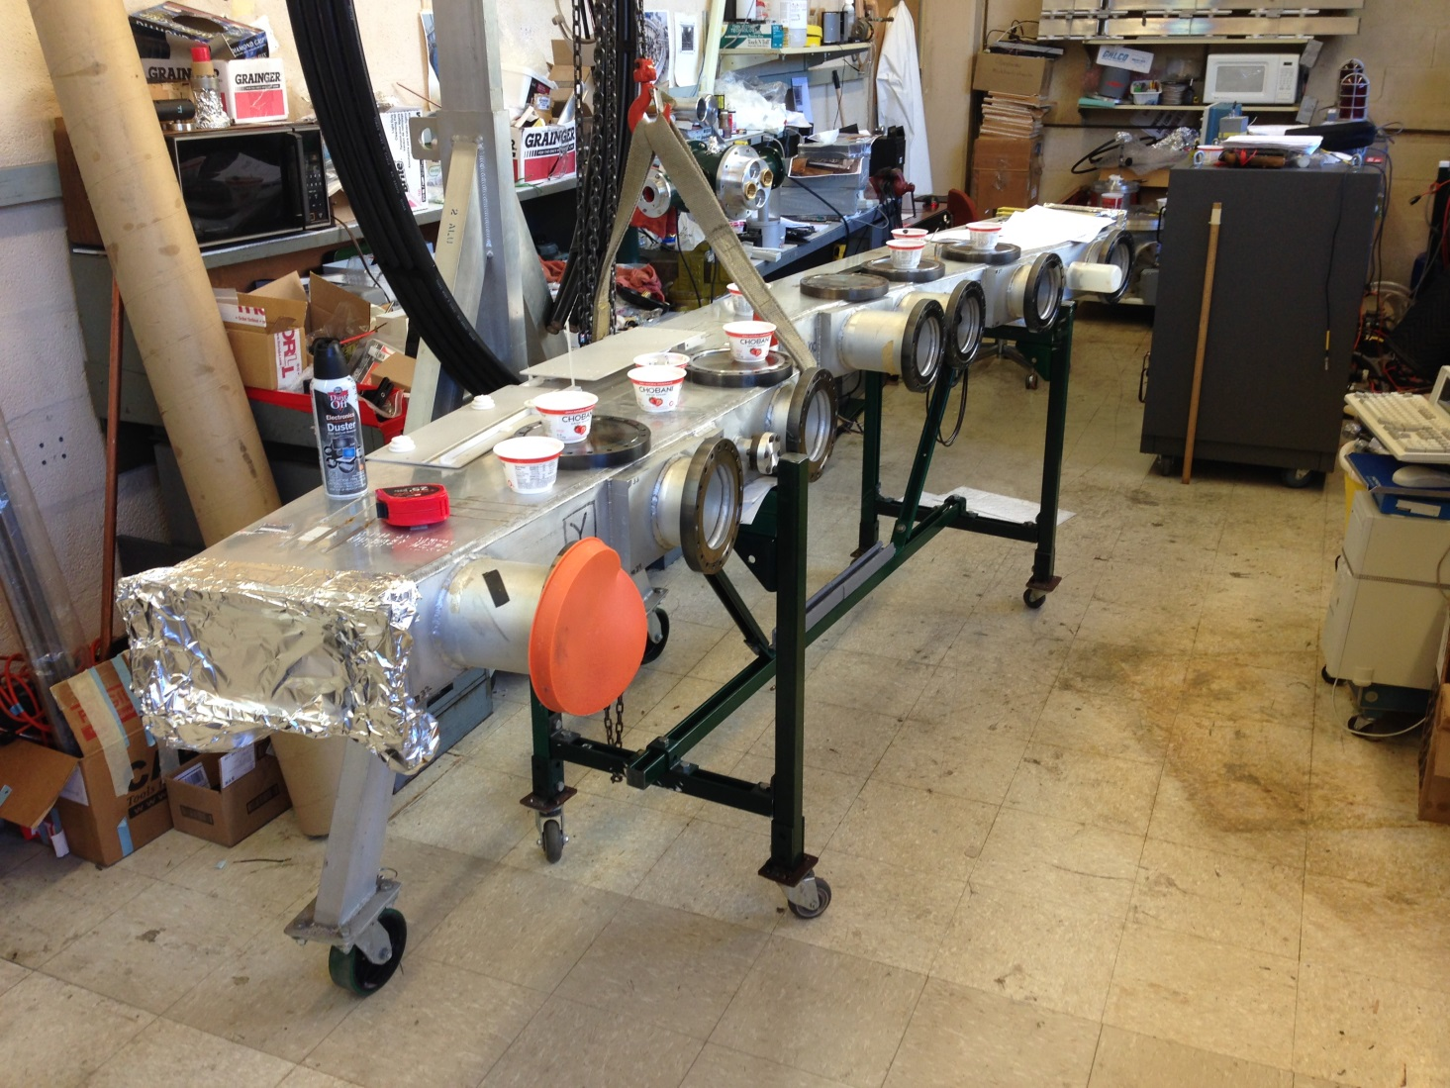
System Test
Kicker cage, plate, rail assembly will be tested in g-2 vacuum chamber in December

Slide 10
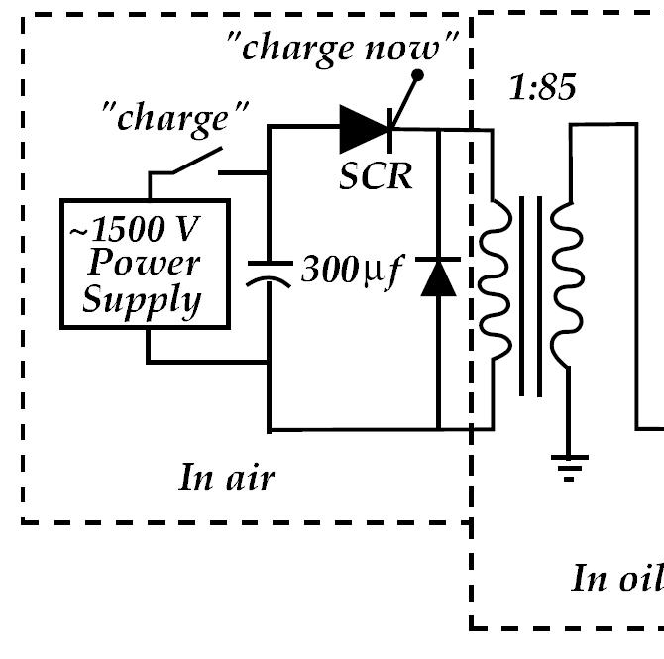
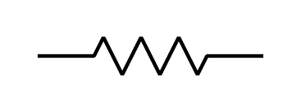
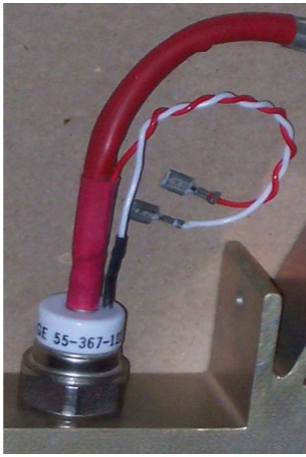
Electronics - Charging Circuit
thyratron
“Inhibit” input
5kΩ
40 kHz switching device
SCR — Silicon Controlled Rectifier -Thyristor
The time between “charge now” and the thyratron triggering ~ 2 ms

Slide 11
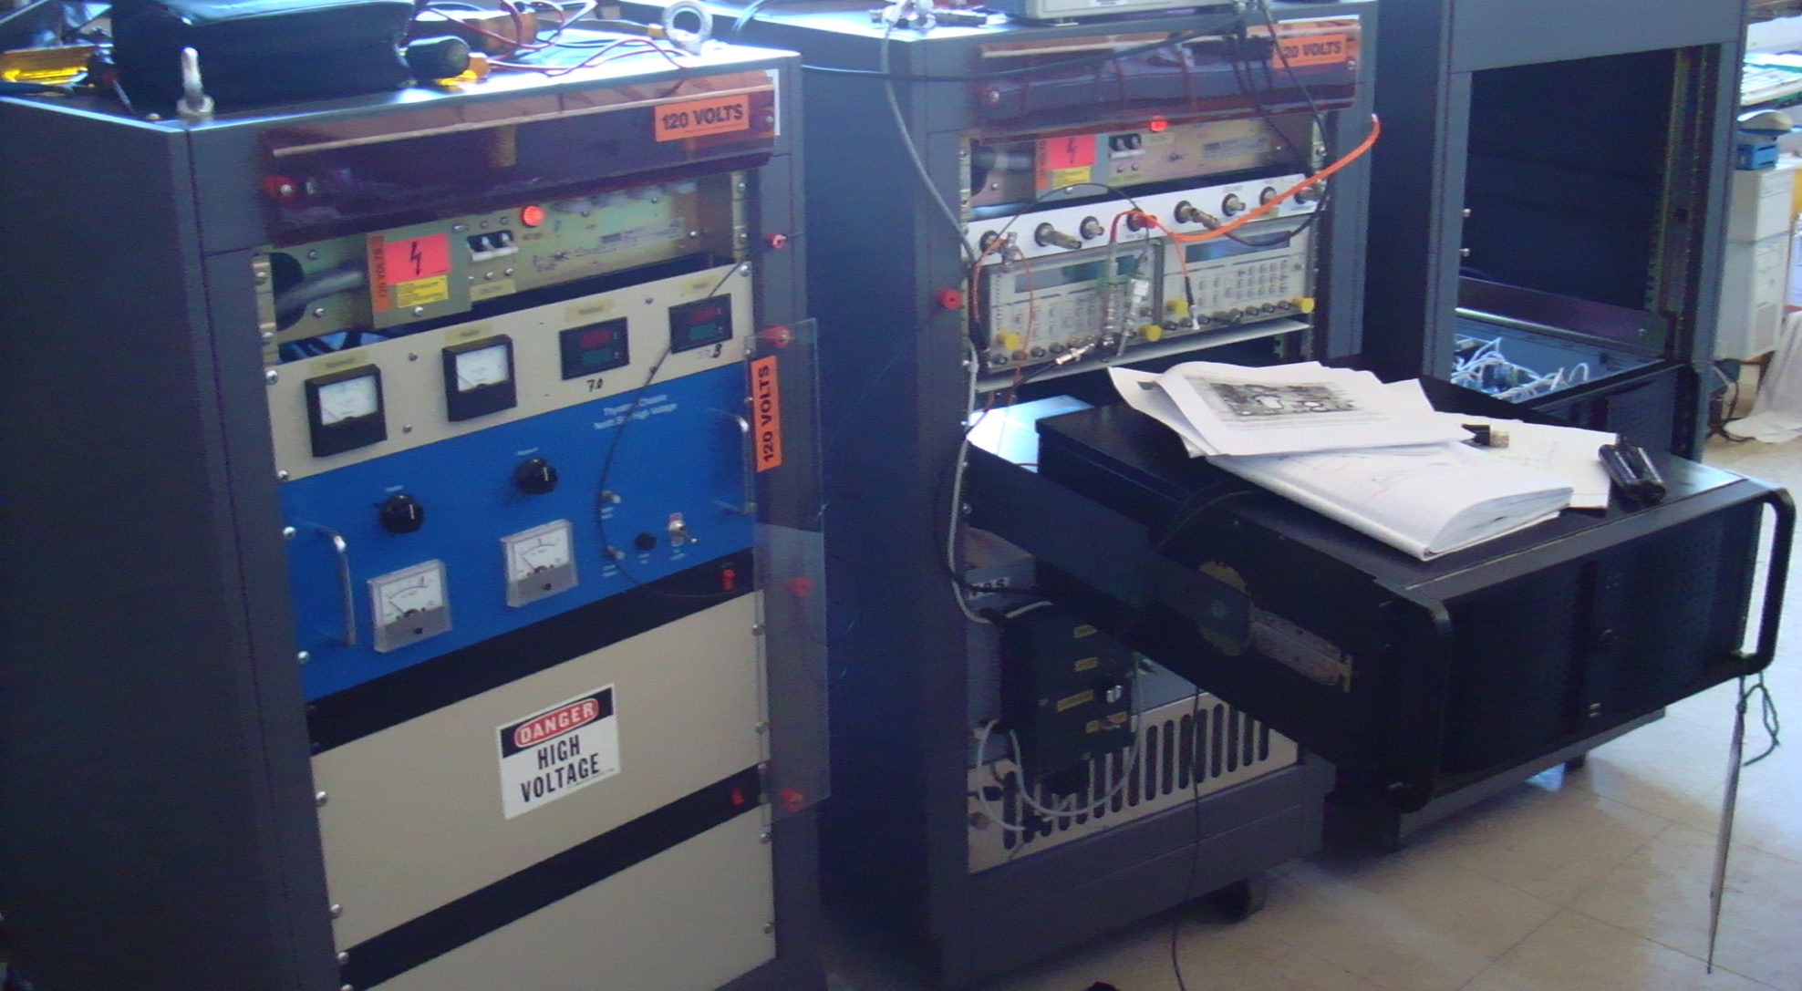
Electronics
For each of three kickers
Thyratron driver
(heater, reservoir, trigger)
Charging supply
High voltage supply
High voltage transformer
Thyratron
On hand at Cornell
1 thyratron driver (commercially available)
3 charging supplies
3 high voltage supplies
3 transformers (some modification required)
2 thyratrons

Slide 12
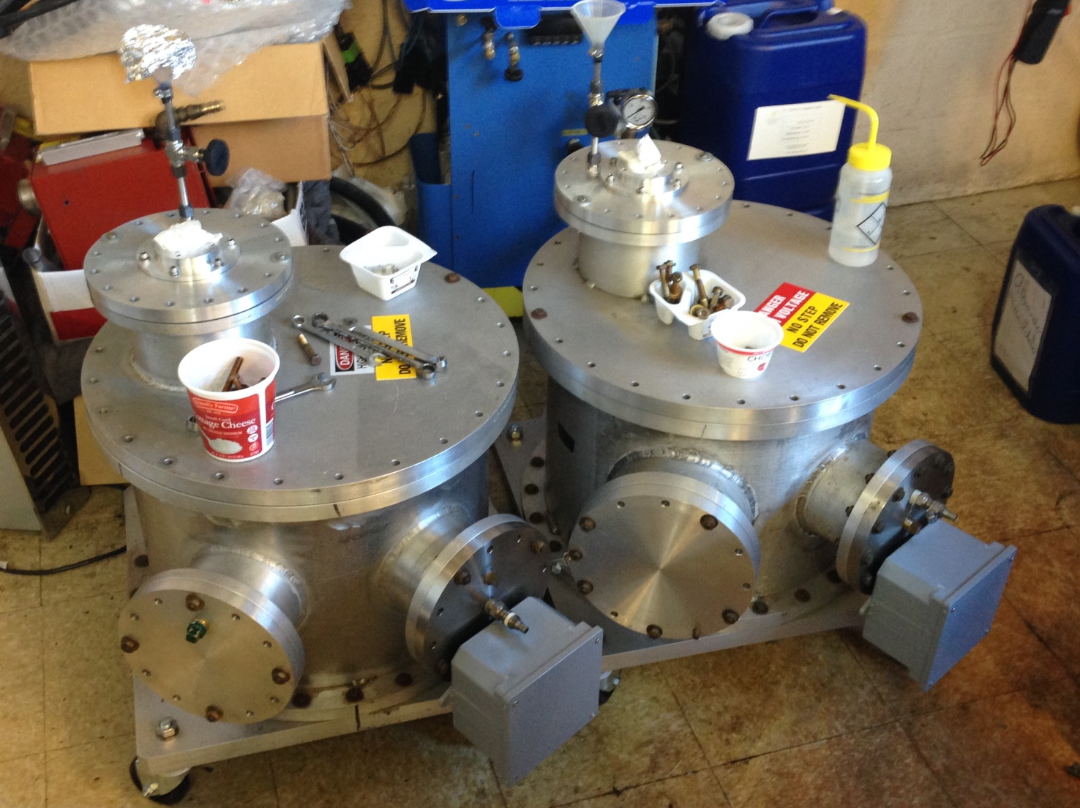
Transformer tanks

Slide 13
Kicker Control and Monitoring
Control
Thyratron driver - on/off
High voltage supply - on/off
Oil pump- on/off
Flourinert pump – on/off
Tunable parameters
Thyratron heater
Thyratron gas reservoir
Charging voltage => kicker field
Triggers
High voltage inhibit (HV to capacitors)
Charging thyristor (Cap bank to HV transformer)
Thyratron trigger
Monitoring
Thyratron heater current and voltage
and reservoir current and voltage
Blumlein charging voltage and
current(~100μs time scale) digitized
Oil flow gauge
Kicker Current
and Kicker B-field (Cornell digitizer)
Interlocks
Oil flow
Thyratron heater timer
etc.
X 3

Slide 14
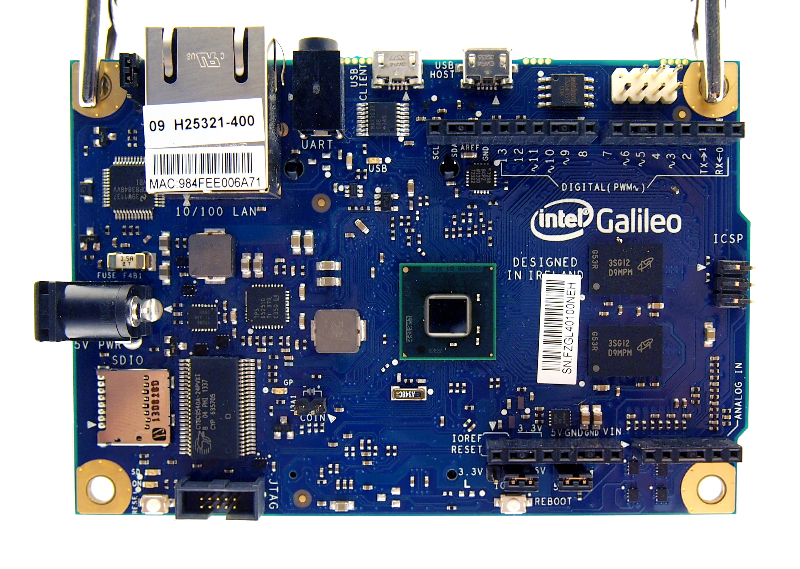
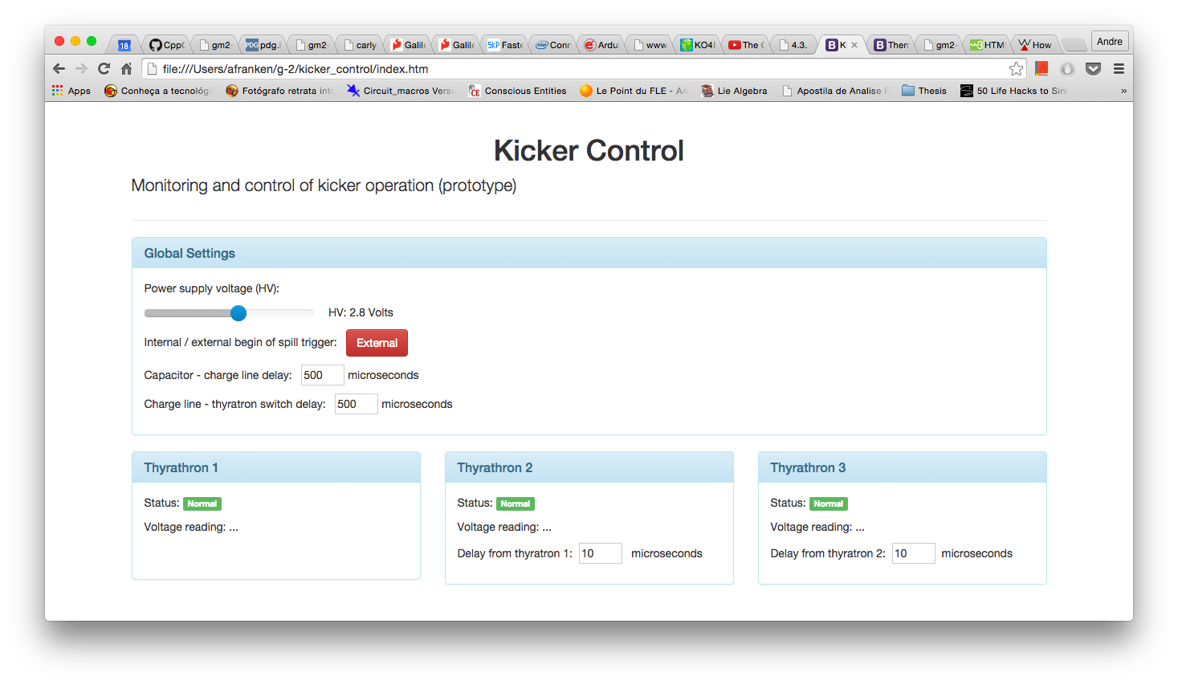
Control and Monitoring
Web interface to Intel Galileo microprocessor via ethernet

Slide 15
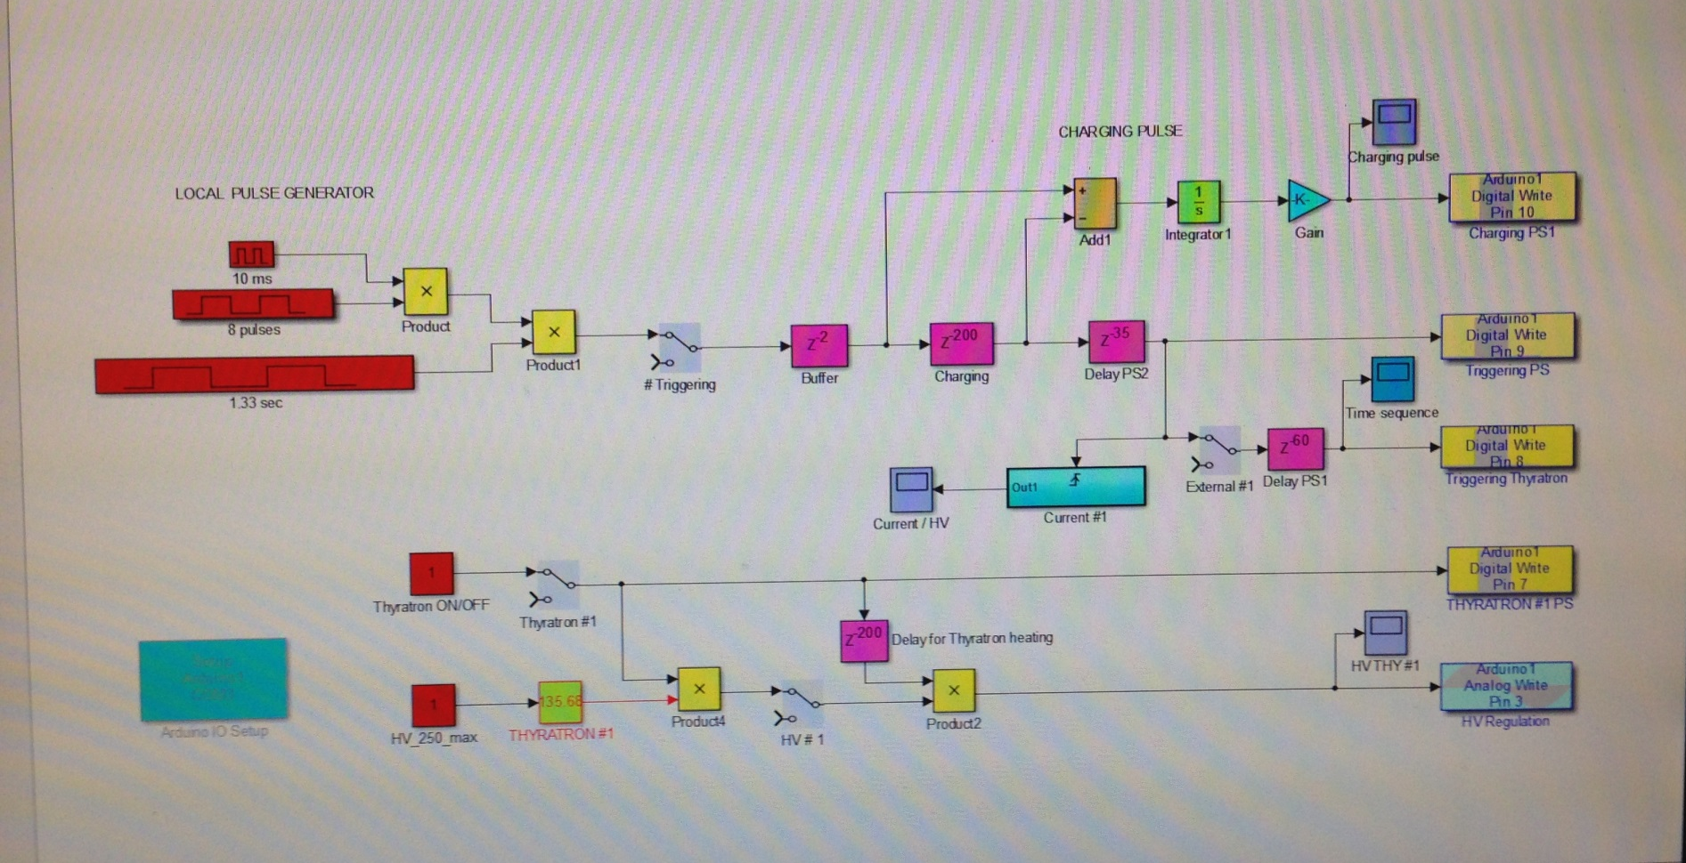
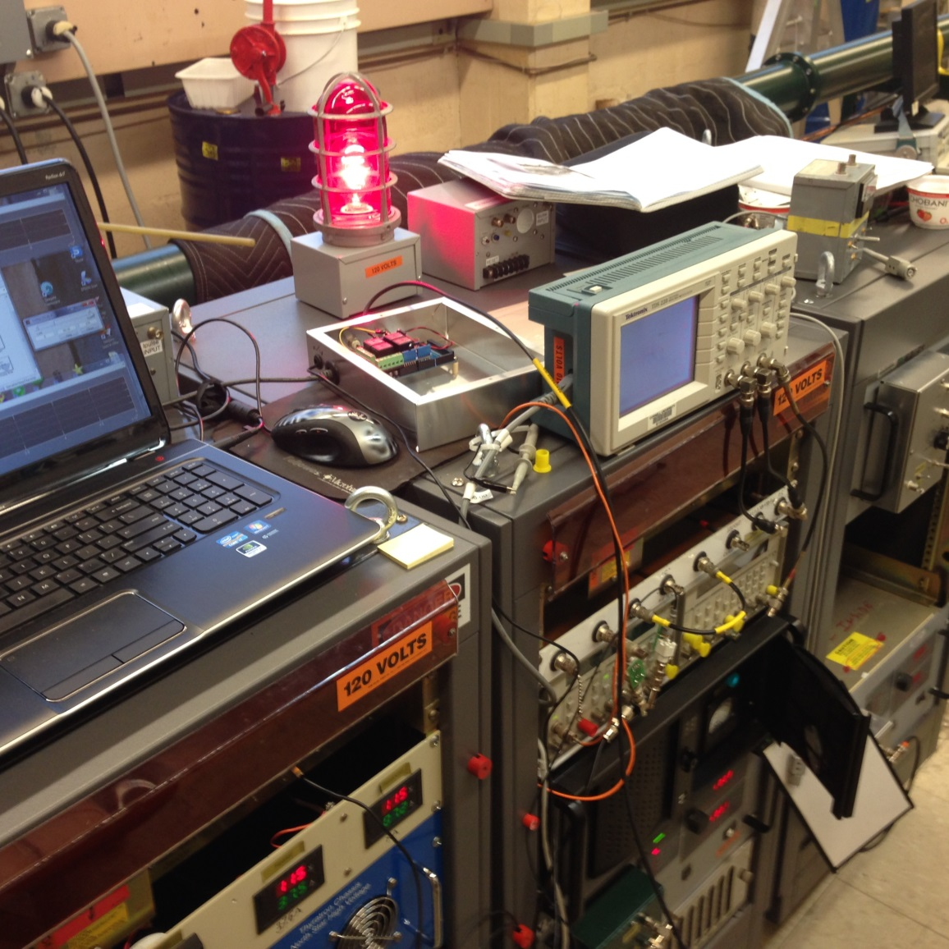
Prototype Microprocessor Control
Operating and programming panel
Arduino 2560

Slide 16
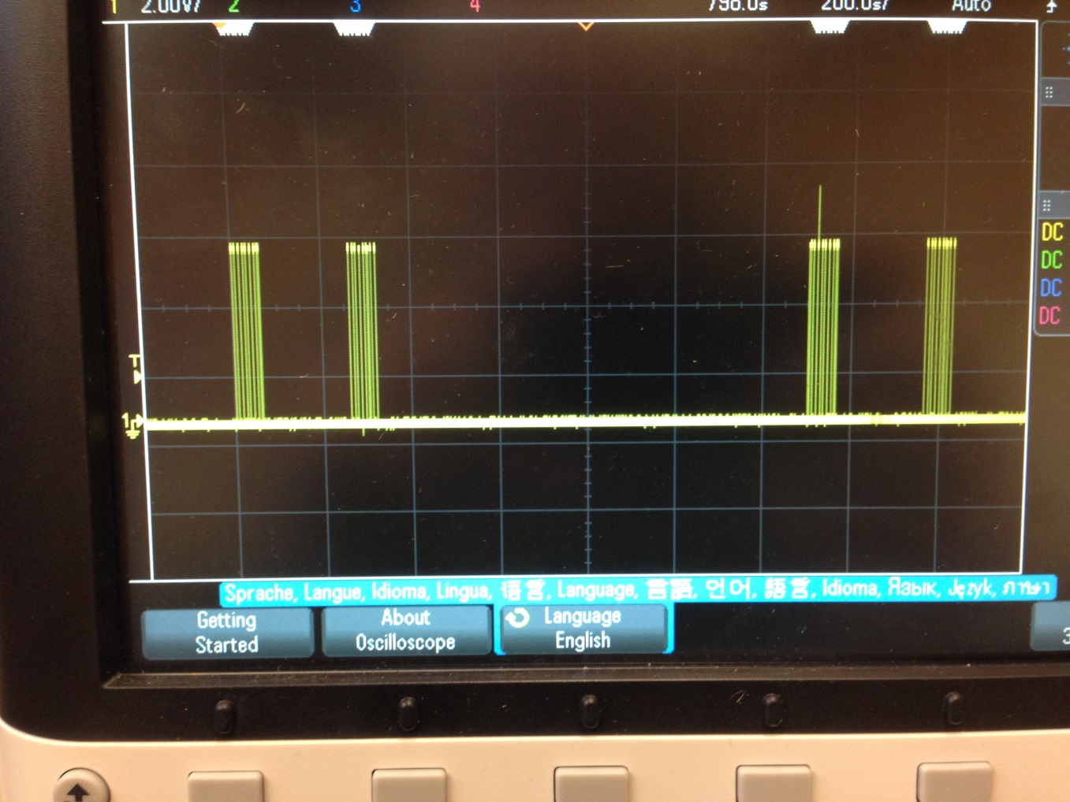
Test Triggers
Trigger pulses programmed in microprocessor

Slide 17
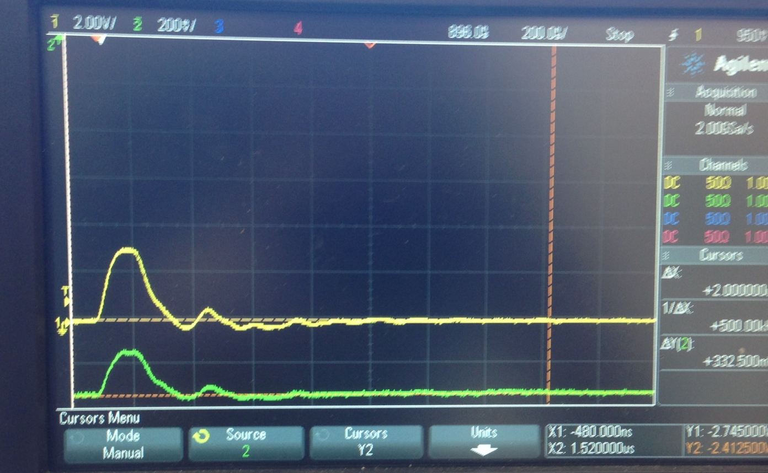
Kicker Pulse
100 ns/div
Pulse from current monitor (upper graph); optical monitor (lower graph).
(Cornell digitizer)

Slide 18
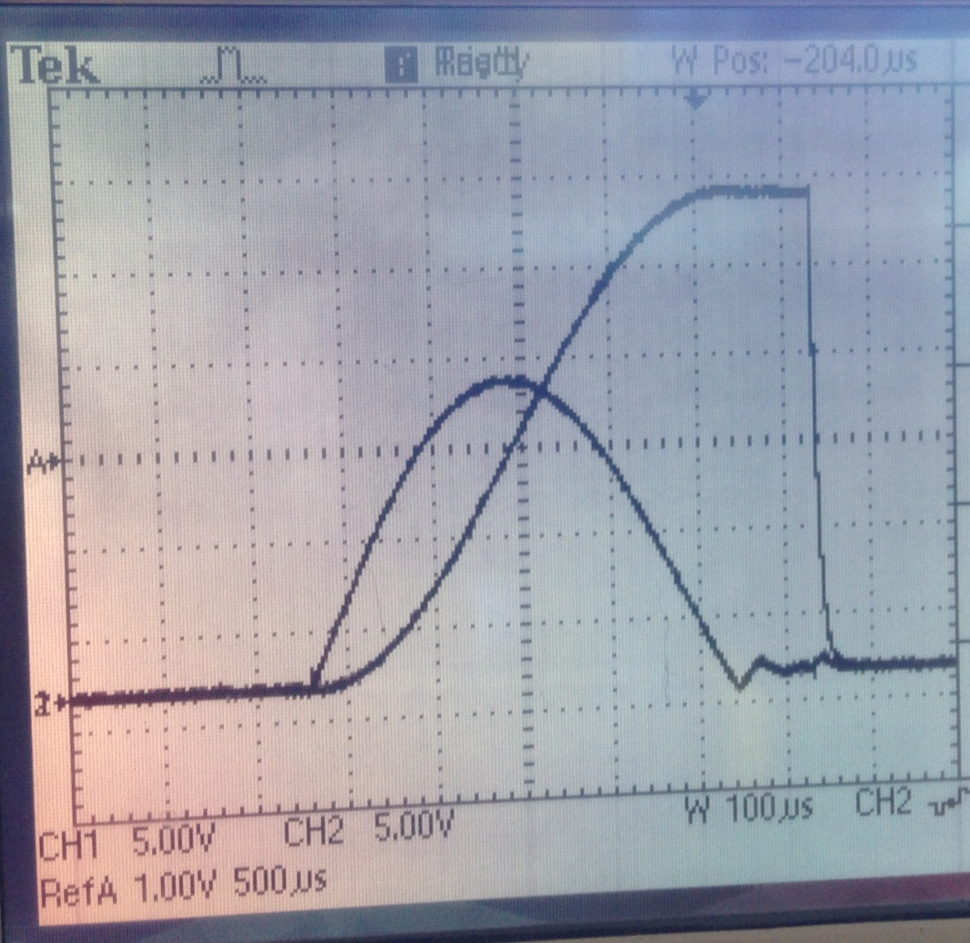
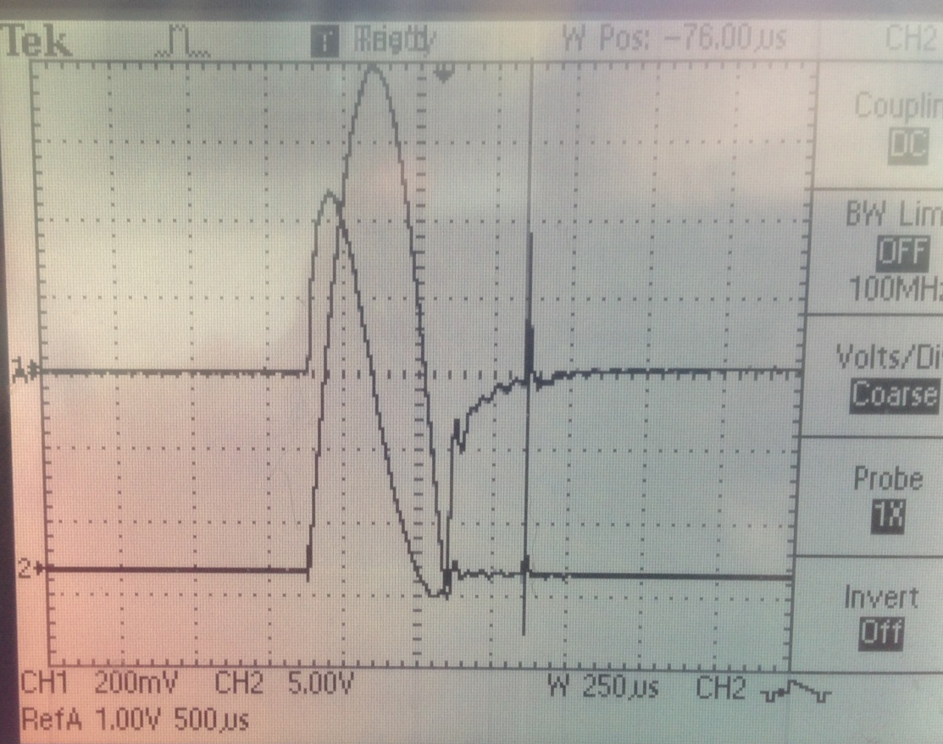
Charging current and voltage
Charging transformer characteristics contributing to signal after main pulse?
Voltage applied to Blumlein
(Voltage at secondary windings)
Current in primary windings
(Power Designs CVT-1A)
Moment of thyratron triggering
Current in secondary windings
(Galileo digitizer)

Slide 19
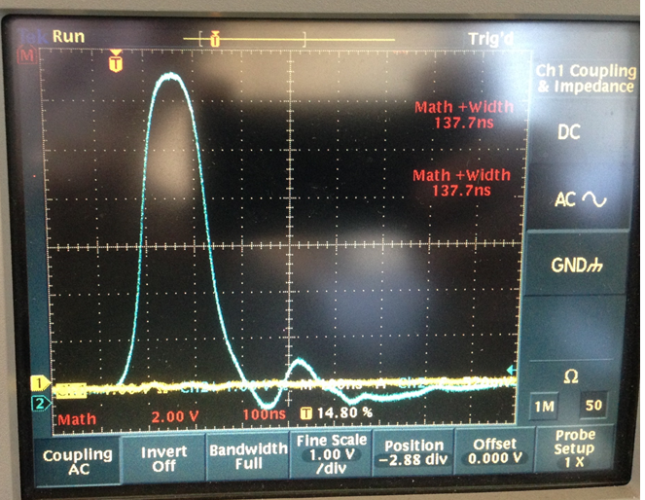
Pearson 3212; 50 kV; 4kA; 12 Hz, Full length Kicker ≈127 cm (50”)
The tail is generated by impedance mismatch?

Slide 20
Kicker pulse
Representation of kicker pulse for simulation

Slide 21
Kicker pulse
Test kicker effectiveness with simulation – compare 4 configurations
4-Uniform field/120ns rectangular pulse (ideal)
3-Curved plates/120ns rectangular pulse
2-Curved plates/measured pulse less tail
1- Curved plates/ measured pulse with tail (actual)
Capture efficiency reduced 17% due to imperfections of kick
Temporal non-uniformity of kicker pulse can introduce early to late systematic

Slide 22
Impedance Matching Tuner
Proposed Impedance matching tuner
Includes resistor ( ~ 500 Ω) and capacitance or diode

Slide 23
Faraday magnetometer

Slide 24
END

Slide 25
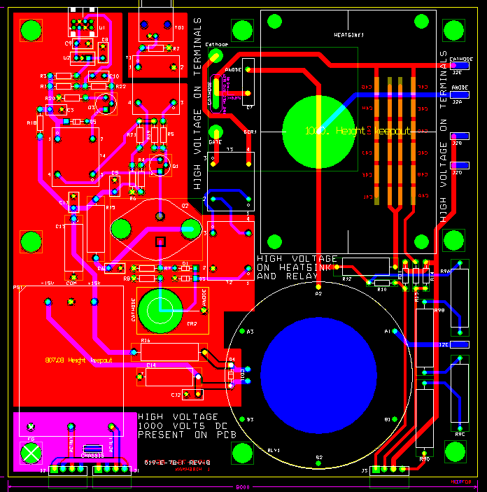
New pulser plate made for replacement of pulsed PS lost at Fermilab

Slide 27
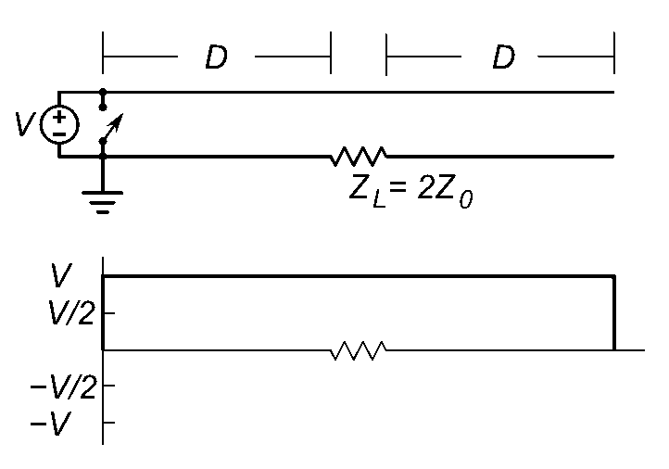
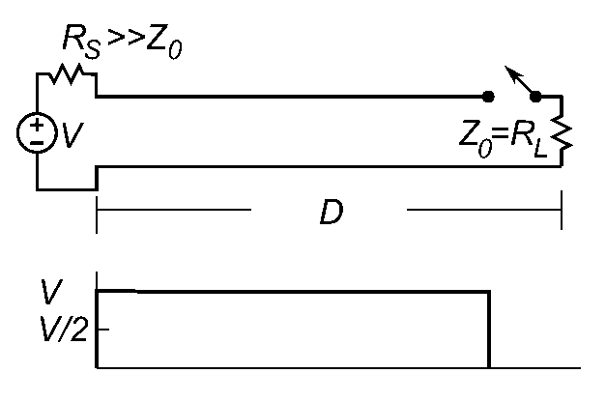


Blumlein Pulse Forming Network
Blumlein
voltage at load is equal to charging voltage
Base of switch (thyratron) at ground
Simple transmission line
voltage at load is ½ charging voltage
Base of switch floats
Pulse length

Slide 28
Blumlein schematic
12.5 Ohm Blumlein
Four parallel 50 Ω coaxial cables couple 12.5Ω
Blumlein to load
5000A X 12.5Ω = 62.5kV

Slide 29
Thyratron
Thyratron | CX1725X
Peak Voltage [kV] | 70
Peak Current [kA] | 15
dI/dt [kA/μs] | >300
Repetition rate [Hz] | 2000
Grids | 2
10.8mrad kick corresponds to
=> 5000 A (E989 kicker plates)
=> 62.5 kV with 12.5 Ω load
Blumlein properties
V_{magnet} = V_{thyratron}
I_{magnet} = ½ I_{thyratron}
CX1725X – 62.5 kV and 10kA at thyratron required to deliver 5kA to 12.5Ω load
at 100 Hz with rise time < 20 ns ✓

Slide 30
12.5 Ω Blumlein triaxial transmission line
Vacuum chamber with kicker magnet
50 Ω coax

Slide 31
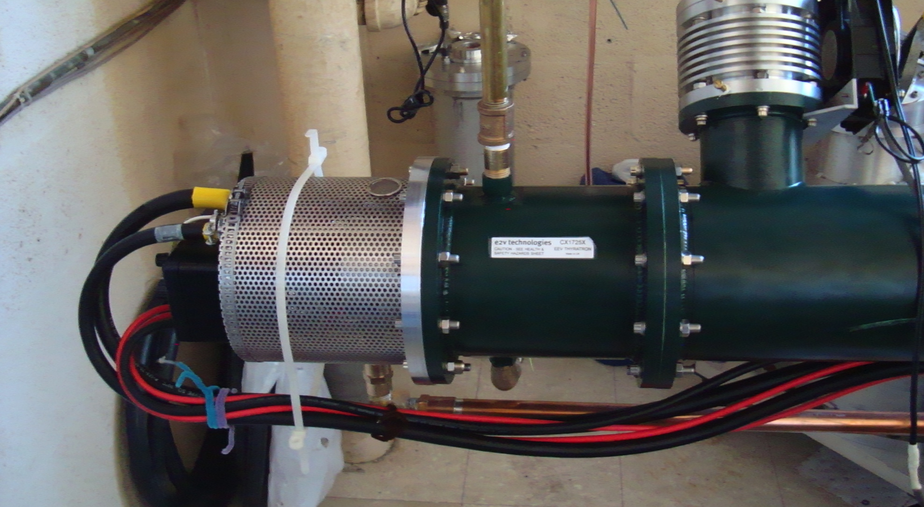
Thyratron switch

Slide 32
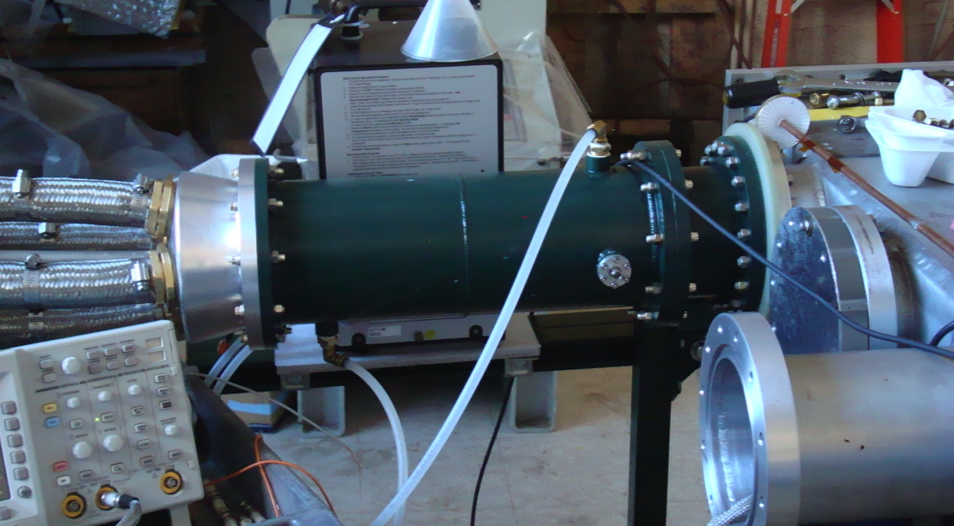
Coupling to magnet
flourinert
4 50Ω coaxial cables
4 load resistors
(12.5Ω equivalent)
Vacuum chamber

Slide 33
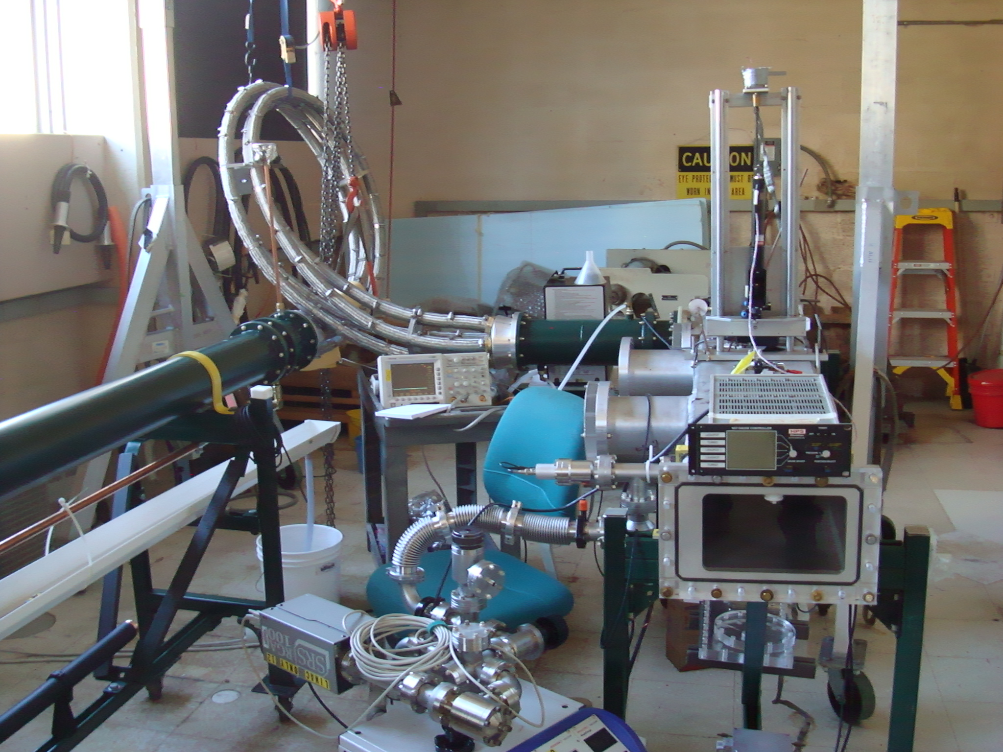
4 parallel 50Ω cables
Load resistors in flourinert
Magnetometer laser
Kicker chamber
Vacuum pump

Slide 34
Pulse characteristics
Broader flat top can be obtained with
Longer Blumlein
Shorter kickers (and additional kickers to achieve integrated kick)
Fine tuning of thyratron gas pressure
Compensation of mismatched lengths of Blumlein transmission lines
Tail can be reduced with
Better matching of blumlein, cables, and load
Kilovac switch to eliminate bleed through of charging transformer
Temporal non-uniformity of kicker pulse can introduce early to late systematic
(SeungCheon Kim – Wednesday talk)

Slide 35
Blumlein Pulse Forming Network
Blumlein
voltage at load is equal to charging voltage
Base of switch (thyratron) at ground
Simple transmission line
voltage at load is ½ charging voltage
Base of switch floats
Pulse length

Slide 37
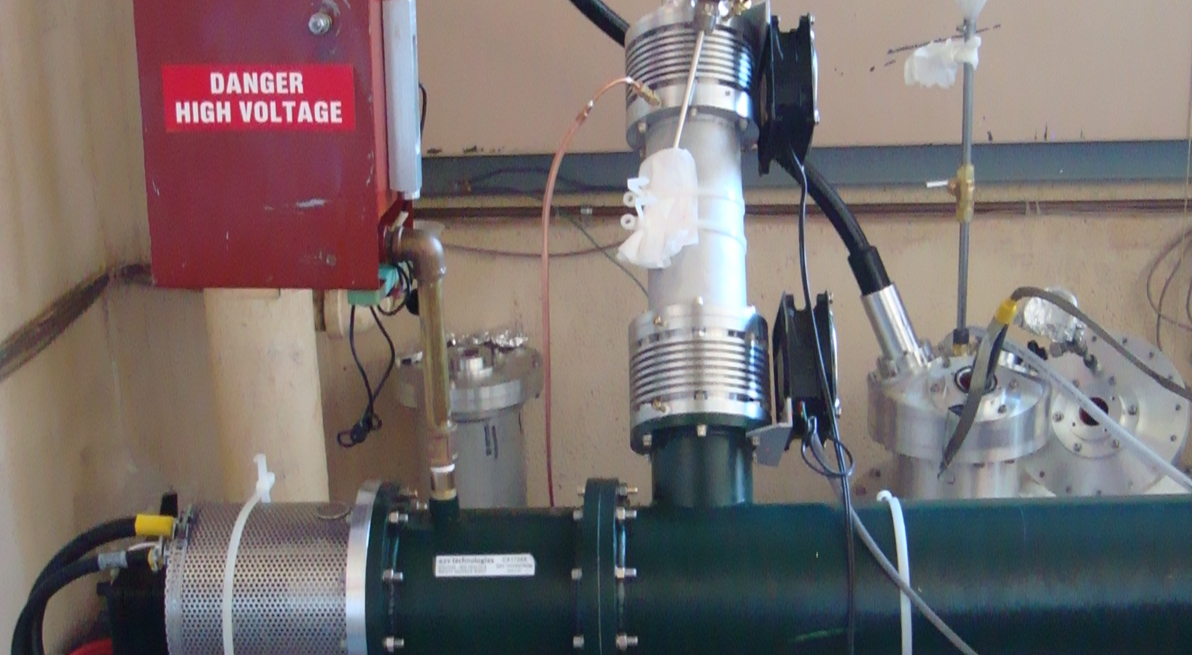
Thyratron and charging input

