Slide 1
Ring Injection Kickers
Collaboration Meeting
July 13, 2015
David Rubin for Alexander Mikhailichenko & SeungCheon Kim

Slide 2
Outline
Kicker WBS
Requirements
Kicker plates
Pulse forming network and thyratron
Power Supply
Pulse characteristics
Trolley rails
Commissioning Plan
Summary

Slide 3
Storage Ring Kicker Requirements
Kickers steer injected muons onto the closed orbit of the storage ring
Requirements:
Kick angle ~ 10.8 to 12.8 mrad
Kicker B-field ~ 285 to 336 Gauss
Integrated B-field ~ 1.11 to 1.31 kG-m
Pulse width(τ_{wid})
120ns < τ_{wid} < 149ns
Repetition rate
~100Hz peak, 12Hz average
3 – 1.3m kickers
τ_{rev} = 149 ns
d = 77 mm, R=7112 mm
kick angle θ = d/R = 10.8 mrad

Slide 4
Outline
Kicker WBS
Requirements
Kicker plates
Pulse forming network and thyratron
Power Supply
Pulse characteristics
Trolley rails
Commissioning Plan
Summary

Slide 5
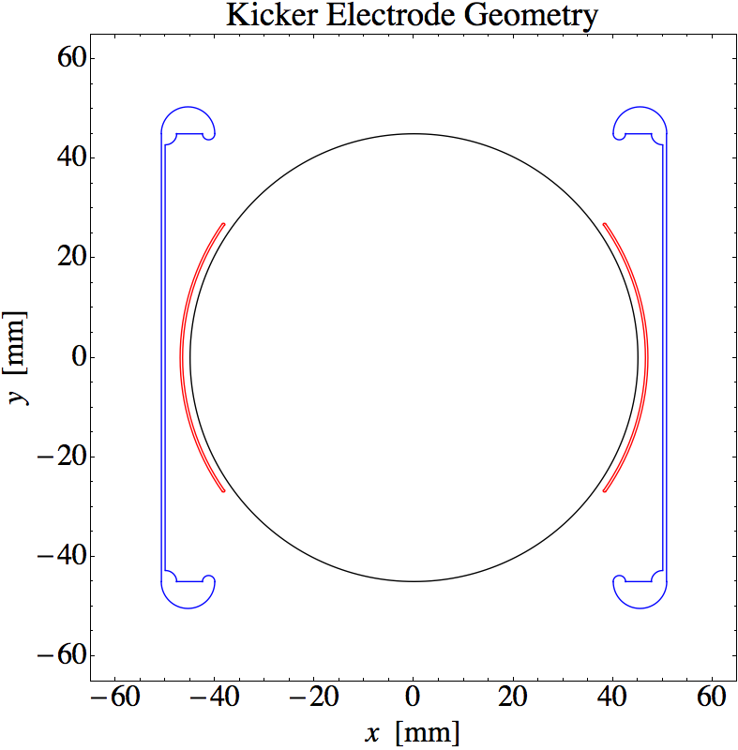
Kicker Plate Design - amplitude
The total length available for the kicker plates is 5.1m
Current travels down one plate and returns on the other.
Plate geometry must accommodate NMR trolley
The inductance of the plates limits the rise and fall time of the current pulse and inductance is proportional to length
(There were three independent 1.7m long kickers in E821)
Plate geometry determines B-field profile and dependence of midplane B-field on plate current
E989 plate geometry is optimized for maximum field
per unit current through the plates
E821 plates
E989 plates

Slide 6
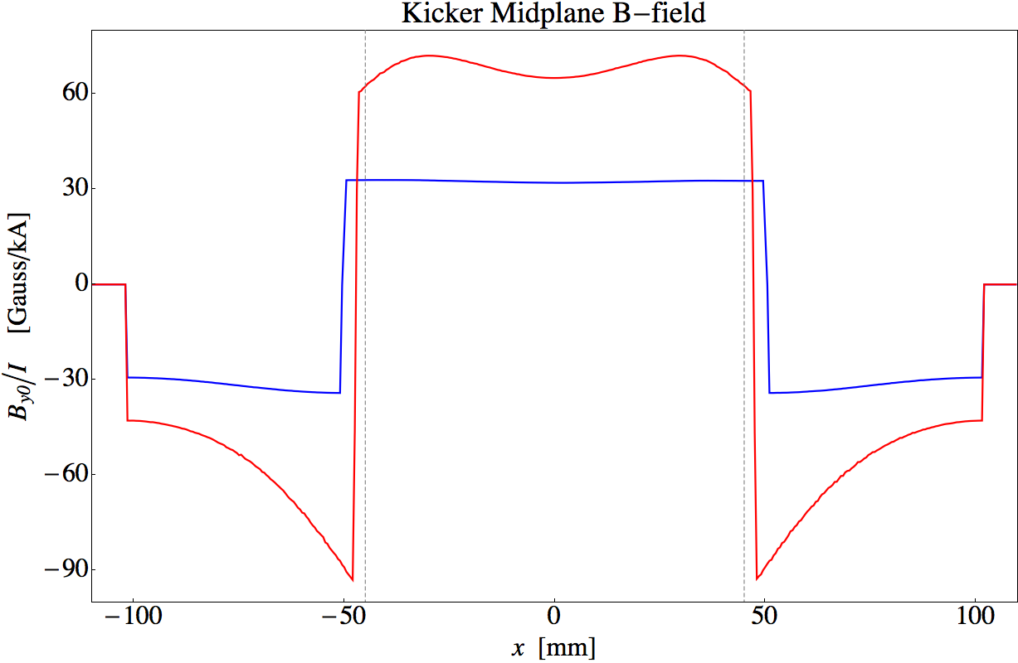
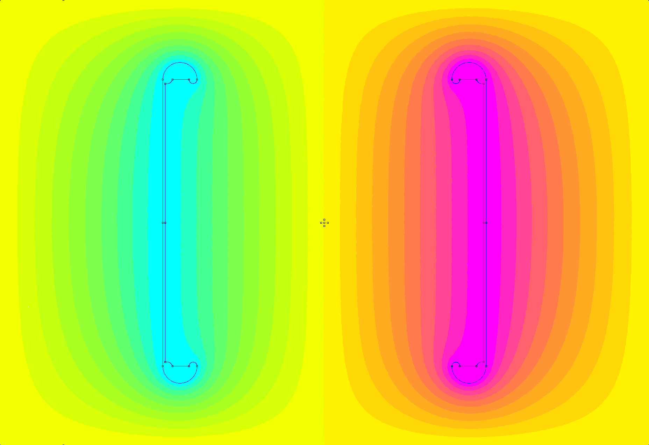
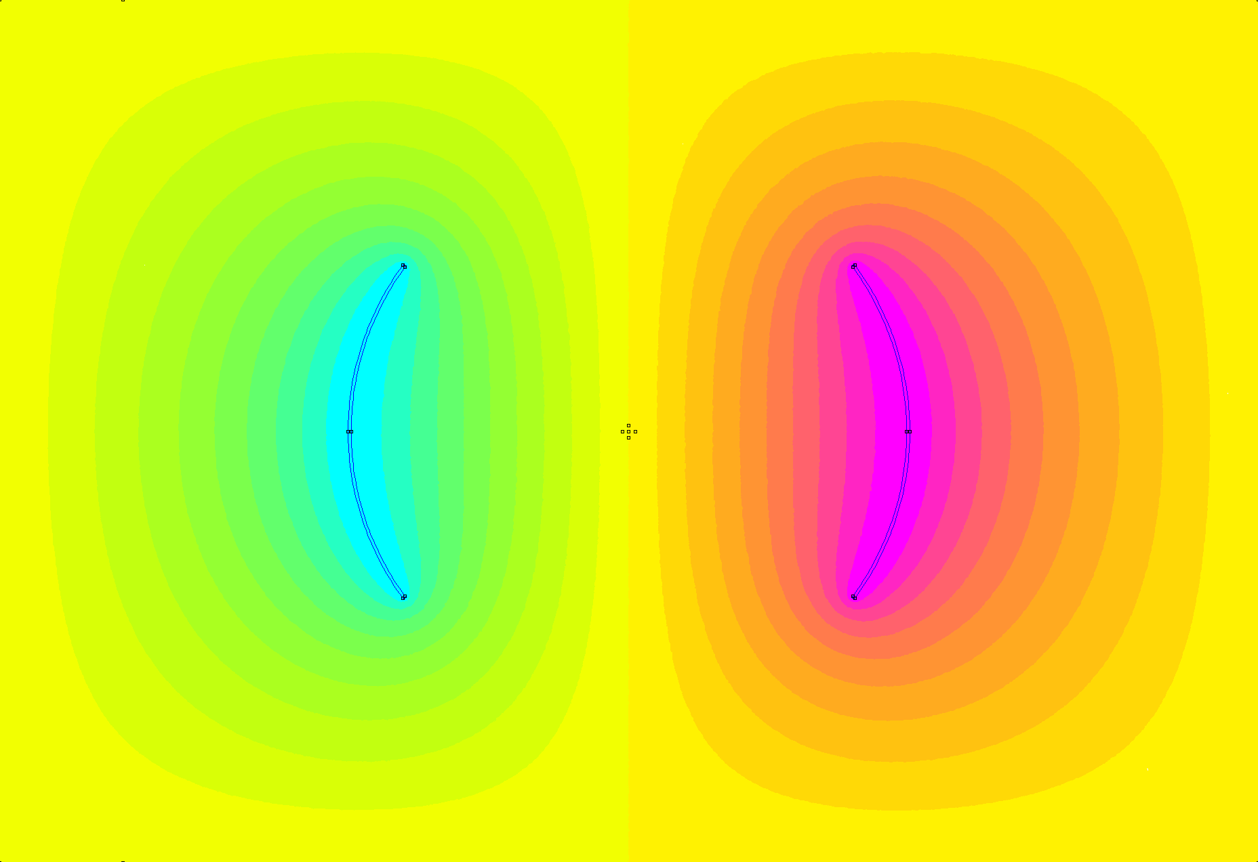
Kicker Plate Design - amplitude
E989
E821
E989 plate geometry yields higher midplane B-field per unit plate current
E821 B-field
E989 B-field

Slide 7
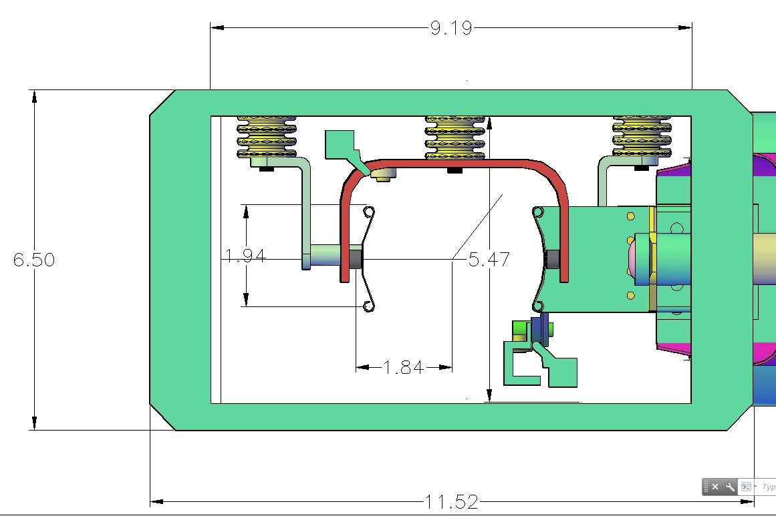
Kicker Plate Design
E 989 plates
E989 plates and trolley rails
Crossover at end of strip line
Current feed from PFN
E 821 plates
3 sets of strip line kickers
Length = 1.7m each
Trolley rail
Kicker plates mounted in ring vacuum chamber

Slide 9
Kicker Magnet
10.8 mrad kick corresponds to 1114 G-m
  292 G for each of 3 - 1.27m long kicker magnets
  0.4 mm thick plates
  Magnet geometry => 65G/kA
  => 4.5 kA/kicker magnet
  => 56 kV on each 12.5Ω Blumlein and matched load
“New” larger aperture inflector” requires 12mrad kick
  => 62 kV / Blumlein

Slide 10
Outline
Kicker WBS
Requirements
Kicker plates
Pulse forming network and thyratron
Power Supply
Pulse characteristics
Trolley rails
Commissioning Plan
Summary

Slide 11
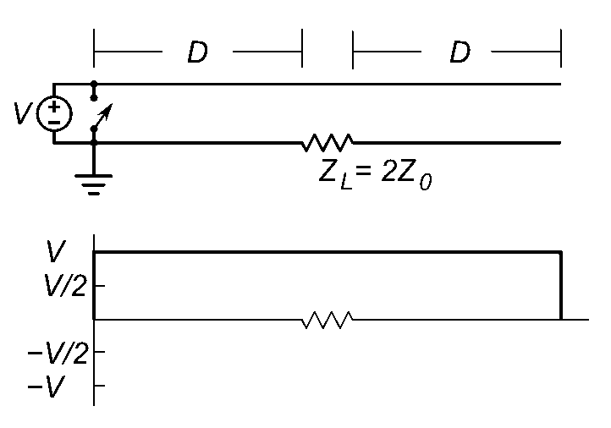
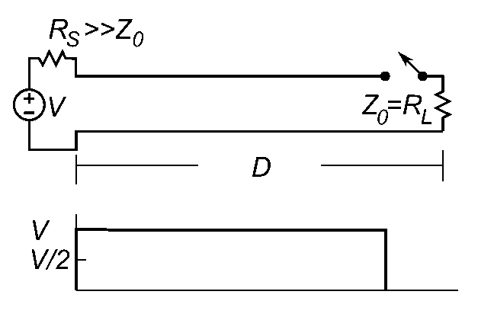


Blumlein Pulse Forming Network
Blumlein
voltage at load is equal to charging voltage
Base of switch (thyratron) at ground
Simple transmission line
voltage at load is ½ charging voltage
Base of switch floats
Pulse length

Slide 12
Blumlein Pulse Forming Network
insulator
thyratron
D = 9m
= 4.7 (Castor oil)
=> τ = 120ns

Slide 13
Blumlein – matched load - magnet

Slide 14
Blumlein schematic
12.5 Ohm Blumlein
Four parallel 50 Ω coaxial cables couple 12.5Ω
Blumlein to load
5000A X 12.5Ω = 62.5kV

Slide 15
Current Generator
12.5 Ω Blumlein triaxial transmission line
Assembled from 6 – 60 inch sections (20 ns/section) (30 ft long)
Filled with Castor oil, ε=4.7, (pulse length τ α √ε) (as compared to Corning 561 silicon oil, ε=2.7)
Concentric tubes are separated with macor standoffs
Two grid(fast) thyratron – rated for up 70kV and 15kA (Note that with Bumlein PFN thyratron current is twice the current through the load)
Coupled via 4 parallel 50Ω coaxial cables and resistors (12.5 Ω equivalent) to the kicker magnet

Slide 16
476.3.5.5 – Thyratron
Thyratron | CX1725X
Peak Voltage [kV] | 70
Peak Current [kA] | 15
dI/dt [kA/μs] | >300
Repetition rate [Hz] | 2000
Grids | 2
10.8mrad kick corresponds to
=> 5000 A (E989 kicker plates)
=> 62.5 kV with 12.5 Ω load
Blumlein properties
V_{magnet} = V_{thyratron}
I_{magnet} = ½ I_{thyratron}
CX1725X – 62.5 kV and 10kA at thyratron required to deliver 5kA to 12.5Ω load
at 100 Hz with rise time < 20 ns ✓

Slide 17
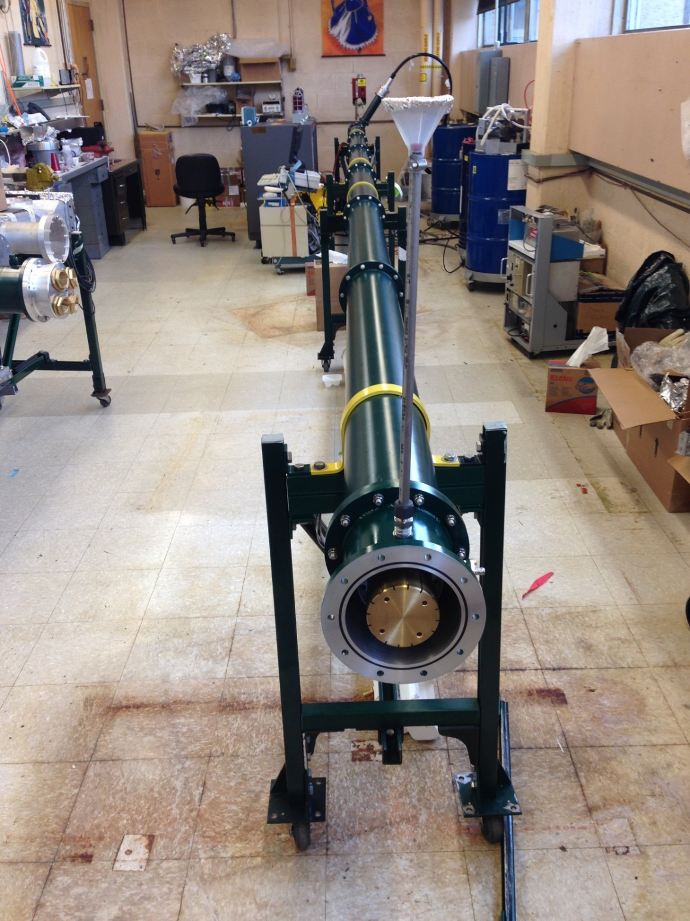
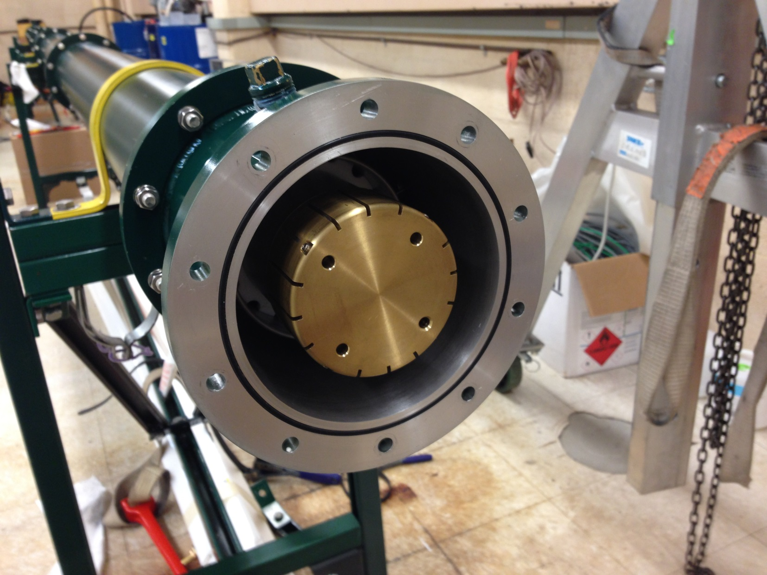
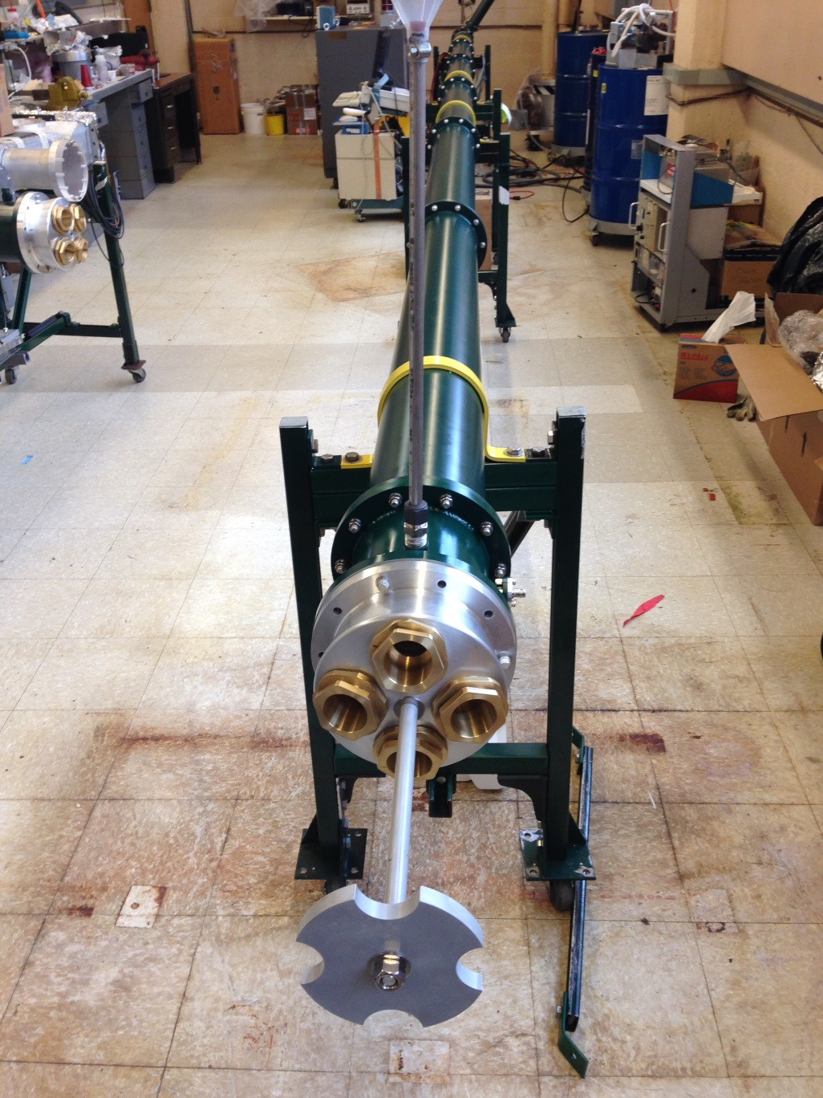
Blumlein - business end
thyratron
Coupling to 4 50Ω coax
Central conductor

Slide 18
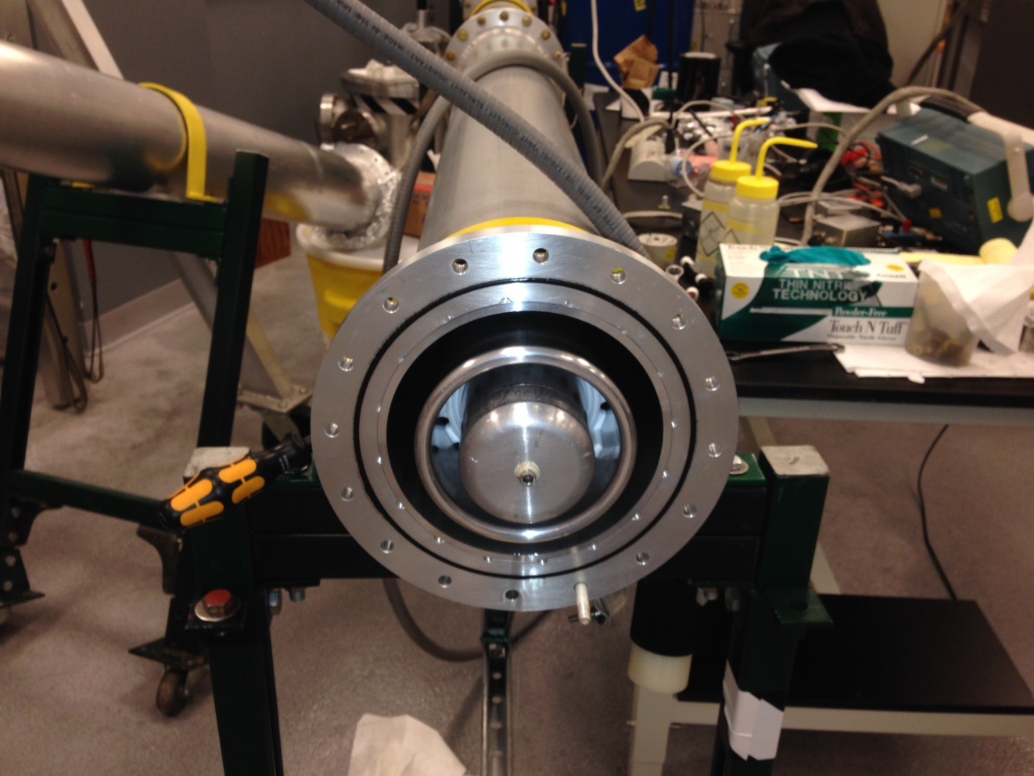
Blumlein tubing
3 concentric tubes – Middle tube charged to +HV

Slide 19
12.5 Ω Blumlein triaxial transmission line
Vacuum chamber with kicker magnet
50 Ω coax

Slide 20
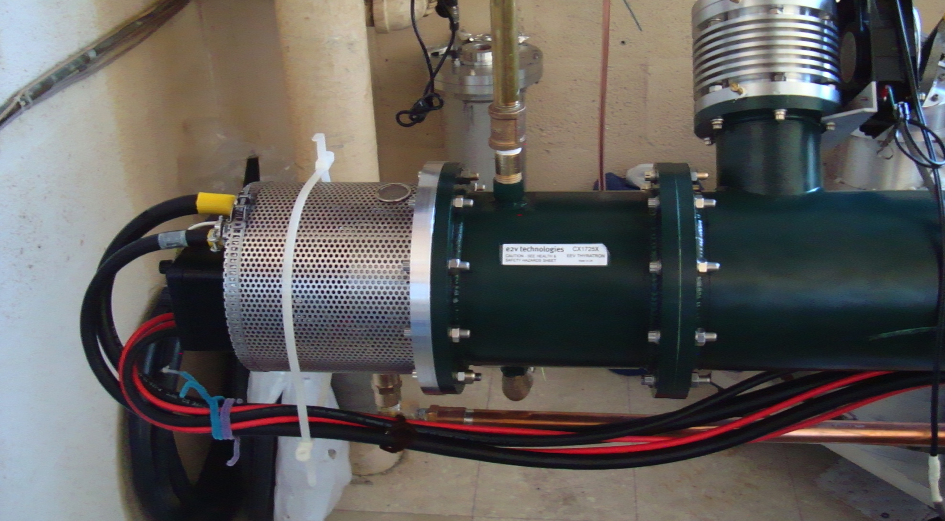
Thyratron switch

Slide 21
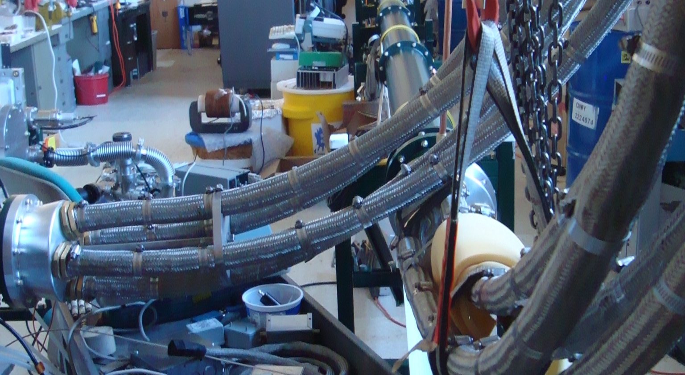
4 –parallel coax to load

Slide 22
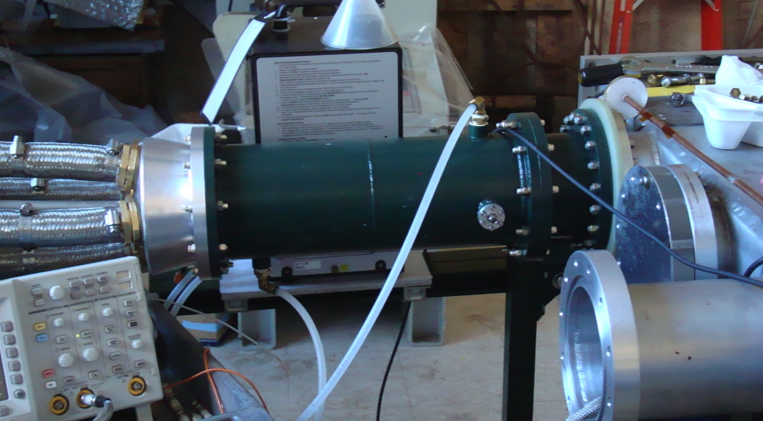
Coupling to magnet
flourinert
4 50Ω coaxial cables
4 load resistors
(12.5Ω equivalent)
Vacuum chamber

Slide 23
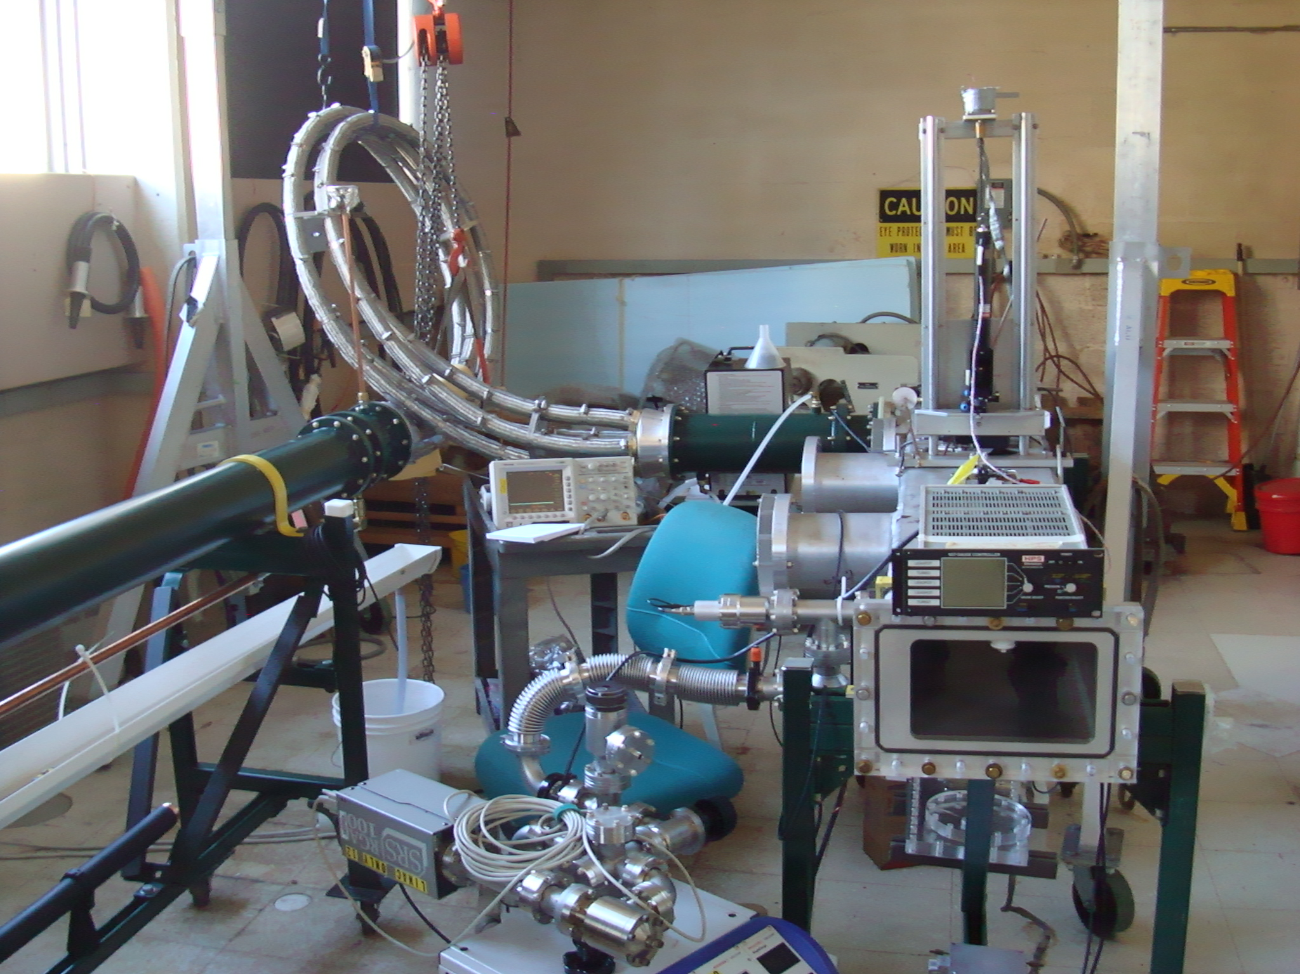
4 parallel 50Ω cables
Load resistors in flourinert
Magnetometer laser
Kicker chamber
Vacuum pump

Slide 24
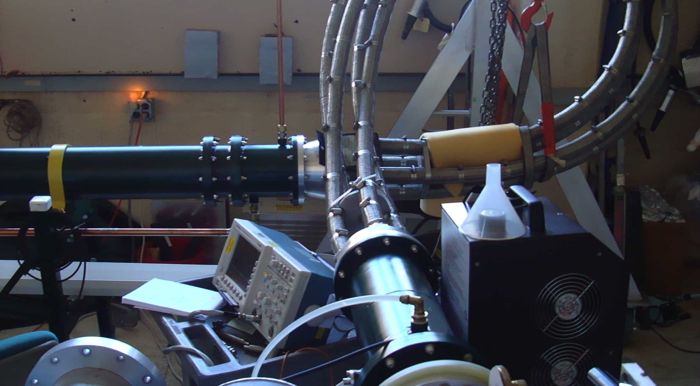
Coupling from Blumlein to Load

Slide 25
Outline
Kicker WBS
Requirements
Kicker plates
Pulse forming network and thyratron
Power Supply
Pulse characteristics
Trolley rails
Commissioning Plan
Summary

Slide 26
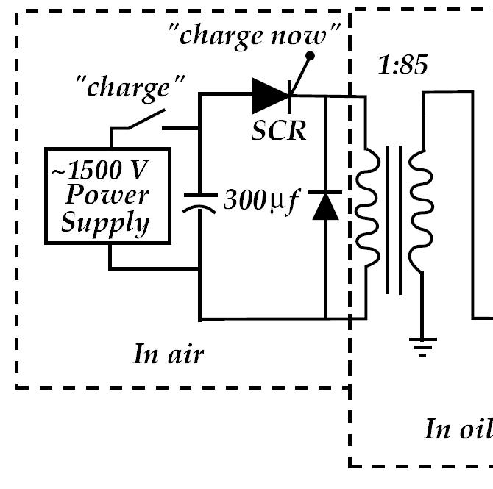
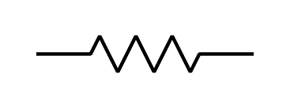
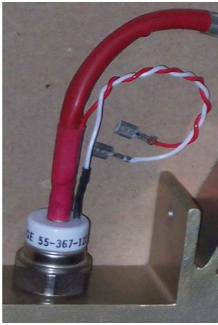
Charging Circuit
thyratron
“Inhibit” input
5kΩ
40 kHz switching device
SCR — Silicon Controlled Rectifier -Thyristor
The time between “charge now” and the thyratron triggering ~ 2 ms

Slide 27
Thyratron driver
High voltage supply
Charging circuit

Slide 28
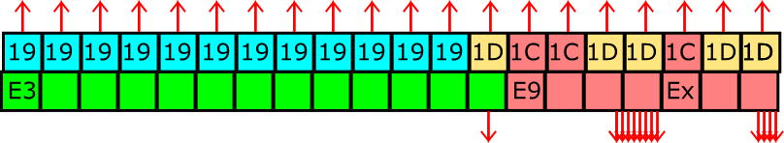
g-2 Proposed Pulse Train (12 Hz mode)
Loss of 1 Nova Pulse
Begin cycle
End cycle
Bunch length
of 1 pulse
11 / 20 Nova Cycles
120 nsec
100Hz
Pulse separation
10 msec
Lens pulse length 400 µsec
193 msec
990 msec
~
~
1
2
3
4
5
6
7
8
9
10
11
12
13
14
15
16
Pulse #
MI Nova Cycle Length
1.33 sec

Slide 29
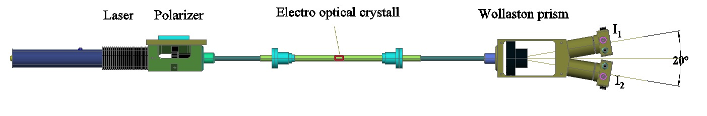
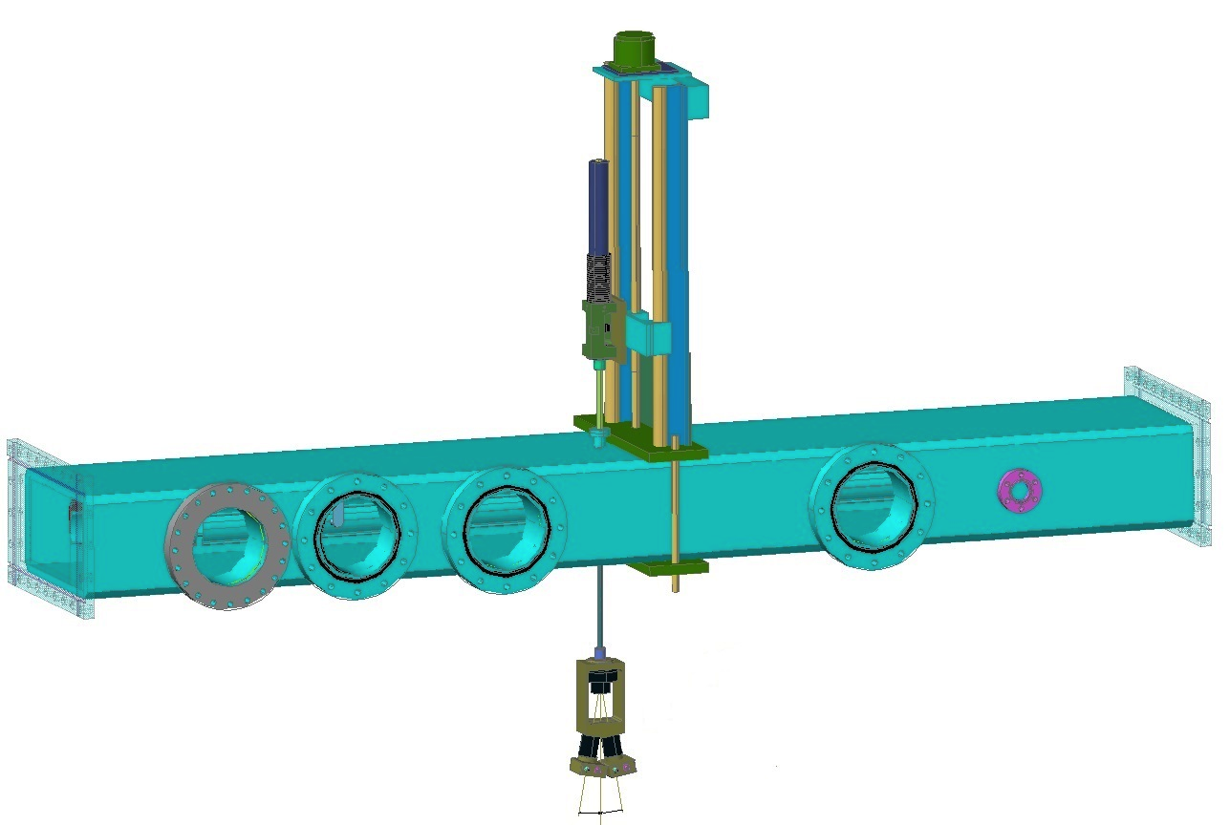
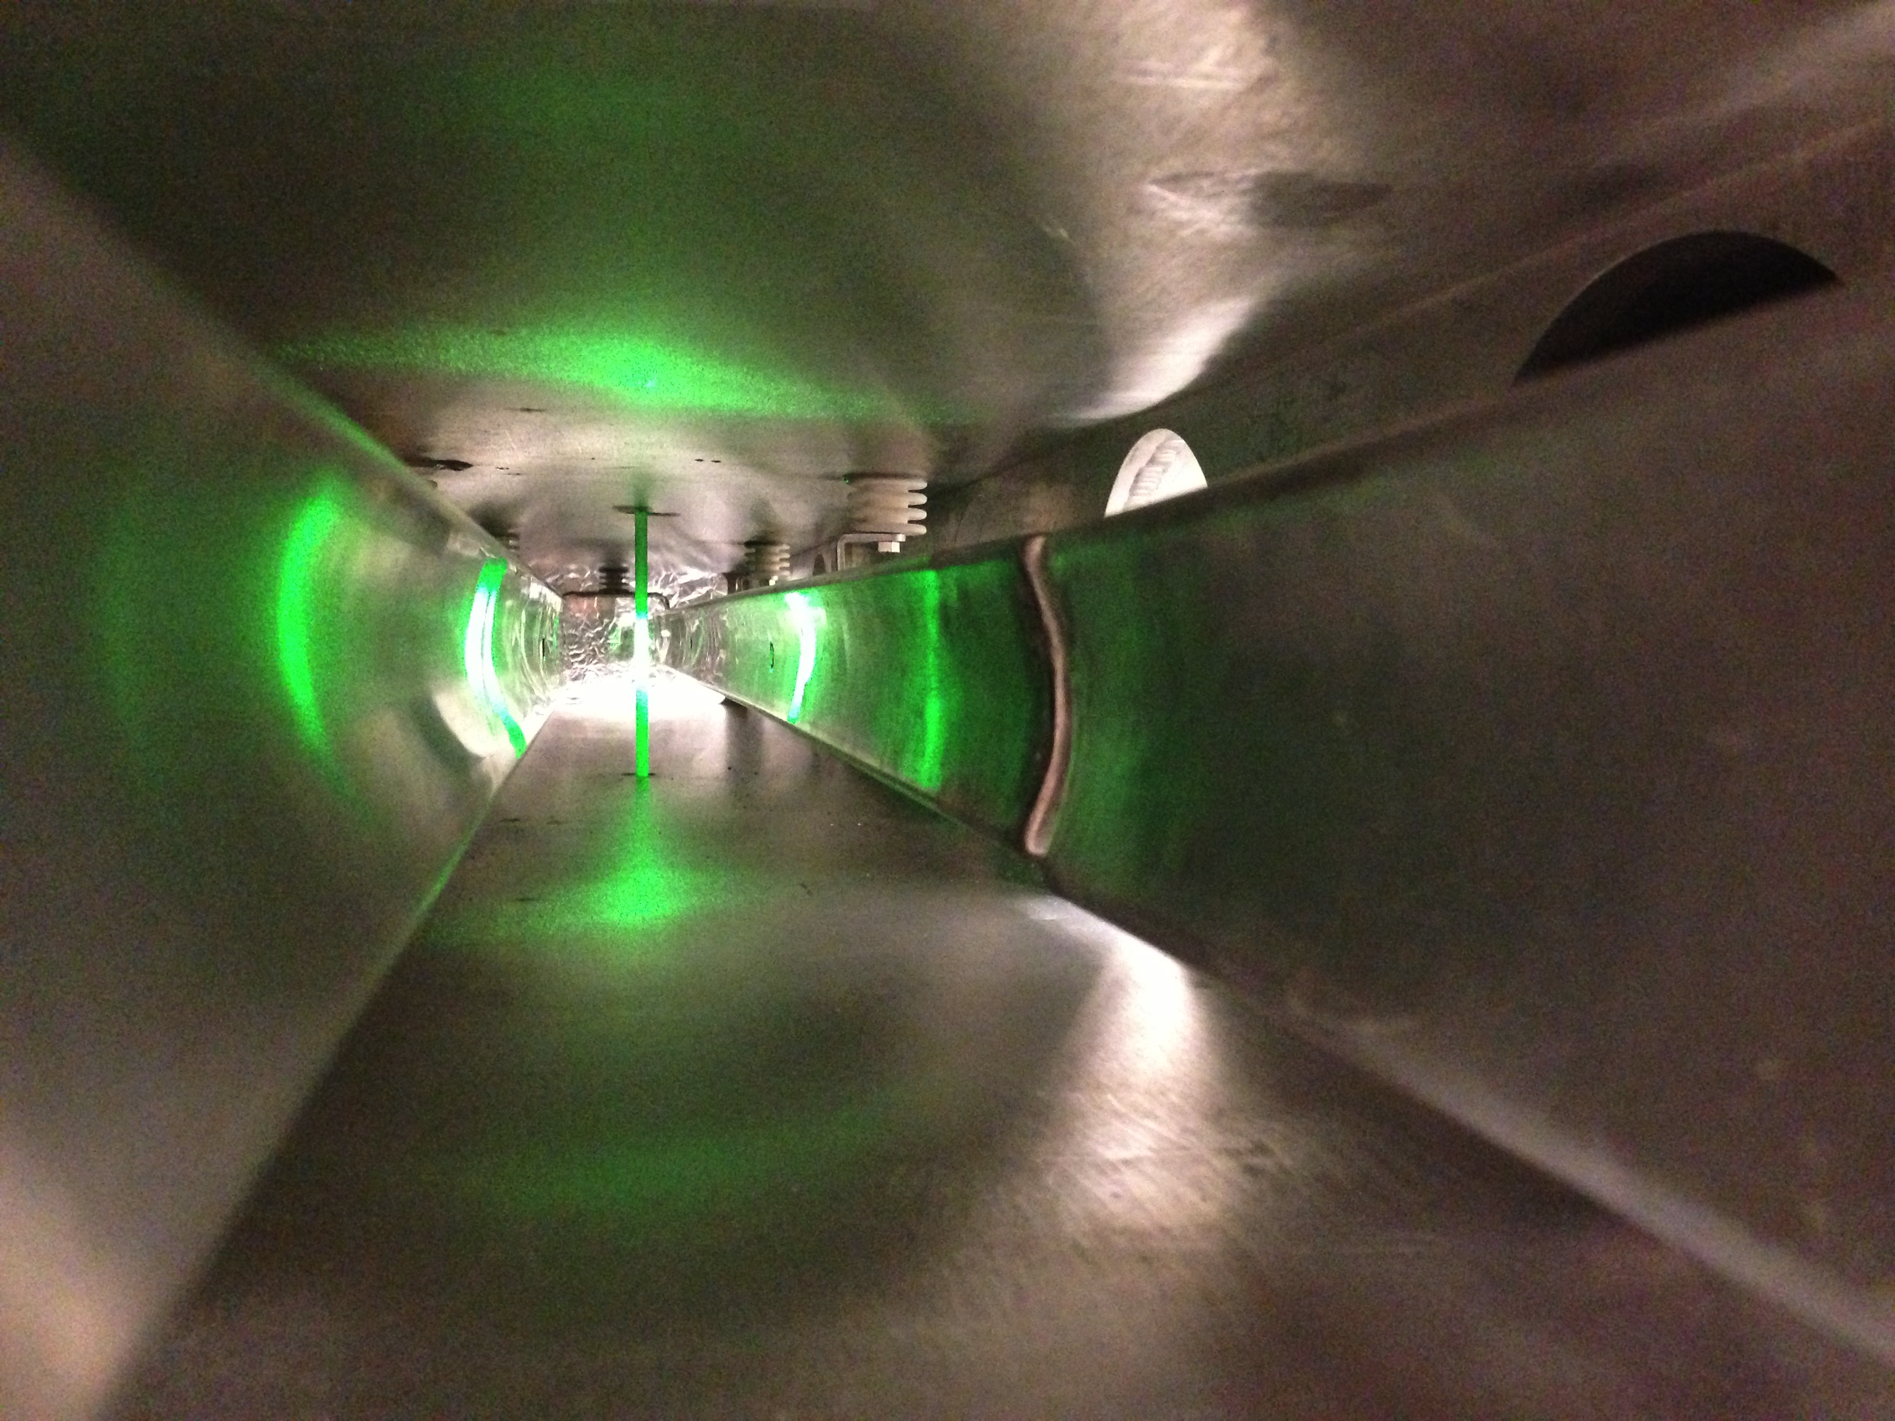
Faraday Magnetometer
High bandwidth measurement of magnetic field of kicker and induced currents

Slide 30
Outline
Kicker WBS
Requirements
Kicker plates
Pulse forming network and thyratron
Power Supply
Pulse characteristics
Trolley rails
Commissioning Plan
Summary

Slide 31
Kicker-Pulser Tests
Tests with 25 Ω Blumlein prototype:
6m, Corning 561 silicon oil
“Curved” kicker plates
shorting bar
E821 Kicker plates were 1.7m long
We find that the associated high inductance stretches the rise and fall time of the pulse
=> E989 plates will be 127cm
kicker plates
20 ns/div
40cm kicker plates, 20ns rise, 50ns flattop
125cm kicker plates, 40ns rise, 30ns flattop

Slide 32
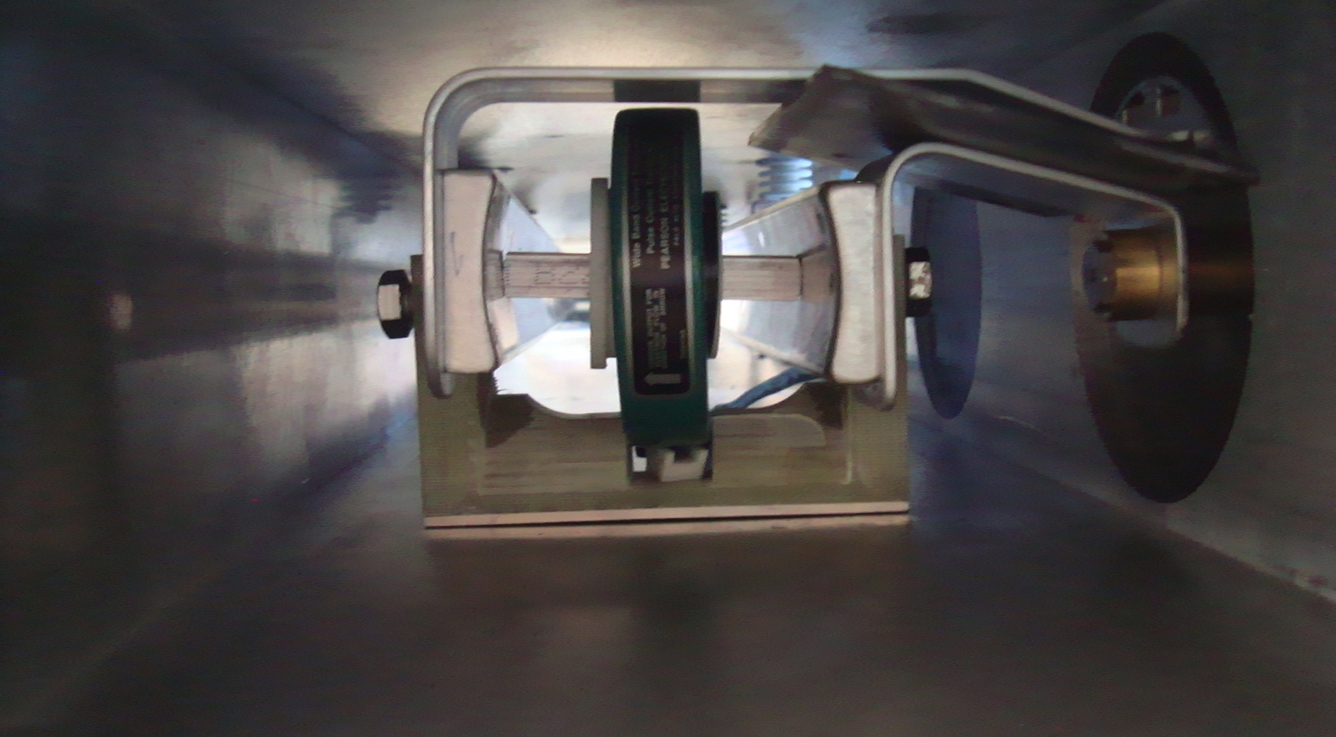
Current transformer and shorted kicker

Slide 33
12.5 Ω Blumlein
35cm kicker plates
Oscillations at the tail triggered by impedance mismatch

Slide 34
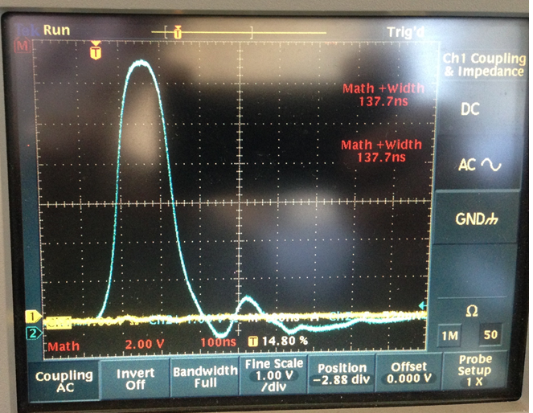
Pearson 3212; 50 kV; 4kA; 12 Hz, Full length Kicker ≈127 cm (50”)
The tail is generated by impedance mismatch?

Slide 35
Kicker pulse
Representation of kicker pulse for simulation

Slide 36
Kicker pulse
Test kicker effectiveness with simulation – compare 4 configurations
4-Uniform field/120ns rectangular pulse (ideal)
3-Curved plates/120ns rectangular pulse
2-Curved plates/measured pulse less tail
1- Curved plates/ measured pulse with tail (actual)
Capture efficiency reduced 17% due to imperfections of kick

Slide 37
Pulse characteristics
Broader flat top can be obtained with
Longer Blumlein
Shorter kickers (and additional kickers to achieve integrated kick)
Fine tuning of thyratron gas pressure
Compensation of mismatched lengths of Blumlein transmission lines
Tail can be reduced with
Better matching of blumlein, cables, and load
Kilovac switch to eliminate bleed through of charging transformer
Temporal non-uniformity of kicker pulse can introduce early to late systematic
(SeungCheon Kim – Wednesday talk)

Slide 38
Impedance Matching Tuner
Proposed Impedance matching tuner
Includes resistor ( ~ 500 Ω) and capacitance or diode

Slide 39
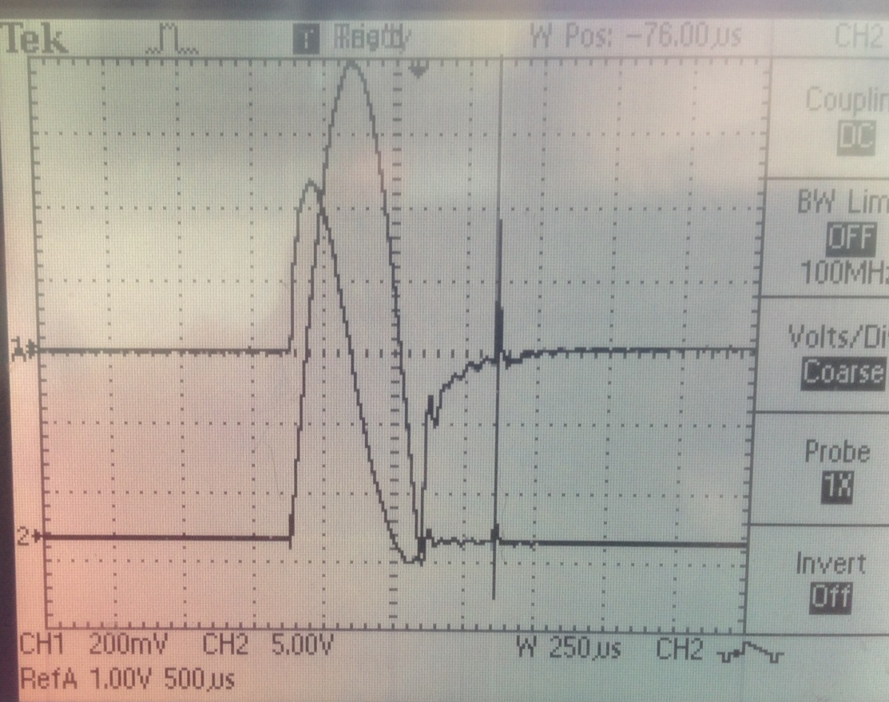
Charging circuit
Current in primary windings
(Power Designs CVT-1A)
Current in secondary windings
(Pearson 410)
Implement kilovac to cut off charging current through kicker?
Moment of thyratron triggering

Slide 40
Blumlein Pulse Forming Network
Blumlein
voltage at load is equal to charging voltage
Base of switch (thyratron) at ground
Simple transmission line
voltage at load is ½ charging voltage
Base of switch floats
Pulse length

Slide 41
Outline
Kicker WBS
Requirements
Kicker plates
Pulse forming network and thyratron
Power Supply
Pulse characteristics
Trolley rails
Commissioning Plan
Summary

Slide 42
Trolley rails

Slide 43
Design for mounting kickers in cages

Slide 44
Risks
Performance
  Failure to achieve specified field kicker amplitude will compromise capture efficiency and increased CBO of those captured
  Failure to turn off after 149 ns will compromise capture and increase CBO
Mitigation
  Required current and voltage well below tube maxima with 12.5 Ω Blumlein
  Pulse rise and fall time can be reduced with shorter kicker plates operating at higher current and/or by increasing the number of plates
  (Another advantage of a larger number of independent kickers is that failure of a single unit has smaller impact on overall performance)
Long tail of pulse
  Improve matching and kill charging current with kilovac
Electromagnetic noise
  Test and mitigate by proper configuration of grounding. Maintaining alternative grounding options during design.

Slide 45
Outline
Introduction to the Kicker WBS
Scope, Key Requirements, & Design
Kicker plates
Pulse Forming Network and Thyratron
Power Supply and Controls
Pulse characteristics
Commissioning Plan
Summary

Slide 46
Quality Assurance
Redundant independent charging supplies
  While a single supply is capable of charging all Blumlein PFN’s, multiple supplies will provide isolation in the event of failure of any one system, and backup in the event of failure of one supply.
Field measurements
Extensive testing at operating current and repetition rate (1 week continuous operation)

Slide 47
Summary
Curved kicker plates efficiently convert current to B-field
  Effect of field non-uniformity on capture efficiency is negligible
12.5 Ω Blumlein coupled to 127 cm plates generates pulse:
  150ns full width/half height
  5.6kA peak current
  364 gauss peak field
  1.39 kG-m (with 3 127cm kickers)
  And 100 Hz repetition rate
  Fewer than 17% of available muons are lost due to
  finite rise and fall
  Tail
  Anticipate sharper rise and fall and reduced tail with further refinement

Slide 48
g-2 Ring injection and storage technical review
May 21-22 at Brookhaven
Charge and findings
Are there significant remaining design risks not yet identified by the project?
We find no significant risks that have not already been identified by the g-2 team.
2. Are there additional construction or operational risks that the project should consider?
The development of the injection kicker system has progressed well. The prototype assembly has produced near-design waveforms and currents. The overall engineering design is sound.
3. Is the designs mature enough that the subsystems should be considered construction- ready enough to proceed with procurements?
The kicker design is substantially complete. Most parts can be procured.
4. Are the QA/QC plans sufficiently developed, or are there other tests that should be performed before final installation of the subsystems?
The prototype Blumlein-and-kicker system has been run for short periods. Pulsed HV systems are subject to fatigue-related failures, and so an operational test would be prudent. Stresses on the proposed Macor insulator material in the pulser should be well understood.

Slide 49
g-2 Ring injection and storage technical review
Recommendation
Perform an extended test of the injection kicker system, equivalent to at least a month of running, with currents above the operating level.
Response: Extended durability tests of the prototype will be conducted at Cornell
49

Slide 50
END

Slide 51
CBO amplitude and Muon capture
Simulation of muon capture and amplitude of CBO of stored muons for
E821 kicker B-field and current pulse and E989 field and pulse
Efficiency of muon capture versus kicker B-field
CBO amplitude of stored muons versus kicker B-field

Slide 52
WBS 476.3.5 ES&H
High voltage (50-100 kV)
  procedure for de-energizing PFN
Transformer oil (volume of Blumlein)
  containment
Redundant, independent charging supplies
X-rays associated with high voltage – measure and limit access while energized

Slide 53
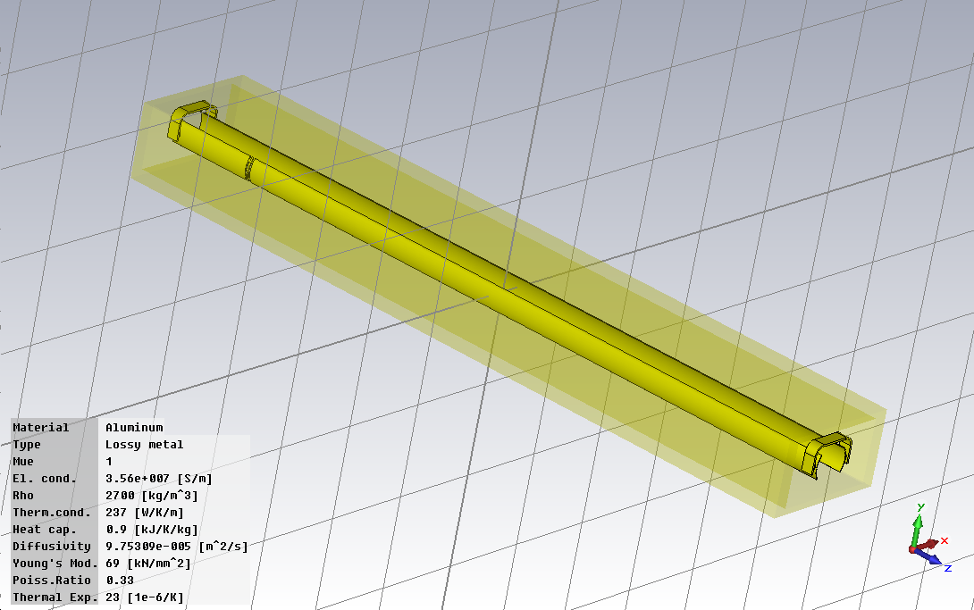
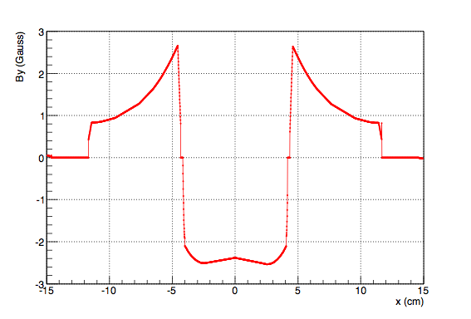
Modeling of Kicker-pulser
CST Microwave Studio
B field current ratio => 1kA = 65G

Slide 54
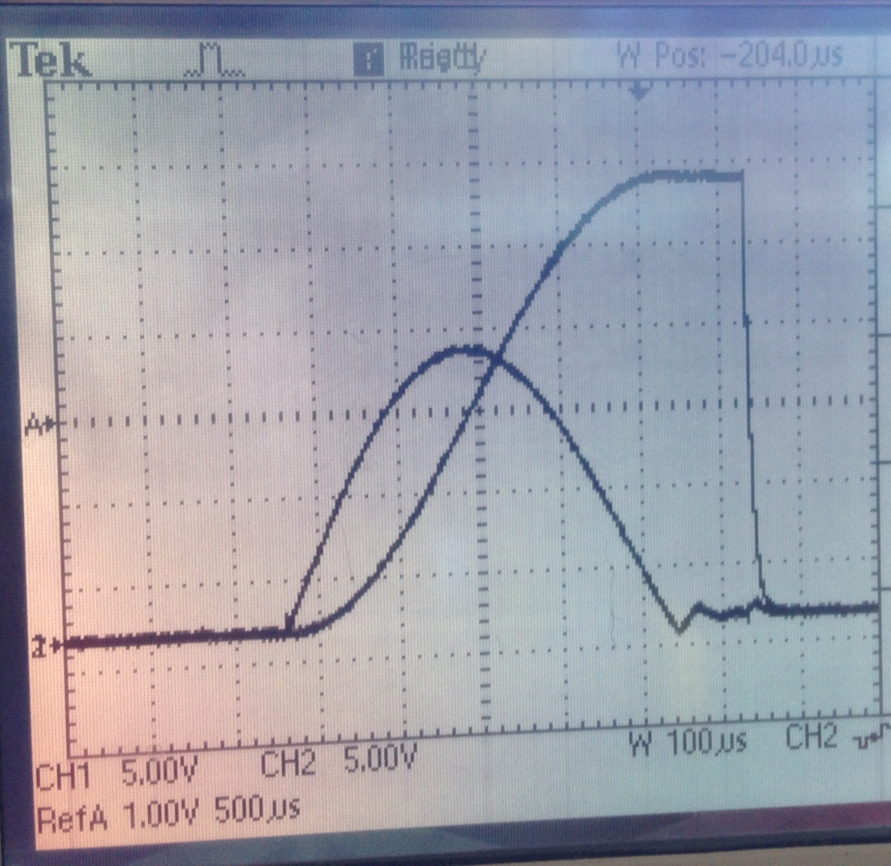
Charging circuit
Charging transformer characteristics contributing to signal after main pulse?
Voltage applied to Blumlein
(Voltage at secondary windings)
Current in primary windings
(Power Designs CVT-1A)
Moment of thyratron triggering
Current in secondary windings

Slide 55
Current Generator
12.5 Ω Blumlein triaxial transmission line
Assembled from 6 – 60 inch sections (20 ns/section) (30 ft long)
Filled with Castor oil, ε=4.7, (pulse length τ α √ε) (as compared to Corning 561 silicon oil, ε=2.7)
Concentric tubes are separated with teflon standoffs (we plan to replace with macor)
Two grid(fast) thyratron – rated for up 70kV – 15kA (7.5 kA in load)
Coupled via 4 parallel 50Ω coaxial cables and resistors (12.5 Ω equivalent) to the kicker magnet

Slide 58
Kicker pulse
Mismatch (Blumlein to coax)
  Impedance matching chamber
  Alternative high voltage coax
Tail
  Charging circuit
Rise and fall time
  Kicker length
Width
  Blumlein length

Slide 59
Impedance Match
Proposed Impedance matching tuner
Includes resistor ( ~ 500 Ω) and capacitance or diode
Match Blumlein impedance to cables

Slide 60
Rise/fall and width
Kicker inductance limits rise and fall
  Inductance proportional to length
  E821 - 3 X 1.7m long magnets
  Requisite 1114 kG-m is realized with
  3 X 1.27 m kickers at 4.5 kA (56kV)
  (leaving 1.2 m of the kicker chambers is unoccupied)
  Faster rise and fall can be achieved by further reducing kicker length and adding additional units to maintain integrated field (access into vacuum chamber?)
Width can be increased by adding sections to Blumlein
(space ?)

Slide 61
Summary
30 ft 12.5 Ω Blumlein tested
  To 4kA (50kV) into 1.27m long kicker (briefly at 12 Hz)
  To 70kV with shorter kicker
Impedance transformer to improve match designed
Charging circuit contribution to tail under investigation
Kicker pulse
  Sufficient amplitude with 1.27m kicker but slow rise and fall limit width at full field
  Solution: Longer Blumlein and/or additional shorter kickers

Slide 63
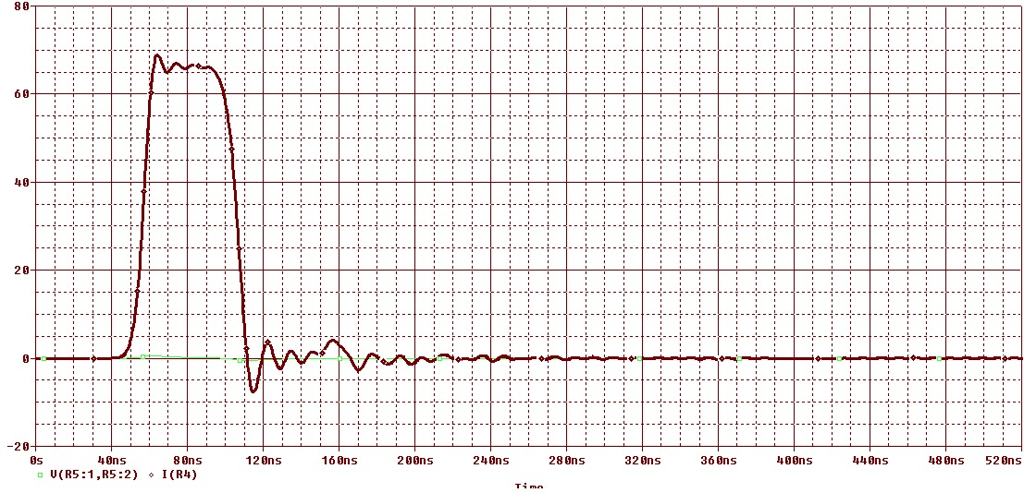
Pulse Forming Network
Requirements:
5 kA
120ns width
Charging voltage
Blumlein pulse forming network
Load resistor matches impedance of Blumlein
Thyratron switch shorts middle conductor of triaxial line to outer conductor
Coax cable couples blumlein center conductor to load
40ns
Current pulse into a matched load computed with equivalent discrete circuit model
Width of pulse is proportional to length of Blumlein

Slide 64
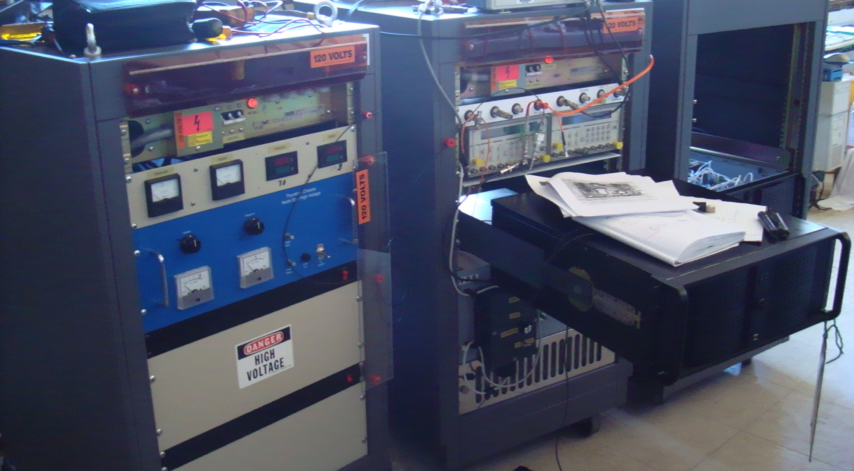

Slide 65
Kicker Magnet
10.8 mrad kick corresponds to 1114 kg-m
  292 G for each of 3 - 1.27m long kicker magnets
  0.4 mm thick plates
  Magnet geometry => 65G/kA
  => 4.5 kA/kicker magnet
  => 56 kV on each Blumlein
“New” larger aperture inflector” requires 12mrad kick
  => 62 kV / Blumlein

Slide 66
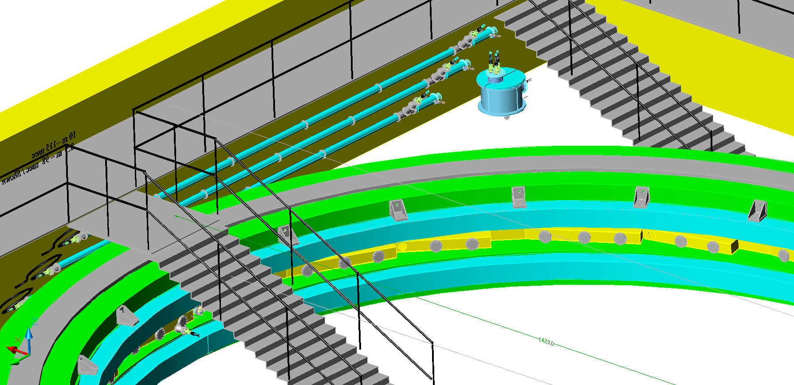
476.3.5.4 – Pulse Forming Network
Load resistor
thyratron
Blumlein
Load resistance matched to impedance of Blumlein
Kicker plates
Pulse width
L = 9m
= 4.7 (Castor oil)
=> τ = 120ns
Blumleins in storage ring hall

Slide 67
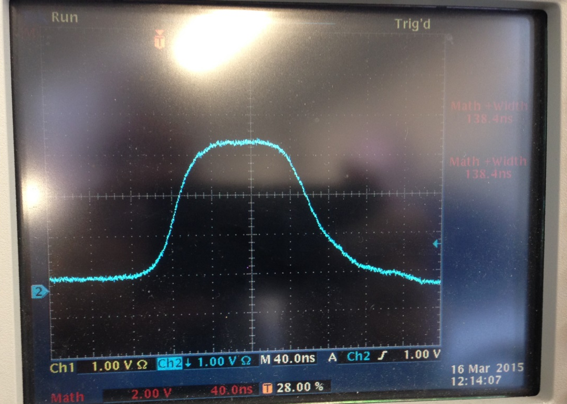
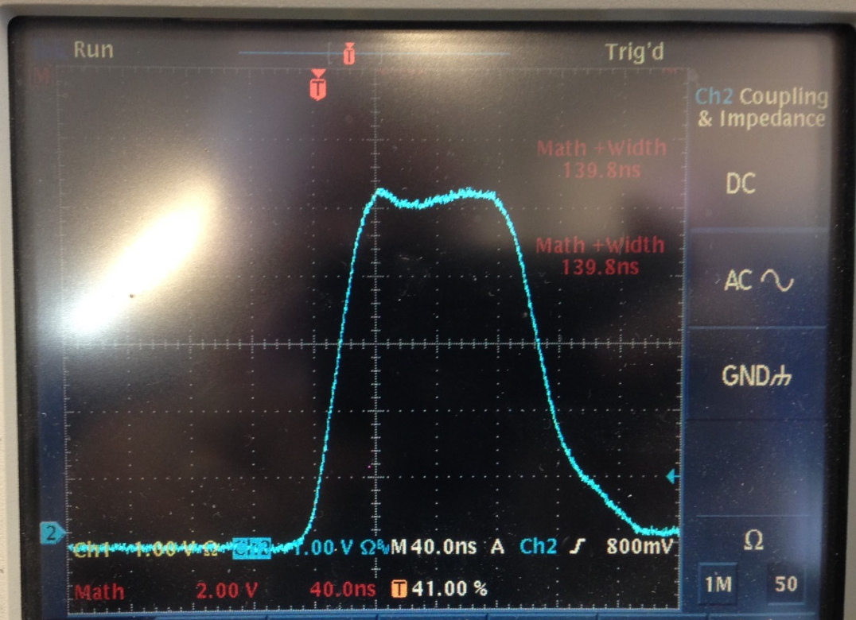
The same charging voltage, but different current monitors
Pearson 6600 current monitor;
Current ≈2 kA; V ≈25 kV
Kicker length ≈ 60 cm;
40 ns/div, 12 Hz
Max current allowed by Pearson 6600
is 2 kA
Pearson 3212 current monitor;
Current ≈2 kA; V ≈25 kV
Kicker length ≈ 60 cm;
40 ns/div; 12 Hz
Max current allowed by Pearson 3212 is 7.5 kA

Slide 68
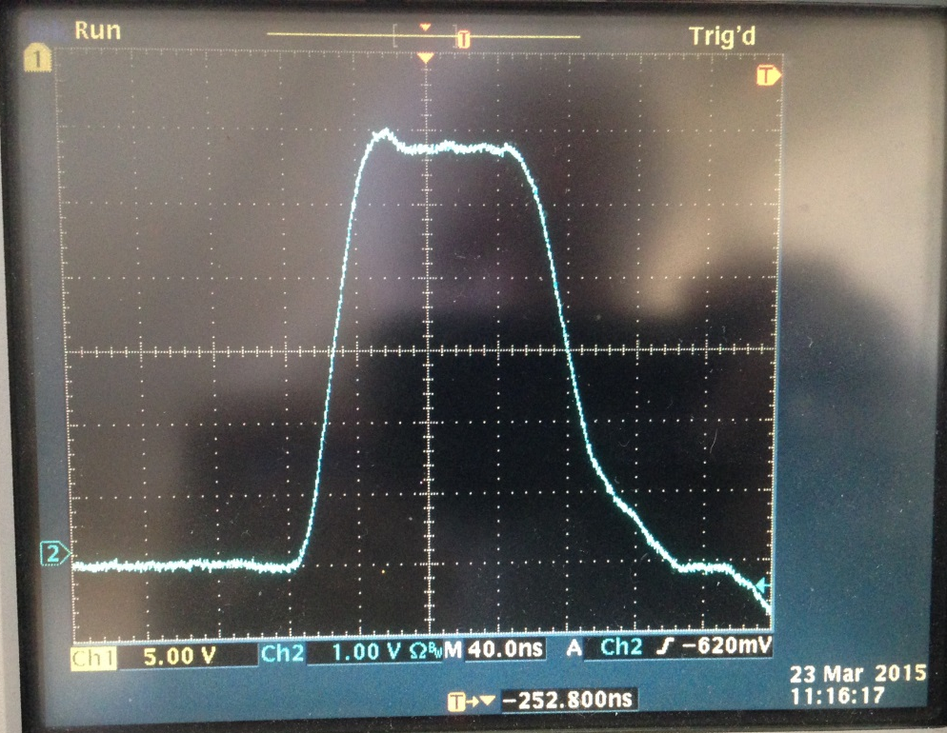
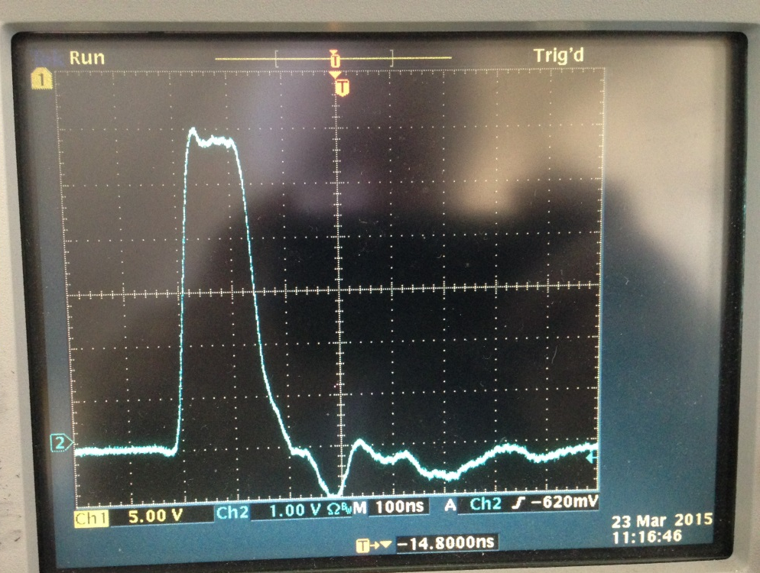
Pearson 3212 current monitor;
Current in a 40 –cm long kicker;
Current value ≈ 2.4 kA;
Charging Voltage≈30 kV;
40ns/div
Same pulse
different time scale
Pearson 3212 current monitor;
Current in a 40 –cm long kicker;
Current value ≈ 2.4 kA;
Charging Voltage≈30 kV;
100 ns/div

Slide 69
g-2 Proposed Pulse Train (11.4 Hz mode)
Extended Cycle Length
Begin cycle
End cycle
Bunch length
of 1 pulse
12 / 21 Nova Cycles
120 nsec
4.2% Loss for Nova per Cycle
g-2 runs at 11.4 Hz
100Hz
Pulse separation
10 msec
Lens pulse length 400 µsec
193 msec
1057 msec
~
~
1
2
3
4
5
6
7
8
9
10
11
12
13
14
15
16
Pulse #
MI Nova Cycle Length
1.3997 sec

Slide 70
Impedance Match
Alternative coax ?
Fermilab cable – measured impedance ~ 55 Ω
Cornell cable
Better match?

Slide 71
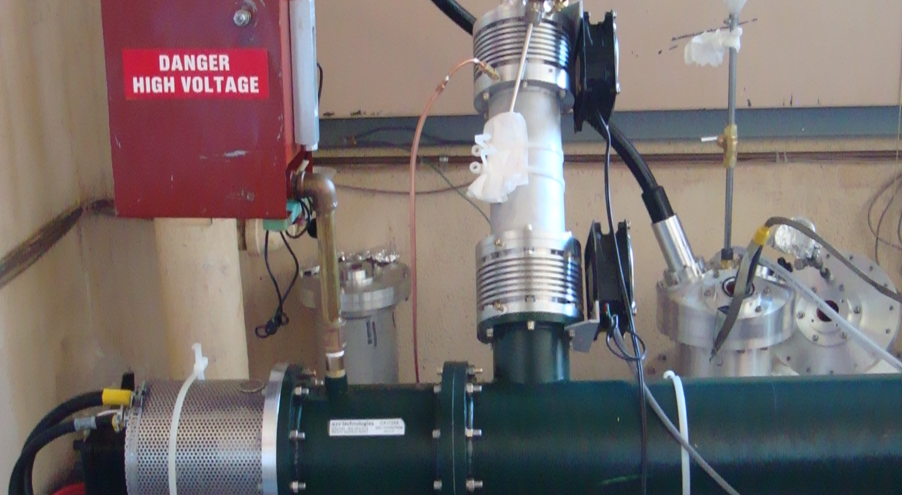
Thyratron and charging input

Slide 73
Load Resistors
Resistors at input to kicker
Each 50 Ω cable loaded to 50 Ω resistor

Slide 75
Load resistors cooled in flourinert

Slide 77
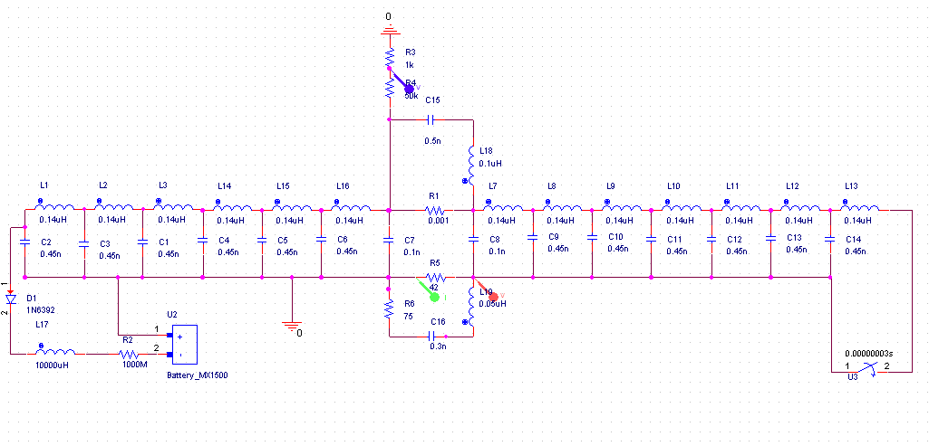
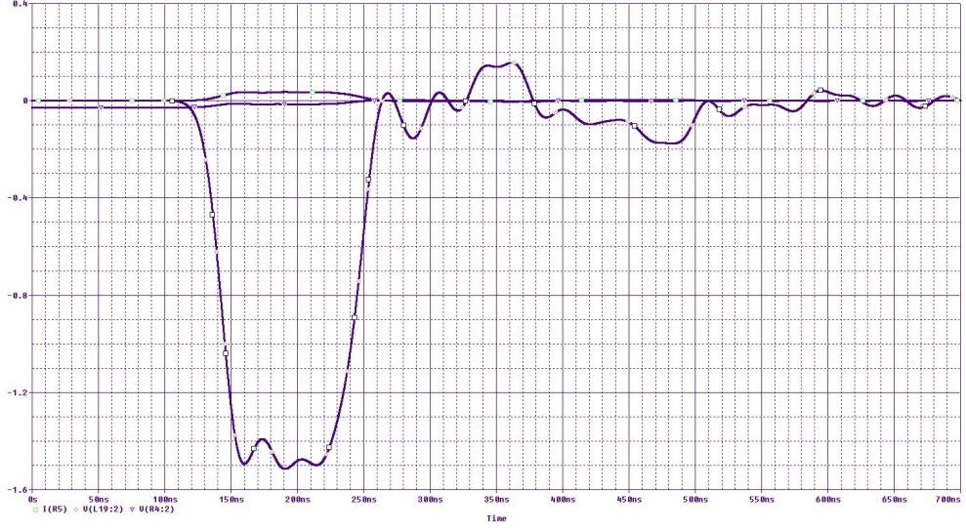
Modeling with PSPICE
Middle tube(inside surface)
Middle tube (outside surface)
Outer tube
Inner tube

Slide 78
Alternatives/Value Engineering
Thyratron – Re use tubes from E821 or purchase new?The E821 tubes are incompatible with the Blumlein PFN and a superior alternative has been identified
PFN – Blumlein determined superior to bi-axial transmission line in terms of length, voltage, configuration of thyratron, etc.
Kicker plates – Narrower curved plates yield significantly higher field per unit current at the cost of increased field roll off. The effects of the roll off is determined to have small effect on capture efficiency.
Length/number of kicker plates – 3 – 127cm long plates. Achieves acceptable rise and fall times, and adequate margin for integrated kick.

