Slide 1
Storage Ring Kicker Update
D. Rubin, A. Mikhailichenko, J. Bennett
Cornell University
June 28, 2012

Slide 2
Kicker function
Kicker magnet
Pulser
Pulser test status

Slide 3
Kickers are 90º in betatron phase from the inflector exit
Injected muons are crossing the central trajectory inside the kickers
Kick directs muons onto central orbit

Slide 4
End of inflector is displaced 7.7cm radially outward from the central orbit
Radius of central orbit = 7.112 m
Kick ~ 10 mrad on first pass and
0 on next turn
E-821 kickers

Slide 5
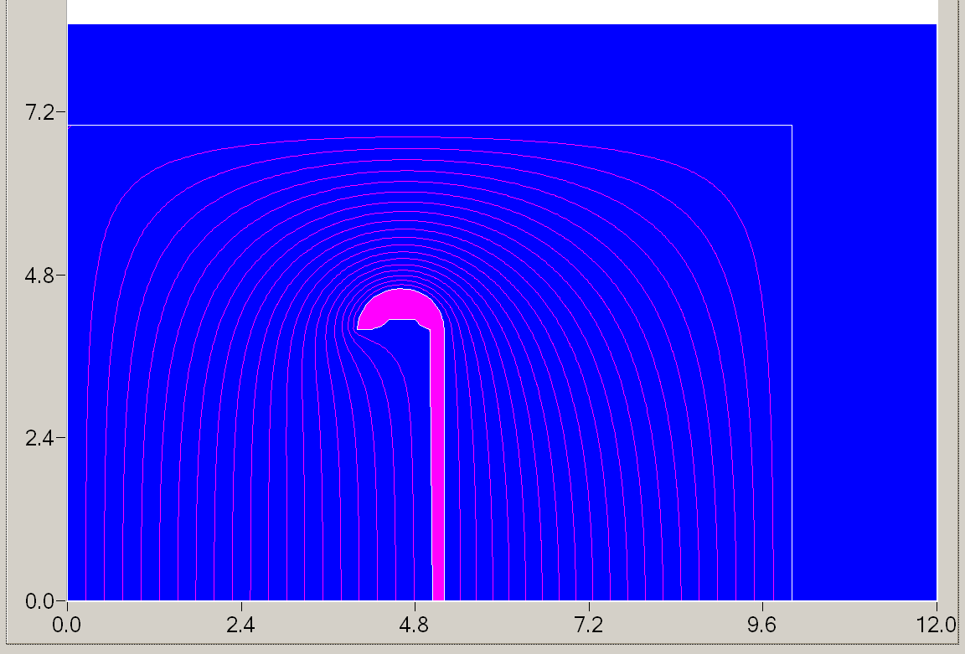
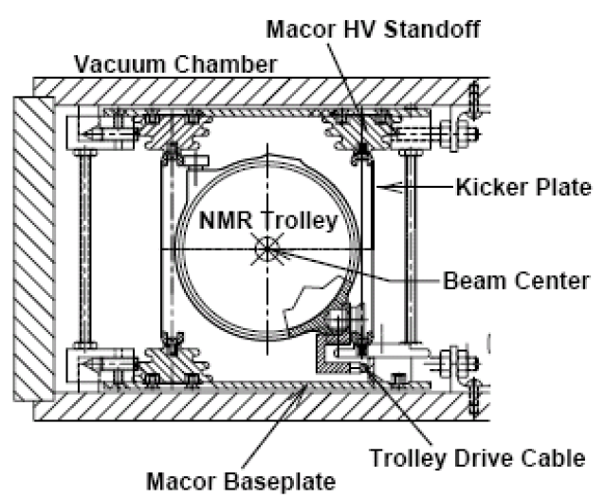
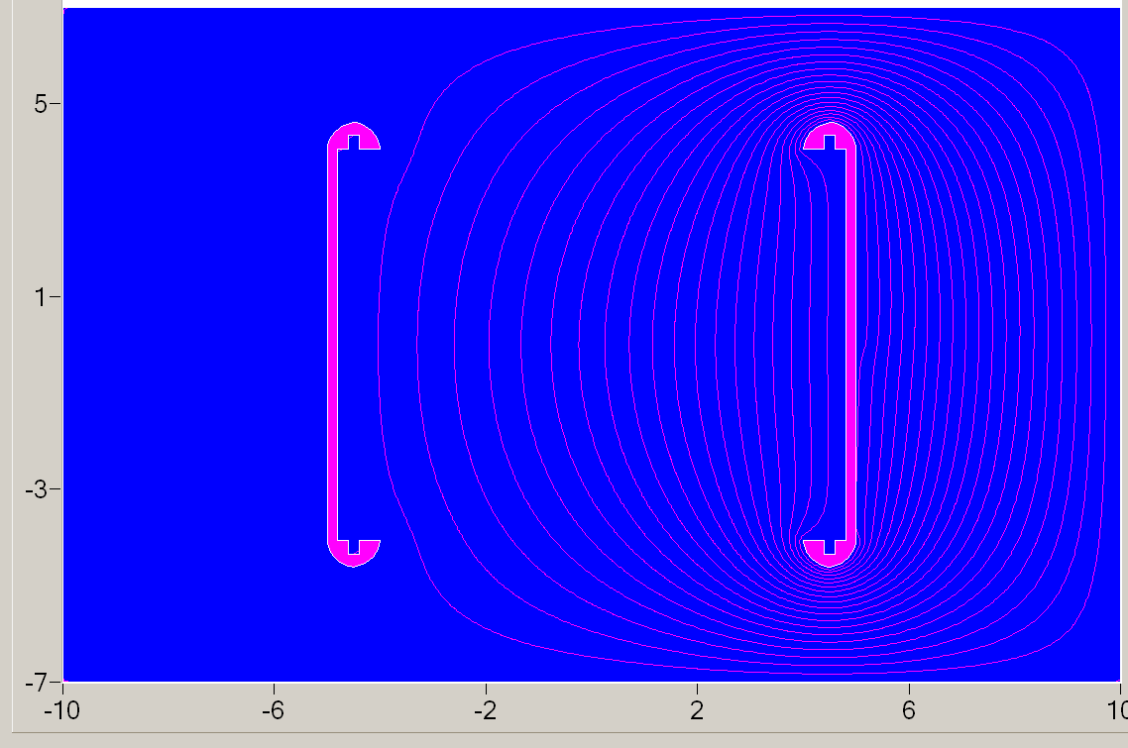
These circled regions influence mostly to the field strength
Magnetic field lines (or electric potential)
Kicker has 3 identical sections of 1.76 m-long each
Each section fed by individual HV pulser
Field distribution in transient moments

Slide 6
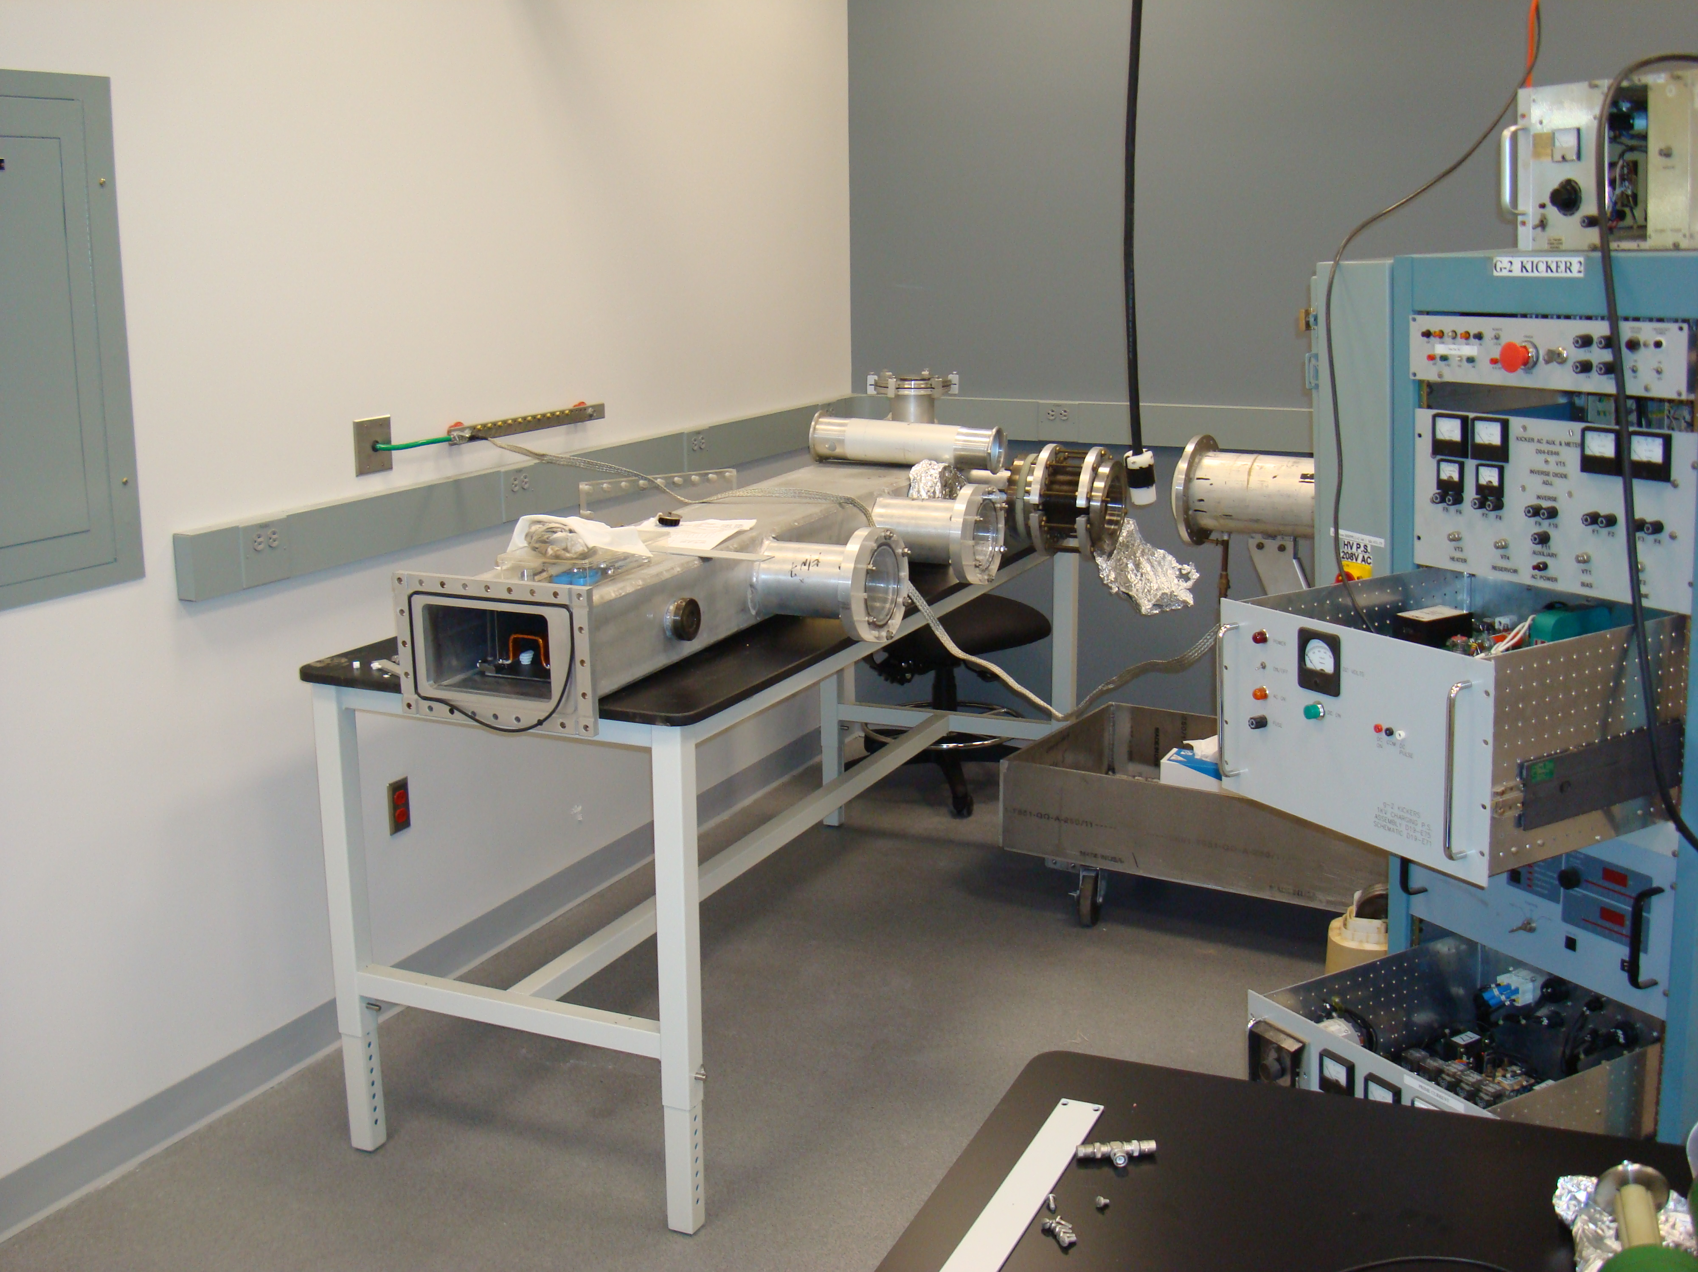
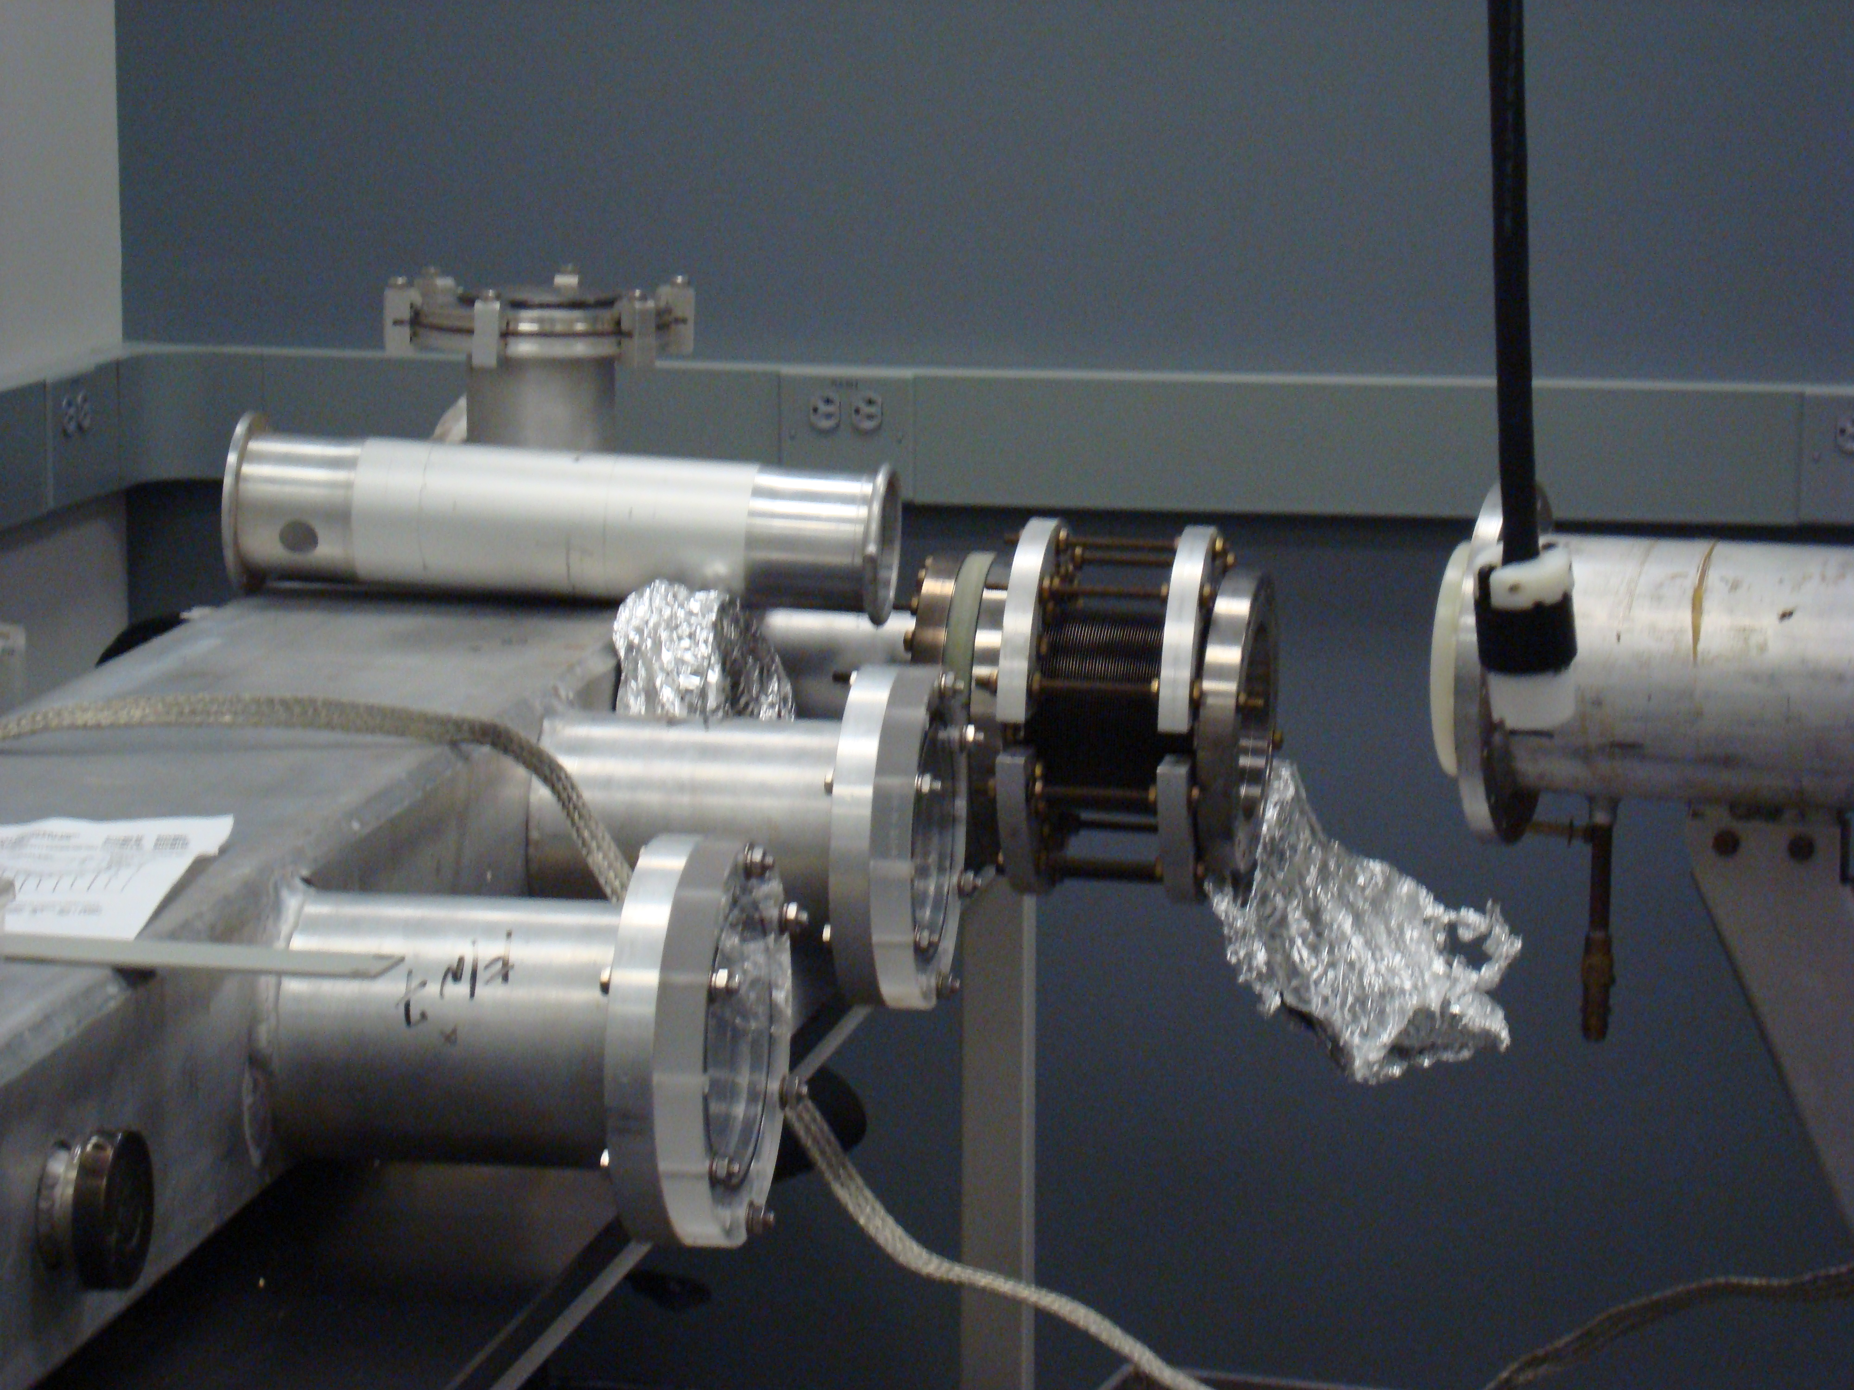
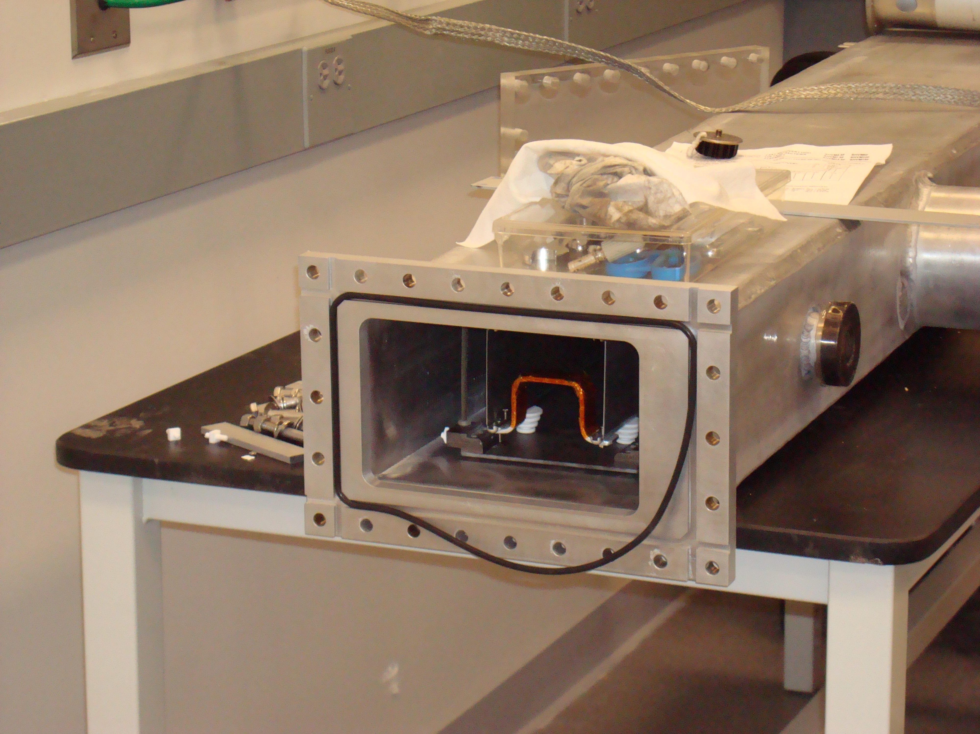
Kicker chamber
Power
Downstream end of kicker

Slide 7
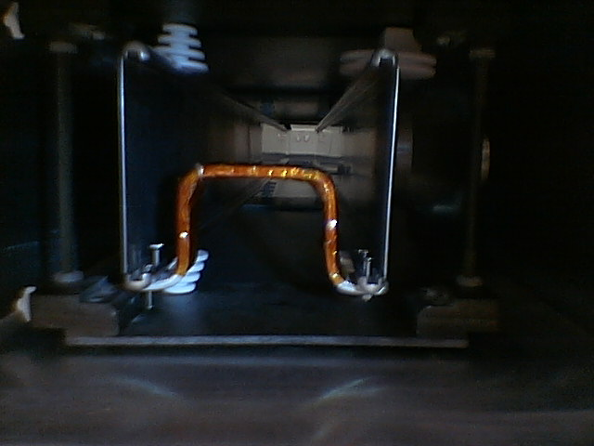
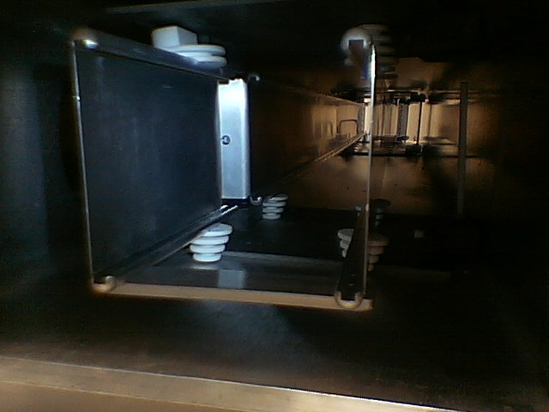
E-821 prototype kicker plates
End jumpers in the model
Macor© insulators

Slide 8
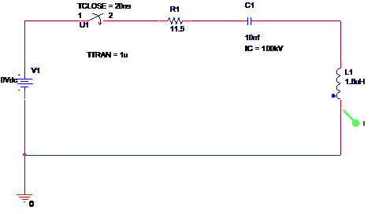
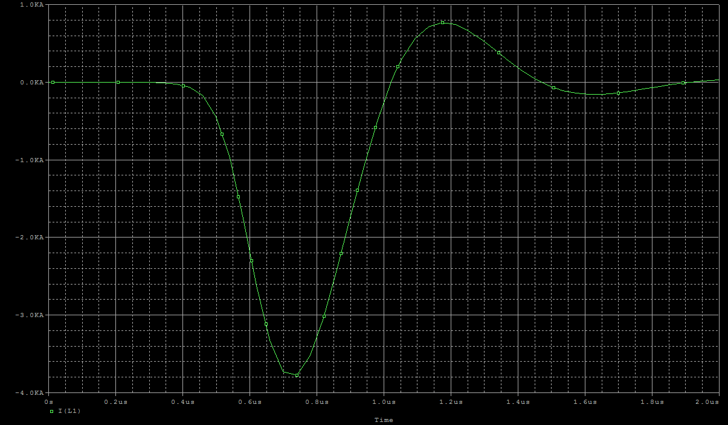
Modeling E-821 pulser with SPICE
(100 kV)
E-821 equivalent circuit
E-821 pulse (200ns/big division)

Slide 9
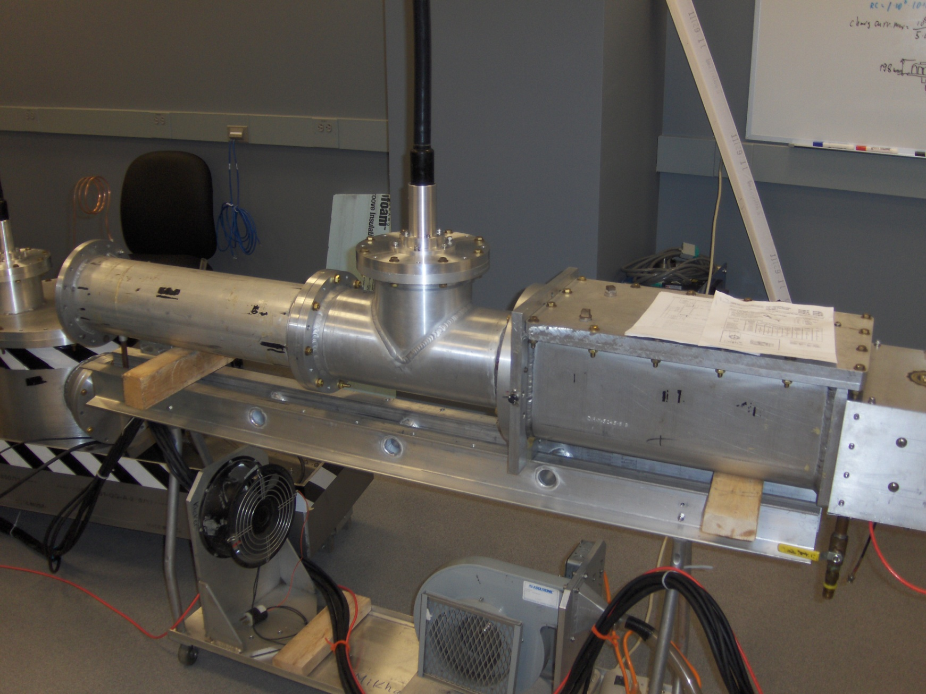
~1.5 m

Slide 10
Kicker Magnet
Kicker changes angle by θ = x_{inf}/β ≅ 10 mrad to put injected muons on central orbit
Now suppose the injected muon has fractional energy error ΔE/E = δ
The ideal kick for off energy muons is θ = (x_{inf} – ηδ)/β = (x_{inf} – x)/β
But the ideal kick for on energy muons with finite divergence angle φ emerging from inflector is θ = x_{inf}/β, independent of φ
Optimum radial field profile depends on
energy and angular distribution of injected beam
Proceed with design that gives uniform field

Slide 11
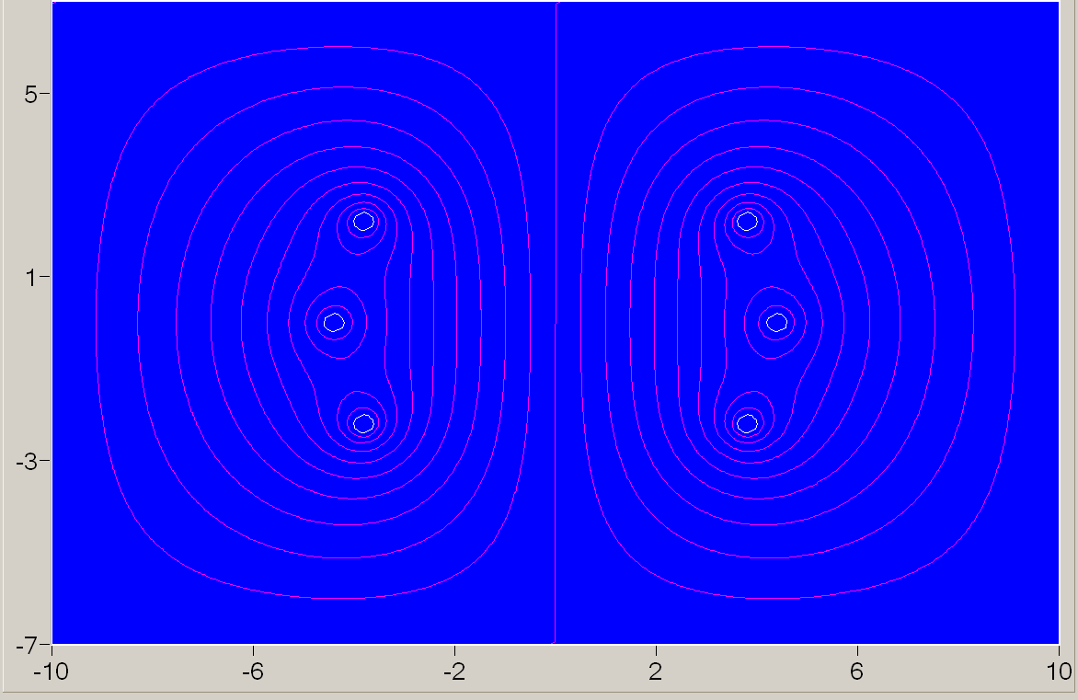
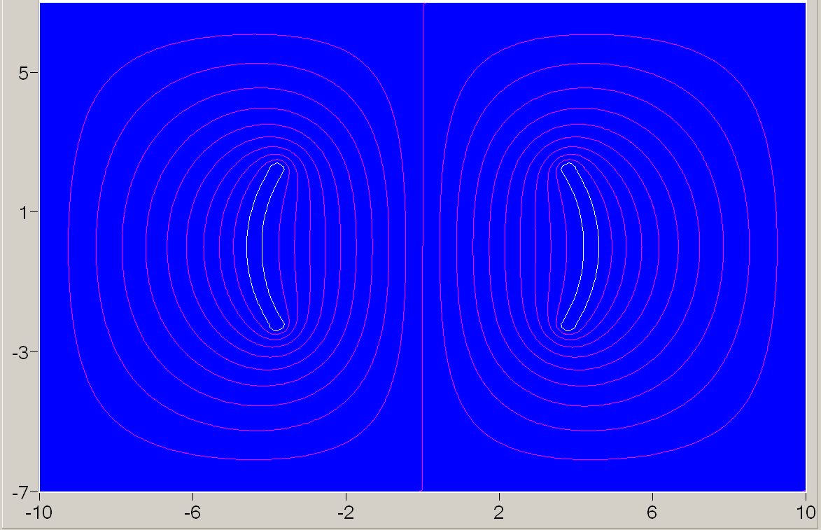
Some profiles of the kicker electrodes and guidelines
Wire style
L.Roberts, “Kicker R&D Work Plan: Options and Time Estimates”, New Muon (g-2) Technical Note #003, August 14, 2008.
Solid serpent style profile
Serpent profile yields 70% greater B-field/Amp than E-821 style
Make an impedance of the stripline kicker as low as possible;
Take care on the field distribution
Choice of materials
Stray fields in surroundings are another subject for research.
Profile of electrodes will be chosen with appropriate 3D modeling

Slide 12
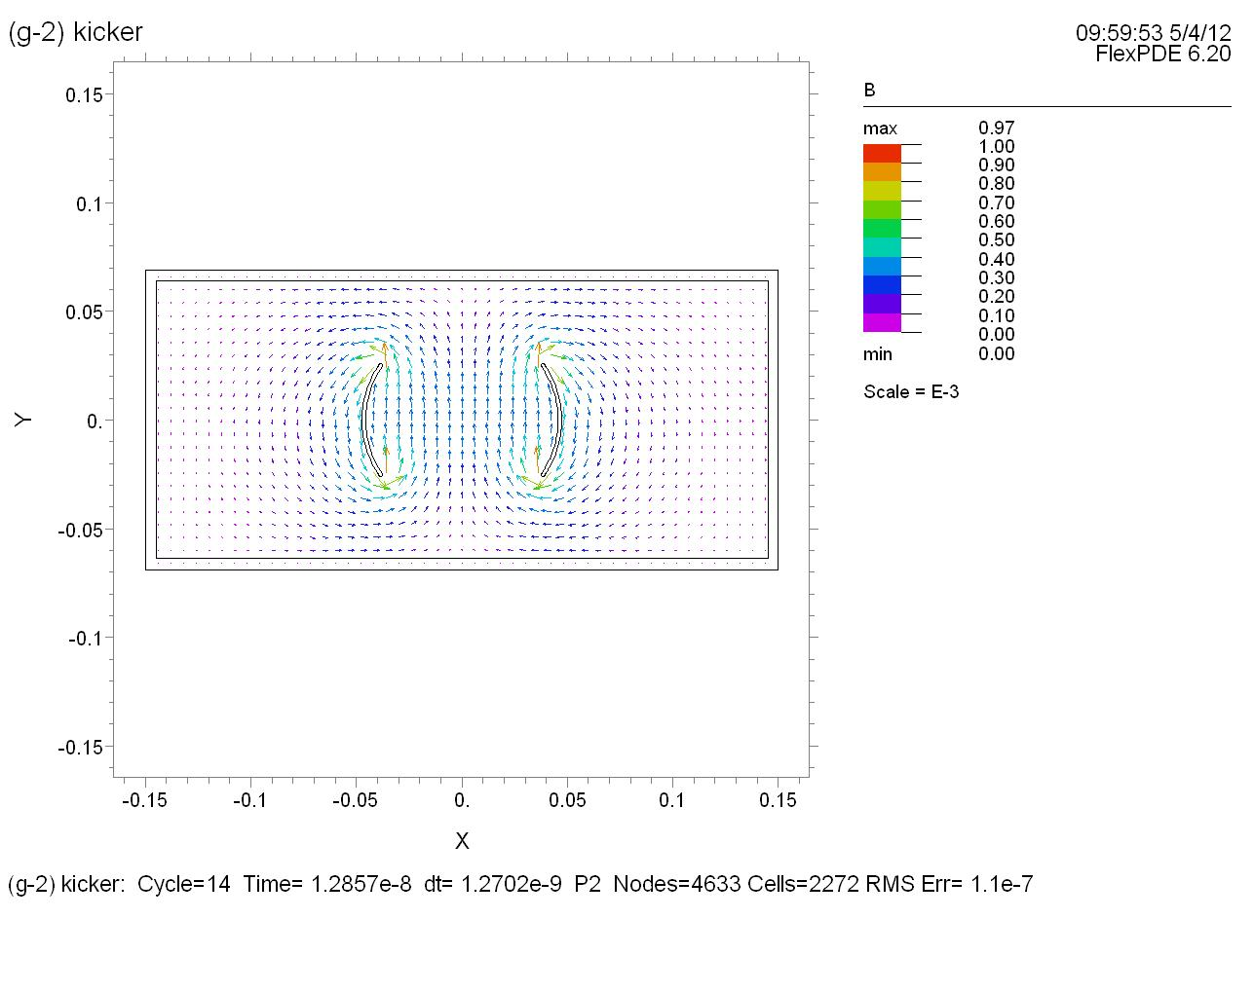
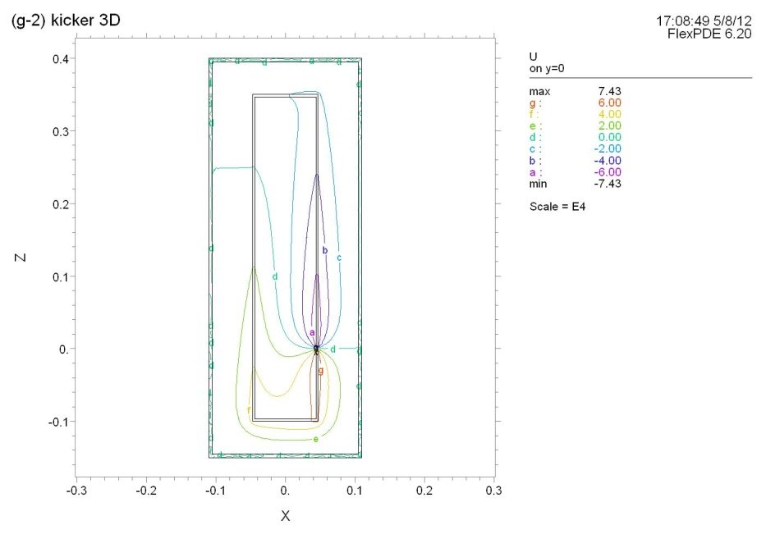
3D field calculation is in progress with FlexPDE
Plans to do this with HFSS and CTS studio (License granted)
Potential distribution. Longitudinal cut, top view
Field distribution in a transverse plane

Slide 13
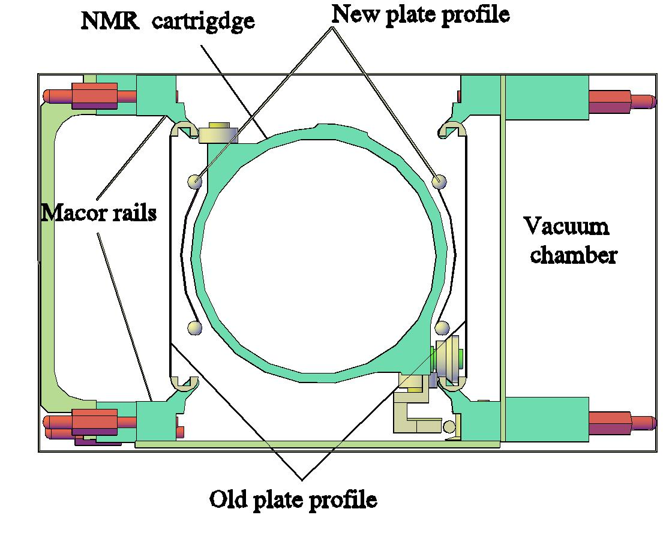

Slide 14
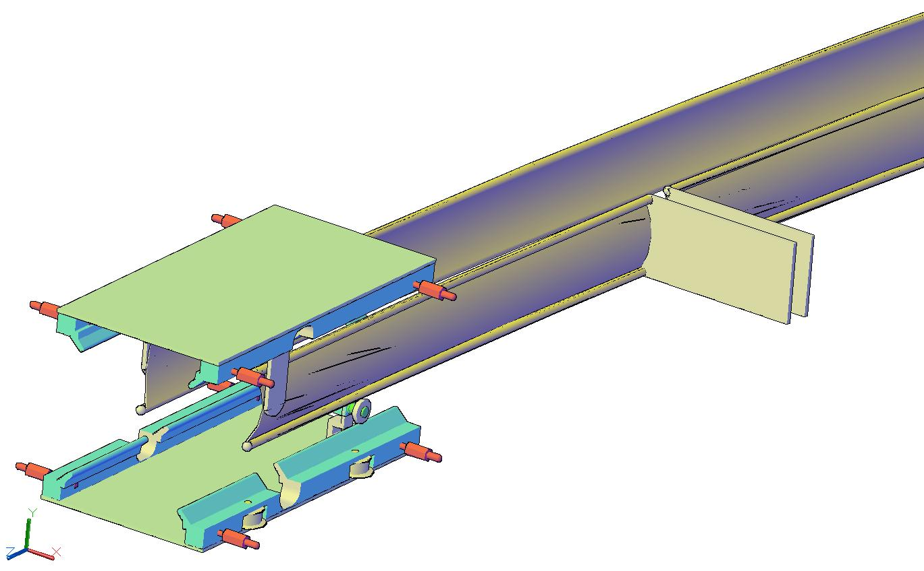
Thin (0.4mm) Al profiled electrodes; will consider Ti also.
Perforation might be useful.
Input
Ceramic (Macor©) rails

Slide 15
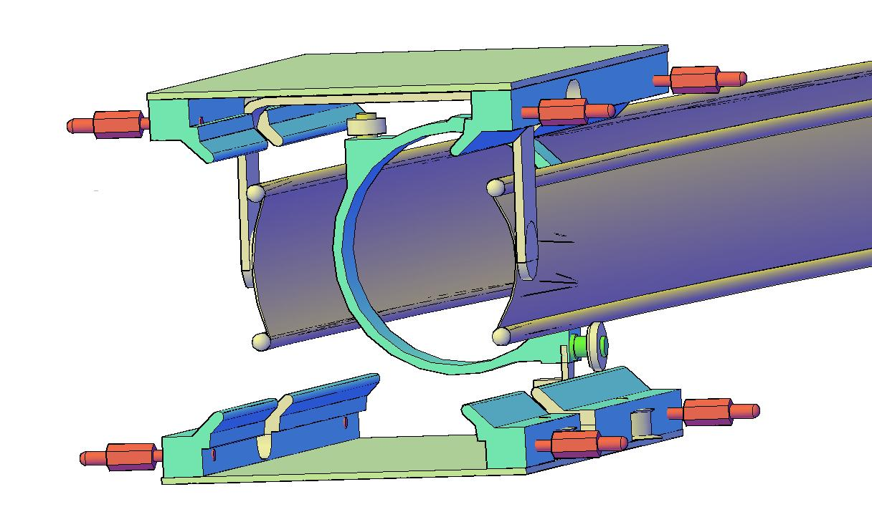
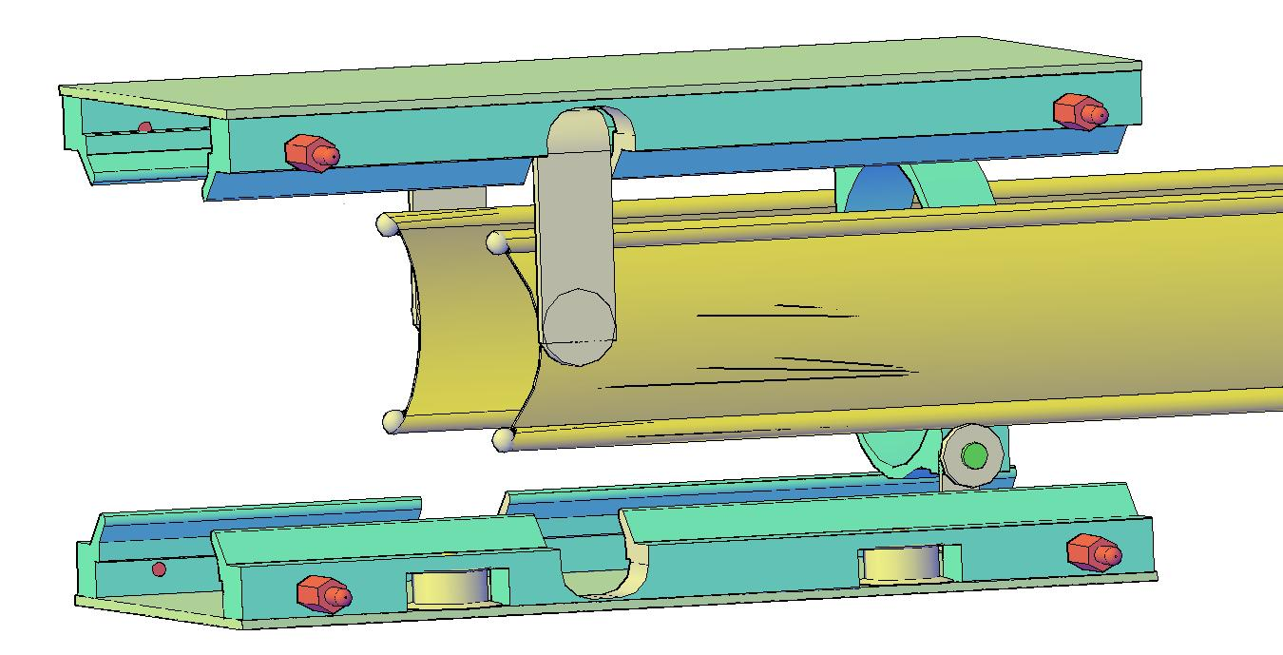
The NMR cartridge profile
End jumper
NMR cable duct wheels

Slide 16
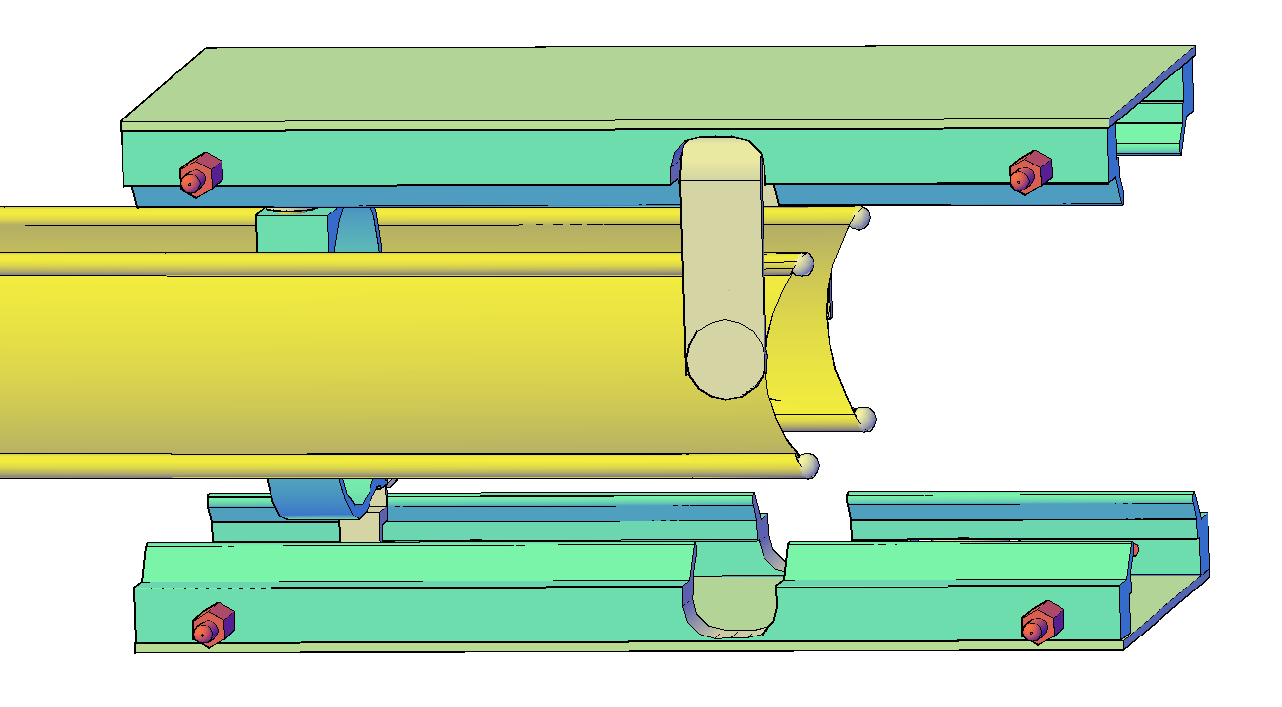
End jumper
Macor© bolts
Macor© rails
Electrodes at the end will have the chamfer (similar to the magnetic pole chamfer) for better 3D field distribution. (The same could be recommended for the electrostatic Quadrupole)

Slide 17
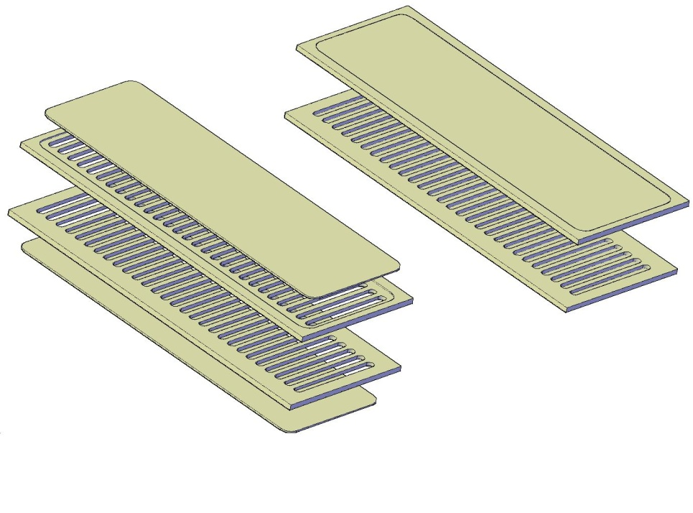
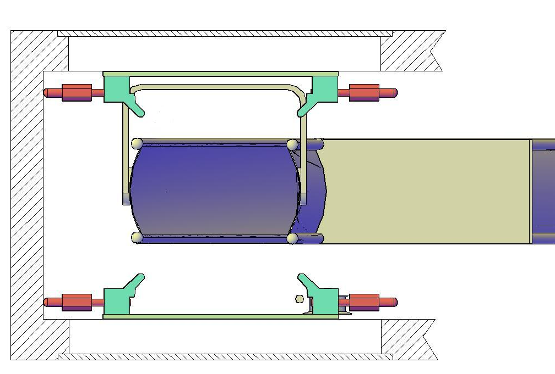
Potential for another 20% increase of kick
Jumper
Macor© rails
Vacuum chamber

Slide 18
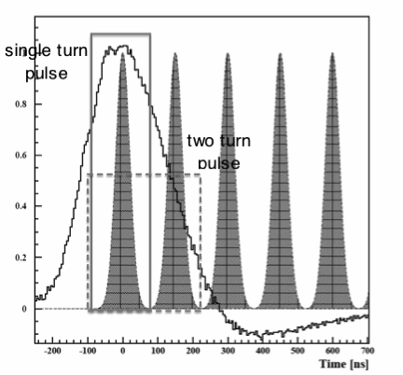
Pulser
RLC pulser
Kicker Pulse width
Matched line (Z₀= Z_{L})
τ = 2L/c √(μ_{r} ε_{r})

Slide 19
Computed pulse shape

Slide 20
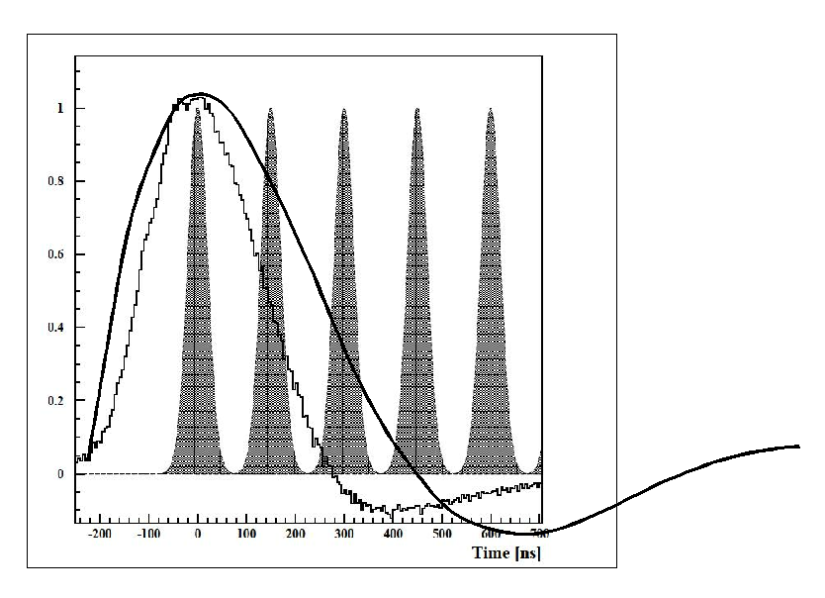
Meanwhile the current shape from previous figures, if embedded in Fig. 51 from [1] (and all other publications), become _{as the following}
The Fig.51 from [1] with superimposed pulse shape obtained from Mathematica©.
The source of this discrepancy is under investigation.

Slide 21
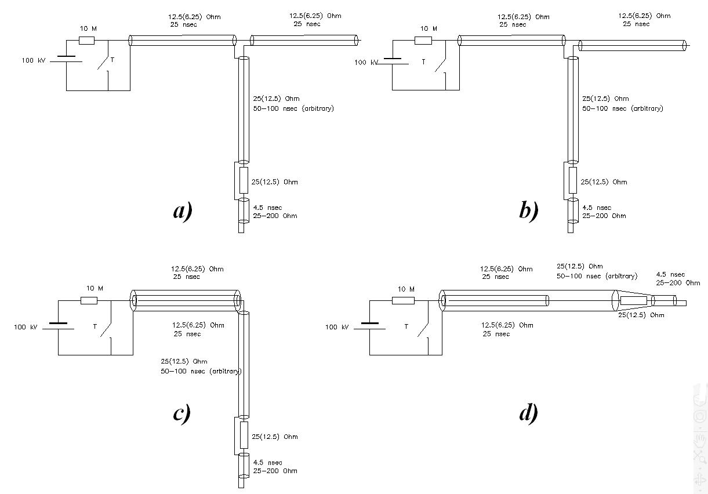
For modeling with PSPICE (Cadence)
a) Original Blumlein scheme;
b) In a second coaxial the conductors are switched, so the potential of inner left coaxial is the same as the potential of outer right coaxial;
c) Right coaxial inserted into the left one. For this purposes its radiuses increased accordingly.
d) Final scheme.

Slide 22
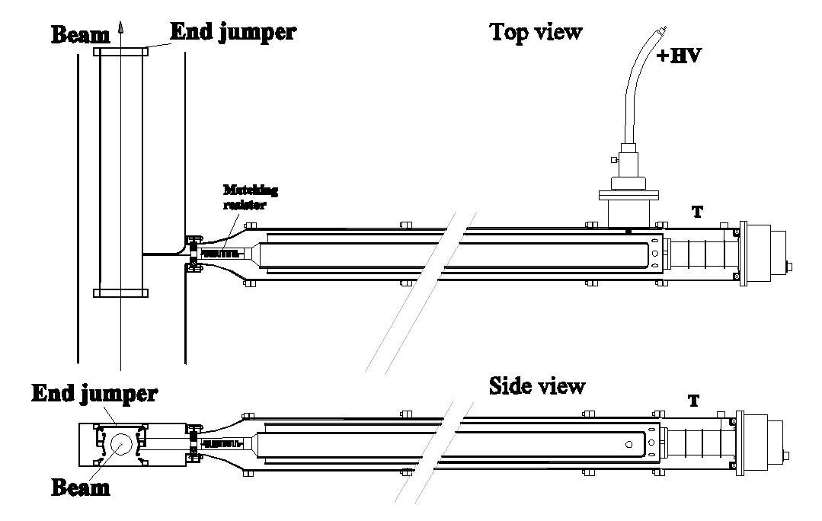
Scheme under development
The tubing of the same outer diameter will be used for prototyping;
in a future the outer diameter can be reduced ~2 times.
We will add~4 m to the length.
+/-
Voltage at the input exists only for the time while the pulse front travels to the end jumper and back
Oil filled tri-axial line
Thyratron
While using a bi-polar thyratron, one can control the HV out-polarity

Slide 23
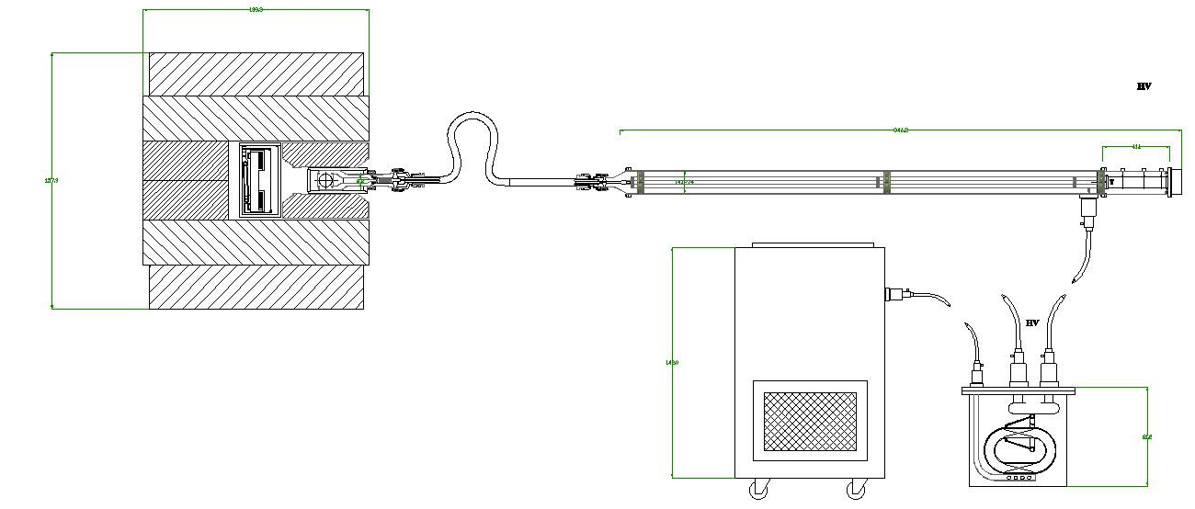

Slide 24
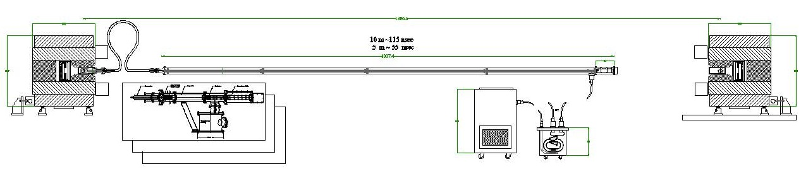
L=10m => τ = 115 ms
Rigid coaxial delay line

Slide 25
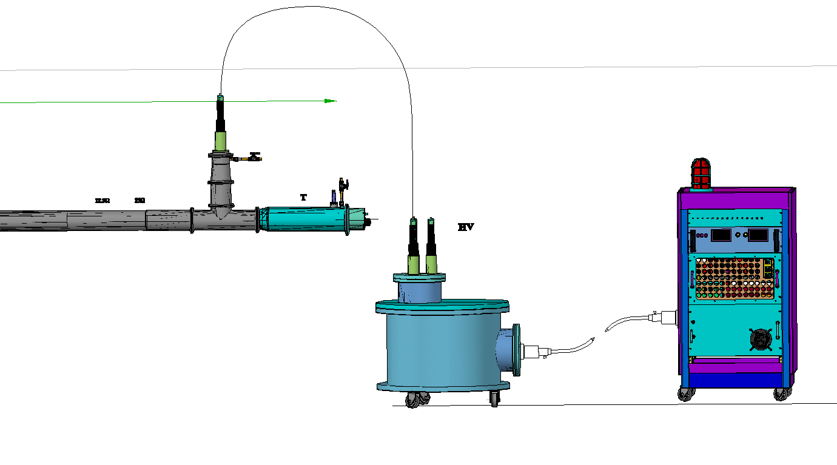
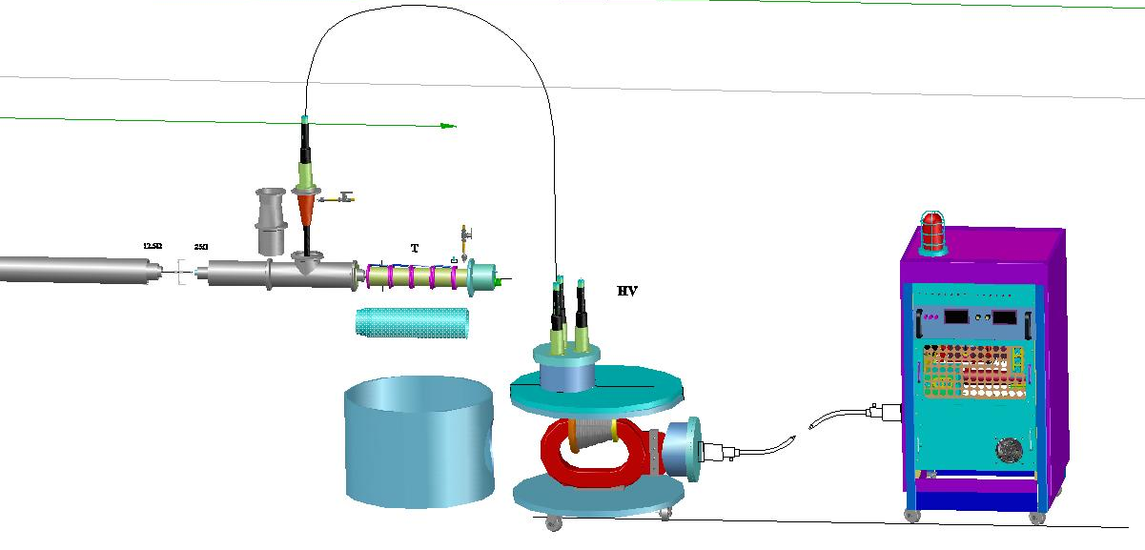
Thyratron end station with transformer tank and HV pulser
For prototyping we are planning to use existing thyratron housing and tubing system

Slide 26
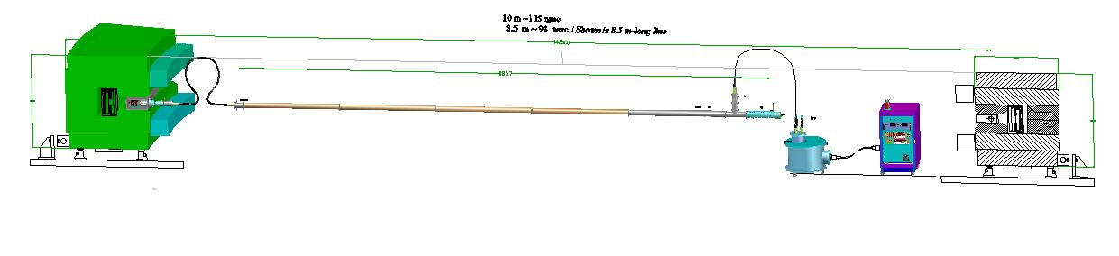
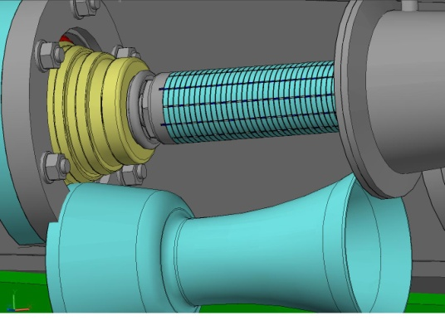
Generator for 120ns pulse line in scale with g-2 ring
Matching resistor

Slide 27
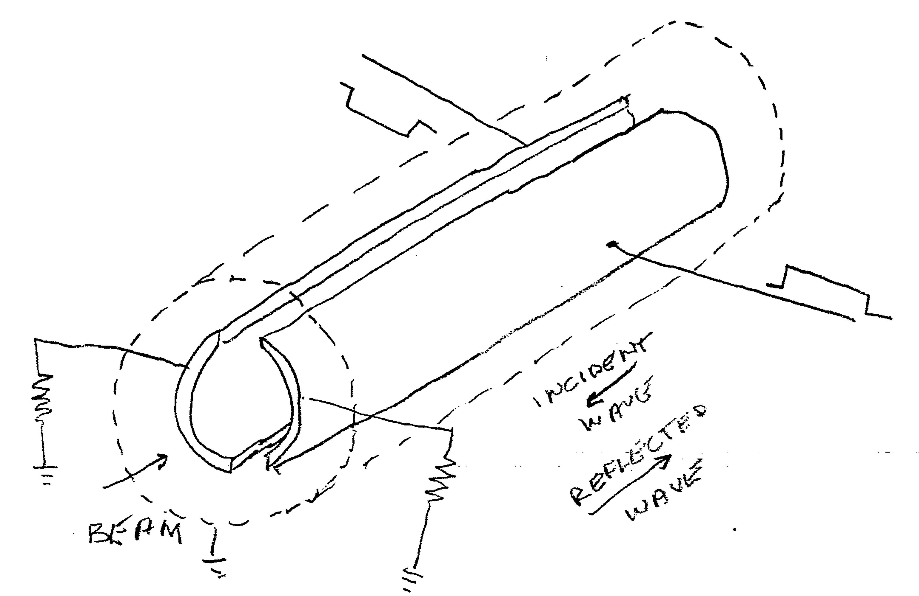
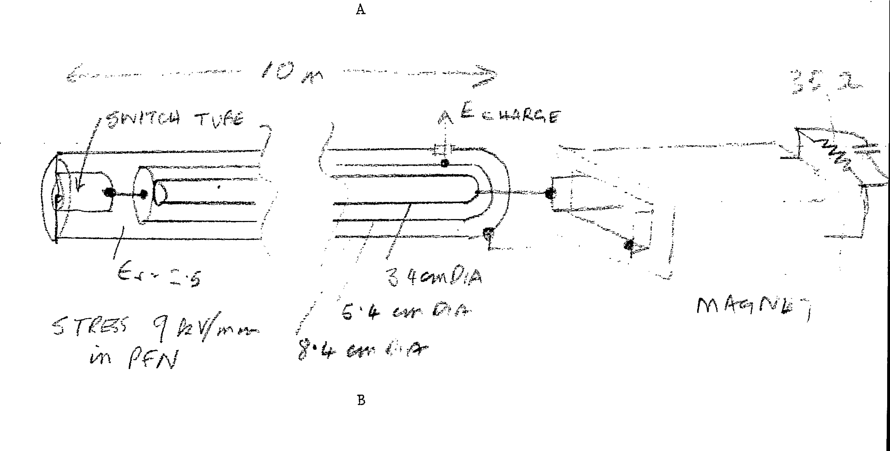
Blumlein application at BNL with
similar to parameters to g-2
Pulsed Power Supplies for RHIC
E. Forsyth, M. Meth, W. Zhang
October 1991

Slide 28
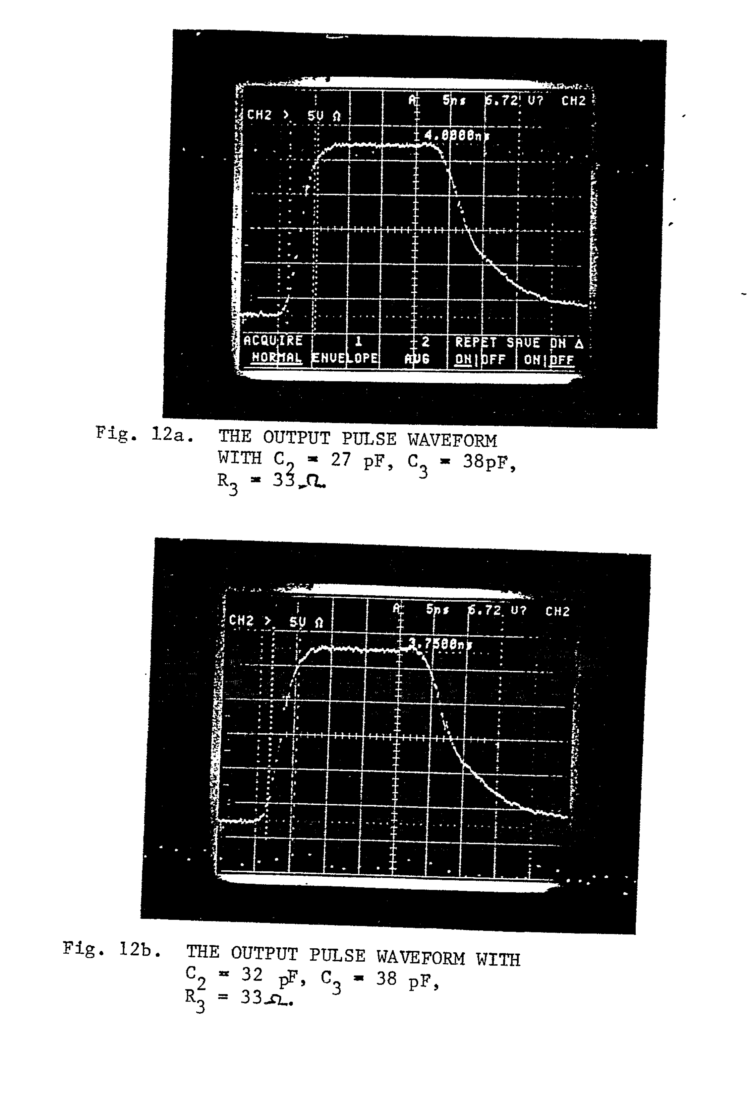
RHIC kicker pulse
RHIC kicker
5ns/div
Kicker pulse with blumlein PFN
Matching components

Slide 29
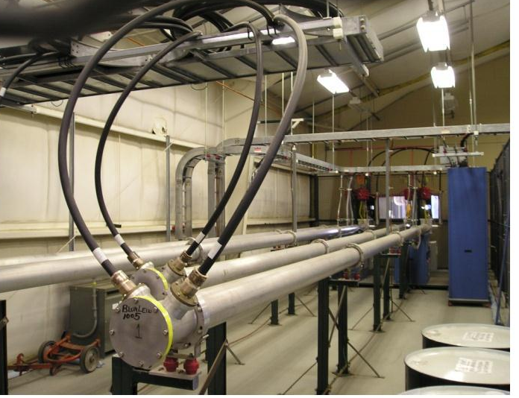
Few triaxial Blumlein generators at RHIC inflector

Slide 30
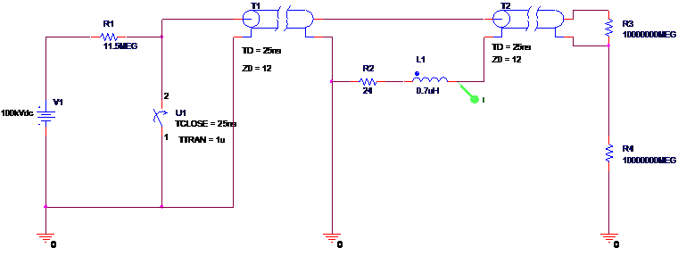
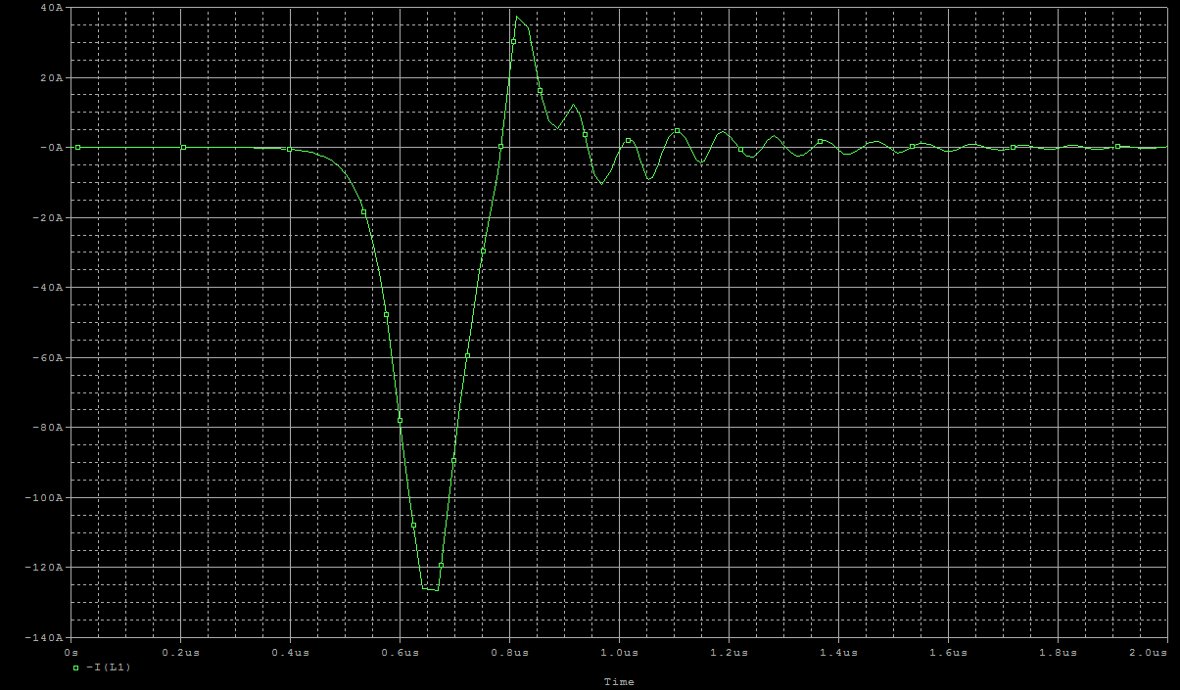
Pulser Modeling
Blumlein equivalent circuit
preliminary

Slide 31
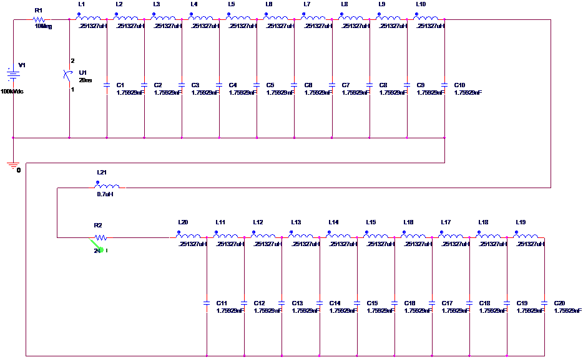
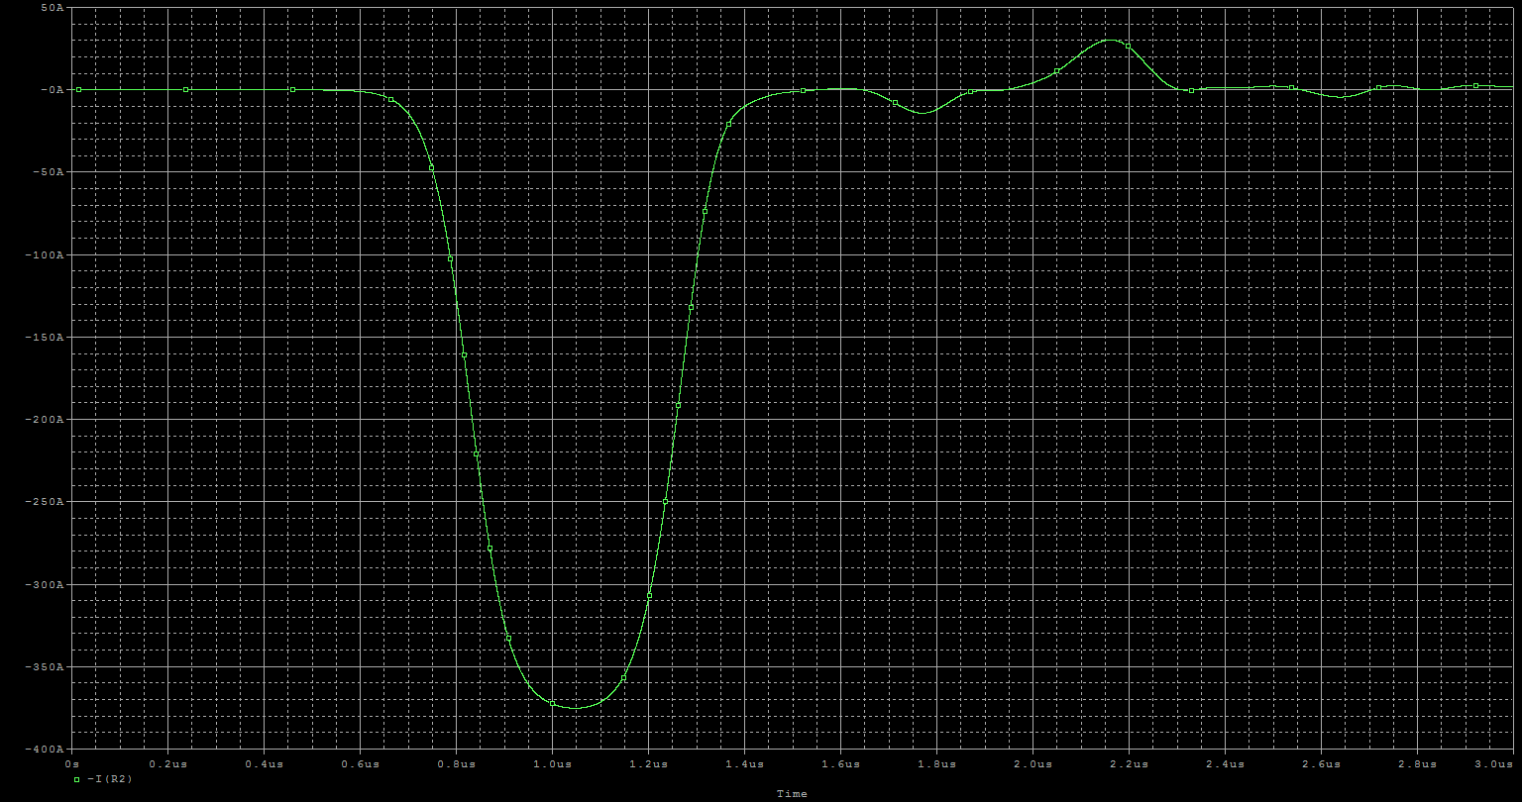
Lumped line blumlein equivalent
Preliminary

Slide 32
Modeling plan
- Continue to develop facility with SPICE
- J. Bennett is learning CST Micro-wave studio to model
- blumlein coax
- magnet stripline
- eddy currents in vacuum chamber
- time dependence of kick field

Slide 33
Status of prototype test
Restoring the E-821 prototype pulser and kicker
Repaired and replaced electronic compnents
- Thyratron electronics
Reservoir
Heater
Trigger pulser (second grid)
(Meanwhile, primary grid supply has failed)
- HV power supply tested
- HV transformer tested

Slide 34
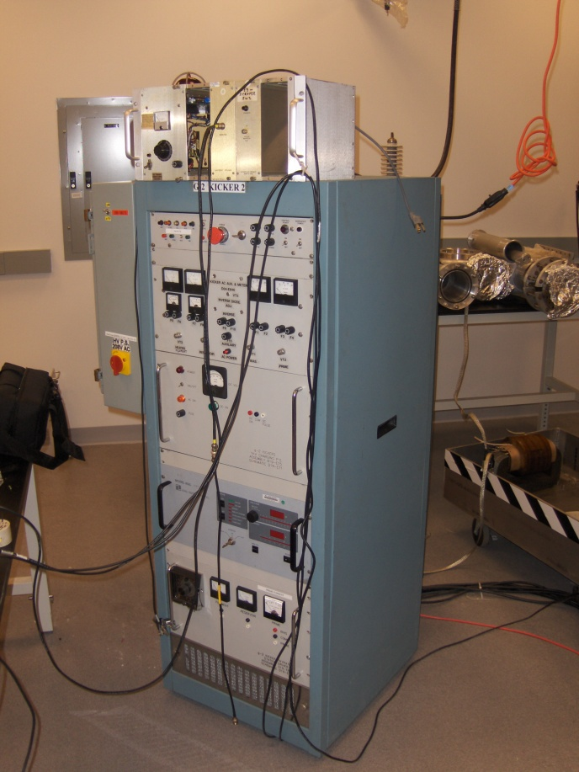
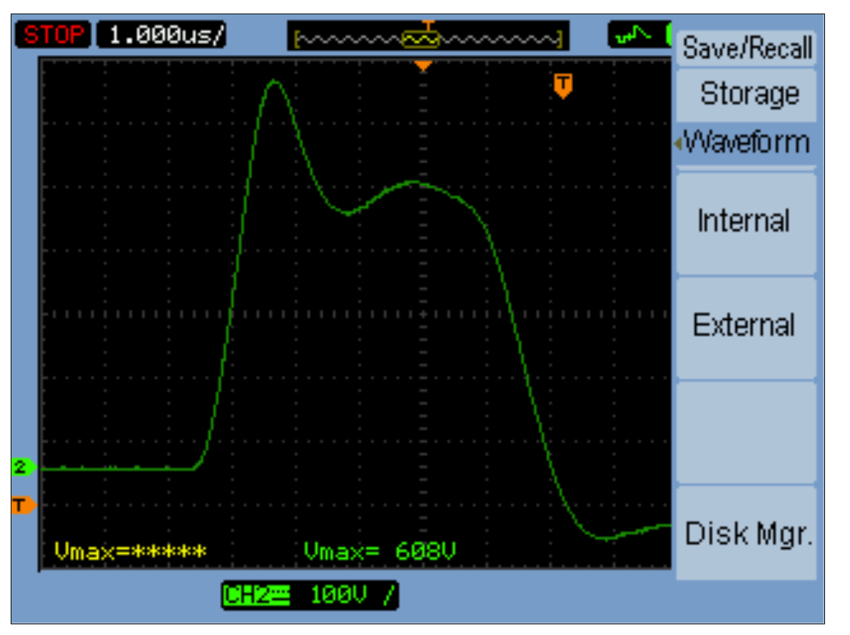
Thyratron grid pulser; this pulse goes to the second grid
Thyratron grid pulser
Unloaded
For triggering CX1699 the amplitude on grid 2 required : 500-2kV, 0.5 μS

Slide 35
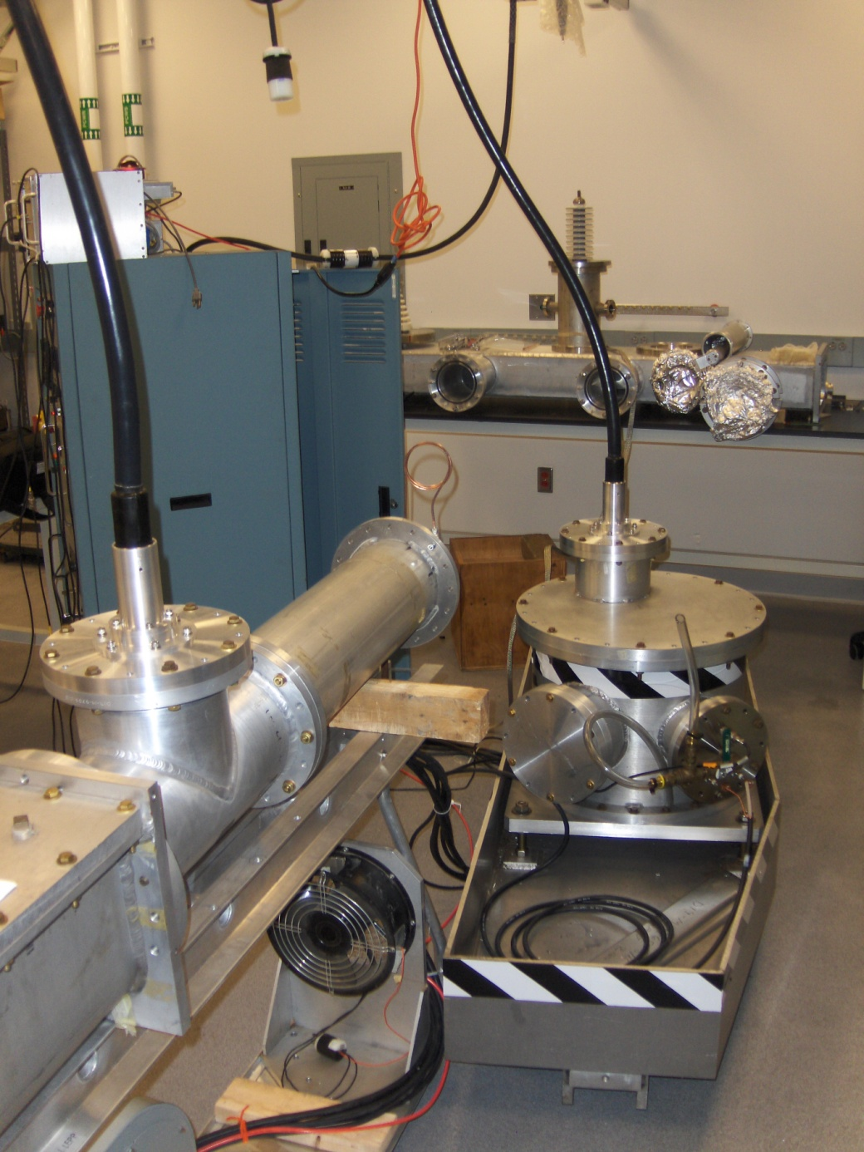
Thyratron/capacitor
HV transformer tank

Slide 36
For the Blumlein generator prototyping this 1.5 m-long section will be extended by 4 meters
~1.5 m
This will allow having 50ns flat top pulse
Fits in the room

Slide 37
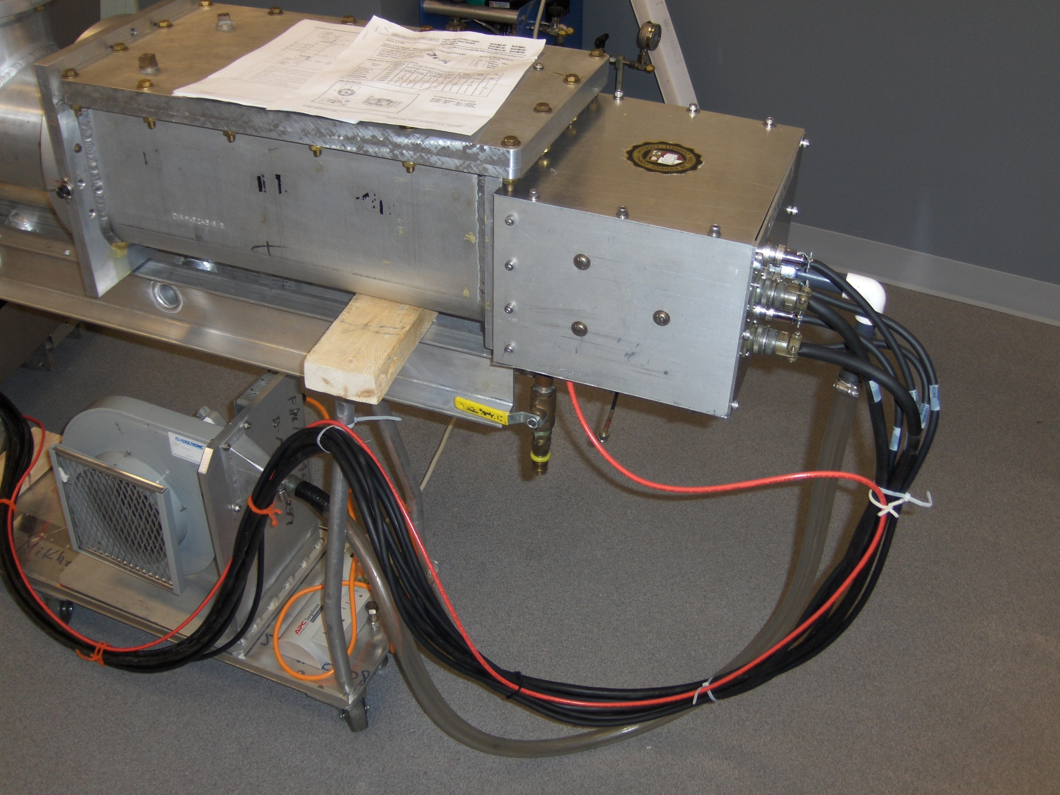
Thyratron housing
Thyratron Terminal Box
Cathode cooling blower
Thyratron Triggering cable (red)

Slide 38
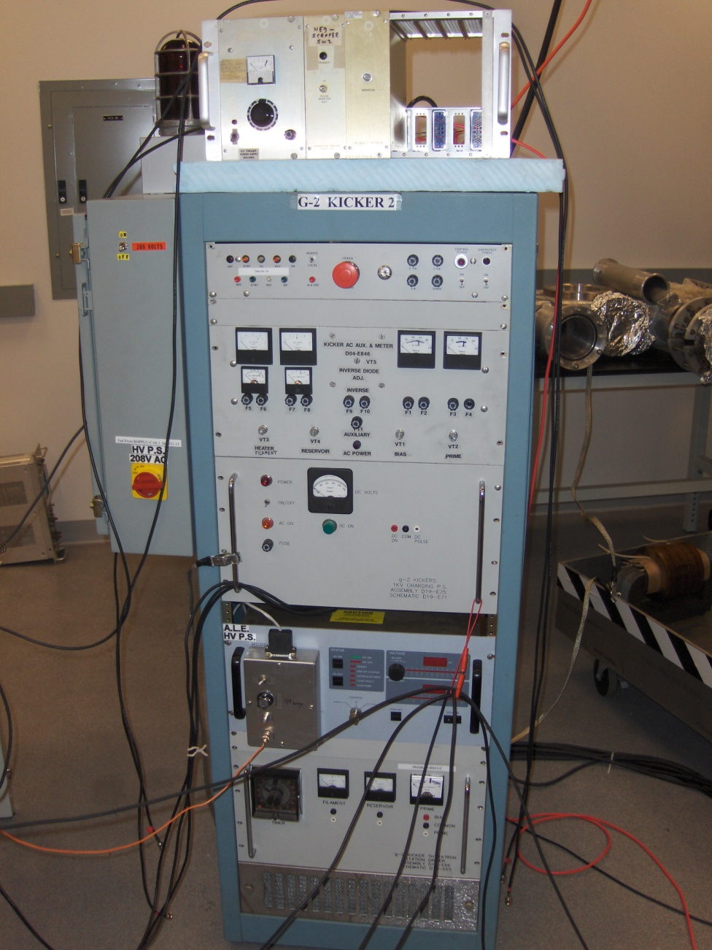
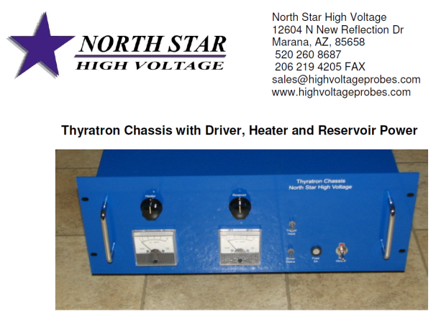
We recommend to purchase the thyratron feeding unit
This block replaces the thyratron triggering pulser, the PS for the heater, reservoir, prime, bias.
The cost is $5500/one
$15000/set of three
For the reference: the cost of this HV PS is 12.5k$
New HV regulation block

Slide 39
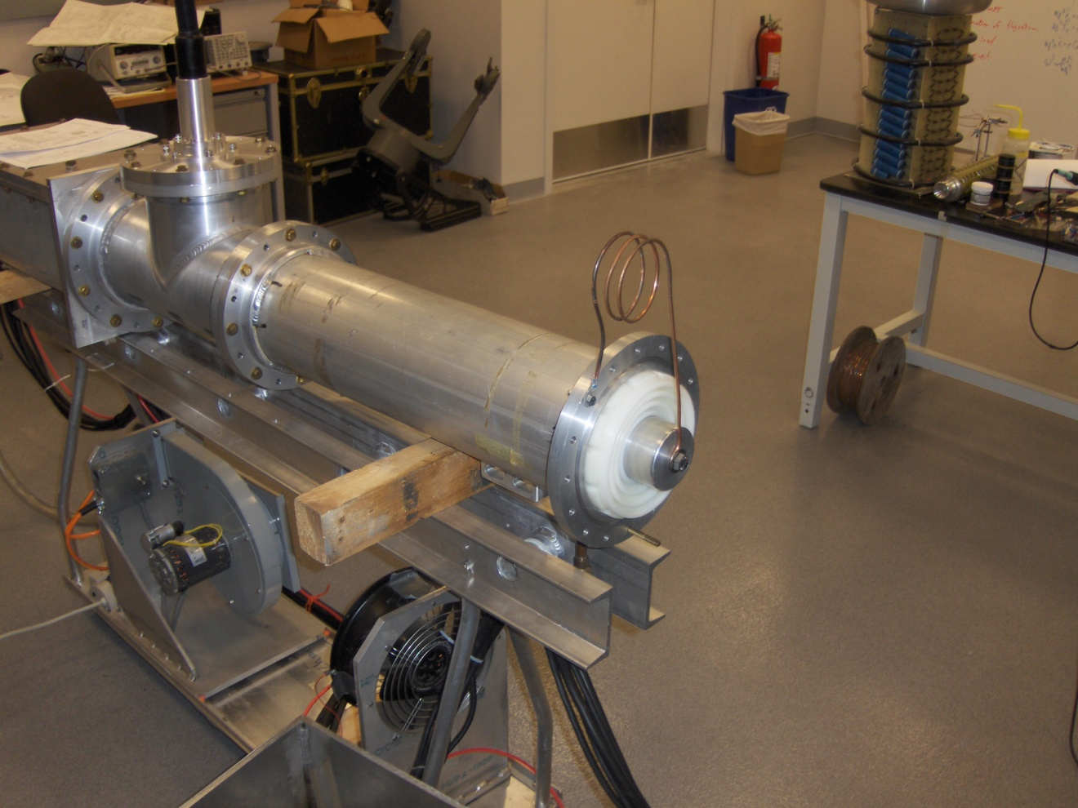
Inductance ~1μH
Without oil this device can operate at ~ 30KV

Slide 40
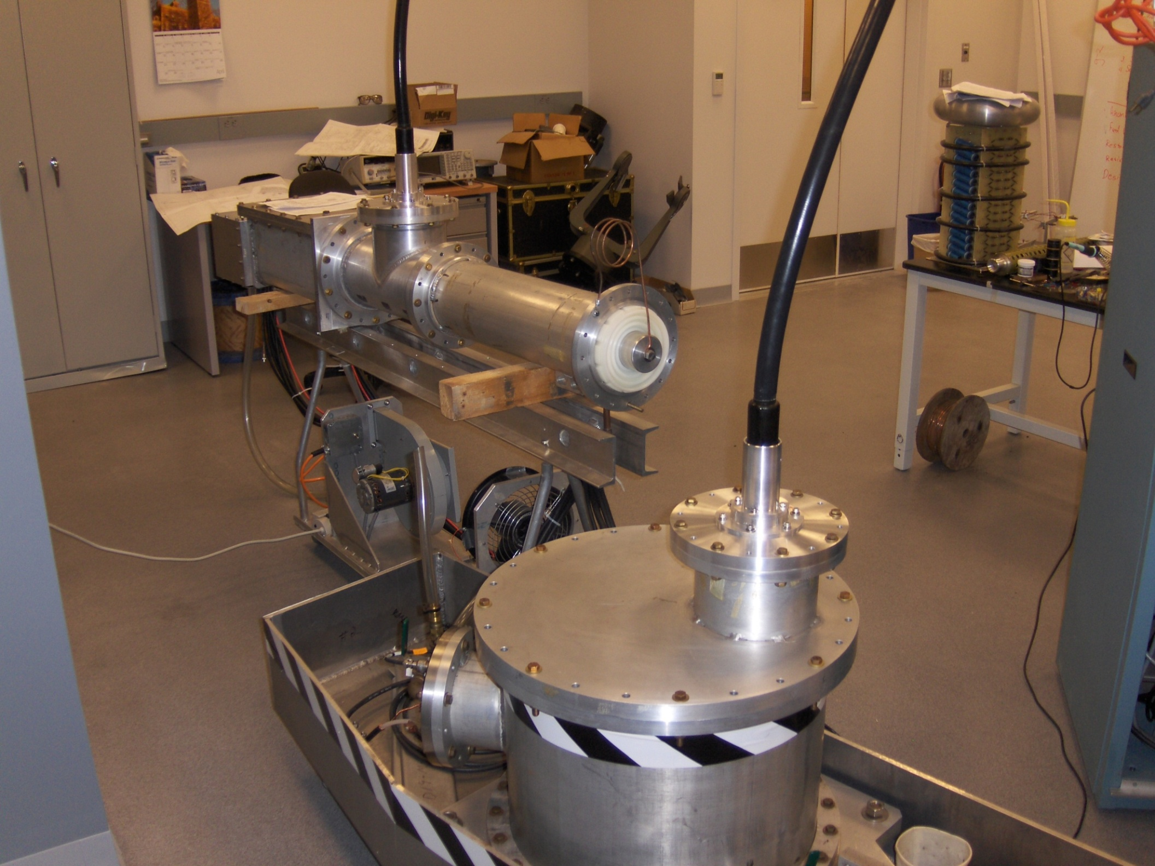
Other view

Slide 41
High voltage operation > 30kV (target is 100kV) requires that HV transformer, resistor, thyratron be bathed in oil – requires flanges to seal.
We had hoped to test without oil, but thyratron does not fire at 30kV
Thyratron problem
or 30kV insufficient to initiate breakdown in tube
Next step is to fill with oil and test with dummy load

Slide 42
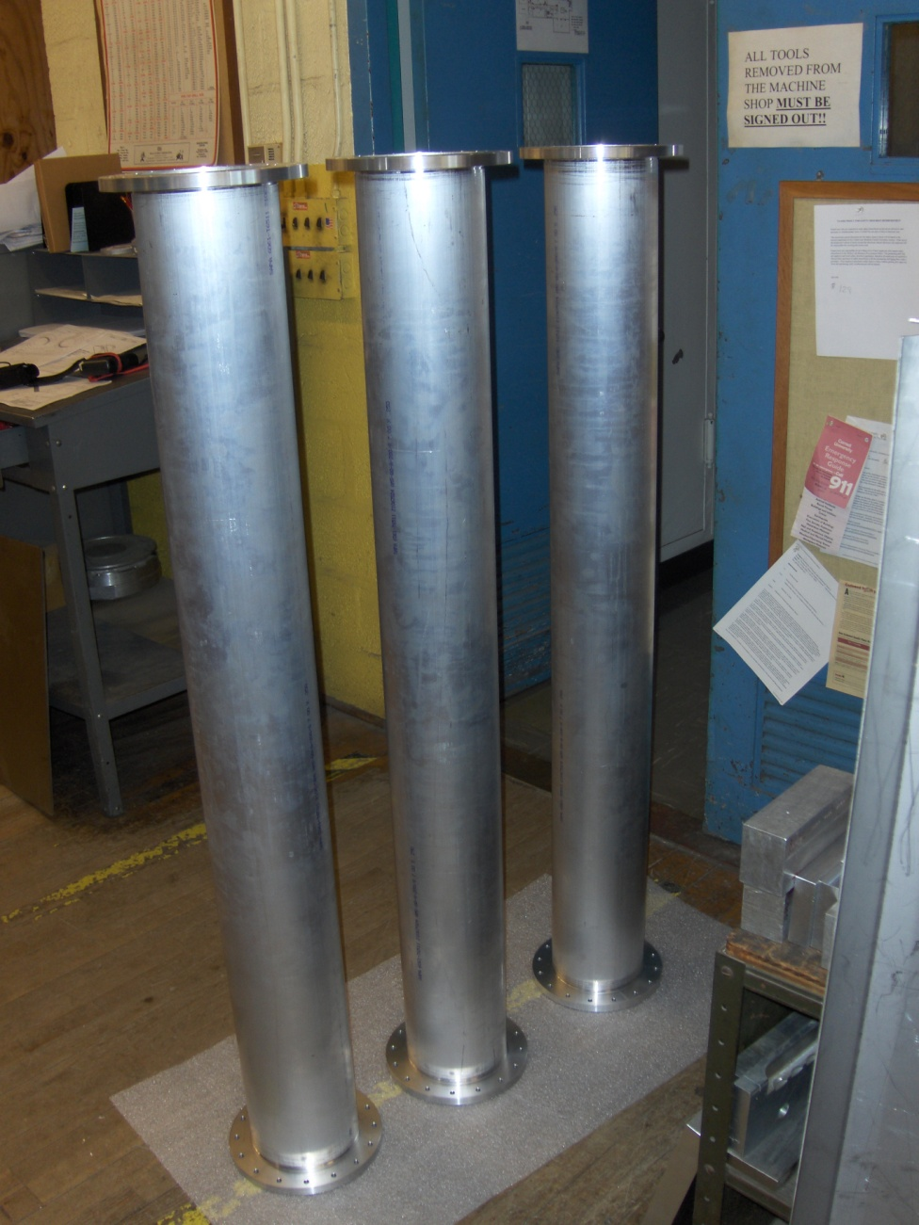
Meanwhile we are building a prototype blumlein
Three sections of the Blumlein generator in a machine shop.

Slide 43
Summary
Design for kicker plates with uniform field
Design for PFN (bumlein) for 50 ns pulse
Developing models of pulser, kicker, including interconnects and vacuum chamber for simulation of time dependence of B-field, eddy currents etc. using SPICE and MicroWave Studio
Very nearly testing E-821 pulser with load
Fabricating prototype blumlein
Plan to test blumlein, and tune, guided by simulation

Slide 44
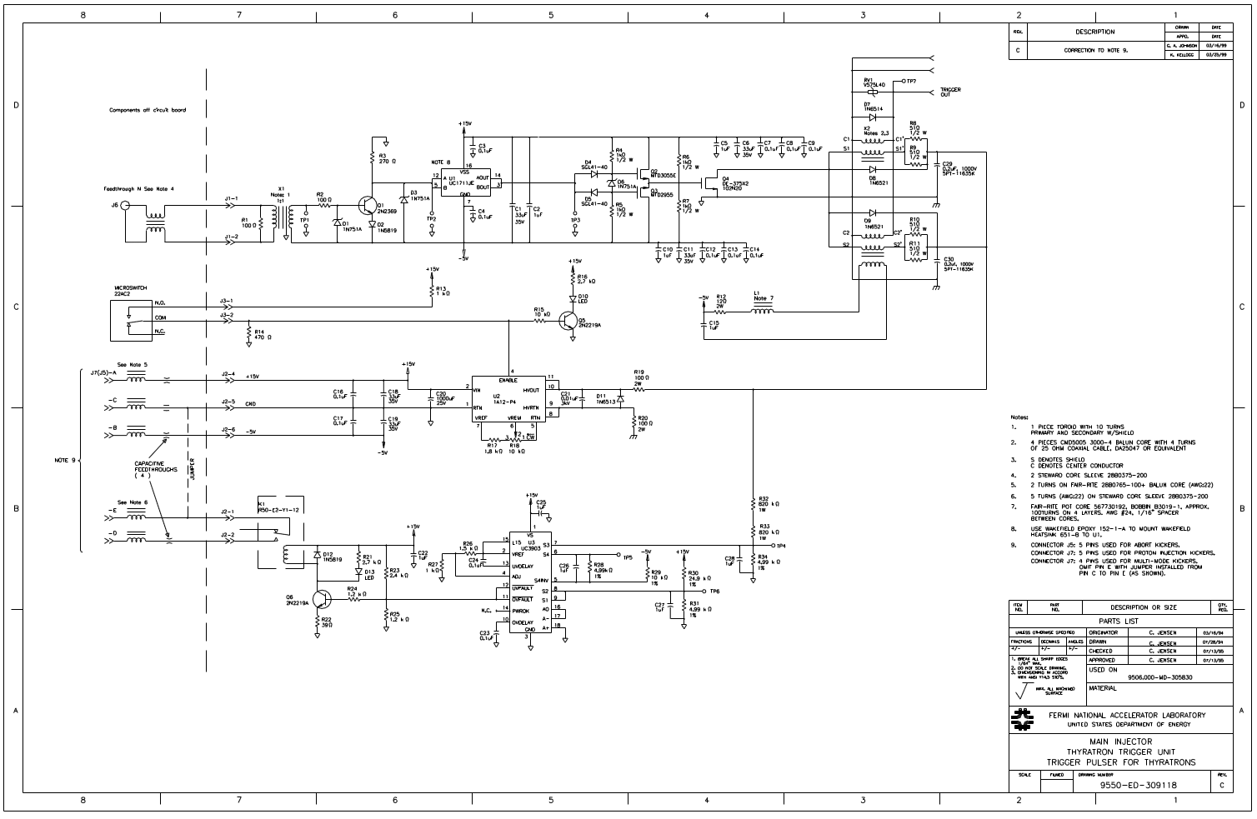
Scheme (and hardware) received from Chris Jensen
This scheme is restored finally and is ready to use.
Generates ~860 V unloaded, ~800ns duration

Slide 45

With matched resistor the distance between HV pulser and the kicker could be arbitrary
Charging pulser
HV transformer
Blumlein pulser:
Provides higher current;
Flat top pulse without tails;
Optimized electrodes will provide higher Field/current ratio
THEORETICALLY JUST A SINGLE KICKER CAN PROVIDE ENTIRE KICK

Slide 46
Vacuum chamber aperture ± 45mm
Energy dependence
x_{inj}
If the kicker field depends on displacement from central orbit according to
kick [mrad] ≈ 10(1-x/x_{inj}) then all energies kicked onto corresponding closed orbit

Slide 47
Dependence on angular distribution of injected muons
Then at Φ = π/2
There is no kick that puts the muon onto the central orbit
The best we can do is to minimize the invariant amplitude

Slide 48

E821 – Pulser schematic

Slide 49

Thyratron feeding section is running

Slide 50
SCOPE OF WORK
At a period of 2012, Cornell plans to provide:
√ Analyses of injection efficiency;
√ Optimization of injection;
√ Analyses of existing kicker system performance with 3D codes;
√ Reinstallation the E-821 hardware at Cornell and test; (accommodation in HV lab)
● Fast field measurement equipment in existing model;
√ Suggest the primary modification of the pulse generator and the kicker;
√ Analyses of a new generator;
● Complete drawings of the new generator and kicker;
● Assembling a full scale prototype of a new pulser (Blumline) and the kicker;
● Test the prototype and the kicker together;
● Design drawings of a Blumlein pulsed system able generation of bi-polar pulses without
mechanical switching;

