Slide 1
CBO and Beam Width Modulation
D. Rubin
October 30, 2014

Slide 2
Tuning: kick, β_{x}, β_{y}, and η

Slide 3
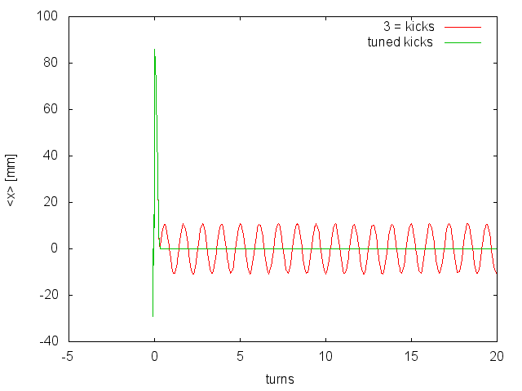
For the reference trajectory that emerges from the center of the inflector and tangential to the ring the kicks that place it onto the closed orbit of the ring:
18mm inflector
Kicker 1 = 237.7 G
Kicker 2 = 220.0 G
Kicker 3 = 173.1 G
36mm inflector
Kicker 1 = 287.9 G
Kicker 2 = 270.0 G
Kicker 3 = 174.7 G

Slide 4
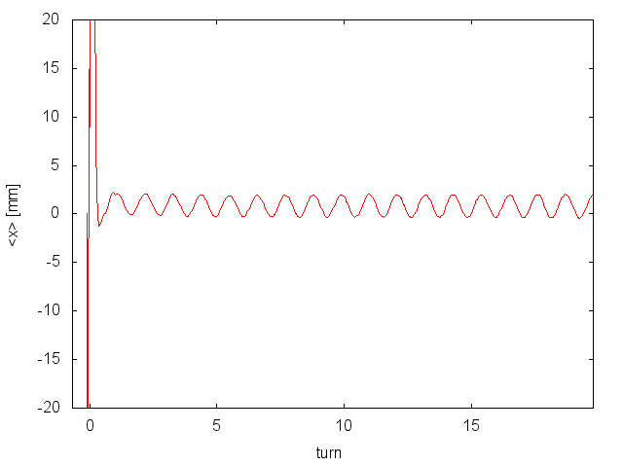
36mm inflector
No scattering
No energy loss
Uniform kicker field
Emittance = 0
Energy spread 0.5%

Slide 5
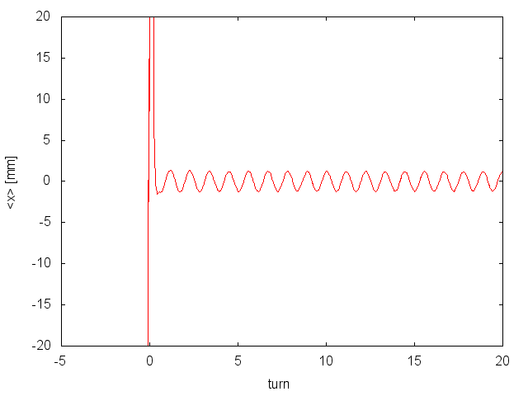
36mm inflector
No scattering
No energy loss
Uniform kicker field
Emittance = 50mm-mrad
Energy spread 0

Slide 6
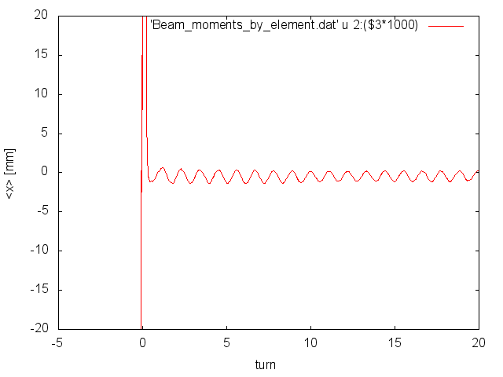
36mm inflector
No scattering
No energy loss
Uniform kicker field
Emittance = 50mm-mrad
Energy spread 0.5%

Slide 7
Conclusion
Residual CBO is not
- Energy spread
- Emittance
- or and energy spread/emittance conspiracy
Asymmetric aperture?
Asymmetric acceptance?

Slide 8
Modulation of beam width
Emittance = 0
Energy spread = 0.5%
Big modulation

Slide 9
Modulation of beam width
Emittance =50mm-mrad
Energy spread = 0
Small

Slide 10
Dependence of beam width modulation on dispersion at inflector exit
Emittance = 0
Delta p/p=0.5%

Slide 11
Evolution over first 20 turns
VD distribution

Slide 12
epsx = 14.e-6 ! emittance at inflector (m-rad)
epsy = 14.e-6 ! emittance at inflector (m-rad)
twiss = 5.0 10.0 0. 0.0 2.0 0. 0. 0. 0.7 0.7 0. 0. ! betax, betay, alphax, alphay, etax, eta
kicker_params%kicker_field = 287.943e-4 270.e-4 174.665e-4 ! Kick strength (Tesla)
quadPlates = 1

Slide 13
pz = 0.01 ! cutoff of longitudinal momentum distribution
pzsigma = 0.01 ! sigma for pzdistr="gaus”
epsx = 14.e-6 ! emittance at inflector (m-rad)
epsy = 14.e-6 ! emittance at inflector (m-rad)
twiss = 5.0 10.0 0. 0.0 2.0 0. 0. 0. 0.7 0.7 0. 0. ! betax, betay, alphax, alphay, etax, twiss = 4.7998E+00 1.8873E+01 2.2813E-01 1.8901E-01 4.8748E+00 4.5077E-01
quadPlates = 1

Slide 14
twiss = 9.1794E+00 1.0684E+01 -2.4185E-01 2.0662E-02 1.1021E+01 -2.7478E-02
! kickerPlates 989, kickerFieldType 2, quadplates 989, quadfield 1
! 821 inflector
twiss = 8.1344E+00 1.6304E+01 -2.2367E-02 2.9548E-02 8.8918E+00 7.8912E-03
kicker plates 1 quadplates 989
821 inflector
twiss = 4.0390E+00 1.3766E+01 1.0595E-02 9.5600E-02 5.7078E+00 5.8104E-01
! kickerPlates 989, kickerFieldType 2, quadplates 821, quadfield 1
! 821 inflector
twiss = 4.2150E+00 1.9093E+01 1.9920E-01 2.3538E-01 4.4990E+00 5.7760E-01
kickerPlates = 1
quadPlates = 821

Slide 15
Quads
- 989: Q1-long offset 7cm
- 821: Q1-long offset 5cm
Kicker
- 989: curved “narrow” plate
- 821: flat “wide” plate
36mm inflector (86mm offset at inflector exit)
Twiss parameters at inflector exit for match to ring
Quads | Kicker | β_{x} [m] | β_{y} [m] | α_{x} | α_{y} | η [m] | η’
821 | 821 | 4.8 | 18.9 | 0.23 | 0.19 | 4.9 | 0.45
821 | 989 | 4.8 | 9.5 | -0.14 | 0.06 | 7.4 | 0.42
989 | 821 | 8.1 | 16.3 | -0.02 | 0.03 | 8.9 | 0.0
989 | 989 | 11.1 | 7.3 | -0.46 | 0.23 | 13.0 | -0.06

