Slide 1
Ring Commissioning

Slide 2
Outline
Diagnostics
  Injection Beam Monitor System (injection line)
  Fiber harps (storage ring)
Variables
  M5 line final focus quadrupoles
  M5 line horizontal and vertical dipole correctors
  Inflector B-field
  Kicker timing and amplitude (X3)
  Quad voltage (X4)
Strategy
  Transmission through injection line
  Optimizing capture and storage in ring

Slide 5
Commissioning
Entrance to inflector
Inflector exit
Scinitillating fiber detectors
=> Centroid and size
Entrance to iron
1X1mm² clad square scintillating fibers

Slide 6
Commissioning
Inflector exit
Entrance to inflector
Entrance to iron
Procedure for tuning injection line trajectory
Center beam on D1 by tuning vertical and horizontal offset with upstream steerings
Center on D2 by tuning vertical and horizontal angle with steerings
Adjust inflector field to center on D3

Slide 7
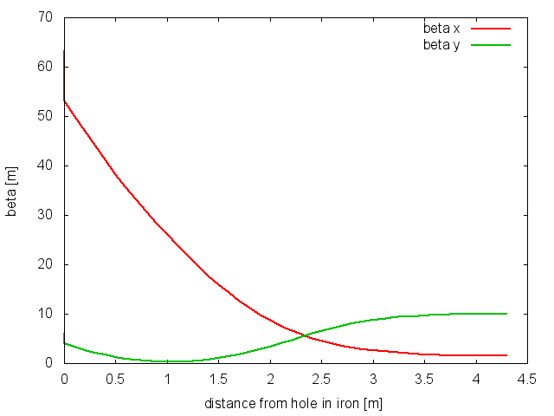
Commissioning
Entrance to inflector
Entrance to iron
Inflector exit
Procedure for tuning final focus
Measure vertical and horizontal beam size on each detector
Adjust upstream quads as required

Slide 8
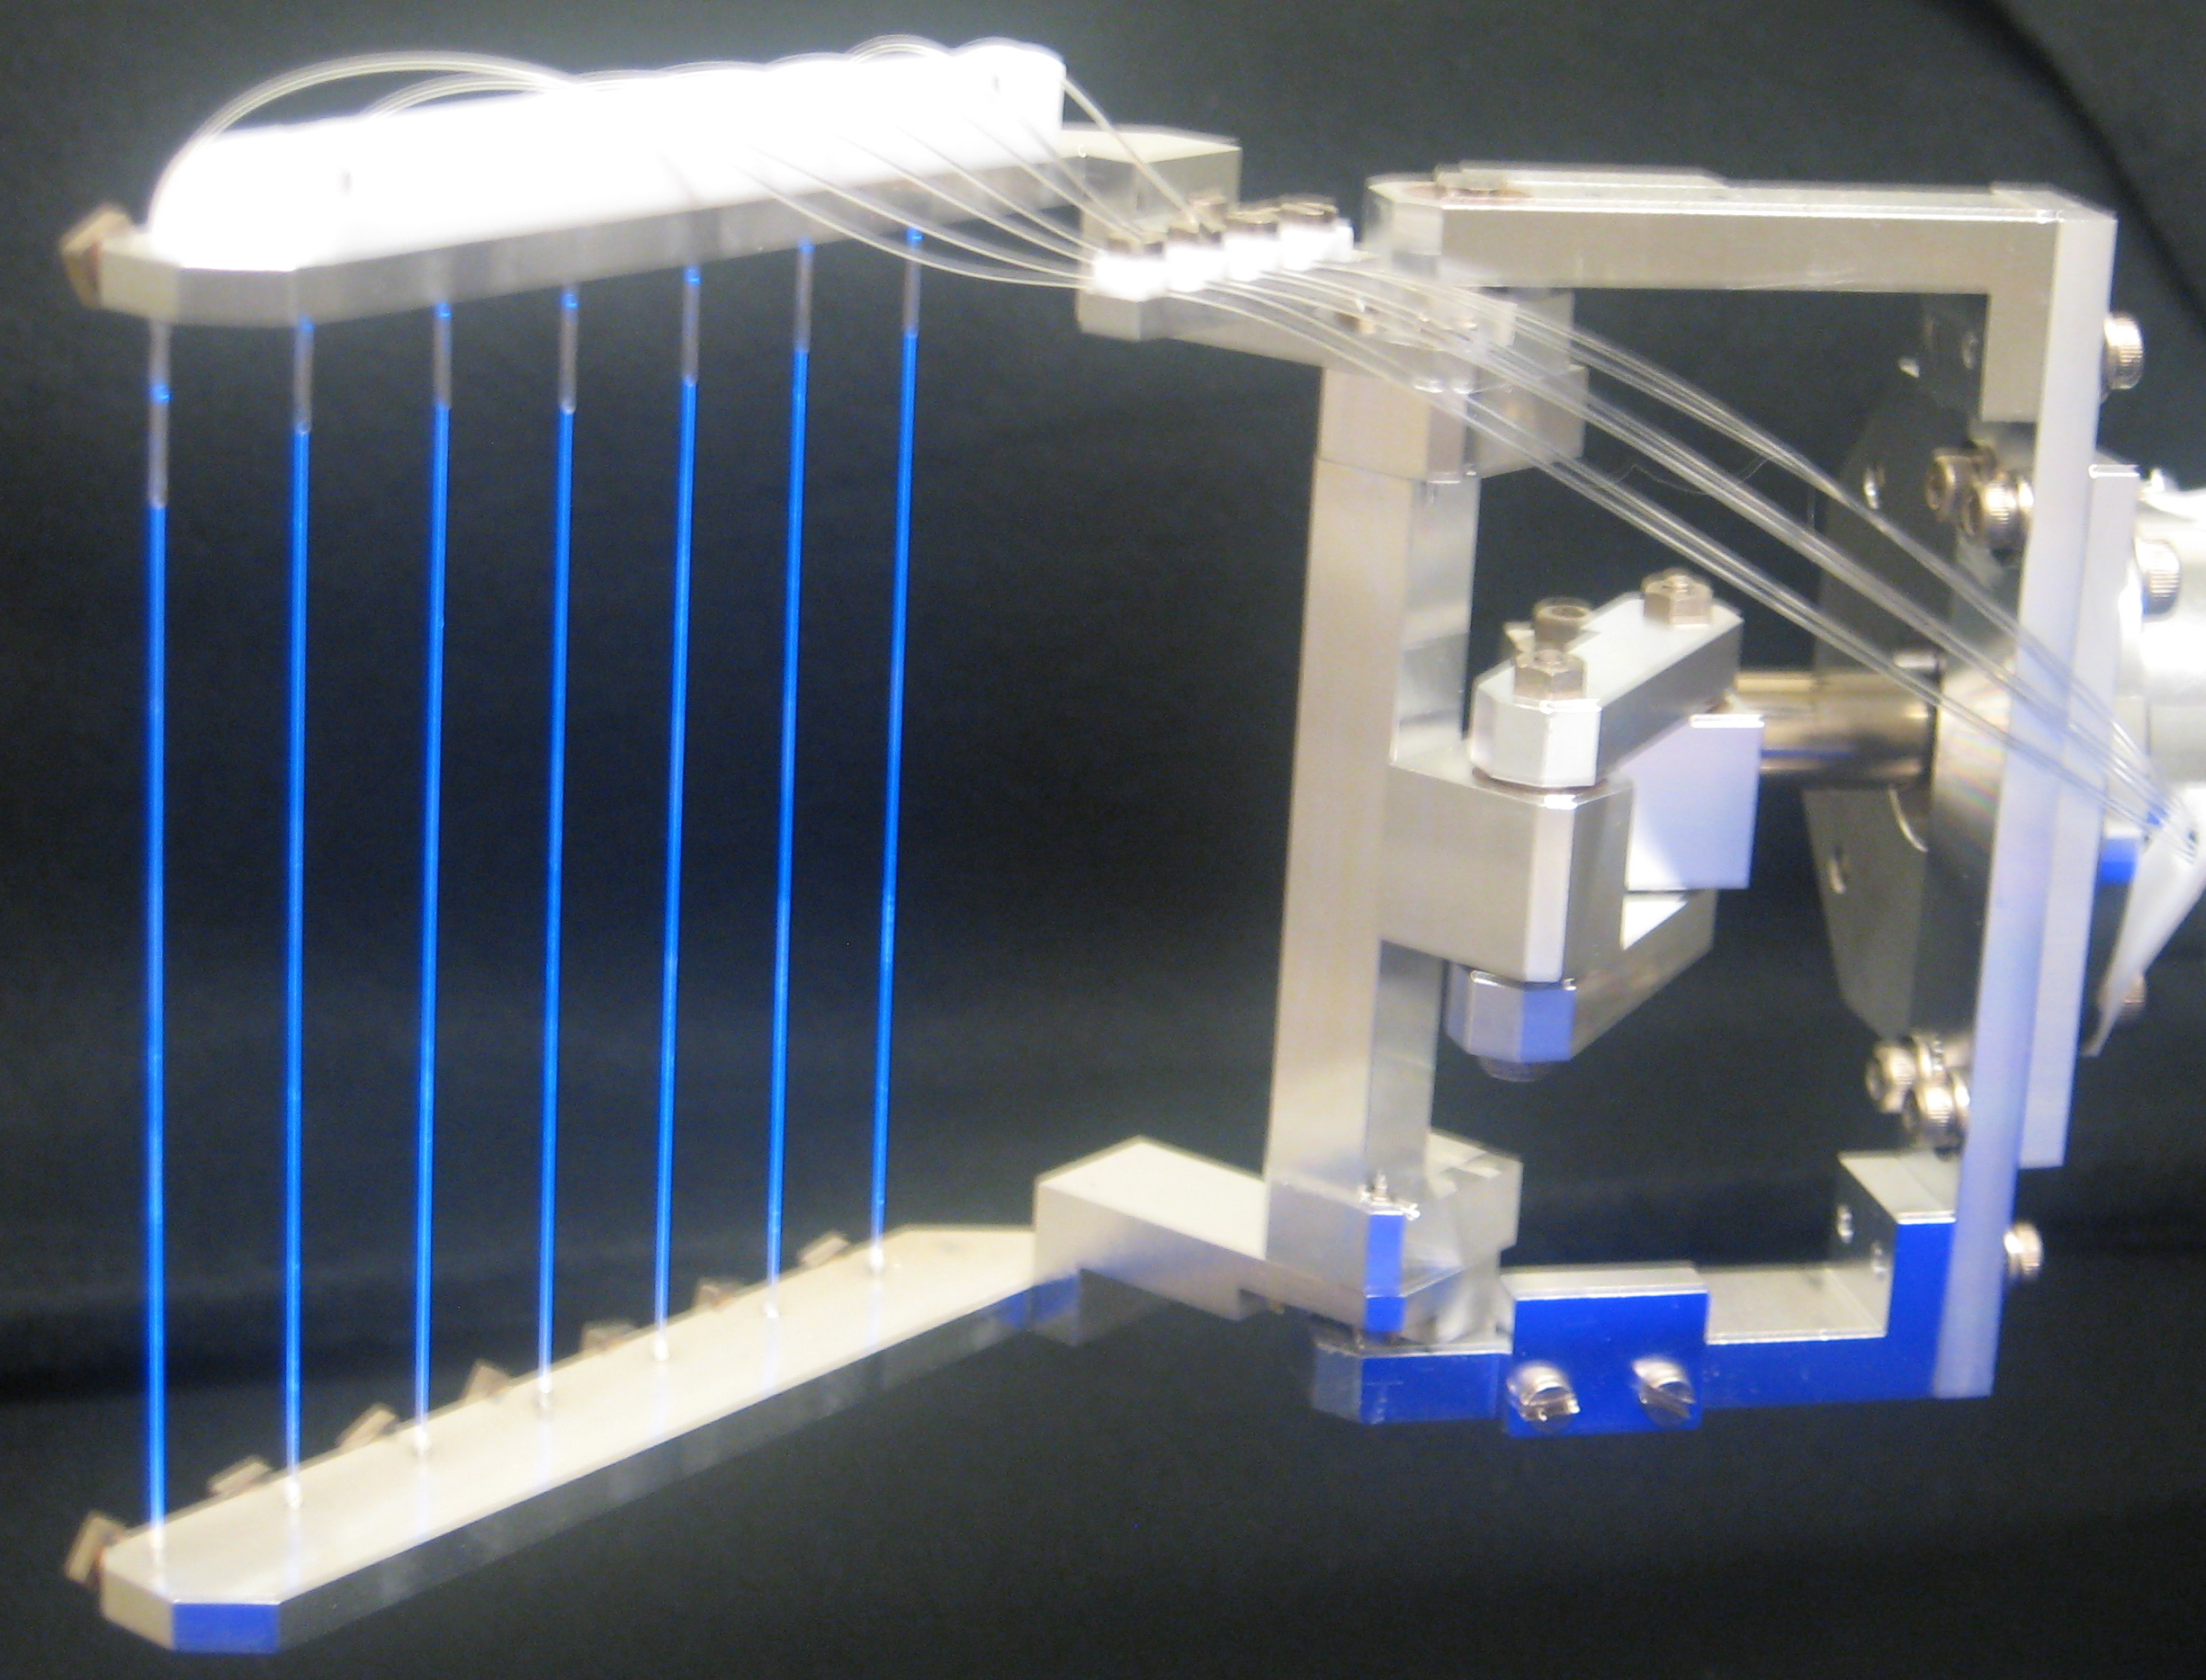
Commissioning
4 - Fiber harps are flipped into the ring for injection tuning.
2 vertical horizontal pairs at
180 deg and 270 deg

Slide 9
Commissioning
Tuning ring kickers
Adjust 3-independent kickers to minimize injection oscillations
Fiber harps give turn by turn position of beam centroid
  Measure dependence of turn by turn horizontal position on each of 3 kickers by varying kicker fields
  Dependence of position on kick is inverted to give kicks that center the beam
  M5 beam line steering can be used to center beam vertically
FFT of position of centroid on fiber harps => betatron tune
  Adjust electrostatic quadrupoles to set tune
FFT of beam width => beta mismatch and energy spread

Slide 10
Commissioning
Tune
Initial angle offset (upstream steerings)
Inflector field
Kicker fields
To maximize capture and minimize CBO

Slide 11
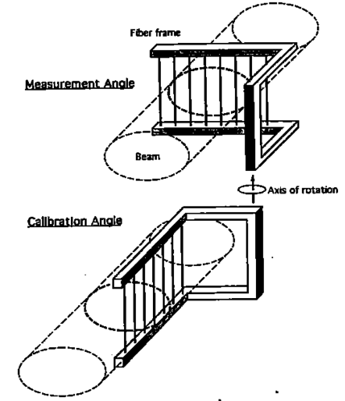
Commissioning

Slide 12
Storage ring optics
Weak focusing
Uniform vertical magnetic field
4 – electrostatic quadrupoles – each with arc length of 39 deg, equally spaced around the ring
Q_{h}=0.904, Q_{v} = 0.433

Slide 13
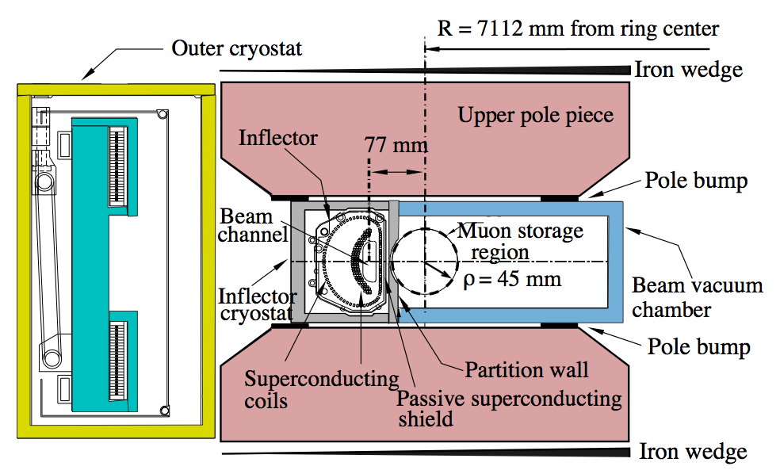
Injection aperture
Apertures
Inflector half-width = 9mm
Inflector half-height = 28mm
Storage volume radius = 45mm

Slide 14
Mismatch
Disparate apertures suggest varying β-functions
With mismatch of twiss parameters at inflector-ring interface, peak β & η in the ring are always greater than closed ring values
=>
Inflector exit
Mismatch example

Slide 15
Acceptance
We maximize transmission and capture by focusing the beam so that inflector and ring have equivalent acceptance
The maximum in the ring depends on the matching according to
Then
We find that inflector and ring have equivalent acceptance if

Slide 16
Dispersion
Energy acceptance of inflector and ring are equivalent if
and since
=>
Tracking simulations indicate optimal capture for
The energy acceptance follows from
=>

Slide 17
Injection Channel
We need to understand how to propagate distribution through injection channel so that at the inflector exit

Slide 18
Injection Channel
Muons come to the end of the M5 line and then propagate through:
Hole in magnet yoke
Dipole fringe field
Inflector
And exit the inflector 77 mm from the center of the dipole aperture
The magnetic field is near zero at the inner surface of the yoke, and rises to 1.45T between the magnet poles, over a distance of ~39cm
39cm

Slide 19
Magnetic field through Injection Channel
De-focusing in dipole fringe field
The vertical magnetic field of the dipole and the inflector along the axis of the injection channel separately(left) and summed(right). The horizontal component is zero due to midplane symmetry. There is net steering and significant focusing
- Horizontally defocusing, vertically focusing

Slide 20
Inflector field gradient
Inflector field map
There is some uncertainty regarding magnitude of the gradient in the inflector.

Slide 21
Injection channel defocusing
The 4.3m injection channel can be modeled as follows
quad
Q_{fringe}(k=-0.36)
quad
Q_{inf}(k=-0.16)
drift
1.6m
1.3m
1.7m
Dipole fringe and inflector overlap
Or we can compute the transfer maps numerically by tracking

Slide 22
Propagating β through injection channel
2% gradient
Hole through iron
18mm inflector
Match at entrance to magnet iron, depends on inflector gradient
Extremes are indicated
fringe
0 gradient
inflector | β_{x} (inc) | α_{x} (inc) | β_{y} (inc) | α_{y} (inc) | η_{x} (inc) | η'_{x} (inc) | β_{x} (exit) | β_{y} (exit) | η_{x} (exit)
E821(WG inf) | 53.1 m | 15.9 | 3.96 m | 3.53 | 0 | 0 | 1.5m | 10m | 0
E821(unif-inf) | 37.72 | 10.82 | 0.958 | 1.15 | 0 | 0 | 1.5m | 10m | 0

Slide 23
Larger aperture inflector
Larger aperture inflector requires
adjustment of
incident offset and angle (to center beam in aperture)
β,η functions at inflector exit
kicker field

Slide 24
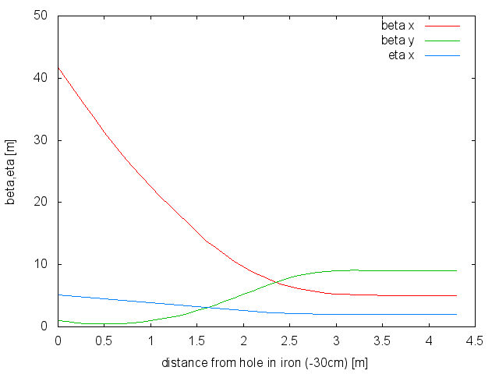
Propagating β through injection channel
With a larger aperture inflector,
β_{x} increases to 5m
η Increases to 2m
36mm inflector
(assume zero gradient in inflector)
inflector | β_{x} (inc) | α_{x} (inc) | β_{y} (inc) | α_{y} (inc) | η_{x} (inc) | η'_{x} (inc) | β_{x} (exit) | β_{y} (exit) | η_{x} (exit)
36mm | 41.8 m | 11.2 | 1.2 m | 2.0 | 5.2m | -1.34 | 5m | 16m | 2m

Slide 25
Injection Simulation
In view of various tradeoffs, identification of optimum focusing, angle and offset at entrance to injection channel, kicker field and timing, quad voltage, etc. are best determined by simulation.
The simulation requires a model
We have developed both a GEANT based model and a BMAD model
Model:
Injection channel (yoke, fringe, inflector) characterized in terms of field maps
Multiple scattering in the coils overlapping the entrance and exit of the inflector (effectively increasing emittance)
Kicker field map based on real plate geometry
Quadrupole fields represented by multipole expansion
Multiple scattering of muons that enter storage region through quad plates
Collimators define storage region aperture
Muons that hit the inner walls of the inflector or the storage ring collimators are assumed lost
Muons that survive 20 turns are captured

Slide 26
Muon distribution
MARS and G4beamline used to simulate pion production, focusing by Lithium lens, collection of muons from pion decay and transport to ring
δΕ/Ε < 2%
ε₀ ∼ 50 mm-mrad
This raw distribution is the starting point for simulation of injection into ring

Slide 27
Initialization of Injection Simulation
Compute σ-matrix of the raw distribution. Extract ε, β_{x},β_{y},α_{x},α_{y} η,δ
Create matrix R(β_{raw} > β_{inf})
Compute matrix R(β_{M5} > β_{inf}) for propagation from end of M5 line through injection channel to the inflector exit
Transform raw distribution as follows:
  X_{start} = R(β_{raw} > β_{inf}) R⁻¹(β_{M5} > β_{inf}) X_{raw}
  The distribution X_{start} tracked to the inflector exit will have the desired β_{inf},α_{inf},η_{inf}
Set initial offset and angle with respect to reference trajectory
Set inflector field, kicker field, pulse width, quad voltage etc.
Track muons through injection channel into and around the ring
Muons that survive 20 turns are stored

Slide 28
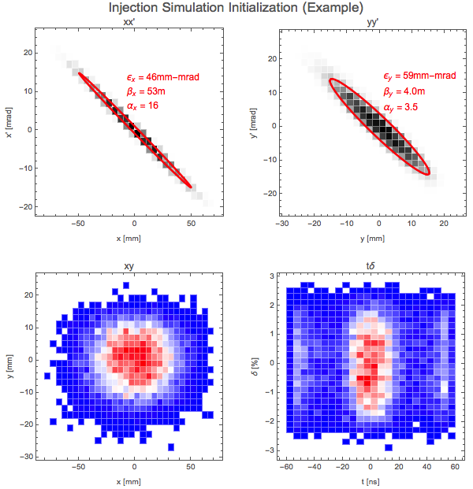
Initialization of Muon Distribution
Raw distribution projected to match point just upstream of entrance to ring magnet iron
Propagation through injection channel
Hole through iron
18mm inflector
fringe
β_{x} =1.5m, β_{y} =10m at inflector exit
inflector | β_{x} (inc) | α_{x} (inc) | β_{y} (inc) | α_{y} (inc) | β_{x} (exit) | β_{y} (exit)
E821(WG inf) | 53.1 m | 15.9 | 3.96 m | 3.53 | 1.5m | 10m

Slide 29
Evolution over first 20 turns

Slide 30
Tuning: kick, β_{x}, β_{y}, and η

Slide 31
Distributions before and after
η=0
±0.5%
Initial distribution projected to inflector exit
Distribution of muons that survive tracking through injection channel
Distribution of muons that survive 20 turns

Slide 32
Lost muons
3.92% stored
7.31% stored
E821 inflector
36mm inflector

Slide 33
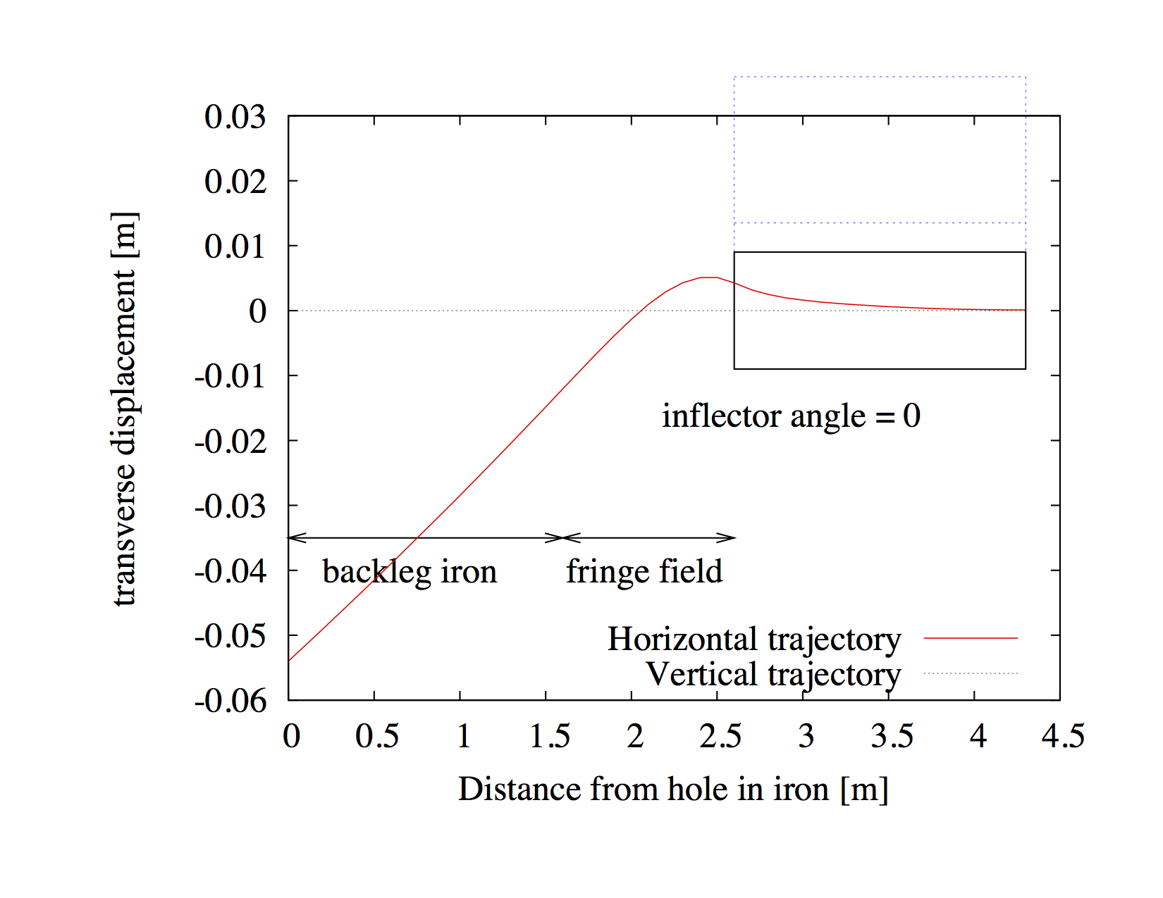
Initial angle and offset
“tune” steering magnets in the M5 line to determine optimum offset and angle of incoming muons (muons surviving 20 turns are “captured”)
Δx’ ~ 0.5 mrad
Δx ~ 3mm
Vary Δx and Δx’ with respect to reference trajectory

Slide 34
Tune β and η at inflector
Muons are either
Lost in the injection channel
Lost in the ring
Or captured
By increasing η and β in the inflector (“tuning” M5 quads), particles that otherwise would be lost in the ring (and into the calorimeters) are scraped away upstream
Maximum capture
β=1.5m
η < 2 m
Minimum lost in ring
η = 2 m

Slide 35
Summary
Inflector and ring apertures are very different
Twiss parameters in the inflector are chosen to maximize transmission and capture
Propagation of twiss parameters backwards to entrance into backleg iron defines matching requirements
The range of matching conditions is specified to include flexibility to accommodate 18mm inflector with or without gradient, as well as a 36mm inflector
Simulations based on detailed models of injection channel and storage ring are used to guide the optimization of parameters (tuning)
  Steering and Focusing at end of M5 line
    Δx and Δx’ at entrance to backleg iron
    β and η at inflector
  Inflector field
  Kicker parameters
    Field and timing for each of the 3 kicker pulsers
  Quadrupole voltage
Providing dependencies of
Capture efficiency
CBO amplitude and modulation of beam width and height
Characteristics of stored beam and lost particles
Two distinct models have been developed, based on BMAD and GEANT respectively, are in reasonable good agreement

Slide 36
END

Slide 37
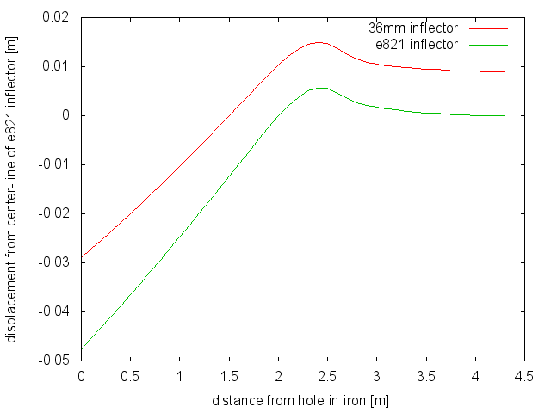
Trajectory
inflector | Offset[cm] | Angle[mrad]
e821 | -4.77 | 22.4
36mm | -2.90 | 17.9
30 cm upstream of yoke

Slide 38
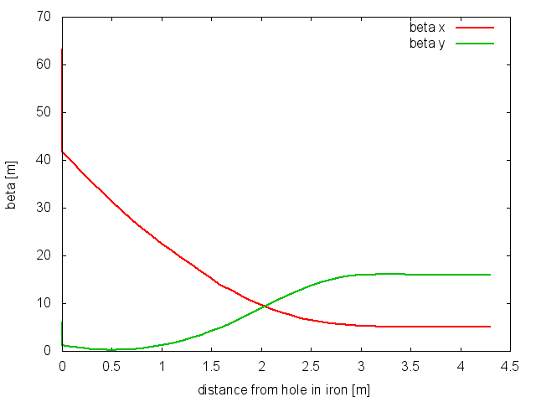
E821 inflector
36mm inflector
inflector | β_{x} (inc) | α_{x} (inc) | β_{y} (inc) | α_{y} (inc) | β_{x} (exit) | β_{y} (exit)
e821 | 53.1 m | 15.9 | 3.96 m | 3.53 | 1.5m | 10m
36mm | 41.8 m | 11.2 | 1.2 m | 2.0 | 5m | 16m

Slide 39
Entrance to inflector
Inflector exit
Silicon detectors ?
=> Centroid and size
Entrance to iron
30 cm upstream of yoke

Slide 41
Evolution of distribution through injection channel and around ring
Entrance to iron
Inflector upstream
Inflector downstream
End 200 turns

Slide 42
Trajectory through injection channel
There is a unique combination of initial offset Δx and angle Δx’for the injected beam that exits along the axis of the inflector.
(Steering magnets near the end of the M5 line provide the flexibility to maximize transmission by tuning Δx and Δx’)

Slide 43
Dependence of optimum β_{y} at the inflector on scattering and kicker field profile
Includes scattering & 989 kicker field
No scattering & 989 kicker field
No scattering & uniform kicker field
Conclusion: Soft dependence on β_{y} . Peak is near 10m.
Note that ring β_{y} = 15.5m. Larger β_{y} increases losses in inflector

Slide 44
Radial beam motion
Beam exits yoke
Beam through outer coil
Beam through Inflector
Beam kicked onto orbit

Slide 45
Propagating twiss parameters
To propagate twiss parameters through the injection channel it is convenient to construct a transfer matrix.
The transport is roughly equivalent to
Drift – Quad – Drift
where the quad G ~ 3.7T/m
In practice we determine the transfer matrix (M) by numerically computing the phase space mapping in the neighborhood of the reference trajectory.

Slide 46
Inflector Aperture
Aperture
Inflector a_{x}= ±9mm,a_{y}= ±28mm
storage ring ±45mm
To clear the inflector aperture
β_{x} ≤ 2m, (β_{y} = 17m)
η ≤ 1.8m

Slide 47
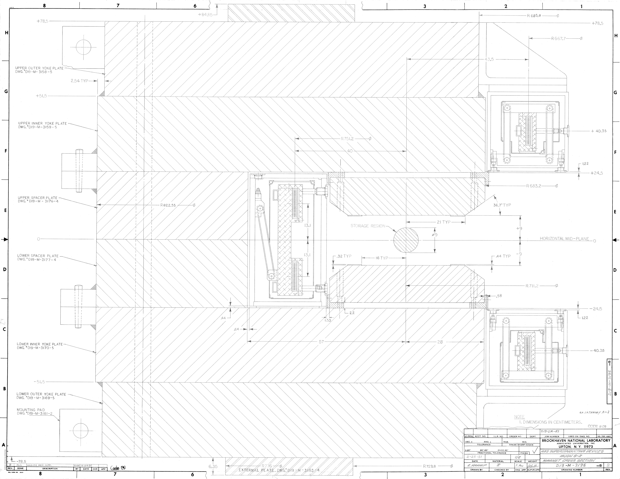

Slide 48
Storage Ring Kicker Requirements
Kickers steer injected muons onto the closed orbit of the storage ring
Requirements:
Kick angle ~ 10.8 to 12.1 mrad
Kicker B-field ~ 218 to 245 Gauss
Integrated B-field ~ 1.11 to 1.25 kG-m
Pulse width(τ_{wid})
120ns < τ_{wid} < 149ns
Repetition rate
~100Hz peak, 12Hz average
3 – 1.7m kickers
τ_{rev} = 149 ns
d = 77 mm, R=7112 mm
kick angle θ = d/R = 10.8 mrad

Slide 49
Phase Space Matching
Larger aperture inflector
Existing inflector
Larger aperture inflector requires
Adjustment of incident offset and angle (to center beam in aperture)
Increased kicker field

