Slide 1
Effect of Removing Middle of Q1(Q3) on capture efficiency
D. Rubin
November 1, 2015

Slide 2

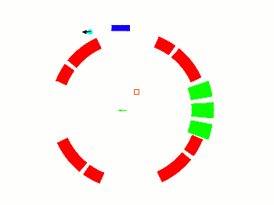
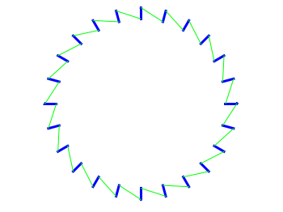

Multiple scattering in Q1 long degrades injection efficiency. What happens if we remove the middle of Q1 long?
Consider two scenarios for evaluation of capture efficiently
Remove middle of Q1 long
Remove middle of Q1 long and Q3 long (symmetry)
In both cases restore tune by increasing the voltage of the remaining quads
inflector
Q1 short
ES quad
Q4 short
kickers
Q2 short
Q3 short

Slide 3
Nominal tunes with complete set of quads (n=0.185) Q_{x} = 0.90386 Q_{y} = 0.43271
Standard injection parameters (at inflector β_{x} =1.5m, β_{y} =10m, η=0)
Inject Volodya’s distribution of 10,000 muons (~2% energy spread)
Include scattering in end coils of inflector – for all 3 configurations
But no scattering in quad plates
Configuration 1 => baseline
Configuration 2 => middle two quarters of Q1-long removed
Configuration 3 => middle two quarters of Q1-long and Q3-long removed (symmetry)
configuration Voltage Number captured
complete set of quads at 31.5 kV 413 (±20)
Eliminate ½ Q1 long
  Remaining quads at 34.5 kV 359 (±20)
Eliminate ½ Q1 long and Q3 long
  Remaining quads at 38.7 kV 369 (±19)

Slide 4
Closed ring β functions for three quad configurations
Horizontal
Vertical
Modulation of horizontal beta function is increased with removal of Q1 and Q3 short, from <1 m to 3 m
Increase in modulation of vertical beta function ~ 1m

Slide 5
But closed ring β functions are not relevant to injection due to mismatch
Effective β functions are shown below
The baseline (all quads powered) has slightly smaller aperture than either of the missing quad configurations, both horizontally and vertically
Missing quads effectively improve matching from inflector into ring

Slide 6
Effective dispersion – energy aperture is reduced with missing quads

Slide 7
Systematic due to uncertainty in transverse position of muon?
The increased modulation of the β functions with the missing pair (Q1 and Q3)
=> greater modulation of width of stored muon distribution
Maximum width is determined by collimators and is independent of quad configuration
Increased modulation of β implies minimum width (and therefore average) is smaller?

Slide 8
Modulation of beam width and height
Beam width
Beam height
Depth of modulation of beam width
Increases by ~ 50% with Q1 off
Increased by ~20% with Q1&Q3 off
Depth of modulation of beam height
Increases by ~ 25% with Q1 off
Negligible difference with Q1&Q3 off

Slide 9
Conclusion
Effect of zeroing voltage of Q1&Q3 short quads, or Q1 short, on capture efficiency is negligible and small respectively (excluding scattering)
If the effect of the reduced scattering (due to removal of the plates of Q1 plates) is included, capture efficiency is likely better with either configuration
Eliminating Q1&Q3 short quads requires operating all remaining quads at ~39 kV
Eliminating quads increases asymmetry of lattice (β-functions).
  Systematics?
  Resonances?
Next: Tracking study with Geant4 based injection simulation, with Q1 short and Q3 short removed?

