Slide 1
Injection
D. Rubin
September 25, 2014

Slide 2
Propagating twiss parameters through the fringe field and inflector
Computing the R-matrix
Inflector field map
Matching to M5 line
821 inflector & 36mm inflector
Aperture
Dependence on proximity of last M5 quad to ring
Dependence of capture efficiency on β_{y} in the inflector
Scattering in inflector end coils
Kicker field profile
Limiting aperture, lost muons, properties of stored beam

Slide 3
Focusing in the fringe field of the magnet along injection path
1.5m
Beam exits hole through iron and enters fringe file
B_{y} increases from 0 to 1.451 T over a distance ~39cm
Effective gradient ~ 1.451T/39cm = 3.72T/m
=> k= -0.36 m⁻²
Path length in the field with this gradient is ~1.5m
Now we approximate the 4.3m long “beam line” as
DQD-line = Drift(1.85m) - Quad(1.5m) - Drift(1.05m) and Quad(k=-0.36)
Note:We are assuming that there is no contribution to the focusing from the inflector field.

Slide 4
Computing the matrix for propagating twiss parameters from the end of the M5 line to the inflector
To Compute the R-matrix by tracking through field maps
Find the reference trajectory that exits along the axis of the inflector
Track in the neighborhood of the reference to determine the matrix
Compare propagation of β through injection channel using 3 different determinations of the R-matrix
By tracking through Wuzeng fringe field map and Wuzeng inflector map
By tracking through Wuzeng fringe field map and uniform inflector field
By matrix multiplication of the elements in the DQD-line

Slide 5
Compare 3 matrices by propagating β_{x} β_{y} for each
Set β_{x} β_{y} in the inflector (these values are that yield best injection)
Use the 3 different matrices to propagate backwards to just upstream of the hole into the iron
Conclusion:
We find that the matrix computed by tracking, assuming a uniform inflector field is in good agreement with the DQD-line approximation.
The matrix computed by tracking using the Wuzeng inflector field map yields somewhat strong horizontal defocusing (as evidenced by the fact that the β_{x} propagates backwards to a higher value at the start)

Slide 6
Possible explanations for the apparent de-focusing from the inflector map
The effect is real. (that is, the inflector field is not uniform)
I have made some mistake implementing the map in the code (very possible)
The map has somehow been mangled ?

Slide 7
Matching to the M5 line
If the M5 line can match to the β,α,η at the start of the injection line then we end up with the desired β,η at the inflector exit

Slide 8
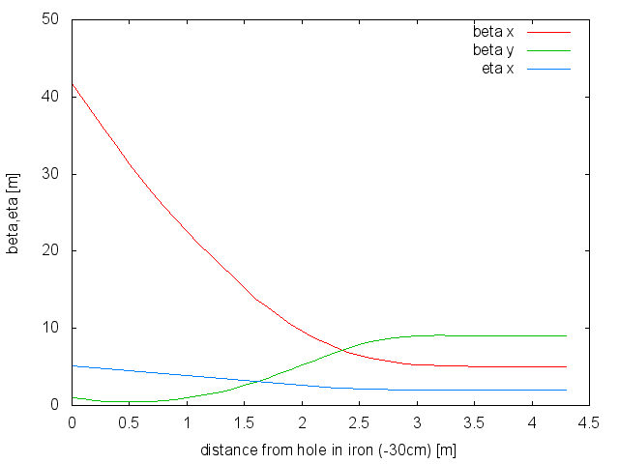
E821 inflector
36mm inflector
inflector | β_{x} (inc) | α_{x} (inc) | β_{y} (inc) | α_{y} (inc) | η_{x} (inc) | η'_{x} (inc) | β_{x} (exit) | β_{y} (exit) | η_{x} (exit)
E821(WG inf) | 53.1 m | 15.9 | 3.96 m | 3.53 | 0 | 0 | 1.5m | 10m | 0
E821(unif-inf) | 37.72 | 10.82 | 0.958 | 1.15 | 0 | 0 | 1.5m | 10m | 0
36mm | 41.8 m | 11.2 | 1.2 m | 2.0 | 5.2m | -1.34 | 5m | 16m | 2m

Slide 9
Match for e821 inflector assuming defocusing in inflector as well as fringe
M5 line
Beam size
Twiss parameters
(Projected inflector aperture)
inflector | β_{x} (inc) | α_{x} (inc) | β_{y} (inc) | α_{y} (inc) | η_{x}(inc) | η’_{x}(inc) | β_{x} (exit) | β_{y} (exit) | η_{x}(exit)
E821(WG inf) | 53.1 m | 15.9 | 3.96 m | 3.53 | 0 | 0 | 1.5m | 10m | 0
Note the large aperture required in Q026

Slide 10
To reduce beam size in final focus quads move Q027 (last quad in M5 line) 50cm closer to iron and then as before,
Match for e821 inflector assuming defocusing in inflector as well as fringe
Twiss parameters
Beam size
inflector | β_{x} (inc) | α_{x} (inc) | β_{y} (inc) | α_{y} (inc) | η_{x}(inc) | η’_{x}(inc) | β_{x} (exit) | β_{y} (exit) | η_{x}(exit)
E821(WG inf) | 53.1 m | 15.9 | 3.96 m | 3.53 | 0 | 0 | 1.5m | 10m | 0
Moving q027 closer to the iron reduces
the required aperture by ± 12 mm

Slide 11
Match for 36mm inflector assuming uniform field in inflector
Beam size
Twiss parameters
inflector | β_{x} (inc) | α_{x} (inc) | β_{y} (inc) | α_{y} (inc) | η_{x} (inc) | η’_{x} (inc) | β_{x} (exit) | β_{y} (exit) | η_{x} (exit)
36mm | 41.8 m | 11.2 | 1.2 m | 2.0 | 0 | 0 | 5m | 16m | 0

Slide 12
Match for 36mm inflector assuming uniform field in inflector,
this time with 2m dispersion at the inflector
X(β) = projected inflector betatron size
X(η) = h (D E/E = 0.002)
(add in quadrature)
Note that if the aperture is less the size indicated, the limiting aperture is here (and not the inflector)
inflector | β_{x} (inc) | α_{x} (inc) | β_{y} (inc) | α_{y} (inc) | η_{x} (inc) | η’_{x} (inc) | β_{x} (exit) | β_{y} (exit) | η_{x} (exit)
36mm | 41.8 m | 11.2 | 1.2 m | 2.0 | 5.2m | -1.34 | 5m | 16m | 2m

Slide 13
Dependence of optimum β_{y} at the inflector on scattering and kicker field profile
Includes scattering & 989 kicker field
No scattering & 989 kicker field
No scattering & uniform kicker field
Conclusion: Soft dependence on β_{y} . Peak is near 10m.
Note that ring β_{y} = 15.5m. Larger β_{y} increases losses in inflector

Slide 14
Optimization with respect to kick, β_{x} and η

Slide 15
Evolution of distribution through injection channel and around ring
Entrance to iron
Inflector upstream
Inflector downstream
End 200 turns

Slide 16
Evolution over first 20 turns

Slide 17
Lost muons
3.92% stored
7.31% stored
E821 inflector
36mm inflector

Slide 18
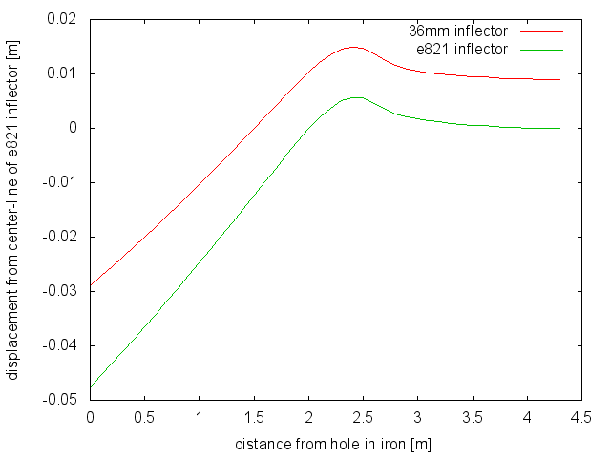
Trajectory
inflector | Offset[cm] | Angle[mrad]
e821 | -4.77 | 22.4
36mm | -2.90 | 17.9
30 cm upstream of yoke

