Slide 1
Kicker/Inflector optimization
Kicker field
Field required to steer injected muons onto magic radius orbit is proportional to displacement of inflector axis.
77mm => 210 Gauss
87 mm => 237 Gauss
Kicker current
E821 kicker plate geometry
=> uniform field over entire storage region
=> Requires 1kA/35 Gauss
=> 210G at 6000A (or 75kV with 12.5 ohm load)
Proposed 989 plate geometry
  Tracking study suggests 20% fewer muons captured due to field nonuniformity at larger amplitudes (that is compared to perfectly uniform field)
  Requires 1kA/60 Gauss
  336 Gauss at 75kV

Slide 2
Thyratron rated for ~75kV
=> 210 Gauss with 821 plates is not impossible (but very little margin)
=> 237 G - not likely
Conclusion: larger aperture inflector is compatible with new 989 kicker plate geometry but incompatible with 821.
Other alternatives require rethinking trolley/rails/ through kicker region.
As we see on next slide, advantage of larger aperture inflector overwhelms disadvantage of 989 kicker plate geometry

Slide 3
Double inflector aperture => 1.60 X muons captured
Remove scatter in coils/shield => 2.2 X muons captured
Muons into inflector – 10000
40 mm-mrad emittance
0.15% energy spread
= 2m at inflector
at inflector is optimized
Kick is optimized
821 inflector horizontal aperture =18mm
989 inflector horizontal aperture = 36mm
Kicker fields are fitted analytic expansion to map computed with femme
No scatter in quad or kicker plates is included
Muons surviving 20 turns are defined as “captured” (vast majority of muons lost are lost in the first few turns)

Slide 4
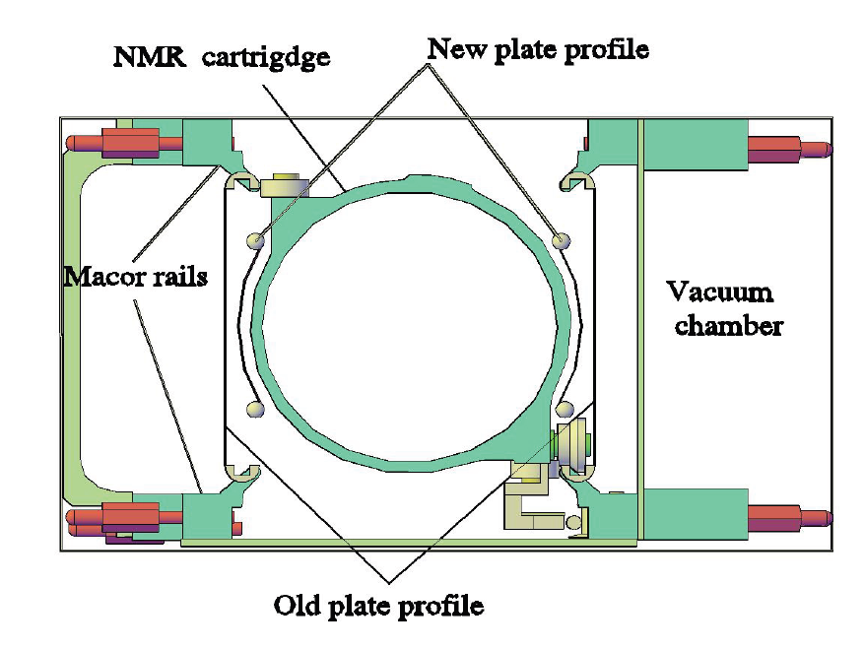

Slide 5
Kicker
Uniform field
e821 pulse shape (RLC)
dependence on b-field
Optimum << 210 G

Slide 6
Uniform kicker field
Square pulse with 150ns width
Dependence on b-field
Optimum at 240G

