Slide 1
KICKER STATUS
G-2 meeting
March 5, 2014

Slide 2
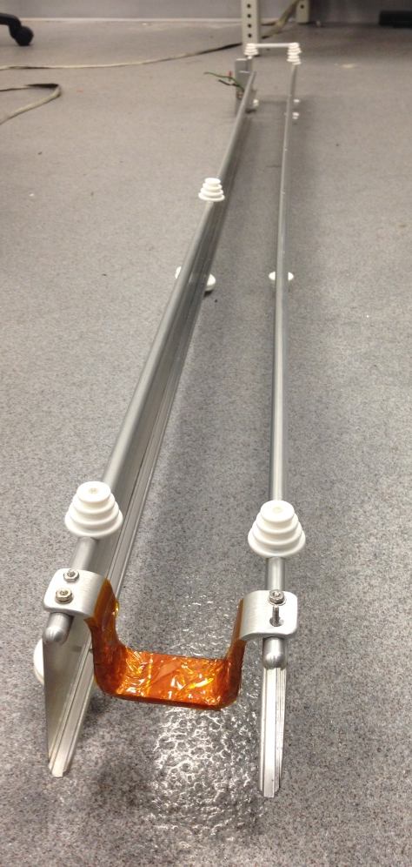
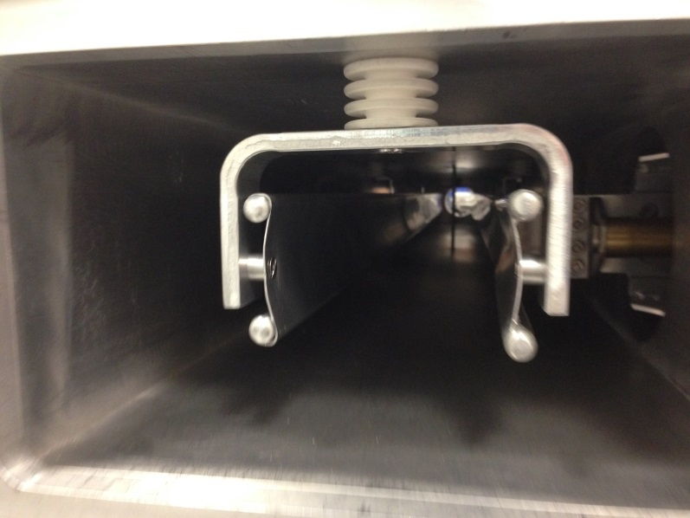
CALCULATIONS OF 3D FIELD CONTINUED
the goal is to know the filed integrals through entire kicker, including the fringe fields.
E-989 jumper; will be much thinner
E-821 Model jumper;
In real kicker it is straight

Slide 3
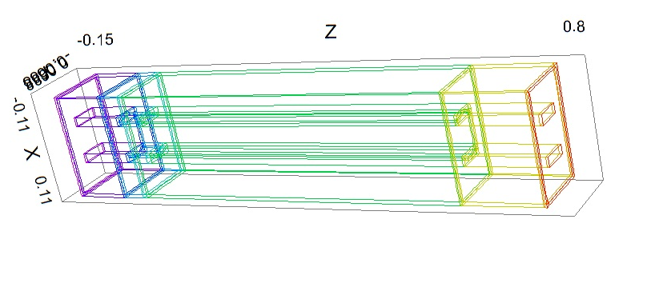
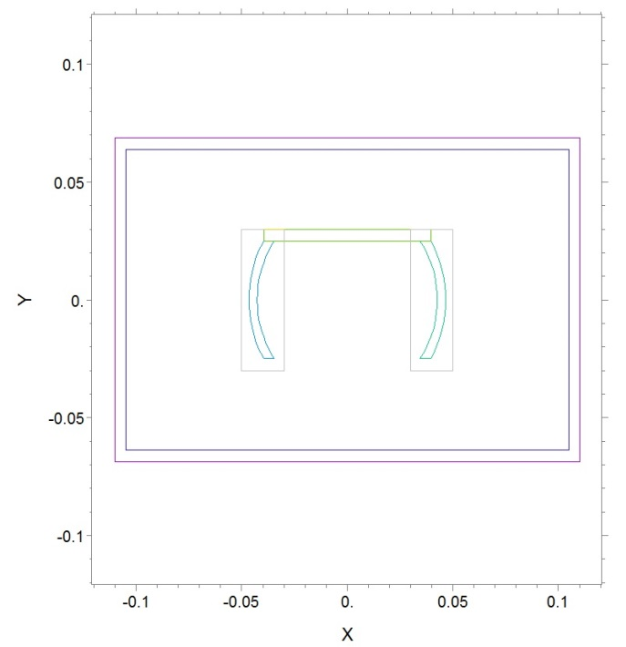
3D simplified model in FlexPDE
Regions with denser
mesh
Input plane with a gap in plate at one side
Simplified jumper;
shape will be adjusted
Length of model reduced to ~80 cm for lowering the number of nodes in a model;
slightly asymmetric in z

Slide 4
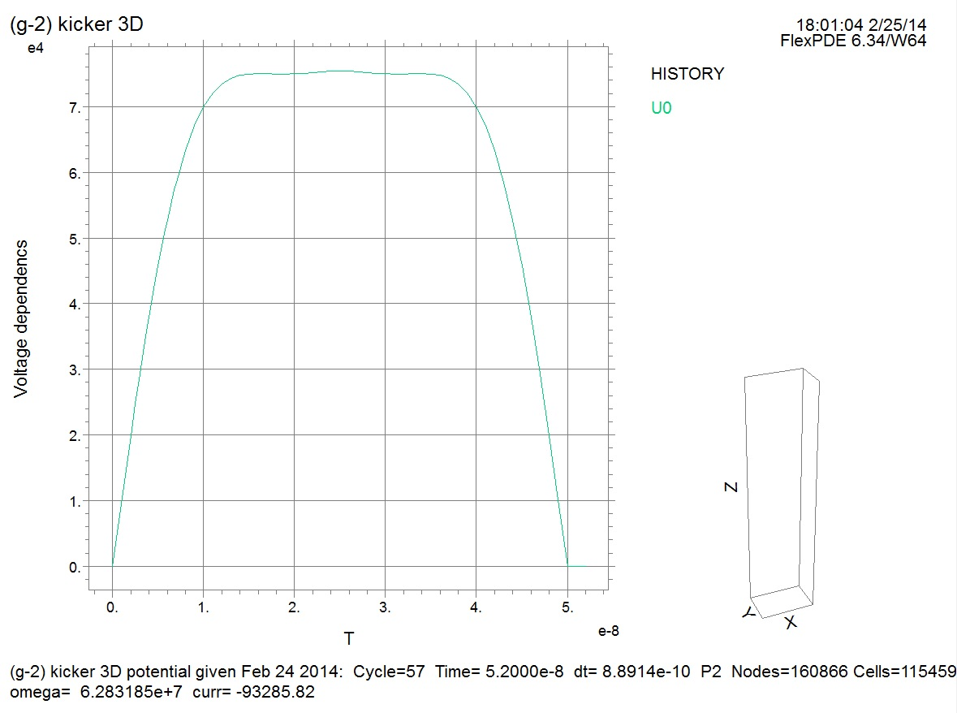
Voltage applied to the gap in the kicker loop
50 ns

Slide 5
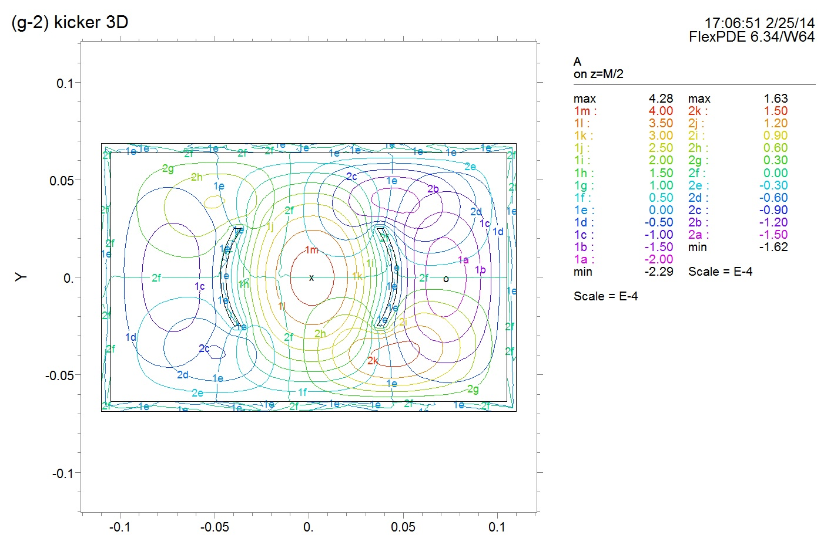
Components of vector potential during the pulse rise
Dimensions are in meters –here and below

Slide 6
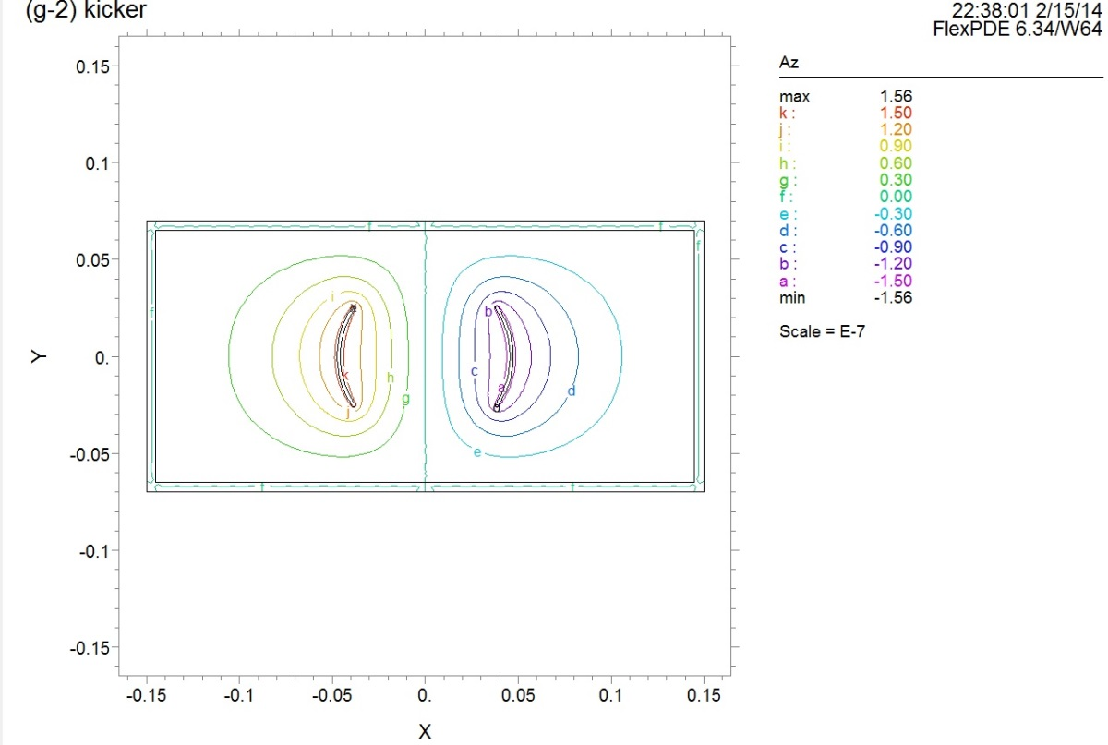
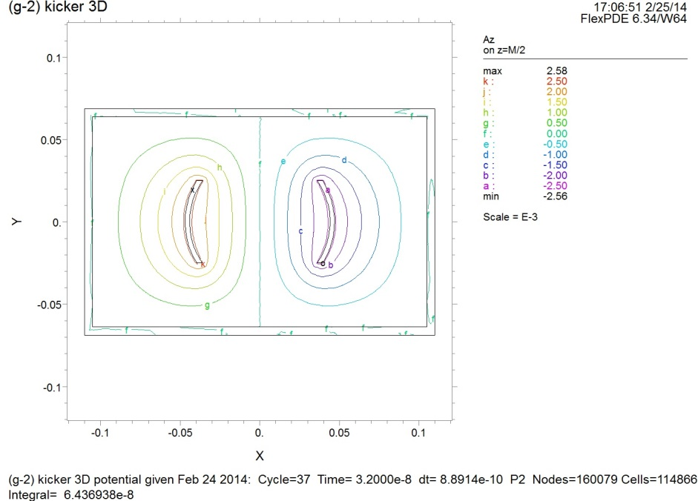
Calculation carried with 2D/3D FlexPDE
Time dependent case, exciting pulse with τ ~ 50 ns
3D
2D
Lines of magnetic field
Chamber cross section is slightly different in 2D and 3D model –just historically

Slide 7
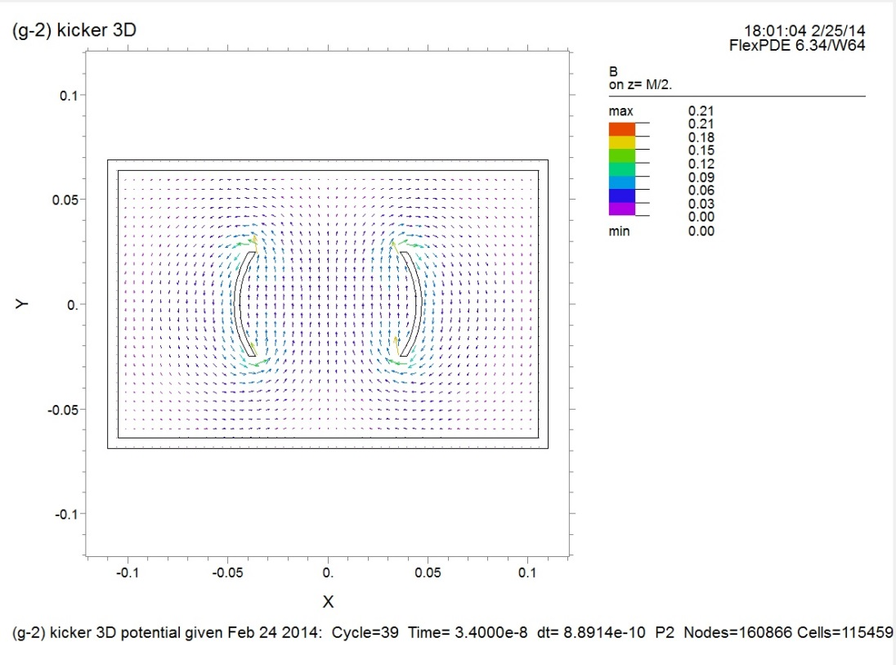
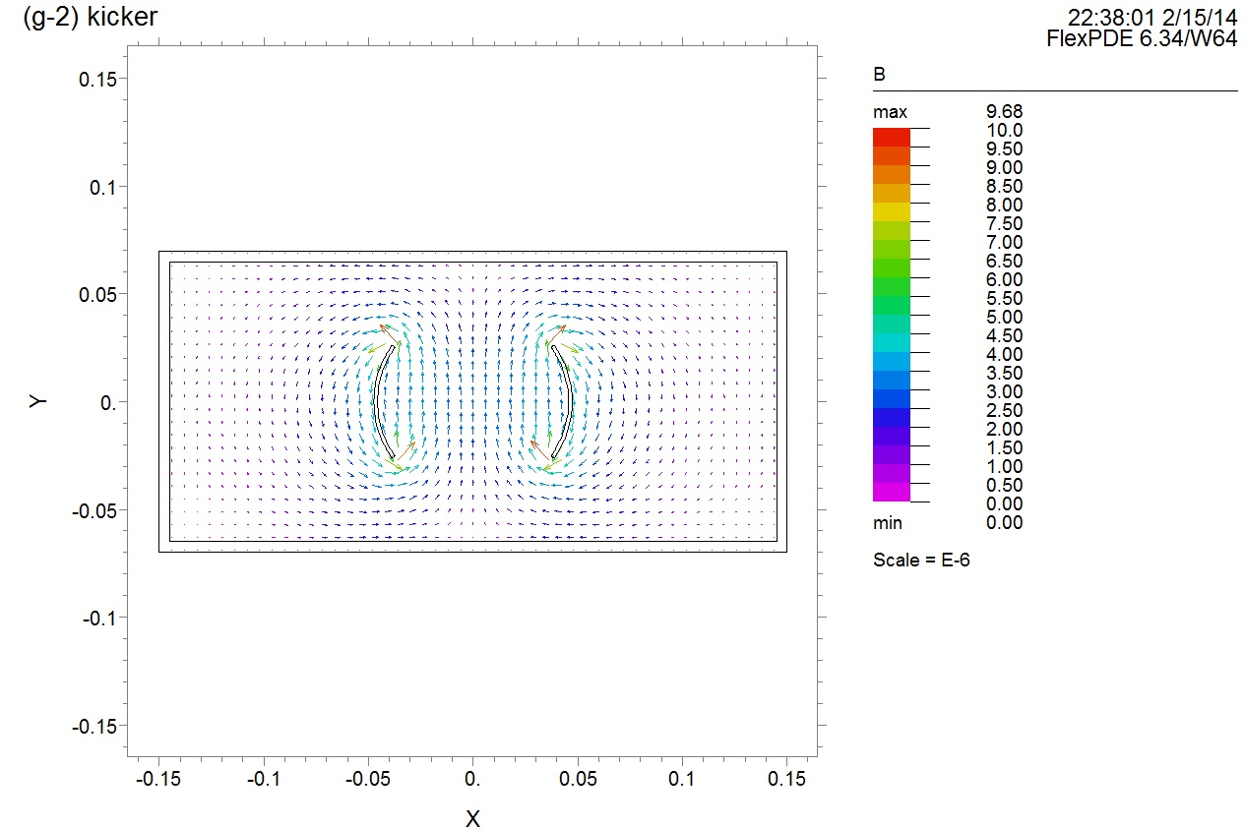
Vector fields for 3D and 2D kickers

Slide 8
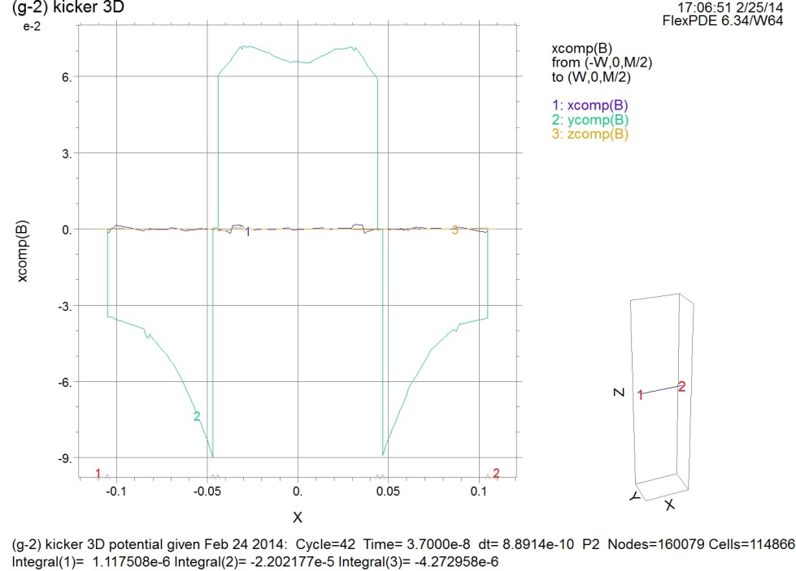
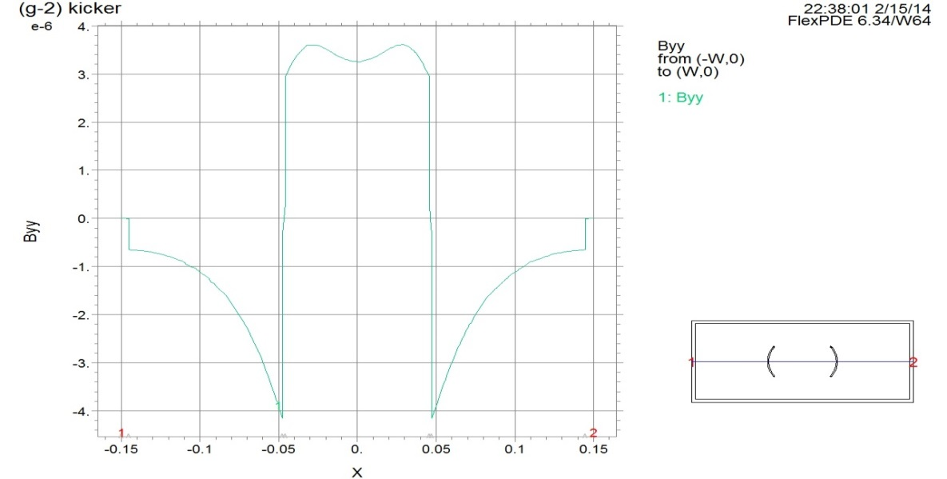
Elevation of vertical component of the field across the chamber for 3D
←
Elevation of vertical component of the field across the chamber for 2D
→

Slide 9
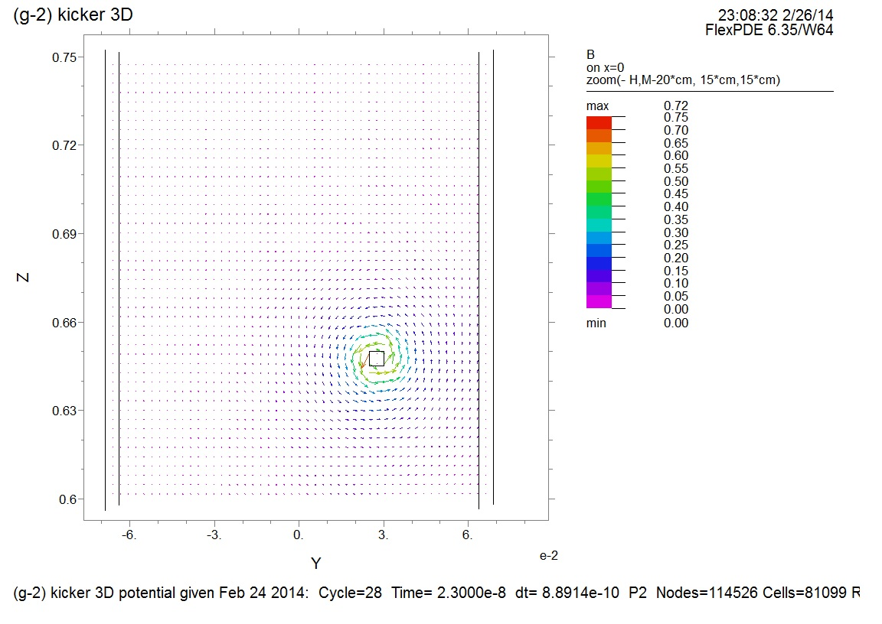
Field around the jumper bar
Median plane
meters
meters

Slide 10
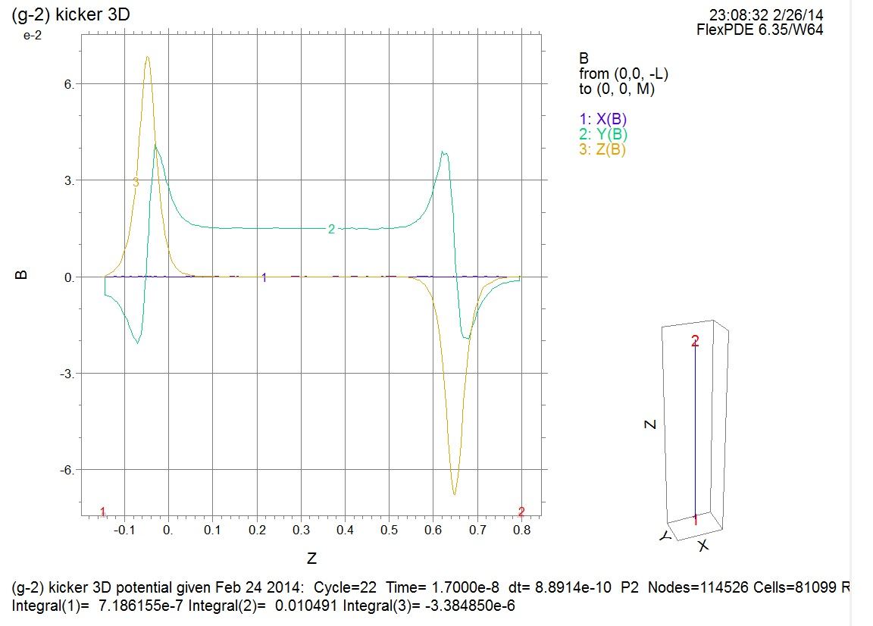
Elevation of Bx, By and Bz along z (central line)
By (vertical working field)
Bz; this component rises substantially while trajectory is higher; ~1/r law
But integral of Bz is below 1/1000 of main field, By integral
Integrals of field components along z-axis

Slide 11
In a future it will be possible to generate the 3D field map for the regions around the jumpers
Model will be developed further
We expect some (not big likely) perturbations of the beam motion by the fringe fields, however –the reason is that the beam current is rectangular to the current running in a jumper

Slide 12
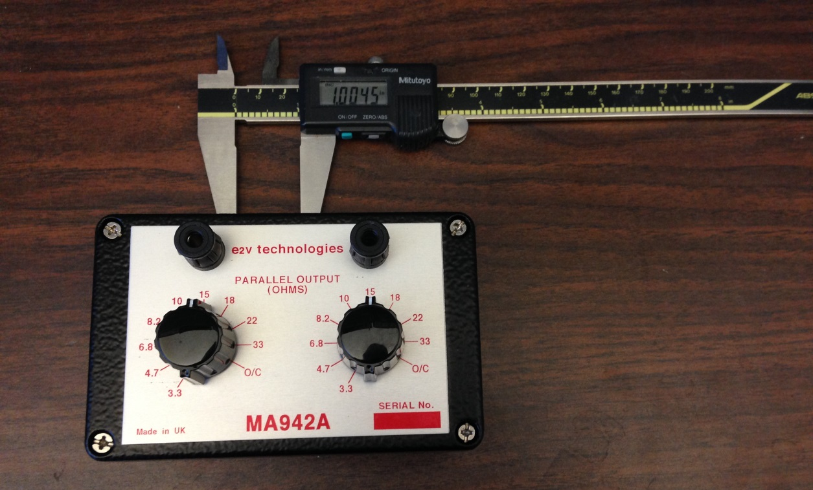
HARDWARE
Resistor block serving for precise regulation of heating
Arrived Feb 14 2014

Slide 13
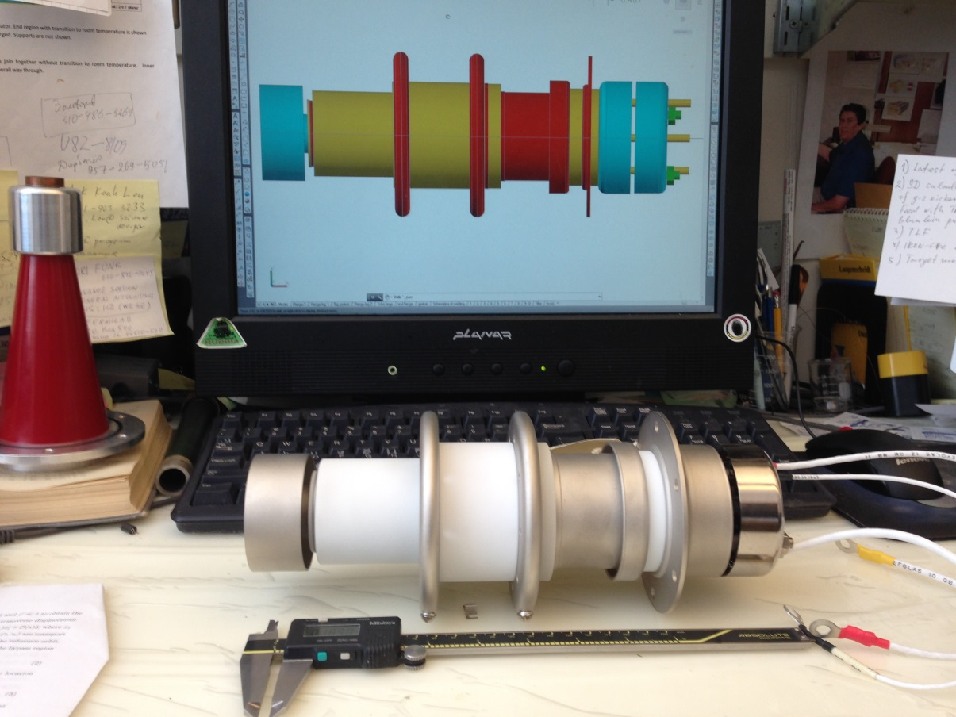
New thyratron CX1725X
Arrived Feb 28 2014

Slide 14
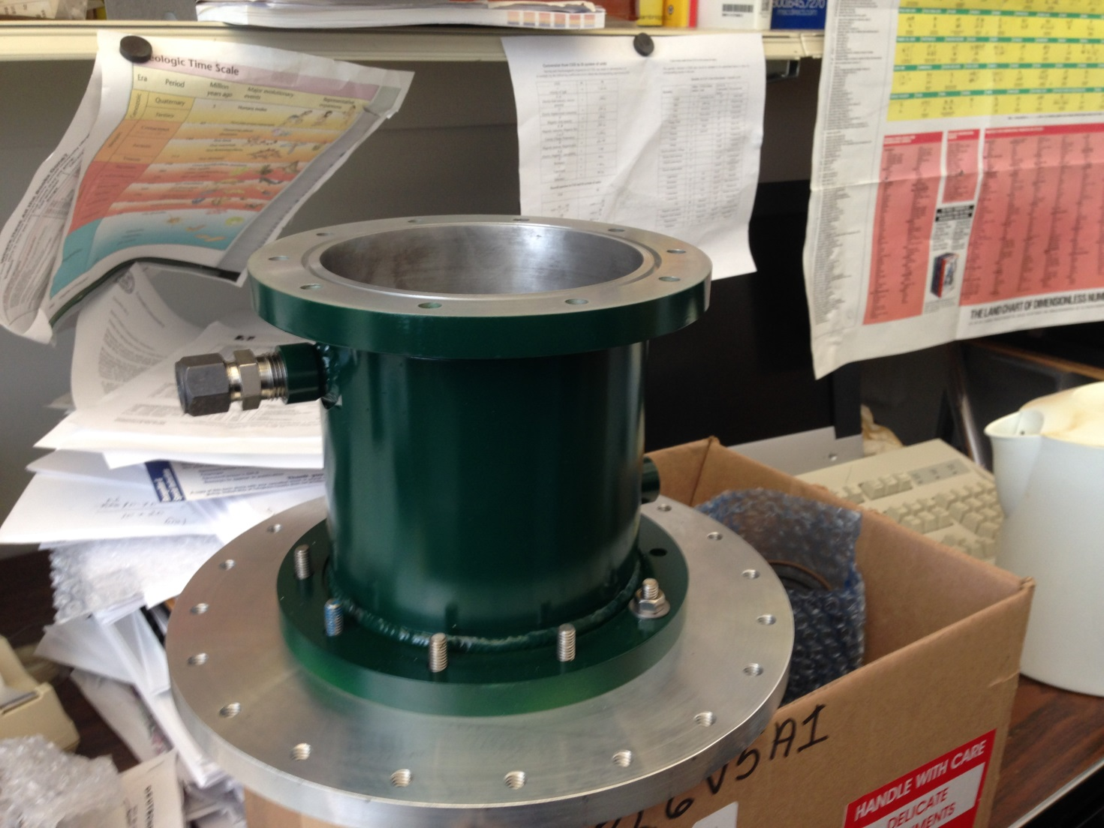
Housing for new thyratron with transition flange for testing in existing triaxial line
This housing will be used in a final design

Slide 15
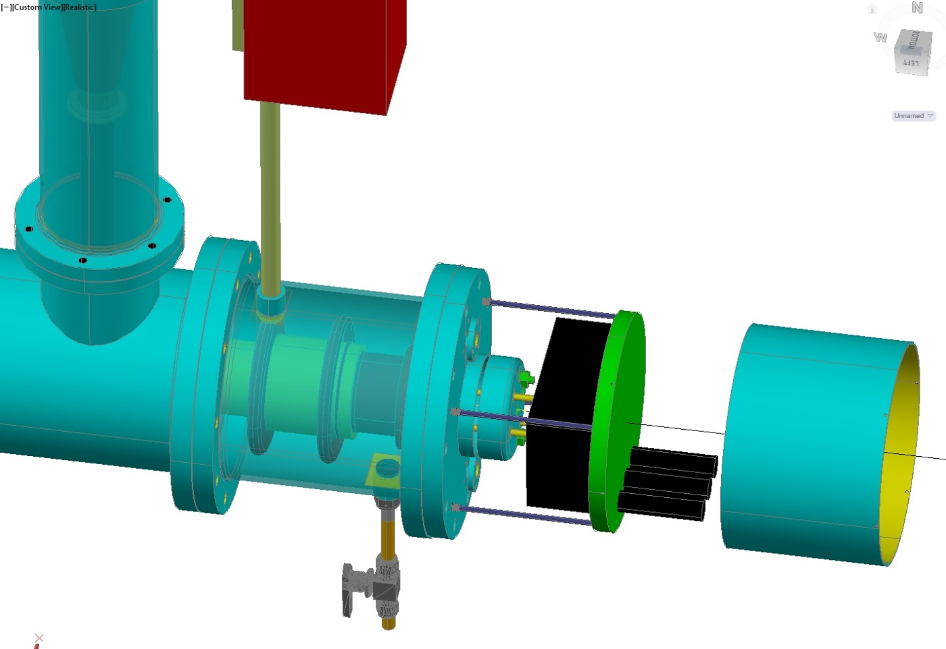
Resistor regulator for reservoir (from slide 12)
Triaxial line
Thyratron
Cover
Housing

Slide 16
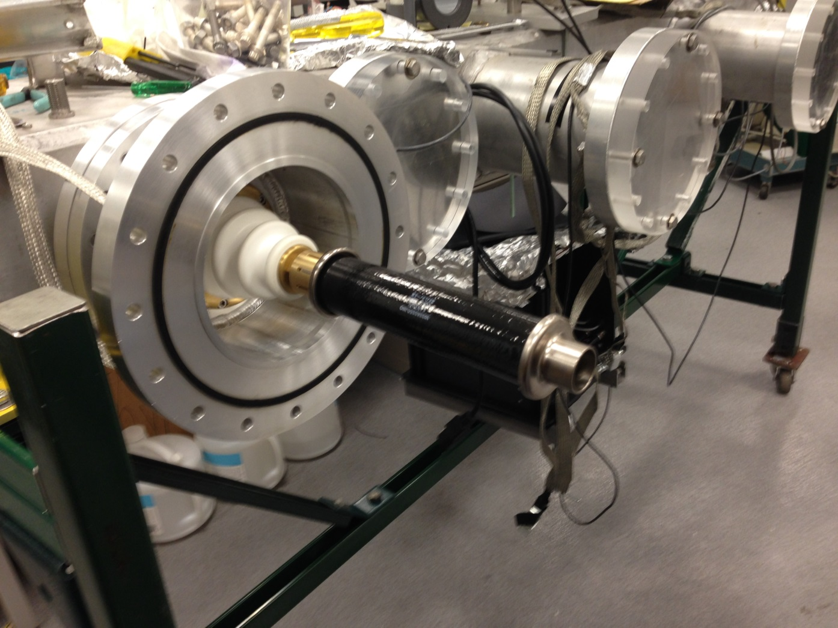
New load resistor
Arrived March 4 2014

Slide 17
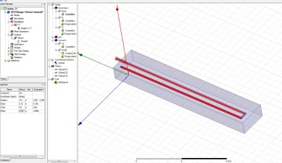
STATUS
Parts for insulating of pulser ground from the chamber are in a process of installation
New thyratron housing with transition flange is manufactured, the flange holding a thyratron itself is in a machine shop
Drawings for the final version of pulser and kicker - in progress;
Resurrected calculations with FlexPDE 3D; edge fields are under evaluation
HFSS code is in study
It is good to equip all inputs with T-ees -for easy change the kicker polarity
Plates for E-821 kicker are in hand, so measurement with the same coil and the same feeding current could be arranged in a future
Longitudinal field distribution for the fringe field evaluation will be done in a future

Slide 18
THE END

Slide 19
CURRENT/FIELD RATIO
Calculated on the basis of the field value at center with respect to the current density integral over the electrode cross section in each case
E-821: 1kA ←generates→ ~35 Gauss
E-989: 1kA ← generates → ~60 Gauss
This ratio reflects the difference in perimeters; one could see from slides #6,#7 that the field is about the same for E-821 and E-989, which means that the current density at the surface of a metal is the same.
(total current) ≈ (current density) x (skin depth) x perimeter
So E-989 is 60/35=1.7 times more effective for the field created per feeding current
3D calculations are in progress

Slide 20
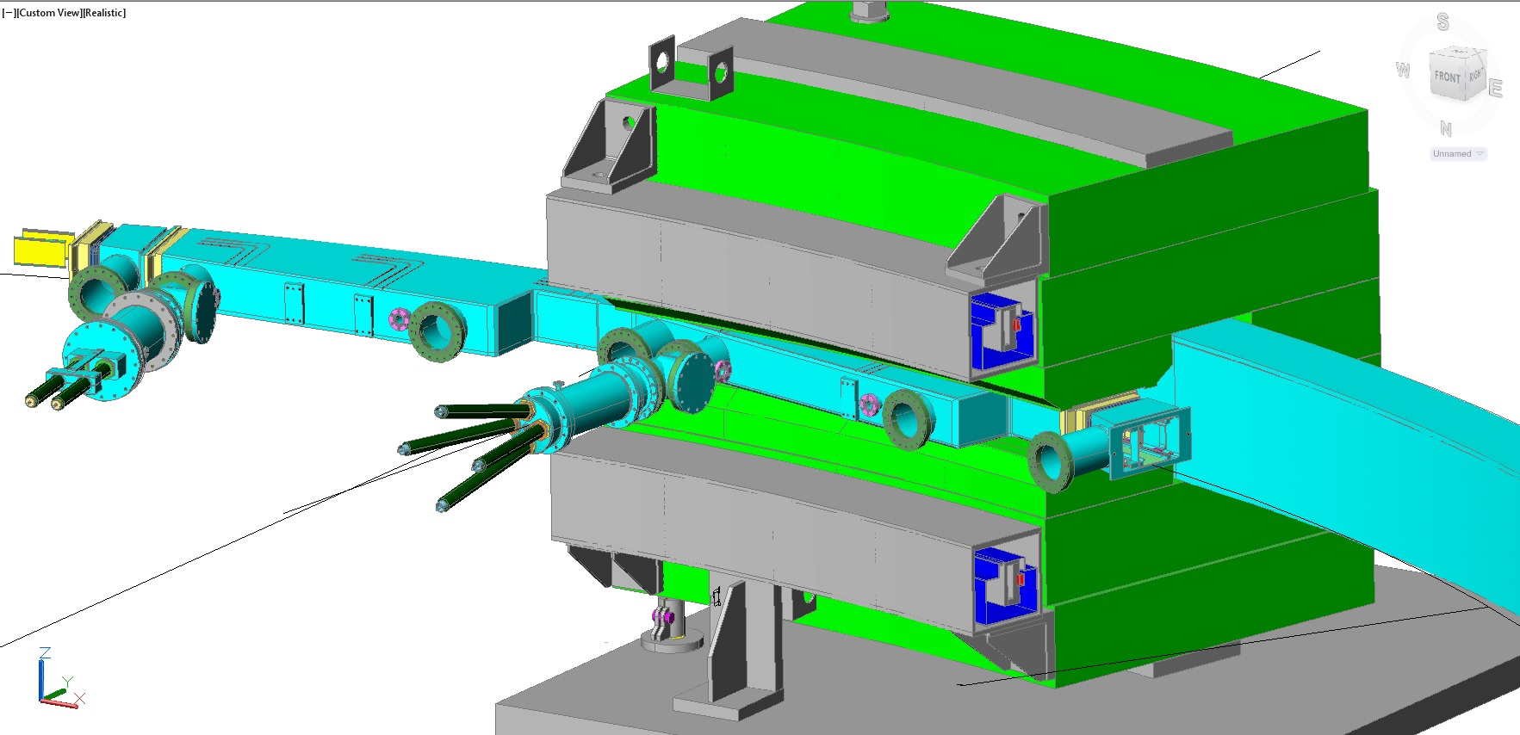
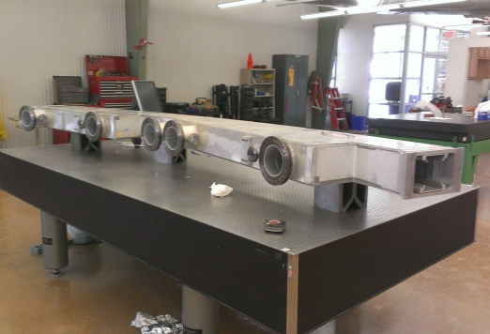
ADDENDUM
ABOUT POSSIBILITY TO SWITCH POLARITY OF THE KICK
Access to the commutation through the flange of T-jouint
These T-s allow switching polarity
without removing the chamber in ~1day

Slide 21
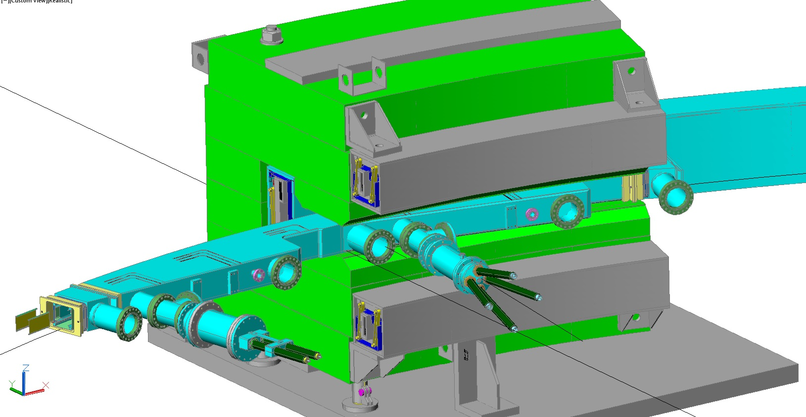
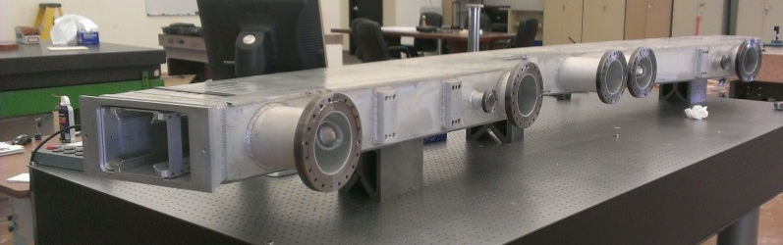
The flip of polarity might be required for run with negatively charged muons
T-ees

Slide 22
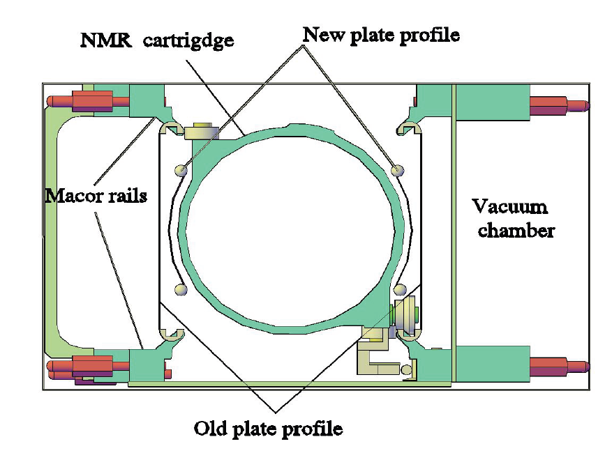
There is no room
for play with the shape
of plates

