Slide 1
Ring Injection Kickers
Collaboration Meeting
November 19, 2015
David Rubin for Alexander Mikhailichenko & SeungCheon Kim & Andre Frankenthal

Slide 2
Kicker Status
Blumlein pulse forming network
Kicker plates and trolley rails
Power Supply
Controls
Trolley rails
Pulse characteristics

Slide 3
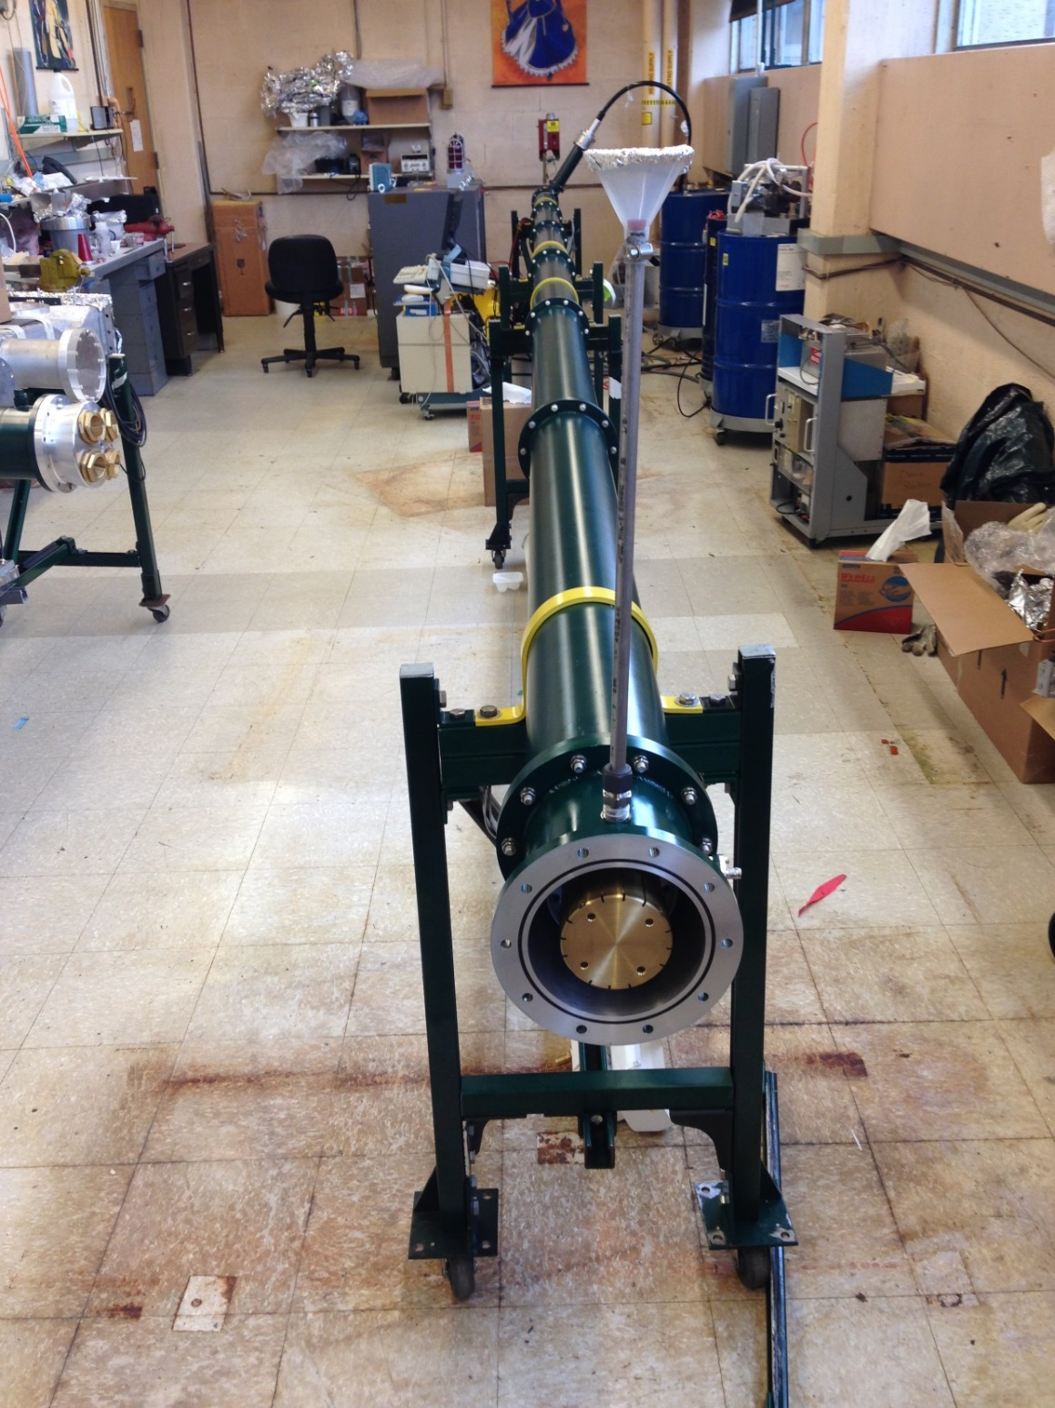
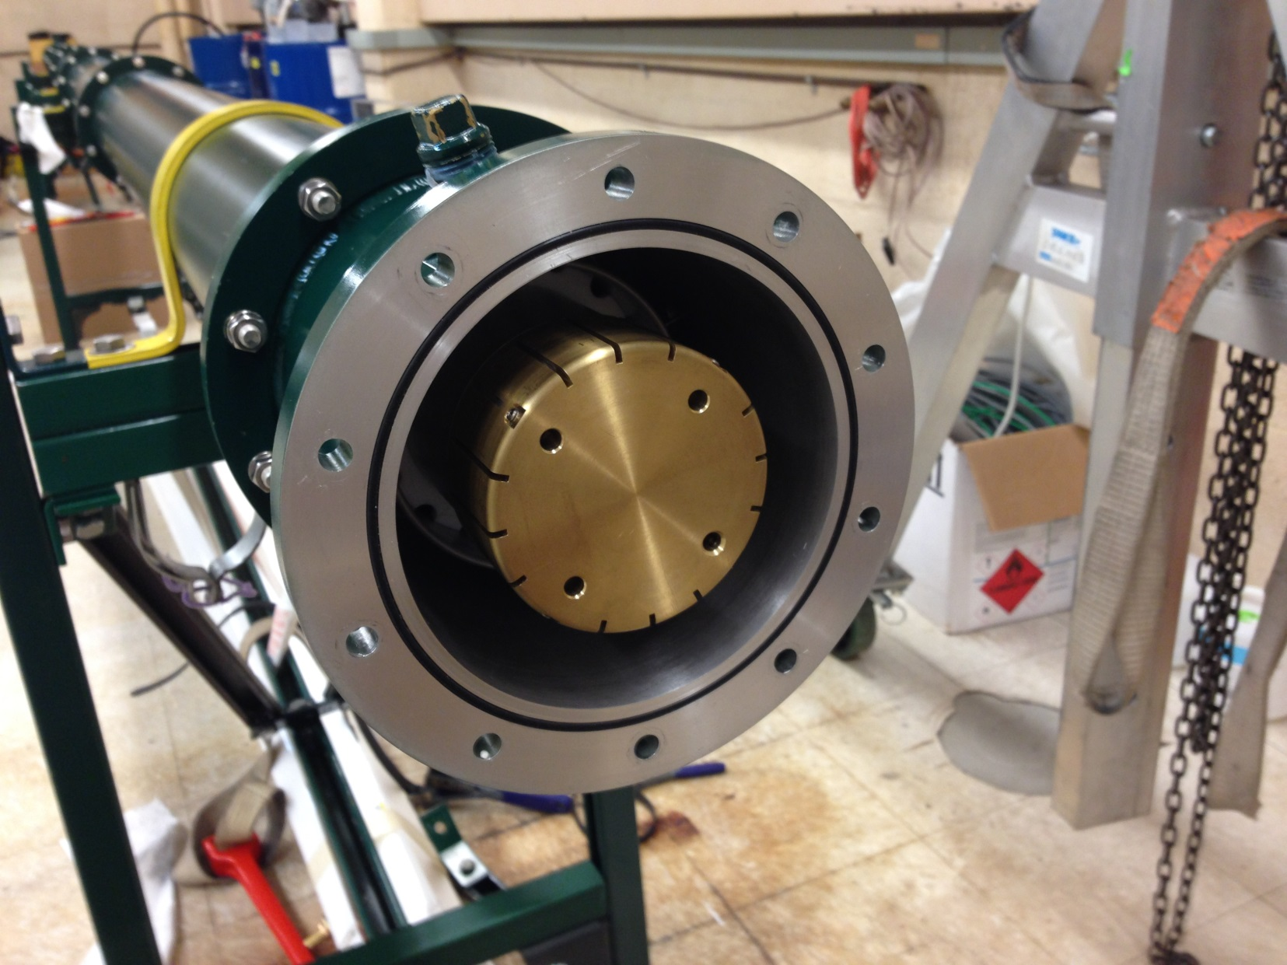
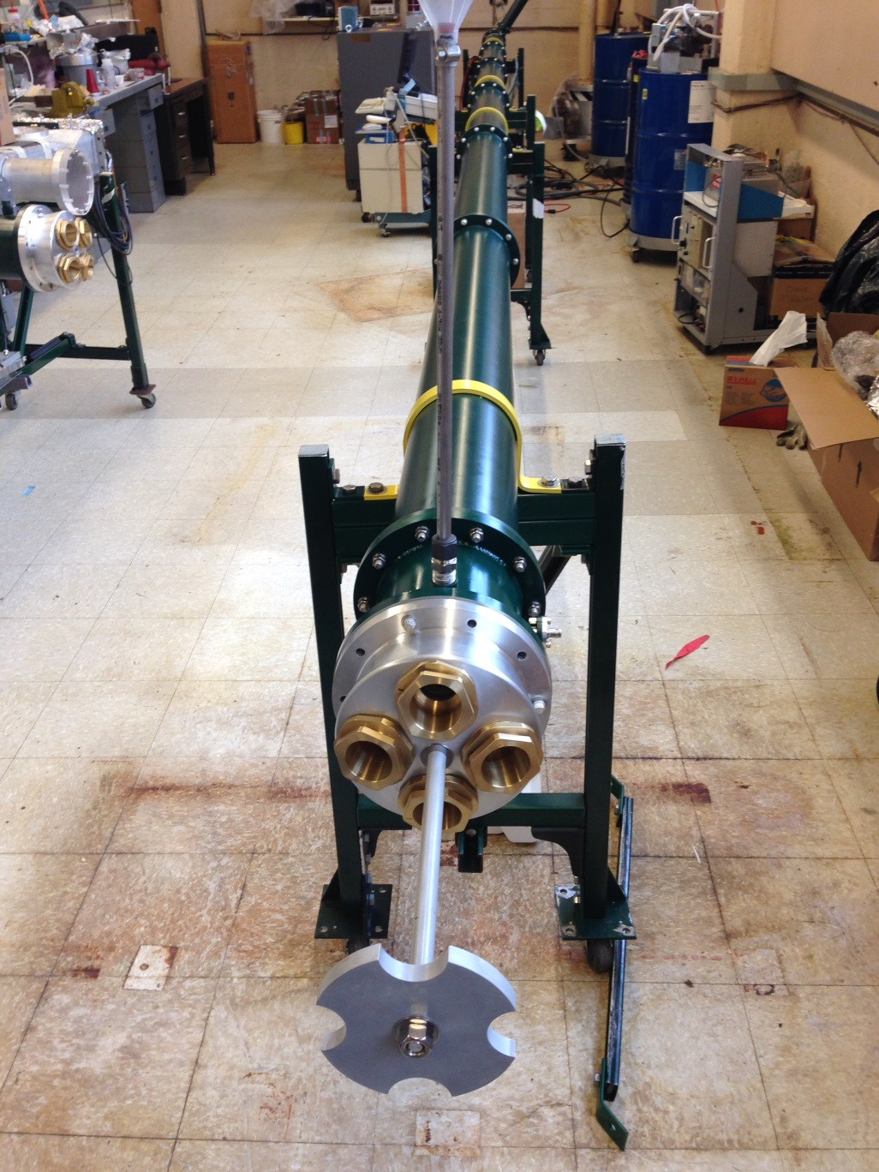
Blumlein
3-30 ft long triaxial tubes
thyratron
Coupling to 4 50Ω coax
Central conductor

Slide 4
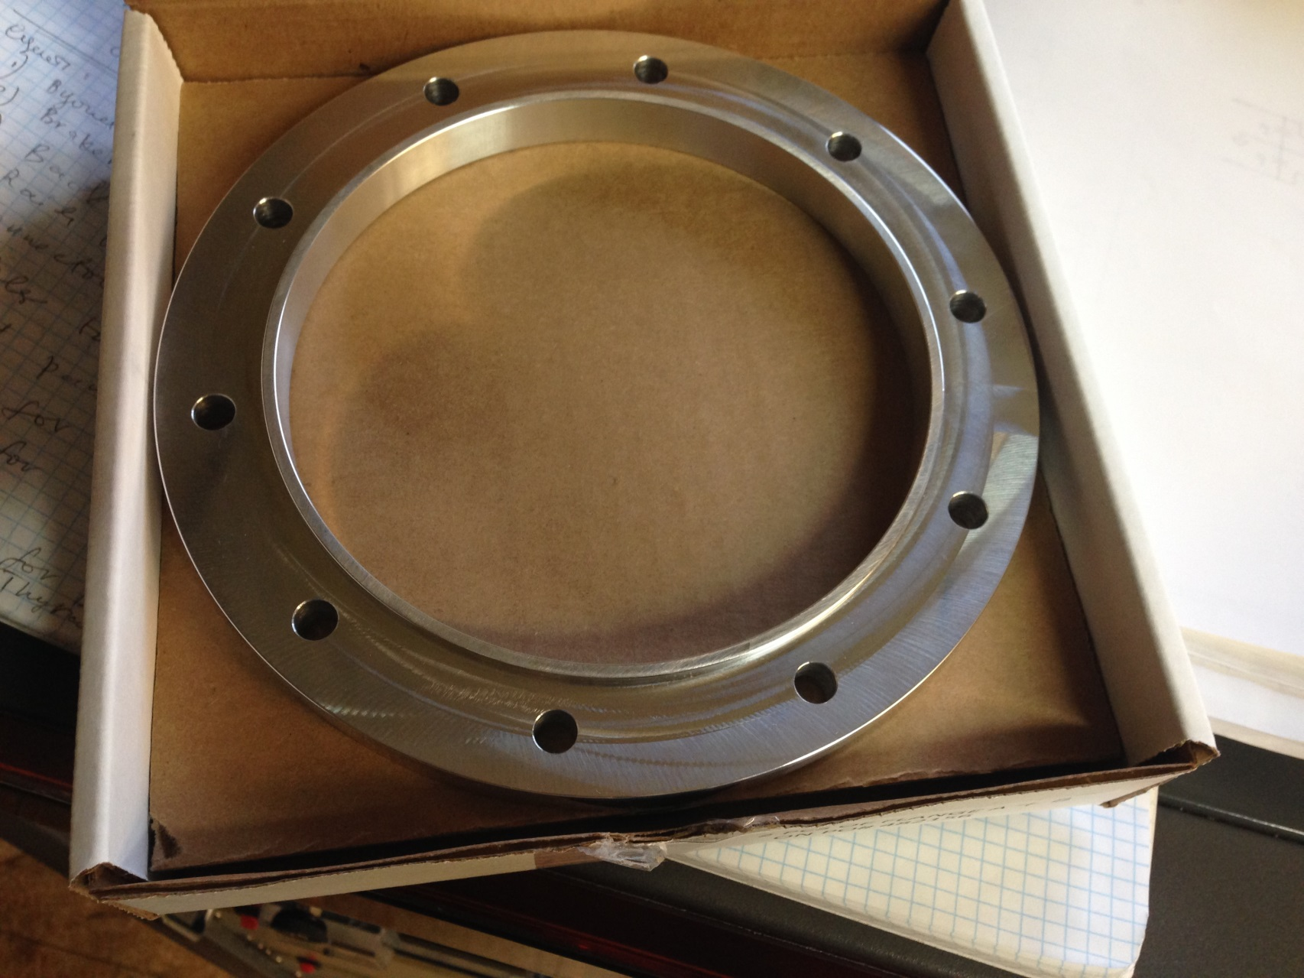
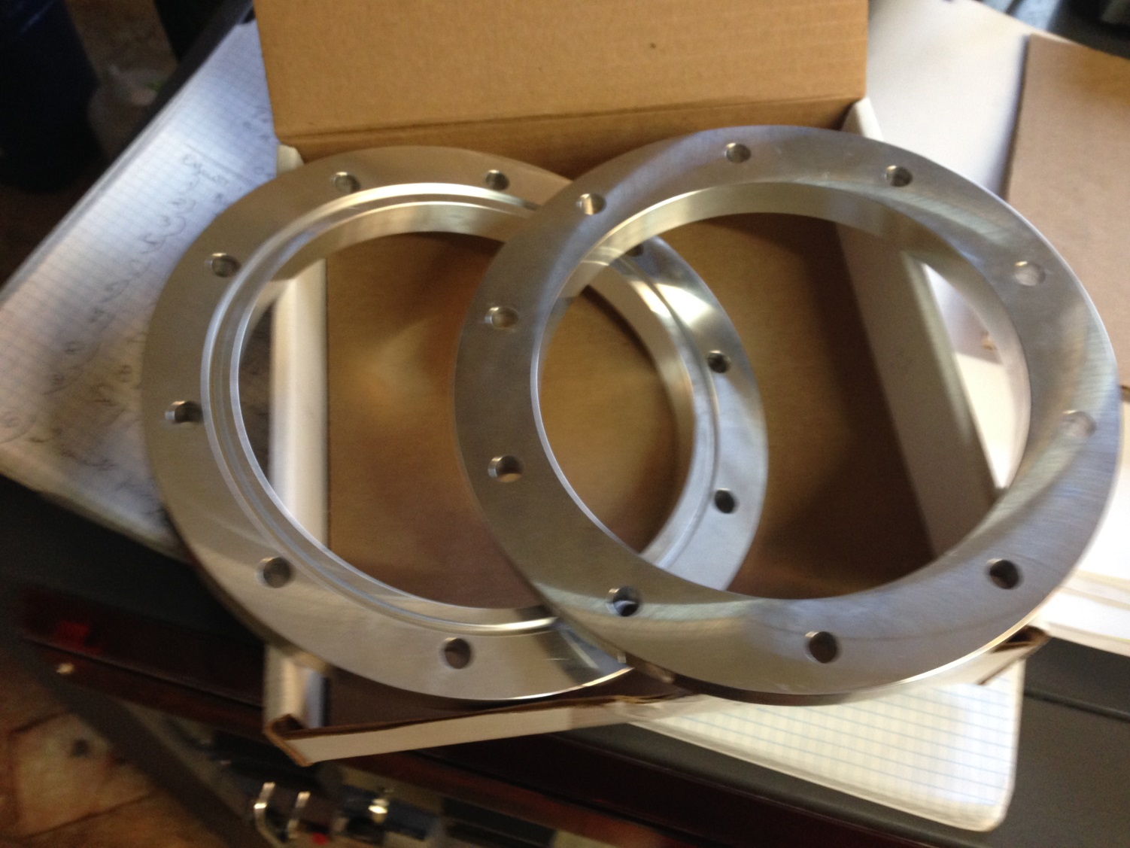
68 flanges manufactured by Hancock Precision Inc. received
Plan to place order for tubes in December
With radii fine tuned to improve impedance match

Slide 5
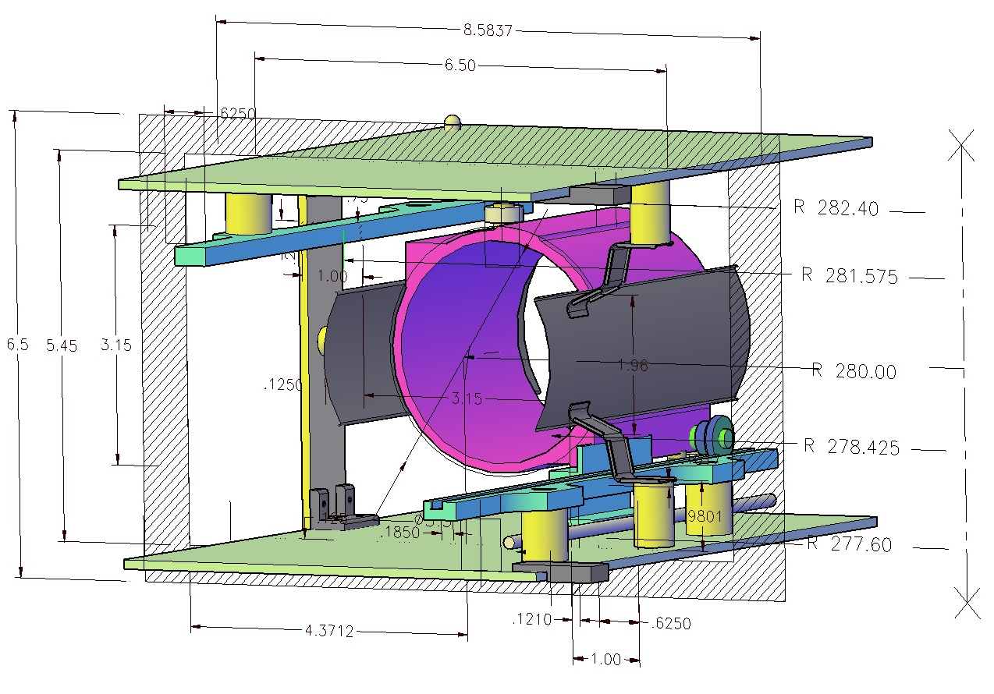
Kicker Cage – Plates - Rails
New cage for kicker plates

Slide 6
Kicker plates – rails - trolley

Slide 7
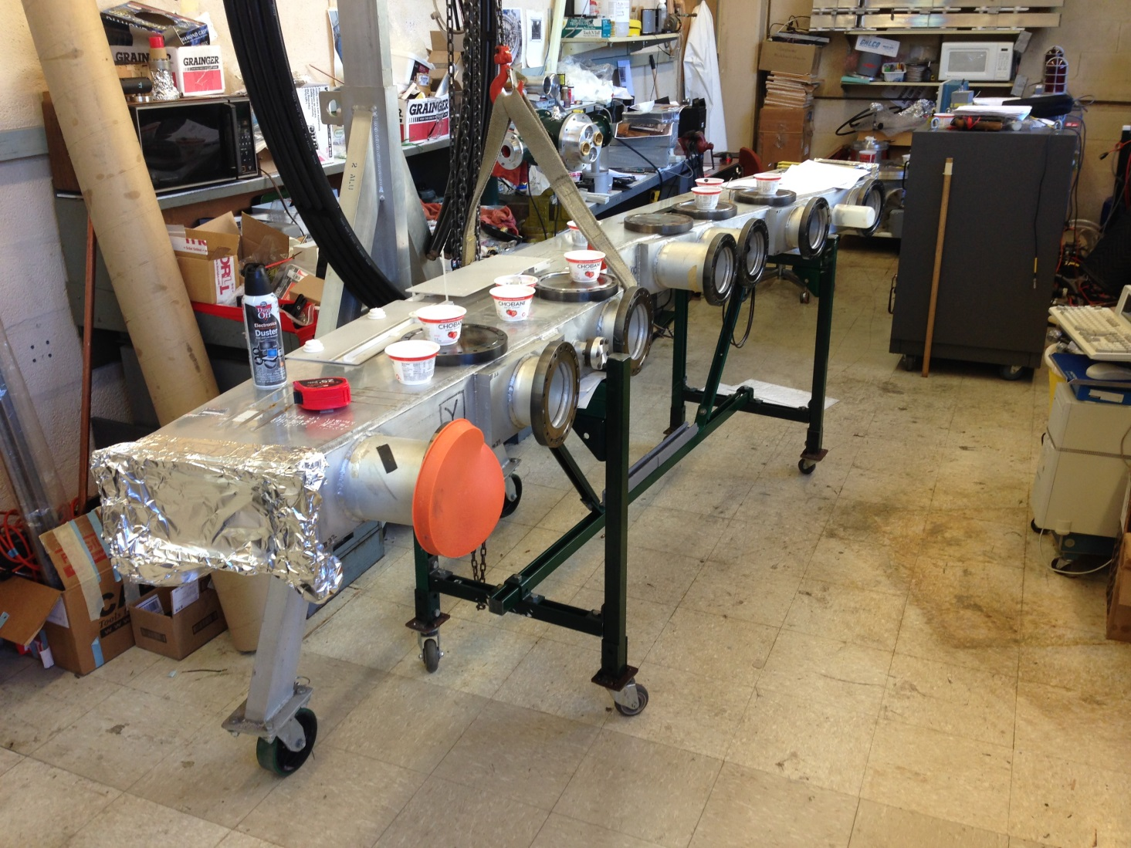
System Test
Kicker cage, plate, rail assembly will be tested in g-2 vacuum chamber in December

Slide 8
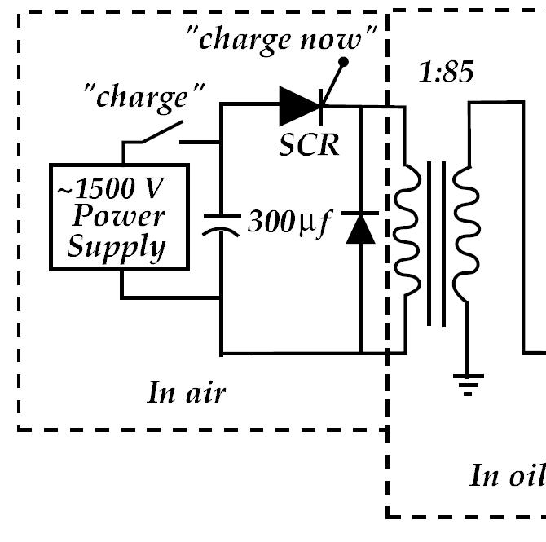
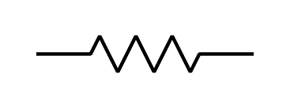
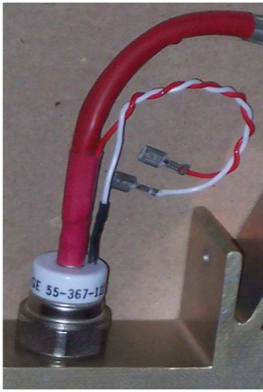
Power supply - Charging Circuit
thyratron
“Inhibit” input
5kΩ
40 kHz switching device
SCR — Silicon Controlled Rectifier -Thyristor
The time between “charge now” and the thyratron triggering ~ 2 ms

Slide 9
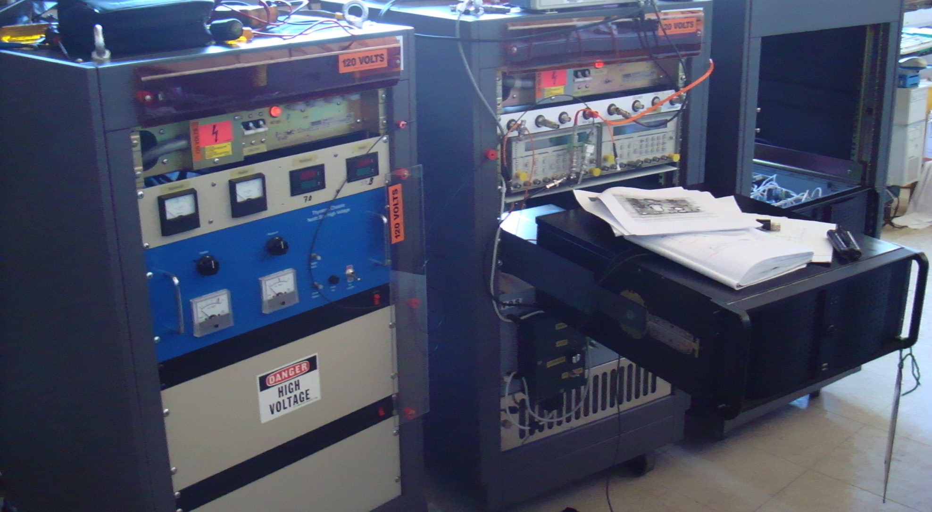
Electronics
For each of three kickers
Thyratron driver
(heater, reservoir, trigger)
Charging supply
High voltage supply
High voltage transformer
Thyratron
On hand at Cornell
1 thyratron driver (commercially available)
3 charging supplies
3 high voltage supplies
3 transformers (some modification required)
2 thyratrons

Slide 10
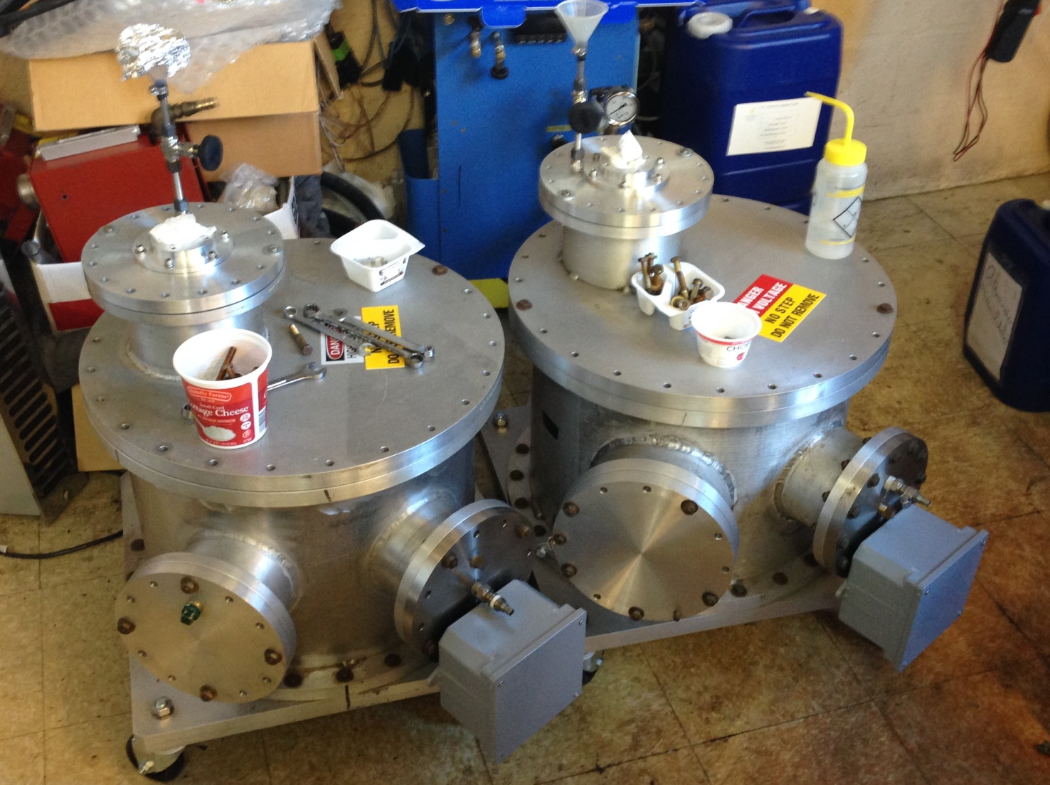
Transformer tanks

Slide 11
Kicker Control and Monitoring
Control
Thyratron driver - on/off
High voltage supply - on/off
Oil pump- on/off
Flourinert pump – on/off
Tunable parameters
Thyratron heater
Thyratron gas reservoir
Charging voltage (kicker field)
Triggers
High voltage inhibit (HV to capacitors)
Charging thyristor
(Cap bank to HV transformer)
Thyratron trigger
Monitoring
Thyratron heater current and voltage
and reservoir current and voltage
Blumlein charging voltage and
current(~100μs time scale) digitized
Oil flow
Kicker Current
And Kicker B-field (Cornell digitizer)
Interlocks
Oil flow
Thyratron heater timer
etc.

Slide 12
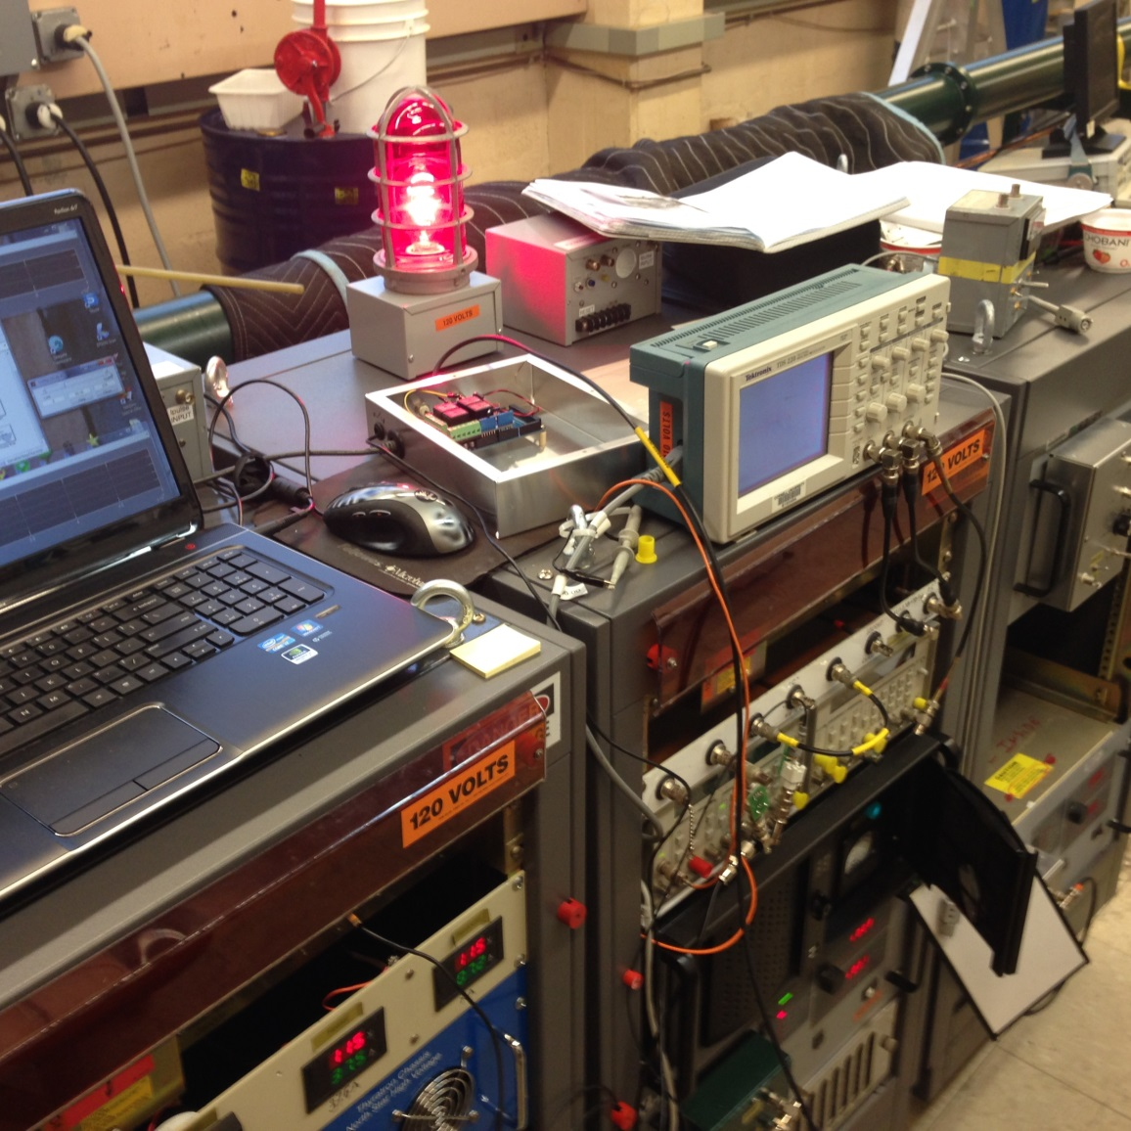
Remote control
Operational control from notebook via Arduino 2560

Slide 13
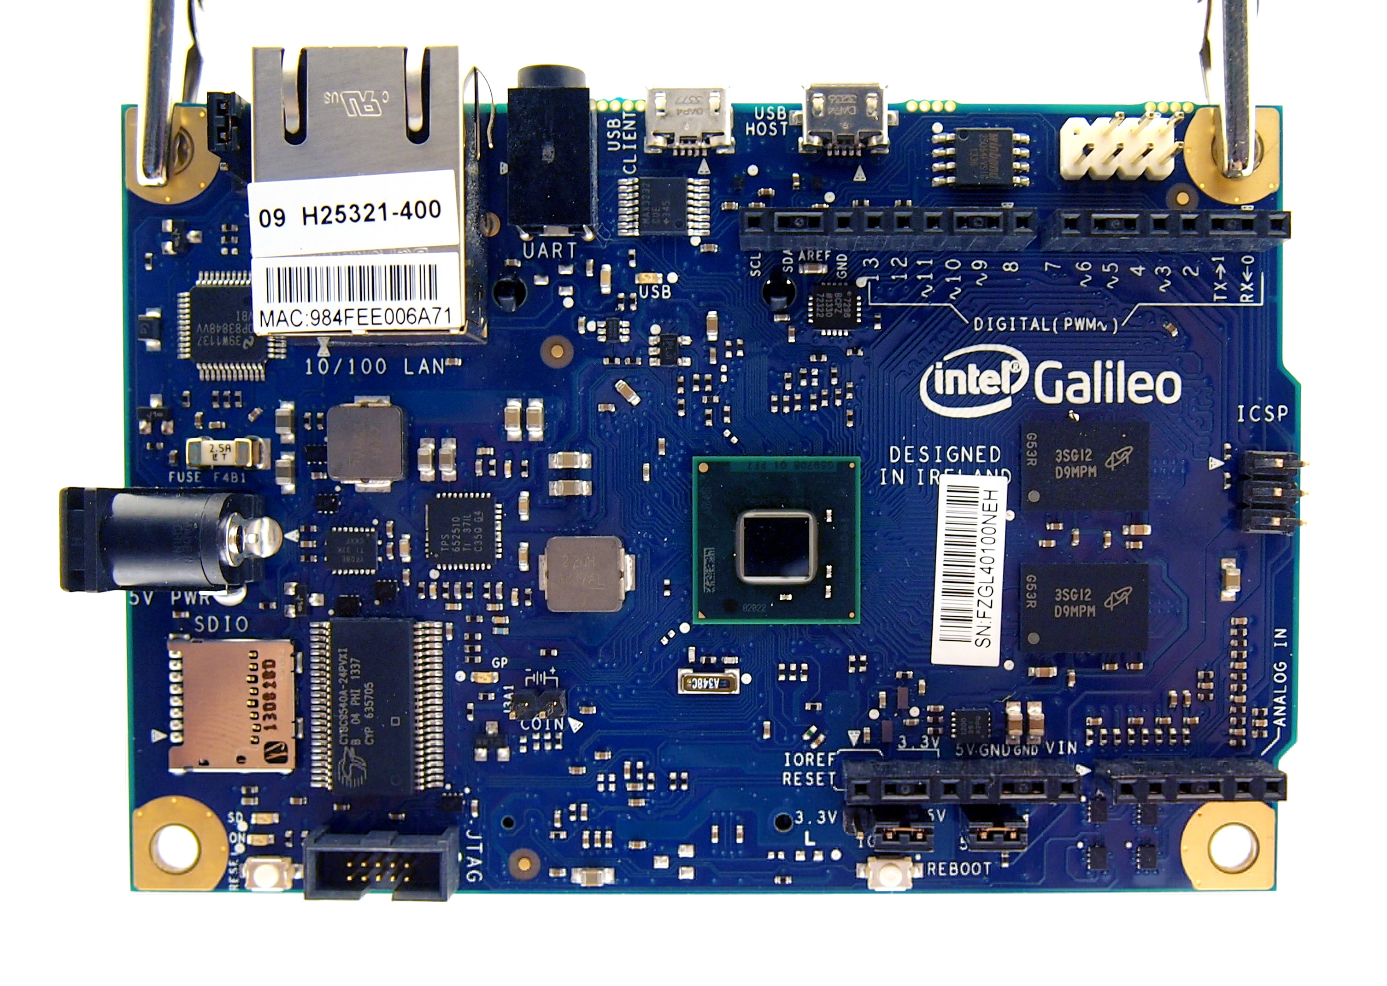
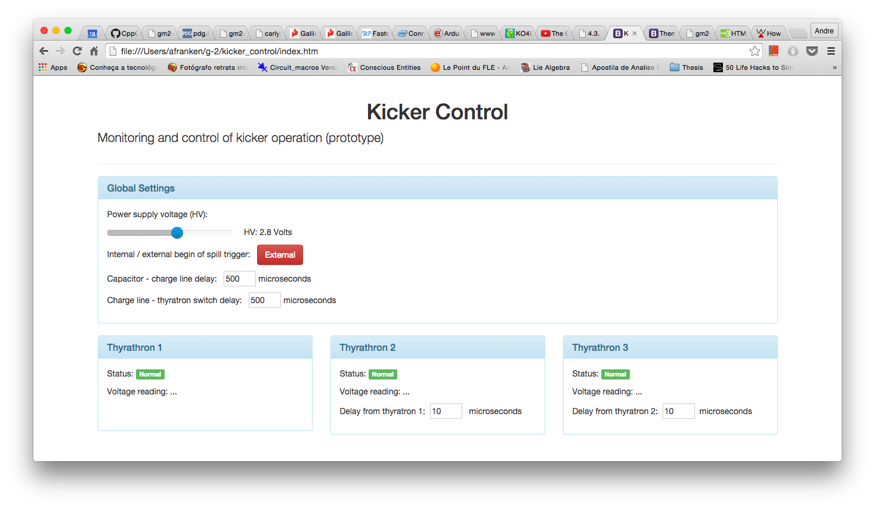
Control and Monitoring
Web interface to Intel Galileo microprocessor via ethernet

Slide 14
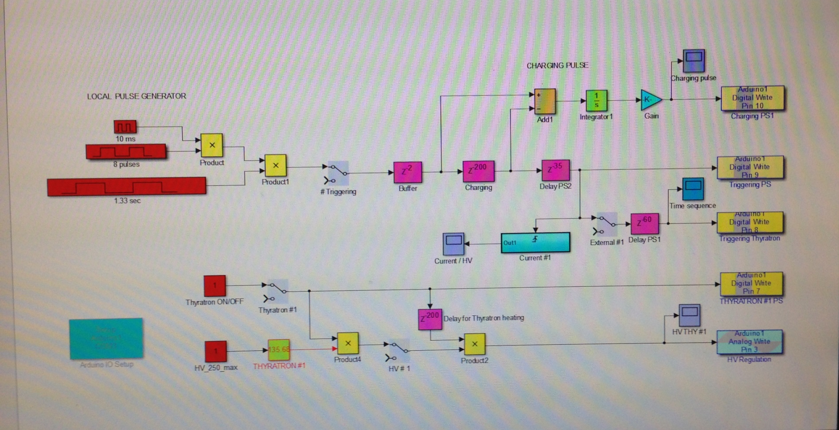
Prototype Microprocessor Control
Operating and programming panel
Arduino 2560

Slide 15
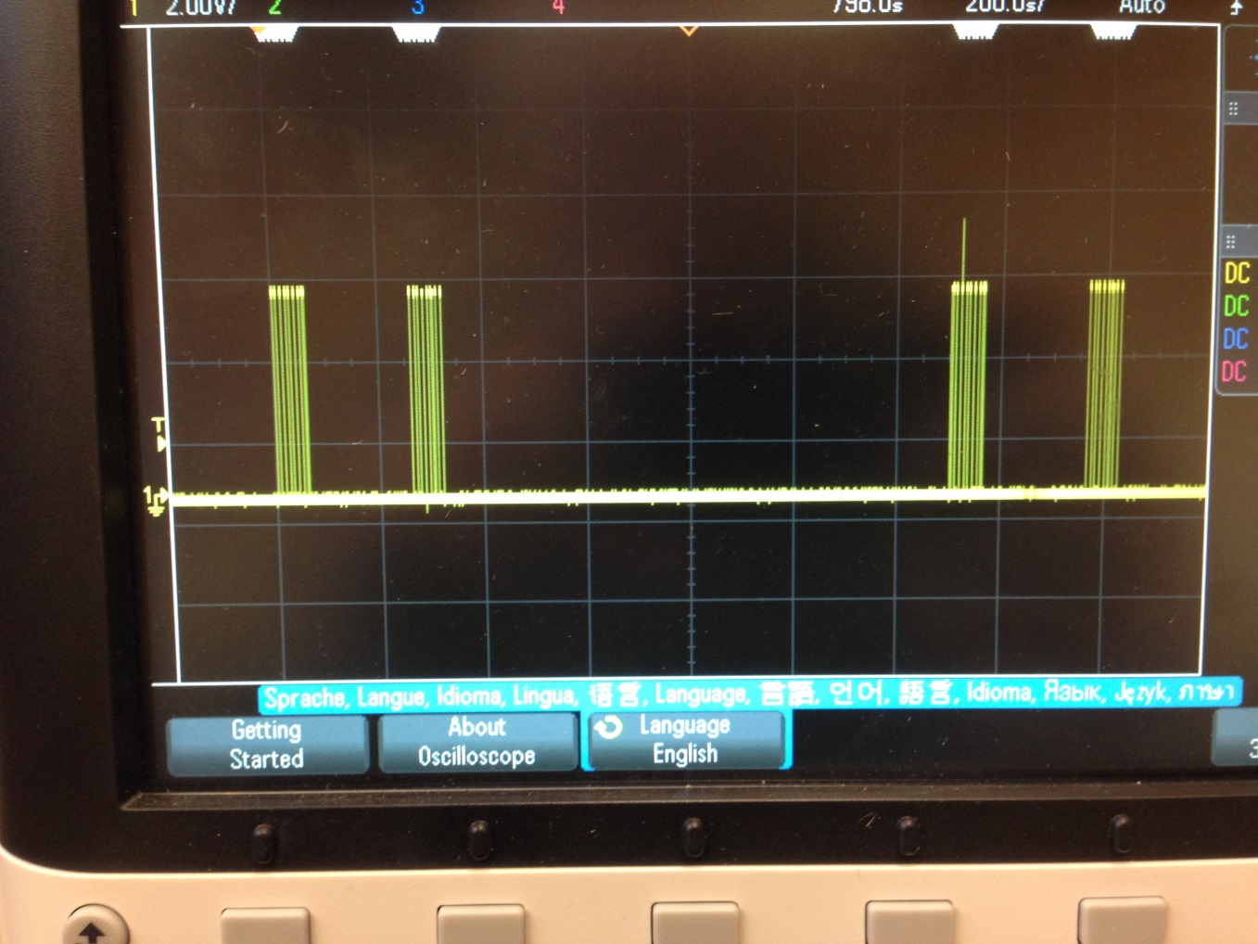
Trigger pulses
Trigger pulses programmed in microprocessor

Slide 16
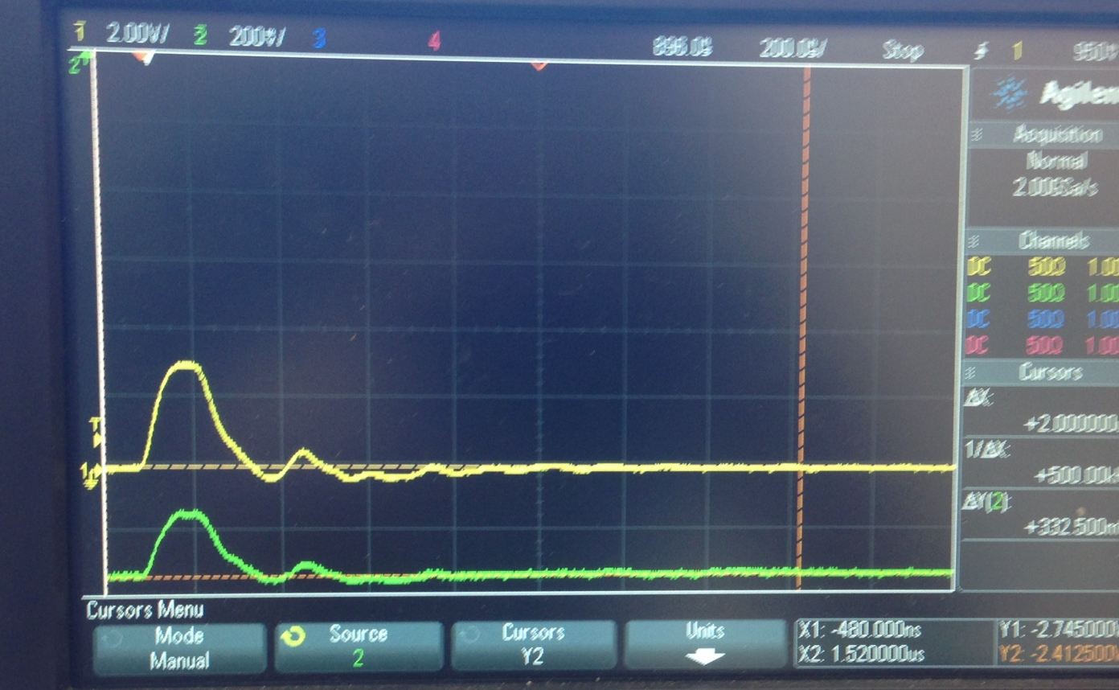
Kicker Pulse
100 ns/div
Pulse from current monitor (upper graph); optical monitor (lower graph).

Slide 17
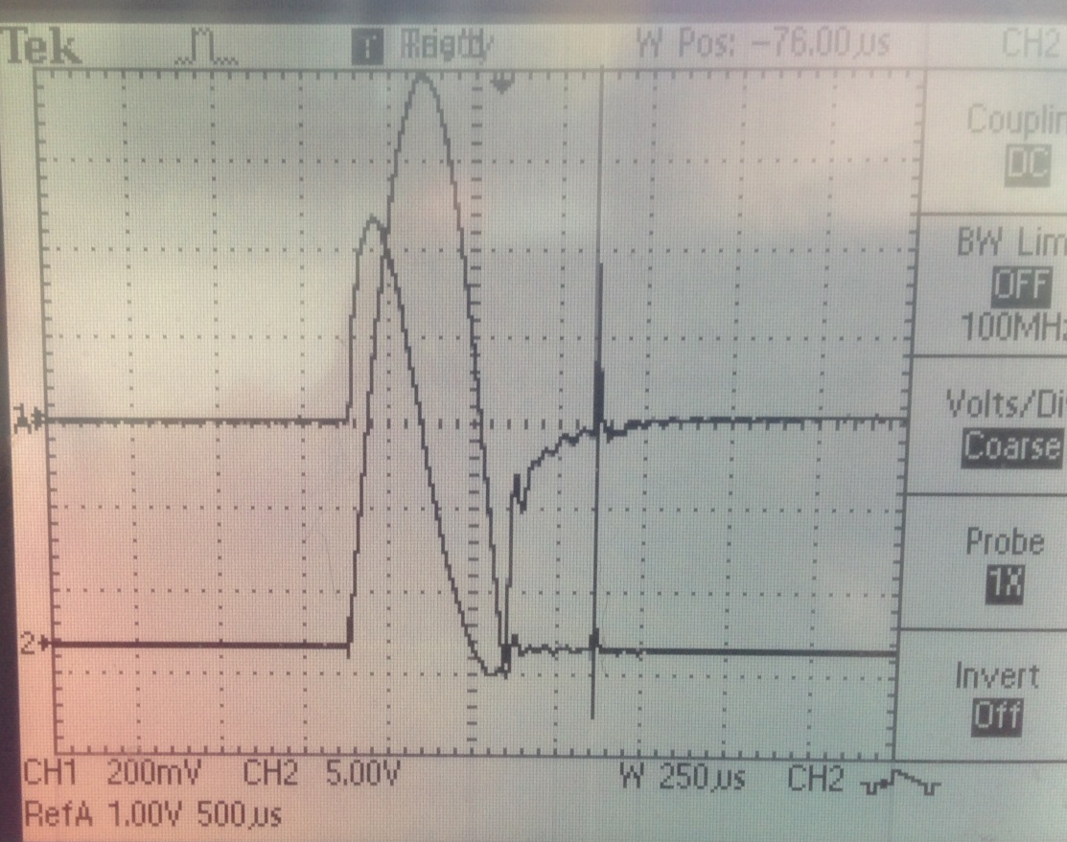
Charging circuit
Current in primary windings
(Power Designs CVT-1A)
Current in secondary windings
(Pearson 410)
Implement kilovac to cut off charging current through kicker?
Moment of thyratron triggering

Slide 18
Kicker pulse
Representation of kicker pulse for simulation

Slide 19
Kicker pulse
Test kicker effectiveness with simulation – compare 4 configurations
4-Uniform field/120ns rectangular pulse (ideal)
3-Curved plates/120ns rectangular pulse
2-Curved plates/measured pulse less tail
1- Curved plates/ measured pulse with tail (actual)
Capture efficiency reduced 17% due to imperfections of kick

Slide 20
Impedance Matching Tuner
Proposed Impedance matching tuner
Includes resistor ( ~ 500 Ω) and capacitance or diode

Slide 21
END

Slide 22
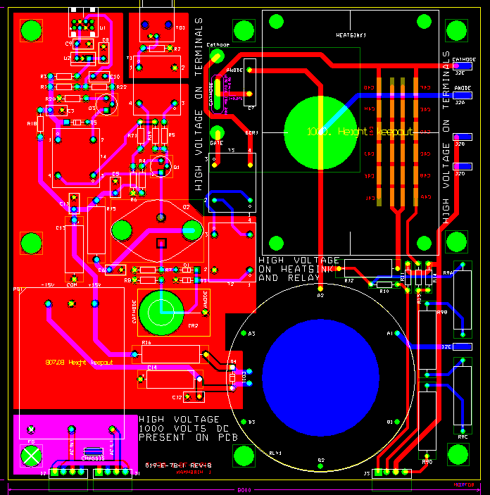
New pulser plate made for replacement of pulsed PS lost at Fermilab

Slide 23
Storage Ring Kicker Requirements
Kickers steer injected muons onto the closed orbit of the storage ring
Requirements:
Kick angle ~ 10.8 to 12.8 mrad
Kicker B-field ~ 285 to 336 Gauss
Integrated B-field ~ 1.11 to 1.31 kG-m
Pulse width(τ_{wid})
120ns < τ_{wid} < 149ns
Repetition rate
~100Hz peak, 12Hz average
3 – 1.3m kickers
τ_{rev} = 149 ns
d = 77 mm, R=7112 mm
kick angle θ = d/R = 10.8 mrad

Slide 24
Outline
Kicker WBS
Requirements
Kicker plates
Pulse forming network and thyratron
Power Supply
Pulse characteristics
Trolley rails
Commissioning Plan
Summary

Slide 25
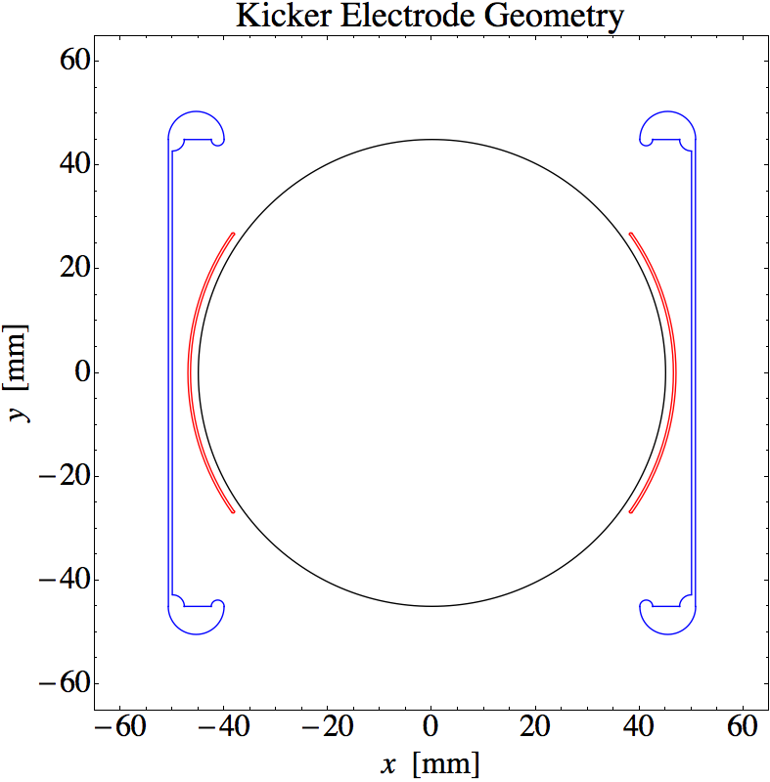
Kicker Plate Design - amplitude
The total length available for the kicker plates is 5.1m
Current travels down one plate and returns on the other.
Plate geometry must accommodate NMR trolley
The inductance of the plates limits the rise and fall time of the current pulse and inductance is proportional to length
(There were three independent 1.7m long kickers in E821)
Plate geometry determines B-field profile and dependence of midplane B-field on plate current
E989 plate geometry is optimized for maximum field
per unit current through the plates
E821 plates
E989 plates

Slide 27
Kicker Magnet
10.8 mrad kick corresponds to 1114 G-m
292 G for each of 3 - 1.27m long kicker magnets
0.4 mm thick plates
Magnet geometry => 65G/kA
=> 4.5 kA/kicker magnet
=> 56 kV on each 12.5Ω Blumlein and matched load
“New” larger aperture inflector” requires 12mrad kick
=> 62 kV / Blumlein

Slide 28
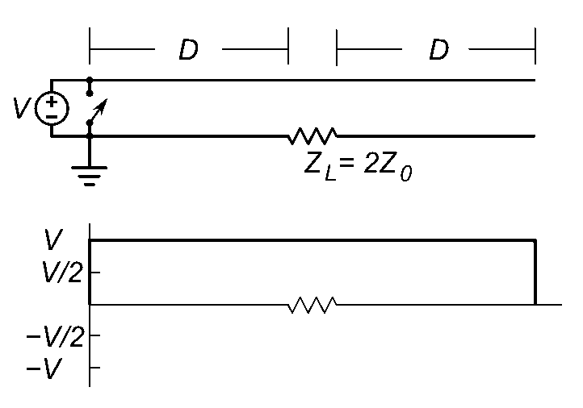
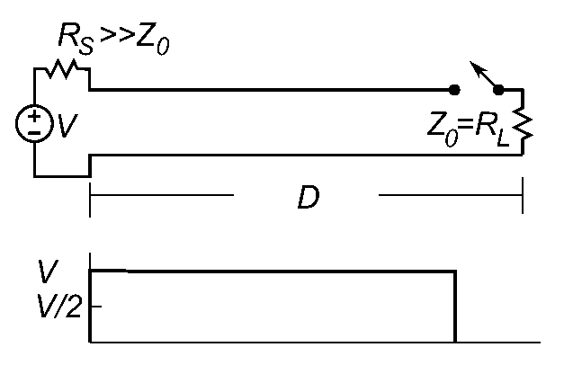


Blumlein Pulse Forming Network
Blumlein
voltage at load is equal to charging voltage
Base of switch (thyratron) at ground
Simple transmission line
voltage at load is ½ charging voltage
Base of switch floats
Pulse length

Slide 29
Blumlein Pulse Forming Network
insulator
thyratron
D = 9m
= 4.7 (Castor oil)
=> τ = 120ns

Slide 30
Blumlein – matched load - magnet

Slide 31
Blumlein schematic
12.5 Ohm Blumlein
Four parallel 50 Ω coaxial cables couple 12.5Ω
Blumlein to load
5000A X 12.5Ω = 62.5kV

Slide 32
Current Generator
12.5 Ω Blumlein triaxial transmission line
Assembled from 6 – 60 inch sections (20 ns/section) (30 ft long)
Filled with Castor oil, ε=4.7, (pulse length τ α √ε) (as compared to Corning 561 silicon oil, ε=2.7)
Concentric tubes are separated with macor standoffs
Two grid(fast) thyratron – rated for up 70kV and 15kA (Note that with Bumlein PFN thyratron current is twice the current through the load)
Coupled via 4 parallel 50Ω coaxial cables and resistors (12.5 Ω equivalent) to the kicker magnet

Slide 33
476.3.5.5 – Thyratron
Thyratron | CX1725X
Peak Voltage [kV] | 70
Peak Current [kA] | 15
dI/dt [kA/μs] | >300
Repetition rate [Hz] | 2000
Grids | 2
10.8mrad kick corresponds to
=> 5000 A (E989 kicker plates)
=> 62.5 kV with 12.5 Ω load
Blumlein properties
V_{magnet} = V_{thyratron}
I_{magnet} = ½ I_{thyratron}
CX1725X – 62.5 kV and 10kA at thyratron required to deliver 5kA to 12.5Ω load
at 100 Hz with rise time < 20 ns ✓

Slide 34
12.5 Ω Blumlein triaxial transmission line
Vacuum chamber with kicker magnet
50 Ω coax

Slide 35
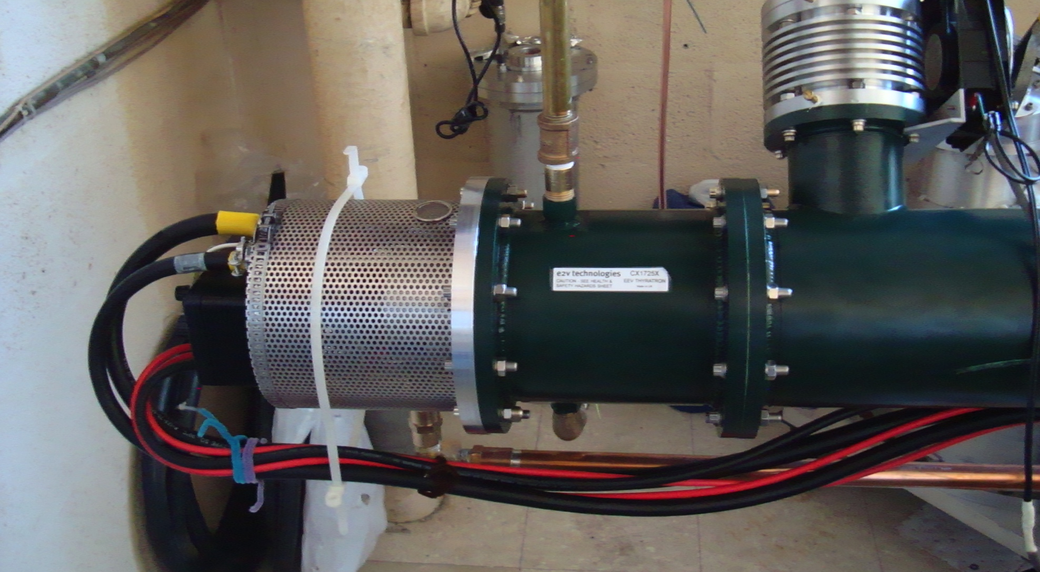
Thyratron switch

Slide 36
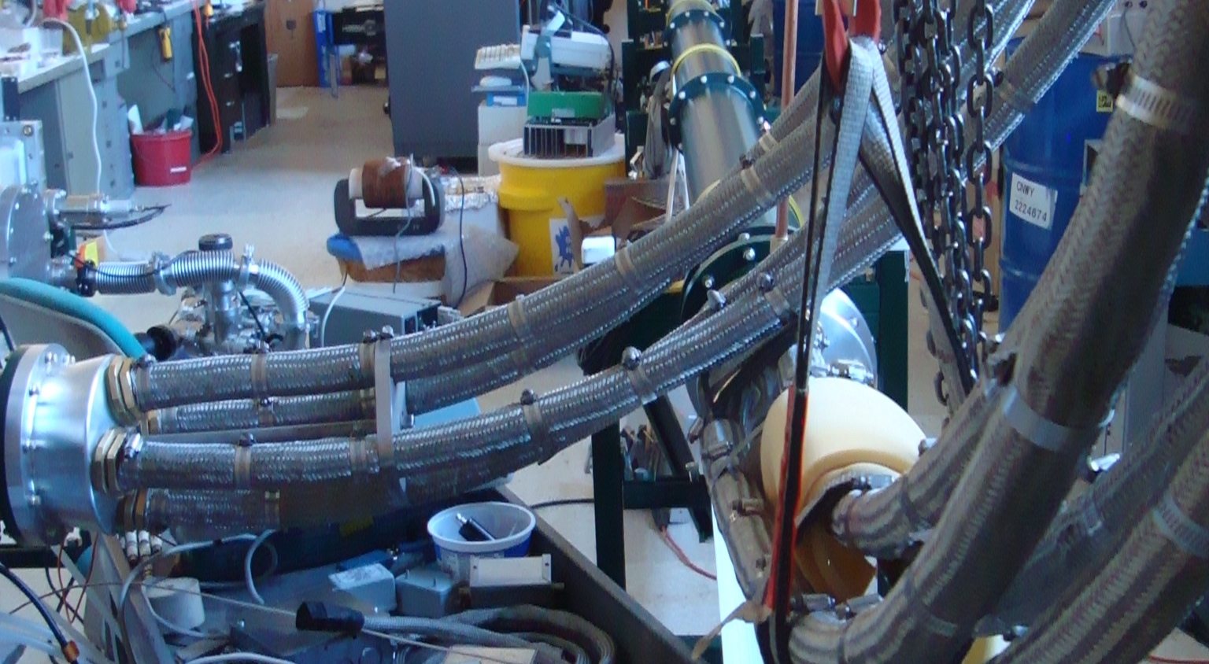
4 –parallel coax to load

Slide 37
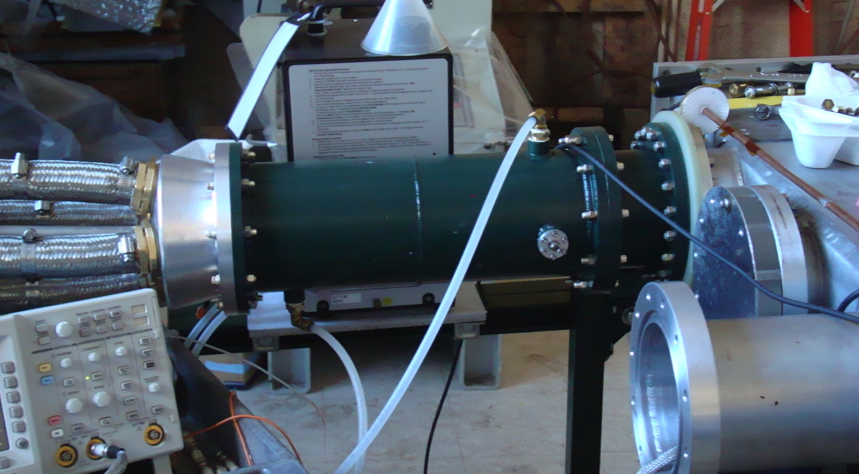
Coupling to magnet
flourinert
4 50Ω coaxial cables
4 load resistors
(12.5Ω equivalent)
Vacuum chamber

Slide 38
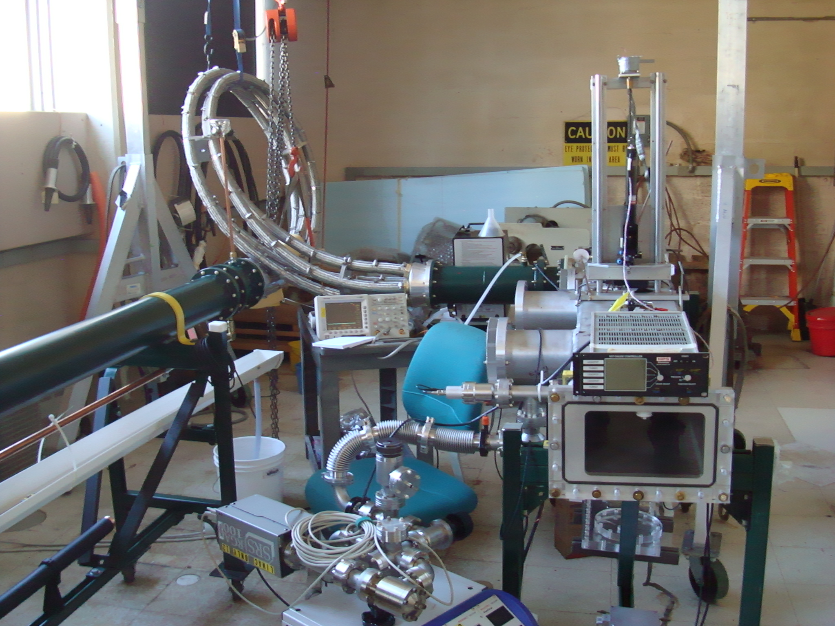
4 parallel 50Ω cables
Load resistors in flourinert
Magnetometer laser
Kicker chamber
Vacuum pump

Slide 39
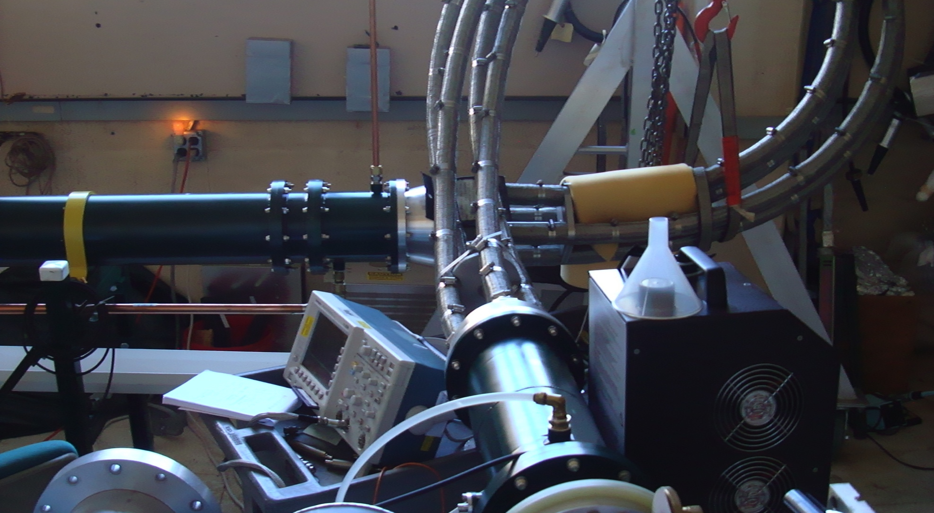
Coupling from Blumlein to Load

Slide 40
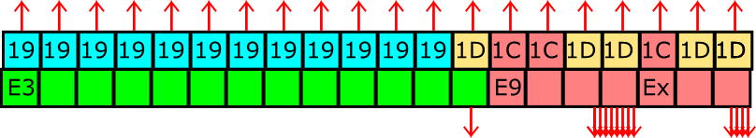
g-2 Proposed Pulse Train (12 Hz mode) Loss of 1 Nova Pulse
Begin cycle
End cycle
Bunch length
of 1 pulse
11 / 20 Nova Cycles
120 nsec
100Hz
Pulse separation
10 msec
Lens pulse length 400 µsec
193 msec
990 msec
~
~
1
2
3
4
5
6
7
8
9
10
11
12
13
14
15
16
Pulse #
MI Nova Cycle Length
1.33 sec

Slide 41
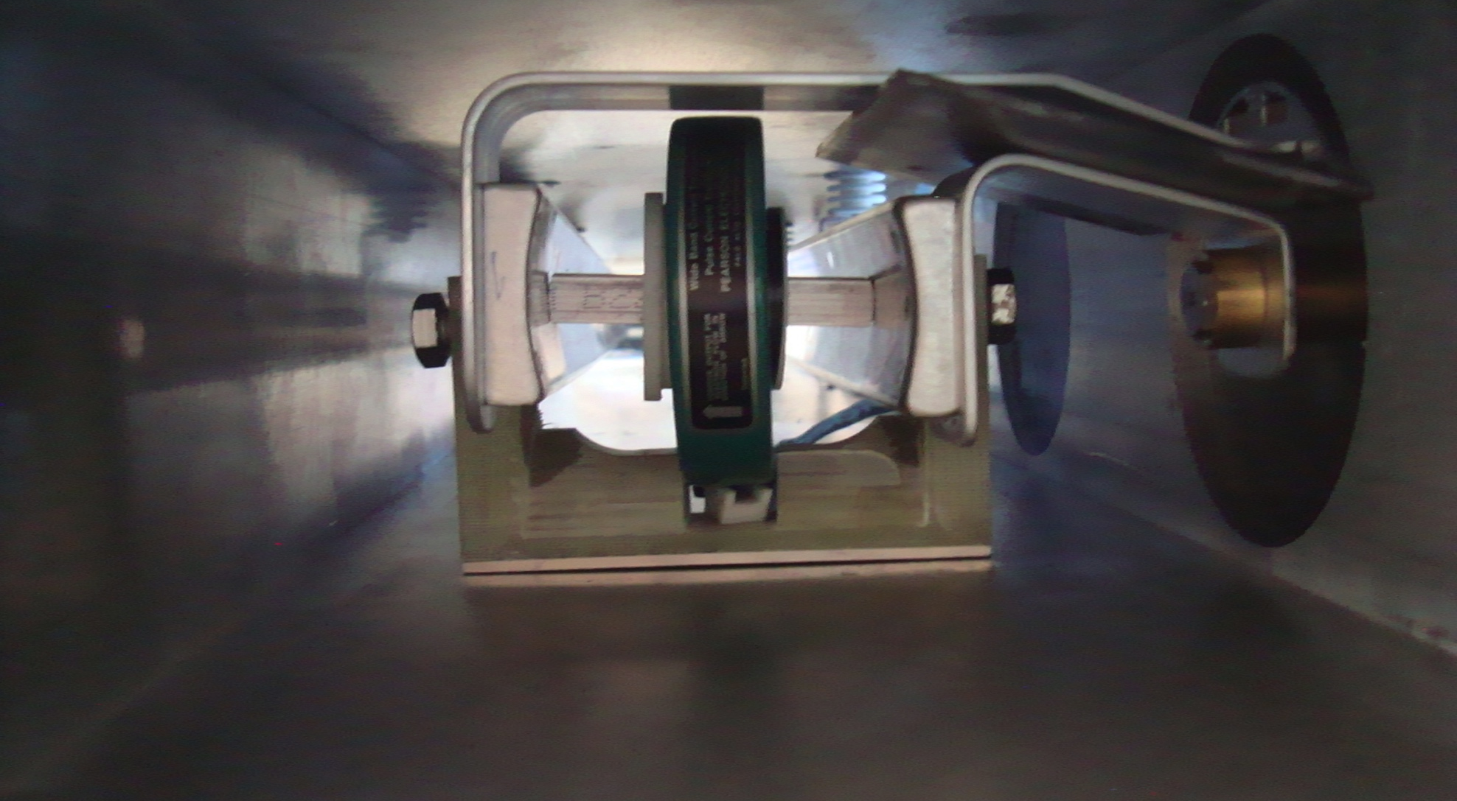
Current transformer and shorted kicker

Slide 42
12.5 Ω Blumlein
35cm kicker plates
Oscillations at the tail triggered by impedance mismatch

Slide 43
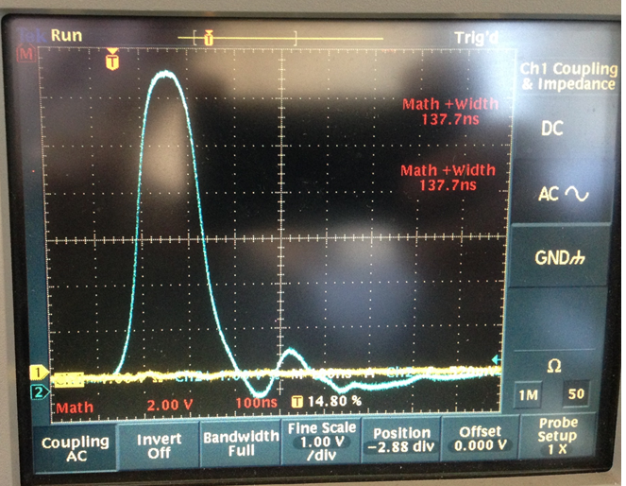
Pearson 3212; 50 kV; 4kA; 12 Hz, Full length Kicker ≈127 cm (50”)
The tail is generated by impedance mismatch?

Slide 44
Pulse characteristics
Broader flat top can be obtained with
Longer Blumlein
Shorter kickers (and additional kickers to achieve integrated kick)
Fine tuning of thyratron gas pressure
Compensation of mismatched lengths of Blumlein transmission lines
Tail can be reduced with
Better matching of blumlein, cables, and load
Kilovac switch to eliminate bleed through of charging transformer
Temporal non-uniformity of kicker pulse can introduce early to late systematic
(SeungCheon Kim – Wednesday talk)

Slide 45
Blumlein Pulse Forming Network
Blumlein
voltage at load is equal to charging voltage
Base of switch (thyratron) at ground
Simple transmission line
voltage at load is ½ charging voltage
Base of switch floats
Pulse length

Slide 46
Summary
Curved kicker plates efficiently convert current to B-field
Effect of field non-uniformity on capture efficiency is negligible
12.5 Ω Blumlein coupled to 127 cm plates generates pulse:
150ns full width/half height
5.6kA peak current
364 gauss peak field
1.39 kG-m (with 3 127cm kickers)
And 100 Hz repetition rate
Fewer than 17% of available muons are lost due to
finite rise and fall
Tail
Anticipate sharper rise and fall and reduced tail with further refinement

Slide 47
CBO amplitude and Muon capture
Simulation of muon capture and amplitude of CBO of stored muons for
E821 kicker B-field and current pulse and E989 field and pulse
Efficiency of muon capture versus kicker B-field
CBO amplitude of stored muons versus kicker B-field

Slide 48
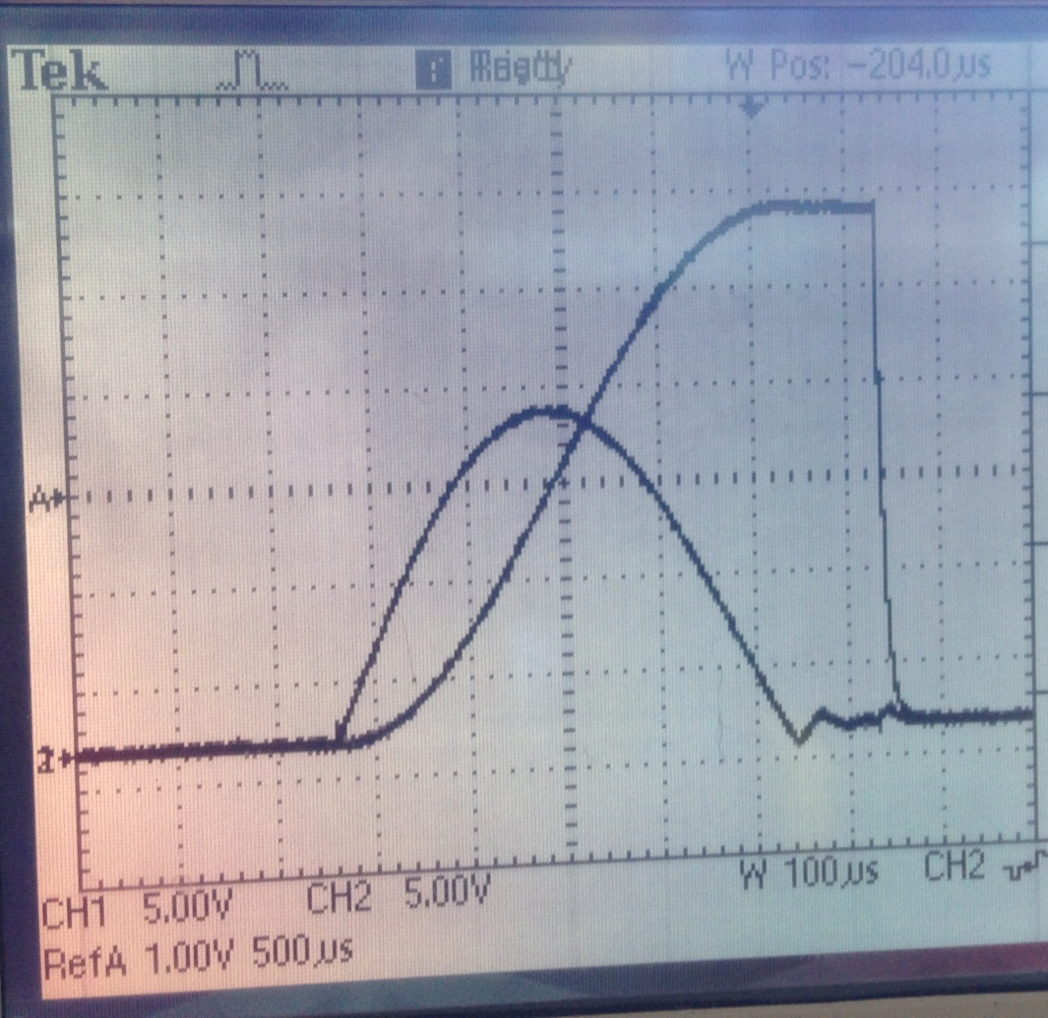
Charging circuit
Charging transformer characteristics contributing to signal after main pulse?
Voltage applied to Blumlein
(Voltage at secondary windings)
Current in primary windings
(Power Designs CVT-1A)
Moment of thyratron triggering
Current in secondary windings

Slide 49
Current Generator
12.5 Ω Blumlein triaxial transmission line
Assembled from 6 – 60 inch sections (20 ns/section) (30 ft long)
Filled with Castor oil, ε=4.7, (pulse length τ α √ε) (as compared to Corning 561 silicon oil, ε=2.7)
Concentric tubes are separated with teflon standoffs (we plan to replace with macor)
Two grid(fast) thyratron – rated for up 70kV – 15kA (7.5 kA in load)
Coupled via 4 parallel 50Ω coaxial cables and resistors (12.5 Ω equivalent) to the kicker magnet

Slide 51
Rise/fall and width
Kicker inductance limits rise and fall
Inductance proportional to length
E821 - 3 X 1.7m long magnets
Requisite 1114 kG-m is realized with
3 X 1.27 m kickers at 4.5 kA (56kV)
(leaving 1.2 m of the kicker chambers is unoccupied)
Faster rise and fall can be achieved by further reducing kicker length and adding additional units to maintain integrated field (access into vacuum chamber?)
Width can be increased by adding sections to Blumlein
(space ?)

Slide 52
Summary
30 ft 12.5 Ω Blumlein tested
To 4kA (50kV) into 1.27m long kicker (briefly at 12 Hz)
To 70kV with shorter kicker
Impedance transformer to improve match designed
Charging circuit contribution to tail under investigation
Kicker pulse
Sufficient amplitude with 1.27m kicker but slow rise and fall limit width at full field
Solution: Longer Blumlein and/or additional shorter kickers

Slide 54
Kicker Magnet
10.8 mrad kick corresponds to 1114 kg-m
292 G for each of 3 - 1.27m long kicker magnets
0.4 mm thick plates
Magnet geometry => 65G/kA
=> 4.5 kA/kicker magnet
=> 56 kV on each Blumlein
“New” larger aperture inflector” requires 12mrad kick
=> 62 kV / Blumlein

Slide 55
Outline
Kicker WBS
Requirements
Kicker plates
Pulse forming network and thyratron
Power Supply
Pulse characteristics
Trolley rails
Commissioning Plan
Summary

Slide 56
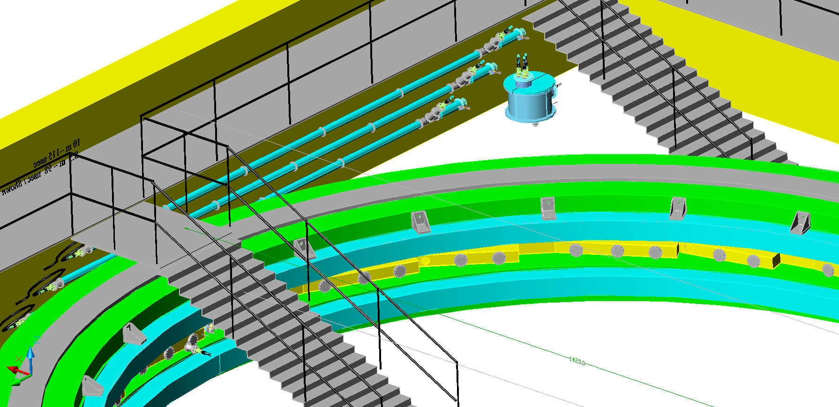
476.3.5.4 – Pulse Forming Network
Load resistor
thyratron
Blumlein
Load resistance matched to impedance of Blumlein
Kicker plates
Pulse width
L = 9m
= 4.7 (Castor oil)
=> τ = 120ns
Blumleins in storage ring hall

Slide 57
g-2 Proposed Pulse Train (11.4 Hz mode) Extended Cycle Length
Begin cycle
End cycle
Bunch length
of 1 pulse
12 / 21 Nova Cycles
120 nsec
4.2% Loss for Nova per Cycle
g-2 runs at 11.4 Hz
100Hz
Pulse separation
10 msec
Lens pulse length 400 µsec
193 msec
1057 msec
~
~
1
2
3
4
5
6
7
8
9
10
11
12
13
14
15
16
Pulse #
MI Nova Cycle Length
1.3997 sec

Slide 58
Impedance Match
Alternative coax ?
Fermilab cable – measured impedance ~ 55 Ω
Cornell cable
Better match?

Slide 59
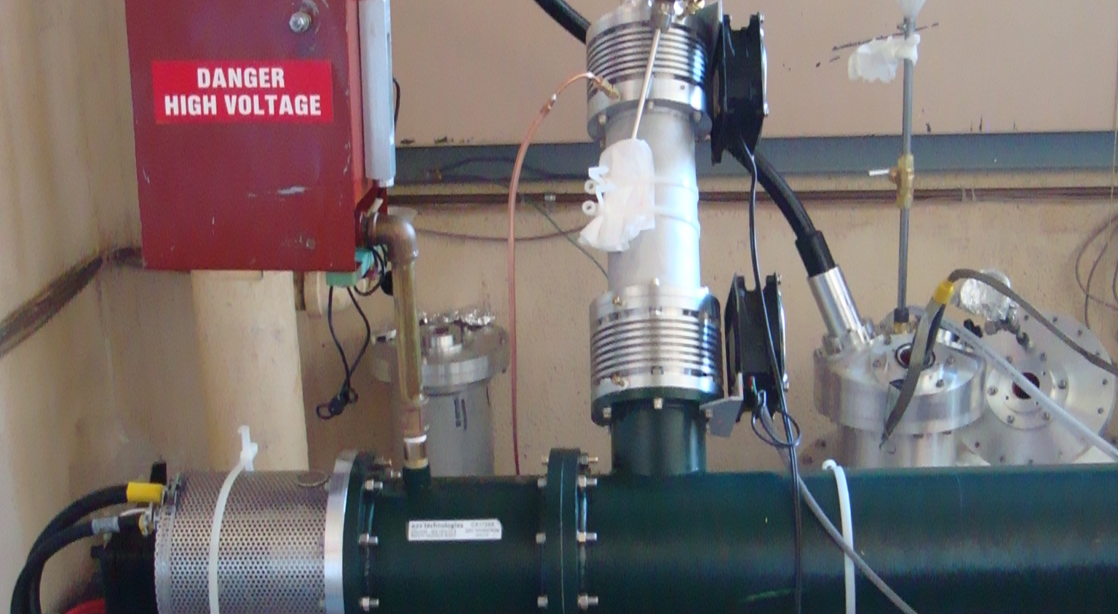
Thyratron and charging input

Slide 61
Alternatives/Value Engineering
Thyratron – Re use tubes from E821 or purchase new?The E821 tubes are incompatible with the Blumlein PFN and a superior alternative has been identified
PFN – Blumlein determined superior to bi-axial transmission line in terms of length, voltage, configuration of thyratron, etc.
Kicker plates – Narrower curved plates yield significantly higher field per unit current at the cost of increased field roll off. The effects of the roll off is determined to have small effect on capture efficiency.
Length/number of kicker plates – 3 – 127cm long plates. Achieves acceptable rise and fall times, and adequate margin for integrated kick.

