Slide 1
Location of Kicker Electronics
Mikhailichenko
August 6, 2015

Slide 2
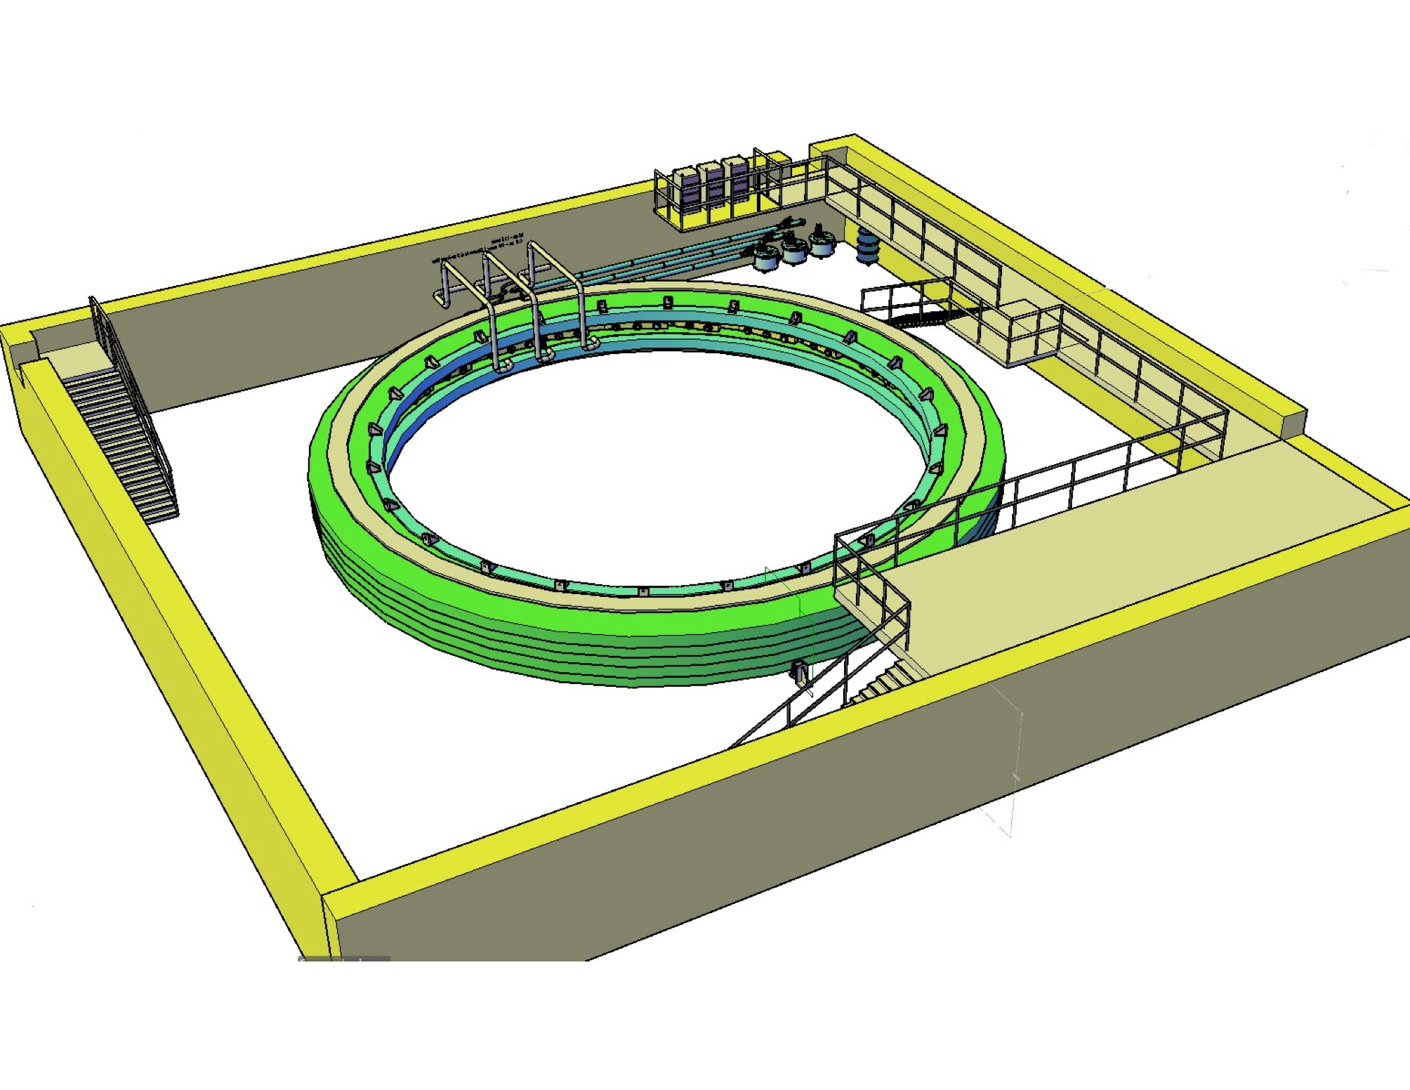

Slide 3
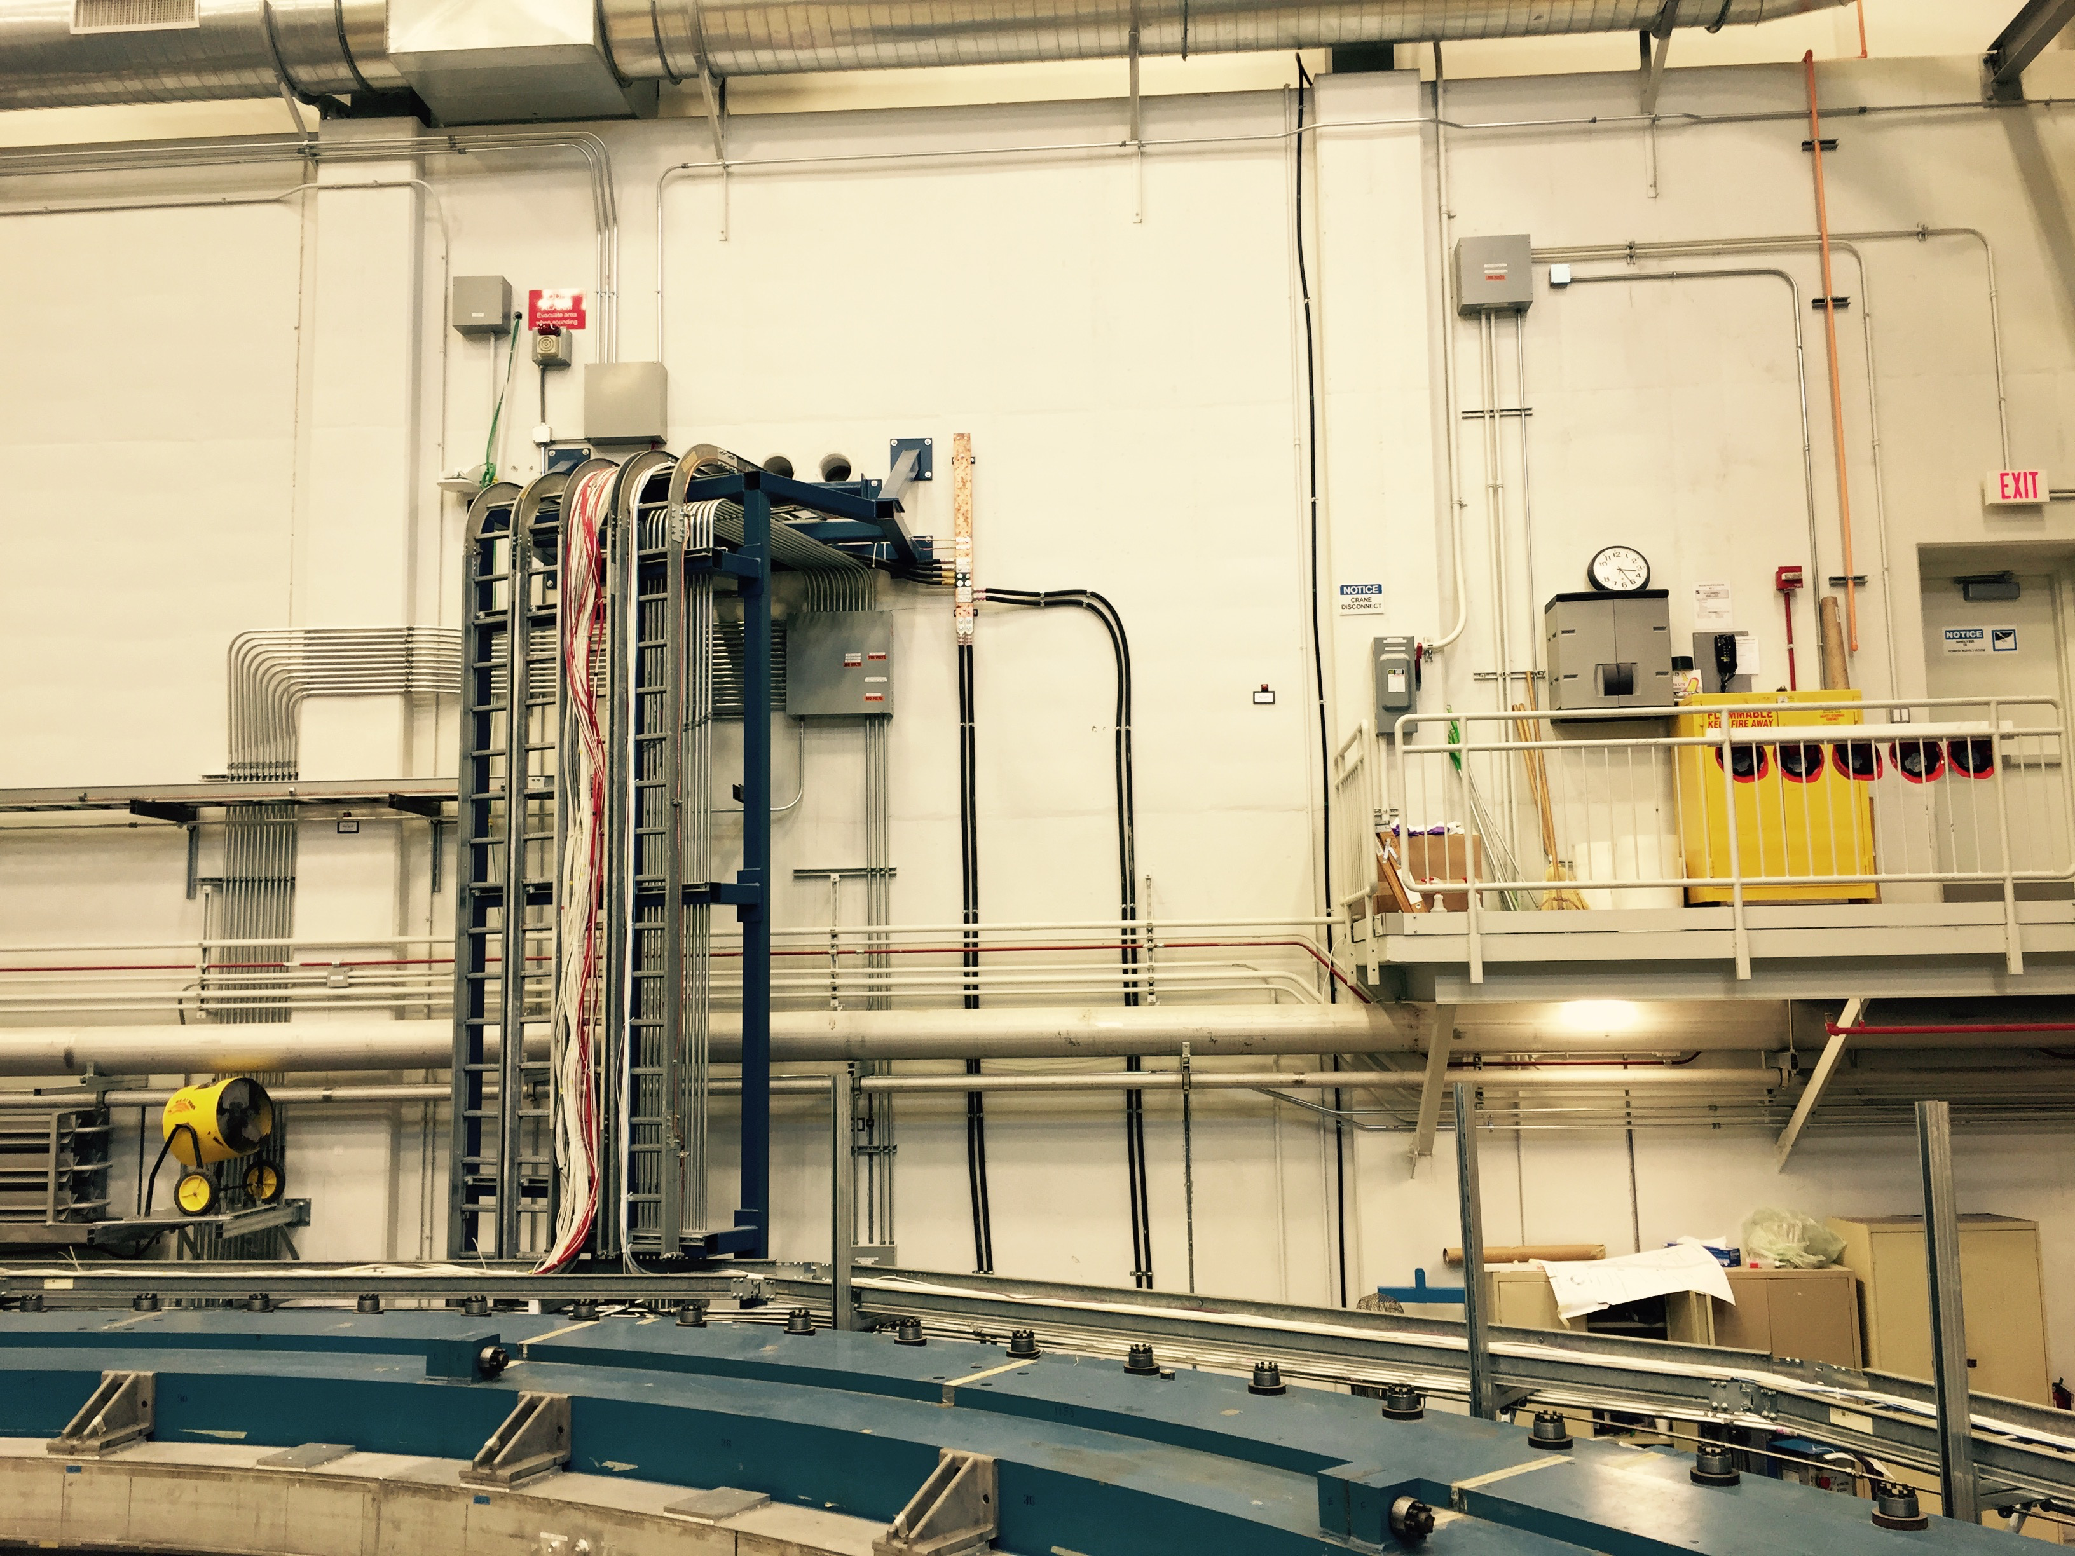

Slide 4
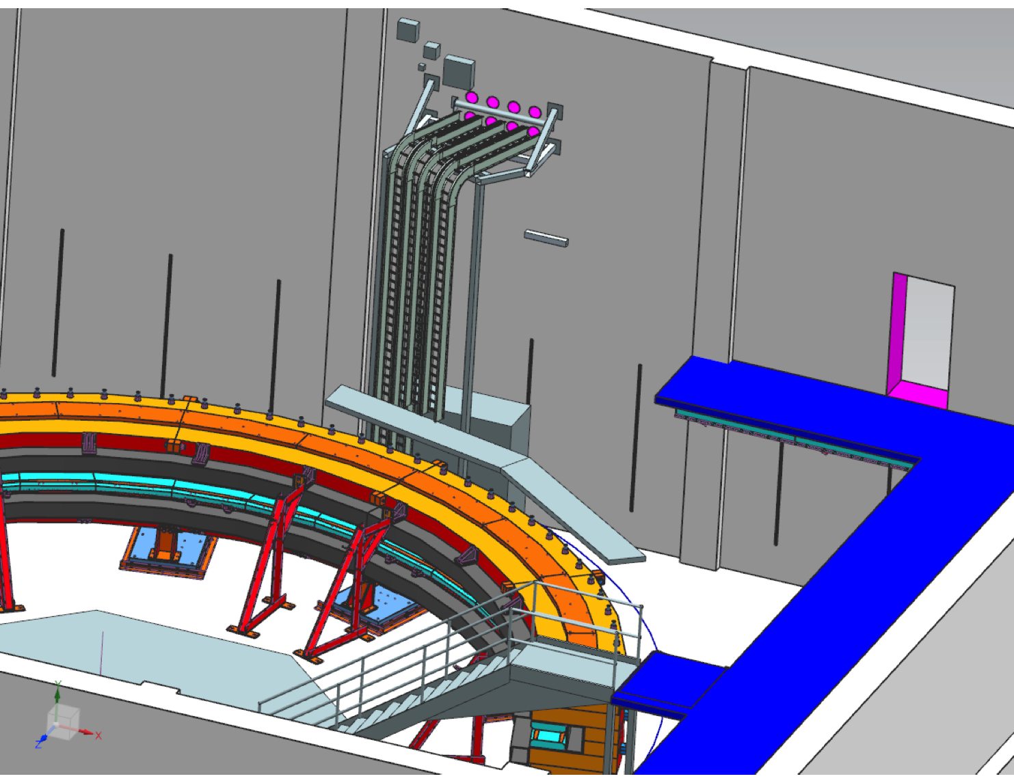

Slide 5
