Slide 1
LATEST UPDATES ON KICKER
General ring meeting
January 22, 2014

Slide 2
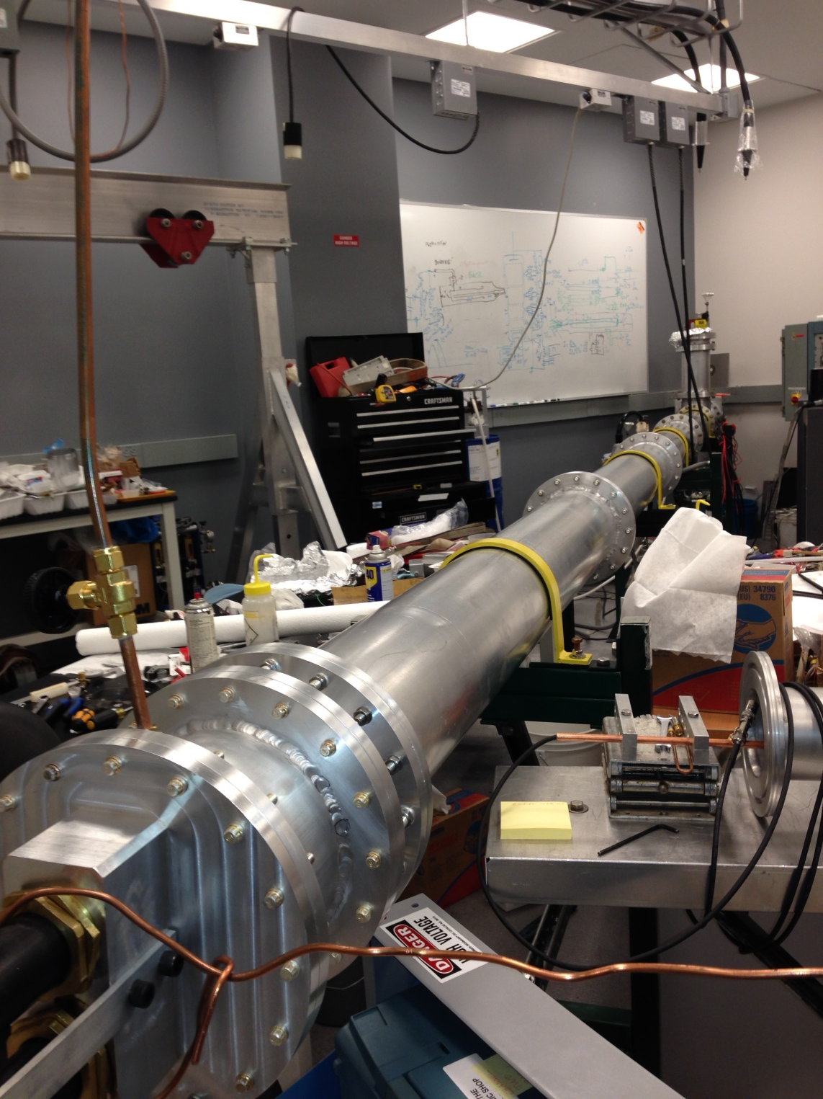
Pulser is assembled in full length

Slide 3
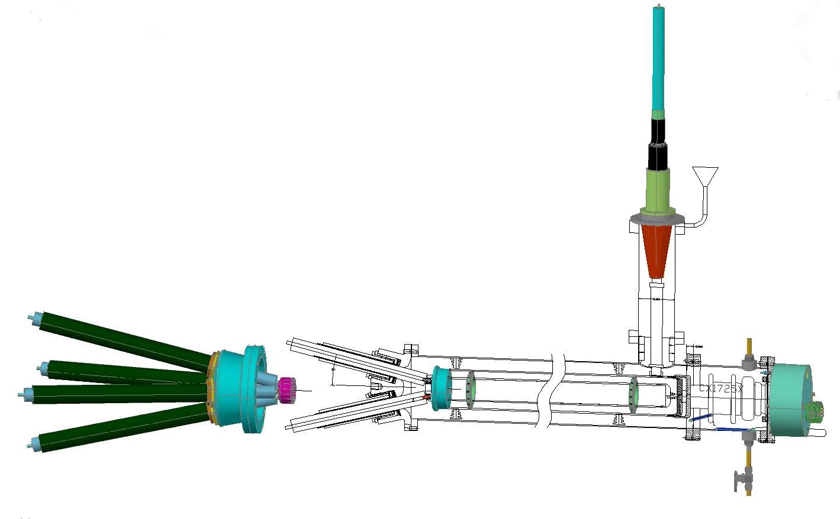
Final design will have 6” outer tubes (instead of current 7”) and impedance 12.5 Ohm (load)
Four 50 Ohm cables in parallel, if 12.5 Ohm cable will be not possible to get in time.
Will be filled with Castor oil
This part will be tested in existing generator; transition flange is manufactured already
Flanges: Ø=8” instead of current Ø=10”

Slide 4
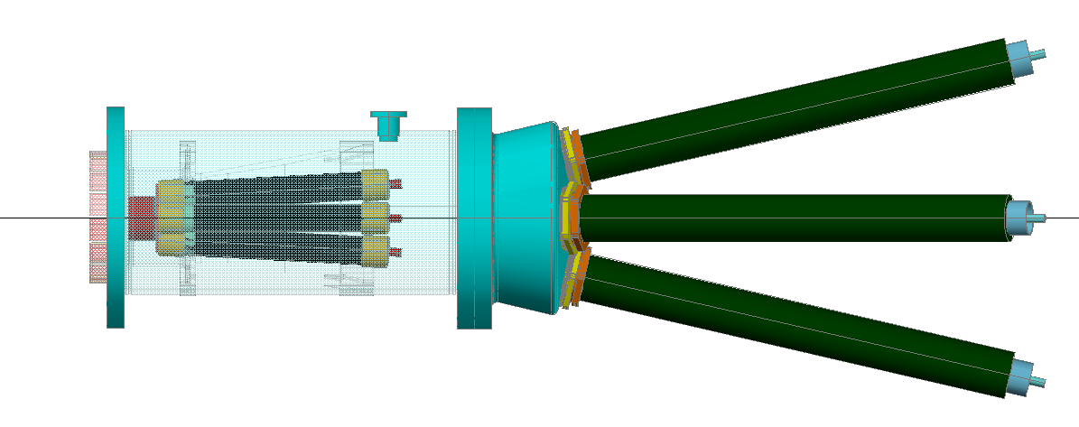
We think that individual load for each cable (50Ω) is the best solution
KANTHAL© resistors (4 pieces); 1” OD; 8” long
This setup reduces the possibility for cables to cross talk
12.5 Ω cable RG 193/U has Steel central conductor with Ø=1”; galvanized
2” outer diameter; rigid

Slide 5
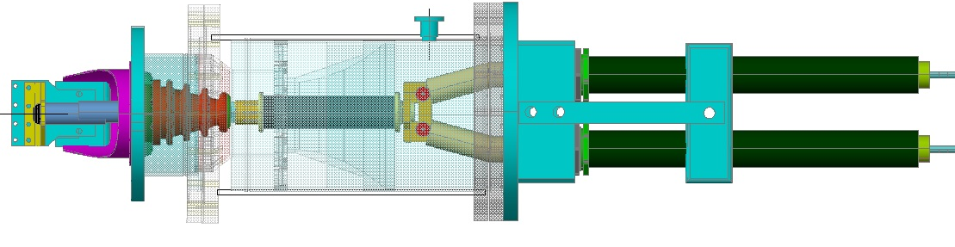
Considering a possibility to insulate the ground electrode of PS from the vacuum chamber;
Minimal modifications required;
This will drastically decrease the noise, especially in a real data acquisition process,
In Faraday monitor also.
CURRENT STATUS
Insulator ring
New KANTHAL© resistor ordered, all parts required for installation exist

Slide 6
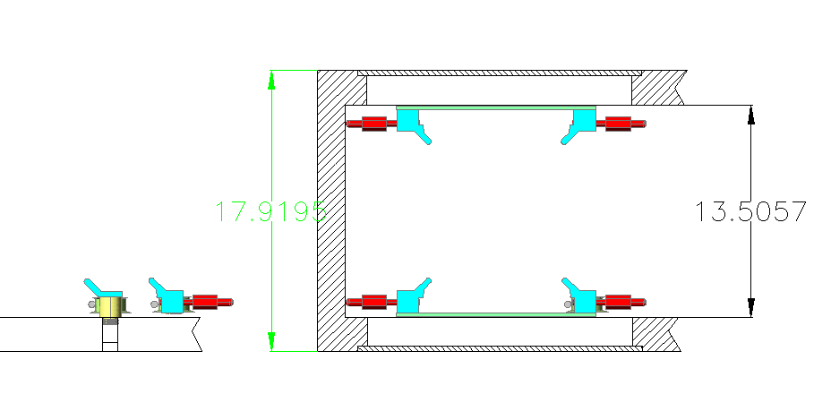
ABOUT RAILS
Suggested rail fixation
Cage concept (vertical spacers are not shown here)
Each rail has appropriate radius to the center of ring
To the center
Every 5” along the azimuth;
These two rails are not in use for NMR cartridge motion
Threaded hole
Knob welded
in a region of kicker, the spacers are made from Macor; is other places –from Aluminum

Slide 7
We recommend to exclude the cage from entire ring, not in the kicker sections only;
Only two rails participate in support of NMR cartridge. Inner low rail is a base one.
It has specific radius so its position could not be arbitrary; so it should be located in exact position. Best way to point to this position is from outside of chamber during mechanical drilling the treaded holes and further welding knobs at the outside (as it was done in the model chamber at Cornell.
Cage amplifies deflection of the rail (caused by vacuum change and/or temperature variations) as it is still based on the chamber walls;
Presence of numerous flanges from inside of chamber allow direct control of rail(s) position as it is visible from the center through these flanges open.
We recommend to assemble the chamber (in the building 38?) and measure actual dimensions, ellipticity, etc.
The rail position control could be done after installation the chamber in the magnet (with open all inner flanges for direct access to the rails)

Slide 8
Center of the ring

Slide 9
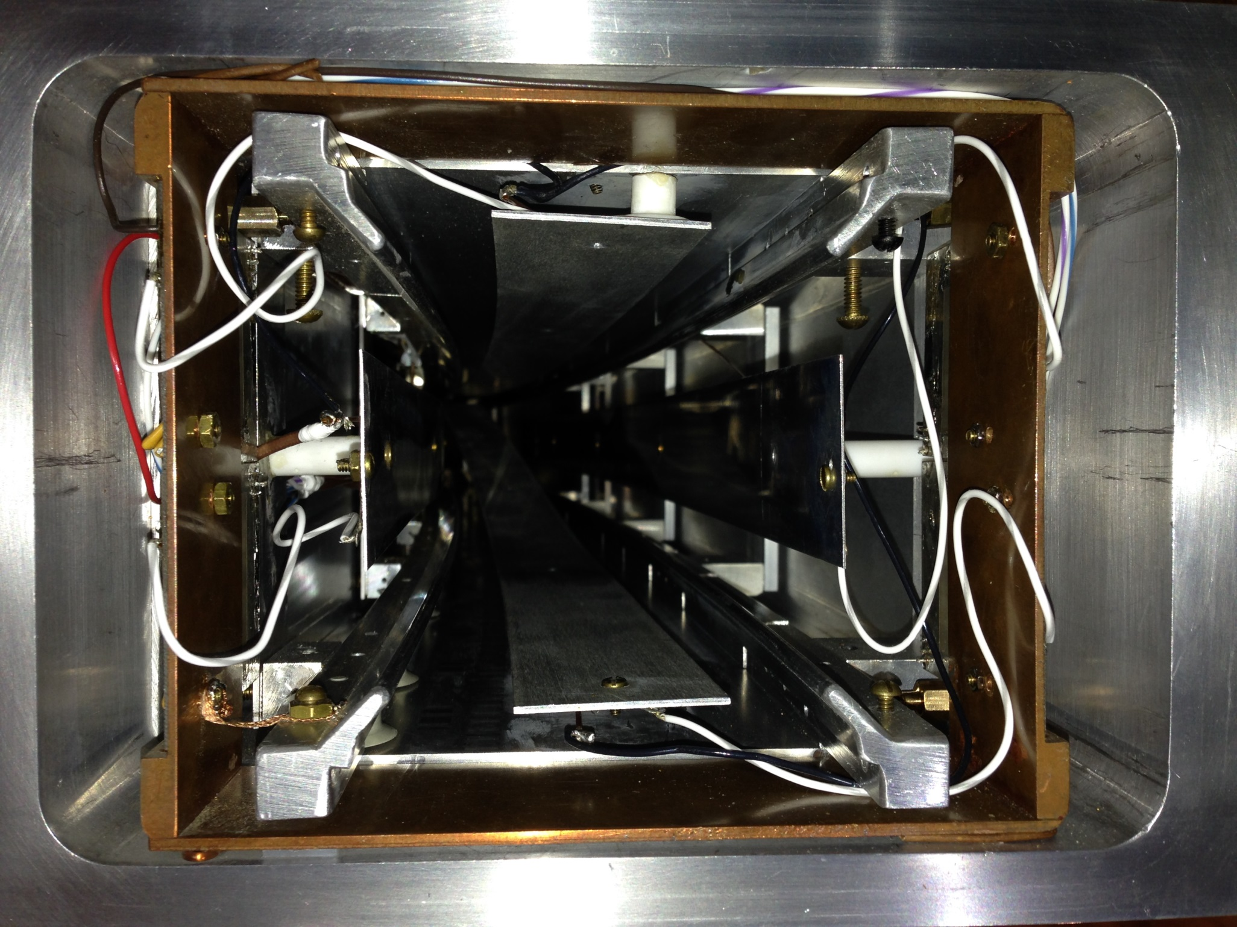
December 10 2013

Slide 10
Intel© GALILEO board arrived;
Programmed for the pulse sequence for g-2

Slide 11
THE END

Slide 12
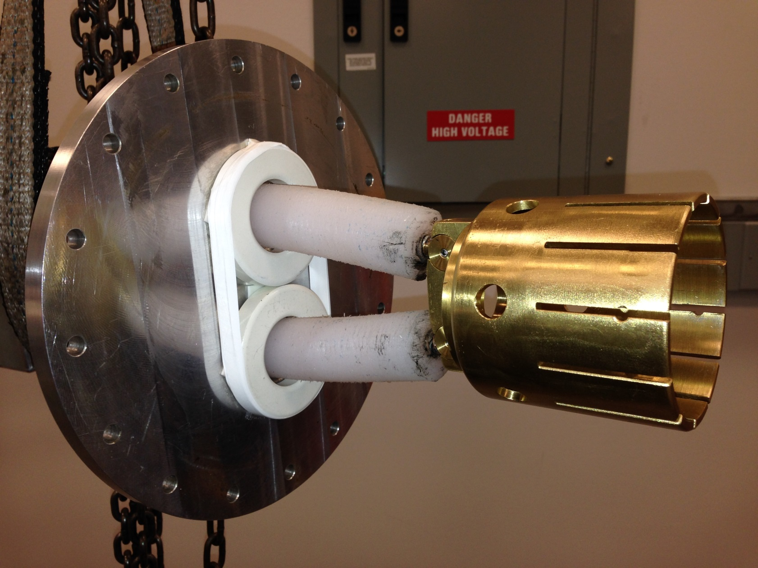
Saturated chokes (ferrite rings) installed at the end of pulser before split into two cables

