Slide 1
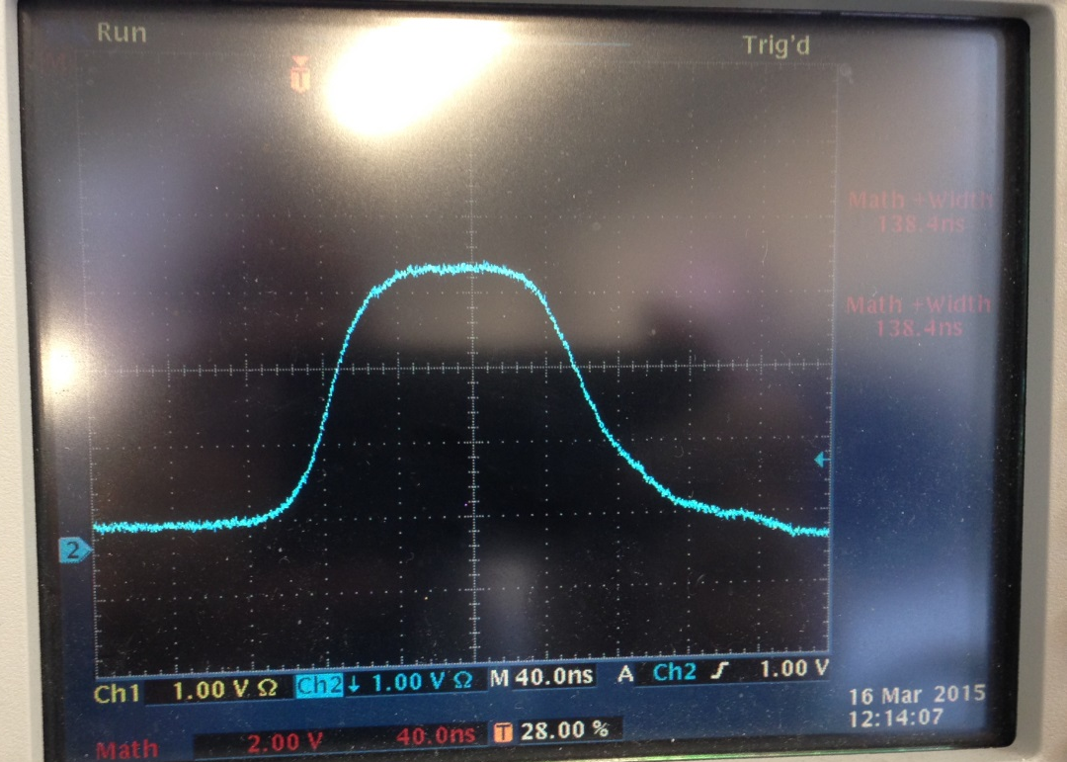
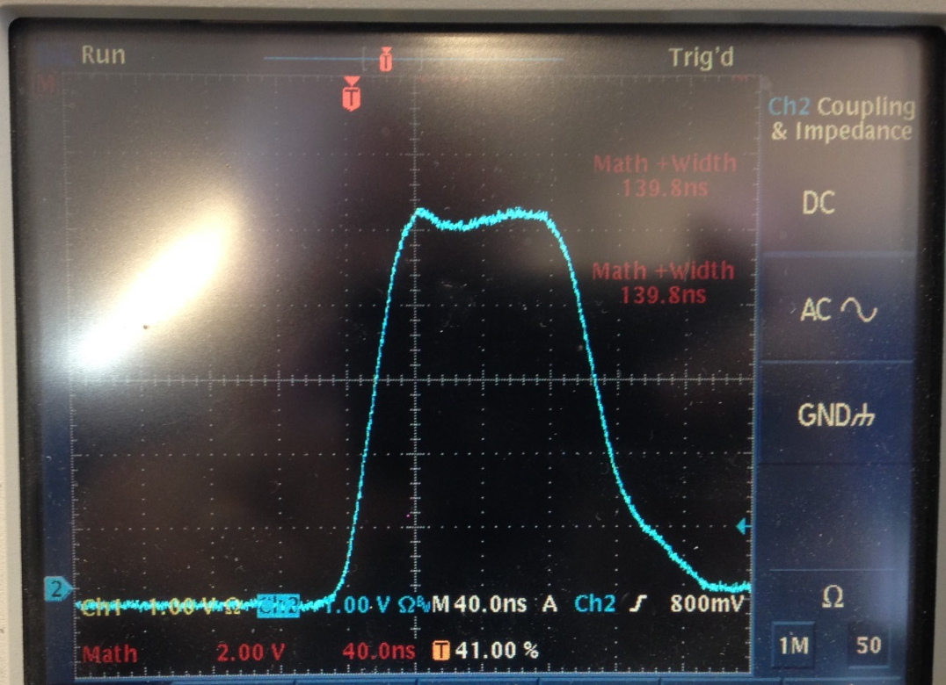
The same charging voltage, but different current monitors
Pearson 6600 current monitor;
Current ≈2 kA; V ≈25 kV
Kicker length ≈ 60 cm;
40 ns/div, 12 Hz
Max current allowed by Pearson 6600
is 2 kA
Pearson 3212 current monitor;
Current ≈2 kA; V ≈25 kV
Kicker length ≈ 60 cm;
40 ns/div; 12 Hz
Max current allowed by Pearson 3212 is 7.5 kA

Slide 2
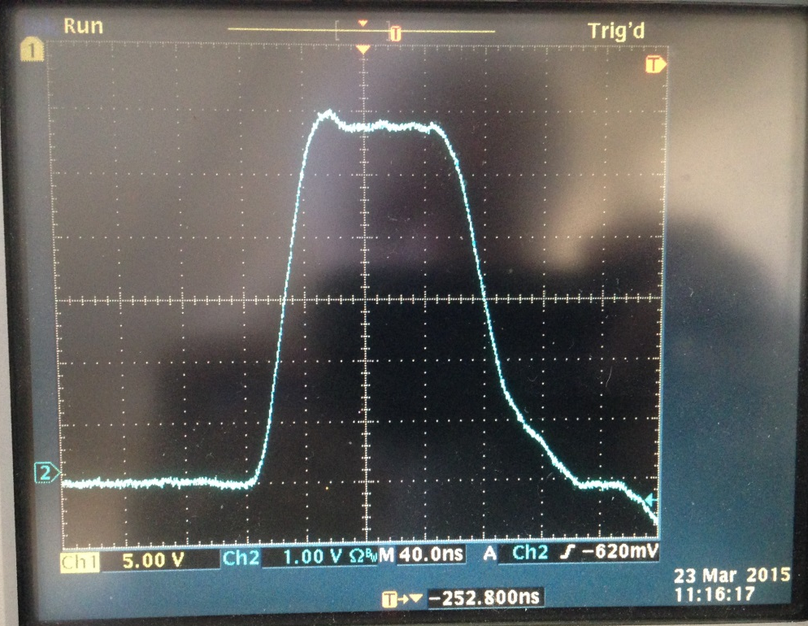
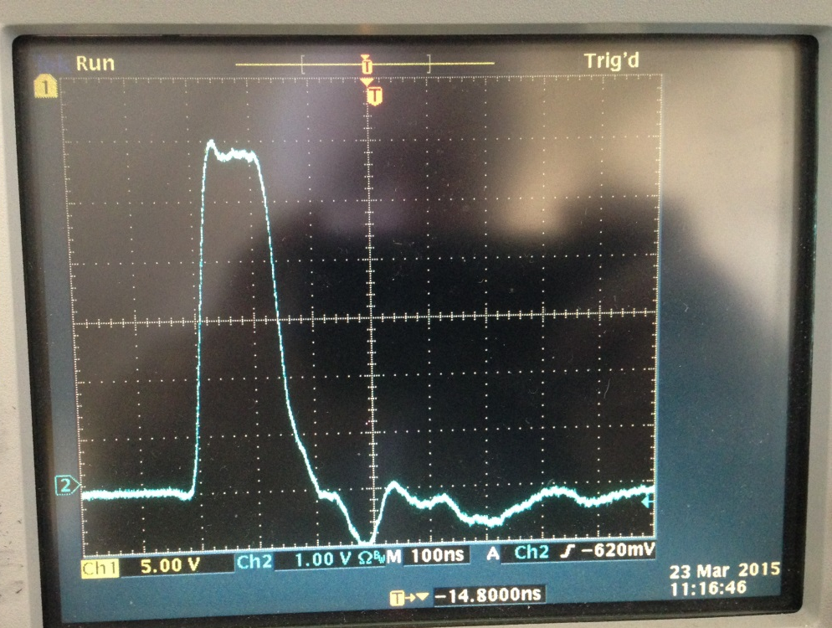
The same pulse; different time scale
Pearson 3212 current monitor;
Current in a 40 –cm long kicker;
Current value ≈ 2.4 kA;
Charging Voltage≈30 kV;
40ns/div
Pearson 3212 current monitor;
Current in a 40 –cm long kicker;
Current value ≈ 2.4 kA;
Charging Voltage≈30 kV;
100 ns/div

Slide 3
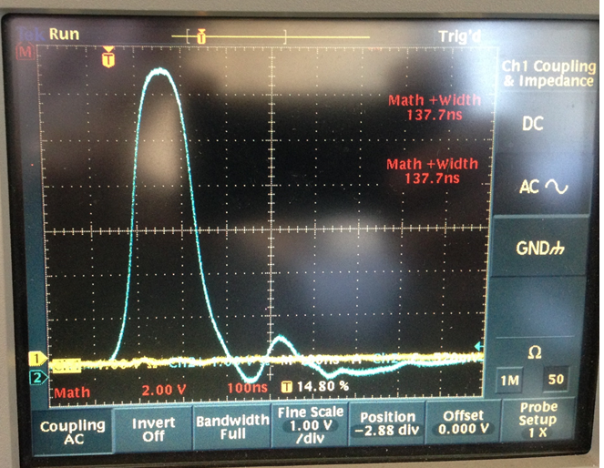
Pearson 3212; 50 kV; 4kA; 12 Hz, Kicker length ≈127 cm (50”)
The tail generated by slight mismatch of impedances.

Slide 4
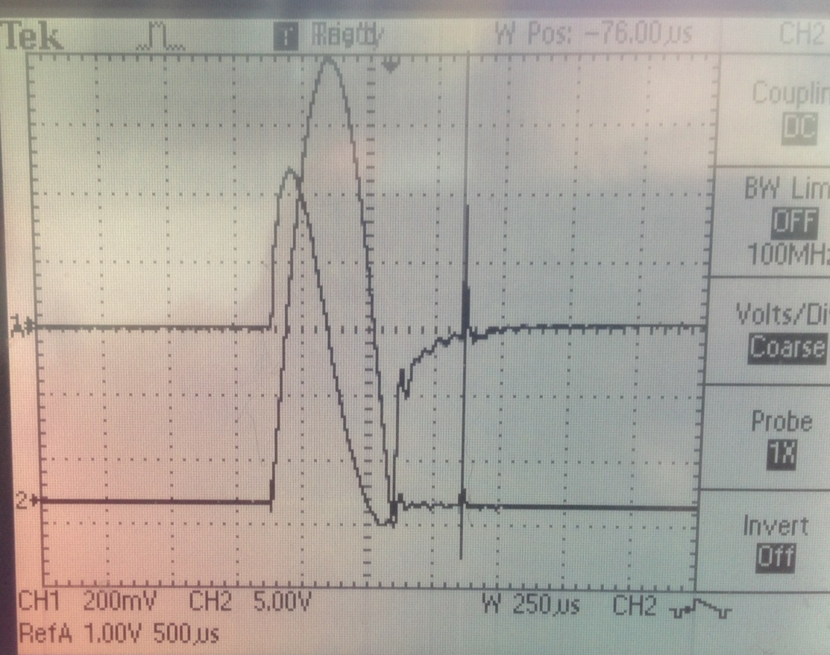
Current in primary windings
(Power Designs CVT-1A)
Current in secondary windings
(Pearson 410)
Moment of thyratron triggering

Slide 5
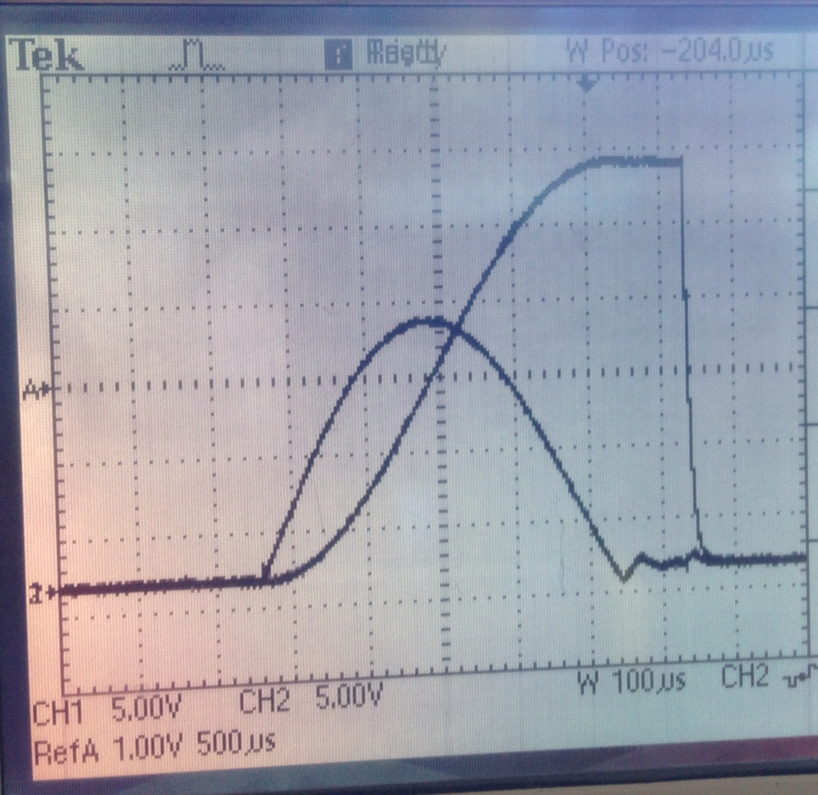
Voltage applied to Blumlein
(Voltage at secondary windings)
Current in primary windings
(Power Designs CVT-1A)
Moment of thyratron triggering

