Slide 1
A.M., December 4, 2104
IMPLICATION OF THE TIMING STRUCTURE OF BEAM
ON THE KICKER OPERATION
Materials used:
[1] Phil Adamson, “Timing of Muon Campus”, November 20, 2014.
[2] Mary Convery, “Proton Beam to the Muon Campus”, November 25, 2014.
STATEMENT
Any time structure does not affect operation of the kicker pulsed PS as soon as the fastest repetition rate remains 100 Hz (10 ms between pulses).
THE END

Slide 2
BACKUP SLIDES

Slide 3
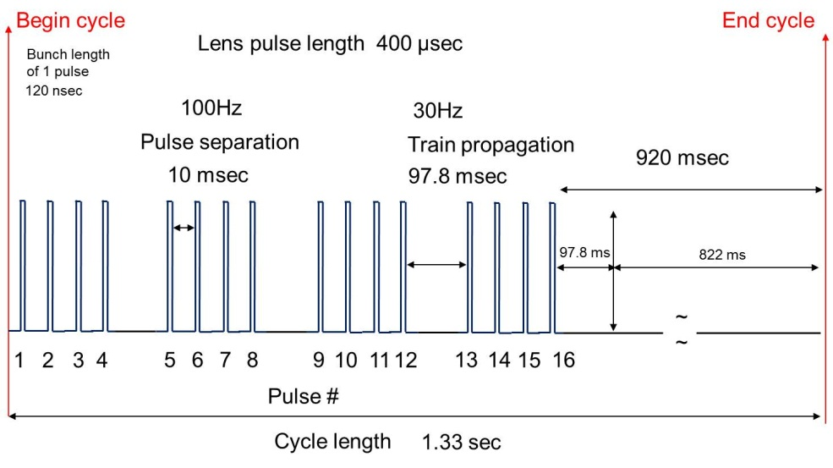
Original g-2 Pulse Train
g-2 average 12Hz pulse scenario

Slide 4
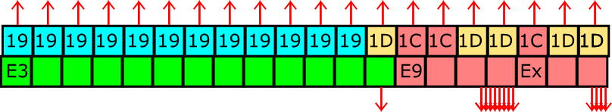
g-2 Proposed Pulse Train (9 Hz mode)
Begin cycle
End cycle
Bunch length
of 1 pulse
12 / 20 Nova Cycles
120 nsec
100Hz
Pulse separation
Lens pulse length 400 µsec
10 msec
167 msec
1066 msec
~
~
1
2
3
4
5
6
7
8
9
10
11
12
Pulse #
MI Nova Cycle Length
1.33 sec

Slide 5
g-2 Proposed Pulse Train (12 Hz mode) Loss of 1 Nova Pulse
Begin cycle
End cycle
Bunch length
of 1 pulse
11 / 20 Nova Cycles
120 nsec
100Hz
Pulse separation
10 msec
Lens pulse length 400 µsec
193 msec
990 msec
~
~
1
2
3
4
5
6
7
8
9
10
11
12
13
14
15
16
Pulse #
MI Nova Cycle Length
1.33 sec

Slide 6
g-2 Proposed Pulse Train (11.4 Hz mode) Extended Cycle Length
Begin cycle
End cycle
Bunch length
of 1 pulse
12 / 21 Nova Cycles
120 nsec
4.2% Loss for Nova per Cycle
g-2 runs at 11.4 Hz
100Hz
Pulse separation
10 msec
Lens pulse length 400 µsec
193 msec
1057 msec
~
~
1
2
3
4
5
6
7
8
9
10
11
12
13
14
15
16
Pulse #
MI Nova Cycle Length
1.3997 sec

Slide 7
g-2 Proposed Pulse Train (6 Hz mode)
Begin cycle
End cycle
Bunch length
of 1 pulse
120 nsec
12 / 20 Nova Cycles
100Hz
Pulse separation
Lens pulse length 400 µsec
10 msec
167 msec
1100 msec
~
~
1
2
3
4
5
6
7
8
Pulse #
MI Nova Cycle Length
1.33 sec

Slide 8
g-2 Pulse Train at the Target (12Hz mode)
Begin cycle
End cycle
Lens pulse length 490 µsec
Bunch length
of 1 pulse
120 nsec
100Hz
30Hz
Pulse separation
Train propagation
800 msec
10 msec
90 msec
~
~
1
2
3
4
5
6
7
8
9
10
11
12
13
14
15
16
Pulse #
Cycle length
1.33 sec

