Slide 1
A. Mikhailichenko, D. Rubin
VACUUM CHAMBER IN A KICKER Telephone meeting September 16 2014

Slide 2
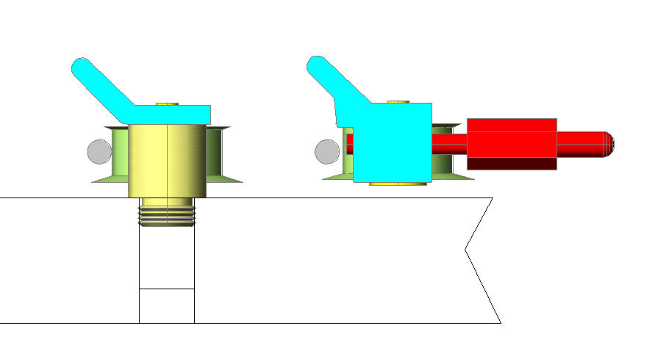
In a Vacuum Chamber meeting on August 19 2014 we introduced the concept of rail design in a kicker region
New rail
E-821 rail in a ring (except the kicker region)
Al
Al
Macor
Vac chamber wall
Aluminum part made with longitudinal interruptions

Slide 3
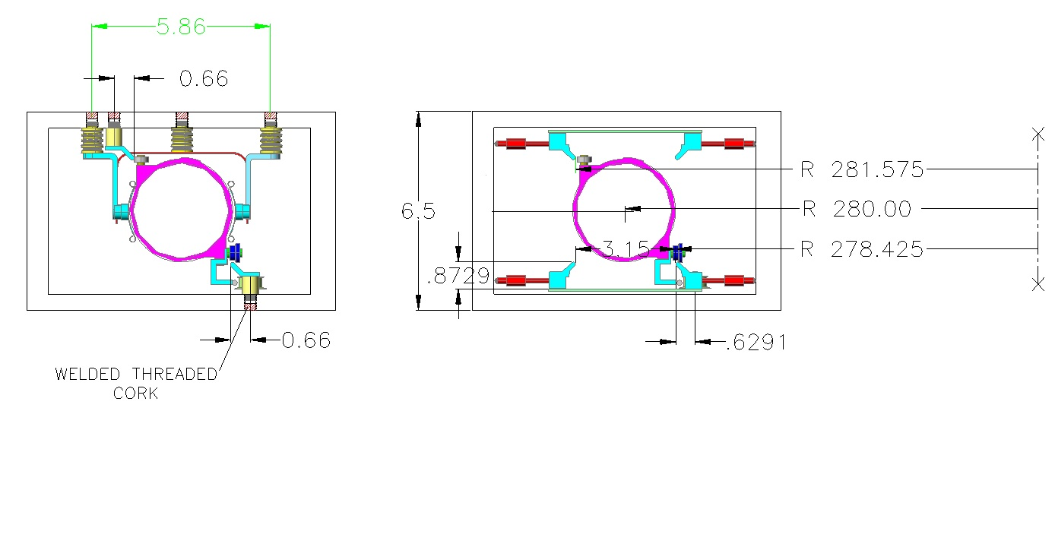
Procedure:
1) Drill holes through
2) Make threads
3) Close with short threaded cork
4) Weld cork outside
5) Shave outer surface

Slide 4
Critical dimensions are the radiuses of rails
As the rails have a curvature with definite radius, the chamber itself should be aligned properly

Slide 5
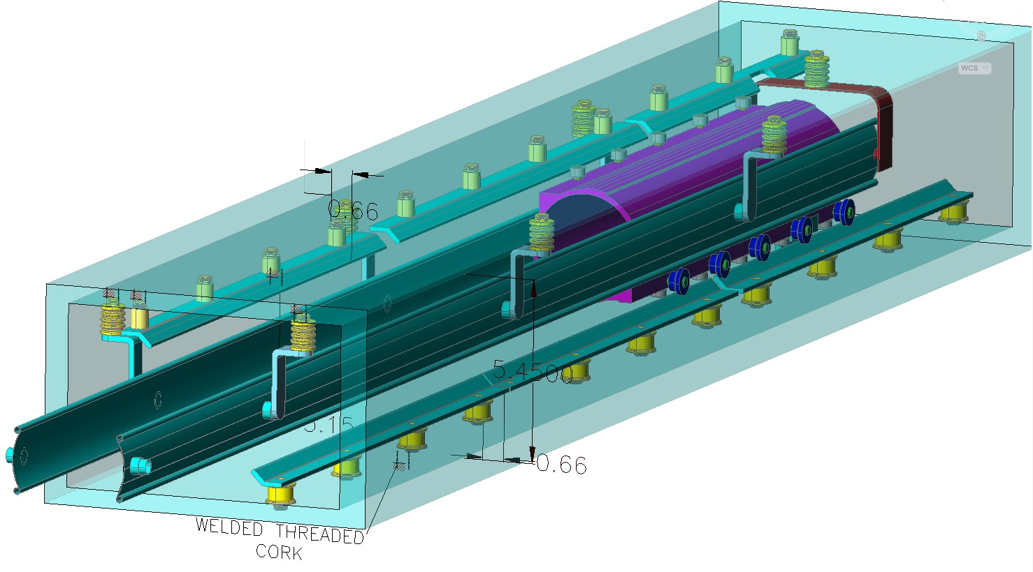
Isometric view of rails and HV plates in a chamber

Slide 6
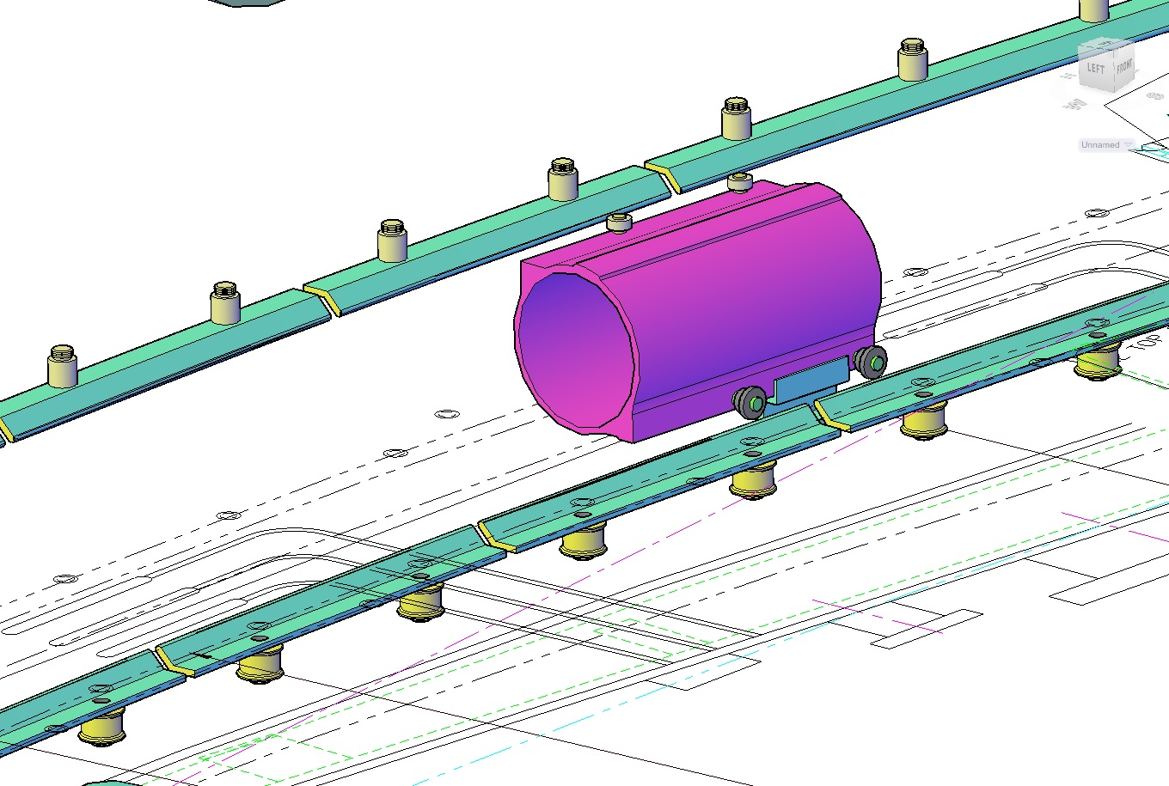
Just rails…
Macor posts
Macor wheels over posts

Slide 7
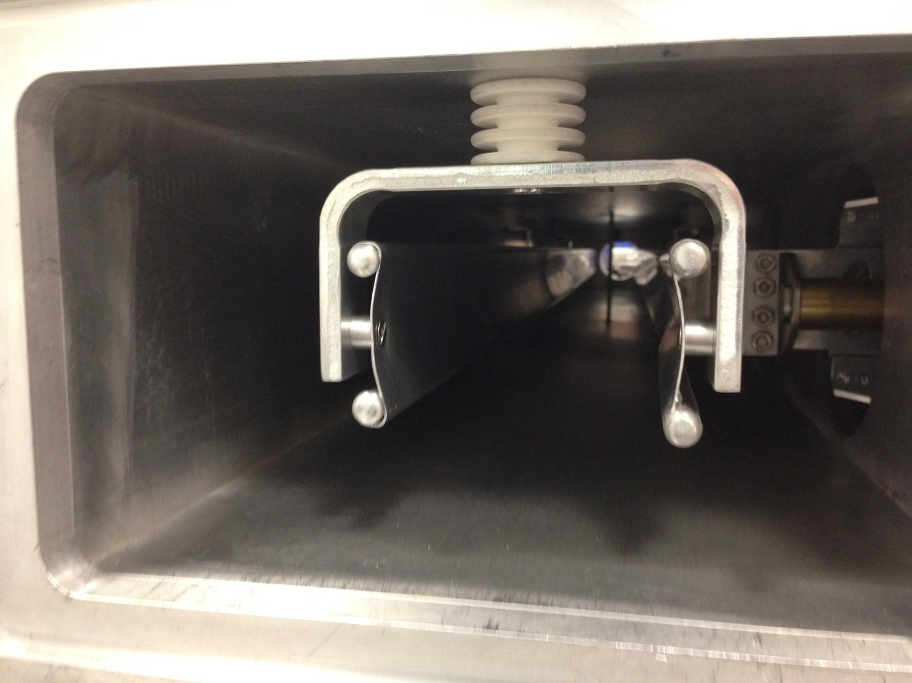
The concept was tested at kicker model
Macor posts screwed into the wall

Slide 8
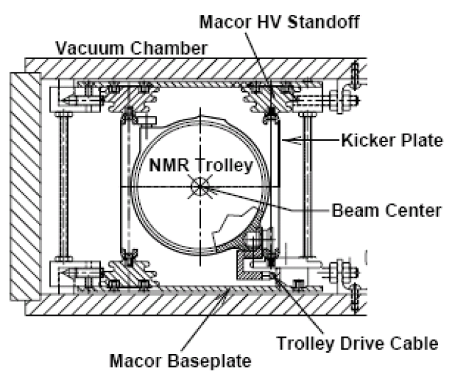
E-821 rails in a region of the kicker plates
Cage attached to the chamber by screws
Vertical
fixators

Slide 9
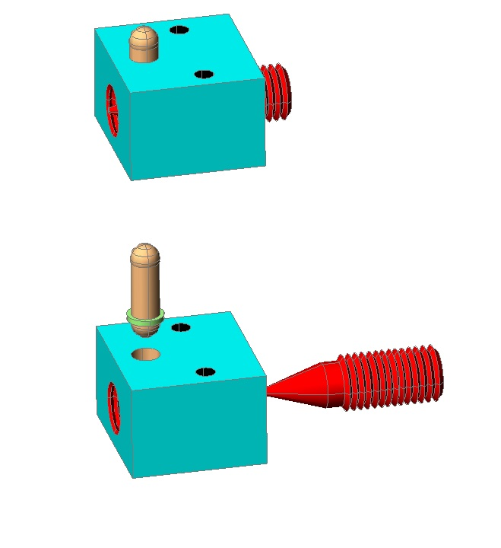
Principle of operation of vertical fixators is very simple:
Important to have an access from one side

Slide 10
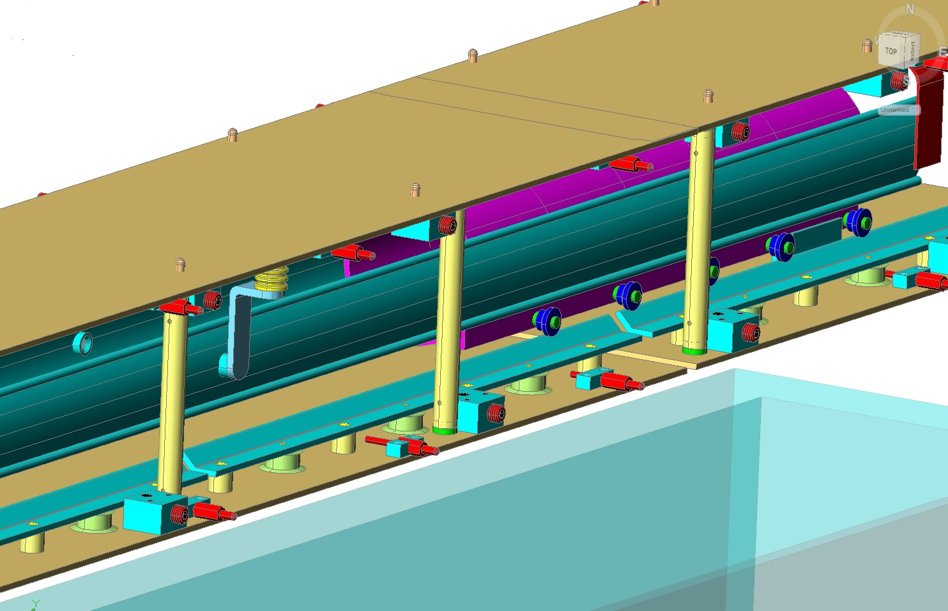
We considered a cage concept of installation of rails and HV plates also
Thin wall cylindrical posts
Vertical fixators
Radial fixators

Slide 11
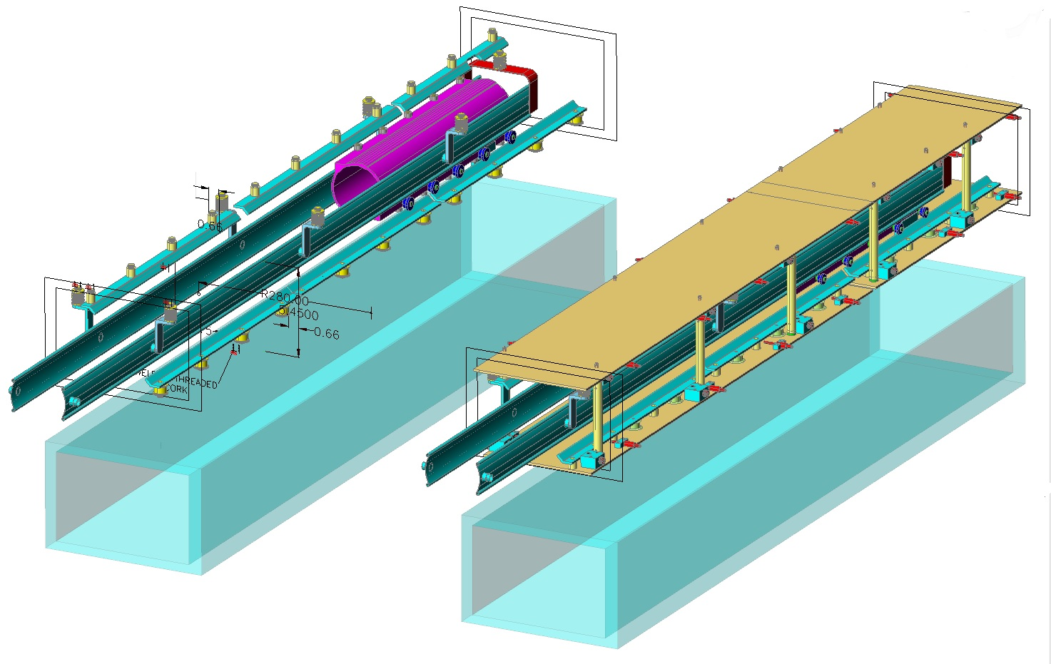
Two concepts in comparison
Pretty flexible base
Semi-transparent vacuum chamber is shifted down for better visibility

Slide 12
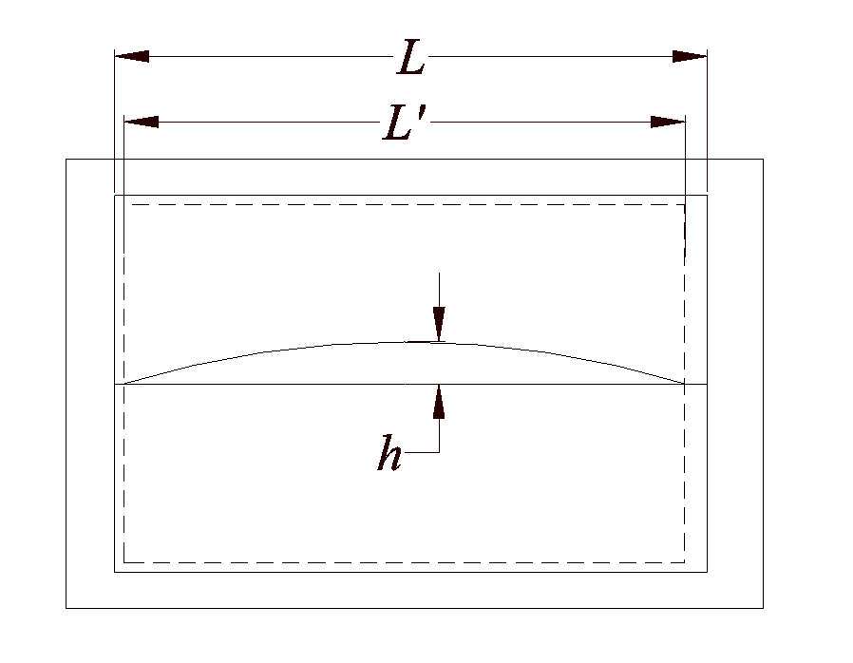
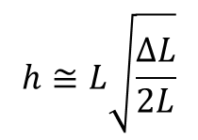
One comment…
Sagitta appearance as a result of chamber shrinkage
$$h≅L\sqrt{\frac{∆L}{2L}}$$
ΔL= L-L'
Shape after temperature changed (cooled)
Original shape (flat)
For Al α=22e-6ºC, L=200mm, ΔT=10º h≈2mm
For a 1ºC the change is h≈0.6 mm
Base plate of cage

Slide 13
CONCLUSIONS
Two concepts considered.
• Cage system demonstrates difficulties in keeping vertical positioning at
all length of the rails, as it fixes the cage position in few points only
• No direct connection of inner rails location and outer surfaces of the
chamber in a cage attachment
• Temperature dependence is more pronounced for the cage system
• More details required for the cage system
• Time consuming procedure of cage alignment
In some sense the chamber itself serves as a cage in our concept.
Further remarks are welcomed…

Slide 14
Backup slides

Slide 15
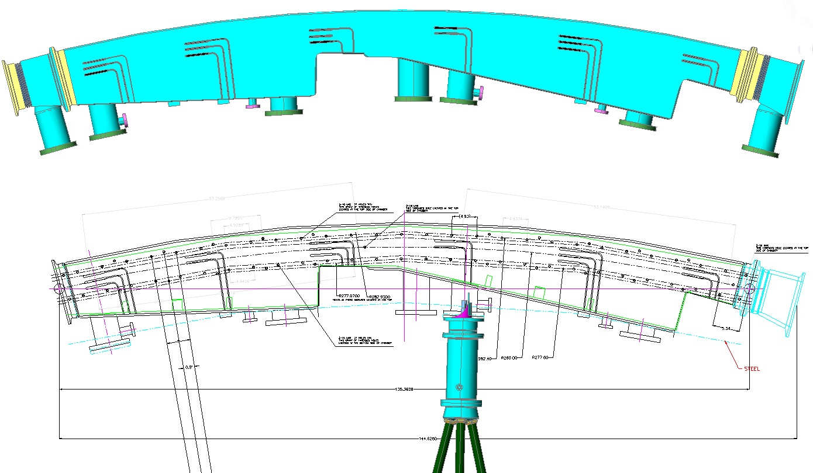

Slide 16
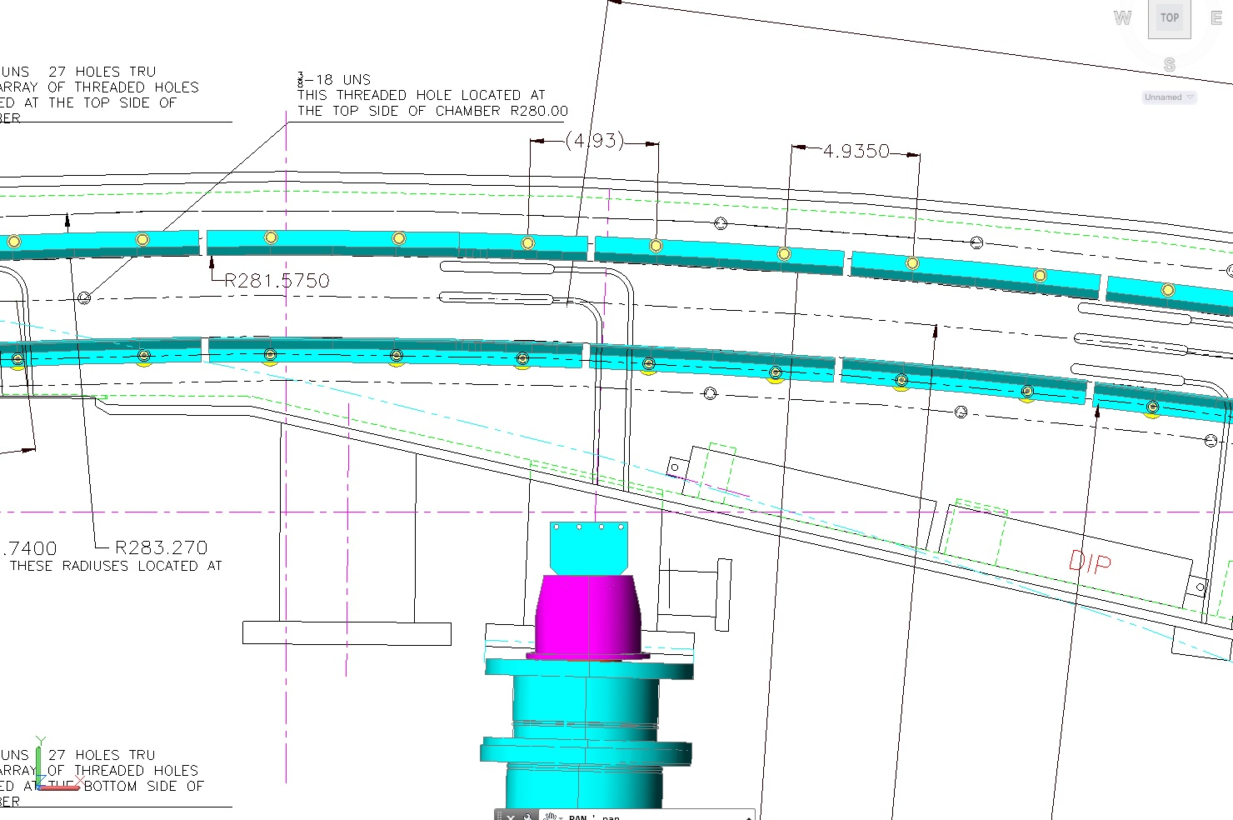

Slide 17
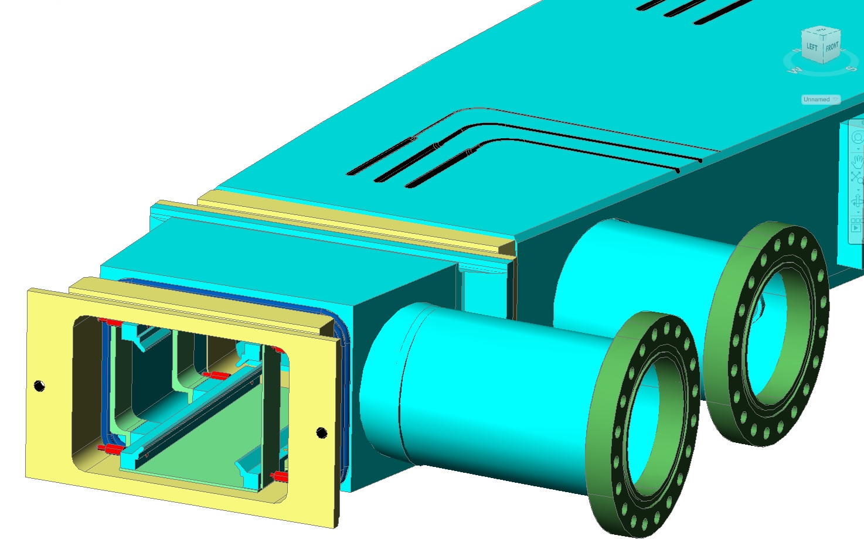

Slide 18
