Slide 1
OSC Layout Update
9/25/18
0.75m bend magnets & vacuum quality considerations

Slide 2
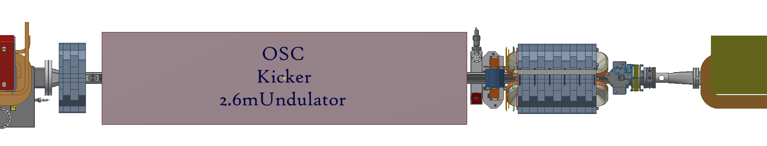
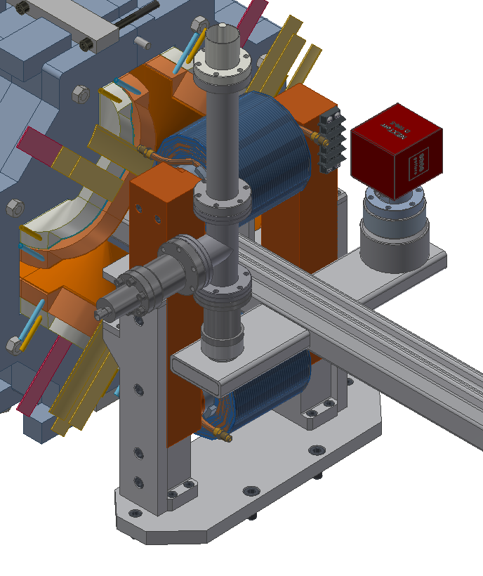
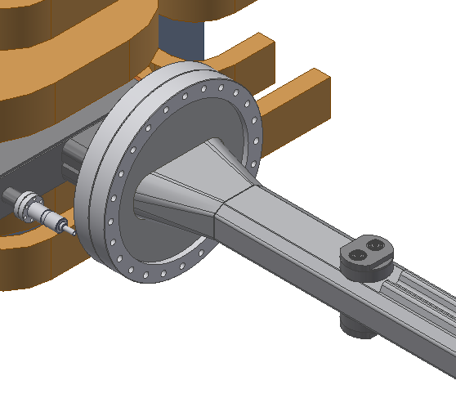
Preliminary vacuum considerations
No space for vacuum connection here,
so transition is directly welded to beam pipe
Added pump port &
CESR MK II shifted
-> 3.5cm
Additional cooling channels will be welded on region inside quad

Slide 3
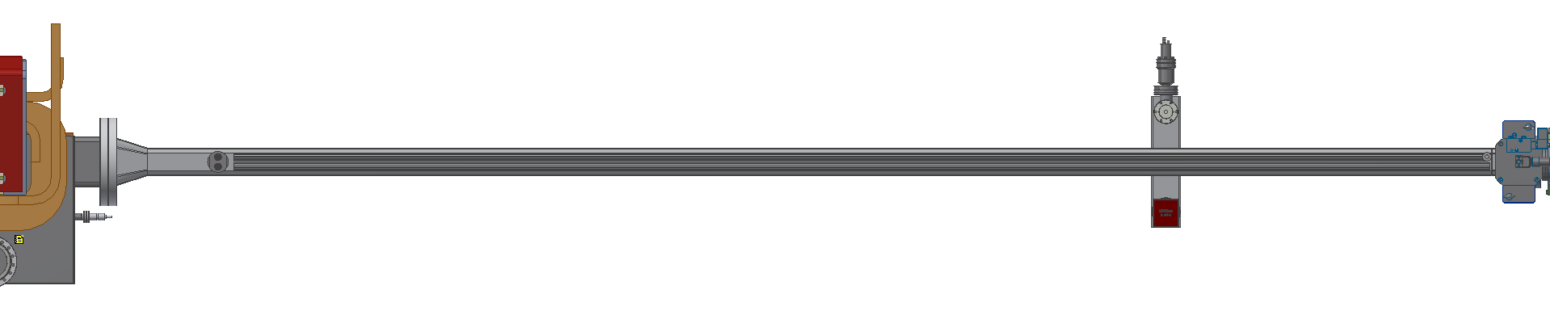
145mm -> 72mm
over 100mm length
4 button BPM
~4m section

Slide 4
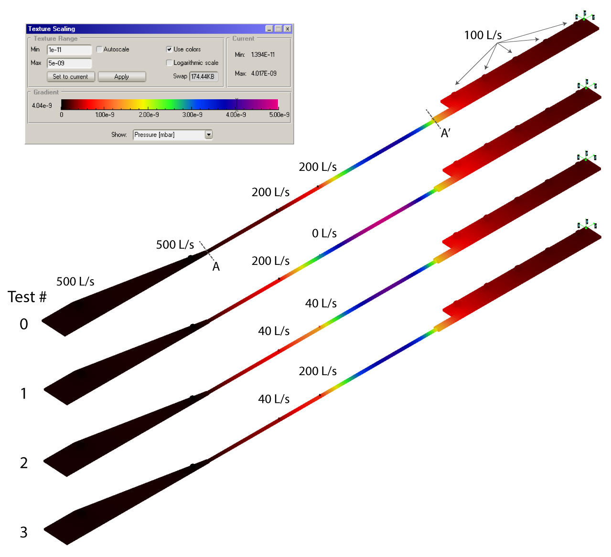
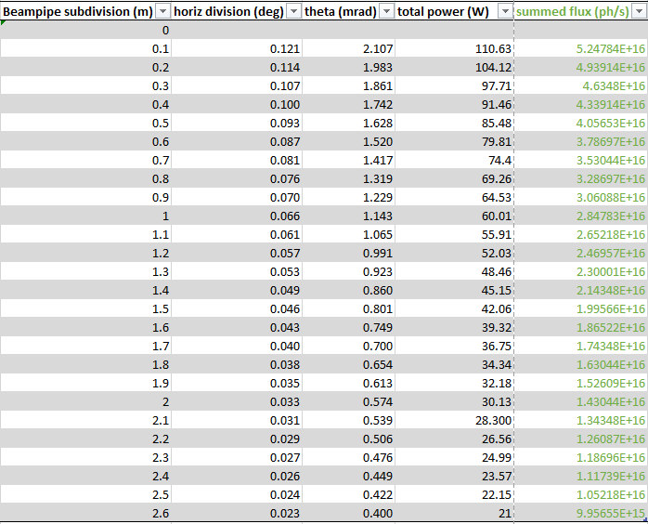
Preliminary MolFlow vacuum simulation results
simulation results show that there is a 0.5-1 decade drop in vacuum quality in the beam pipe through the undulator
the beam pipe through the undulator is subdivided into 10 cm segments and the gas load from synchrotron radiation is applied to it

Slide 5
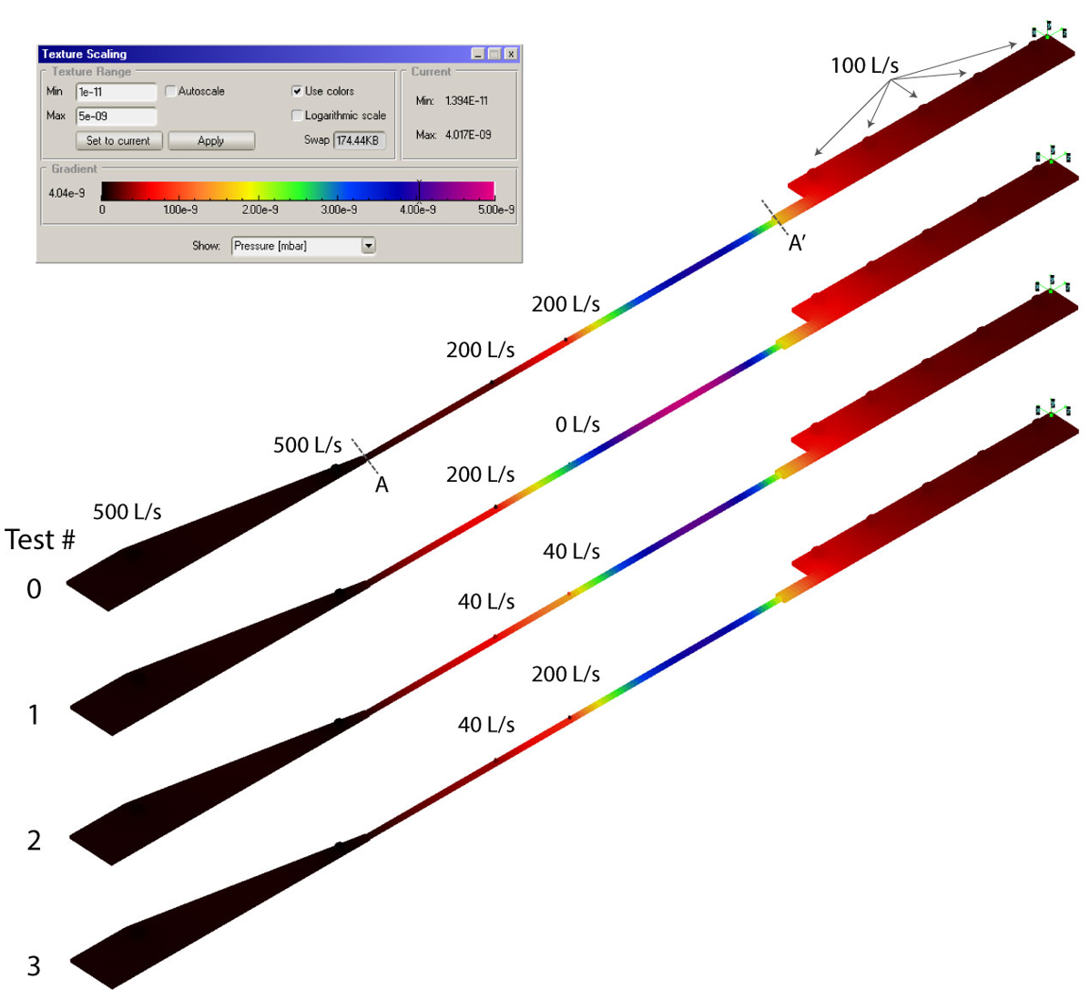
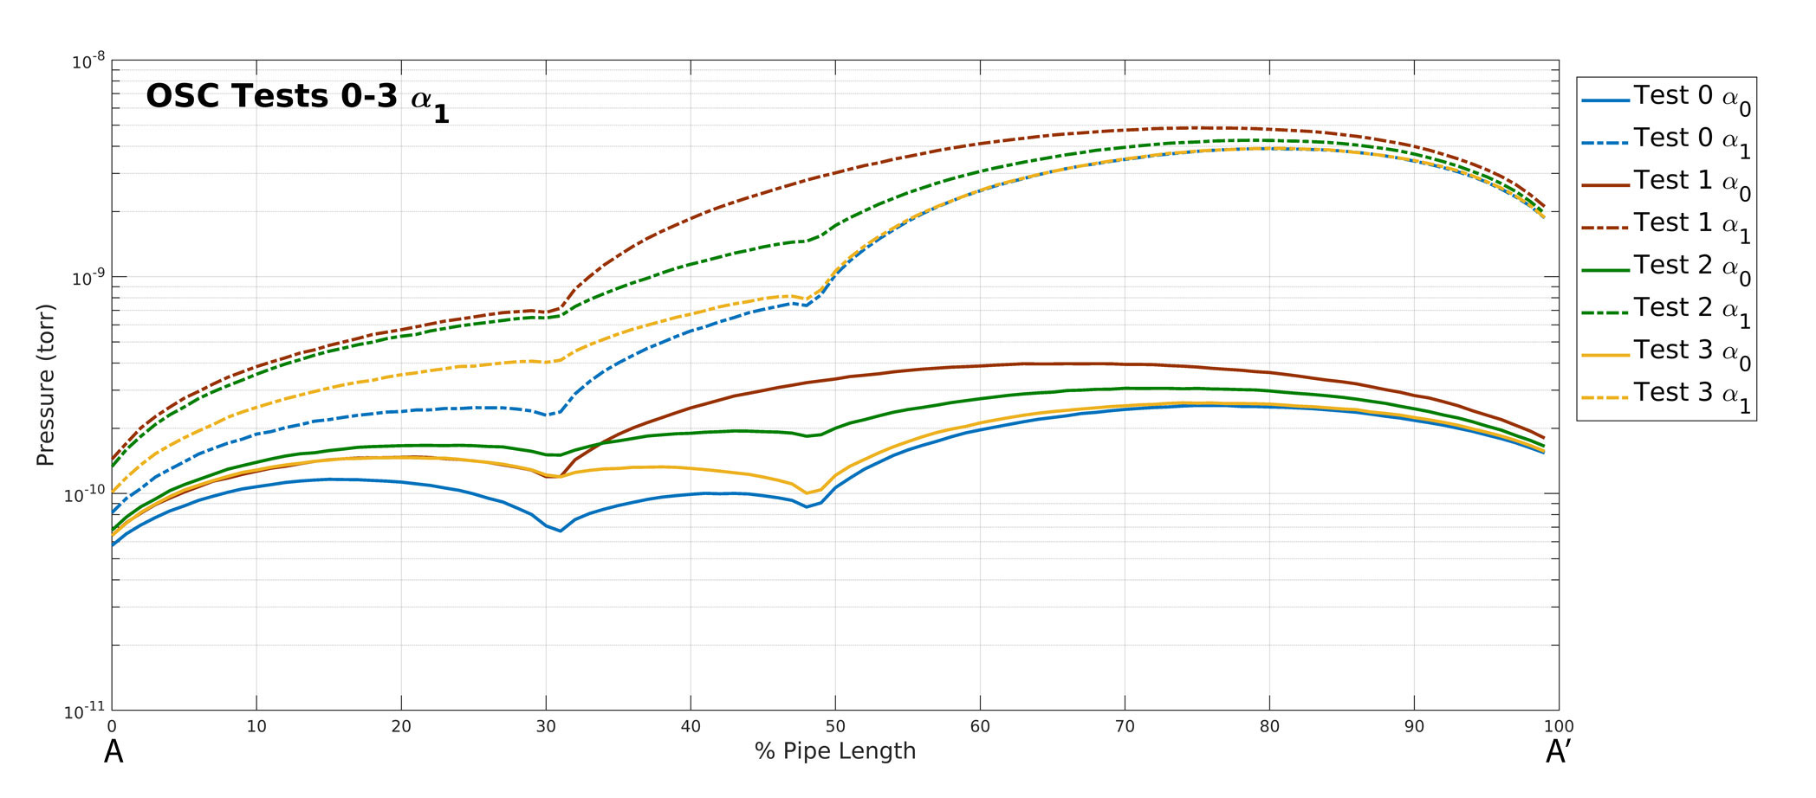
Preliminary MolFlow vacuum simulation results
Desorption yield: α₁ = 1E-5
Undulator Beam Pipe Region
α₀ is the case without SR gas load: only thermal outgassing at 1e-12 torr-l/s-cm^2

Slide 6
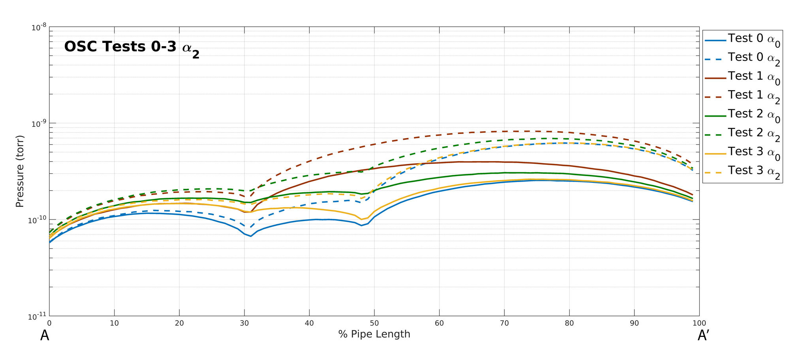
Preliminary MolFlow vacuum simulation results
Desorption yield: α₂ = 1E-6
Undulator Beam Pipe Region
α₀ is the case without SR gas load: only thermal outgassing at 1e-12 torr-l/s-cm^2

Slide 7
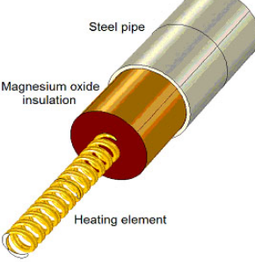

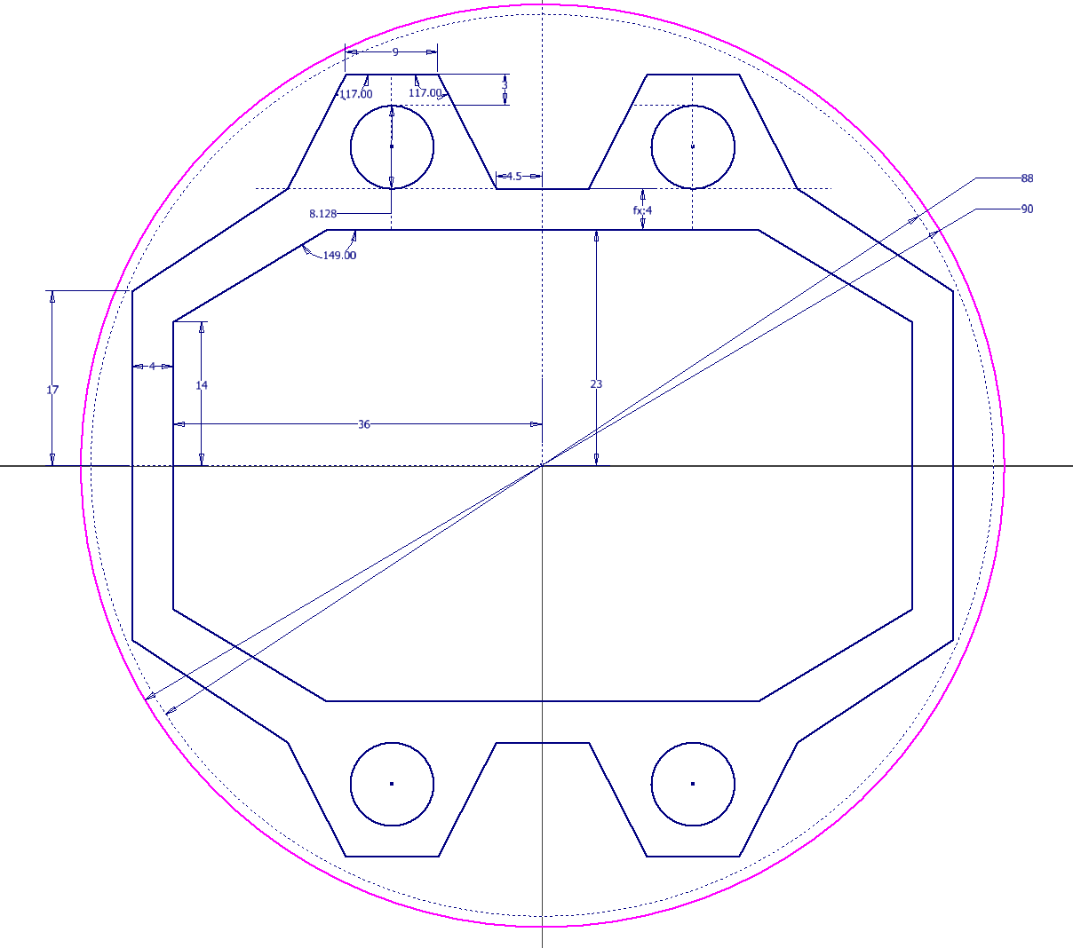
OSC Undulator 4 Channel Extrusion Profile
cooling
channel
calrod
90 mm
54 mm
46 mm
72 mm
80 mm
cooling
channel
calrod

Slide 8
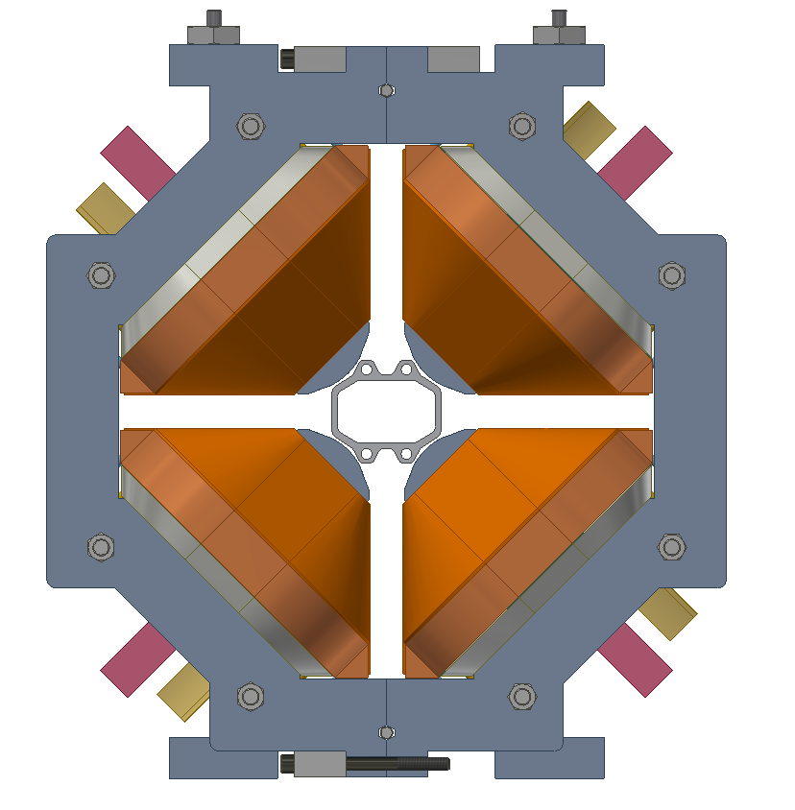
Fitment inside helical undulator and CESR MK II Quad
90 mm

Slide 9
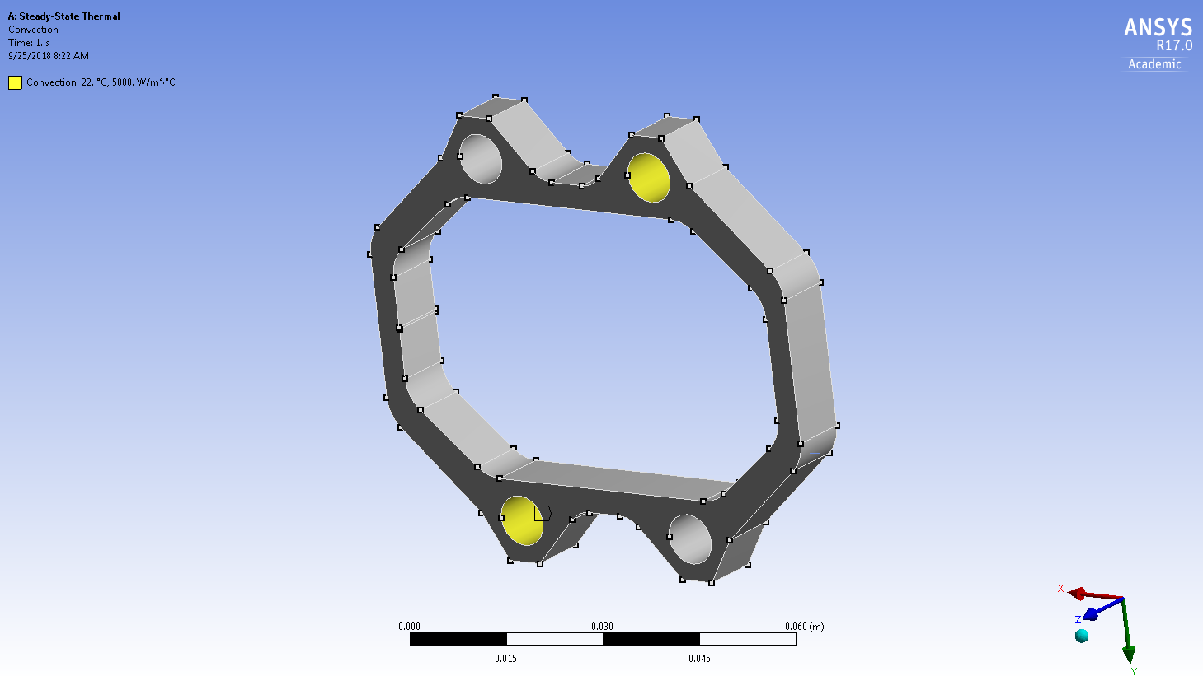
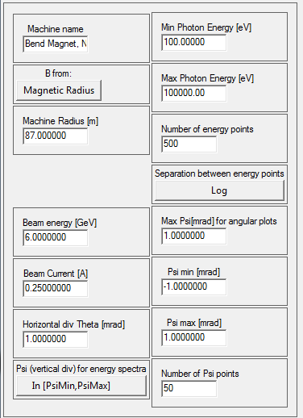
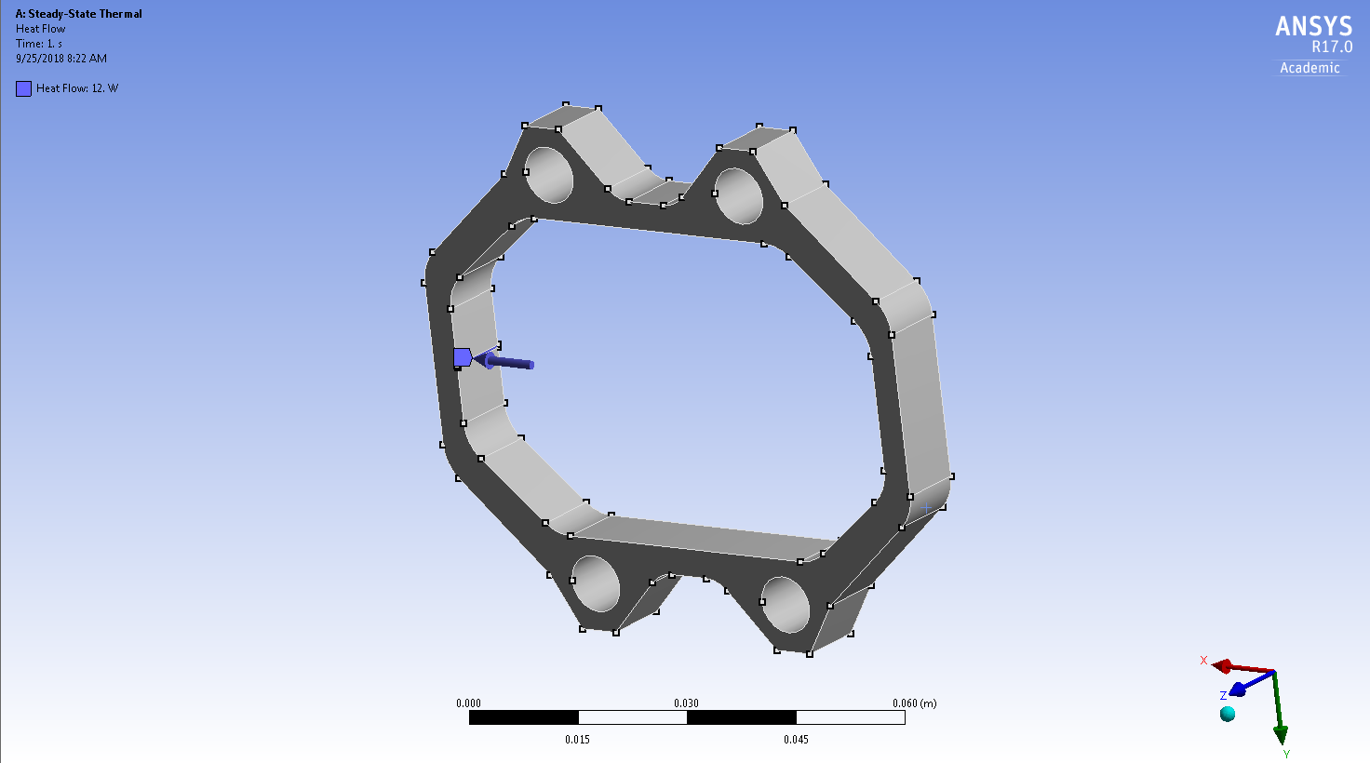
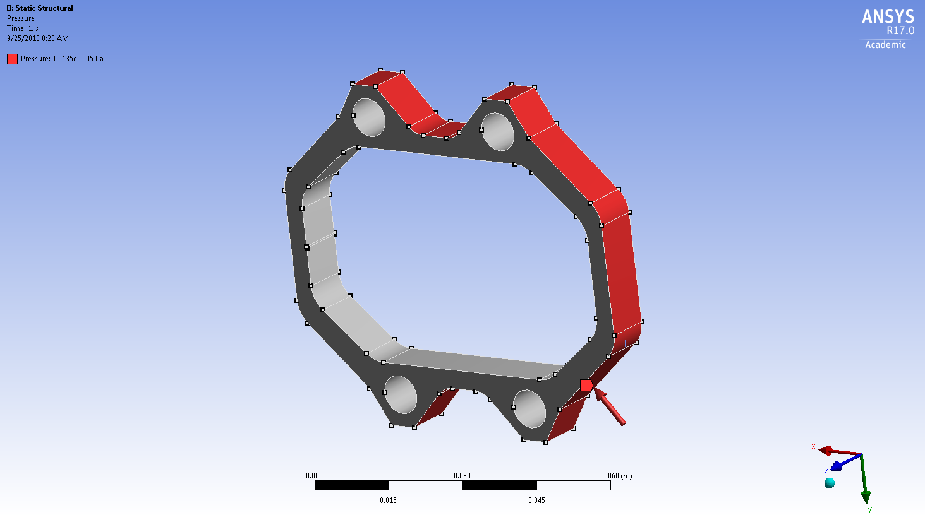
Simulation Parameters in XOP
and ANSYS
6 GeV, 250 mA
1mrad slice of bend magnet radiation
5000 W/m^2 *C film coefficient
cooling applied to opposing corners
1 atm pressure to check bending stress

Slide 10
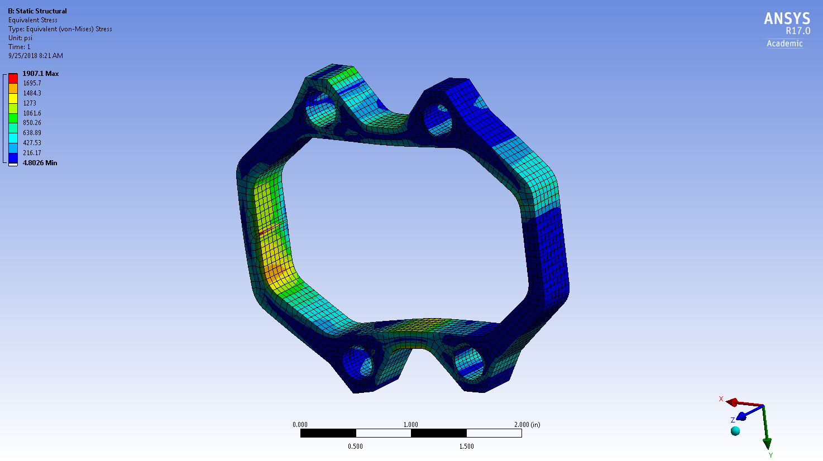
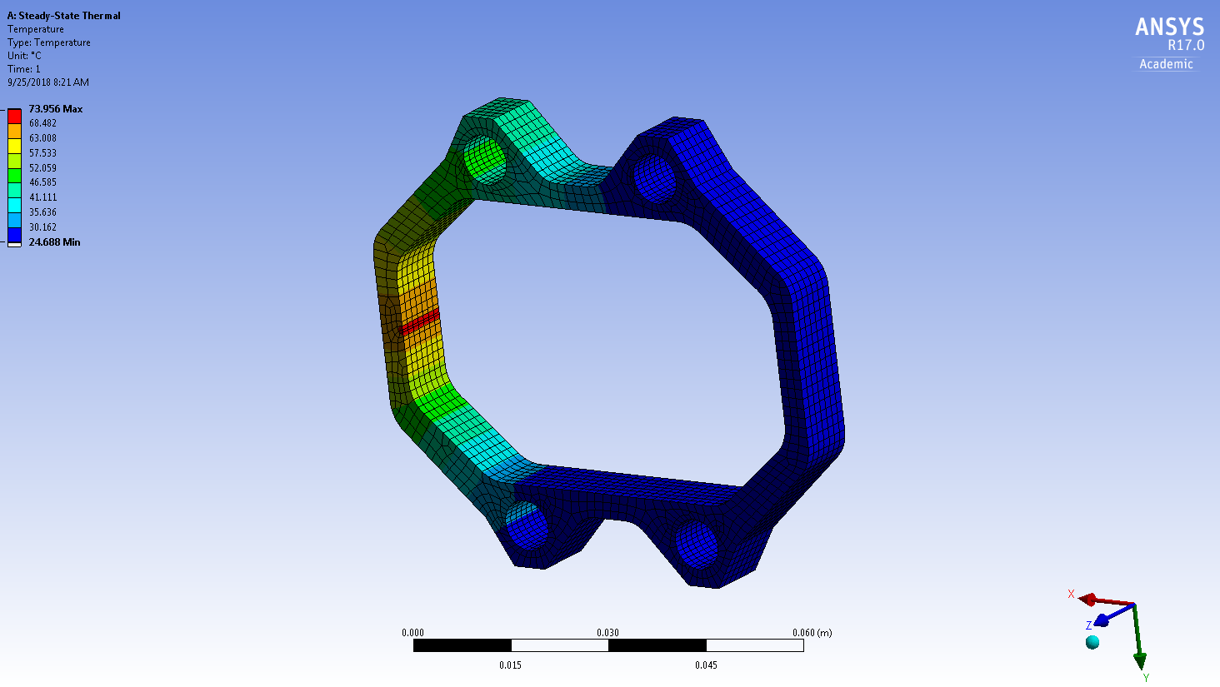
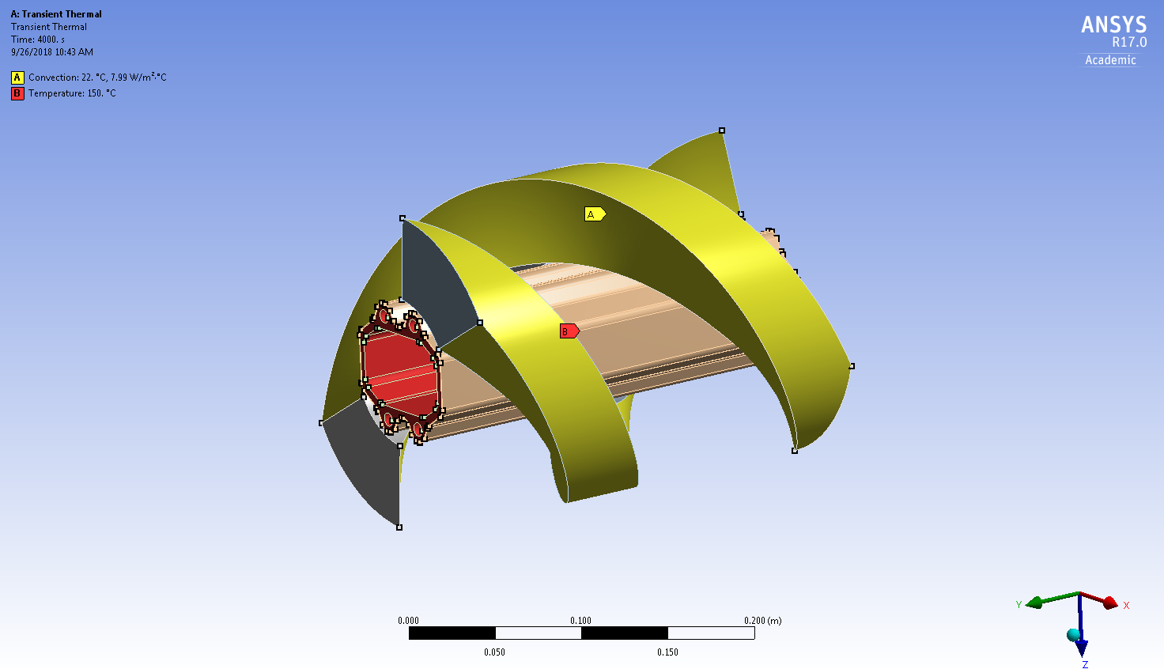
Static Stress Analysis
Conservative estimate of 74 °C peak temperature along side wall
Bending stresses OK
Thermal Analysis

