Slide 1
Bypass - layout
D.Rubin
July 18, 2018

Slide 3
B48W
B48E
Q48 (60cm, large aperture) => MKII (Q7)
Q49 (95cm, large aperture) => Q03W – mounted on movable table
Q0(E/W) – normal CESR aperture (20cm)
Q1,Q2 (E/W) – aperture to accommodate flared chamber (20cm)
4 – 1m dipoles - R=40m (2mm delay), R=30m (5mm delay)
2 undulators – 2.6m

Slide 4
2 mm delay > 9cm displacment
5 mm delay > 15 cm displacement

Slide 5
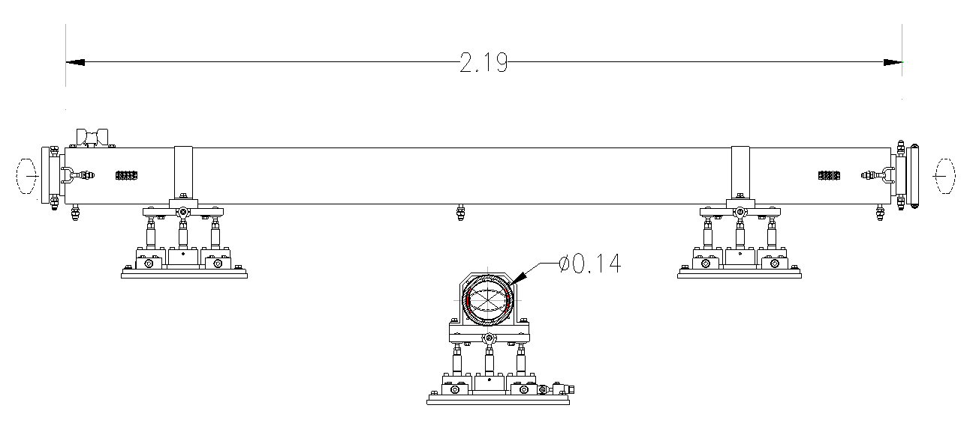
HELICAL UNDULATOR
Dimensions in meters

Slide 6
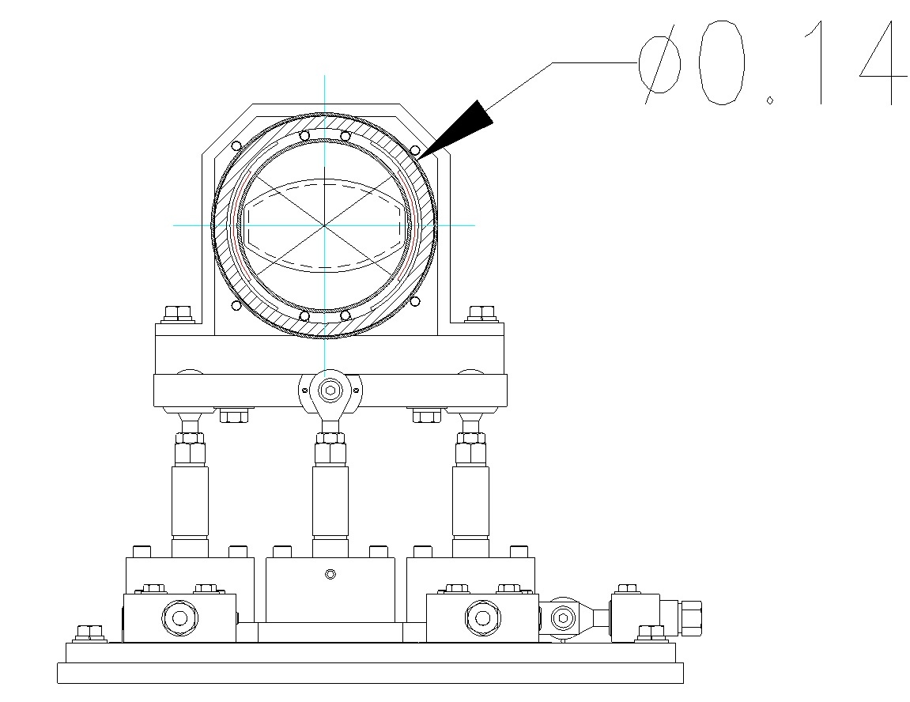
6

Slide 7
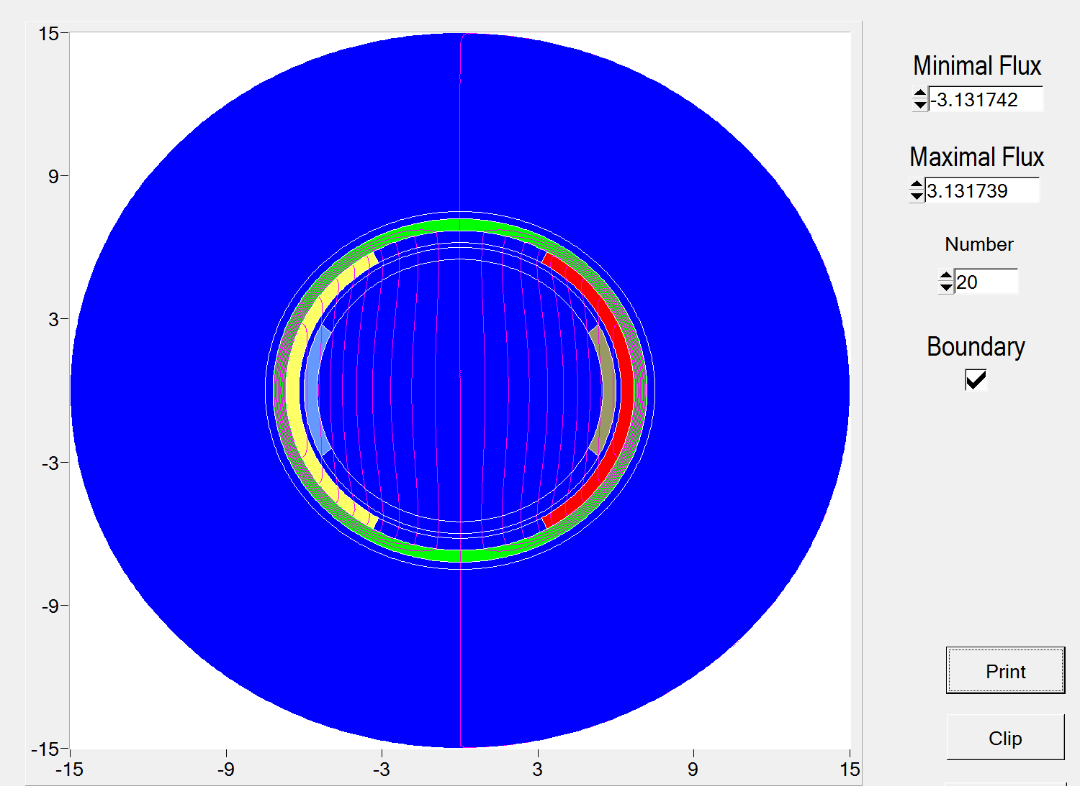
I=±0.75 kA
λ_{U} =35 cm
Iron
I=±3 kA

