Slide 1
Alexander Mikhailichenko, Jan 5 2018
UNDULATORS FOR OSC (1)

Slide 2
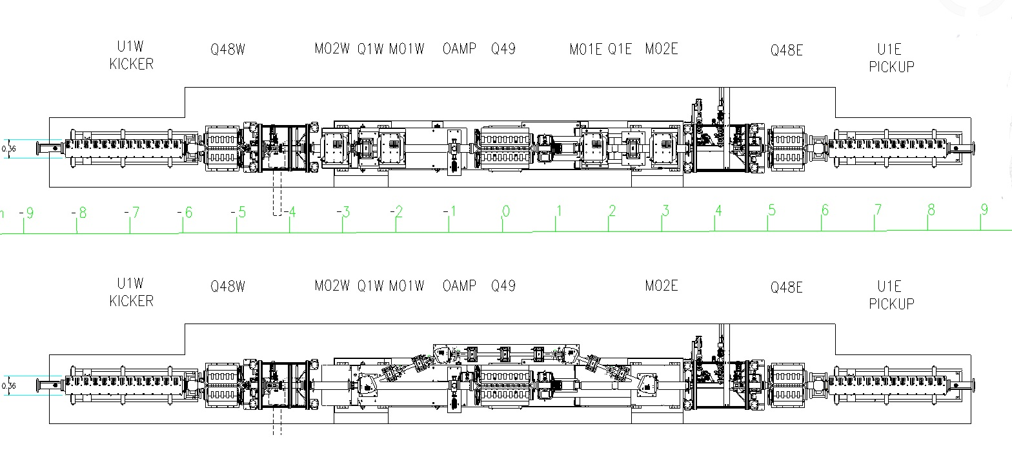
Variant 1: WIDE CHAMBER
UNDULATOR
UNDULATOR
OPTICAL AMPLIFIER
UNDULATOR
UNDULATOR
Variant 2: SEPARATE CHAMBER

Slide 3
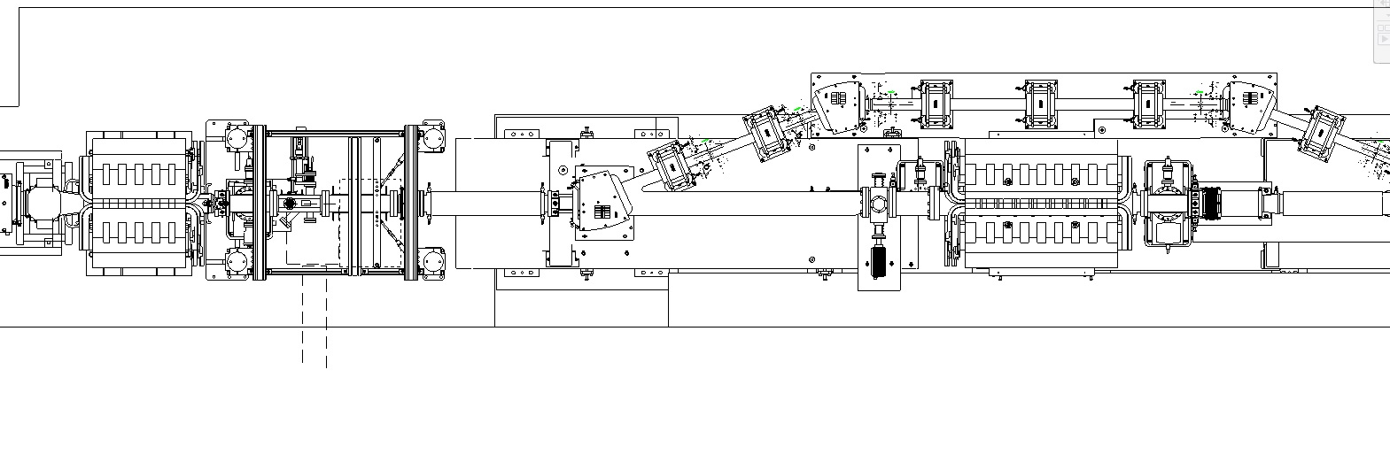
ZOOMED…
56 cm
Kicker undulator
Sextupoles

Slide 4
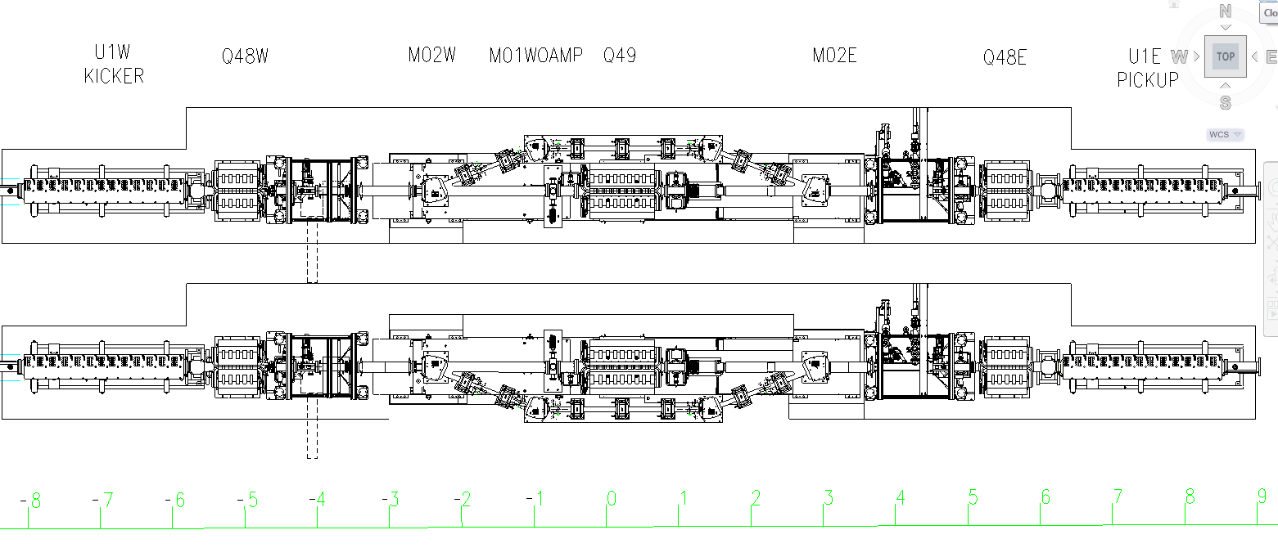
TWO ORIENTATIONS OF BYPASS- INSIDE OR OUTSIDE…
Inside allocation might give some relief for design of crotch

Slide 5
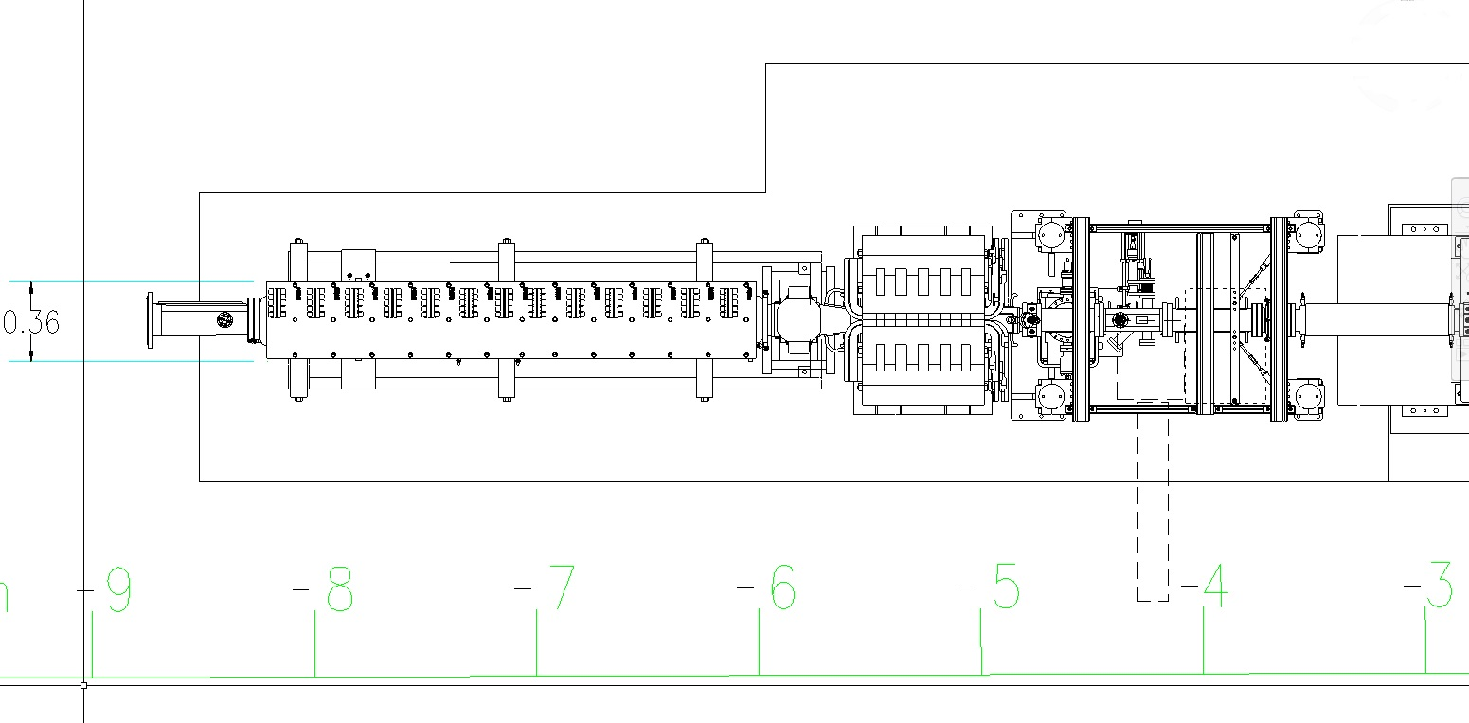
REGION AROUND UNDULATOR
Q48W
Numbers in meters from center of Q49

Slide 6
Two types of undulators are possible: the planar one and the helical one
In planar undulator the odd harmonics only have nonzero intensity in straightforward direction
In helical undulator the first harmonic only has nonzero intensity in a straightforward direction;
When the energy is higher, period of undulator should be bigger or amplifier should work at
higher frequency;
Dependence on the K-factor is favorable for a helical undulator;
$K≤1, γ$ $≈800 (for now)$

Slide 7
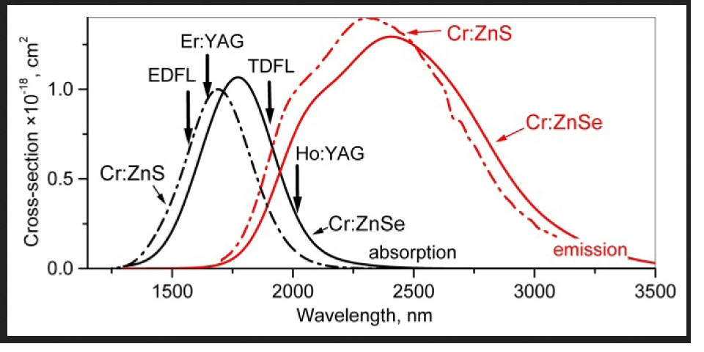
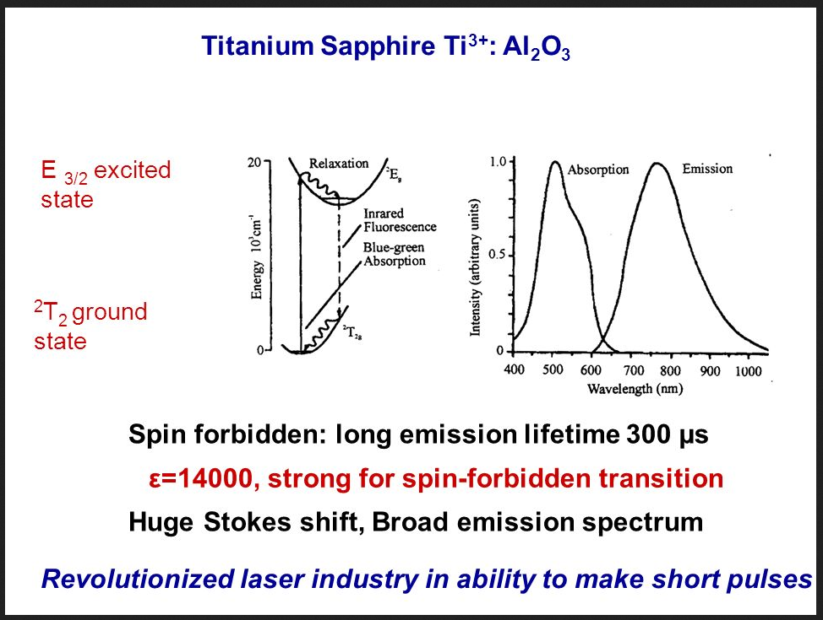
Cr:ZnSe
Ti:Al₂O₃

Slide 8
So, two wavelengths are:
λ _{Ti:AlO}≈750nm and λ _{Cr:ZnSe}≈2500nm
With $K≈1, γ$ $≈800 \left(400MeV\right) this yields:$
With $K≈1, γ$ $≈600 \left(300MeV\right) this yields:$

Slide 9
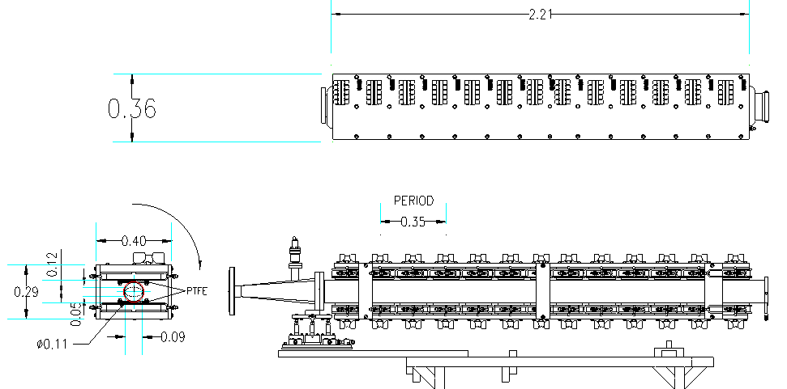
PLANAR UNDULATOR
--keep constant, while tapering at the edge with K=1/4; 3/4; 1

Slide 10
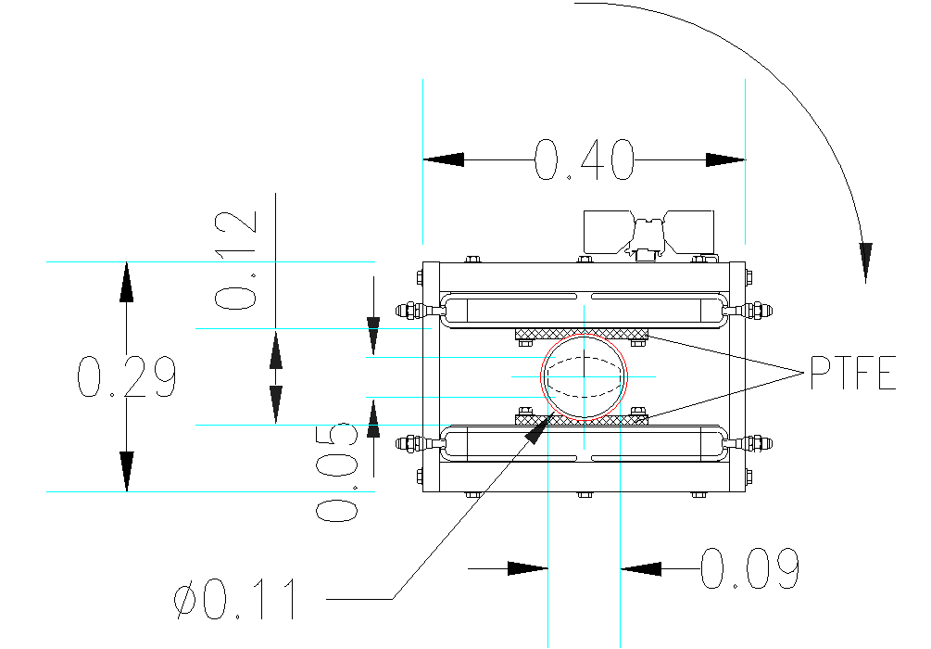
CROSS SECTION SCALED VIEW
Undulator could be tilted by 90º

Slide 11
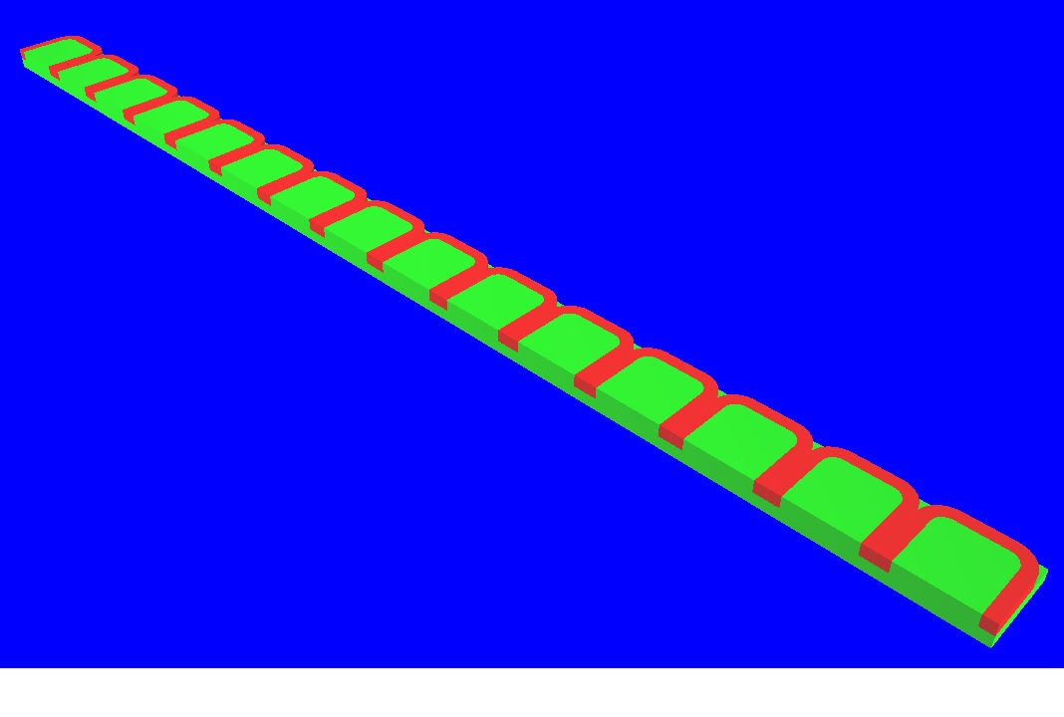
¼ of undulator

Slide 12
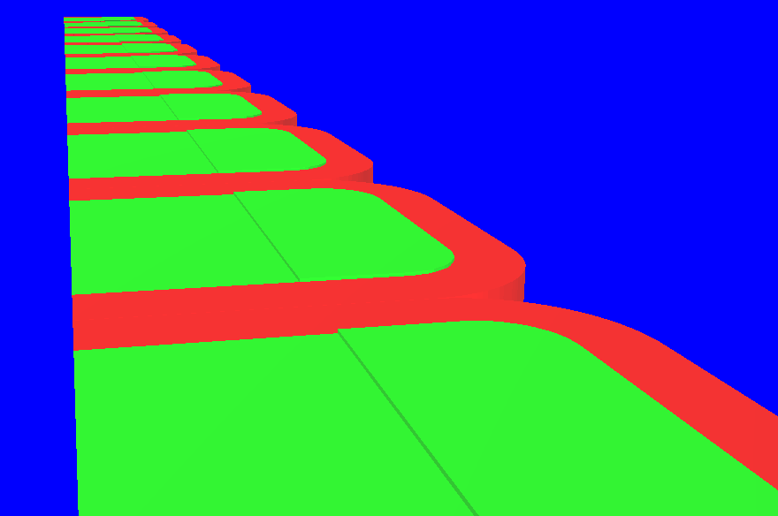
More detailed view…

Slide 13
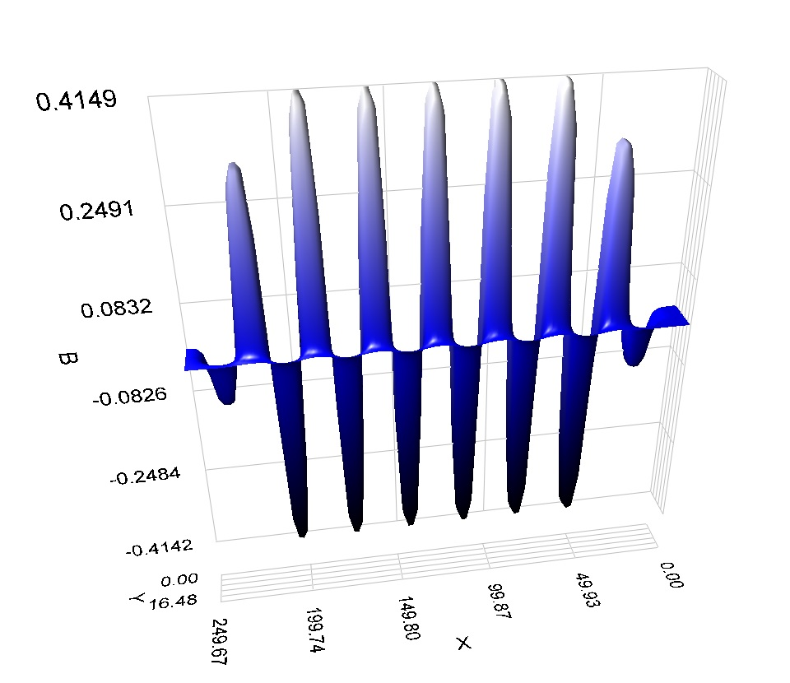

Slide 14
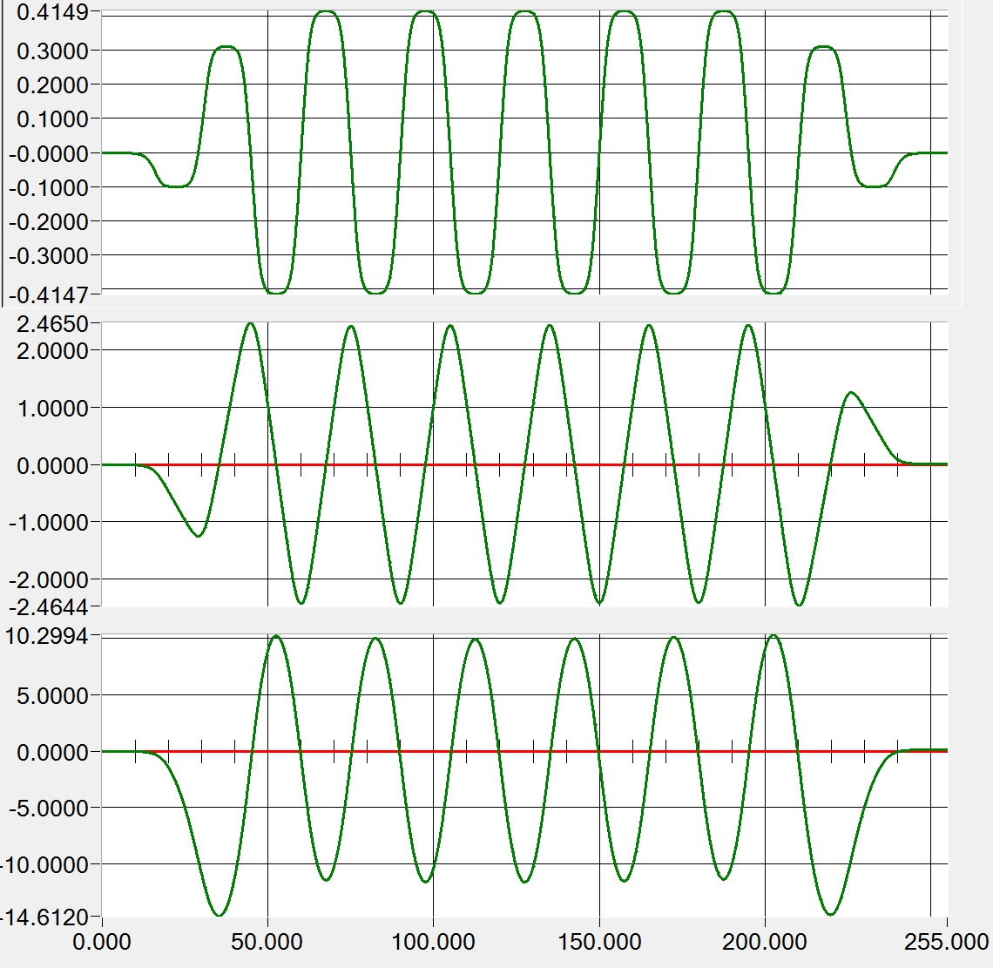
kG
Field elevation →
kGxcm
First integral →
kGxcm²
Second integral →

Slide 15
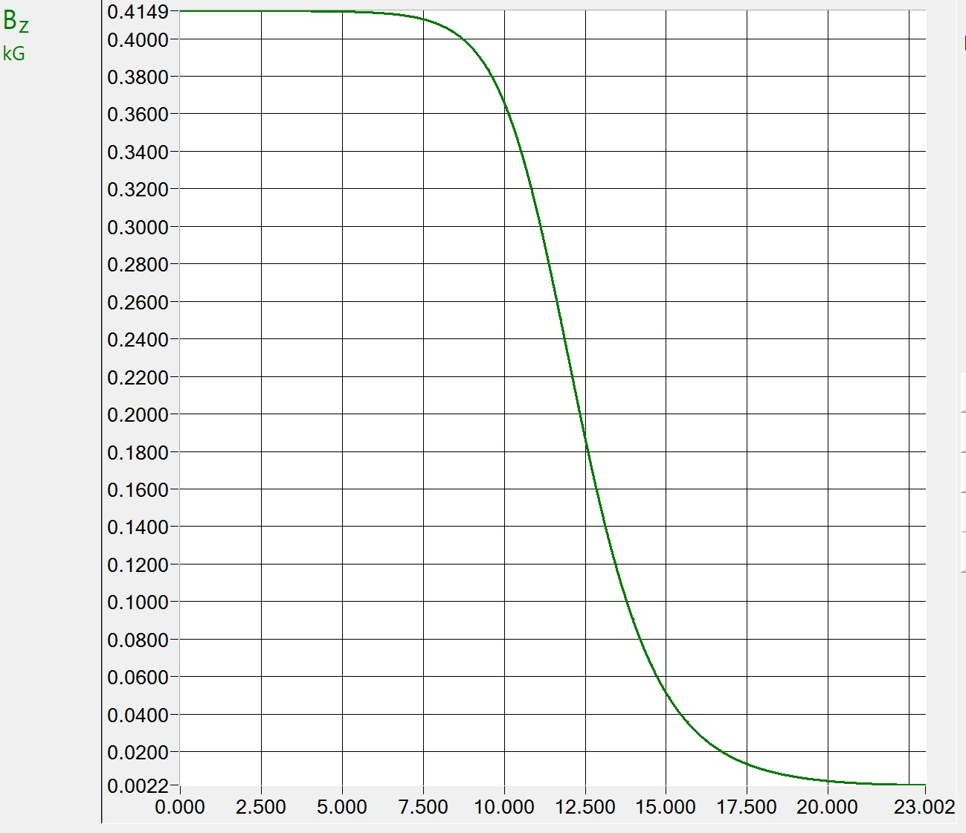
Field elevation across the pole apart from center
Current density is
2.5 A/mm² ;
1kA total;
K≈1.15

Slide 16
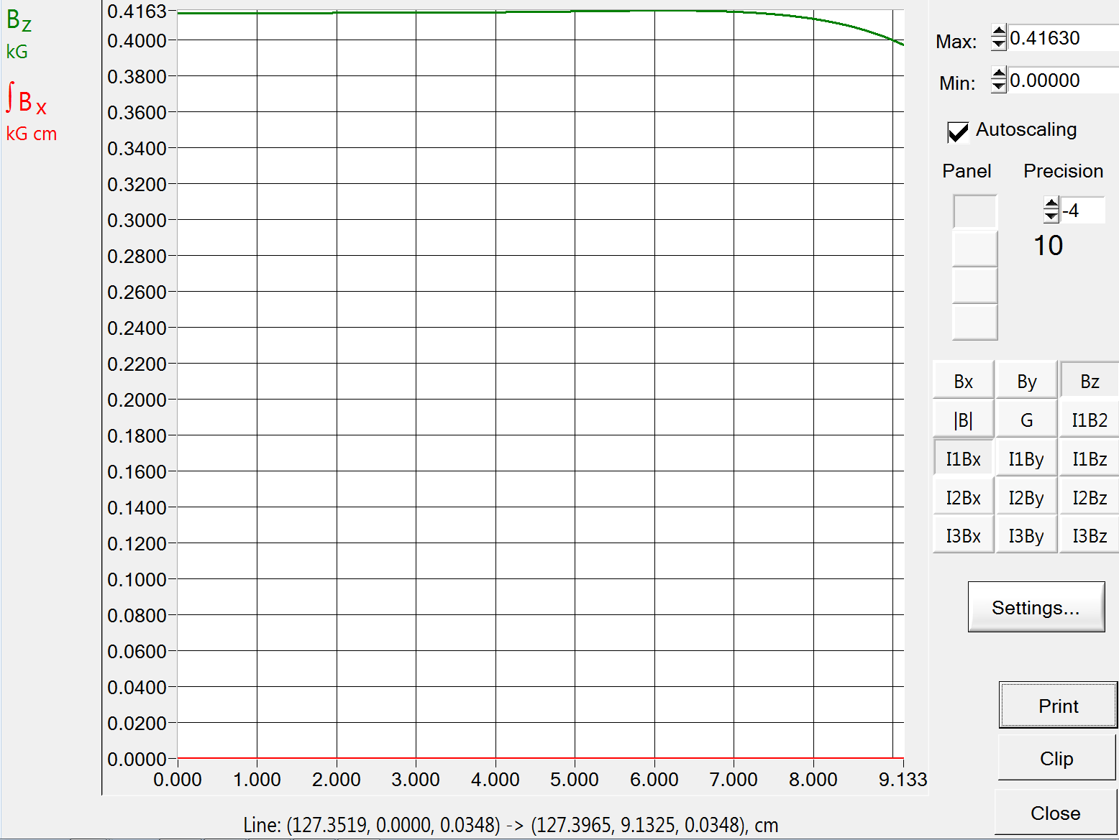
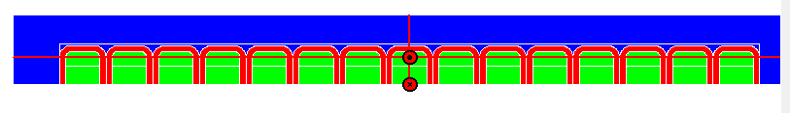
Central region zoomed…
To this point
From this point

Slide 17
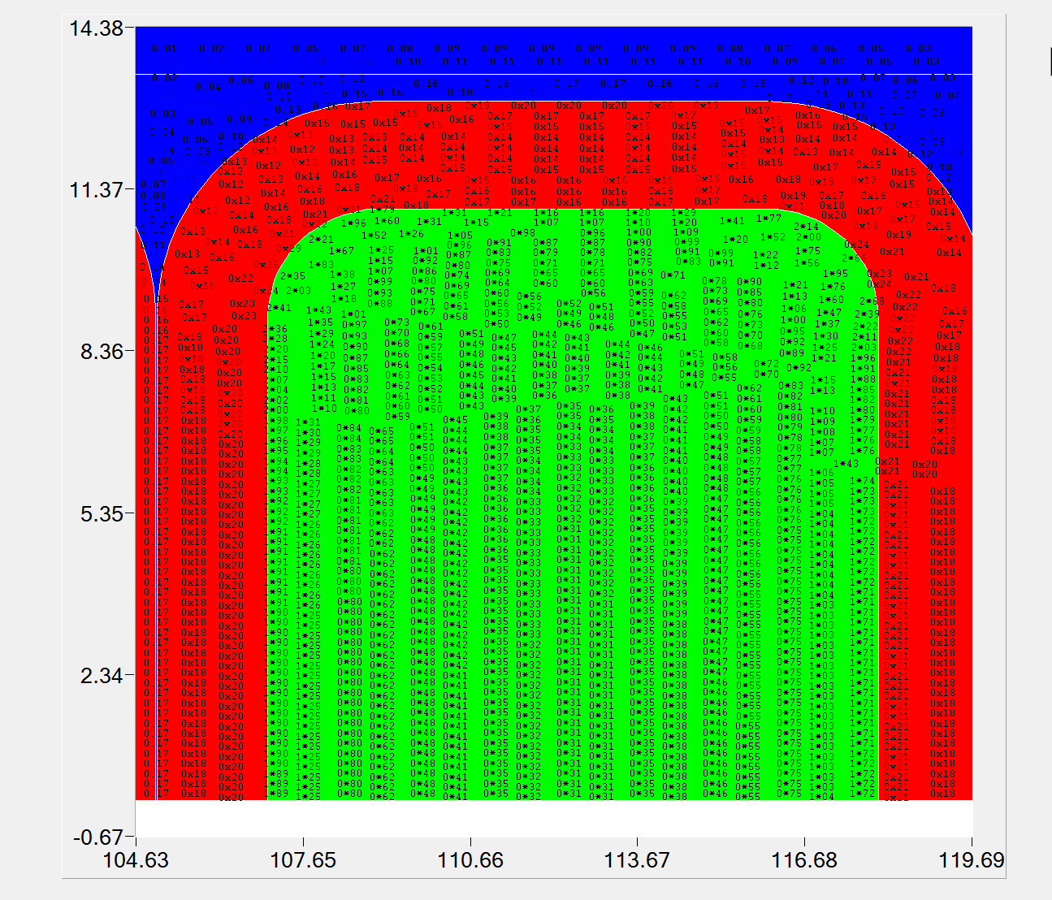
Digital map across the pole

Slide 18
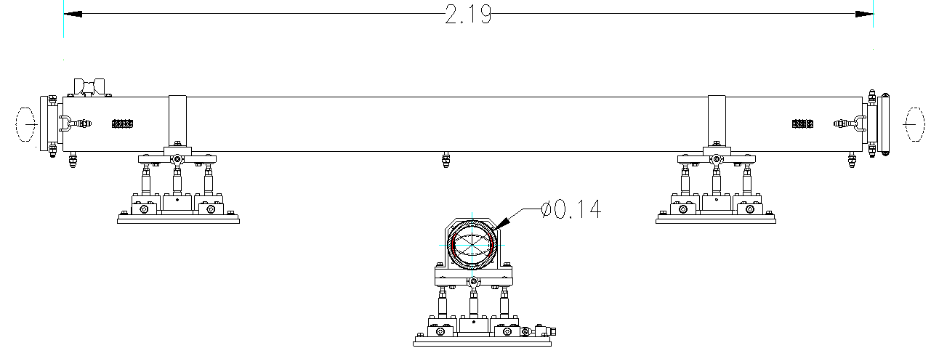
HELICAL UNDULATOR
Dimensions in meters

Slide 19
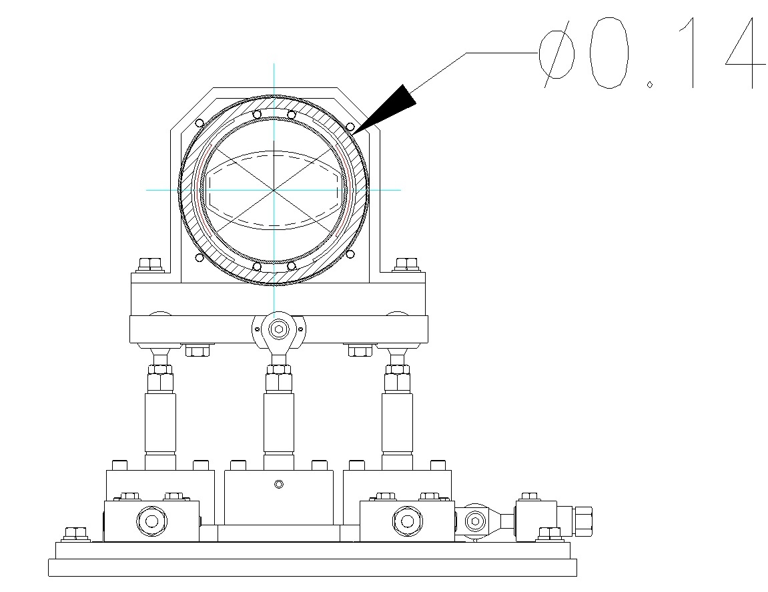
Could have an option to be tilted

Slide 20
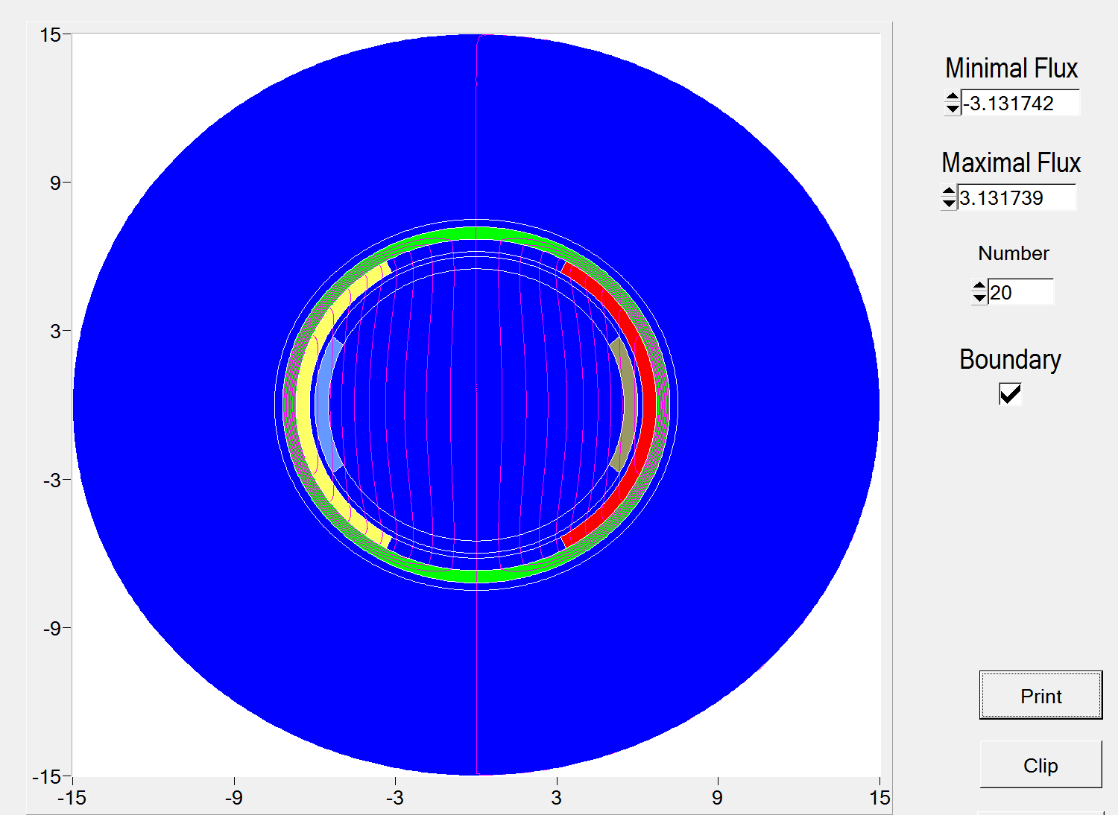
I=±0.75 kA
λ_{U} =35 cm
Iron
I=±3 kA

Slide 21
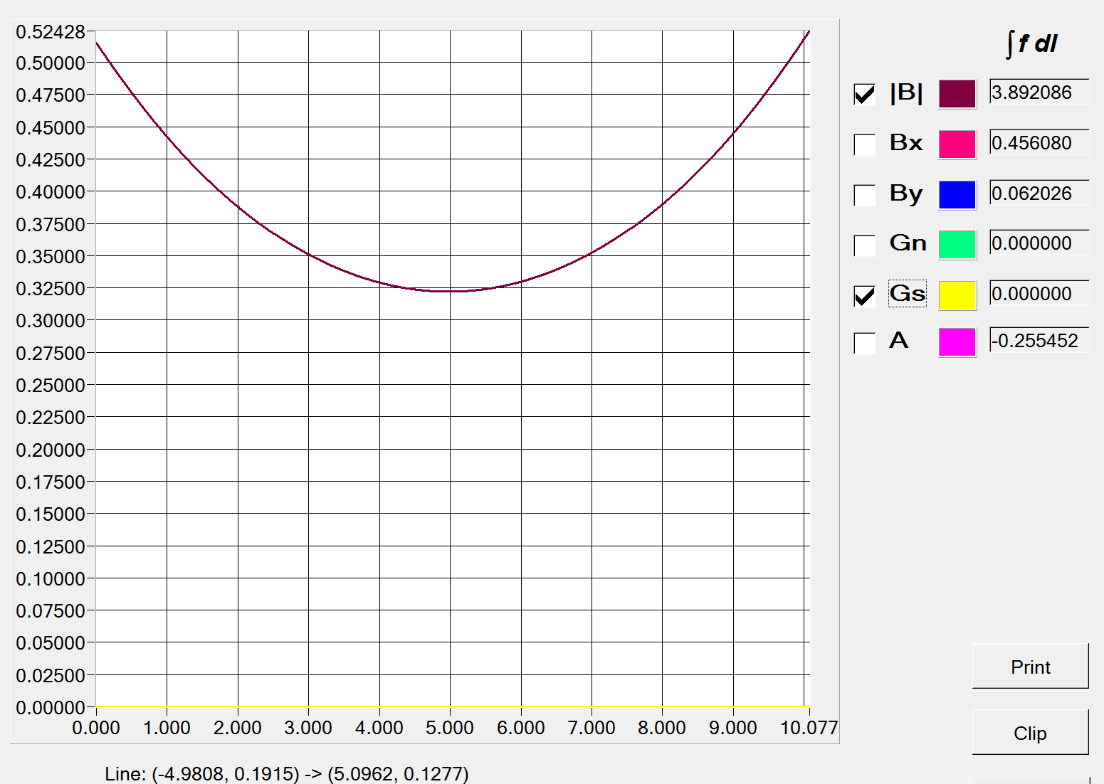
Dipole mode
λ_{U} =35 cm
I=3+0.75 kA (total)
K=1.06
For current density 15 A/mm², the cross section comes to be
Area≈250 mm²

Slide 22
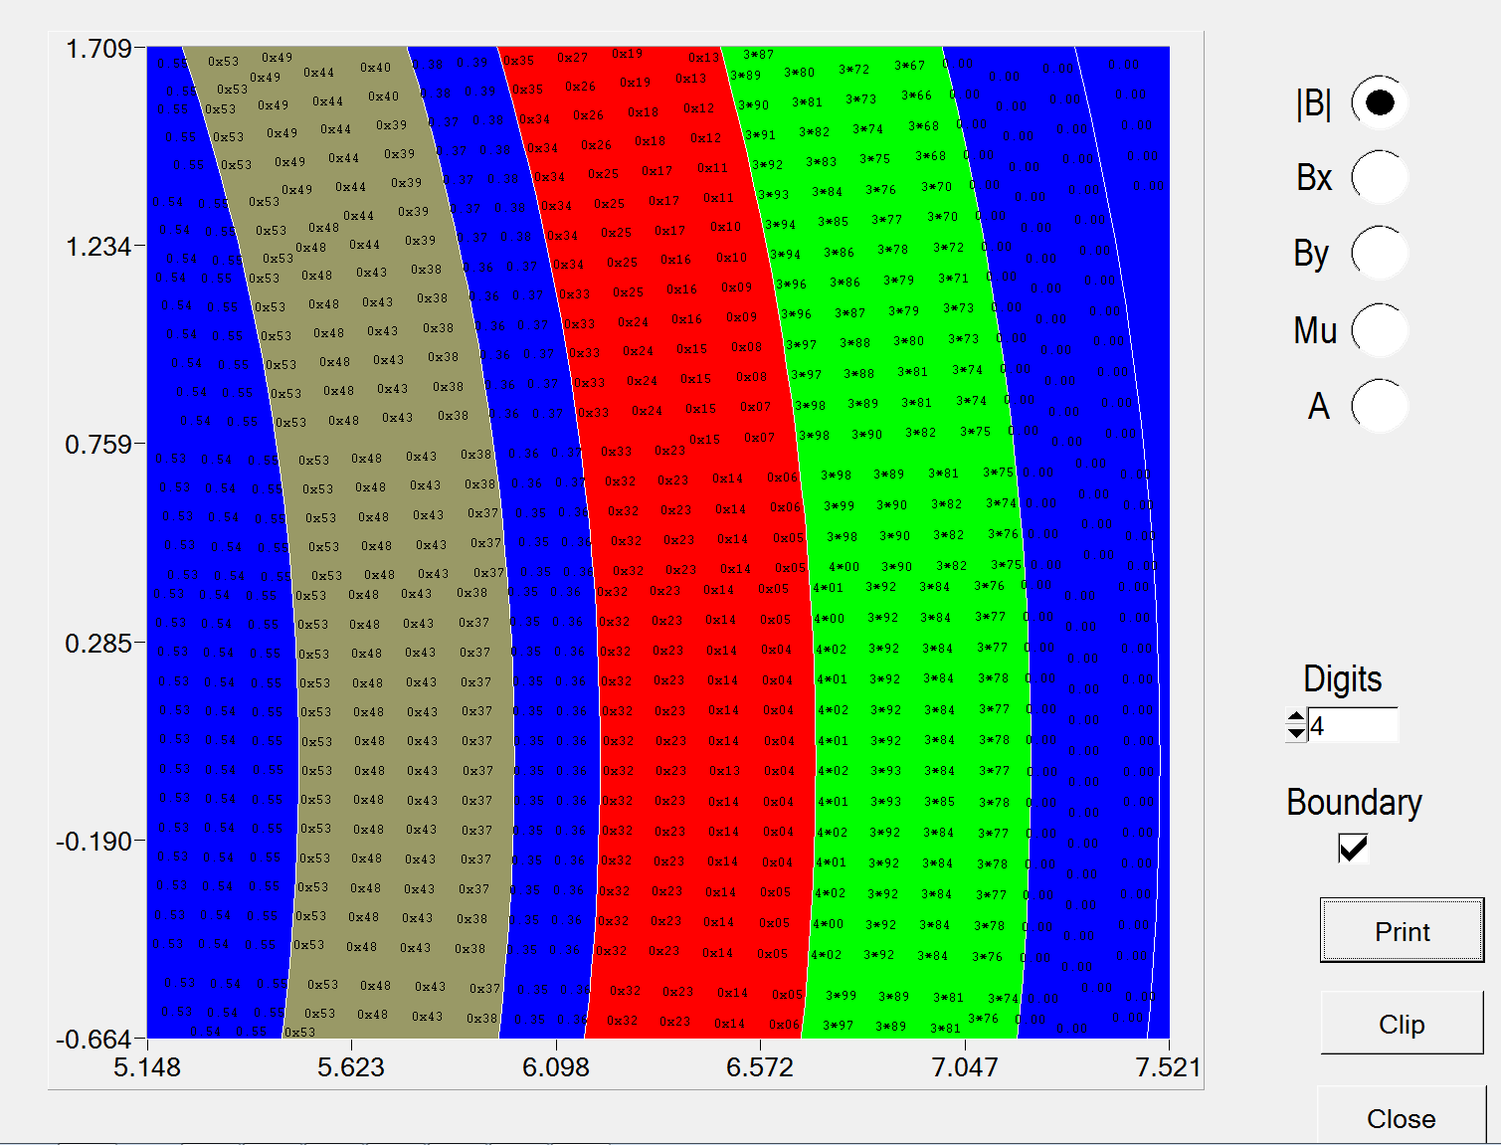
~4 kG max in Iron

Slide 23
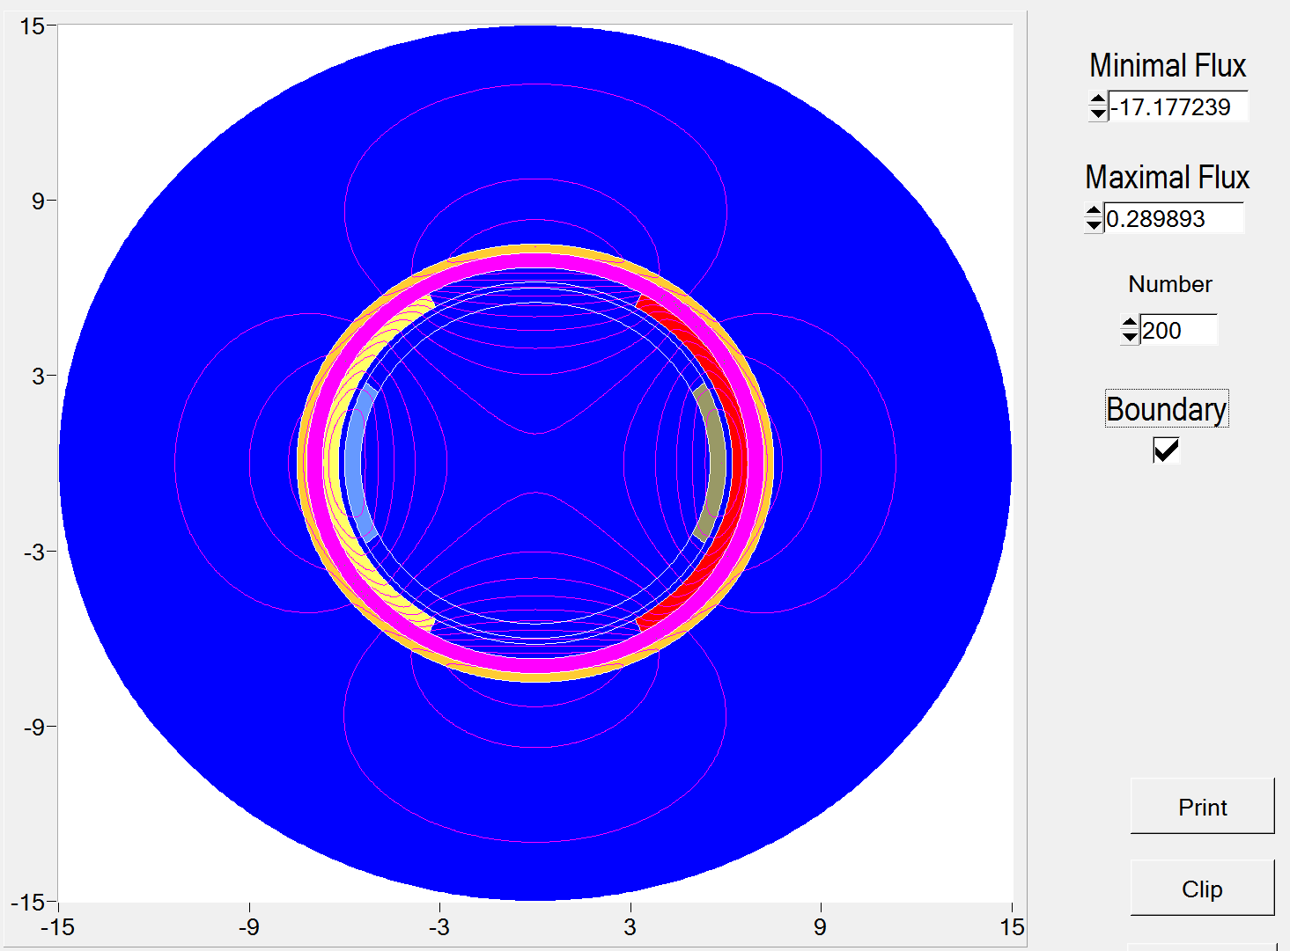
HELICAL UNDULATOR IN A QUADRUPOLE MODE
I=-7.5 kA

Slide 24
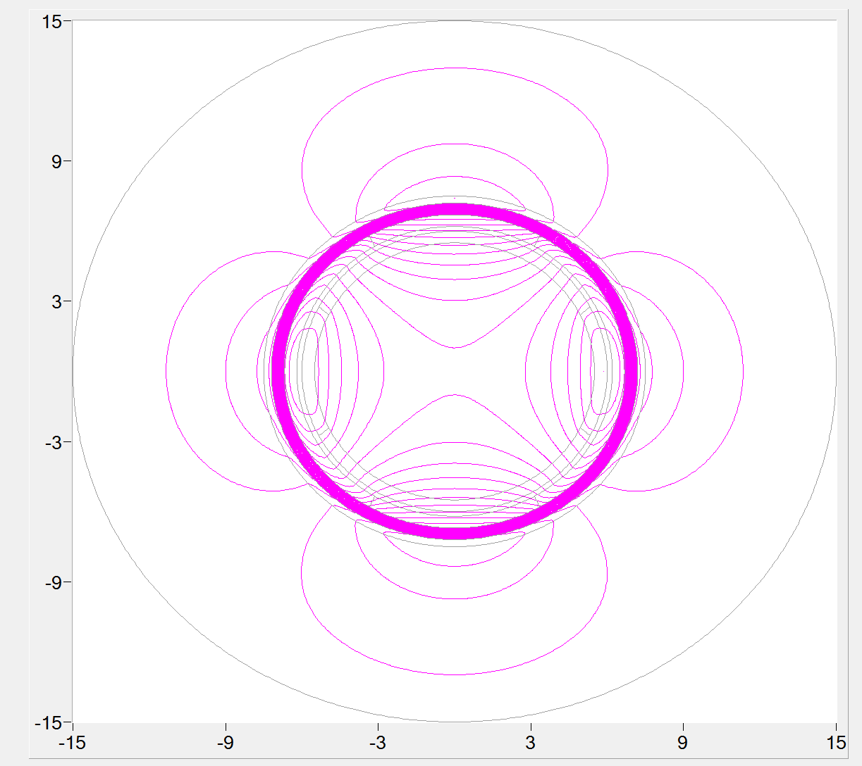
The same as in previous slide, but without painting the boundaries…
Period of helix=35 cm

Slide 25
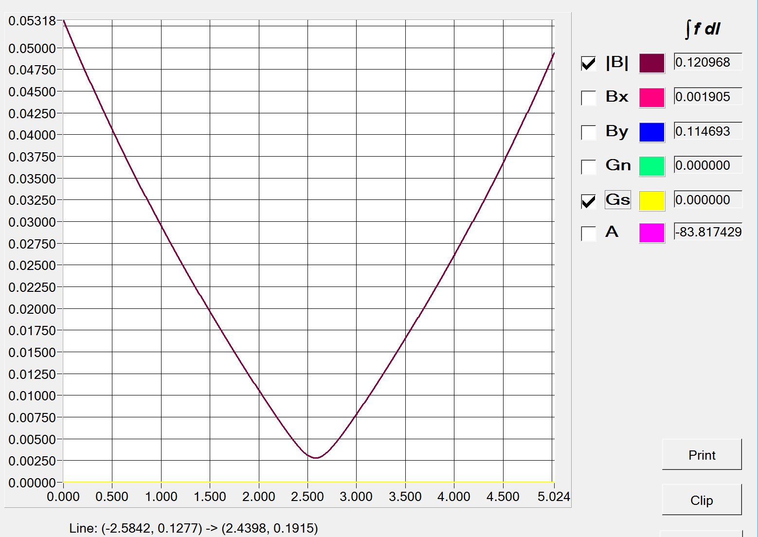

Slide 26
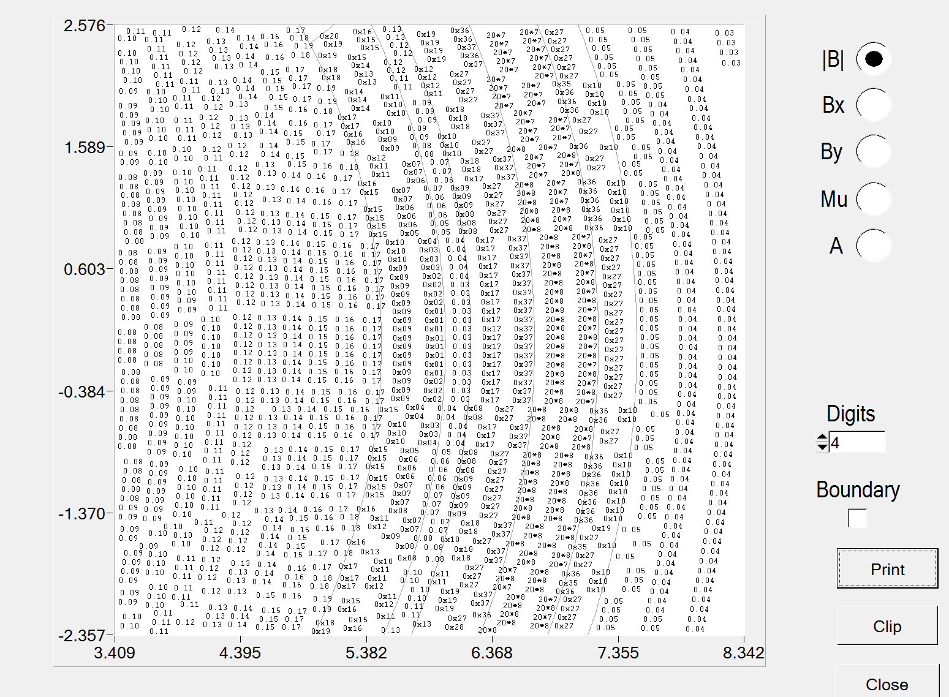
20 kG in few places…

Slide 28
Planar dipole undulator is a no risk option (design and construction)
Helical dipole undulator is the same
Smallest operational energy of CESR is a decisive parameter…
Drawings could be made in one month after the final version is chosen

Slide 29
THE END

Slide 30
k

Slide 31
