Slide 1
Test of Optical Stochastic Cooling in CESR
September 27, 2017

Slide 2
Stochastic Cooling
Equilibrium emittance is a property of the storage ring magnet configuartion and beam energy
Stochastic cooling is a technique for reducing the emittance with a high bandwidth feedback system
  Damping rate scales with the bandwidth of the feedback
  SC proven effective with proton beams that have no radiation damping in the microwave regime (~ GHz– damping times measured in hours
Optical stochastic cooling is stochastic cooling with feedback that operates in the optical band (million GHz) – damping times < seconds - allowing promise for reducing emittance in electron beams
All feedback systems have:
  Pickup to measure the position or energy
  Kicker to correct the position and/or energy error
CESR multibunch feedback uses a BPM as pickup and a strip line kicker (100 MHz)
Optical stochastic cooling uses undulators for pickup and kicker

Slide 3
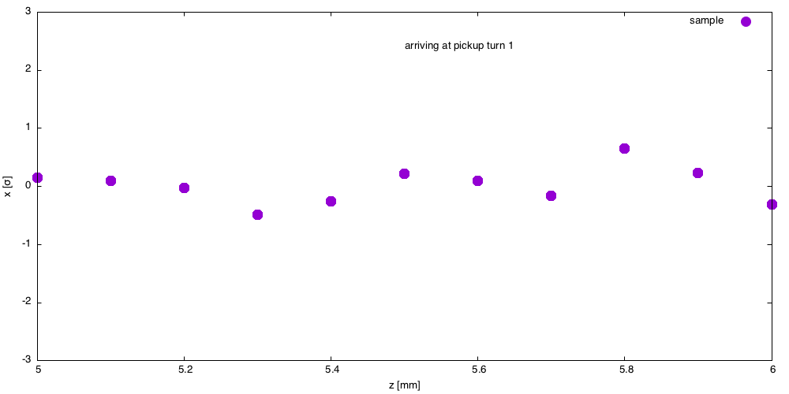
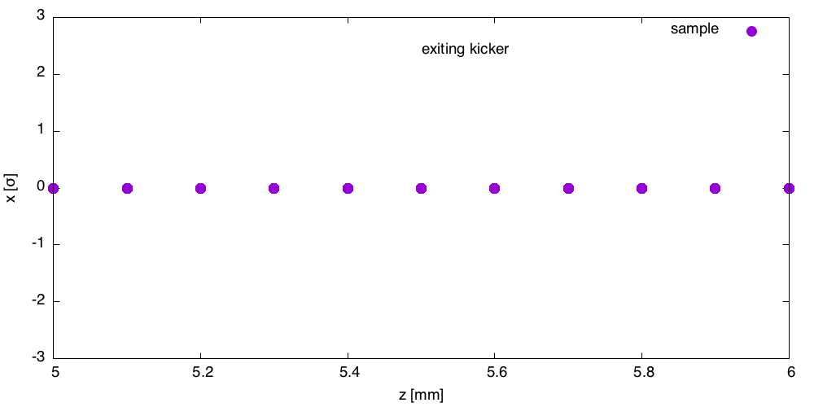
Multi bunch Feedback
Kicker corrects offset
Pickup measures offset
Each represents centroid of distributon of particles

Slide 4
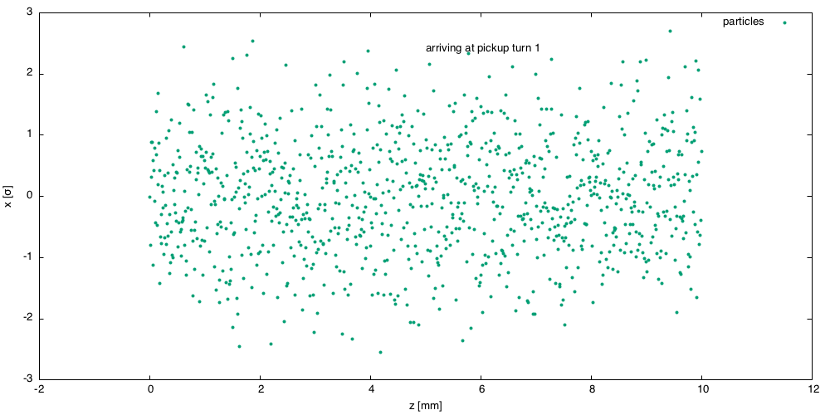
Each bunch is a collection of particles
Goal: reduce bunch width (emittance)
=> cool the beam
Bunch width σ_{x} = 1
Bunch length = 10 mm

Slide 5
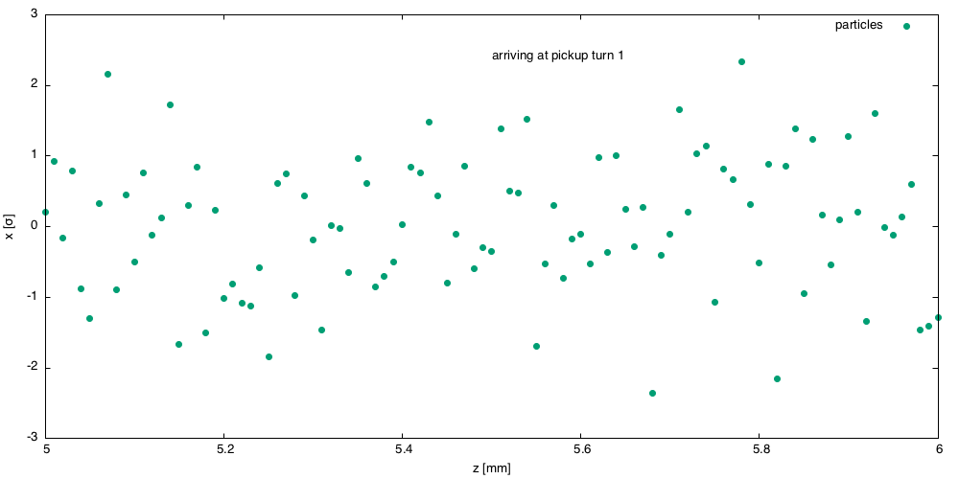
0.1 mm slice of the distributioin

Slide 6
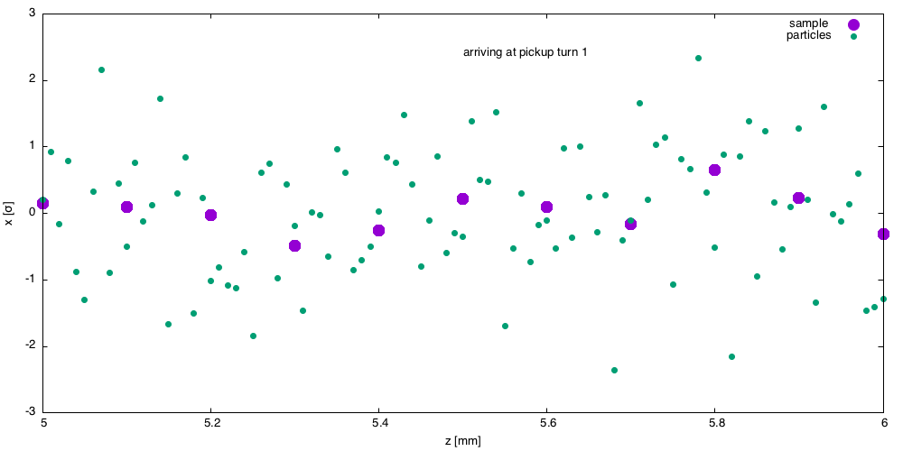
Centroid of 0.1mm sllice

Slide 7
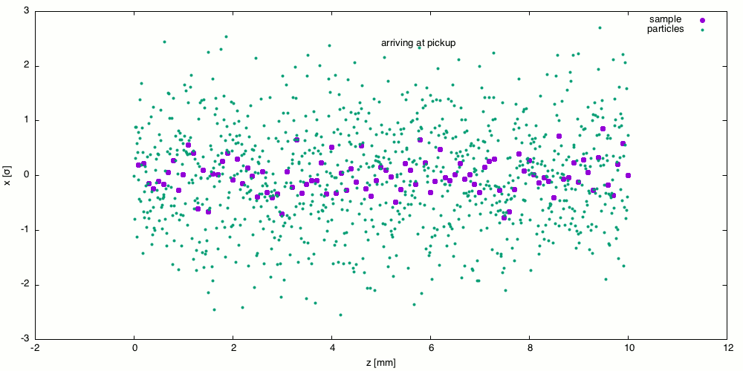


Slide 8
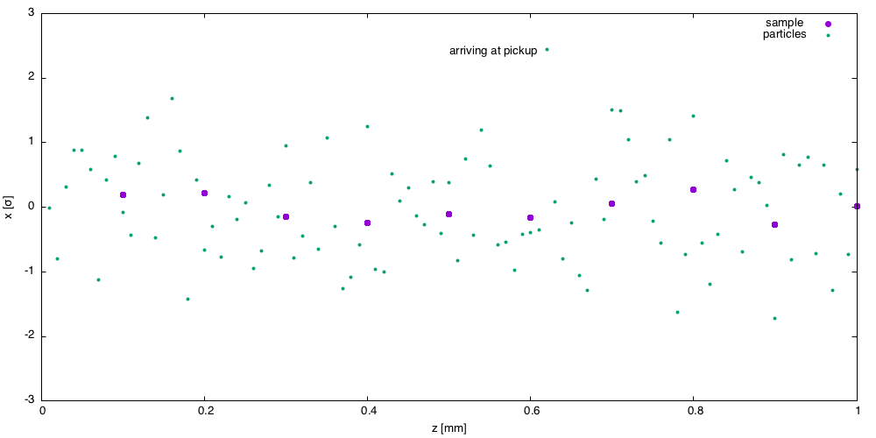

Slide 9
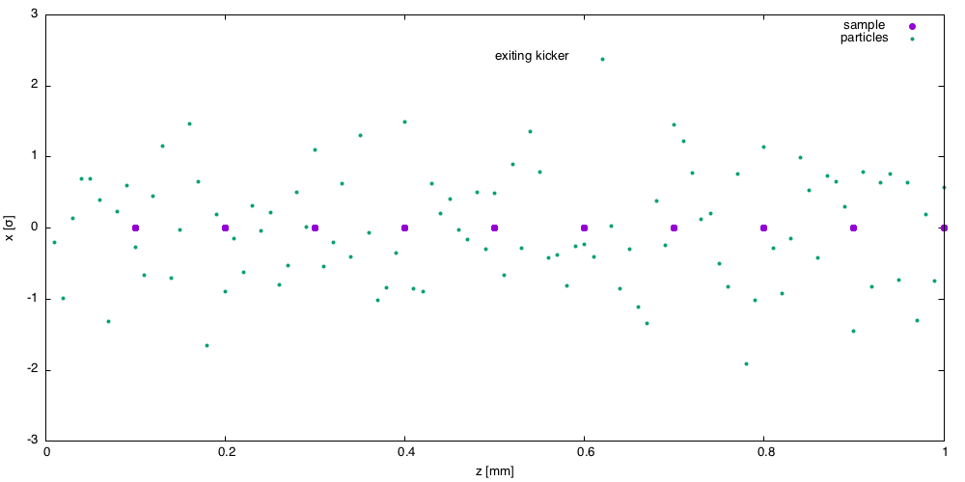

Slide 10
Mixing as particles travel around the ring.
Now centroid of each slide is no longer at zero

Slide 12
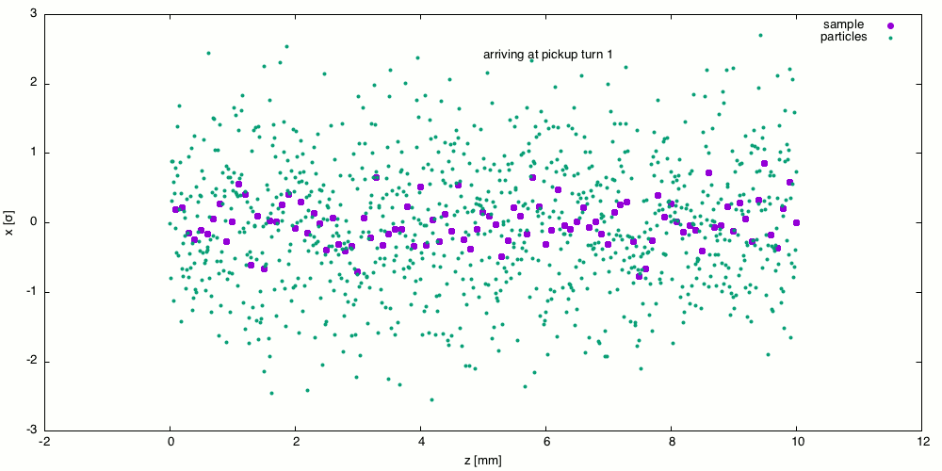


Slide 13
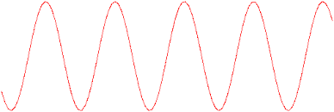
Pickup
Particles oscillate transversely in pickup undulator.
The wavelength of the radiation
E-field
k
E-field
k
amplifier

Slide 15
L3 bypass
Tentative magnet plan
Replace Q49 with Q4W – (extended horizontal aperture) h = 9-20cm
CesrTA chicane magnets => 4 bends
4 new Panofsky style quadrupoles
2 new undulators – 6 pole, 1.5m, 500 G, normal conducting
Repurpose south arc choppers for Panofsky quads and undulators
Wide horizontal aperture vacuum chamber – new
(No change to Q48 E/W)

Slide 16
Components of OSC experiment
Delay bypass beam line
  Delay electron beam by about 2mm/c to compensate for time delay of optical amplifier and
  Couple transverse phase space to longitudinal position to enable cooling
  Tolerances consistent with optical wavelength (~1 micron)
Low energy (<0.5 GeV) operation of CESR
  Lattice design
  Injection
  Power supply stability, quads and dipole
  Undulators
  IBS
Demonstration of interaction of radiation from pickup undulator with radiation in kicker as a function of delay
  Detector?
Optics and optical amplifier amplifier
Demonstration of cooling

Slide 17
Components of OSC experiment
Delay bypass beam line
  Delay electron beam by about 2mm/c to compensate for time delay of optical amplifier and
  Couple transverse phase space to longitudinal position to enable cooling
  Tolerances consistent with optical wavelength (~1 micron)
Low energy (<0.5 GeV) operation of CESR
  Lattice design
  Injection
  Power supply stability, quads and dipole
  Undulators
  IBS
Demonstration of interaction of radiation from pickup undulator with radiation in kicker as a function of delay
  Detector?
Optics and optical amplifier amplifier
Demonstration of cooling

Slide 18
bypass
beam
9cm
pickup
kicker
Q48W
amplifier
Q48E
ΔS = 2mm
L3

