Slide 1
Test of Optical Stochastic Cooling in CESR
October 13, 2017

Slide 2
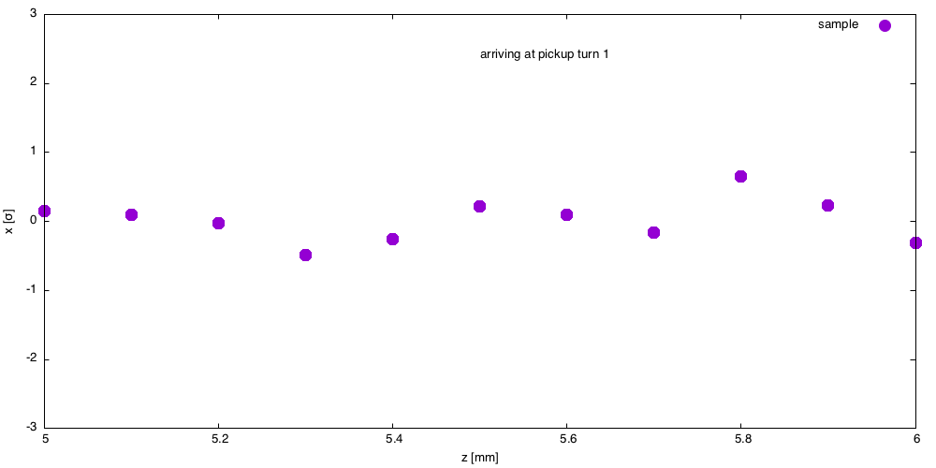
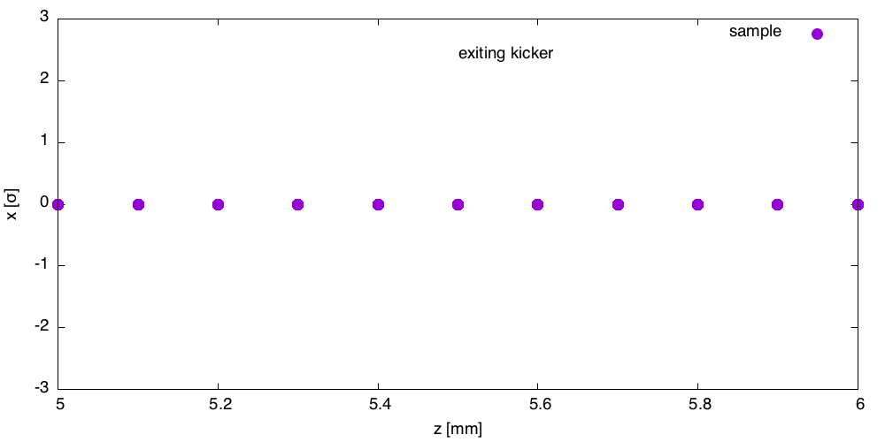
Multi bunch Feedback
Kicker corrects offset
Pickup measures offset
Each represents centroid of distributon of particles

Slide 3
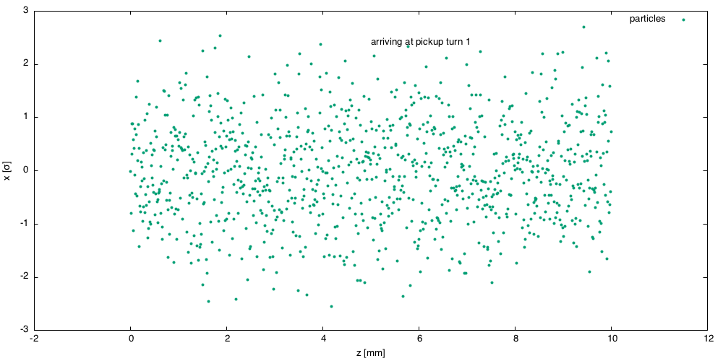
Each bunch is a collection of particles
Goal: reduce bunch width (emittance)
=> cool the beam
Bunch width σ_{x} = 1
Bunch length = 10 mm

Slide 4
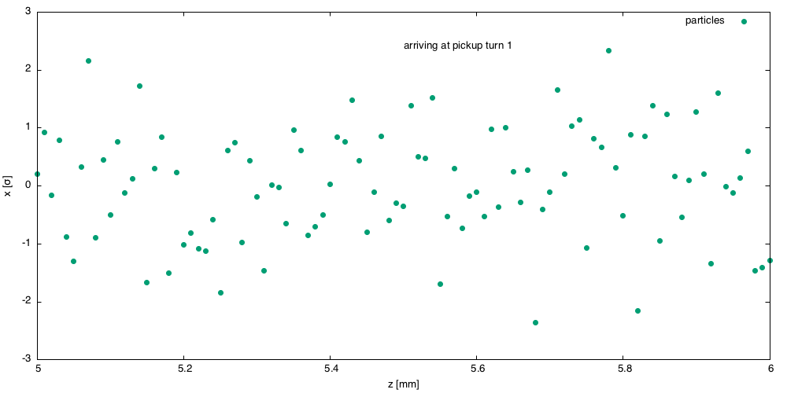
0.1 mm slice of the distributioin

Slide 5
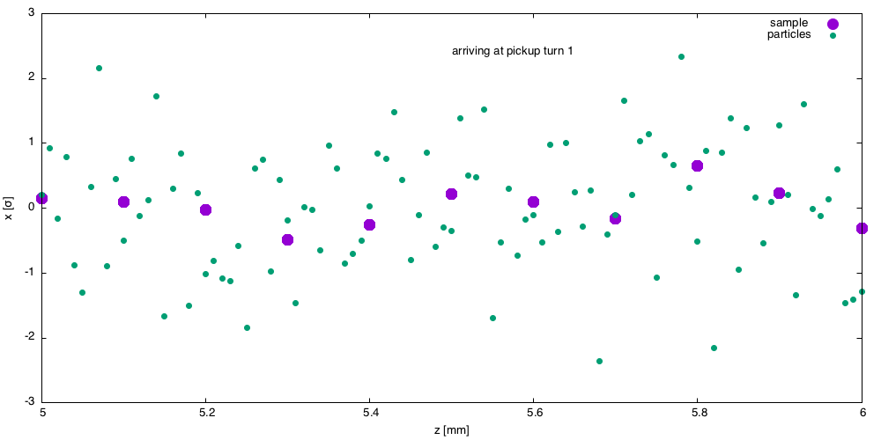
Centroid of 0.1mm sllice

Slide 6
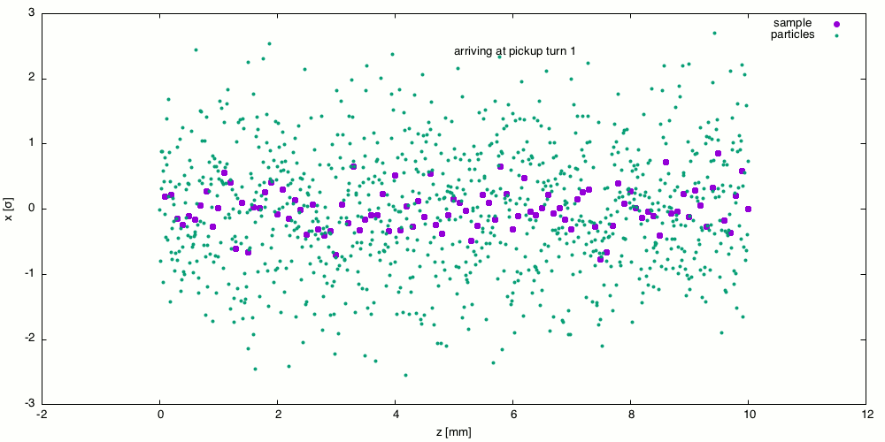


Slide 7
bypass
beam
9cm
pickup
kicker
Q48W
amplifier
Q48E
ΔS = 2mm
L3

Slide 8
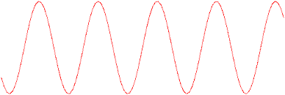
Pickup
Particles oscillate transversely in pickup undulator.
The wavelength of the radiation
E-field
k
E-field
k
amplifier

Slide 10
L3 bypass
Tentative magnet plan
Replace Q49 with Q4W – (extended horizontal aperture) h = 9-20cm
CesrTA chicane magnets => 4 bends
4 new Panofsky style quadrupoles
2 new undulators – 6 pole, 1.5m, 500 G, normal conducting
Repurpose south arc choppers for Panofsky quads and undulators
Wide horizontal aperture vacuum chamber – new
(No change to Q48 E/W)

