Slide 1
pick up undulator radiation pattern
beam energy = 500 MeV, current = 0.39 amp (1nC bunch), Bmax = 0.1024 T (K = 2.87), lambda_und = 30 cm, lambda_1 = 800 nm
11/17/2017

Slide 2
B-field (5 full periods)

Slide 3
trajectory

Slide 4
scan around the fundamental (6 m)
on axis
integrated over the detector area
~20 microWatt

Slide 5
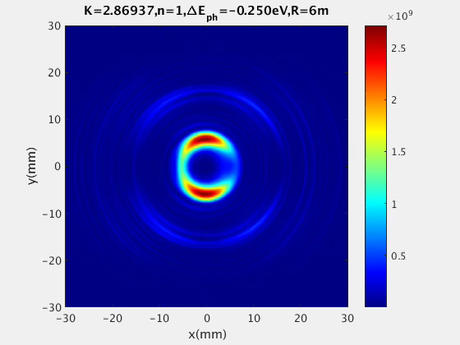
rad pattern (animation)

Slide 6
@ the location of the crystal (6m)

Slide 7
next steps: use the wavepacket from a single electron to compute the energy gain ∫E v dt in the kicker undulator
self-interaction region

