Slide 1
OSC simulation update
Suntao Wang
9/26/2017

Slide 2
Q48W
Q48E
Und_pick
Und_kick
In tracking simulation at each turn:
Record the particle distribution in z at the end of Und_pick
Slice z to small steps
Find the x centroid of the particles within each z step and calculate the difference Δx=x_{cen} – x_{co}
Shift the particles within each step to the closed orbit x at Und_kick
Bunch length σ_{z}=10 mm
Need +/- 3σ_{z} to cover the whole bunch, so total length 60 mm
Example:
3σ_{z}
Step size: δσ_{z} = 100 μm,
number of slices = 3σ_{z}/ δσ_{z} + 2= 602
N_particle = 1000
< - 3σ_{z}
>= 3σ_{z}

Slide 3
Found that in order for this cooling to occur, need to kick the particles at the element with α_{x}=0 or small
x'
x'
x
x
α_{x}≠0
α_{x}=0

Slide 4
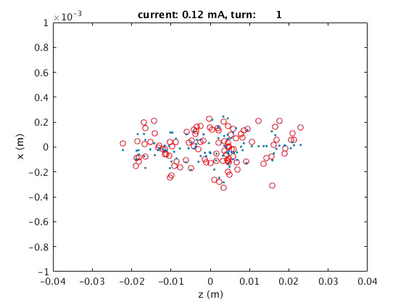
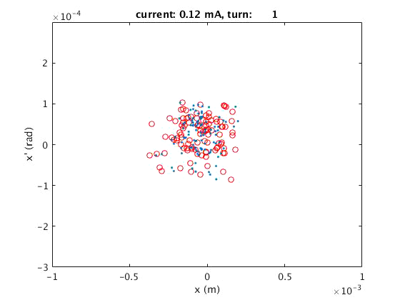
For the test, choose “IP_L0” as the pickup and kick elements
Step size: δσ_{z} = 1 mm, bunch length~ 10 mm
number of slices = 3σ_{z}/ δσ_{z} + 2= 62
D_turns=0.062*N
For δσ_{z}=1mm
N=2E9
τ=317 s
For δσ_{z}=1μm
τ=0.317 s

Slide 5
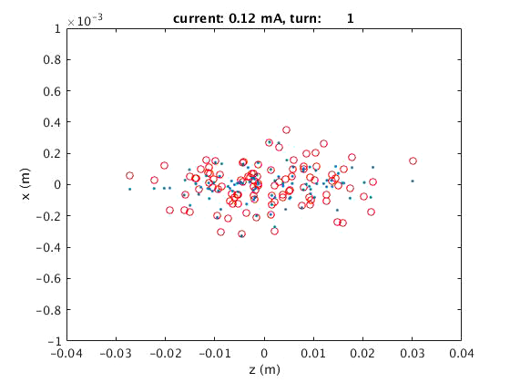
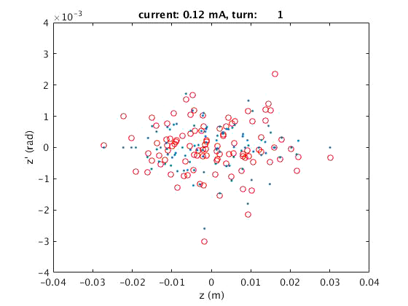
Add δp -> 0 to the sliced particles every turn
Energy spread reduce as well as x amplitude decrease
ε_{a}, ε_{c}, and energy spread decrease

