Slide 1
AUXILIARY FIELD H
Notes:
WRITTEN BY: Steven Pollock (CU-Boulder)

Slide 2
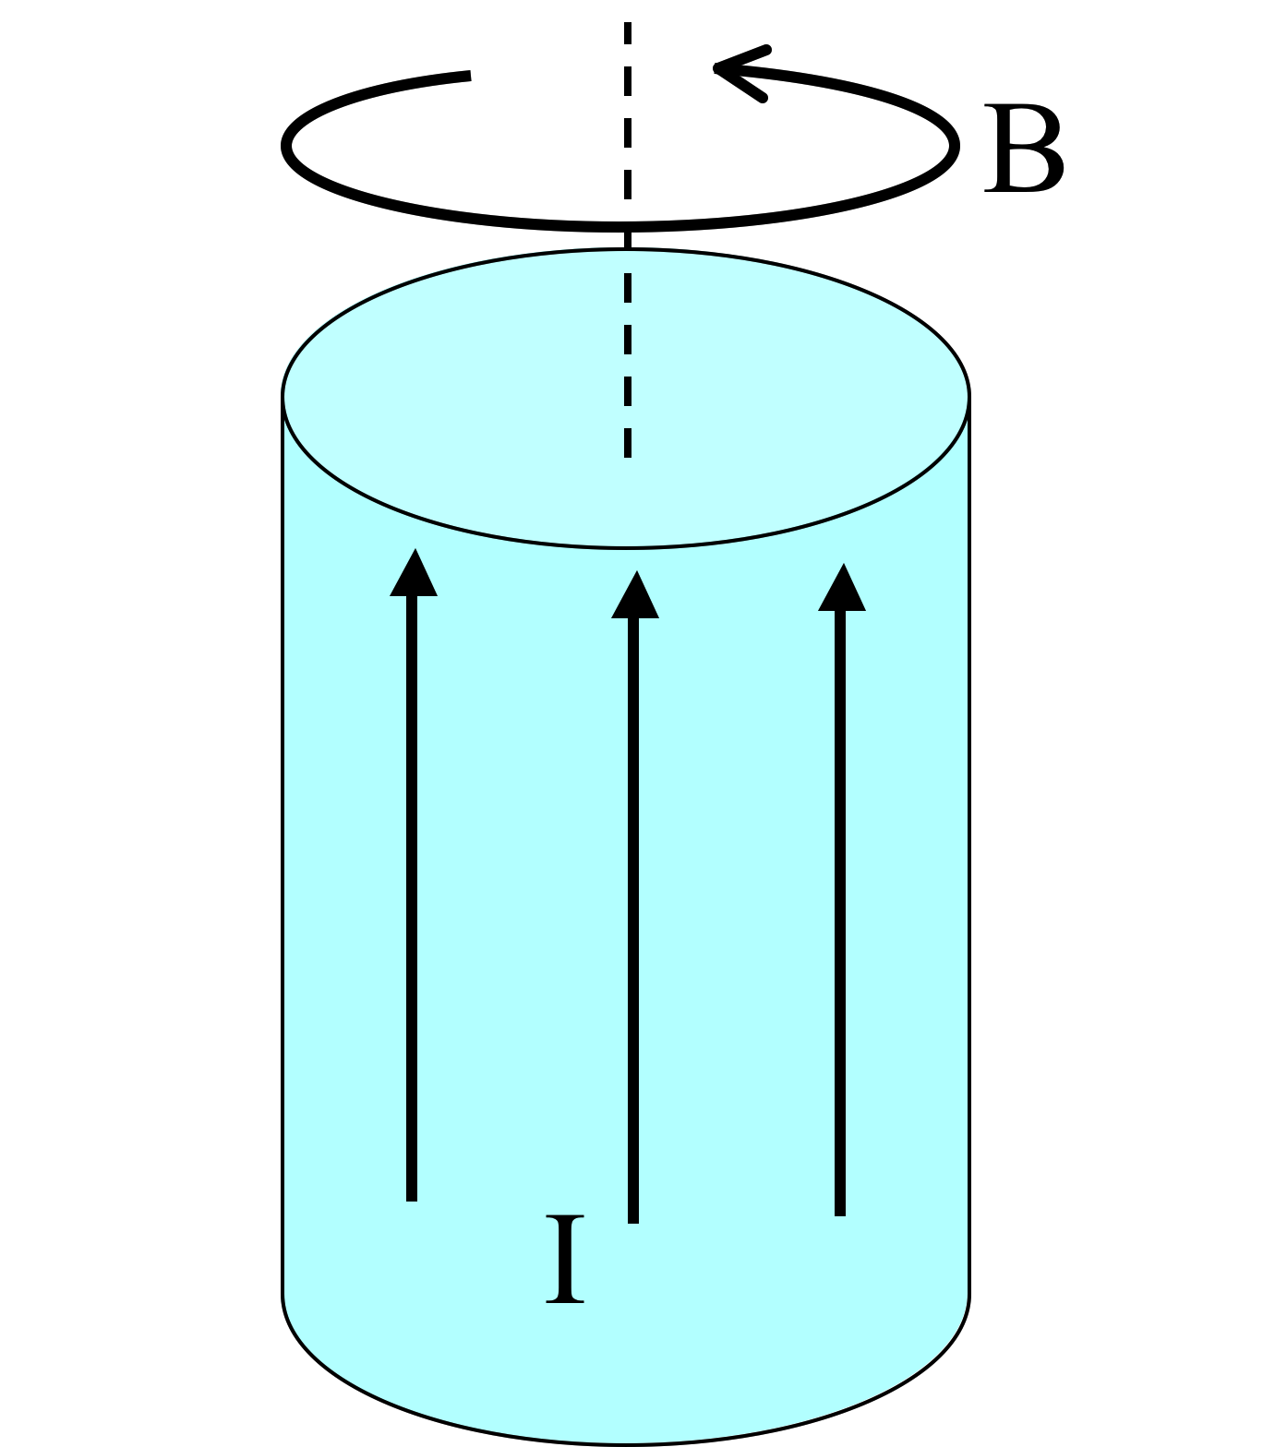
A very long aluminum (paramagnetic!) rod carries a uniformly distributed current I along the +z direction. We know B will be CCW as viewed from above. (Right?)
What about H and M inside the cylinder?
6.8
Both are CCW
B) Both are CW
C) H is CCW, but M is CW
D) H is CW, M is CCW
E) ???
Notes:
CORRECT ANSWER: A

Slide 3
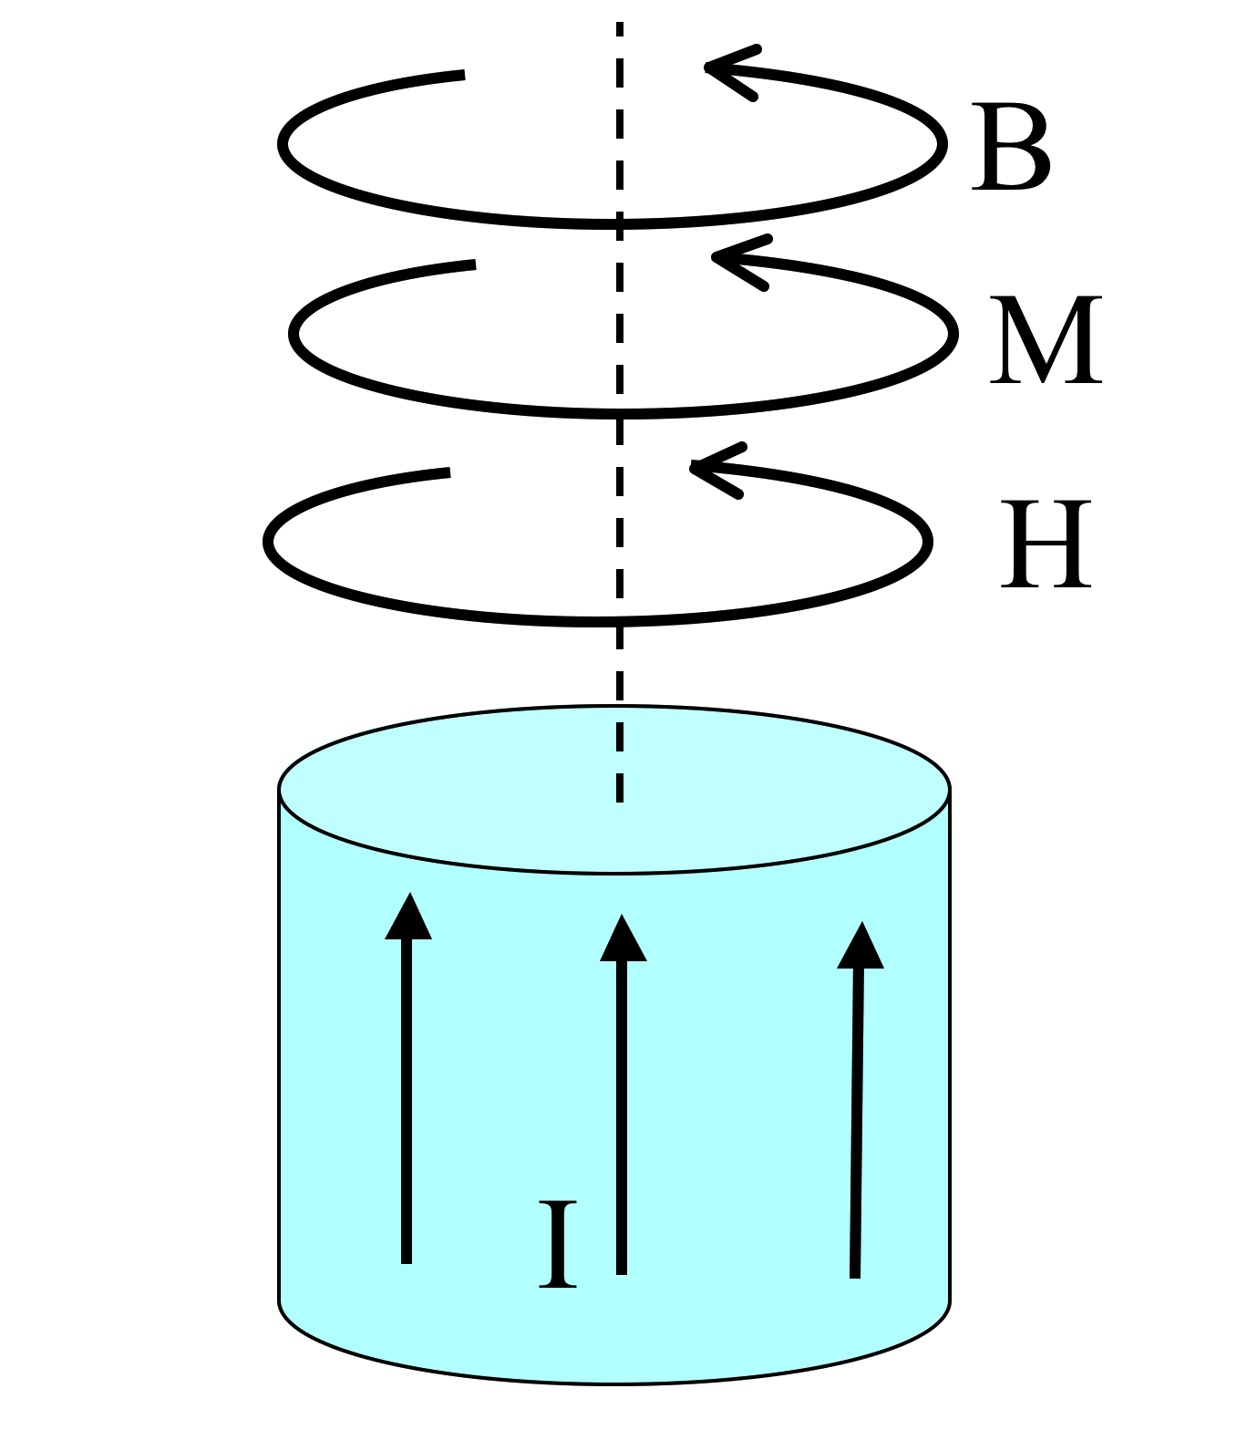
A very long aluminum (paramagnetic!) rod carries a uniformly distributed current I along the +z direction. What is the direction of the bound volume current?
J_{B} points parallel to I
J_{B} points anti-parallel to I
It’s zero!
Other/not sure
Notes:
CORRECT ANSWER: A

Slide 4
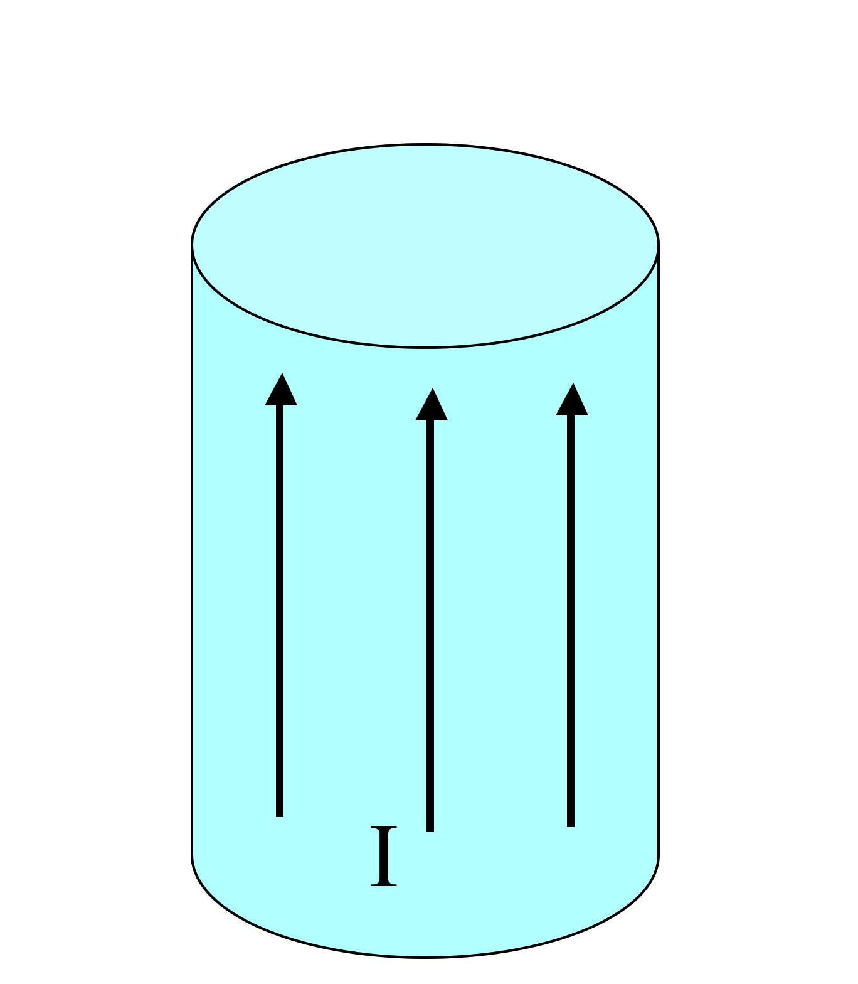
A very long aluminum (paramagnetic!) rod carries a uniformly distributed current I along the +z direction.
What is the direction of the bound surface current?
6.9b
K_{B} points parallel to I
K_{B} points anti-parallel to I
Other/not sure
Notes:
CORRECT ANSWER: B

Slide 5
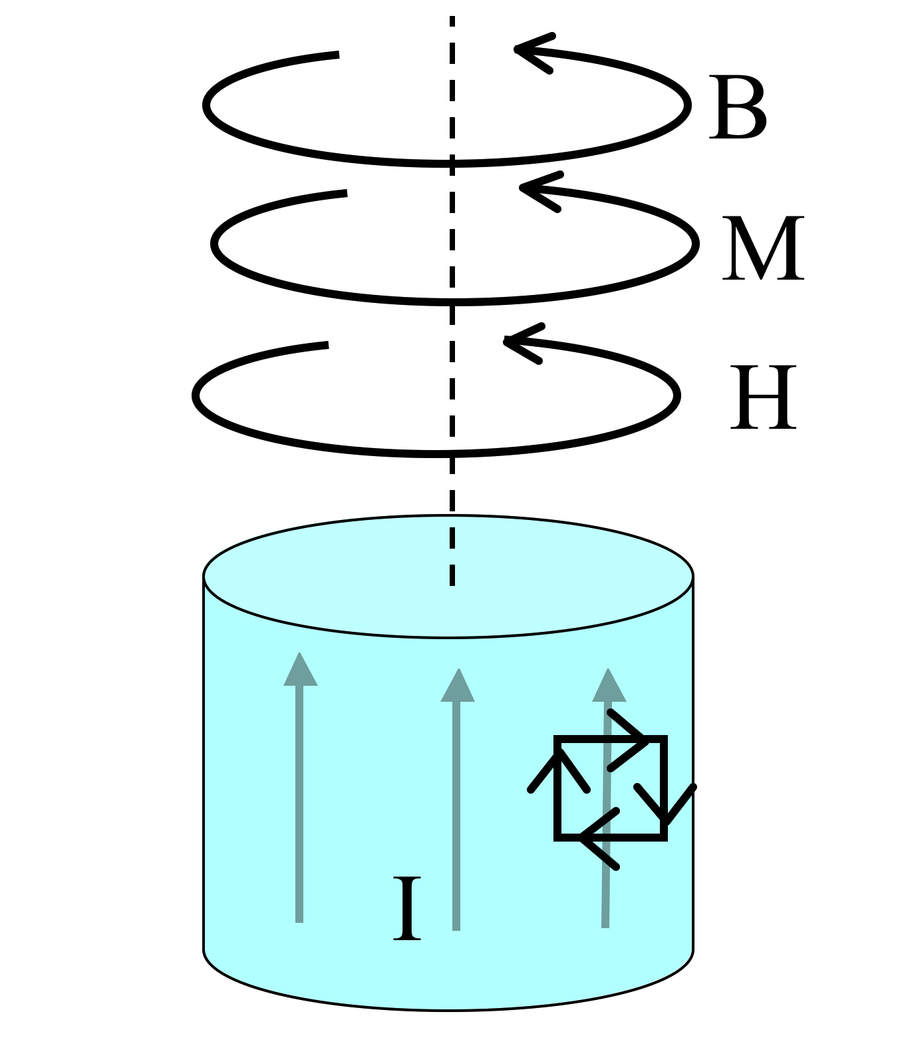
Summary:
A very long aluminum (paramagnetic!) rod carries a uniformly distributed current I along the +z direction.
J_{B} points parallel to I
K_{B} points anti-parallel to I
Total bound current vanishes, conservation of charge!

Slide 6
6.8
What if that long rod (the wire) was made of copper (diamagnetic!) instead. Of B, M, H, and J_bound, which ones “flip sign”?
A) All 4 flip
B) 3 of the 4 flip
C) 2 of the 4 flip
D) 1 of them flips
E) None of them flips
The “para” case
The “dia” case
Notes:
CORRECT ANSWER: C

Slide 7
What if that long rod (the wire) was made of copper (diamagnetic!) instead. Of B, M, H, and J_bound, which ones “flip sign”?
6.8
A) All 4 flip
B) 3 of the 4 flip
C) 2 of the 4 flip
D) 1 of them flips
E) None of them flips
The “para” case
The “dia” case
Notes:
Animated to show the answer

Slide 8
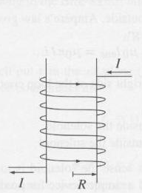
Inside a hollow solenoid,
B=B₀=μ₀nI.
What is the formula for H inside?
Notes:
CORRECT ANSWER: nI

Slide 9
Inside a hollow solenoid,
B=B₀=μ₀nI, ( so H=H₀=nI )
If the solenoid is filled with a normal paramagnetic material, like aluminum, what is B inside?...
Still exactly B₀
B) a little more than B₀
C) a lot more
D) a little less than B₀
E) a lot less than B₀
Notes:
CORRECT ANSWER: B

Slide 10
Inside a hollow solenoid,
B=B₀=μ₀nI, ( so H=H₀=nI )
If the solenoid is filled with iron, what is H inside?...
H₀
B) a little more than H₀
C) a lot more
D) a little less than H₀
E) a lot less than H₀
Notes:
CORRECT ANSWER: A

Slide 11
BOUNDARY VALUE PROBLEMS
Notes:
WRITTEN BY: Steven Pollock (CU-Boulder)

Slide 12
I have a boundary sheet, and would like to learn about the change (or continuity!) of H(parallel) across the boundary.
6.11
H(above)
H//(above)
Am I going to need to know about
A)
B)
C)
???
Notes:
CORRECT ANSWER: A

Slide 13
I have a boundary sheet, and would like to learn about the change (or continuity!) of H(perp) across the boundary.
6.11b
H(above)
H⊥(above)
Am I going to need to know about
A)
B)
C)
???
Notes:
CORRECT ANSWER: B

Slide 14
A very long rod carries a uniformly distributed current I along the +z direction.
Compare the B-field OUTSIDE when the rod is a paramagnet (e.g. Al) to the B-field outside when the rod is a diamagnet (e.g. Cu)
6.8
B outside the paramagnetic rod is …
Slightly smaller than…
The same as…
Slightly larger than…
B outside the diamagnetic rod
Notes:
CORRECT ANSWER: B

Slide 15
LINEAR AND NONLINEAR MEDIA
Notes:
WRITTEN BY: Steven Pollock (CU-Boulder)

Slide 16
A large chunk of paramagnetic material (χ_{m}>0) has a uniform field B₀ throughout its bulk, and thus a uniform H₀=??
6.10
Notes:
CORRECT ANSWER: B0/mu

Slide 17
A large chunk of paramagnetic material (χ_{m}>0) has a uniform field B₀ throughout its bulk, and thus a uniform H₀ = B₀/μ = B₀ / μ₀(1+χ_{M})
We then cut out a cylindrical hole (very skinny, very tall!)
6.10
What is M at the center of that hole?
χ_{Μ}H₀ B) little more than χ_{Μ}H₀
C) Little less than χ_{Μ}H₀ D) Zero
E) ??? (it depends/not sure)
Notes:
CORRECT ANSWER: D

Slide 18
A large chunk of paramagnetic material (χ_{m}>0) has a uniform field B0 throughout its interior.
We cut out a cylindrical hole (very skinny, very tall!)
6.10
What is B at the center of that hole?
B₀ B) more than B₀ C) less than B₀
D) ??
Notes:
CORRECT ANSWER: C

Slide 19
A large chunk of paramagnetic material (χ_{m}>0) has a uniform field B0 throughout its interior.
We cut out a wafer-like hole (very wide, very short!)
6.10b
What is B at the center of that hole?
B₀ B) more than B₀ C) less than B₀
D) ??
Notes:
CORRECT ANSWER: A

Slide 20
A sphere (with a spherical cavity inside it) is made of a material with very large positive χ_{m.}
It is placed in a region of uniform B field.
Which figure best shows the resulting B field lines?
E) None of these can be even remotely correct
Notes:
CORRECT ANSWER: A

Slide 21
Mu-metal (75% nickel, 15% iron, plus copper and molybdenum) acts as a sort of “magnetic shield”...
(there is no perfect “Faraday cage” effect for magnetism - why not)
Notes:
See previous slide, makes for a lot of good discussion points. (The picture is just a sketch - might think about using MMA to generate more exact figure?

Slide 22
A superconducting ring sits above a strong permanent magnet (N side up). If you drop the ring, which way will current flow (as viewed from above), and what kind of force will the ring feel?
A) CW/repulsive
B) CW/attractive
C) CCW/repulsive
D) CCW/attractive
E) No net current will flow/no net force
To think about/discuss:
Remember Lenz’ law? What does it say about this situation?
What will the resulting motion of the ring look like?
What if you dropped a magnet onto the ring, instead of dropping the ring onto the magnet?
Notes:
CORRECT ANSWER: A

Slide 23
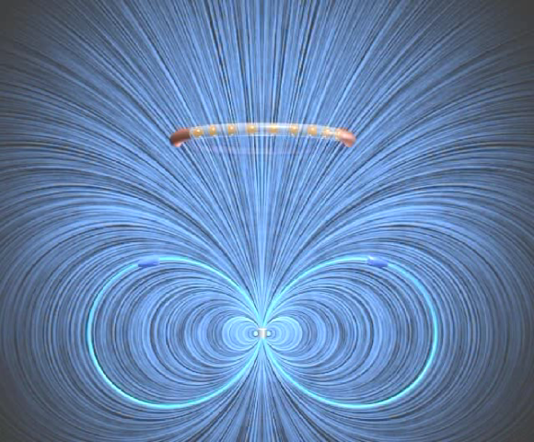
A superconducting ring sits above a strong permanent magnet (N side up). If you drop the ring, which way will current flow (as viewed from above), and what kind of force will the ring feel?
A) CW/repulsive
B) CW/attractive
C) CCW/repulsive
D) CCW/attractive
E) No net current will flow/no net force
To think about/discuss:
Remember Lenz’ law? What does it say about this situation?
What will the resulting motion of the ring look like?
What if you dropped a magnet onto the ring, instead of dropping the ring onto the agnet?
Notes:
http://web.mit.edu/8.02t/www/802TEAL3D/visualizations/faraday/index.htm

Slide 24
A large chunk of paramagnetic material (χ_{m}>0) has a uniform field B0 throughout its interior.
We cut out a wafer-like hole (very wide, very short!)
6.10b
What is B at the center of that hole?
B₀ B) more than B₀ C) less than B₀
D) ??
Notes:
CORRECT ANSWER: A

Slide 25
Charge Conservation
5.10
Which of the following is a statement of charge conservation?
A)
B)
C)
D)
E) Not sure/can't remember
Notes:
25
CORRECT ANSWER: D

Slide 26
EMF I
Consider two situations:
1) a loop (purple) moves right at velocity v(loop)
2) a magnet (blue region) moves left, at v(mag).
If |v(loop)| = |v(mag)|,
what will the ammeter read in each case?
(Call CW current positive)
Blue region = uniform (but localized!) B field
out of page
B
I₁ > 0, I₂ = 0
I₁ < 0, I₂ = 0
I₁ = I₂
I₁ = -I₂
I₁ = 0, I₂ = 0 (special case)
A
Notes:
26
CORRECT ANSWER: C

Slide 27
7.3
Taking div(Ampere’s law) gave us:
But current conservation says:
Conclusion: Ampere’s law is WRONG!
Notes:
Final lecture, Spring 2013, SJP

Slide 28
7.2
How can we restore current conservation?
(without losing the “correct” features,
obtained from experiment!)
Not very “symmetric” either…
Maxwell fixed it up!
Notes:
Final lecture, Spring 2013, SJP

Slide 29
Maxwell’s equations:
7.5
This last term saves the day!
NOW when we take div(Maxwell-Ampere), we get an extra term,
yielding

Slide 30
Maxwell’s equations:
7.5
In vacuum…?

Slide 31
Maxwell’s equations:
7.5
In vacuum!

Slide 32
Maxwell’s equations:
7.5
In vacuum, what is ?
In vacuum (!!!)....

Slide 33
It’s a wave equation…. With a solution
With speed

Slide 34
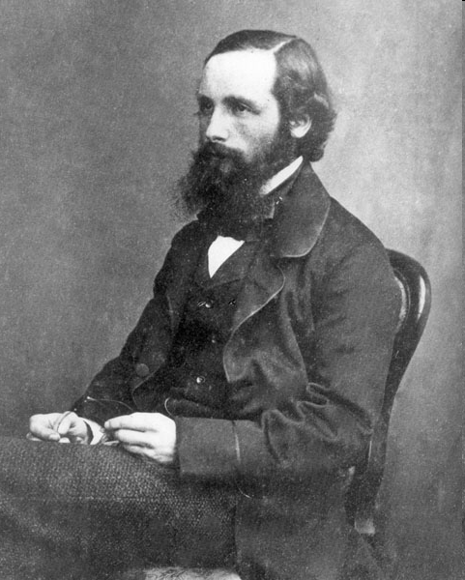
James Clerk Maxwell
Scottish 1831-1879
"From a long view of the history of mankind – seen from, say, ten thousand years from now – there can be little doubt that the most significant event of the 19th century will be judged as Maxwell’s discovery of the laws of electrodynamics. The American Civil War will pale into provincial insignificance in comparison with this important scientific event of the same decade."
– R.P. Feynman
Notes:
Final lecture, Spring 2013, SJP

