Slide 1
FIELDS FROM MAGNETIZED OBJECTS + BOUND CURRENTS
Notes:
WRITTEN BY: Steven Pollock (CU-Boulder)

Slide 2
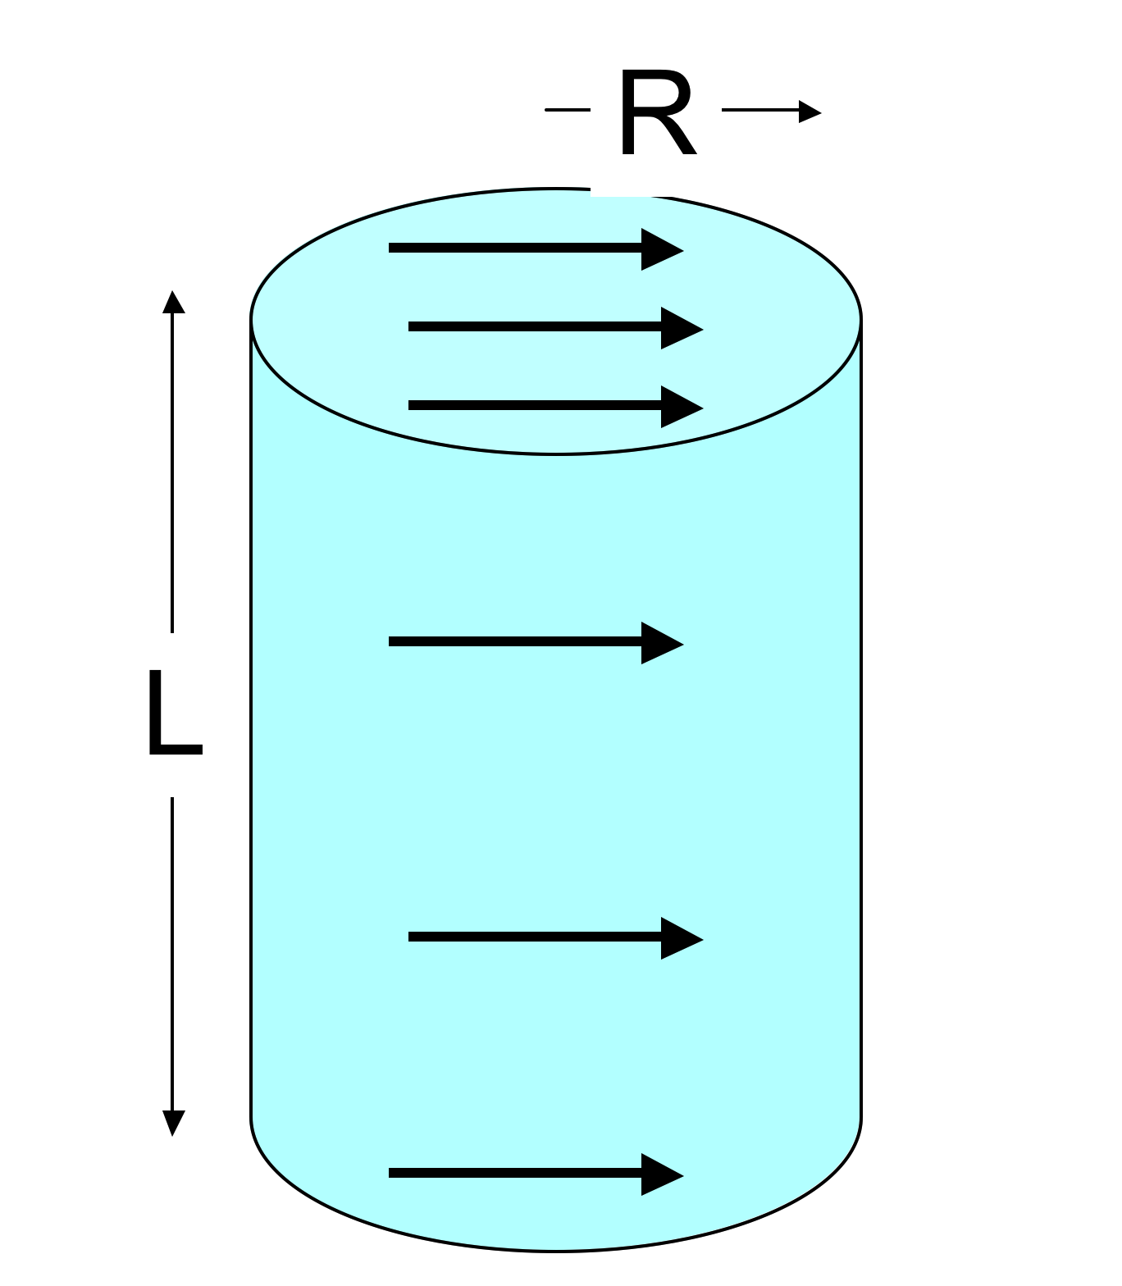
A solid cylinder has uniform magnetization M throughout the volume in the x direction as shown. What's the magnitude of the total magnetic dipole moment of the cylinder?
6.4
Α) πR² L M
B) 2πR L M
C) 2πR M
D) πR ²M
E) Something else/
it’s complicated!
Notes:
CORRECT ANSWER: A

Slide 3
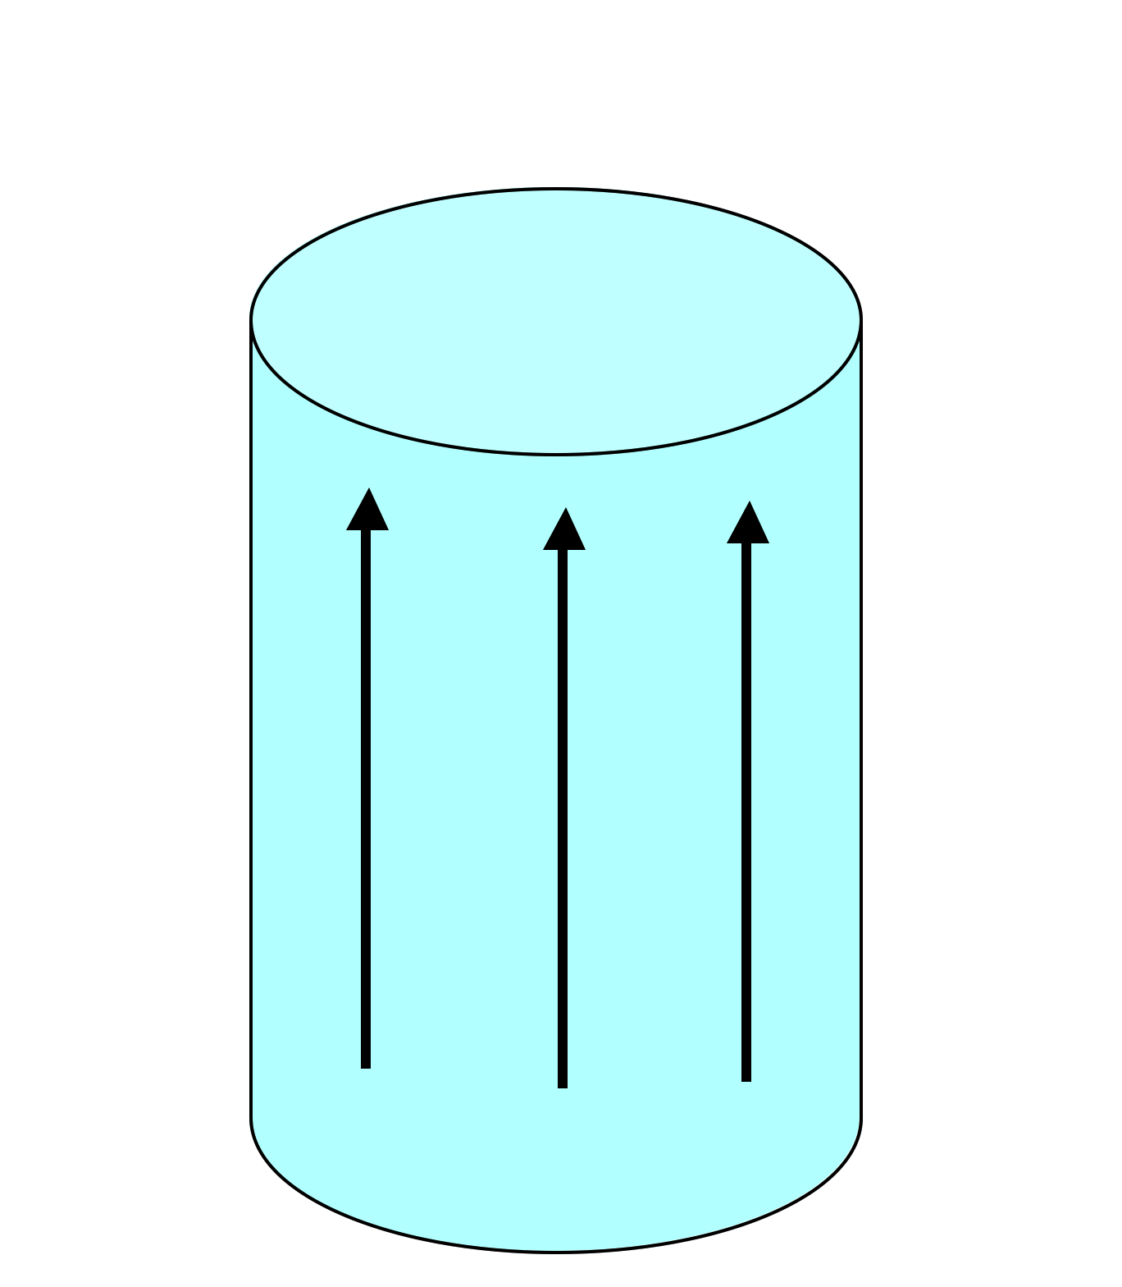
A solid cylinder has uniform magnetization M throughout the volume in the z direction as shown. Where do bound currents show up?
6.3
Everywhere: throughout the volume and on all surfaces
Volume only, not surface
Top/bottom surface only
Side (rounded) surface only
All surfaces, but not volume
Notes:
CORRECT ANSWER: D

Slide 4
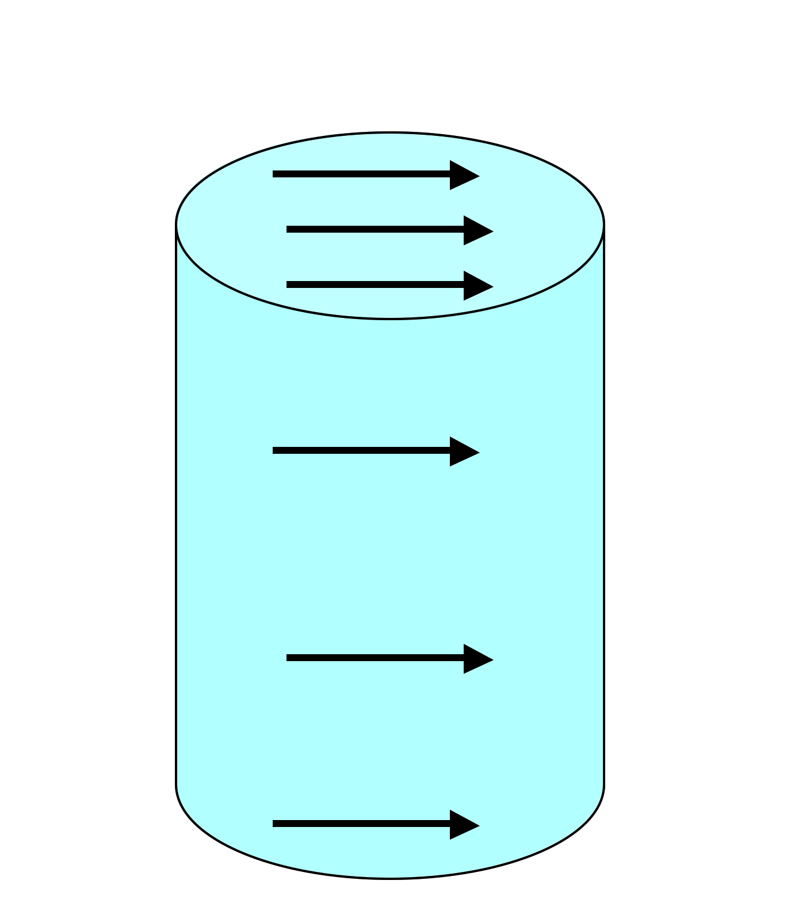
A solid cylinder has uniform magnetization M throughout the volume in the x direction as shown. Where do bound currents show up?
6.5
Top/bottom surface only
Side (rounded) surface only
Everywhere
Top/bottom, and parts of (but not all of) side surface (but not in the volume)
Something different/other combination!
Notes:
CORRECT ANSWER: D

Slide 5
A solid cylinder has uniform magnetization M throughout the volume in the z direction as shown. What will the B field look like?
(Consider if the cylinder is tall and thin, or short and fat, separately)
To discuss:
Notes:
CORRECT ANSWER: n/a

Slide 6
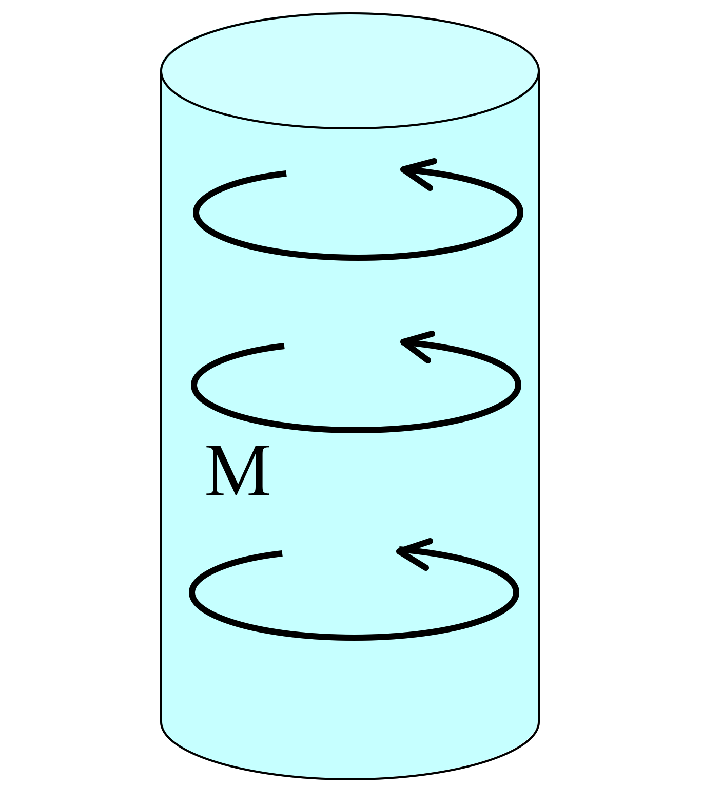
A solid cylinder has uniform magnetization M throughout the volume in the φ direction as shown. In which direction does the bound surface current flow on the (curved) sides?
6.21
There is no bound surface current.
The current flows in the ±φ direction.
The current flows in the ±s direction.
The current flows in the ±z direction.
The direction is more complicated than the answers B, C, or D.
Notes:
CORRECT ANSWER: D

Slide 7
A sphere has uniform magnetization M in the z direction.
6.6
Which formula is correct for this surface current?
A)
B)
C)
D)
E) None of these!
M
Notes:
CORRECT ANSWER: B

Slide 8
BOUND CURRENT PROBLEMS WITH REFERENCE TO “H”

Slide 9
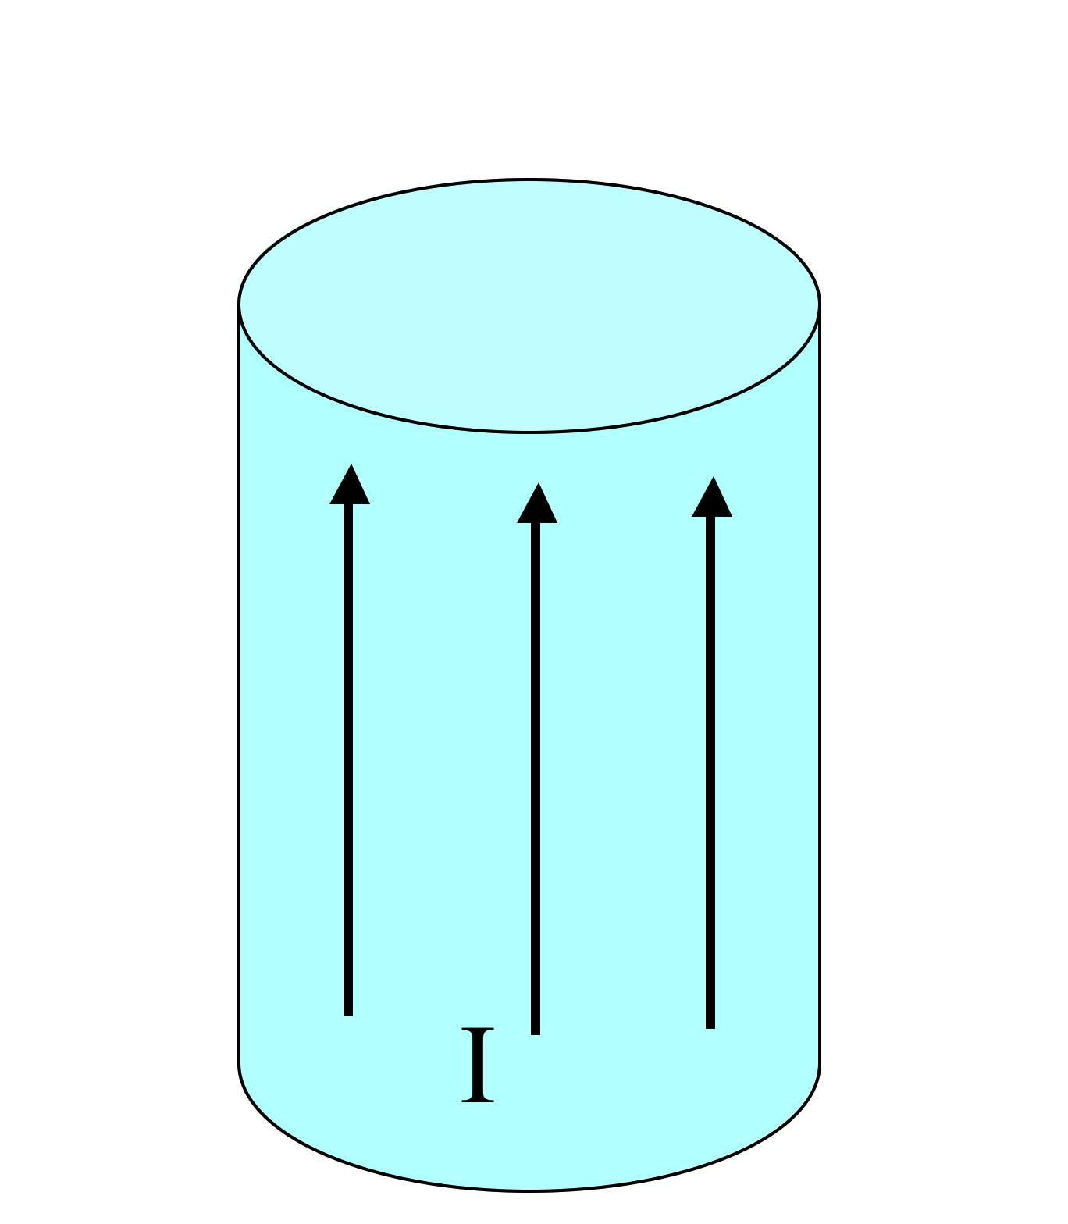
A very long aluminum (paramagnetic!) rod carries a uniformly distributed current I along the +z direction.
What is the direction of the bound volume current?
6.9
J_{B} points parallel to I
J_{B} points anti-parallel to I
It’s zero!
Other/not sure
Notes:
CORRECT ANSWER: A

Slide 10
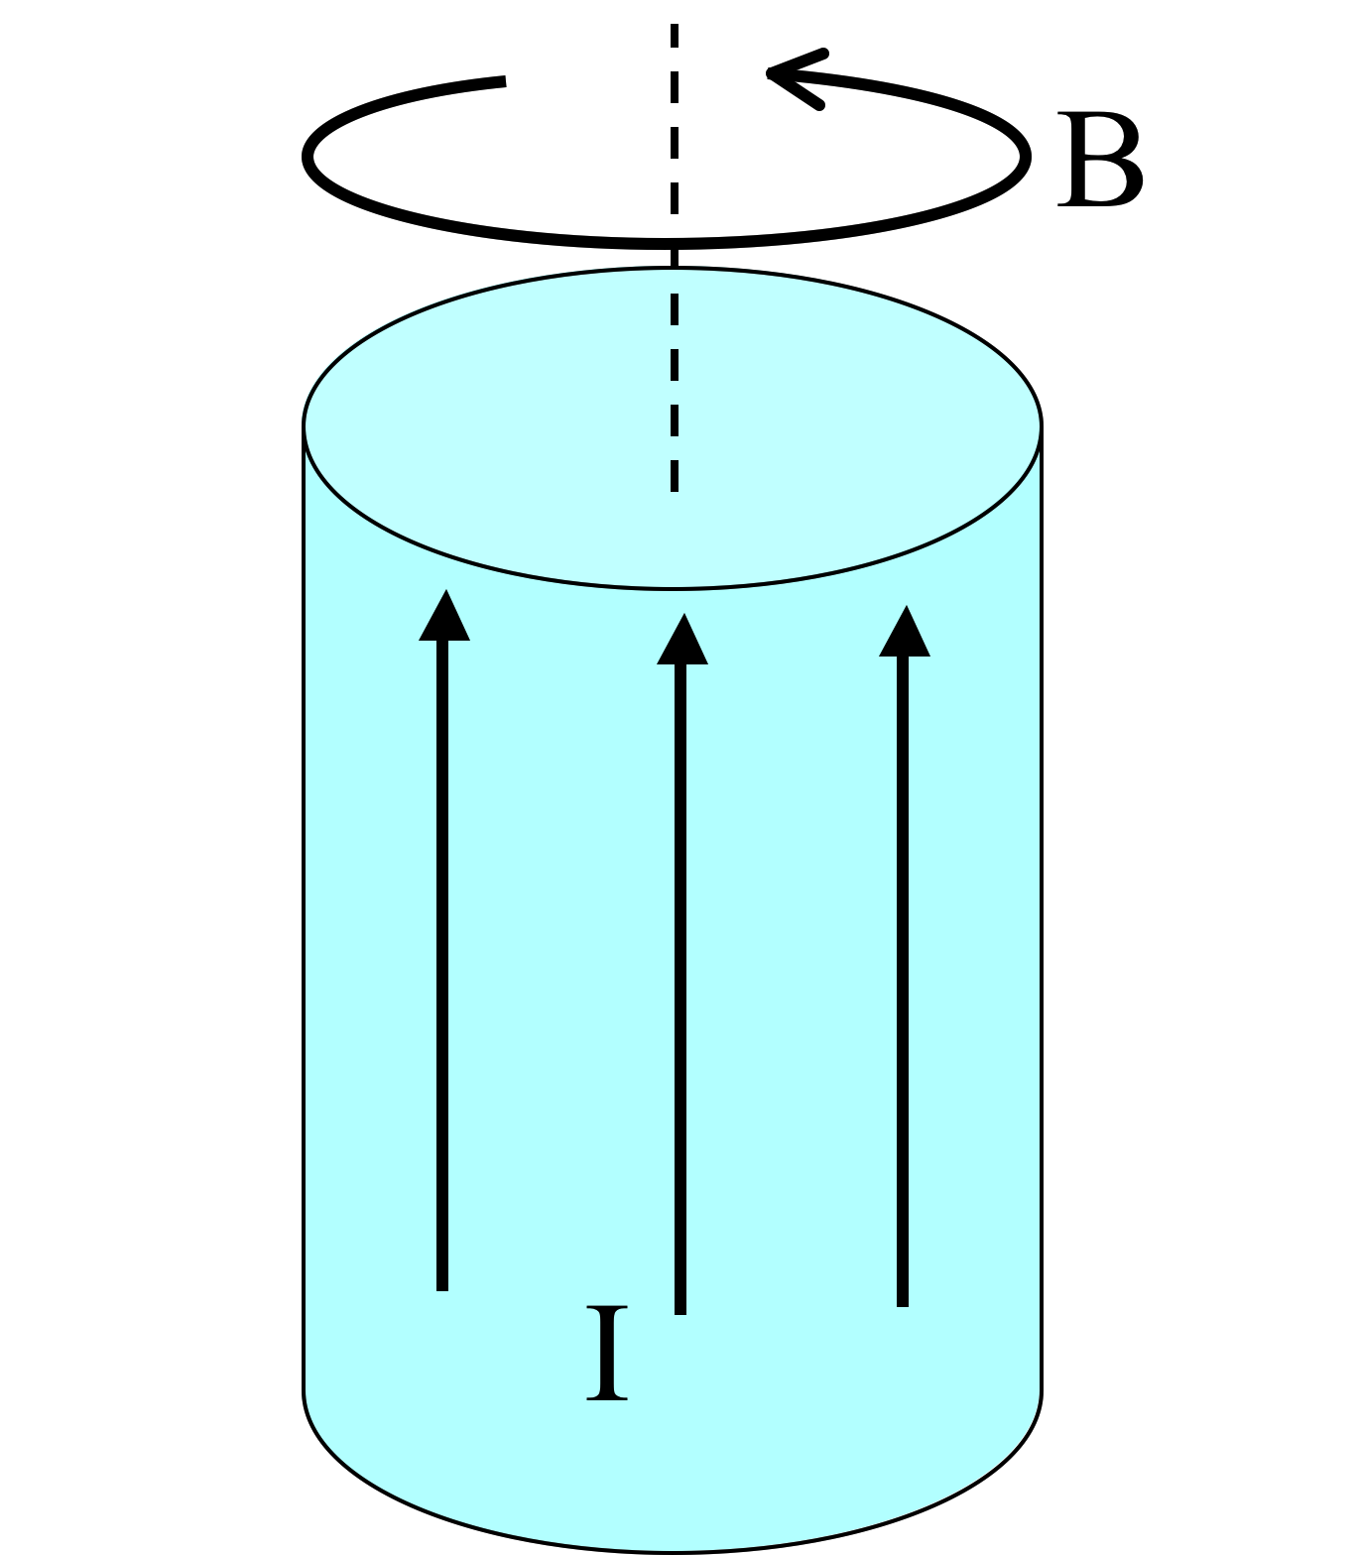
A very long aluminum (paramagnetic!) rod carries a uniformly distributed current I along the +z direction. We know B will be CCW as viewed from above. (Right?)
What about H and M inside the cylinder?
6.8
Both are CCW
B) Both are CW
C) H is CCW, but M is CW
D) H is CW, M is CCW
E) ???
Notes:
CORRECT ANSWER: A

Slide 11
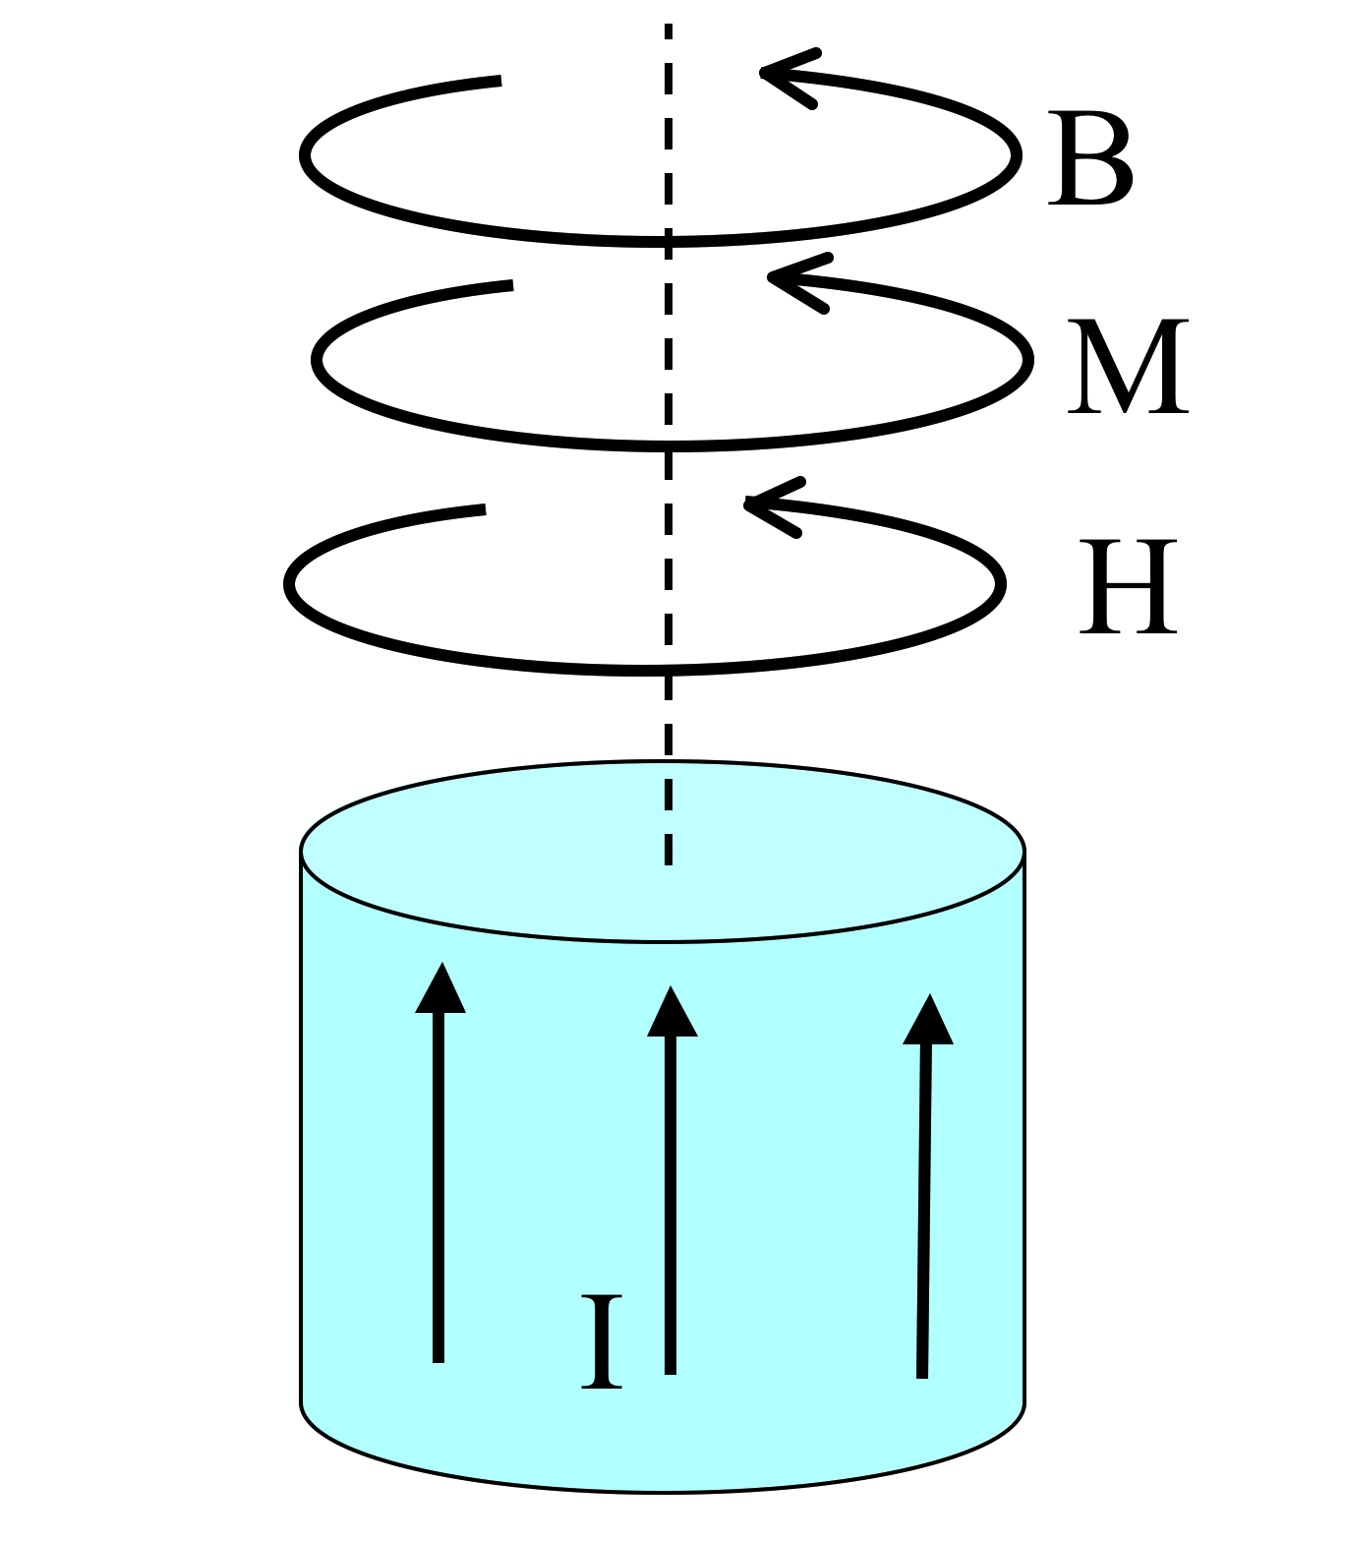
A very long aluminum (paramagnetic!) rod carries a uniformly distributed current I along the +z direction. What is the direction of the bound volume current?
J_{B} points parallel to I
J_{B} points anti-parallel to I
It’s zero!
Other/not sure
Notes:
CORRECT ANSWER: A

Slide 12
A very long aluminum (paramagnetic!) rod carries a uniformly distributed current I along the +z direction.
What is the direction of the bound surface current?
6.9b
K_{B} points parallel to I
K_{B} points anti-parallel to I
Other/not sure
Notes:
CORRECT ANSWER: B

Slide 13
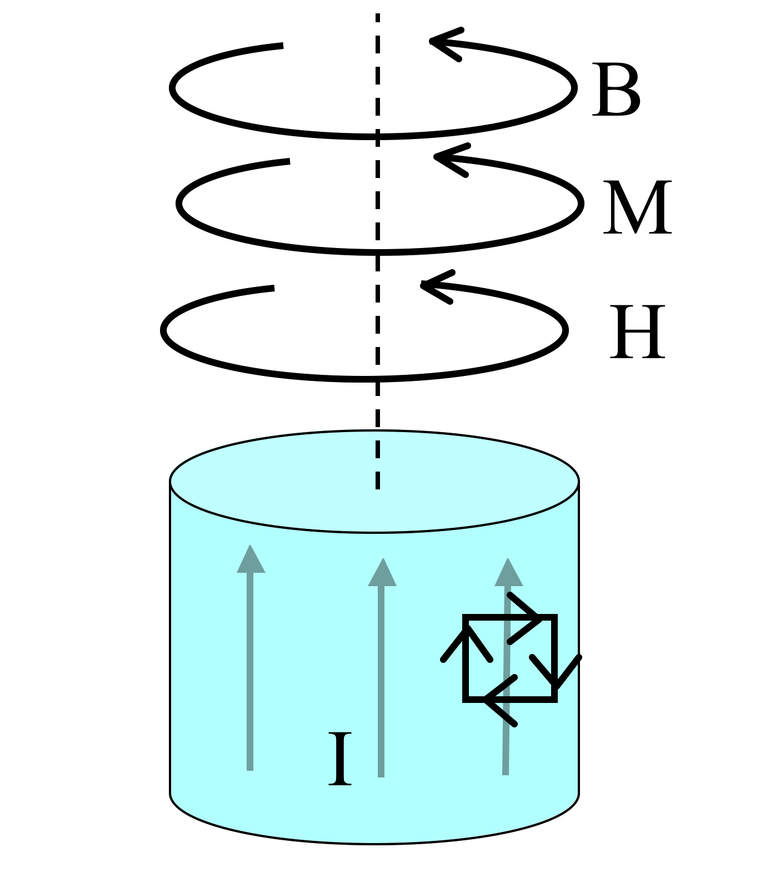
Summary:
A very long aluminum (paramagnetic!) rod carries a uniformly distributed current I along the +z direction.
J_{B} points parallel to I
K_{B} points anti-parallel to I
Total bound current vanishes, conservation of charge!

Slide 14
6.8
What if that long rod (the wire) was made of copper (diamagnetic!) instead. Of B, M, H, and J_bound, which ones “flip sign”?
A) All 4 flip
B) 3 of the 4 flip
C) 2 of the 4 flip
D) 1 of them flips
E) None of them flips
The “para” case
The “dia” case
Notes:
CORRECT ANSWER: C

Slide 15
What if that long rod (the wire) was made of copper (diamagnetic!) instead. Of B, M, H, and J_bound, which ones “flip sign”?
6.8
A) All 4 flip
B) 3 of the 4 flip
C) 2 of the 4 flip
D) 1 of them flips
E) None of them flips
The “para” case
The “dia” case
Notes:
Animated to show the answer

