Slide 1
7.10
Recall the machined copper from last class, with steady current flowing left to right through it
I
I
In steady state, do you expect there will be any surface charge accumulated anywhere on the walls of the conductor?
A) Yes
B) No
© University of Colorado, 2011
Notes:
Correct Answer: A

Slide 2

Electricity and Magnetism II
7.1
Griffiths Chapter 7 Maxwell’s Equations
Clicker Questions

Slide 3
In the interior of a metal in static equilibrium the charge density ρ is:
7.2
zero always
never zero.
sometimes zero, sometime non-zero, depending on the conditions.
Notes:
Correct Answer: A

Slide 4
Charge Conservation
7.3
Which of the following is a correct statement of charge conservation?
A)
B)
C)
D)
E) None of these, or more than one.
Notes:
4
Correct Answer: E

Slide 5
For everyday currents in home electronics and wires, which answer is the order of magnitude of the instantaneous speed of the electrons in the wire?
7.4
more than km/s
m/s
mm/s
μm/s
nm/s
Notes:
Correct Answer: A

Slide 6
An electric current I flows along a copper wire (low resistivity) into a resistor made of carbon (high resistivity) then back into another copper wire.
In which material is the electric field largest?
7.5
I
In the copper wire
In the carbon resistor
It’s the same in both copper and carbon
It depends on the sizes of the copper and carbon
Notes:
Correct Answer: D

Slide 7
7.6
A copper cylinder is machined to have the following shape. The ends are connected to a battery so that a current flows through the copper.
A
B
C
Rank order (from greatest to smallest, e.g. A=C>B)
Magnitude of E field
Conductivity
Current
Current Density
© University of Colorado, 2011

Slide 8
Inside this resistor setup, what can you conclude about the current density J near the side walls?
7.7
V₀
V=0
I
I
J??
Must be exactly parallel to the wall
Must be exactly perpendicular to the wall
Could have a mix of parallel and perp components
No obvious way to decide!?
Notes:
Correct Answer: A

Slide 9
Inside this resistor setup, (real world, finite sizes!) what does the E field look like inside ?
7.8
V₀
V=0
I
I
E??
Must be uniform and horizontal
Must have some nonuniformity, due to fringing effects!
Notes:
Correct Answer: A

Slide 10
7.9
Recall the machined copper from last class, with steady current flowing left to right through it
I
I
In the “necking down region” (somewhere in a small-ish region around the head of the arrow), do you think
A)
B)
© University of Colorado, 2011
Notes:
Correct Answer: A

Slide 11
The resistivity, ρ, is the inverse of the conductivity, σ. The units of ρ are:
7.11
Amps/volt
V/m
m/ohm
ohm*m
Joules/m
Notes:
Correct Answer: D

Slide 12
A steady electric current I flows around a circuit containing a battery of voltage V and a resistor R. Which of the following statements about is true?
7.12
It is zero around the circuit because it’s an electrostatic field
It is non-zero around the circuit because it’s not an electrostatic field
It is zero around the circuit because there is no electric field in the battery, only in the rest of the circuit
It is non-zero around the circuit because there is no electric field in the battery, only in the rest of the circuit!
None of the above
Notes:
Correct Answer: A

Slide 13
EMF is the line integral of the total force per unit charge around a closed loop.
The units of EMF are:
7.13
Farads
Joules.
Amps, (that’s why current flows.)
Newtons, (that’s why it’s called emf)
Volts
Notes:
Correct Answer: E

Slide 14
7.14
Imagine a charge q able to move around a tube which makes a closed loop. If we want to drive the charge around the loop, we cannot do this with E-field from a single stationary charge.
+
q
Can we drive the charge around the loop with some combination of stationary + and – charges?
Yes
No
+
Notes:
Correct Answer: B

Slide 15
7.15
A circuit with a battery with voltage difference ΔV is attached to a resistor. The force per charge due to the charges is E. The force per charge inside the battery is f = f_{bat} + E
How many of the following statements are true?
0
1
2
3
4
B
A
Notes:
Correct Answer: D

Slide 16
7.16
Is there a nonzero EMF around the (dashed) closed loop, which is partway inserted between two charged isolated capacitor plates.
++++++++++++++++
- - - - - - - - - - - - - - - -
EMF=0 here
EMF≠0 here
C) ? I would need to do a nontrivial calculation to decide
Notes:
Correct Answer: A

Slide 17
One end of rectangular metal loop enters a region of constant uniform magnetic field B, with initial constant speed v, as shown.
What direction is the magnetic force on the loop?
7.17
B
v
L
Up the “screen” ⬆
Down the “screen” ⬇
To the right ➔
To the left ⬅
The net force is zero
B
Notes:
Correct Answer: D

Slide 18
One end of rectangular metal loop enters a region of constant uniform magnetic field B, with initial constant speed v, as shown.
What direction is the magnetic force on the loop?
7.18
B
v
L
Up the “screen” ⬆
Down the “screen” ⬇
To the right ➔
To the left ⬅
The net force is zero
B
Notes:
Correct Answer: D

Slide 19
One end of rectangular metal loop enters a region of constant uniform magnetic field B, out of page, with constant speed v, as shown. As the loop enters the field is there a non-zero emf around the loop?
7.19
B
v
L
B
Yes, current will flow CW
Yes, current will flow CCW
No
Notes:
Correct Answer: A

Slide 20
A rectangular metal loop moves through a region of constant uniform magnetic field B, with speed v at t = 0, as shown.
What is the magnetic force on the loop at the instant shown? Assume the loop has resistance R.
7.20
w
B
v
L
B
2L² vB²/R (right) B) 2L² vB²/R (left) C) 0
D. Something else/not sure...
Notes:
Correct Answer: C

Slide 21
Consider two situations:
1) Loop moves to right with speed |v|
2) Magnet moves to left with (same) speed |v|
What will the ammeter read in each case?
(Assume that CCW current => positive ammeter reading)
7.21
B
A
I₁>0, I₂=0 B) I₁= I₂ > 0 C) I₁= -I₂ > 0
D) I₁= I₂ = 0 E) Something different/not sure
Notes:
Correct Answer: B

Slide 22
Faraday found that EMF is proportional to the negative time rate of change of B. EMF is also the line integral of a force/charge. The force is
7.22
The magnetic Lorentz force.
an electric force.
the strong nuclear force.
the gravitational force.
an entirely new force.
Notes:
Correct Answer: B

Slide 23
A time changing B creates an electric field via Faraday’s Law:
7.23
Now I have no idea how to find E.
This law suggests a familiar way to find E in all situations.
This law suggests a familiar way to find E in sufficiently symmetrical situations.
I see a path to finding E, but it bears no relation to anything we have previously seen.
Notes:
Correct Answer: N/A/ Survey

Slide 24
A stationary rectangular metal loop is in a region of uniform magnetic field B, which has magnitude B decreasing with time as
B=B₀-kt. What is the direction of the field B_{ind} created by the induced current in the loop, in the plane region inside the loop?
7.24
B
w
B
A) Into the screen B) Out of the screen
C) To the left D) To the right E) other/??
Notes:
Correct Answer: B

Slide 25
A stationary rectangular metal loop is in a region of uniform magnetic field B, which has magnitude B decreasing with time as
B=B₀-kt. What is the direction of the field B_{ind} created by the induced current in the loop, in the plane region inside the loop?
7.25
B
w
B
A) Into the screen B) Out of the screen
C) To the left D) To the right E) other/??
Notes:
Just showing the induced current for previous one (7.24)

Slide 26
A rectangular metal loop is moving thru a region of constant uniform magnetic field B, out of page, with constant speed v, as shown. Is there a non-zero emf around the loop?
7.26
B
v
B
Yes, current will flow CW
Yes, current will flow CCW
No
Notes:
Correct Answer: C

Slide 27
7.28
A loop of wire is near a long straight wire which is carrying a large current I, which is decreasing. The loop and the straight wire are in the same plane and are positioned as shown. The current induced in the loop is
A) counter-clockwise B) clockwise C) zero.
I to the right, but decreasing.
loop
Notes:
Correct Answer: B

Slide 28
The current in an infinite solenoid with uniform magnetic field B inside is increasing so that the magnitude B is increasing with time as B=B₀+kt. A small circular loop of radius r is placed NON-coaxially inside the solenoid as shown. What is the emf around the small loop?
(Assume CW is the direction of dl in the EMF loop integration)
7.29
B
r
kπr²
-kπr²
Zero
Nonzero, but need more information for value
Not enough information to tell if zero or non-zero
Notes:
Correct Answer: A

Slide 29
The current in an infinite solenoid with uniform magnetic field B inside is increasing so that the magnitude B in increasing with time as B=B₀+kt. A small circular loop of radius r is placed outside the solenoid as shown. What is the emf around the small loop? (Assume CW is the positive direction of current flow).
7.30
r
B
kπr²
-kπr²
Zero
Nonzero, but need more information for value
Not enough information to tell if zero or non-zero
Notes:
Class: CONCEPTUAL
Correct Answer: C
____________________________________
Phys 3320, Fa11 (SJP) Lecture #9
0, 0, [100], 0, 0
____________________________________
Fall 2011 Comments
We got 100% on this one, but the discussion is still good – and in particular, the question of “how can the answer be zero if we just computed a nonzero E out there? And, it even *looks* “curly” (in that it curls around the origin) but we’re saying here it has zero curl out there...
LA Notes:
Ragole: Students said there was no change in flux through the loop (which did not contain the solenoid) and thus there would be no EMF.
Rehn: One student thought that EMF was not 0 outside, but was then convinced by another student that it was. This student's argument was that since Curl.E = 0 outside, any closed line integral must also be 0. This seems to be a persistent problem, from what I have seen.
====================================
ERK, 10 Dec 2008
Flux rule for induced emf

Slide 30
The current in an infinite solenoid of radius R with uniform magnetic field B inside is increasing so that the magnitude B in increasing with time as B=B₀+kt. If I calculate V along path 1 and path 2 between points A and B, do I get the same answer?
7.31
B
Path 1
B
A
Path 2
R
Yes
No
Need more information
Notes:
Correct Answer: A

Slide 31
The current in an infinite solenoid with uniform magnetic field B inside is increasing so that the magnitude B in increasing with time as B=B₀+kt. A small circular loop of radius r is placed coaxially inside the solenoid as shown. Without calculating anything, determine the direction of the field B_{ind} created by the induced current in the loop, in the plane region inside the loop?
7.32
B
r
Into the screen
Out of the screen
CW
CCW
Not enough information
Notes:
Correct Answer: A

Slide 32
Faraday found that EMF is proportional to the negative time rate of change of B. To make an equality, the proportionality factor has units of:
7.33
meters
m/sec
sec/m²
m²
Volts
Notes:
Correct Answer: D

Slide 33
The current in an infinite solenoid with uniform magnetic field B inside is increasing so that the magnitude B in increasing with time as B=B₀+kt. A small circular loop of radius r is placed coaxially inside the solenoid as shown. What is the emf around the small loop? (Assume CW is the positive direction of around the loop).
7.34
B
r
kπr²
-kπr²
Zero
Nonzero, but need more information for value
Not enough information to tell if zero or non-zero
Notes:
Correct Answer: A

Slide 34
The current in an infinite solenoid with uniform magnetic field B inside is increasing so that the magnitude B is increasing with time as B=B₀+kt. A circular loop of radius r is placed coaxially outside the solenoid as shown. In what direction is the induced E field around the loop?
7.35
B
r
CW
CCW
The induced E is zero
Not enough information
Notes:
Correct Answer: B

Slide 35
7.36
If the arrows represent an E field, is the rate of change in magnetic flux (perpendicular to the page) through the dashed region zero or nonzero?
dΦ/dt=0 B) dΦ/dt ≠0 C) ???
Notes:
Correct Answer: A

Slide 36
If the arrows represent an E field (note that |E| is the same everywhere), is the rate of change in magnetic flux (perpendicular to the page) in the dashed region zero or nonzero?
7.38
dΦ/dt =0 B) dΦ/dt is non-zero
C) Need more info...
Notes:
Correct Answer: B

Slide 37
A long solenoid of cross sectional area, A, creates a magnetic field, B₀(t) that is spatially uniform inside and zero outside the solenoid.
7.40
B(t)
Yes, yes. I already get it.
Ah! Now I’m pretty sure I can find E.
Still not certain how to proceed.
Notes:
Class: SURVEY
Correct Answer: N/A
___________________________________

Slide 38
A long solenoid of cross sectional area, A, creates a magnetic field, B₀(t) that is spatially uniform inside and zero outside the solenoid. SO:
7.41
B(t)
Notes:
Correct Answer: D

Slide 39
A current, I₁, in Coil 1, creates a total magnetic flux, Φ₂, threading Coil 2.
If instead, you put the same current around Coil 2, then the resulting flux threading Coil 1 is:
7.42
Something that you need to calculate for the particular geometry.
Is equal to the flux through Coil 2 if the geometry is symmetrical.
Is always equal to the flux that I₁ caused in Coil 2.
Causes no net flux in Coil 1.
Notes:
Correct Answer: C

Slide 40
The current I₁ in loop 1 is increasing. What is the direction of the induced current in loop 2, which is co-axial with loop 1?
7.43
2
I₁
The same direction as I₁
The opposite direction as I₁
There is no induced current
Need more information
Notes:
Correct Answer: B

Slide 41
The current I₁ in loop 1 is increasing. What is the direction of the induced current in loop 2, which lies in the same plane as loop 1?
7.44
2
I₁
The same direction as I₁
The opposite direction as I₁
There is no induced current
Need more information
Notes:
Correct Answer: A

Slide 42
The current I₁ in loop 1 is decreasing. What is the direction of the induced current in loop 2, which lies in a plane perpendicular to loop 1 and contains the center of loop 1?
7.45
I₁
2
CW
CCW
There is no induced current
Need more information
Notes:
Correct Answer: C

Slide 43
Two flat loops of equal area sit in a uniform field B which is increasing in magnitude. In which loop is the induced current the largest? (The two wires are insulated from each other at the crossover point in loop 2.)
7.46
2
1
B
1
2
They are both the same.
Not enough information given.
Notes:
Correct Answer: A

Slide 44
7.47
A loop of wire 1 is around a very long solenoid 2.
= the flux thru loop 1 due to
the current in the solenoid.
2
= the flux thru solenoid due to
the current in the loop 1
1
Which is easier to compute?
M₁₂ B) M₂₁
C) equally difficult to compute
Notes:
Correct Answer: A

Slide 45
A current, I₁, in Coil 1, creates a total magnetic flux, Φ₂, threading Coil 2:
If instead, you put the same current around Coil 2, then the resulting flux threading Coil 1 is:
7.48
Something that you need to calculate for the particular geometry.
Is equal to the flux through Coil 2 only if the geometry is symmetrical.
Is always equal to the flux that I₁ caused in Coil 2.
Is nearly certain to differ from flux that was in Coil 2.
Notes:
Correct Answer: C

Slide 46
A long solenoid of cross sectional area, A, length, l, and number of turns, N, carrying current, I, creates a magnetic field, B, that is spatially uniform inside and zero outside the solenoid. It is given by:
7.49
B
Notes:
Correct Answer: C

Slide 47
A long solenoid of cross sectional area, A, length, l, and number of turns, N, carrying current, I, creates a magnetic field, B, that is spatially uniform inside and zero outside the solenoid. The self inductance is:
7.50
Notes:
Correct Answer: D

Slide 48
Consider a cubic meter box of uniform magnetic field of 1 Tesla and a cubic meter box of uniform electric field of 1 Volt/meter. Which box contains the most energy?
7.51
The box of magnetic field
The box of electric field
They are both the same
Not enough information given
Notes:
Correct Answer: A

Slide 49
Two long solenoids, A and B, with same current I, same turns per length n. Solenoid A has twice the diameter of solenoid B.
7.52
Energy = U, energy density = u = U/V.
U_{A} >U_{B} , u_{A} = u_{B}
U_{A} =U_{B} , u_{A} < u_{B}
U_{A} >U_{B} , u_{A} < u_{B}
U_{A} >U_{B} , u_{A} > u_{B}
None of these
A
B
Notes:
Correct Answer: A

Slide 50
The laws governing electrodynamics which we have derived so far are:
7.53
These laws are valid
Always
if the charges are not accelerating
if the fields are static
if the currents are steady
if the fields are not in matter, but in vacuum
Notes:
Class: CONCEPTUAL
Correct Answer: A

Slide 51
Ampere’s Law relates the line integral of B around some closed path, to a current flowing through a surface bounded by the chosen closed path.
7.54
By calling it a ‘Law’, we expect that:
It is neither correct nor useful.
It is sometimes correct and sometimes easy to use.
It is correct and sometimes easy to use.
It is correct and always easy to use.
None of the above.
Notes:
Class: CONCEPTUAL
Correct Answer: C
___________________________

Slide 52
Take the divergence of the curl of any (well-behaved) vector function F, what do you get?
7.55
Always 0
A complicated partial differential of F
The Laplacian:
Wait, this vector operation is ill-defined!
E. ???
Notes:
Class: MATH
Correct Answer: A

Slide 53
Take the divergence of both sides of Faraday’s law:
7.56
What do you get?
0=0 (is this interesting!!?)
A complicated partial differential equation (perhaps a wave equation of some sort ?!) for B
Gauss’ law!
???
Notes:
Class: MATH
Correct Answer: A
_______________________________

Slide 54
Take the divergence of both sides of Ampere’s law:
7.57
According to this, the divergence of J =
A complicated partial differential of B
Always 0
??
Notes:
Class: MATH
Correct Answer: C
_______________________________

Slide 55
Our four equations, Gauss’s Law for E and B, Faraday’s Law, and Ampere’s Law are entirely consistent with many experiments. Are they consistent with charge conservation?
7.58
Yes. And, I’m prepared to say how I know
No. And, I’m prepared to say how I know.
????
Notes:
Class: MATH/PHYSICS
Correct Answer: A
_______________________________

Slide 56
Ampere’s Law relates the line integral of B around some closed path, to a current flowing through a surface bounded by the chosen closed path.
7.59
The path can be:
Any closed path
Only circular paths
Only sufficiently symmetrical paths
Paths that are parallel to the B-field direction.
None of the above.
Notes:
Class: MATH/PHYSICS
Correct Answer: A
_______________________________

Slide 57
Ampere’s Law relates the line integral of B around some closed path, to a current flowing through a surface bounded by the chosen closed path.
7.60
The surface can be:
Any closed bounded surface
Any open bounded surface
Only surfaces perpendicular to J.
Only surfaces tangential to the B-field direction.
None of the above.
Notes:
Class: MATH/PHYSICS
Correct Answer: B

Slide 58
Stoke’s Theorem: line v. surface integral
7.61
Rank order (over blue surfaces) where J is uniform, going left to right:
A) iii > iv > ii > i
B) iii > i > ii > iv
C) i > ii > iii > iv
D) Something else!!
E) Not enough info given!!
Notes:
58
Class: MATH/PHYSICS
Correct Answer: D

Slide 59
7.62
We are interested in B on the dashed “Amperian loop”,
and plan to use to figure it out.
What is I_{thru} here?
I B) I/2 C) 0 D) Something else
E) Not enough information has been given!
I
I
Notes:
Class: MATH/PHYSICS
Correct Answer: A
_______________________________

Slide 60
7.63
We are interested in B on the dashed “Amperian loop”,
and plan to use to figure it out. What is I_{thru}?
The surface over which we will integrate J.dA is shown
in light blue.
I B) I/2 C) 0 D) Something else E) ??
I
I
Notes:
Class: MATH/PHYSICS
Correct Answer: A

Slide 61
7.64
We are interested in B on the dashed “Amperian loop”,
and plan to use to figure it out. What is I_{thru}?
The surface over which we will integrate J.dA is shown
in light blue.
I B) I/2 C) 0 D) Something else E) ??
I
I
Notes:
Class: MATH/PHYSICS
Correct Answer: C
_______________________________

Slide 62
A constant current flows into a capacitor. Therefore, the capacitor voltage drop:
7.65
is zero.
is a non-zero constant.
C) has a constant change with time.
has a constant integral with time.
None of the above.
Notes:
Class: CONCEPTUAL
Correct Answer: D
_________________________

Slide 63
A parallel plate capacitor has a constant current delivered to it, leading to a relationship between current and voltage of:
7.66
Notes:
Class: MATH/PHYSICS
Correct Answer: D

Slide 64
Our four equations, Gauss’s Law for E and B, Faraday’s Law, and Ampere’s Law are entirely consistent with many experiments.
Are they RIGHT?
7.67
Yes. And, I’m prepared to say how I know
No. And, I’m prepared to say how I know.
What?! Are we philosophers?
Notes:
Class: SURVEY
Correct Answer:

Slide 65
Our four equations, Gauss’s Law for E and B, Faraday’s Law, and Ampere’s Law are entirely consistent with many experiements. Are they INTERNALLY CONSISTENT?
7.68
Yes. And, I’m prepared to say how I know
No. And, I’m prepared to say how I know.
Ummm…, could we play with them for a bit?
Notes:
Class: SURVEY
Correct Answer:

Slide 66
The complete differential form of Ampere’s law is now argued to be: .
The integral form of this equation is:
7.69
E) Something else/???
Notes:
Class: MATH
Correct Answer: D

Slide 67
Consider a large parallel plate capacitor as shown, charging so that Q = Q₀+βt on the positively charged plate. Assuming the edges of the capacitor and the wire connections to the plates can be ignored, what is the direction of the magnetic field B halfway between the plates, at a radius r?
7.70
s
A.
a
z
B. 0
r
I
I
C.
D.
Q
-Q
E. ???
d
Notes:
Class: MATH/PHYSICS
Correct Answer: A

Slide 68
Consider a large parallel plate capacitor as shown, charging so that
Q = Q₀+βt on the positively charged plate. Assuming the edges of the capacitor and the wire connections to the plates can be ignored, what kind of amperian loop can be used between the plates to find the magnetic field B halfway between the plates, at a radius r?
7.71
D. A different loop!
E) Not enough symmetry for a useful loop
a
A
B
r
s
I
I
z
C
Q
-Q
d
Notes:
Class: MATH/PHYSICS
Correct Answer: B

Slide 69
Consider a large parallel plate capacitor as shown, charging so that Q = Q₀+βt on the positively charged plate. Assuming the edges of the capacitor and the wire connections to the plates can be ignored, what is the magnitude of the magnetic field B halfway between the plates, at a radius r?
7.72
s
A.
a
z
B.
r
I
I
C.
D.
Q
-Q
d
E. None of the above
Notes:
Class: MATH/PHYSICS
Correct Answer: E

Slide 70
The laws governing electrodynamics which we have derived so far are:
7.73
These laws are valid
Always
if the charges are not accelerating
if the fields are static
if the currents are steady
if the fields are not in matter, but in vacuum
Notes:
Class: MATH/PHYSICS
Correct Answer: A

Slide 71
The cube below (side a) has uniform polarization P₀
(which points in the z direction.)
What is the total dipole moment of this cube?
7.74
zero
B) a³ P₀
C) P₀
D) P₀ /a³
E) 2 P₀ a²
z
x
Notes:
Class: MATH/PHYSICS
Correct Answer: B
________________________________

Slide 72
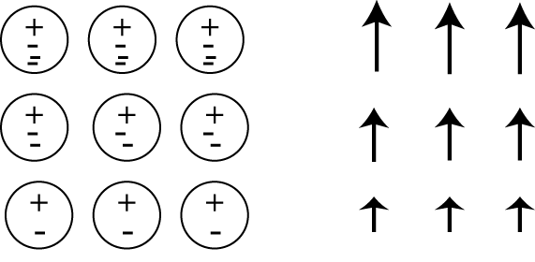
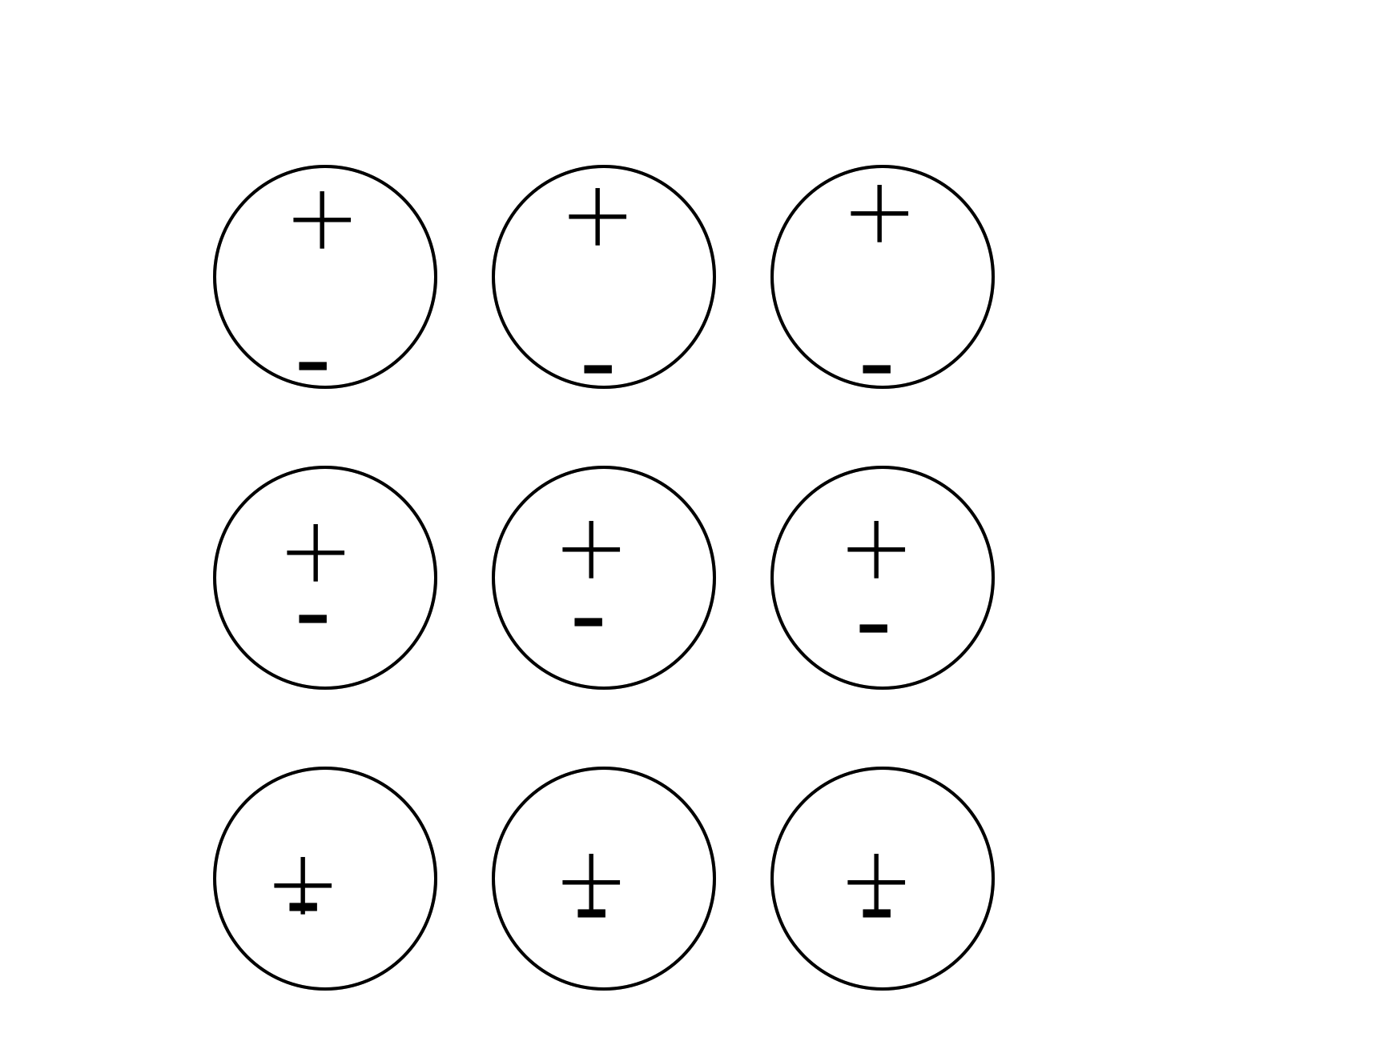
In the following case, is the bound surface and volume charge zero or nonzero?
7.75
ρ_{b} =0, σ_{b}≠0
ρ_{b} ≠0, σ_{b}≠0
ρ_{b} =0, σ_{b}=0
ρ_{b} ≠0, σ_{b}=0
Physical dipoles idealized dipoles
Notes:
Class: CONCEPTUAL
Correct Answer: B
72

Slide 73
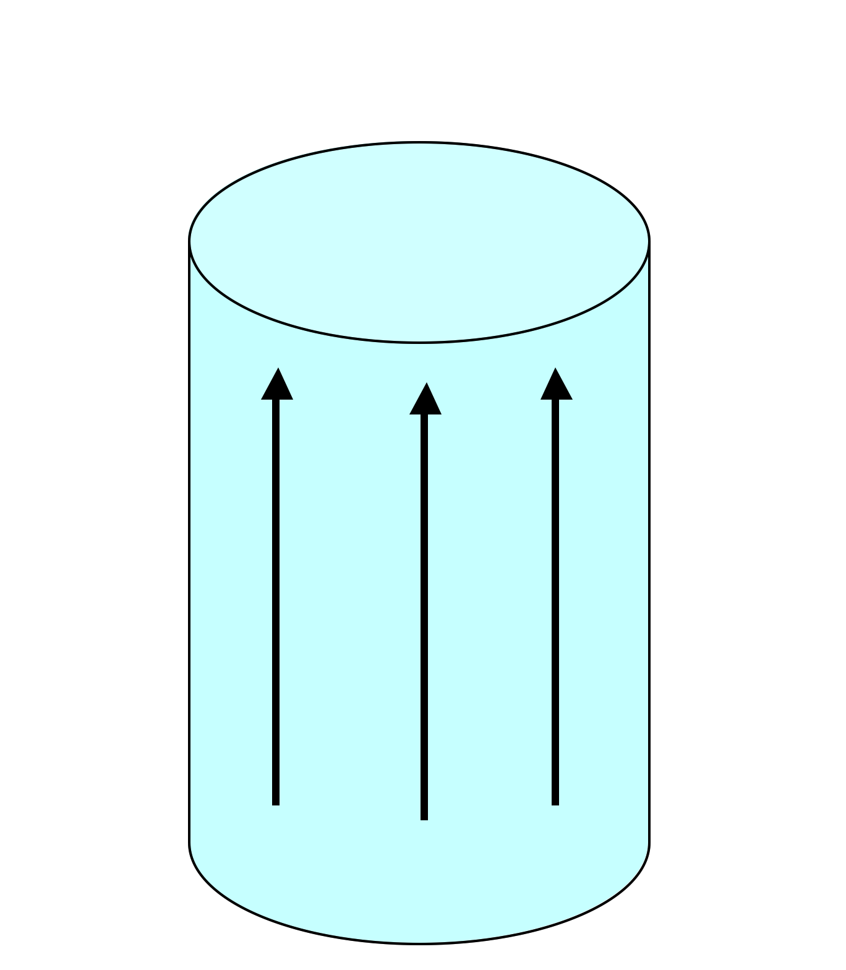
A solid cylinder has uniform magnetization M throughout the volume in the z direction as shown. Where do bound currents show up?
7.76
Everywhere: throughout the volume and on all surfaces
Volume only, not surface
Top/bottom surface only
Side (rounded) surface only
All surfaces, but not volume
M
Notes:
Class: CONCEPTUAL
Correct Answer: D

Slide 74
Choose boundary conditions
7.77
Choose all of the following statements that are implied by
(I) (II)
(III)
A) (I) only B) (II) only C) (I) and (II) only
D) (I) and (III) only E) Some other combo!
Notes:
Class: MATH/PHYSICS
Correct Answer: C
74

Slide 75
Choose boundary conditions
7.78
Choose all of the following statements that are implied by
(for any closed surface you like)
(I)
(II)
(III)
A) (I) only B) (III) only C) (I) and (II) only
D) (I) and (III) only E) Something else!
Notes:
Class: MATH/PHYSICS
Correct Answer: D
75

