Slide 1
Potential and E-field
= external work done on charge to move it

Slide 2
Potential and E-field
The fact that V is well defined arises from
Which is exactly the same as (!)

Slide 3
Potential and E-field
One way to find V(r) (given charges):

Slide 4
One way to find V(r) (given charges):
Voltage V = kq/r from a point charge !

Slide 5
So, what does
Have to do with
And why is that the same as

Slide 6
Fundamental theorem:
Divergence theorem:
Stoke’s (or “curl”) theorem:

Slide 7
What is the curl of this vector field, V in the region shown below?
1.8
non-zero everywhere
Zero at some points, non-zero others
zero curl everywhere shown
Notes:
CORRECT ANSWER: A
7

Slide 8
What is the curl of this vector field, V in the region shown below?
1.8
non-zero everywhere
Zero at some points, non-zero others
zero curl everywhere shown
Notes:
8

Slide 9
What is the curl of this vector field, V in the region shown below?
1.8
Notes:
9

Slide 10
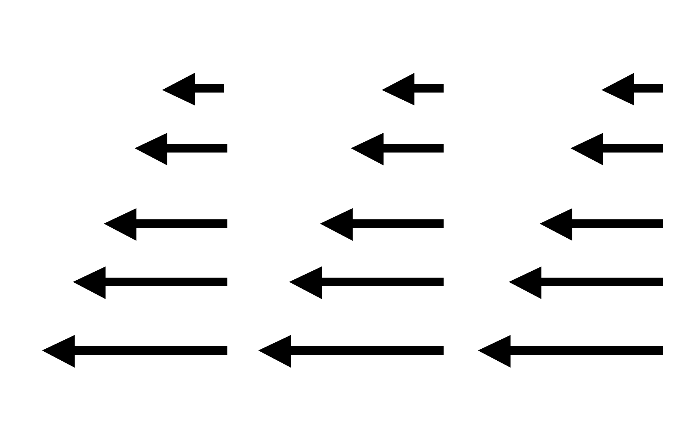
Which of the following could be a static physical E-field in a small region?
2.43b/1.7b
I
II
Only I B) Only II
C) Both D) Neither
E) Cannot answer without further info
Notes:
10
CORRECT ANSWER: B

Slide 11
(with )
It is also true that where
Question: is the following mathematically ok?
Yes B) No C) ???
Notes:
CORRECT ANSWER: A

Slide 12
Could the following electrostatic field possibly exist in a finite region of space that contains no charges? (A, and c are constants with appropriate units)
A) Sure, why not?
B) No way
C) Not enough info to decide
Notes:
CORRECT ANSWER: B
12

Slide 13
Given a sphere with uniform surface charge density σ what can you say about the potential V inside this sphere? (Assume as usual, V(∞)=0)
V=0 everywhere inside
V = non-zero constant everywhere inside
C) V must vary with position, but is zero at the center.
D) None of these.
Notes:
CORRECT ANSWER: B

Slide 14
Why is in electrostatics?
Because
Because E is a conservative field
Because the potential between two points is independent of the path
All of the above
NONE of the above - it's not true!
Notes:
CORRECT ANSWER: D

Slide 15
A uniformly charged ring, in the xy plane, centered on the origin, has radius a and total charge Q. V(r = ∞) = 0.
What is the voltage at z on the z-axis?
z
a
Notes:
CORRECT ANSWER: C

Slide 16
A uniformly charged ring, in the xy plane, centered on the origin, has radius a and total charge Q. V(r = ∞) = 0.
What is the voltage at z on the z-axis?
z
a
dq
Notes:
Animated, this helps explain the previous answer.

Slide 17
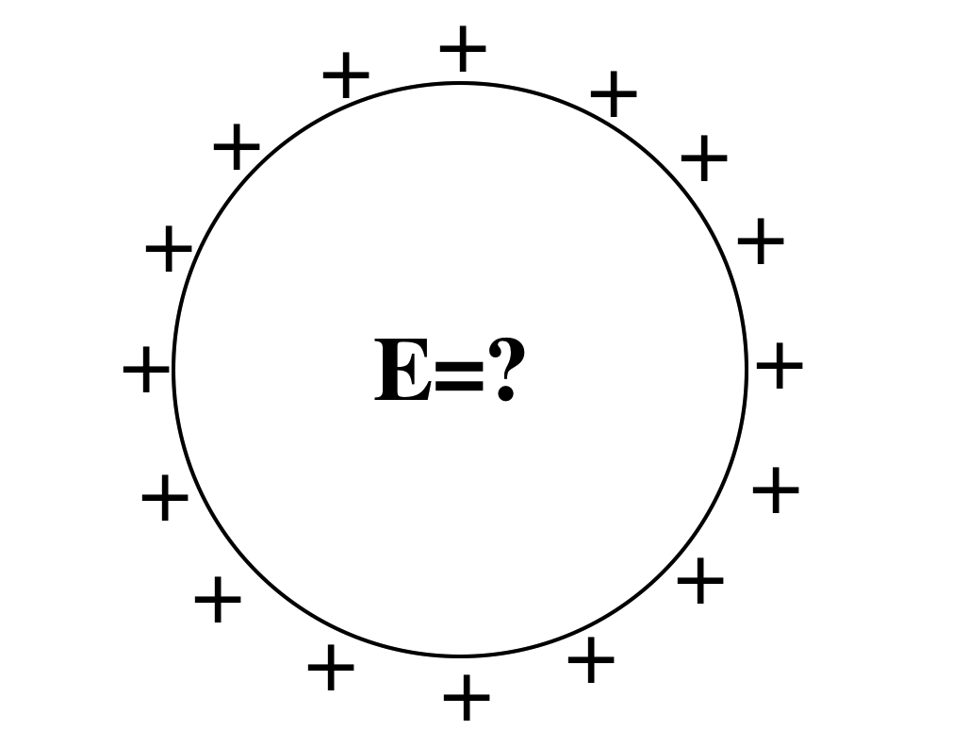
A spherical shell has a uniform positive charge density on its surface. (There are no other charges around)
What is the electric field inside the sphere?
A: E=0 everywhere inside
B: E is non-zero everywhere in the sphere
C: E=0 only at the very center, but non-zero elsewhere inside the sphere.
D: Not enough info given
Notes:
17
CORRECT ANSWER: A

Slide 18
Could this be a plot of |E|(r)? Or V(r)? (for SOME physical situation?)
A) Could be E(r), or V(r)
B) Could be E(r), but can't be V(r)
C) Can't be E(r), could be V(r)
D) Can't be either E) ???
Notes:
CORRECT ANSWER: B

Slide 19
The voltage is zero at a point in space.
You can conclude that :
The E-field is zero at that point.
B) The E-field is non-zero at that point
C) You can conclude nothing at all about the E-field at that point
Notes:
CORRECT ANSWER: C

Slide 20
The voltage is constant everywhere along a line in space.
V=constant
You can conclude that :
A) The E-field has constant magnitude along that line.
B) The E-field is zero along that line.
C) You can conclude nothing at all about the magnitude of E along that line.
Notes:
CORRECT ANSWER: C

Slide 21
Consider an infinitesimal path element dL directed radially inward, toward the origin as shown.
y
In spherical coordinates, the correct expression for dL is:
x
Notes:
CORRECT ANSWER: A

Slide 22
Given a spherical SHELL with uniform surface charge density σ (no other charges anywhere else) what can you say about the potential V inside this sphere? (Assume as usual, V(∞)=0)
V=0 everywhere inside
V = non-zero constant everywhere inside
C) V must vary with position, but is zero at the center.
D) Could be A OR B!
E) None of these, it’s something else!
Notes:
CORRECT ANSWER: B

Slide 23
We usually choose V(r → ∞) ≡ 0 when calculating the potential of a point charge to be V(r) = +κq/r. How does the potential V(r) change if we choose our reference point to be V(R)=0 where R is closer to +q than r.
+q
R
r
∞
A V(r) is positive but smaller than kq/r
B V(r) is positive but larger than kq/r
C V(r) is negative
D V(r) doesn’t change (V is independent of choice of reference)
Notes:
23
CORRECT ANSWER: C

Slide 24
+Q
+Q
A
B
Two isolated spherical shells of charge, labeled A and B, are far apart and each has charge Q. Sphere B is bigger than sphere A. Which shell has higher voltage? [V(r=∞) = 0]
A) Sphere A B) Sphere B
C) Both have same voltage.
Notes:
CORRECT ANSWER: A

Slide 25
Why is in electrostatics?
Because
Because E is a conservative field
Because the potential (voltage) between two points is independent of the path
All of the above
NONE of the above - it's not true!
Notes:
25
CORRECT ANSWER: D

Slide 26
V
A parallel plate capacitor is attached to a battery which maintains a constant voltage difference V between the capacitor plates. While the battery is attached, the plates are pulled apart. The electrostatic energy stored in the capacitor
A) increases
B) decreases
C) stays constant.
Notes:
CORRECT ANSWER: B

