Slide 1
Three identical charges +q sit on an equilateral triangle.
2.47
What would be the final KE of the top charge if you released it (keeping the other two fixed)
B)
C) D)
E) other
Notes:
CORRECT ANSWER: C

Slide 2
Three identical charges +q sit on an equilateral triangle.
2.48
What would be the final KE of the top charge if you released
all three?
B)
C) D)
E) other
Notes:
CORRECT ANSWER: A

Slide 3
Does system energy “superpose”?
That is, if you have one system of charges with total stored energy W1, and a second charge distribution with W2… if you superpose these charge distributions, is the total energy of the new system simply W1+W2?
Yes
No
Notes:
CORRECT ANSWER: B

Slide 4
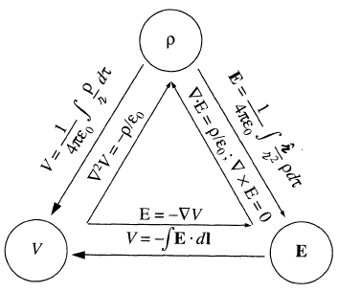

Slide 5
r
Two charges, +q and –q, are a distance r apart. As the charges are slowly moved together, the total field energy
A) increases
B) decreases
C) remains constant
(Come up with two different reasons for your answer. )
Notes:
CORRECT ANSWER: B

Slide 6
+Q
-Q
A parallel-plate capacitor has +Q on one plate, -Q on the other. The plates are isolated so the charge Q cannot change. As the plates are pulled apart, the total electrostatic energy stored in the capacitor
A) increases
B) decreases
C) remains constant.
(Come up with two different reasons for your answer. )
Notes:
CORRECT ANSWER: A

