Slide 1
Potential and E-field
= external work done on charge to move it
Notes:
USED IN: Spring 2013 (Pollock)
LECTURE NUMBER: 8 (intro to voltage)
This slide was my “motivation for the definition”. It’s physical. qV is “work done”, you pay for it, it’s real! I walked through the critical point that if *I* (the external agent) am the one moving test q around, I am doing –F(electric), so that – sign is critical to get the EXTERNAL work.
WRITTEN BY: Steven Pollock

Slide 2
Potential and E-field
The fact that V is well defined arises from
Which is exactly the same as (!)
Notes:
USED IN: Spring 2013 (Pollock)
LECTURE NUMBER: 8 (intro to voltage)
Part of the formal introduction,
Slide is animated. FIRST I argue (remind, did not prove!) that “del” (gradient) inverts line integrals, and vice versa. So one of the two top formulas follows from the other.
Someone asked about this: is it always true, for any functions? I started to say, sure, it’s *math*, so far E and V could just be “A” and “B”, arbitrary functions. Then I hedged and said “well, as always, they must be well-behaved in the usual mathematical ways, no pathological functions please”. And finally I said, you know, this will turn out to be super important coming up very soon: Clearly E in physics is… physical, it should be finite. So in fact that PHYSICAL constraint on E suggests that V better NEVER be discontinuous (otherwise, del will blow up and give an unphysical E). So we ARE going to find that voltage is always continuous everywhere, and this will help us solve problems! It was a nice “foreshadowing” (we’ll talk about it more next lecture)
The next part is motivation to review/discuss Curl, and Stoke’s theorem. At this point, I have not explained or proven why curl(E) is zero, or why the 2 statements are the same, but I promise I would get to BOTH of those soon. Right here, instead, I mrerely wanted to argue that IF the line integral around a loop vanishes, then the non-closed integral in the definition is independent of path choice. (A picture on the board and splitting the loop integral up into two parts, then “reversing” one of them, is all that is needed here)
Student comment: They thought V was NOT “well defined” (they knew about arbitrary constant). Nice, I pointed out that that’s built in to the choice of origin here. So, THIS formula has no ambiguity (given an origin), the ambiguity is that I can pick any origin I want. I used that to point out that FROM THIS FORMULA (at the top), Delta V is independent of the origin, and there’s your voltmeter!
WRITTEN BY: Steven Pollock

Slide 3
Potential and E-field
One way to find V(r) (given charges):
Notes:
USED IN: Spring 2013 (Pollock)
LECTURE NUMBER: 8 (intro to voltage)
Here, I am arguing that the definition at the top and the “conclusion “ (that E is –grad(V)) sort of look circular. And they sort of ARE unless you have some OTHER way to find V.
The formula at the bottom looks formal, and I point that out. The next slide helps “make sense” of what it’s saying
WRITTEN BY: Steven Pollock

Slide 4
One way to find V(r) (given charges):
Voltage V = kq/r from a point charge !
Notes:
USED IN: Spring 2013 (Pollock)
LECTURE NUMBER: 8 (intro to voltage)
Here I am taking the “ugly looking” formal formula and moving them in two steps to what it MEANS, where it comes from – it’s what they already know from intro physics.
WRITTEN BY: Steven Pollock

Slide 5
So, what does
Have to do with
And why is that the same as
Notes:
USED IN: Spring 2013 (Pollock)
LECTURE NUMBER: 8 (intro to voltage)
Returning to my promise to explain the math connection (Stoke’s theorem). I DEFINE curl to be limit (area ->0) circulation/unit area. And then define circulation.
Some brief discussion of the vector nature of curl (circulation AROUND an axis)
Some brief discussion of the signs (right hand rule for which way to integrate)
WRITTEN BY: Steven Pollock

Slide 6
Fundamental theorem:
Divergence theorem:
Stoke’s (or “curl”) theorem:
Notes:
USED IN: Spring 2013 (Pollock)
LECTURE NUMBER: 8 (intro to voltage)
This is largely review, walk through it again, and get THEM to call out the animated right hand sides before they show up.
Use my definition (prev slide) of what curl means to “prove” Stoke’s theorem (by summing up the little circulations to get the big circulation).
This theorem answers my previous question: If curl(E)=0, then line integral of E is always zero, and vice versa. Still haven’t shown/proven WHY curl(E) =0 (that’s coming next), but if it is,
Then we have now shown why curl(E)=0 implies voltage is well defined.
But proof or no proof, Curl(E) IS=0 in statics, A Maxwell equation, put it up on the board!
WRITTEN BY: Steven Pollock

Slide 7
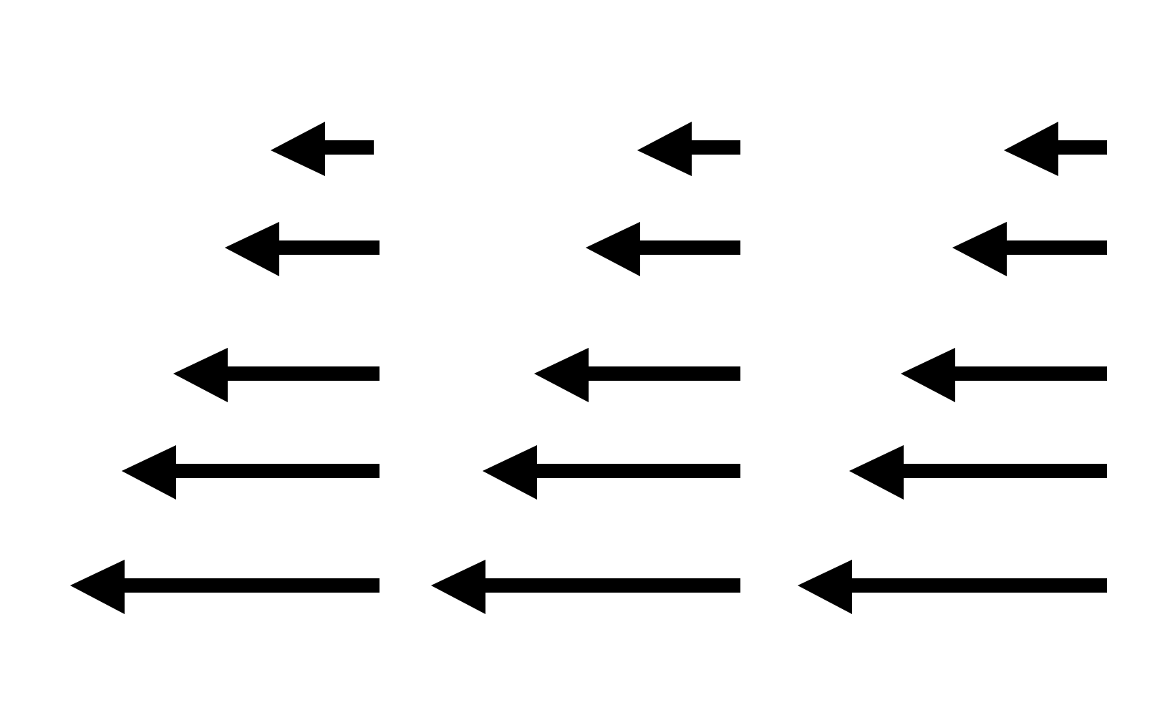
Which of the following could be a static physical E-field in a small region?
2.43b/1.7b
I
II
Only I B) Only II
C) Both D) Neither
E) Cannot answer without further info
Notes:
7
CORRECT ANSWER: B
USED IN: Fall 2008 (Dubson) and Spring 2008 and ‘13 (Pollock)
LECTURE NUMBER: Dubson (Week 3, Lecture 6). Pollock (Lecture 8).
STUDENT RESPONSES: 0% [[91%]] 6% 4% 0% (FALL 2008)
50% correct (SPRING 2008)
0 [[95]], 0, 5%, 0 (Sp ’13)
INSTRUCTOR NOTES: Answer is B (I is forbidden by curl)
Used at start of class. In ‘08 50% correct. Good discussion, which was not merely about “seeing the curl” but also we discussed the field in II wrt Gauss law. (So, some students said II was no good because it has a nonzero divergence, thinking “small region” must have rho=0.) We also got into a nice discussion when I argued that there MUST be charge in region II, since div is clearly 0 (which turns out not to be correct - a student pointed out that this is the field as you approach a negative line charge on the left. So we had to talk about the 3-D *assumptions* I was implicitly making. Another student wanted to argue (incorrectly) this was the field if you have two SHEETS on either side, with low sigma on the right, and high negative sigma on the left. So that made a nice review conversation too. -SJP
Remarkably similar conversations in Sp ‘13! I did not get to hear from the few students who thought “Neither”.
WRITTEN BY: Steven Pollock (CU-Boulder)

Slide 8
Notes:
No real time for this, rushed!

Slide 9
(with )
It is also true that where

Slide 10
(with )
It is also true that where

Slide 11
(with )
It is also true that where
Question: is the following mathematically ok?
Yes B) No C) ???
Notes:
NO TIME in 2013.
CORRECT ANSWER: A
USED IN: Spring 2008 (Pollock)
LECTURE NUMBER: 7
STUDENT RESPONSES: [[57%]] 43% 0% 0% 0%
INSTRUCTOR NOTES: Pretty much split A and B! (I sort of guided the confusion, suggesting that, who knows, maybe this is one of those “integration by parts” situations that means you need a second surface term when you try to slide the Del around.) Anyway - I think this was a really good one - good discussion, this kind of formal operation is still hard for them *especially* given their confusions about what curly R means… Answer is yes, the gradient has nothing to do with the “prime” variables, this is fine (and the key step in our derivation of voltage) -SJP
WRITTEN BY: Steven Pollock (CU-Boulder)

Slide 12
Notes:
Skipped. Summary?

Slide 13
Could the following electrostatic field possibly exist in a finite region of space that contains no charges? (A, and c are constants with appropriate units)
A) Sure, why not?
B) No way
C) Not enough info to decide
Notes:
Skipped
CORRECT ANSWER: B
USED IN:
LECTURE NUMBER: 7 SKIPPED
STUDENT RESPONSES:
INSTRUCTOR NOTES:. Good conversation starter, regarding units, and div must be zero if we’re in a charge free region, and curl must be zero…
Answer is no, because Del dot E is not zero. (Curl is ok) Of course, this doesn't require them to TAKE the curl, since div already says it's no good... so if the operation of taking the curl is what you WANT to focus on, you will have to adapt the question. -SJP
Previously gave this question with a choice of E fields and asked which was physically possible -- took too much time (50% correct).
WRITTEN BY: Steven Pollock (CU-Boulder)
13

Slide 14
Which of the following electrostatic fields could exist in a finite region of space that contains no charges?
A)
B)
C)
D)
None of these
Notes:
Skipped
14

Slide 15
Given a sphere with uniform surface charge density σ what can you say about the potential V inside this sphere? (Assume as usual, V(∞)=0)
V=0 everywhere inside
V = non-zero constant everywhere inside
C) V must vary with position, but is zero at the center.
D) None of these.
Notes:
Skipped in ‘13
CORRECT ANSWER: B
USED IN: Spring 2008 (Pollock), Fall 2009 (Schibli)
LECTURE NUMBER: 9
STUDENT RESPONSES: 17% [[ 67%]] 17% 0% 0% (SPRING 2008)
23% [[ 73%]] 5% 0% 0% (FALL 2009)
INSTRUCTOR NOTES: Used this as the “lead in” question start of class. 2/3 got it, lots argued for A (which I also heard during office hours) but several also argued for C. Not sure if the confusion was just misreading the problem (thinking of it as a solid sphere), but I got *asked* about that during the question, and was extremely clear that this was supposed to be JUST A SHELL of charges with nothing inside. (SO, I just now edited the problem to say “and no other charges anywhere else”, we’ll see if that helps?) Although as usual, leaving in ambiguities sometimes makes for more fruitful and active discussions/arguments!) -SJP
WRITTEN BY: Steven Pollock (CU-Boulder)

Slide 16
Why is in electrostatics?
Because
Because E is a conservative field
Because the potential between two points is independent of the path
All of the above
NONE of the above - it's not true!
Notes:
Skipped
CORRECT ANSWER: D
USED IN: Fall 2008 (Dubson) and Spring 2008 (Pollock)
LECTURE NUMBER: Dubson (Week 3, Lecture 6). Pollock (Lecture 7).
STUDENT RESPONSES: 6% 6% 9% [[79%]] 0% (FALL 2008)
9% 9% 14% [[55%]] 14% (SPRING 2008)
INSTRUCTOR NOTES: . I used it as a “start of class” clicker question, before covering this material, so it was sort of a “reading question” 57% chose d) I then came back to it later in the lecture (though we didn’t re-vote) to talk through points a, b, and c…-SJP
WRITTEN BY: Steven Pollock (CU-Boulder)

Slide 17
A uniformly charged ring, in the xy plane, centered on the origin, has radius a and total charge Q. V(r = ∞) = 0.
What is the voltage at z on the z-axis?
z
a
Notes:
CORRECT ANSWER: C
USED IN: Fall 2008 (Dubson), Sp 2013 (Pollock)
LECTURE: Dubson (Week 3, Lecture 7)Pollock (2013) (Week 4, Lecture 9) (Pre-class question)
STUDENT RESPONSES: 0% 4% [[90%]] 6% 0% (FALL 2008)
0% 19%, [[69%]] 6%, 6% Sp ‘13
INSTRUCTOR NOTES:
Given the high success from Dubson’s students, and the simple question, I thought this would be quick. But, students did NOT all get it, they were making some sort of “Gauss law says this acts like a point at the origin argument” (Maybe?) I used this to review curly R, (see next slide),
(One student was struggling with how to go from the integral of lambda dl to Q, he was introducting 2 Pi, not seeing that the integral IS Q. )
WRITTEN BY: Mike Dubson (CU-Boulder)

Slide 18
A uniformly charged ring, in the xy plane, centered on the origin, has radius a and total charge Q. V(r = ∞) = 0.
What is the voltage at z on the z-axis?
z
a
dq
Notes:
Animated, this helps explain the previous answer.

Slide 19
Summary:
Def of potential:
How do you compute it:
What good is it?
Where did it come from?
Which by Stoke’s theorem is
mathematically equivalent to:
Notes:
LECTURE: Pollock (Week 4, Lecture 9)
Took some time on this. Students were confused about the first two equations, one did not realize that “dr” is NOT d^3r, so thought the top two equations were the exact same thing (and thus, was confused why it’s 1/R instead of 1/R^2)
Reminded them of the “hidden” element of curl(E)=0 buried in the definition of V, and the fact that the computation formula is only valid if the charges are localized (and we are setting V(infinity)=0)

Slide 20
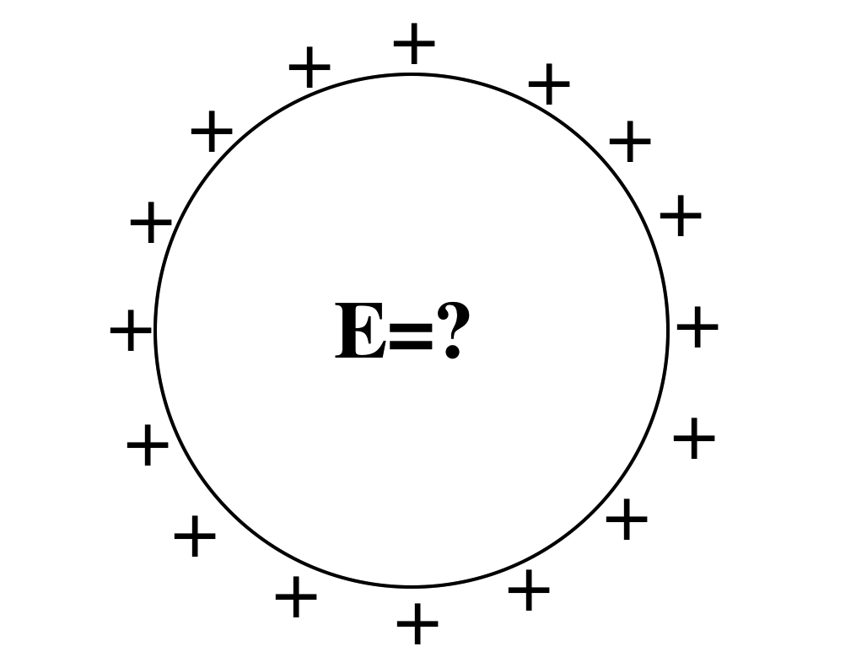
A spherical shell has a uniform positive charge density on its surface. (There are no other charges around)
What is the electric field inside the sphere?
A: E=0 everywhere inside
B: E is non-zero everywhere in the sphere
C: E=0 only at the very center, but non-zero elsewhere inside the sphere.
D: Not enough info given
Notes:
20
CORRECT ANSWER: A
USED IN: Fall 2008 (Dubson) and Spring 2008 (Pollock)
LECTURE NUMBER: Dubson (Week 3, Lecture 7). Pollock (Lecture 8).
STUDENT RESPONSES: [[92%]] 8% 0% 0% 0% (FALL 2008)
[[ 91%]] 0% 9% 0% 0% (SPRING 2008)
INSTRUCTOR NOTES: L8,Used as lead in to “continuity/boundary conditions”. 91% correct, but still worth making sure they know WHY E=0 everywhere, that is, can they articulate the symmetry argument (that E must be radial) from which Gauss’ law gives the answer. (Many seem to think if flux is zero, then E is zero, so they can get the right answer for inadequate reasoning!) -SJP
WRITTEN BY: Steven Pollock (CU-Boulder), from a freshman question by M. Dubson

Slide 21
Could this be a plot of |E|(r)? Or V(r)? (for SOME physical situation?)
A) Could be E(r), or V(r)
B) Could be E(r), but can't be V(r)
C) Can't be E(r), could be V(r)
D) Can't be either E) ???
Notes:
CORRECT ANSWER: B
USED IN: Fall 2008 (Dubson) and Spring 2008 and 13 (Pollock), Fall 2009 (Schibli)
LECTURE NUMBER: Dubson (Week 3, Lecture 7). Pollock (Lecture 8 in 2008, Lecture 9 in 13) Schibli
STUDENT RESPONSES: 31% [[57%]] 12% 0% 0% (FALL 2008)
27% [[73%]] 0% 0% 0% (SPRING 2008)
7% [[93%]] 12% 0% 0% (FALL 2009)
6, [[89]], 2, 4, 0 (Spring ‘2013)
INSTRUCTOR NOTES: 73% correct. (I preceded it by 2.26, which made the E part easier, since they had just, 10 minutes earlier, SEEN this E field!) Nice discussion possibilities, we had some good arguments brought out about WHY we know V(r) can not be discontinuous.
My answer is B, E can jump, but V cannot, in physical situations -SJP
WRITTEN BY: Steven Pollock (CU-Boulder)

Slide 22
The voltage is zero at a point in space.
You can conclude that :
The E-field is zero at that point.
B) The E-field is non-zero at that point
C) You can conclude nothing at all about the E-field at that point
Notes:
CORRECT ANSWER: C
USED IN: Fall 2008 (Dubson), Fall 2009 (Schibli)
LECTURE NUMBER: Dubson (Week 3, Lecture 7) Schibli. No time in Sp 13, just discussed (Lecture 9)
STUDENT RESPONSES: 10% 0% [[90%]] 0% 0% (FALL 2008)
30% 0% [[70%]] 0% 0% (FALL 2009)
INSTRUCTOR NOTES:
WRITTEN BY: Mike Dubson (CU-Boulder)

Slide 23
The voltage is constant everywhere along a line in space.
V=constant
You can conclude that :
A) The E-field has constant magnitude along that line.
B) The E-field is zero along that line.
C) You can conclude nothing at all about the magnitude of E along that line.
Notes:
CORRECT ANSWER: C
USED IN: Fall 2008 (Dubson)
LECTURE NUMBER: Dubson (Week 3, Lecture 7 and Week 3, Lecture 8) . No time in Sp 13, just discussed (Lecture 9)
STUDENT RESPONSES: 18% 10% [[73%]] 0% 0% (FALL 2008: Week 3, Lecture 7)
11% 2% [[87%]] 0% 0% (FALL 2008: Week 3, Lecture 8)
INSTRUCTOR NOTES:
WRITTEN BY: Mike Dubson (CU-Boulder)

Slide 24
+Q
+Q
A
B
Two isolated spherical shells of charge, labeled A and B, are far apart and each has charge Q. Sphere B is bigger than sphere A. Which shell has higher voltage? [V(r=∞) = 0]
A) Sphere A B) Sphere B
C) Both have same voltage.
Notes:
Skipped in ‘13
CORRECT ANSWER: A
USED IN: Fall 2008 (Dubson), Fall 2009 (Schibli)
LECTURE NUMBER: Dubson (Week 3, Lecture 8) Schibli
STUDENT RESPONSES: [[66%]] 6% 28% 0% 0% (FALL 2008)
[[55%]] 2% 43% 0% 0% (FALL 2009)
INSTRUCTOR NOTES:
WRITTEN BY: Mike Dubson (CU-Boulder)

Slide 25
Why is in electrostatics?
Because
Because E is a conservative field
Because the potential (voltage) between two points is independent of the path
All of the above
NONE of the above - it's not true!
Notes:
25
Skipped in ‘13
CORRECT ANSWER: D
USED IN: Fall 2008 (Dubson) and Spring 2008 (Pollock)
LECTURE NUMBER: Dubson (Week 3, Lecture 6). Pollock (Lecture 7).
STUDENT RESPONSES: 6% 6% 9% [[79%]] 0% (FALL 2008)
9% 9% 14% [[55%]] 14% (SPRING 2008)
INSTRUCTOR NOTES: . I used it as a “start of class” clicker question, before covering this material, so it was sort of a “reading question” 57% chose d) I then came back to it later in the lecture (though we didn’t re-vote) to talk through points a, b, and c…-SJP
WRITTEN BY: Steven Pollock (CU-Boulder)

Slide 26
V
A parallel plate capacitor is attached to a battery which maintains a constant voltage difference V between the capacitor plates. While the battery is attached, the plates are pulled apart. The electrostatic energy stored in the capacitor
A) increases
B) decreases
C) stays constant.
Notes:
Skipped in ‘13. (more on this idea in next section of clicker questions too, on energy)
CORRECT ANSWER: B
USED IN: Fall 2008 (Dubson)
LECTURE: Dubson (Week 4, Lecture 11)
STUDENT RESPONSES: 50% [[30%]] 20% 0% 0% (FALL 2008)
INSTRUCTOR NOTES:
WRITTEN BY: Mike Dubson (CU-Boulder)

