Slide 1
METHOD OF IMAGES
Notes:
-SJP
WRITTEN BY: Steven Pollock (CU-Boulder)

Slide 2
Calculate voltage (everywhere in space!) for 2 equal/opposite point charges a distance “d” above and below the origin. Where is V(r)=0?

Slide 3
A point charge +Q sits above a very large grounded conducting slab. What is E(r) for other points above the slab?
Simple Coulomb’s law:
B) Something more complicated
+Q
r
z
y
x
Notes:
CORRECT ANSWER: B

Slide 4
Infinite grounded conducting slab
Notes:
From Charles Baily:

Slide 5
Boundary Conditions:
(grounded)

Slide 6
A point charge +Q sits above a very large grounded conducting slab. What is the electric force on this charge?
0 B)
C)
D) Something more complicated
+Q
d
z
y
x
Notes:
CORRECT ANSWER: B

Slide 7
A point charge +Q sits above a very large grounded conducting slab. What's the energy of this system?
B) Something else.
+Q
d
z
y
x
Notes:
CORRECT ANSWER: B

Slide 8
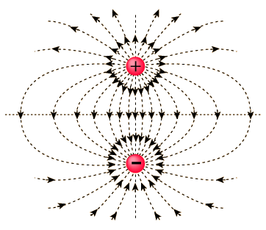
Notes:
Second Explanation – There is energy in the fields, and we can see that if the first expression is the energy in the fields of a dipole, then the physical situation only has half the volume of space containing electric field lines. So, we'd expect that there's half as much energy in the fields.
If there aren't any questions about this, I'd like to use my remaining time to tell you something about my education research, and how this has influenced my approach to teaching physics at all levels of instruction.

Slide 9
Two ∞ grounded conducting slabs meet at right angles. How many image charges are needed to solve for V(r)?
one
B) two
C) three
D) more than three
E) Method of images won't work here
+Q
r
Notes:
CORRECT ANSWER: C

Slide 10
Could we use the method of images
for THIS problem? Find V(r) everywhere z>0,
Given these two charges above a (grounded,
infinite, conducting) plane?
Yes, it requires 1 “image charge”
Yes, it requires 2 images
Yes, more than 2 image charge
No, this problem can NOT be solved using the “trick” of image charges…
Notes:
CORRECT ANSWER: B

Slide 11
Could we use the method of images
for THIS problem? Find V(r) everywhere z>0,
Given these two charges above a (grounded,
infinite, conducting) plane?
Notes:
Animation for the previous question.

