Slide 1
MULTIPOLE EXPANSION
Notes:
-SJP
WRITTEN BY: Steven Pollock (CU-Boulder)

Slide 2
Dipole moment - off center
The dipole moment,
+q
r₁
d
x
r₂
-q

Slide 3
Dipole moment - off center
+q
d
-q
r₁
y
r₂
x
Notes:
CORRECT ANSWER: A

Slide 4
A small dipole (dipole moment p=qd) points in the z direction.
We have derived
Which of the following is correct (and "coordinate free")?
A) B)
C) D)
E) None of these
Notes:
CORRECT ANSWER: A

Slide 5
An ideal dipole (tiny dipole moment p=qd) points in the z direction.
We have derived
Sketch this E field...
(What would change if the dipole
separation d was not so tiny?)

Slide 6
Sketch this E field…

Slide 7
For a dipole at the origin pointing in the z-direction, we have derived
z
+
For the dipole p = q d shown, what does the formula predict for the direction of E(r=0)?
d
x
-
Down B) Up C) some other direction
D) The formula doesn't apply.
Notes:
CORRECT ANSWER: D

Slide 8
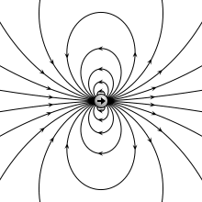

Notes:
http://upload.wikimedia.org/wikipedia/commons/a/aa/VFPt_dipole_animation_electric.gif
It’s animated, moves from point to finite dipole!
I believe it is “distorted”.

Slide 9
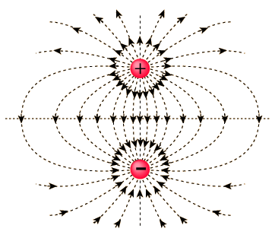

Slide 10
Notes:
It’s an animated gif! Click the arrow to make it go.
http://upload.wikimedia.org/wikipedia/commons/a/aa/VFPt_dipole_animation_electric.gif

Slide 11
Griffiths argues that the force on a dipole in an E field is:
3.23
If the dipole p points in the z direction, what direction is the force?
Also in the z direction
B) perpendicular to z
C) it could point in any direction
Notes:
CORRECT ANSWER: C

Slide 12
Griffiths argues that the force on a dipole in an E field is:
3.24
If the dipole p points in the z direction, what can you say about E if I tell you the force is in the x direction?
E simply points in the x direction
B) Ez must depend on x
C) Ez must depend on z
D) Ex must depend on x
E) Ex must depend on z
Notes:
CORRECT ANSWER: E

Slide 13
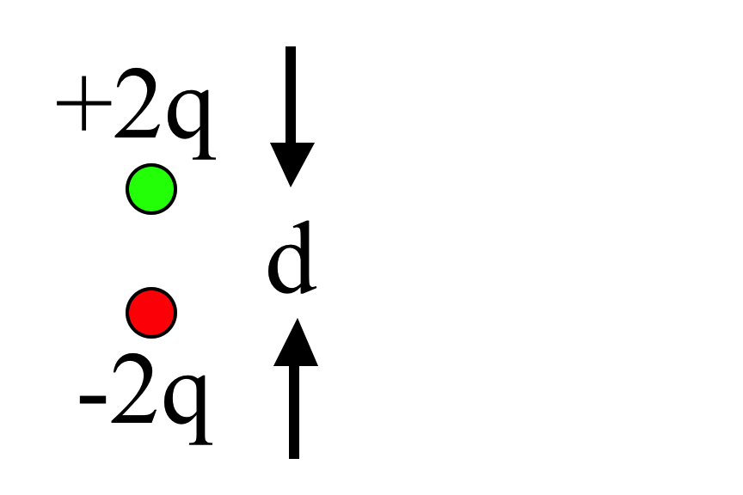
What is the magnitude of the dipole moment of this charge distribution?
3.27
qd
B) 2qd
C) 3qd
D) 4qd
E) It's not determined
Notes:
CORRECT ANSWER: B

Slide 14
Dipole moment - off center
MD6.1
+2q
What is the dipole moment of this system? (Note: it is NOT overall neutral!)
d
0
-q
x
Notes:
CORRECT ANSWER: B

Slide 15
Dipole moment - off center
MD6.1
+2q
What is the dipole moment of this system? (Note: same as last question, just shifted in z!)
d/2
r₁
d
0
x
r₂
d/2
-q
Notes:
CORRECT ANSWER: B

Slide 16
MD6 - 3
For a collection of point charges, the dipole moment is defined as
Consider the two charges, +2q and –q, shown.
Which statement is true?
A) The dipole moment is independent of the origin.
B) The dipole moment depends on the position of the origin.
C) The dipole moment is zero.
D) The dipole moment is undefined.
+2q
y
r₁
d
-q
r₂
x
Notes:
CORRECT ANSWER: B

Slide 17
You have a physical dipole, +q and -q a finite distance d apart.
When can you use the expression:
A) This is an exact expression everywhere.
B) It's valid for large r
C) It's valid for small r
D) ?
Notes:
17
CORRECT ANSWER: B

Slide 18
You have a physical dipole, +q and -q, a finite distance d apart.
When can you use the expression
A) This is an exact expression everywhere.
B) It's valid for large r
C) It's valid for small r
D) ?
Notes:
18
CORRECT ANSWER: A

Slide 19
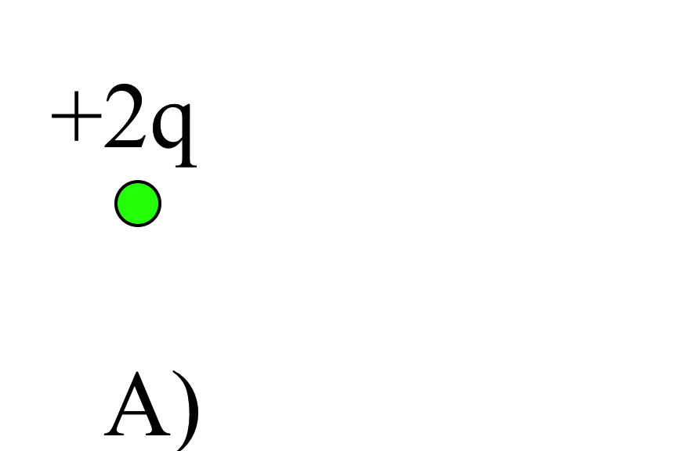
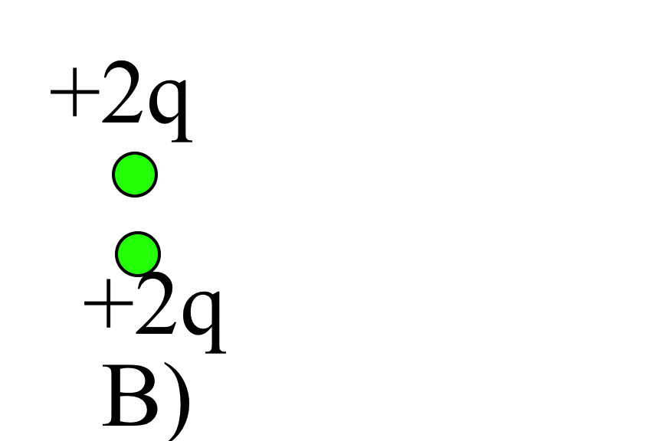
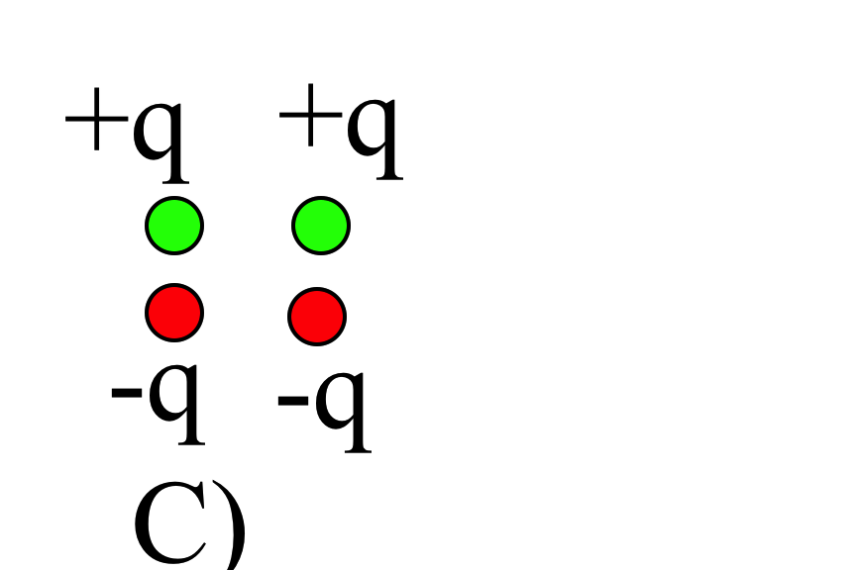
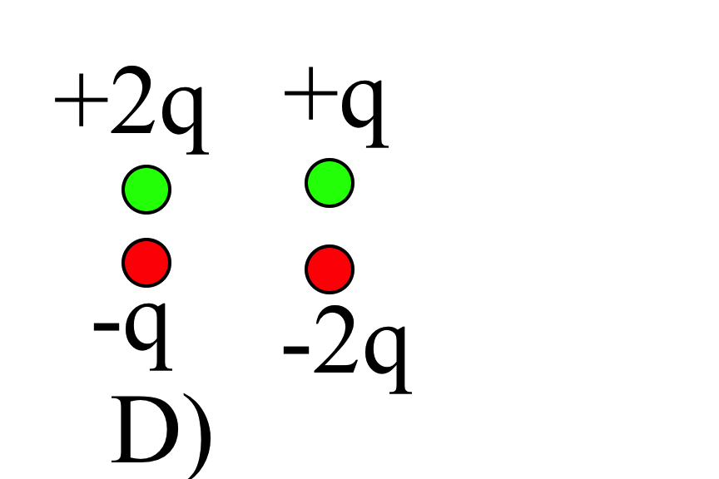
Which charge distributions below produce a potential which looks like C/r² when you are far away?
E) None of these, or more than one of these!
(Note: for any which you did not select, how DO they behave at large r?)
Notes:
CORRECT ANSWER: E

Slide 20
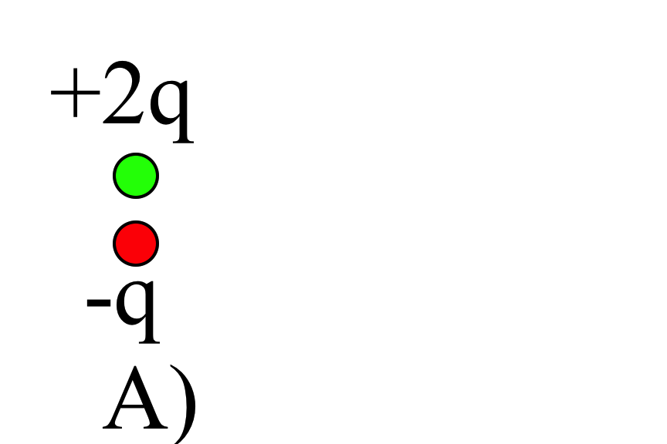
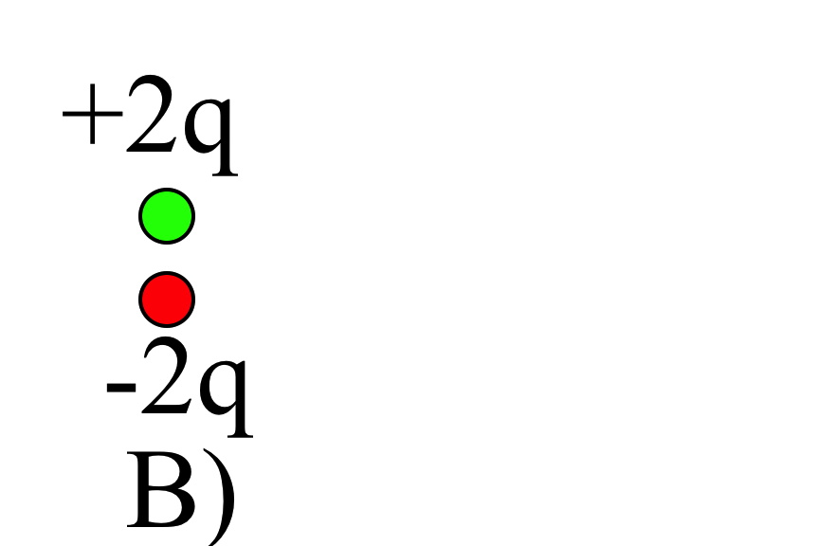
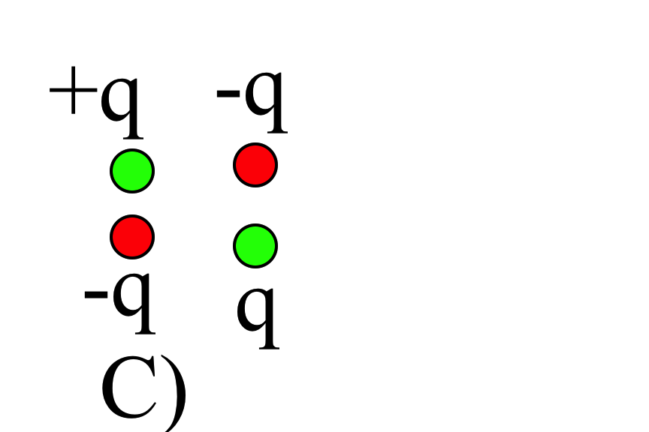
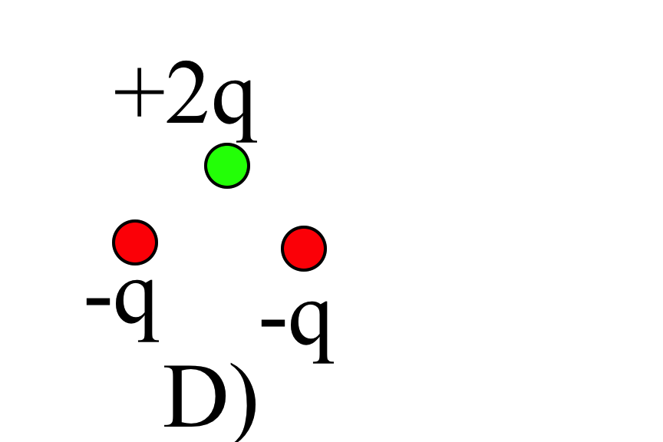
Which charge distributions below produce a potential which looks like C/r² when you are far away?
3.26
E) None of these, or more than one of these!
(Note: for any which you did not select, how DO they behave at large r?)
Notes:
CORRECT ANSWER: E

Slide 21
In terms of the multipole expansion
V(r) = V(mono) + V(dip) + V(quad) + … the following charge distribution has the form:
= +q
= - q
A) V(r) = V(mono) + V(dip) + higher order terms
B) V(r) = V(dip) + higher order terms
C) V(r) = V(dip)
D) V(r)=only higher order terms than dipole
E) No higher terms, V(r)=0 for this one.
Notes:
CORRECT ANSWER: D

Slide 22
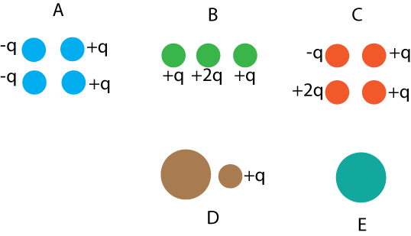
In which situation is the dipole term the leading non-zero contribution to the potential?
A) A and C
B) B and D
C) only E
D) A and E
E) Some other combo
Notes:
CORRECT ANSWER: D

Slide 23

What is the direction of the dipole moment of the blue sphere?
the dipole moment is zero (or is ill defined)
Notes:
23
CORRECT ANSWER: E

