Slide 1
CURRENTS & CHARGE CONTINUITY
Notes:
WRITTEN BY: Steven Pollock (CU-Boulder)

Slide 2
Current through a Wire
A student argues that the current through a wire flows throughout its volume, you:
Agree, resistance is inversely proportional to cross sectional area, not circumference
Disagree, it must flow only on the surface of the wire because the negative charges repel each other
Agree for different reasons
Disagree for different reasons
Notes:
2
CORRECT ANSWER: A or C

Slide 3
Positive ions flow right through a liquid, negative ions flow left.
The spatial density and speed of both ions types are identical.
Is there a net current through the liquid?
5.5
Yes, to the right
B) Yes, to the left
C) No
D) Not enough information given
Notes:
CORRECT ANSWER: A

Slide 4
Current I flows down a wire (length L) with a square cross section (side a)
If it is uniformly distributed over the entire wire area, what is the magnitude of the volume current density J?
5.7
A) B)
C) D)
E) None of the above !
Notes:
CORRECT ANSWER: A
4

Slide 5
Current I flows down a wire (length L) with a square cross section (side a)
If it is uniformly distributed over the outer surfaces only, what is the magnitude of the surface current density K?
5.6
A) B)
C) D)
E) None of the above
Notes:
CORRECT ANSWER: C
5

Slide 6
A "ribbon" (width a) of surface current flows (with surface current density K)
Right next to it is a second identical ribbon of current.
Viewed collectively, what is the new total surface current density?
5.8
K
a
Notes:
CORRECT ANSWER: n/a

Slide 7
A "ribbon" (width a) of surface current flows (with surface current density K)
Right next to it is a second identical ribbon of current.
Viewed collectively, what is the new total surface current density?
5.8
A) K
B) 2K
C) K/2
D) Something else
a
Notes:
CORRECT ANSWER: A

Slide 8
A "ribbon" (width a) with uniform surface current density K passes through a uniform magnetic field B_{ext}. Only the length b along the ribbon is in the field. What is the magnitude of the force on the ribbon?
ERK5-1
KB
aKB
abKB
bKB/a
KB/(ab)
B_{ext}
a
K
b
Notes:
CORRECT ANSWER: C

Slide 9
Charge Conservation
5.10
Which of the following is a statement of charge conservation?
Notes:
9
CORRECT ANSWER: D

Slide 10
Charge Conservation
5.10
Which of the following is a statement of charge conservation?
A)
B)
C)
D)
E) Not sure
Notes:
10
CORRECT ANSWER: D

Slide 11
Charge Conservation
5.10
Which of the following is a statement of charge conservation?
A)
B)
C)
D)
E) Not sure
Notes:
11
CORRECT ANSWER: B (I changed the order or responses from last time, used to be D was correct)

Slide 12
Is the total net charge in the universe conserved? How about the total mass?
Charge is conserved; total mass is conserved
Charge is conserved; total mass is not conserved
Charge is not conserved; total mass is conserved
Charge is not conserved; total mass is not conserved
Dude! How should I know?
Notes:
CORRECT ANSWER: B

Slide 13
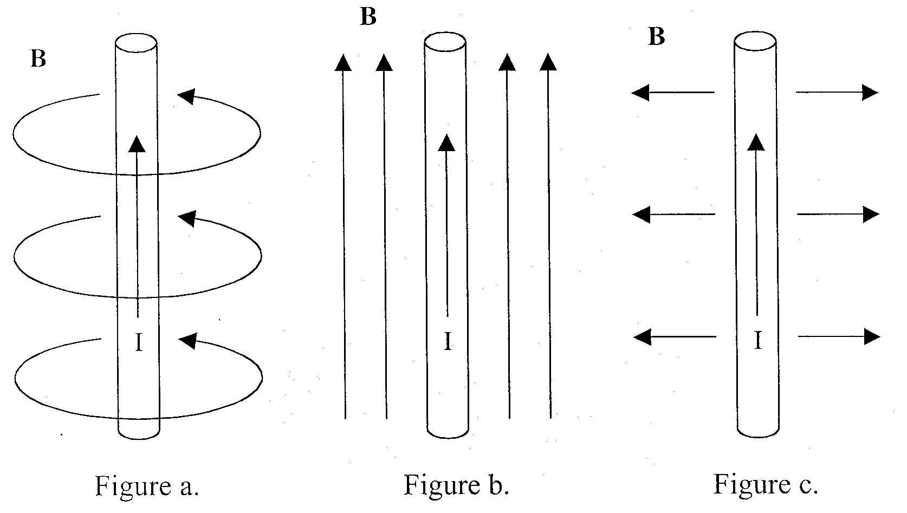
Until now, you have been told that magnetic fields loop around a current carrying wire. But how do you know that there are no other components? Show (mathematically) which of the below B-field components are/not possible.
Notes:
This comes later, Ampere’s law!

