Slide 1
Magnetic fields, B
- Features
- Force
- Sources
Notes:
Lecture 28, 2013

Slide 2
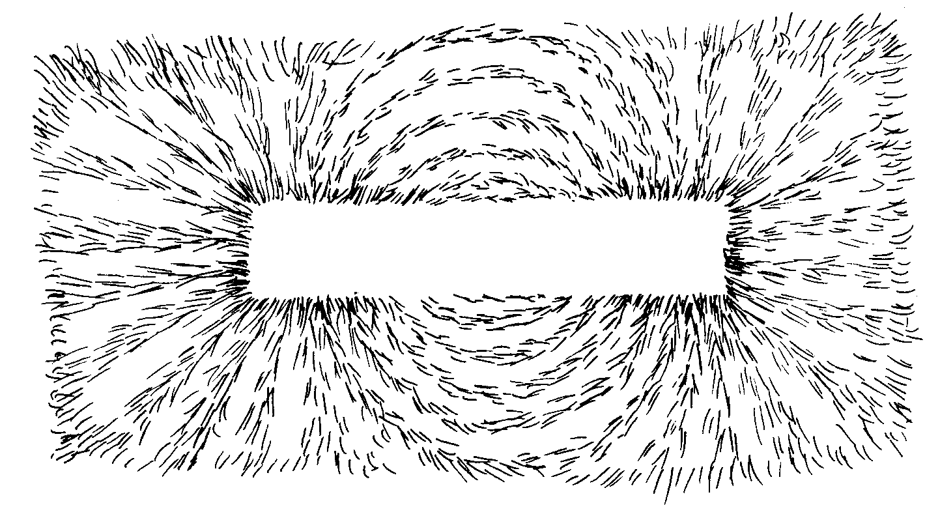
filings
Notes:
Lecture 28, 2013

Slide 3
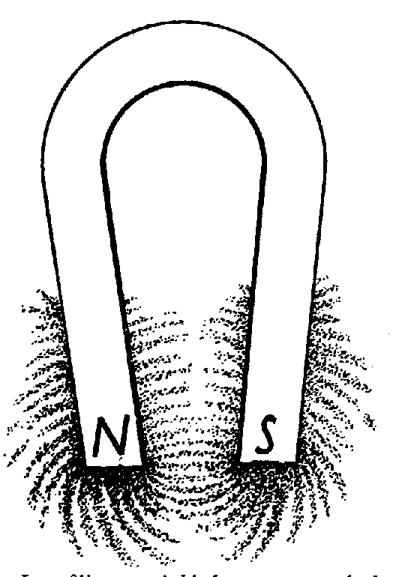
Notes:
Lecture 28, 2013

Slide 4
LORENTZ FORCE
Notes:
WRITTEN BY: Steven Pollock (CU-Boulder)

Slide 5
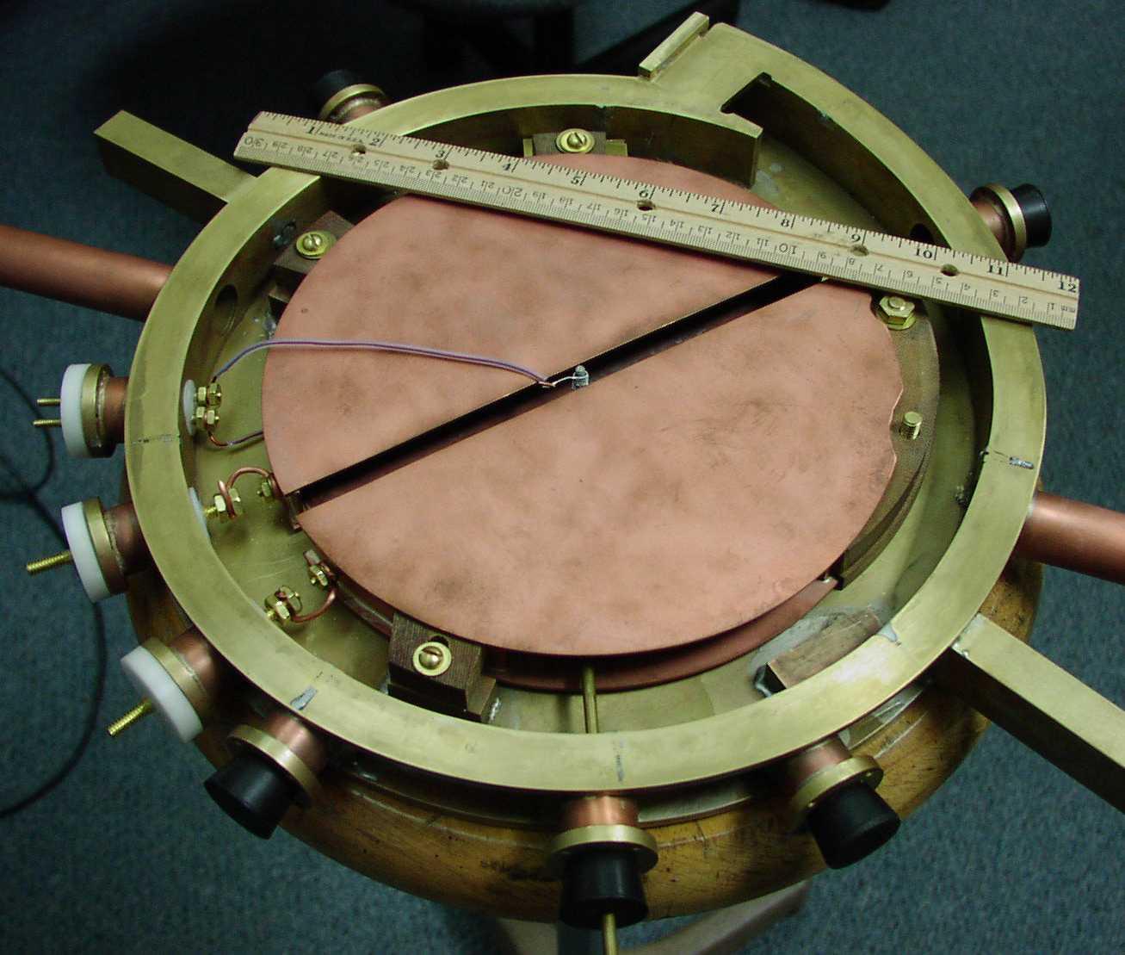
Cyclotron (undergraduate project @ Knox College)
Notes:
CORRECT ANSWER:
USED IN: Fall 2009 (Schibli)
LECTURE NUMBER:
STUDENT RESPONSES:
INSTRUCTOR NOTES:
WRITTEN BY: Thomas Schibli (CU-Boulder)

Slide 6
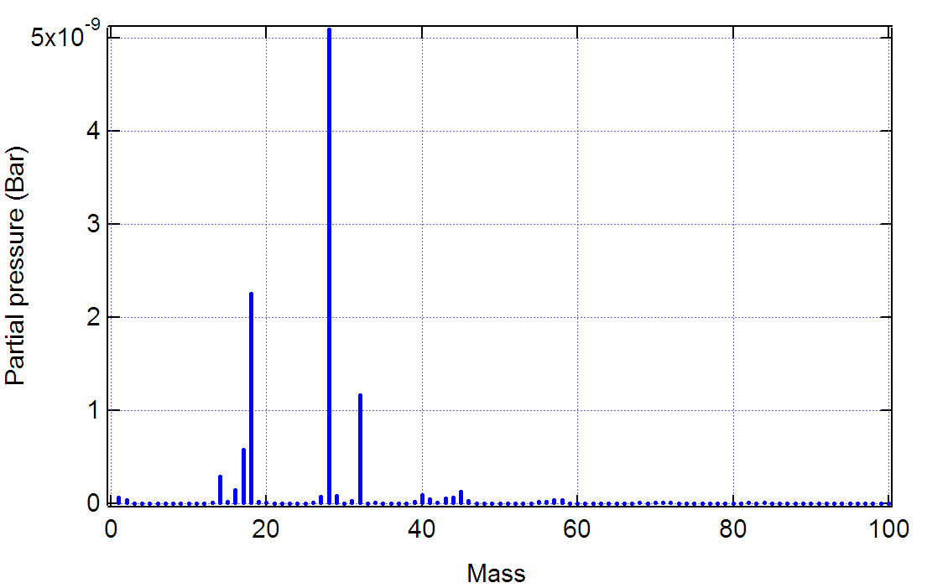
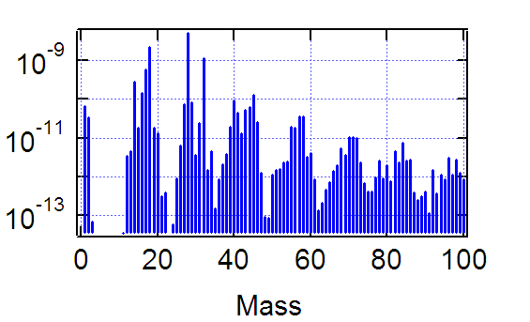
Mass spectrometer
N₂
H₂O
O₂
H
H₂
Ar
Hydro-carbons (oils)

Slide 7
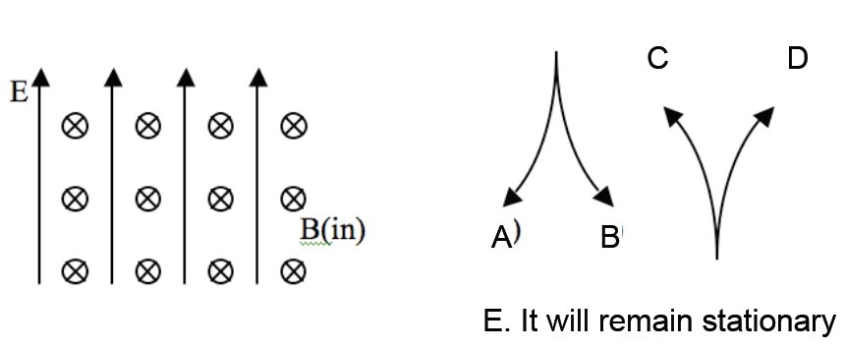
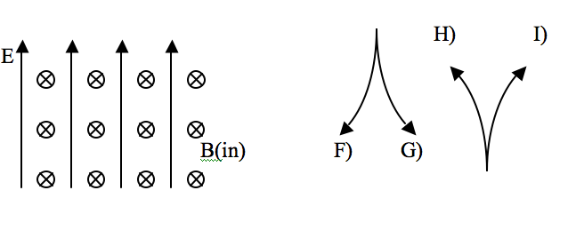
A proton (q=+e) is released from rest in a uniform E and uniform B. E points up, B points into the page. Which of the paths will the proton initially follow?
C
D
A
B
E. It will remain stationary
(To think about: what happens after longer times?)
Notes:
CORRECT ANSWER: C

Slide 8
A proton (speed v) enters a region of uniform B. v makes an angle θ with B.
What is the subsequent path of the proton?
5.3
A) Helical
B) Straight line
C) Circular motion, ⊥ page.
(plane of circle is ⊥ B)
D) Circular motion ⊥ page.
(plane of circle at angle θ w.r.t. B)
E) Impossible. v should always be ⊥ B
Notes:
8
CORRECT ANSWER: A

Slide 9

Notes:
Lect 29, Sp 2013
Followup to previous clicker question

Slide 10

Notes:
Lect 29, Sp 2013
Just for fun

Slide 11
A wire loop in a B field has a current I.
The B-field is localized, it’s only in the hatched region, roughly zero elsewhere.
Which way is I flowing to hold the mass in place?
5.4
B (into page, uniform)
L
CW
B) CCW
C) You cannot “levitate”
like this!
I
m
Notes:
CORRECT ANSWER: A

Slide 12
A wire loop in a B field has a current I.
The mass is "levitated" by the magnetic force F_{mag}=ILB. If you increase the current , does the magnetic force do positive work on the mass?
5.4
B (into page, uniform)
Yes
B) No
L
I
m
Notes:
CORRECT ANSWER: B

