Slide 1
BOUNDARY VALUE PROBLEMS WITH DIELECTRICS
Notes:
WRITTEN BY: Steven Pollock (CU-Boulder)

Slide 2
You have a straight boundary between two linear dielectric materials (ε_{r} has one value above, another below, the boundary) There are no free charges in the regions considered. What MUST be continuous across the b’ndary? i) E(parallel) ii) E(perpendicular) iii) D(parallel) iv) D(perpendicular)
4.10a
i and iii B) ii and iv
C) i and ii D) iii and iv
E) Some other combination!
Notes:
CORRECT ANSWER: E
2

Slide 3
Two different dielectrics meet at a boundary. The E field in each region near the boundary is shown. There are no free charges in the region shown. What can we conclude about tan(θ₁)/tan(θ₂)?
θ₂
Done with I
Not yet…
Region 2 (ε₂)
E₂
E₁
θ₁
Region 1 (ε₁)

Slide 4
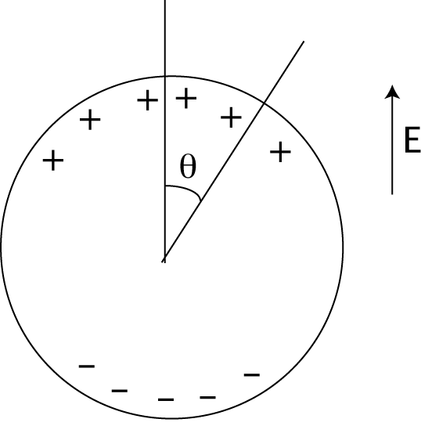
You put a conducting sphere in a uniform E-field. How does the surface charge depend on the polar angle (θ)?
4.2a
a) Uniform + on top half, uniform – on bottom
b) cos(θ)
c) sin(θ)
d) Nothing simple, it yields an infinite series of cos’s with coefficients.
Notes:
4
CORRECT ANSWER: B

Slide 5
Now what if the sphere is a dielectric? How do you expect the bound surface charge to depend on the polar angle (θ)?
4.2b
Uniform + on top half, uniform – on bottom
cos(θ)
c) Nothing simple, it yields an infinite series of cos’s with coefficients.
Notes:
CORRECT ANSWER: B
5

Slide 6
You have a boundary between two linear dielectric materials (ε_{r} has one value above, another below, the boundary) Choose the correct formula(s) for V at the boundary
4.10b
A) B)
C) D)
E) None of these, or MORE than one...
Notes:
CORRECT ANSWER: A
6

Slide 7
You have a boundary between two linear dielectric materials (ε_{r} has one value above, another below, the boundary) Define ε=ε₀ε_{r} Choose the correct formula(s) for V at the boundary
4.10
A) B)
C) D)
E) None of these, or MORE than one...
Notes:
CORRECT ANSWER: E
7

