Slide 1
BIOT SAVART LAW
Notes:
WRITTEN BY: Steven Pollock (CU-Boulder)

Slide 2
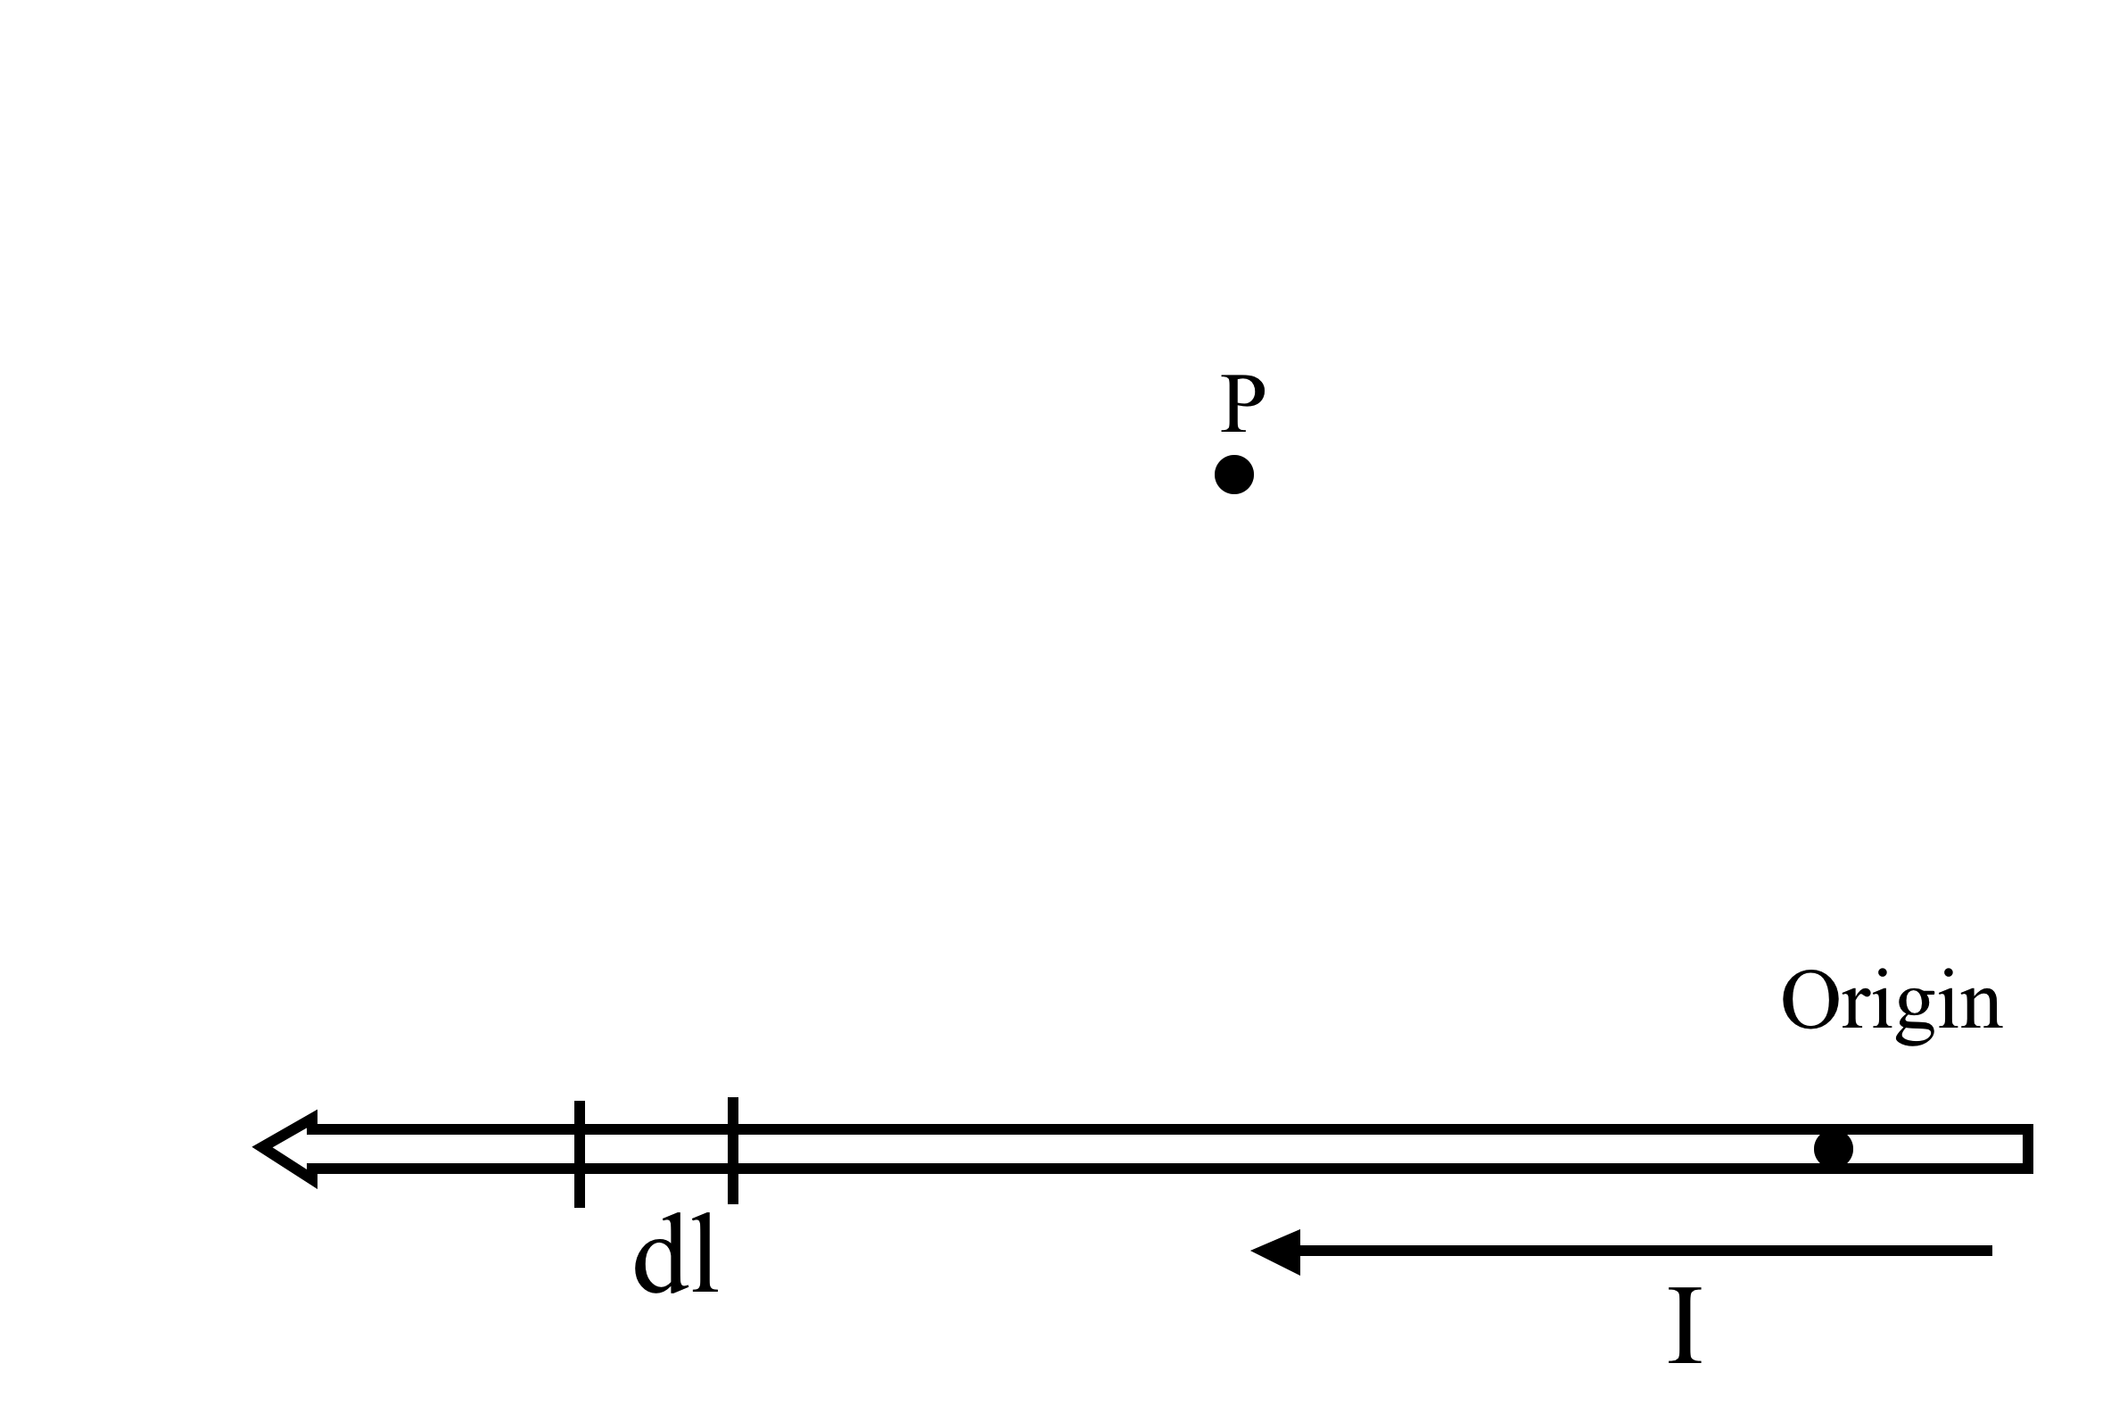
To find the magnetic field B at P due to a current-carrying wire we use the Biot-Savart law,
5.11
In the figure, with “dl” shown, what is ?
Notes:
2

Slide 3
To find the magnetic field B at P due to a current-carrying wire we use the Biot-Savart law,
5.11
In the figure, with “dl” shown, which purple vector best represents ?
E) None of these!
Notes:
3
CORRECT ANSWER: A

Slide 4
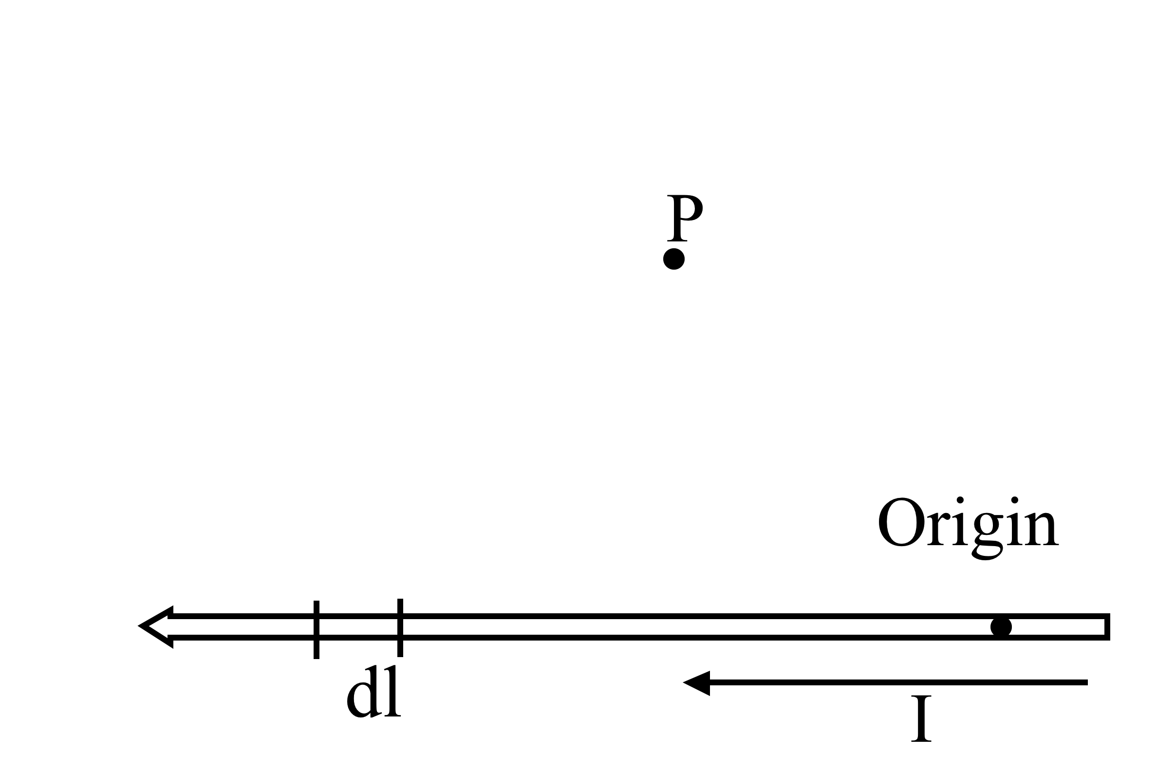
To find the magnetic field B at P due to a current-carrying wire we use the Biot-Savart law,
5.12
What is the direction of the infinitesimal contribution dB(P) created by current in dl?
Up the page
Directly away from dl
(in the plane of the page)
Into the page
Out of the page
Some other direction
Notes:
4
CORRECT ANSWER: C

Slide 5
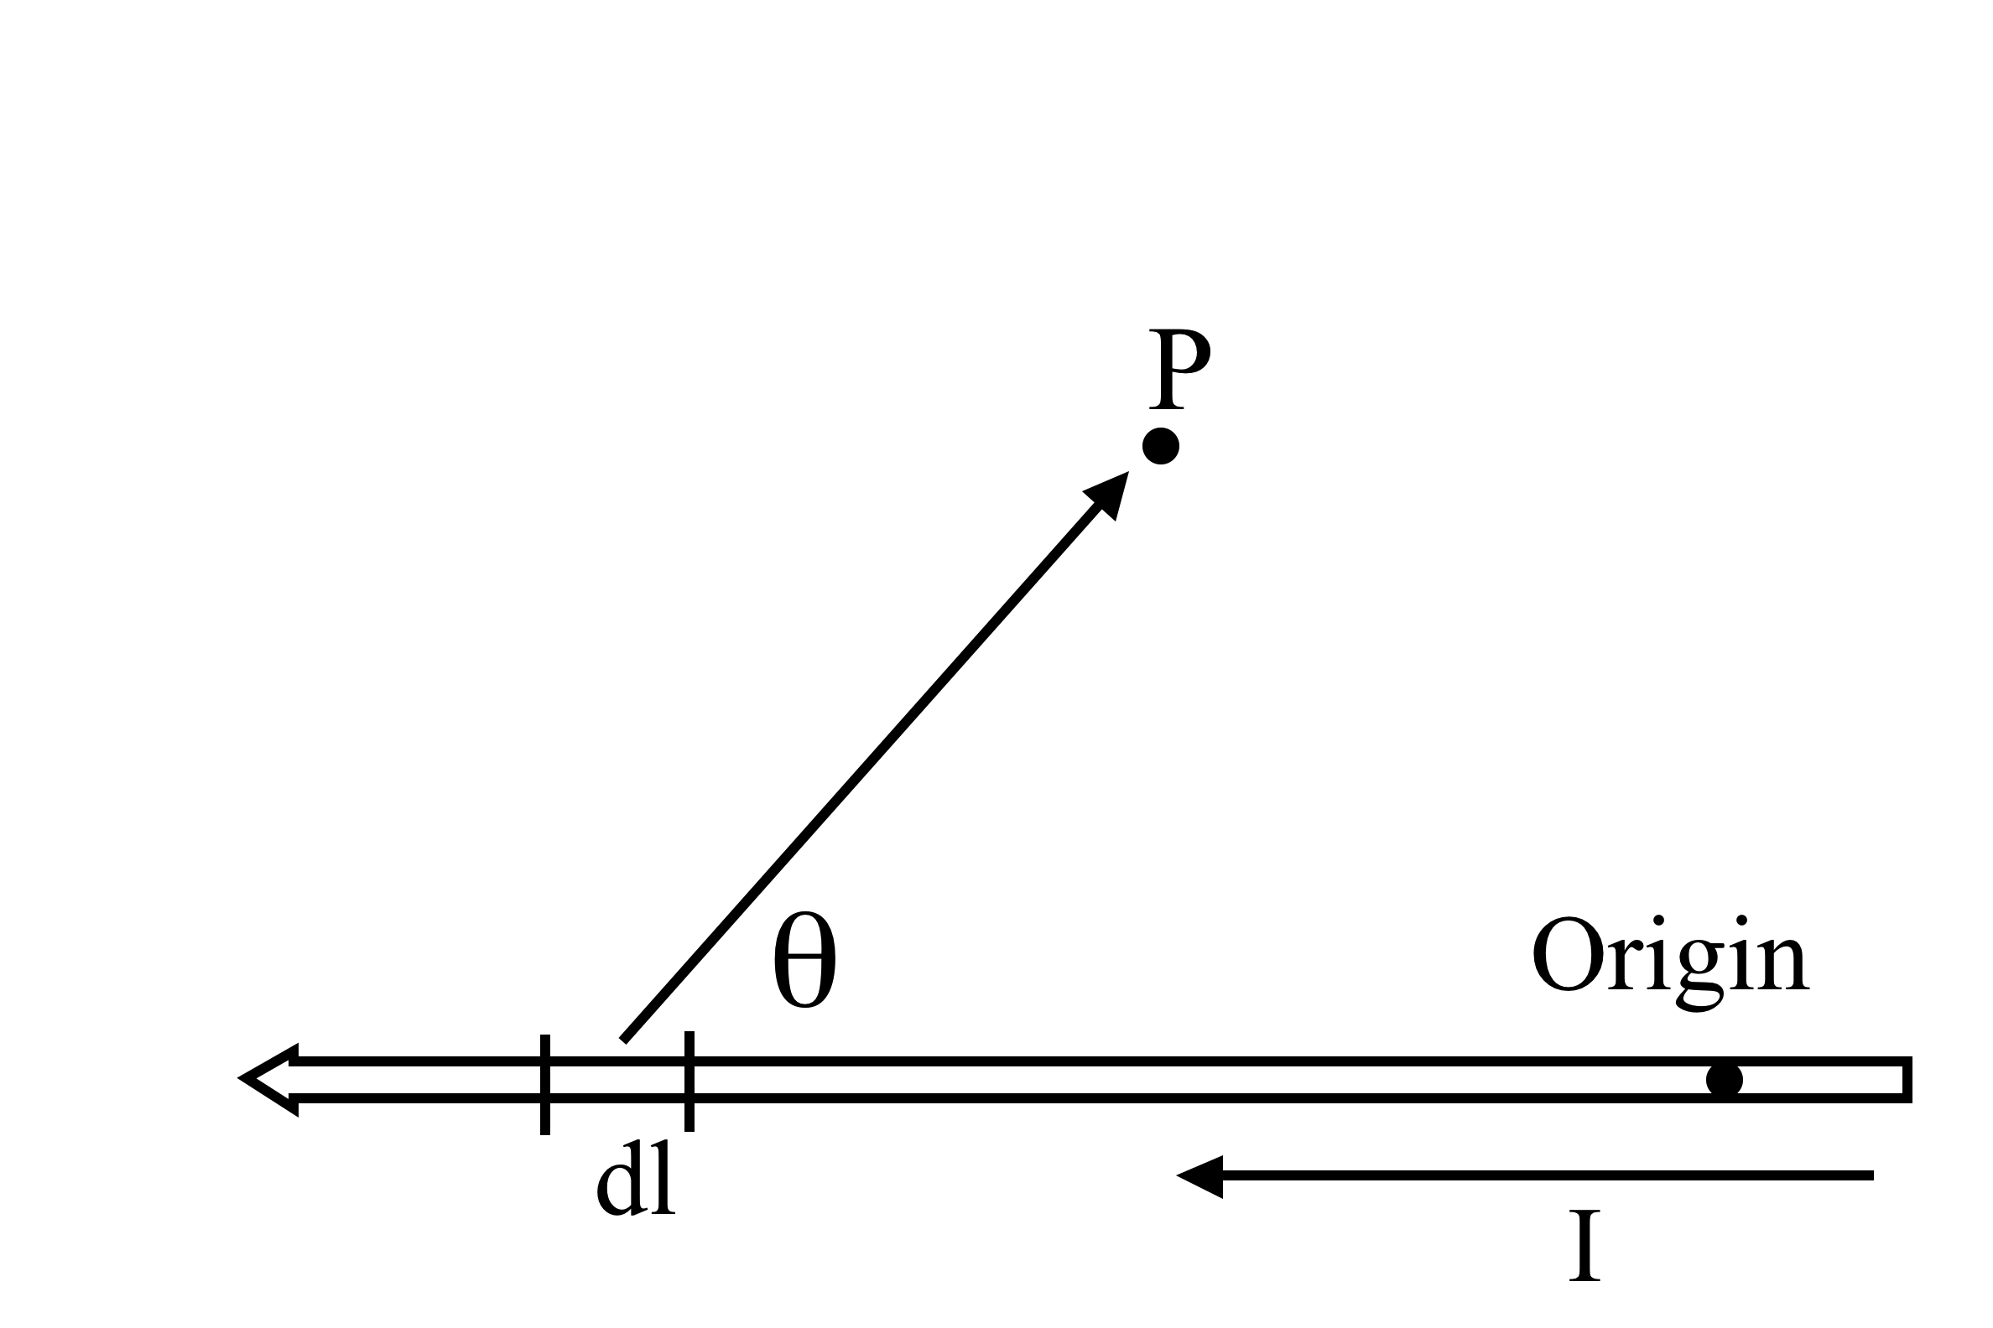
To find the magnetic field B due to a current-carrying wire, below, we use the Biot-Savart law,
5.13
What is the magnitude of
?
Notes:
5

Slide 6
To find the magnetic field B due to a current-carrying wire, below, we use the Biot-Savart law,
5.13
What is the magnitude of
?
b)
d) e) something else!
(And, what's here, given that P = (x,y,z)?)
Notes:
6
CORRECT ANSWER: A

Slide 7
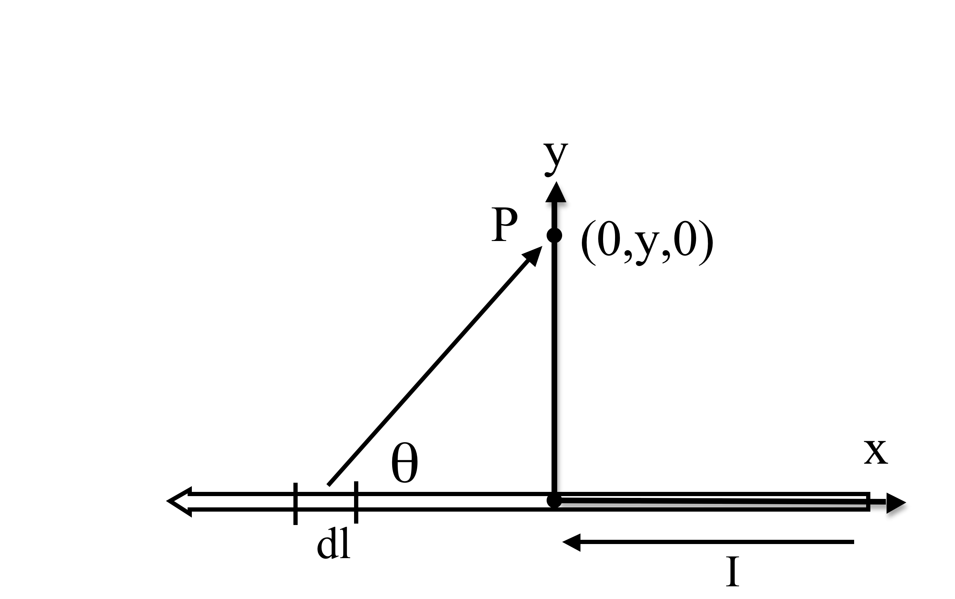
To find the magnetic field B due to a current-carrying wire, below, we use the Biot-Savart law,
5.13m
What is the value of
I ?
(What's here, given that P = (0,y,0)?)
Notes:
7

Slide 8
To find the magnetic field B due to a current-carrying wire, below, we use the Biot-Savart law,
5.13m
What is the value of
I ?
b)
c) d) e) Other!
Notes:
8
CORRECT ANSWER: D

Slide 9
What is B at the point shown?
5.14
A)
B)
C)
D)
E) None of these
s
I
I
(What direction
does it point?)
Notes:
CORRECT ANSWER: C

Slide 10
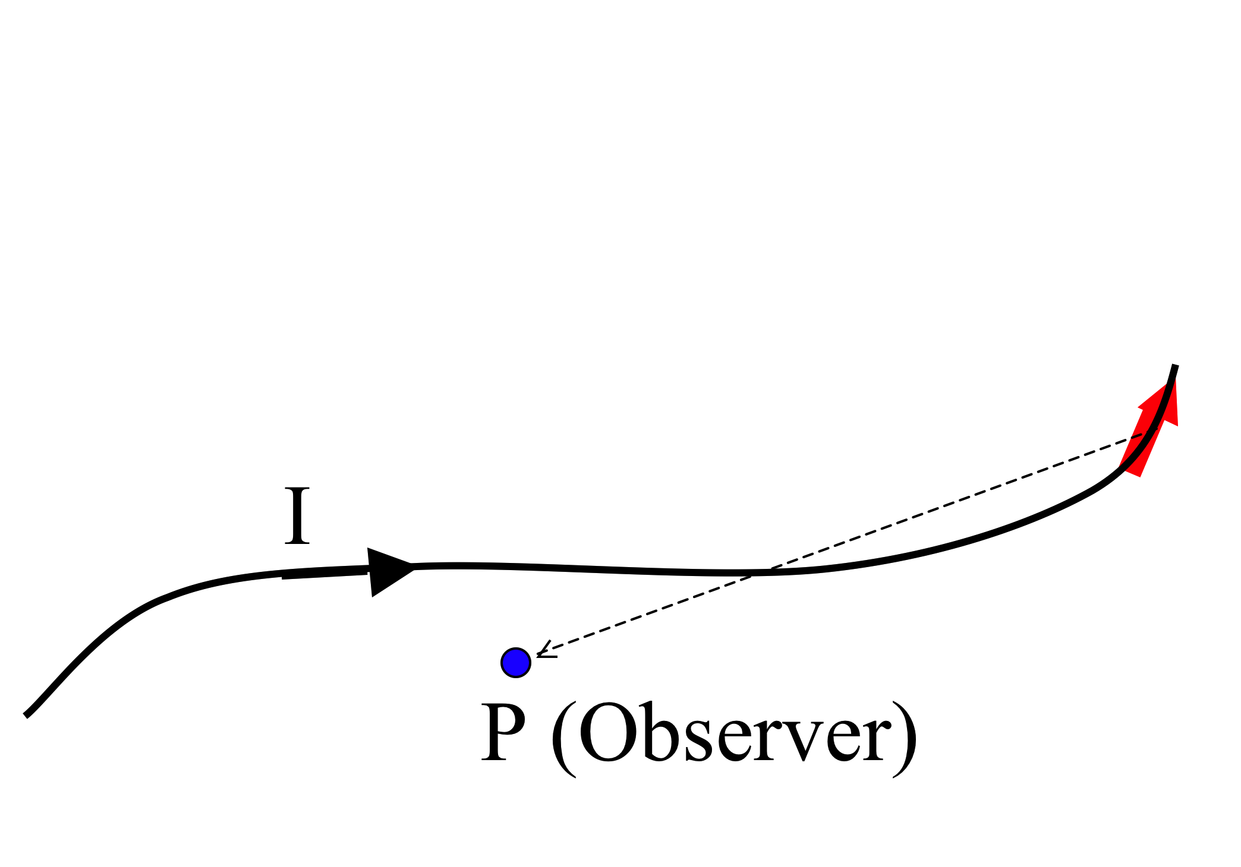
What do you expect for direction of B(P)?
5.16
com
How about direction of dB(P) generated JUST by the segment of current dl in red?
A) B(p) in plane of page, ditto for dB(P, by red)
B) B(p) into page, dB(P, by red) into page
C) B(p) into page, dB(P, by red) out of page
D) B(p) complicated - has mult component (not ⊥ or || to page), ditto for dB(P, by red)
E) Something else!!
Notes:
10
CORRECT ANSWER: C

Slide 11
I have two very long, parallel wires each carrying a current I₁ and I₂, respectively. In which direction is the force on the wire with the current I₂?
Up
Down
Right
Left
Into or out of the page
I₁
I₂
(How would your answer change if you reverse the direction of both currents?)
Notes:
CORRECT ANSWER: D

Slide 12
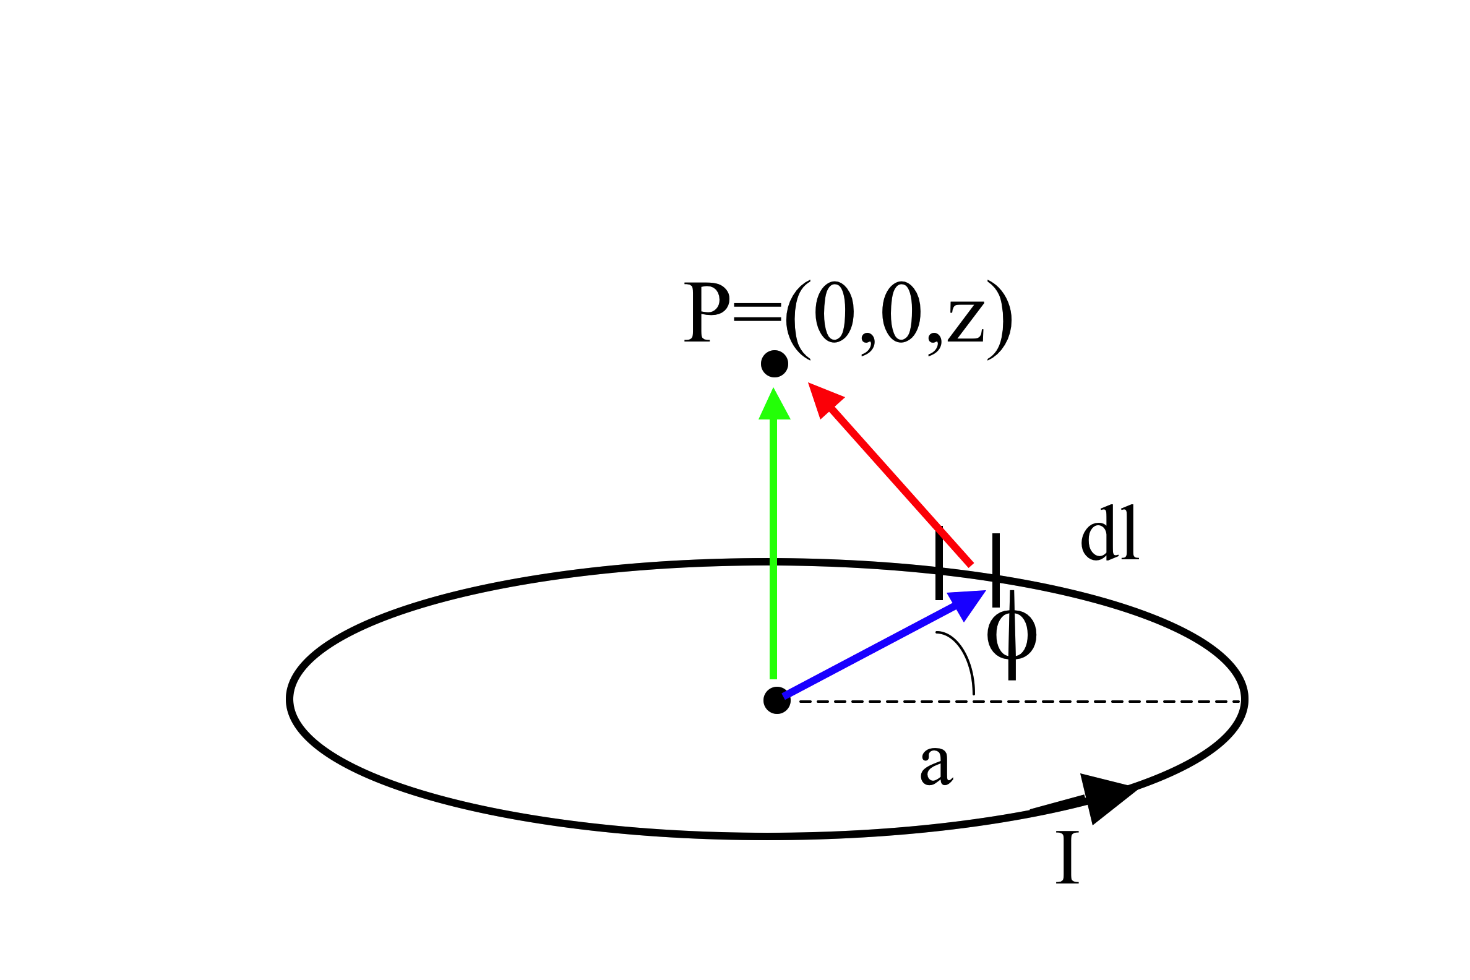
To find the magnetic field B due to a current-carrying loop, we use the Biot-Savart law,
5.15
What is the magnitude of ?
A) B)
D)
E) Something quite different!
(Which colored arrow is ? r? r’? )
Notes:
12
CORRECT ANSWER: D

Slide 13
To find the magnetic field B due to a current-carrying loop, we use the Biot-Savart law,
5.15b
What is dB_{z} (the contribution to the vertical component of B from this dl segment?)
A) B)
D)
E) Something quite different!
Notes:
13
CORRECT ANSWER: A

Slide 14
Consider the B-field a distance z from a current sheet in the z = 0 plane:
MD10-1
The B-field has
y-component only
z-component only
y and z-components
x, y, and z-components
Other
z
y
K
x
Notes:
CORRECT ANSWER: A
14

Slide 15
Here is the integral expression for the B-field a distance z from a current sheet in the z = 0 plane:
MD10-1
z
The B-field has
y-component only
z-component only
y and z-components
x, y, and z-components
y
K
x
Notes:
CORRECT ANSWER: A
15

