Slide 1
DIVERGENCE & CURL OF B; STOKES THEOREM
Notes:
WRITTEN BY: Steven Pollock (CU-Boulder)

Slide 2
Amperian loop analysis:
Consider the infinite uniform current sheet K flowing in the x direction.
I. Which variables (x, y, z) can B depend on?
II. Which vector components (B_{x}, B_{y}, B_{z}) can be non-zero?
Give your reasoning for each variable and component.
III. What loop would you use to find B? Why?

Slide 3
MD11-3
A large cube of volume V is made up of many smaller cubes. Each smaller cube (labeled with index i) has volume v_{i}, so that
The flux of the vector field F over small cube i is
If we add up all the fluxes over all the little cubes
will this equal the flux over the big cube ?
Yes B) No
C) Depends on the vector field F
Notes:
CORRECT ANSWER: A

Slide 4
MD11-1
Stoke's Theorem says that for a surface S bounded by a perimeter L, any vector field B obeys
S
L
Does Stoke's Theorem apply for any surface S bounded by a perimeter L, even one such as this balloon-shaped surface S :
Yes
B) No
C) Sometimes
S
L
Notes:
CORRECT ANSWER: A

Slide 5
Choose all of the following Maxwell’s equations for electrostatics and magnetostatics that need to be changed if magnetic charges exist:
(I) the one related to
(II) the one related to
(III) the one related to
(I) only
(II) only
(III) only
(I) and (II) only
(I) and (III) only
Notes:
CORRECT ANSWER: E

Slide 6
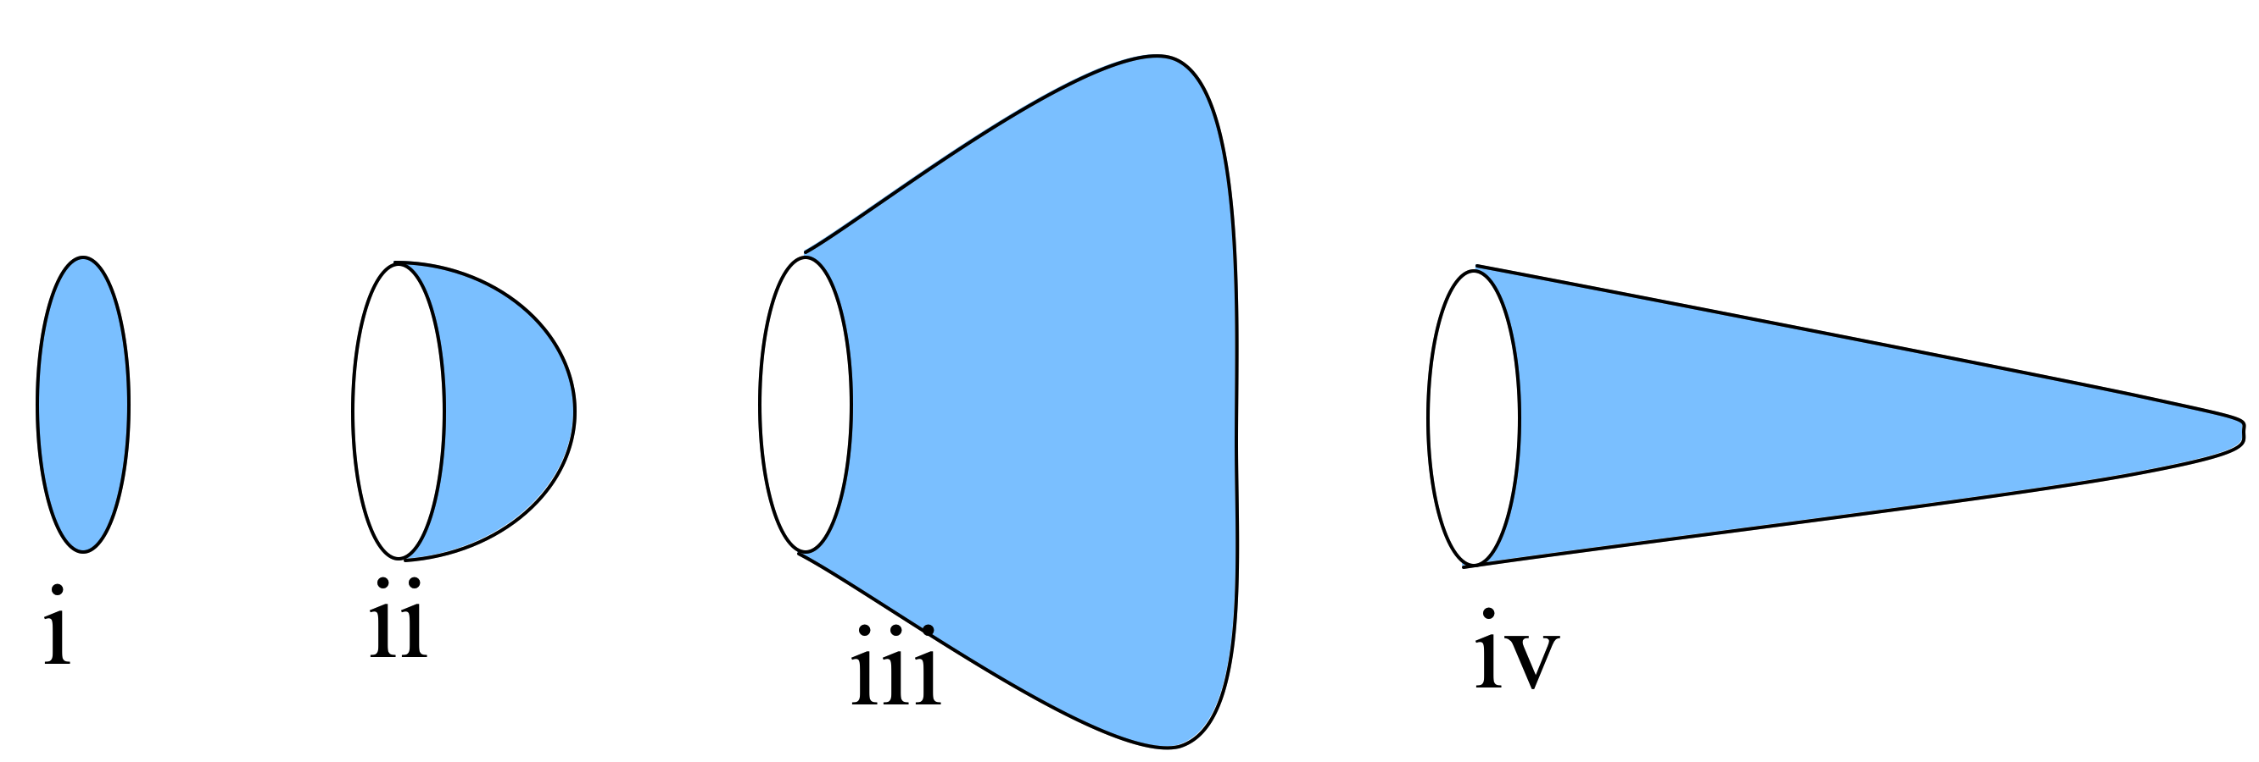
Stoke’s Theorem: line v. surface integral
5.16
Rank order (over blue surfaces) where J is uniform, going left to right:
A) iii > iv > ii > i
B) iii > i > ii > iv
C) i > ii > iii > iv
D) Something else!!
E) Not enough info given!!
Notes:
6
CORRECT ANSWER: D

Slide 7
The figure shows a static magnetic field in a region of space. Could this region of space be “empty”?
1.4
Yes, it could be empty space (with currents somewhere off to the sides creating it)
No, there must be static charges (ρ) in there.
No, there must be a current density (J) in the plane of the page in this (boxed) region
No, there must be a current density (J) perpendicular to the plane of the page in this region.
Other/???
Notes:
CORRECT ANSWER: D

Slide 8
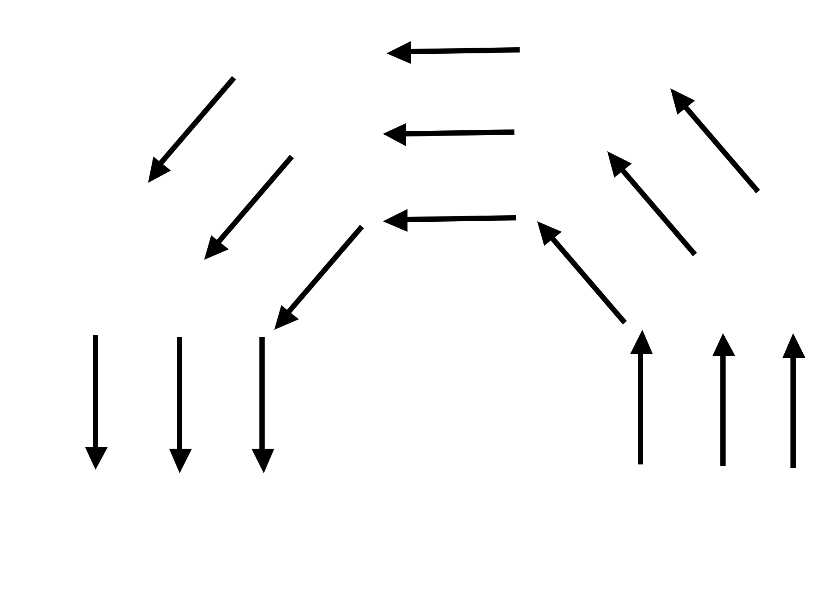
ONLY CLICK AFTER YOU FINISH p.2, part iib:
If the arrows represent a B field (note that |B| is the same everywhere), is there a nonzero J (perpendicular to the page) in the dashed region?
5.17a
Yes
No
Need more information to decide
Notes:
CORRECT ANSWER: A

Slide 9
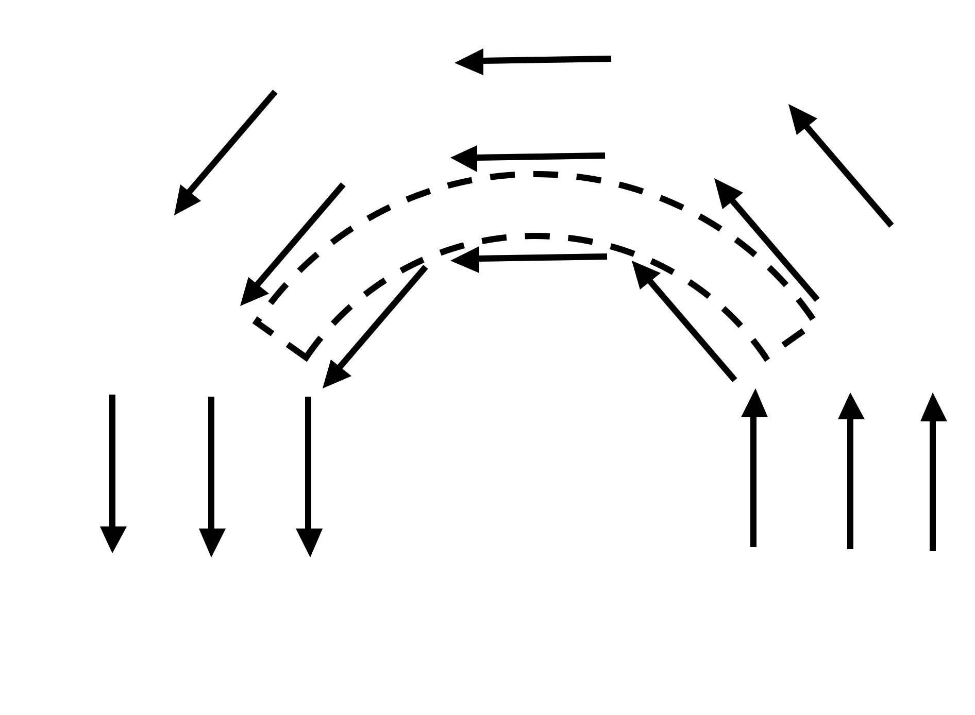
If the arrows represent a B field (note that |B| is the same everywhere), is there a nonzero J (perpendicular to the page) in the dashed region?
5.17b
Yes
No
Need more information to decide
Notes:
CORRECT ANSWER: A

Slide 10
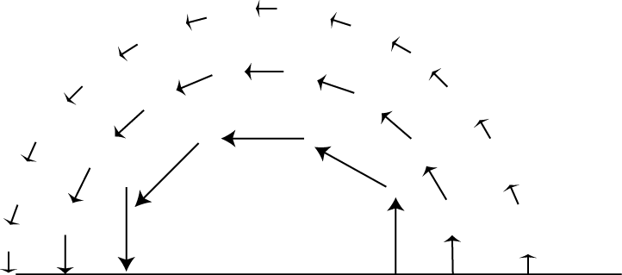
If the arrows represent a B field, is there a J (perpendicular to the page) in the dashed region?
5.17c
Yes
No
Need more information to decide
Notes:
CORRECT ANSWER: C

Slide 11
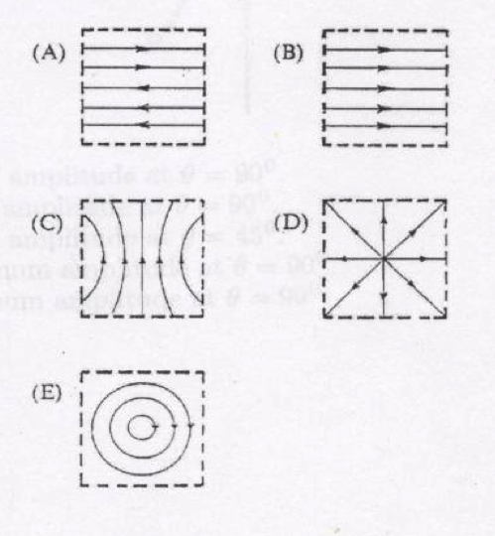
Pick a sketch showing B field lines that violate one of Maxwell’s equations within the region bounded by dashed lines.
5.18
(What currents would be needed to generate the others?)
Notes:
CORRECT ANSWER: D
11

Slide 12
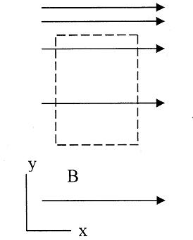
The magnetic field in a certain region is given by
(C is a positive constant) Consider the imaginary loop shown. What can you say about the electric current passing through the loop?
5.19
must be zero
must be nonzero
Not enough info
Notes:
CORRECT ANSWER: B

Slide 13
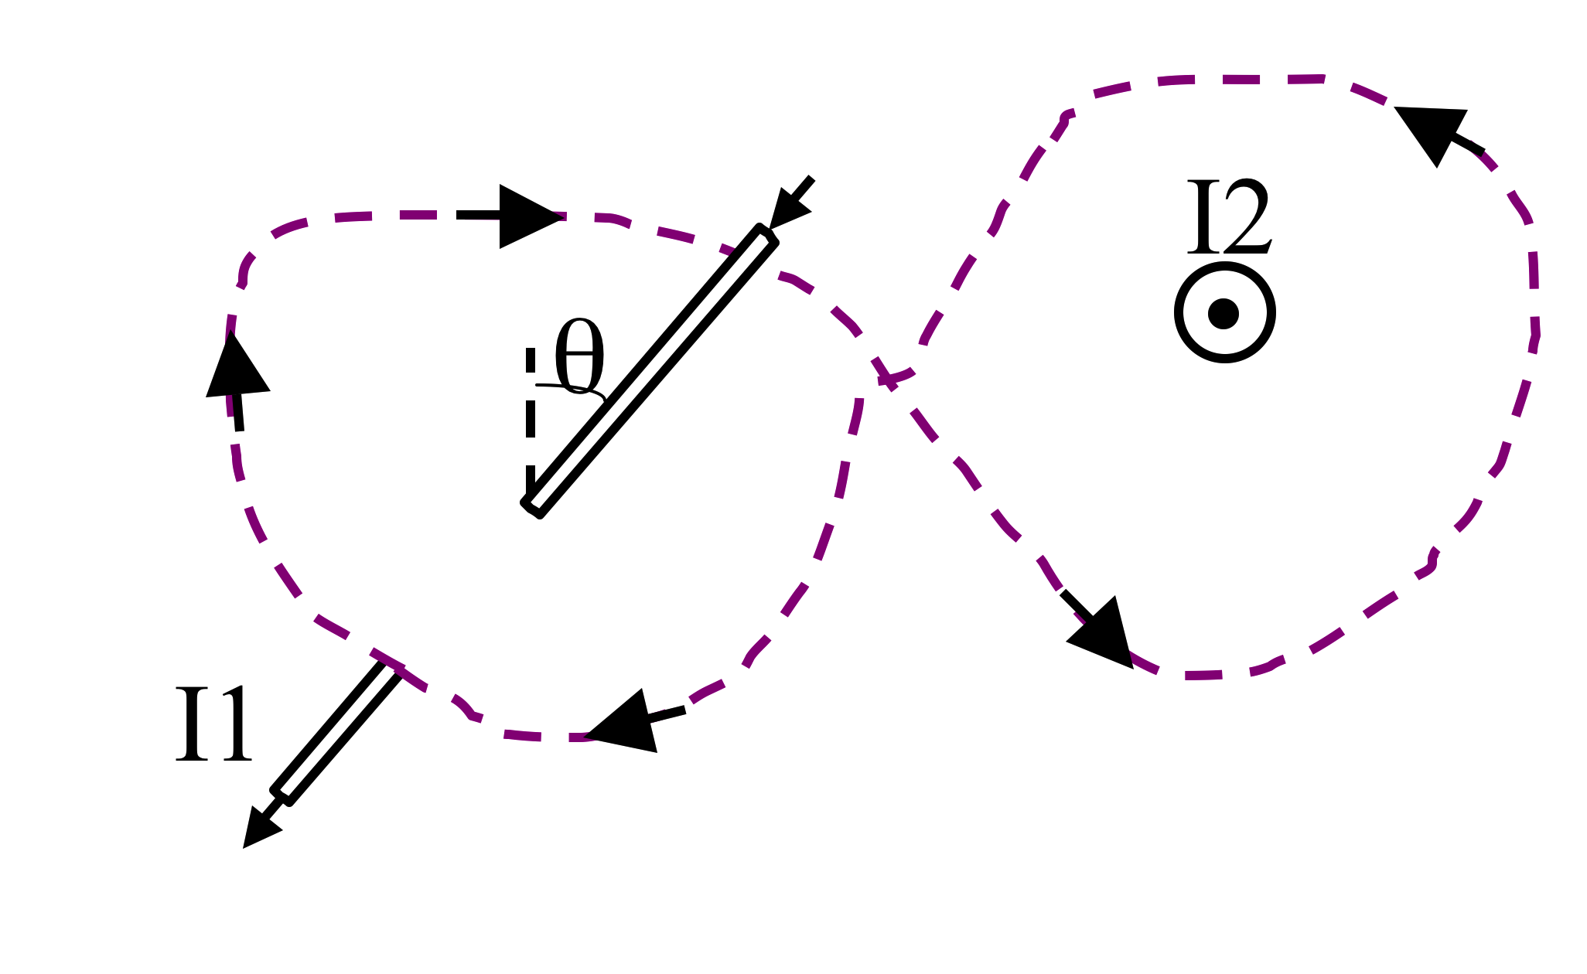
What is around this purple (dashed) Amperian loop?
5.22
μ₀ (|I₂ | +|I₁ |) B) μ₀ (|I₂|-|I₁|)
C) μ₀ (| I₂ | + | I₁ | sinθ) D) μ₀ (| I₂ | - | I₁ | sinθ)
E) μ₀ (| I₂ | + | I₁ | cosθ)
Notes:
CORRECT ANSWER: A

Slide 14
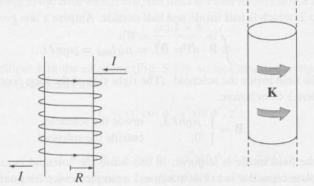
A solenoid has a total of N windings over a distance of L meters. We "idealize" by treating this as a surface current running around the surface.
What is K?
5.20
I B) NI C) I/L D) I N/L
E) Something else...
Notes:
CORRECT ANSWER: D

Slide 15
MD11-3
z
An infinite solenoid with surface current density K is oriented along the z-axis. Apply Ampere's Law to the rectangular imaginary loop in the yz plane shown. What does this tell you about Bz, the z-component of the B-field outside the solenoid?
K
Bz is constant outside
Bz is zero outside
Bz is not constant outside
It tells you nothing about Bz
Notes:
CORRECT ANSWER: A
USED IN: Fall 2008 (Dubson), Fall 2009 (Schibli)
LECTURE NUMBER: Dubson (Week 11, Lecture 29)
STUDENT RESPONSES: [[35%]] 41% 4% 20% 0% (FALL 2008)
[[24%]] 45% 5% 26% 0% (FALL 2009)
[[64]], 21, 2, 13 (Sp ‘13), but I left the vote open while discussing it, before that the distribution was very spread out.
INSTRUCTOR NOTES: I had DONE this loop the previous class, there were lots of ideas, including the idea that it tells you nothing because the integral is zero, and many thought that it would tell you B=0 because the integral is zero (!!, not because of the boundary condition at infinity)
WRITTEN BY: Mike Dubson (CU-Boulder)
15

Slide 16
MD11-3
z
An infinite solenoid with surface current density K is oriented along the z-axis. Apply Ampere's Law to the rectangular imaginary loop in the yz plane shown.
We can safely assume that B(s→∞)=0. What does this tell you about the B-field outside the solenoid?
K
|B| is a small non-zero constant outside
|B| is zero outside
|B| is not constant outside
We still don’t know anything about |B|
Notes:
CORRECT ANSWER: B
16

Slide 17
Infinite Solenoid
5.23
Loop 1
Loop 2


Loop 3
In the case of the infinite solenoid we used loop 1 to argue that the B-field outside is zero. Then we used loop 2 to find the B-field inside. What would loop 3 show?
The B-field inside is zero
It does not tell us anything about the B-field
Something else
Notes:
CORRECT ANSWER: C

Slide 18
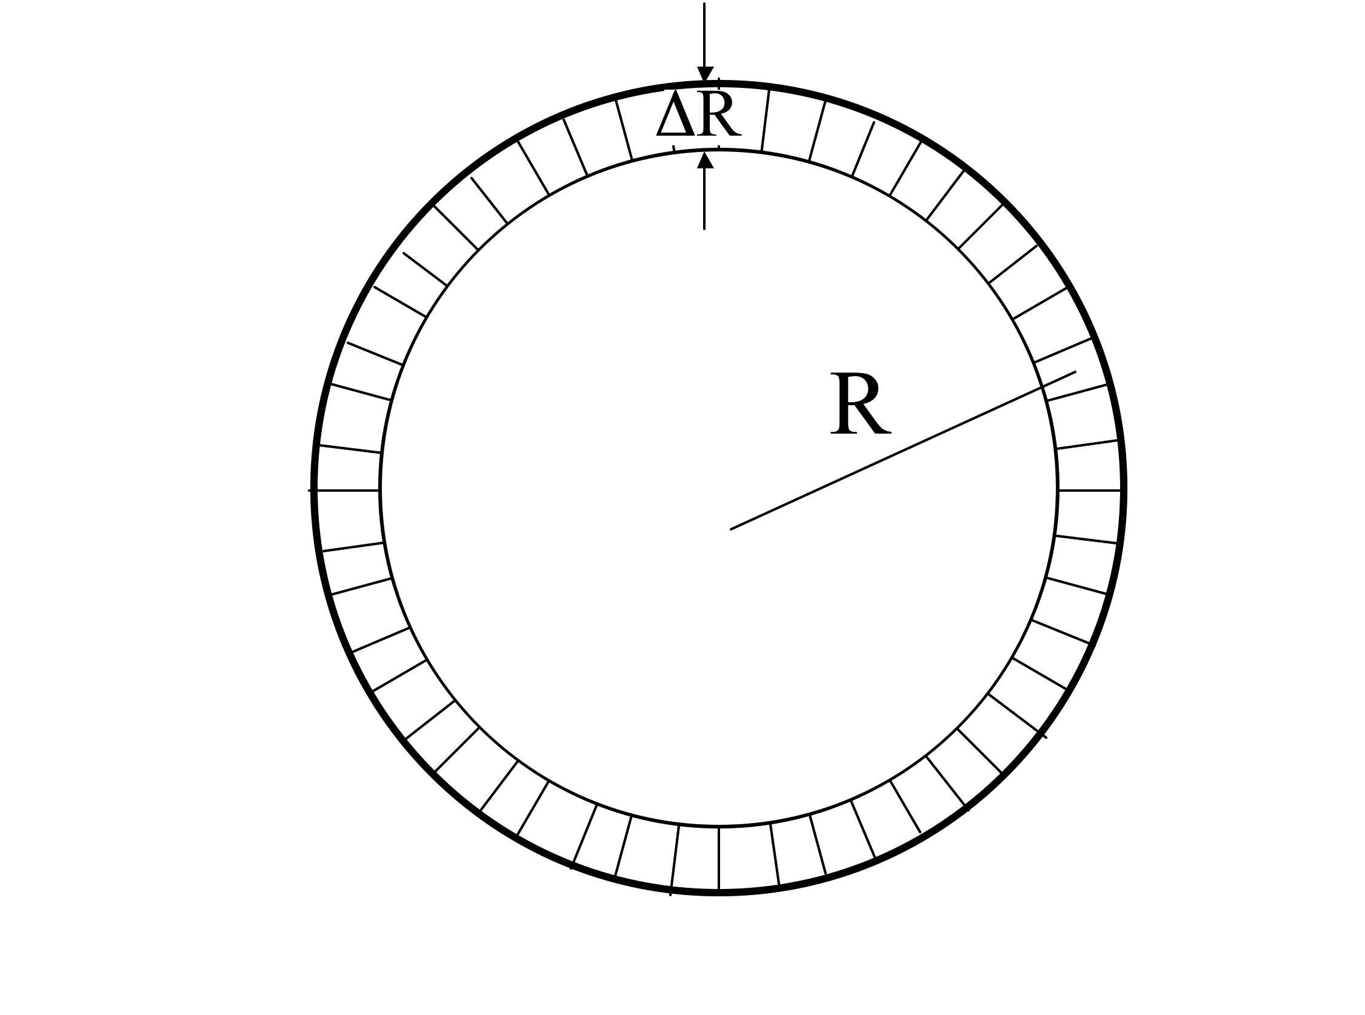
A thin toroid has (average) radius R and a total of N windings with current I.
We "idealize" this as a surface current running around the surface.
What is K, approximately?
5.21a
I/R B) I/(2 π R)
C) NI/R D) NI/(2 π R)
E) Something else
Notes:
CORRECT ANSWER: D

Slide 19

What direction do you expect the B field to point?
5.21b
Azimuthally
Radially
C) In the z direction
(perp. to page)
D) Loops around the rim
E) Mix of the above...
Notes:
CORRECT ANSWER: A

Slide 20
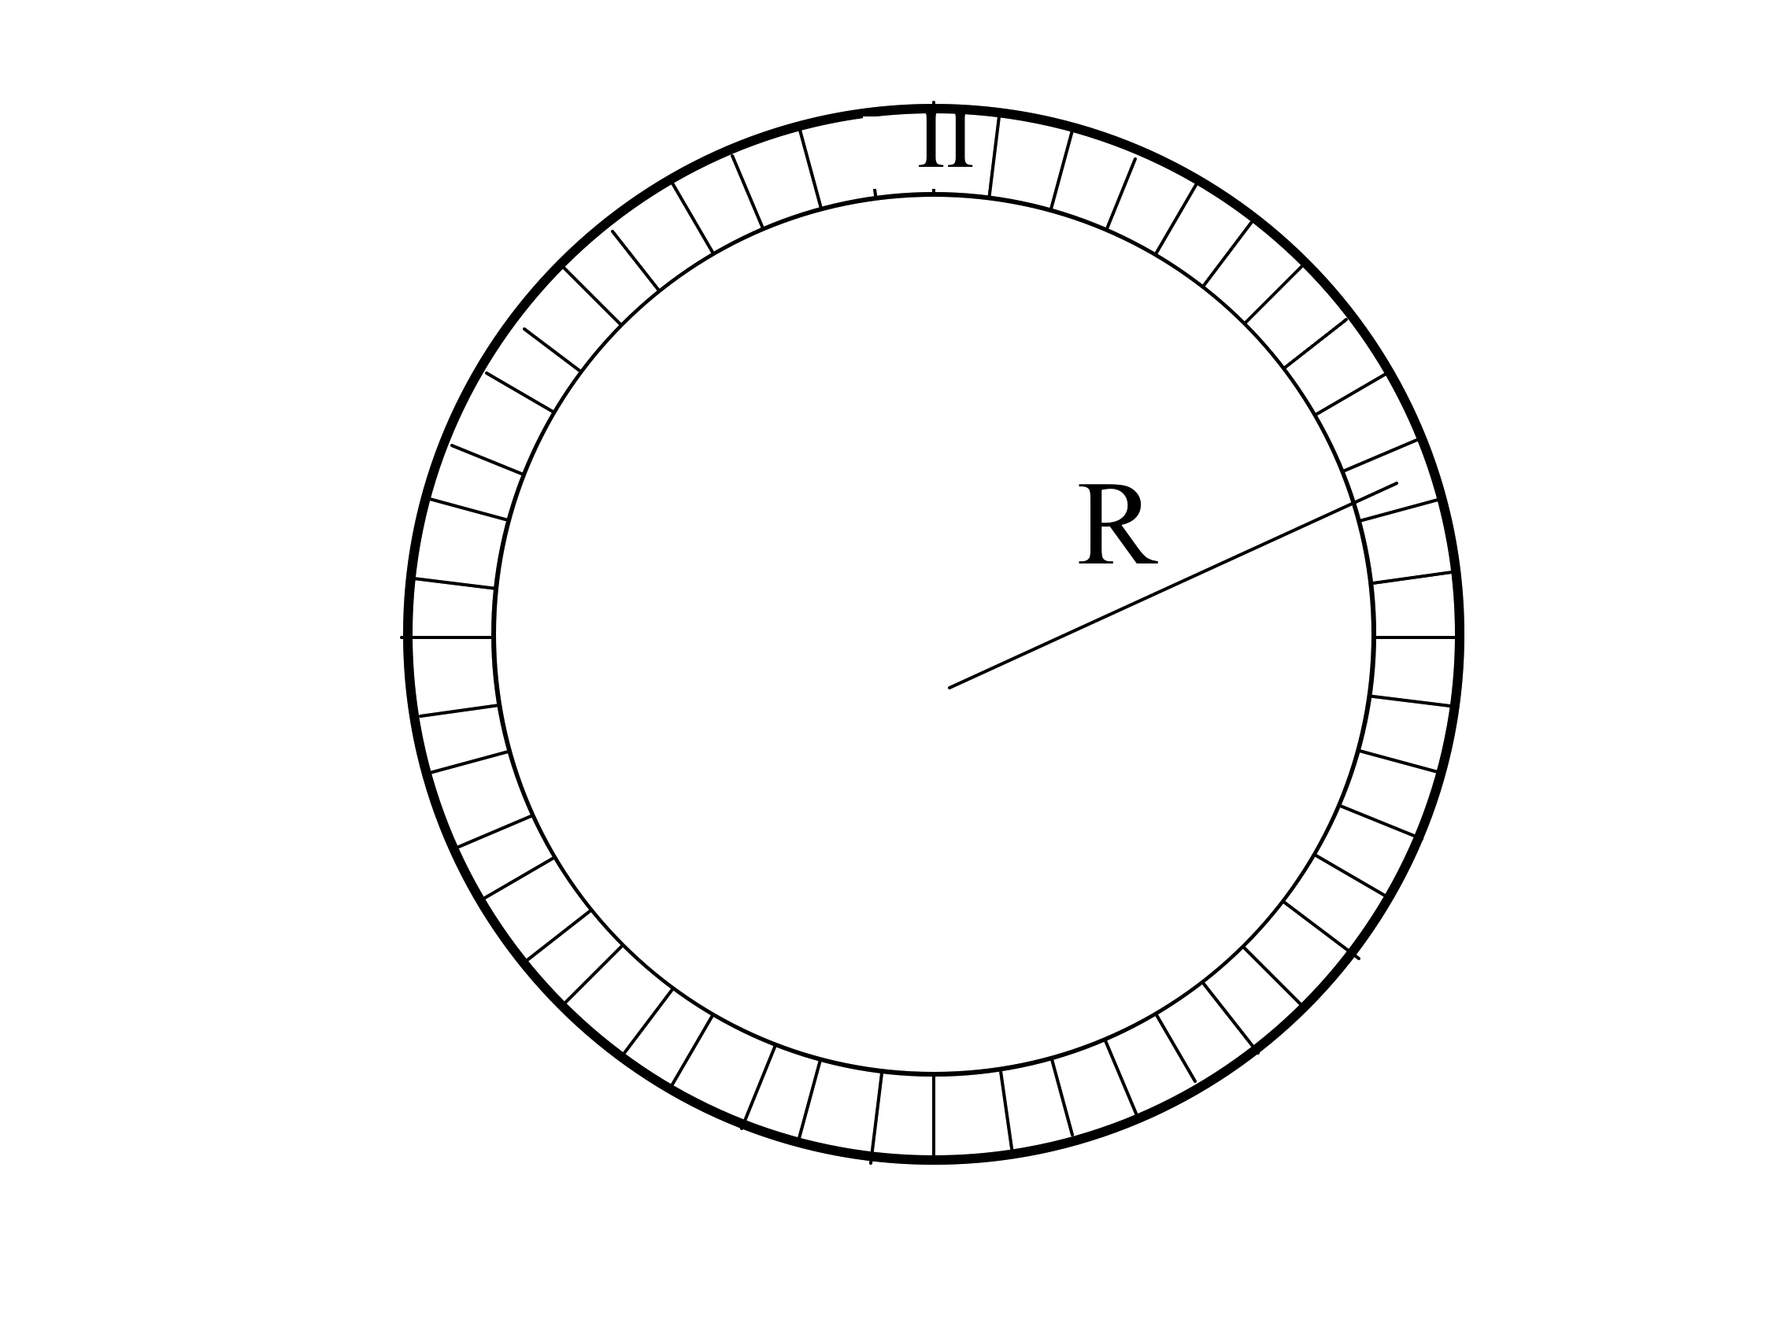
What Amperian loop would you draw to find B “inside” the Torus (region II)
5.21c
Large “azimuthal” loop
B) Smallish loop from
region II to outside
(where B=0)
C) Small loop in region II
D) Like A, but perp to page
E) Something entirely different
Notes:
CORRECT ANSWER: A

Slide 21
Which Amperian loop would you draw to learn something useful about B anywhere?
K
z
x

Slide 22
Which Amperian loops are useful to learn about B(x,y,z) somewhere?
Notes:
(I argue A *is* useful, it can be used to teach us that the B field does not diminish with distance from the sheet (once we have used symmetry to argue that it can only have a z component out there)
(And of course B is also useful to figure out B explicitly)

Slide 23
An electron is moving in a straight line with constant speed v. What approach would you choose to calculate the B-field generated by this electron?
v
e⁻
Biot-Savart
Ampere’s law
Either of the above.
Neither of the above.
Notes:
CORRECT ANSWER: D
23

Slide 24
BOUNDARY CONDITIONS
Notes:
In 2013 this came a little later.
WRITTEN BY: Steven Pollock (CU-Boulder)

Slide 25
Choose boundary conditions
5.28
When you are done with p. 1:
Choose all of the following statements that are implied if for any/all closed surfaces
(I)
(II)
(III)
A) (I) only
B) (II) only
C) (III) only
D) (I) and (II) only
E) (I) and (III) only
Notes:
CORRECT ANSWER: E
25

Slide 26
I have a boundary sheet, and would like to learn about the change (or continuity!) of B(parallel) across the boundary.
6.11
B(above)
B//(above)
Am I going to need to know about
A)
B)
C) ???
Notes:
CORRECT ANSWER: A

Slide 27
If B=B₀ in the +x direction just RIGHT of the sheet, what can you say about B just LEFT of the sheet?
+x direction
-x direction
+z direction
-z direction
Something else!
B₀
K
z
x
Notes:
Correct answer: E

Slide 28
In general, which of the following are continuous as you move past a boundary?
5.28b
A) A B) Not all of A, just A_{perp}
C) Not all of A, just A//
D) Nothing is guaranteed to be continuous regarding A
Notes:
CORRECT ANSWER: A

