Slide 1
Ivan Bazarov for the ERL team
Initial Beam Results from the Cornell High-Current ERL Injector Prototype

Slide 2
Contents
Parameters
ERL phase1a timeline
Main technical areas
DC gun commissioning
Laser & photocathodes
Space charge limit
RF effects on the beam
Present status and outlook

Slide 3
Introduction
ERL as alternative to storage rings as a continuous source of hard x-rays
Electron (primary beam) brightness
E.g. modern storage rings: 200 mA 3 / 0.03 nm-rad horizontal / vertical emittances
ERL with I_{avg} = 100 mA, need ε_{x,y} = 0.2 nm-rad, or assuming γ = 10⁴, ε_{nx,y} = 2 mm-mrad normalized rms (source) emittance for comparable performance
Short pulses desired (by some): ~1 ps at GHz rate

Slide 4
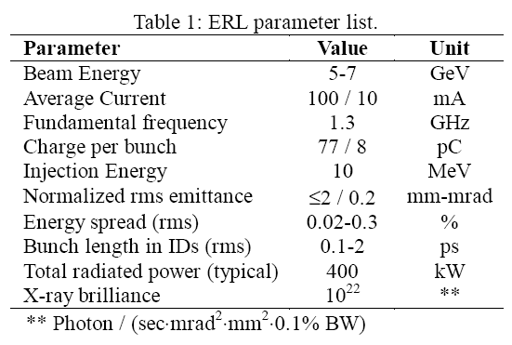
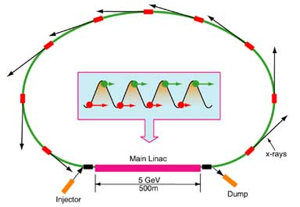
Parameters
No suitable electron source exists to drive an ERL
Cornell ERL prototype proposed in 2001: to address outstanding source and high avg current issues

Slide 5
ERL Phase1a: source R&D
Beam energy 5-15MeV
Max average current 100 mA
RMS norm. emittance ≤2 mm-mrad
Max beam power 0.5 MW
RMS pulse duration 2-3 ps

Slide 6
Timeline
2001: ERL prototype proposal submitted
2005: NSF funds the injector part (~45%) of the proposal, $$$ received on Valentine’s day
2006: Sept 7, 1st beam time out of DC gun
2007-8: Photocathode studies and space charge characterization underway using 50MHz laser
2008: Spring. Completion of the SRF injector cryomodule
2008: Summer. Accelerator installation finished. July 9, 1st beam with all SRF cavities on

Slide 7
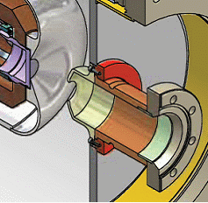
Why DC gun?
Three photogun types: DC, normal conducting RF, superconducting RF
DC: 10mA max, 5 mm-mrad (100 pC) good vacuum (low gradient ≤ 10 MV/m, breakdn.)
RF: 32mA max, 5-10 mm-mrad (1-7nC), some vacuum issues (26MV/m cathode gradient, heating)
SRF: promises 30MV/m or more cathode field, good vacuum, no experience with high current (yet)
No fundamental reason to choose one or the other: we picked DC gun because of expertise available

Slide 8
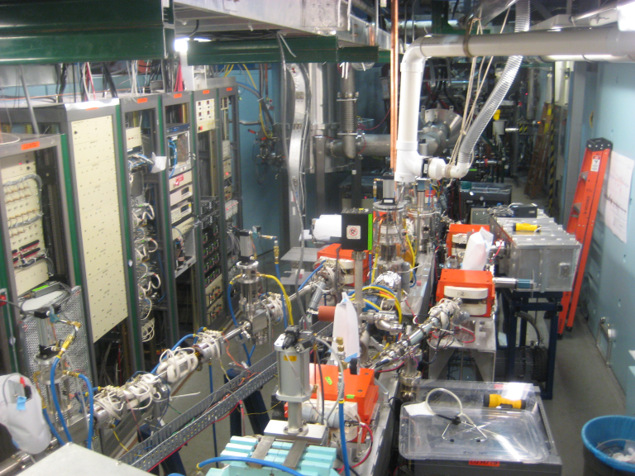
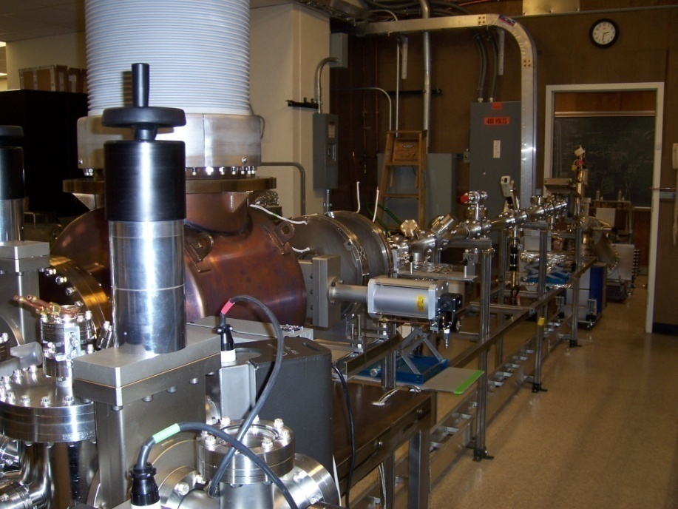
Phase1a ERL beam work
Beam studies after the DC gun till 03/2008
Thereafter, commissioning the 10MeV injector
10 MeV photoinjector
before 03/2008
gun dev. lab

Slide 9
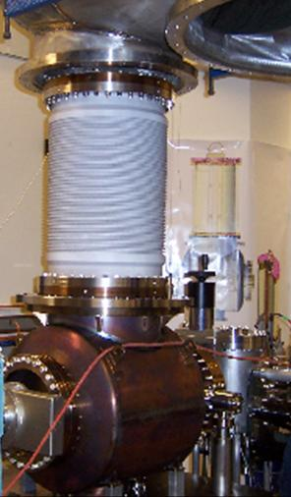
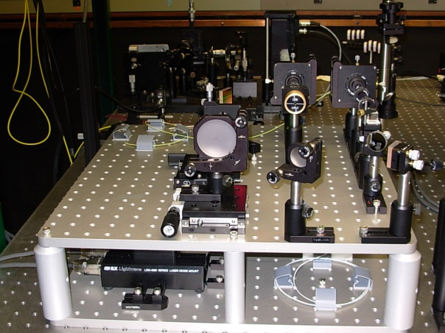
Technical area: DC gun & laser
DC photogun operational for over 3 years
Strong points: quick photocathode removal & activation, excellent vacuum (good lifetime)
Major issue: field emission & ceramic puncture (425→250 kV)
Laser system: individual pulse characteristics demonstrated at ×26 lower rep. rate
Ran into several (thermal handling) difficulties when trying to extend avg power to 20W green (>50 W IR)

Slide 10
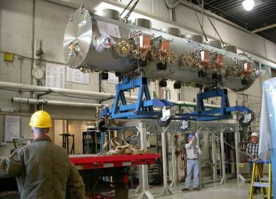
Technical area: SRF
Talk next week by Matthias
RF installation beam ready as of May 2008
SRF cavities processed to allow 10MeV operation, further processing underway to reach 15MeV (some issues with low Q₀’s)
Good field stability
Tricky to setup 1st cavity due to V_{gun} = 250 kV
Discovered problems with stray magnetic fields inside the module

Slide 11
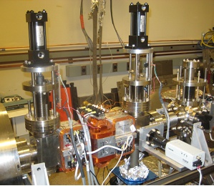
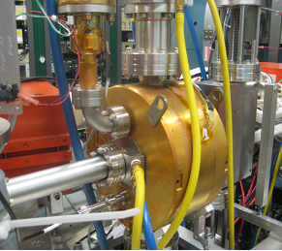
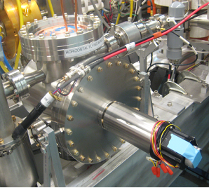
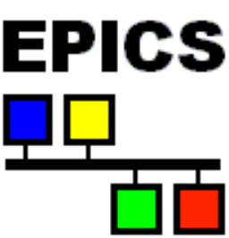
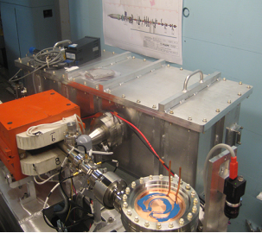
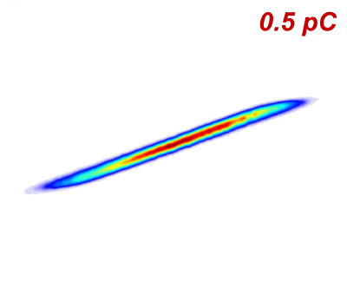
Technical area: beam instrument.
Beam instrumentation to characterize 6D phase space
Emittance measurement
Time domain (<0.1ps)
‘Flying wire’ ~MW beam
transverse profile


?
BPMs, Timing & Control System
THz interferometer for bunch profile characterization

?
Δθ →
Δx →
February 22, 2009
I.V. Bazarov, Faculty Lunch
11

Slide 12
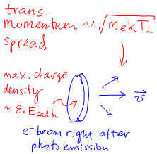
Space charge brightness limit
For short laser pulse (pancake beam after emission), max charge density is defined by E_{cath}
Solid angle is set by transverse momentum spread of photoelectrons characterized by trans. temperature
Combining these two leads to normalized brightness and emittance limits
B_{n}
ε₀mc²
E_{cath}
3
kT⊥
=
∈_{n⊥}
=
q
f
_{max}
2π
kT⊥
10πε₀mc²
E_{cath}

Slide 13
Space charge considerations
Space charge forces must be controlled at all stages in the injector (space charge dominated)
Virtual cathode: quenching of accelerating gradient due to excessive charge extraction
Stay away from this limit (q/q_{vc} < ½) to avoid brightness degradation at the photocathode

Slide 14
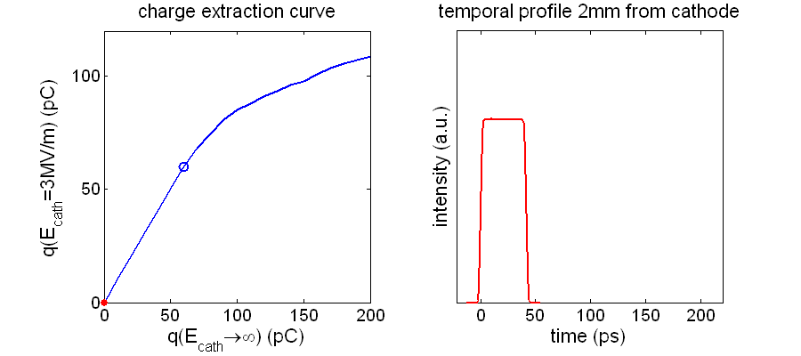
Space charge dominated
Pack a bunch smartly: putting as many electrons in each bunch as possible does not work…

Slide 15
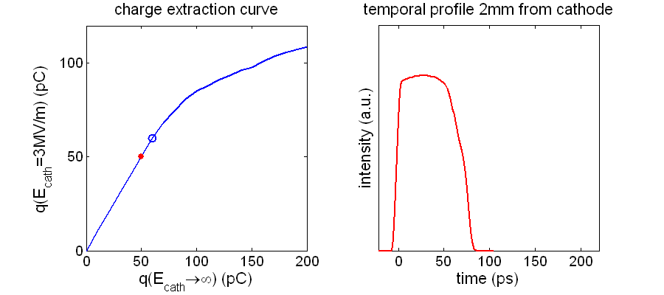
Space charge dominated
Pack a bunch smartly: putting as many electrons in each bunch as possible does not work…

Slide 16
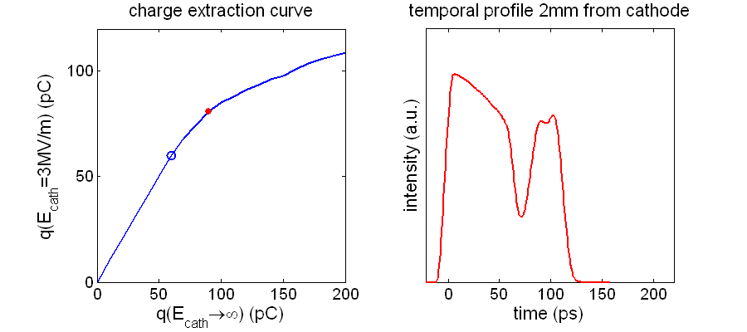
Space charge dominated
Pack a bunch smartly: putting as many electrons in each bunch as possible does not work…
virtual cathode

Slide 17
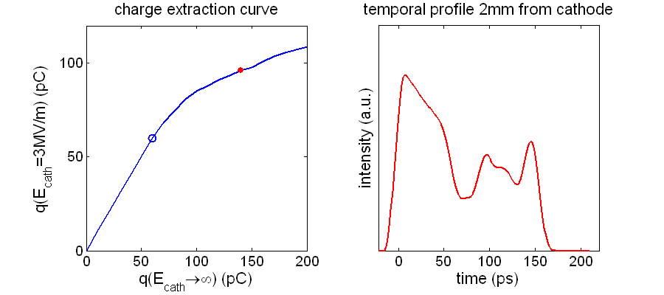
Space charge dominated
Pack a bunch smartly: putting as many electrons in each bunch as possible does not work…
virtual cathode

Slide 18
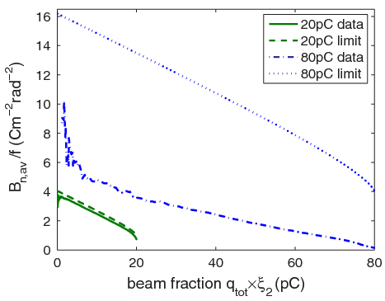
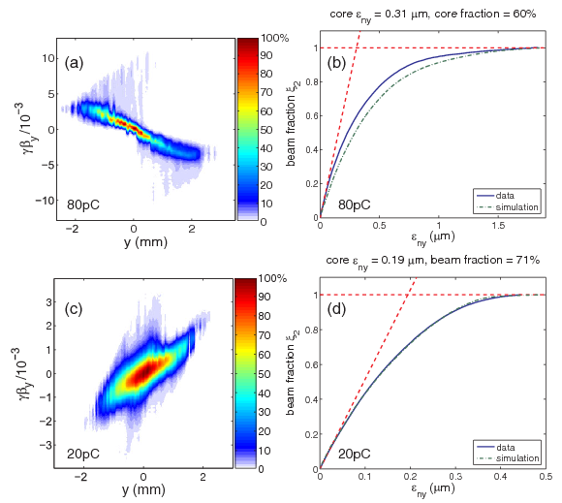
250kV DC gun data
80 pC, ε_{nx} = 1.8± 0.2 μm
at v.c. limit
¼ below v.c.
20 pC, ε_{nx} = 0.43± 0.05 μm
PRL, 102 (2009) 104801

Slide 19
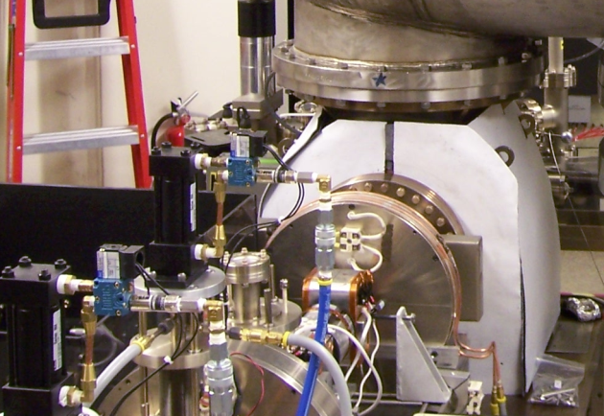
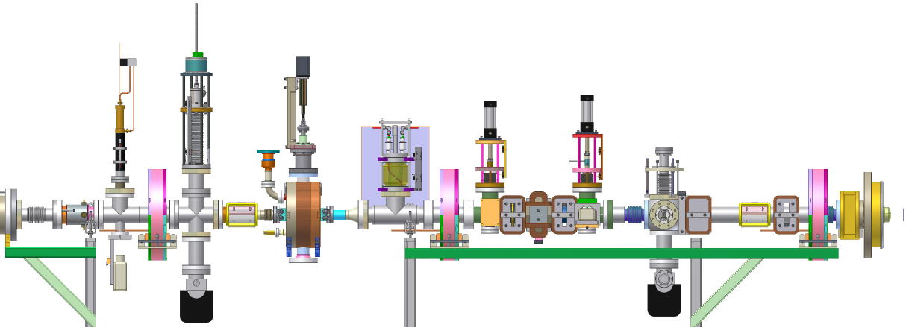
Gun beamline studies
Benchmarking space charge codes
Photocathode characterization
Laser shaping and temporal characterization
SOL1
EMS
VC1
solenoid
deflecting RF cavity
region of study for space charge: 1.244 m
solenoid
emittance meas. system
beam
Faraday cup
solenoid
viewscreen
viewscreen
cathode
beam scanner
wirescanner
beam scanner
anode
laser entrance

Slide 20
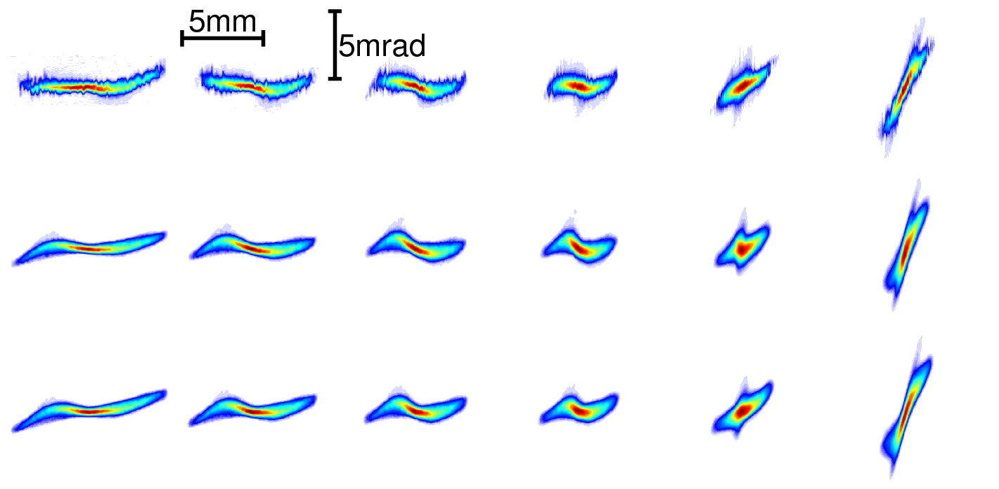
Space charge code validation
z = 1.244m
0
100%
20 pC/bunch
data
Parmela3D
GPT
3.4A
SOL1
3.9A
PRSTAB, 11 (2008) 100703

Slide 21
Photocathode studies
Beam quality-wise, two important figures of merit
Effective transverse thermal energy → brightness limit
Response time → one’s ability to shape laser and linearize space charge forces
Limiting our study to NEA photocathodes: GaAs, GaN, and GaAsP
GaAs remains the best out of what we looked into (no perfect photocathode)

Slide 22
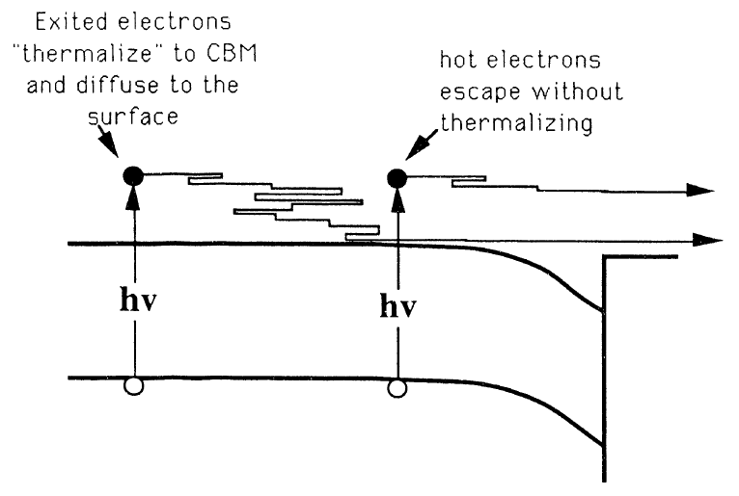
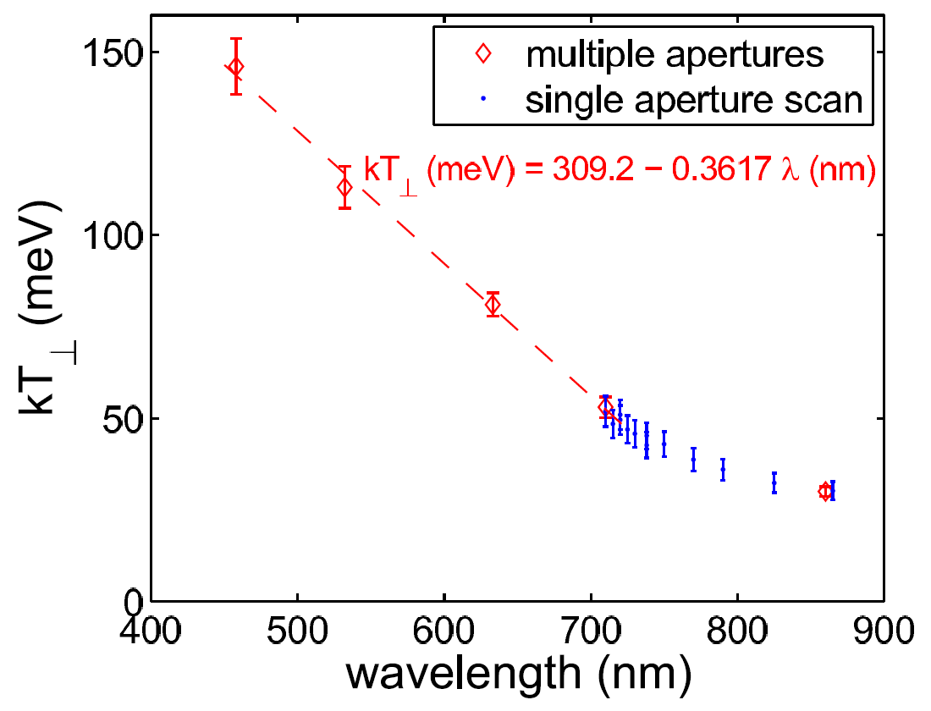
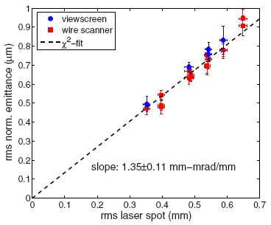
kT vs. wavelength
relates spot size to emittance
kT
ε
=
σ
n
,
th
⊥
mc
2
JAP, 103 (2008) 054901
JAP, 105 (2009) 083715
GaAs
GaN @ 260 nm

Slide 23
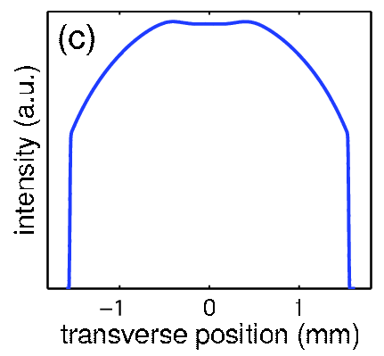
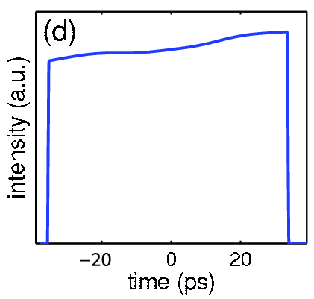
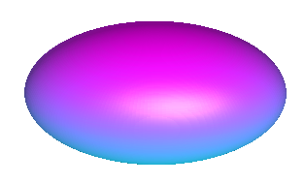
Laser shaping
Desired 3D distribution in free space is a uniformly filled ellipsoid → linear space charge forces
Actual ideal laser shape is convoluted by
The boundary condition of the cathode
Nonrelativistic energy / bunch compression
desired laser shape
shape after the gun

Slide 24
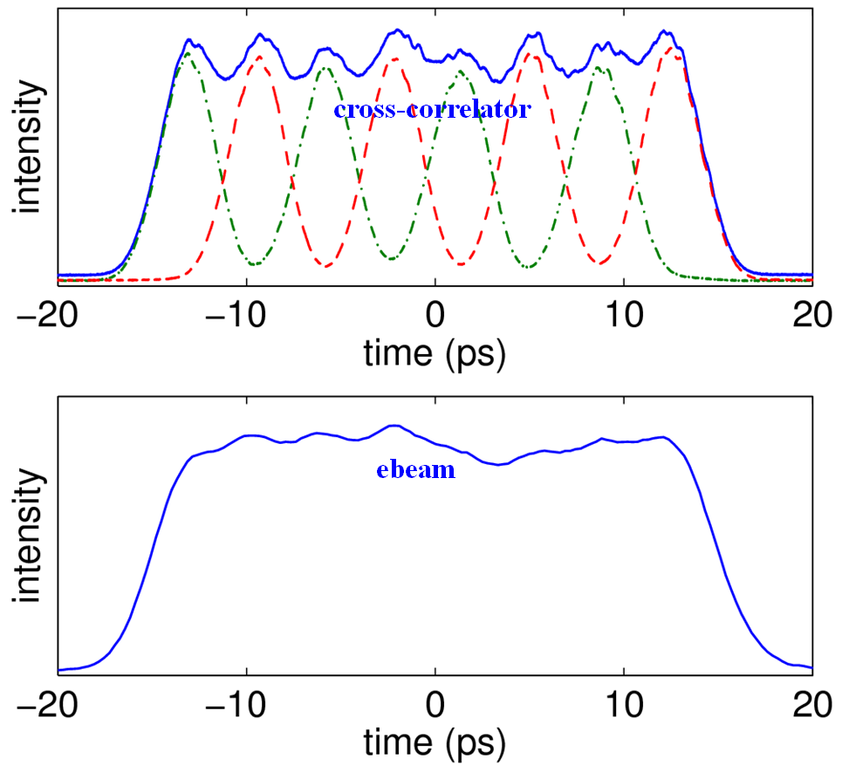
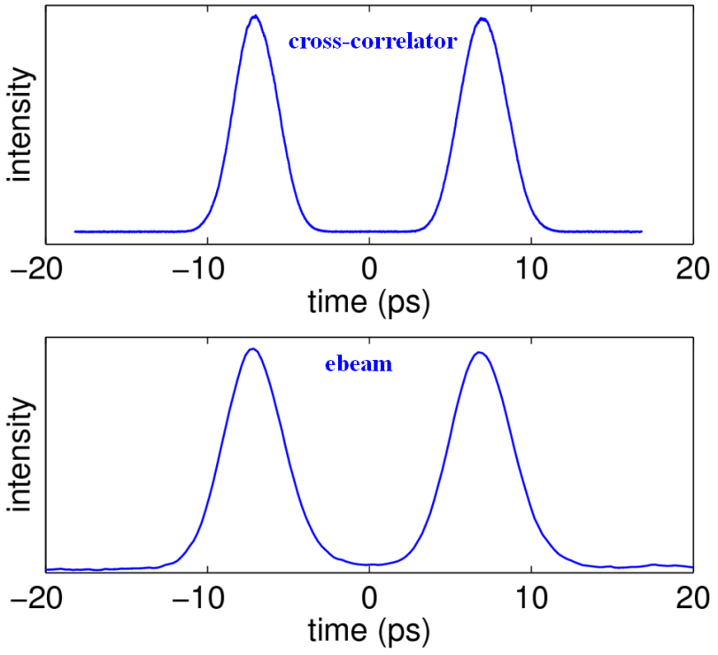
One robust method
App Opt, 46 (2007) 8488
PRSTAB, 11 (2008) 040702
Three crystals
One crystal
useful diagnostics tool with RF on

Slide 25
Beam dynamics with RF
kick
focusing
kick
focusing
tail
head

Slide 26
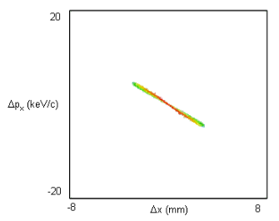
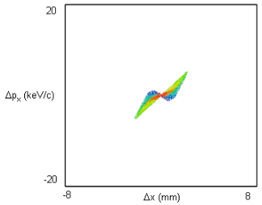
RF focusing
If space charge is kept in check (force is linear), RF induced emittance dominates
RF cavities focus or defocus the beam depending on phase, kinetic energy and gradient
Before 1st cavity
After 1st cavity
ε_{nx} = 0.37 μm
ε_{nx} = 1.2 μm
rf emittance growth “bow-tie” pattern

Slide 27
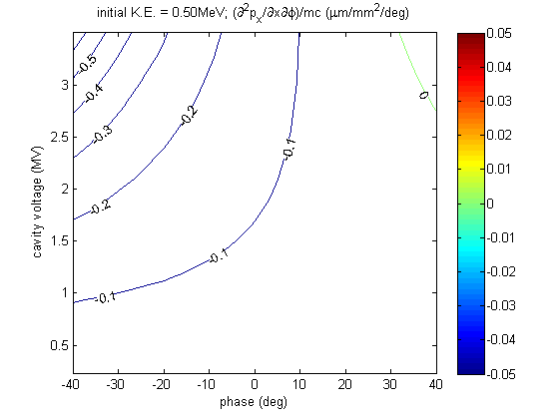
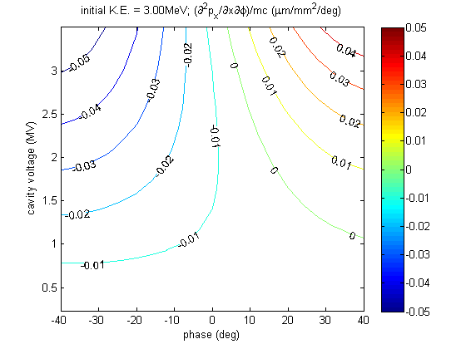
RF emittance cancelation
RF induced emittance growth can be cancelled (yet to be demonstrated with beam)
K.E. = 0.5 MeV
K.E. = 3 MeV
cavity #3,4,…
correcting rf
emittance and
energy spread
cavity #1 some
bunching

Slide 28
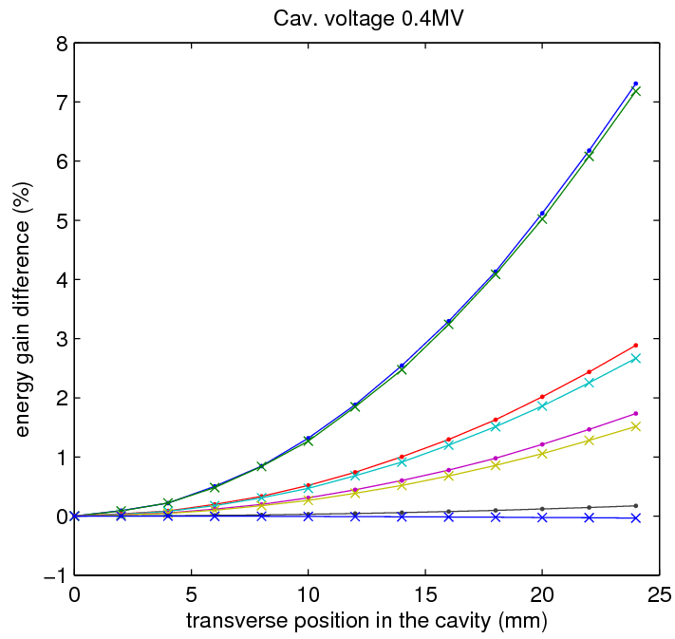
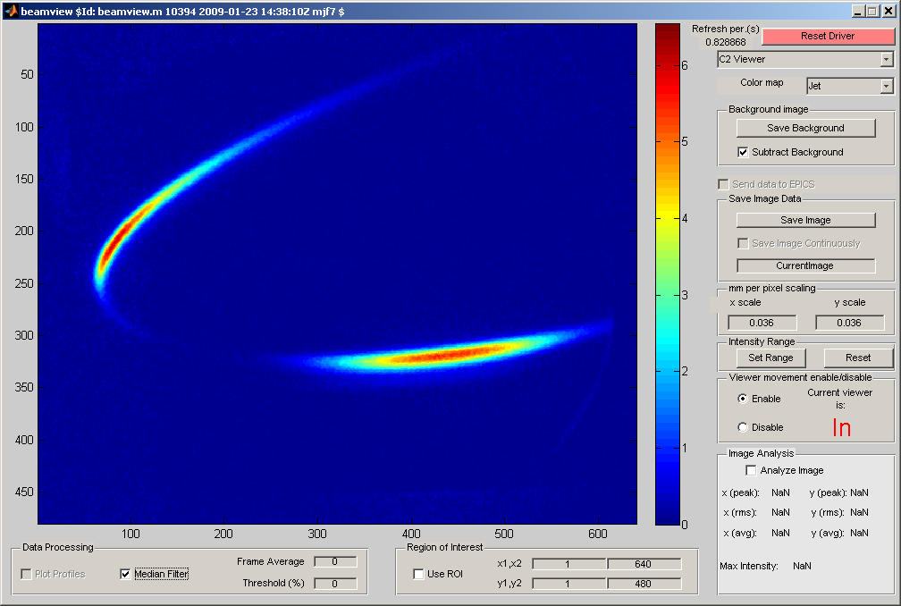
Low gun voltage implications
Low gun voltage introduces several challenges in the 1st cavity
Energy gain is transverse position dependent
1st cavity acts as a phase shifter
Time & energy diagnostics proves very useful
0.25 MeV
t
0.5 MeV
0.75 MeV
3 MeV
E

Slide 29
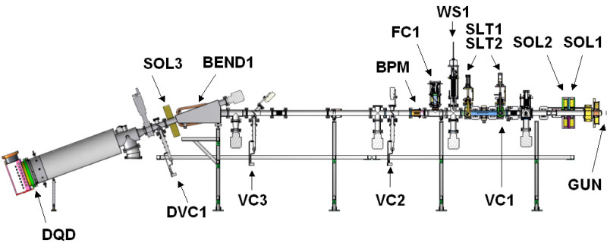
High current status
gas backstream from the dump
20 mA DC current demonstrated from the gun as limited by gas backstream from the dump (~5m away)
5MeV beam running so far reached 4mA as limited by our ability to setup a clean beam (radiation losses)
beam direction

Slide 30
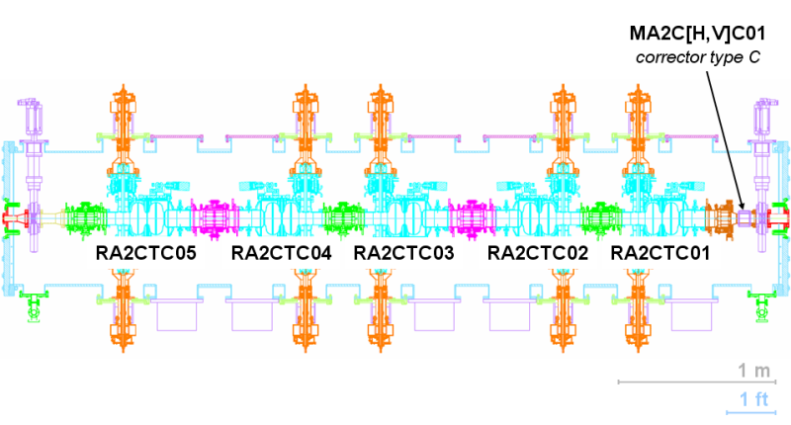
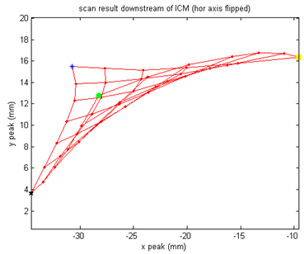
Problem with the cryomodule
Stray magnetic fields inside the cryomodule increase losses and thwart beam based alignment
Planning to open the cryomodule to eliminate the problem
Grid pattern downstream
Top View
RF off, 250kV
beam direction

Slide 31
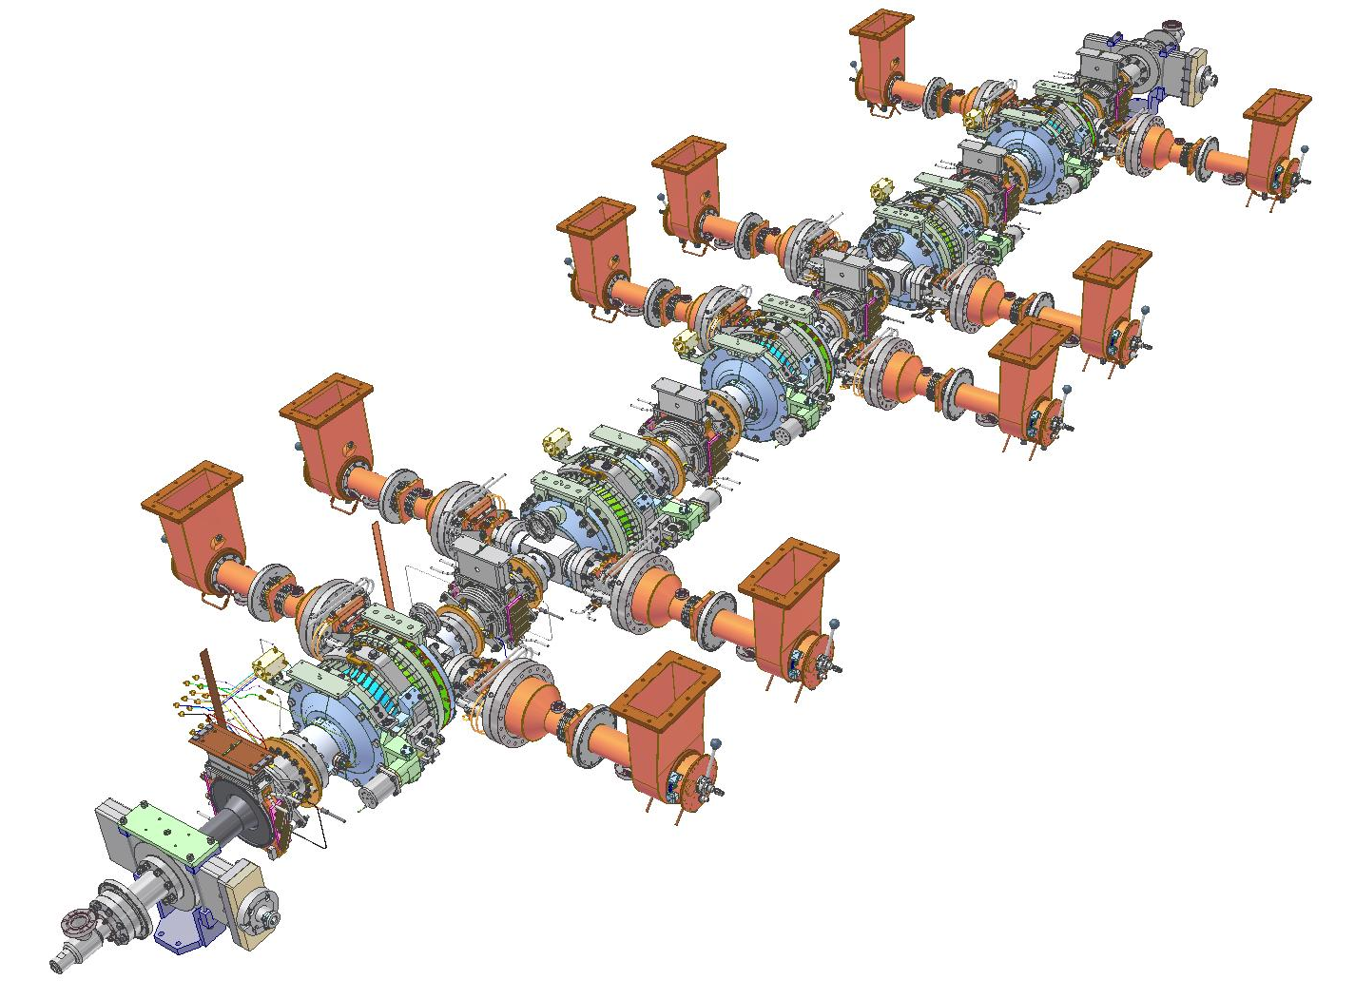
Localizing stray fields
#5
#4
Using RF couplers with DC voltage applied to localize the bad field region
#3
#2
#1
Top View
beam direction

Slide 32
Things to look forward to
RF emittance compensation
Merger: chromatic effects with space charge
High current: ion effect
High current: long range wake fields

Slide 33
Summary
Learned many valuable lessons from the gun operation despite low voltage & ceramic woes
11 months after 10 MeV injector installation complete and 10 months of initial beam running we are in the thick in commissioning
Found some problems that require action
Work in parallel on several new ceramics (an improved ceramic to arrive end of April) and second gun to reach 500kV

Slide 34
Acknowledgements
John Barley, Sergey Belomestnykh, Mike Billing, Eric Chojnacki, John Dobbins, Bruce Dunham, Richard Erhlich, Mike Forster, Steve Gray, Colwyn Gulliford, Georg Hoffstaetter, Heng Li, Yulin Li, Matthias Liepe, Xianghong Liu, Florian Loehl, Valery Mejdidzade, Dimitre Ouzounov, Hasan Padamsee, Peter Quigley, David Rice, Hisham Sayed, Valery Shemelin, Charles Sinclair, Eric Smith, Karl Smolensky, Charlie Strohman, Maury Tigner, Alexander Temnykh, Vadim Vescherevich, Frank Wise, and more…

