Slide 1
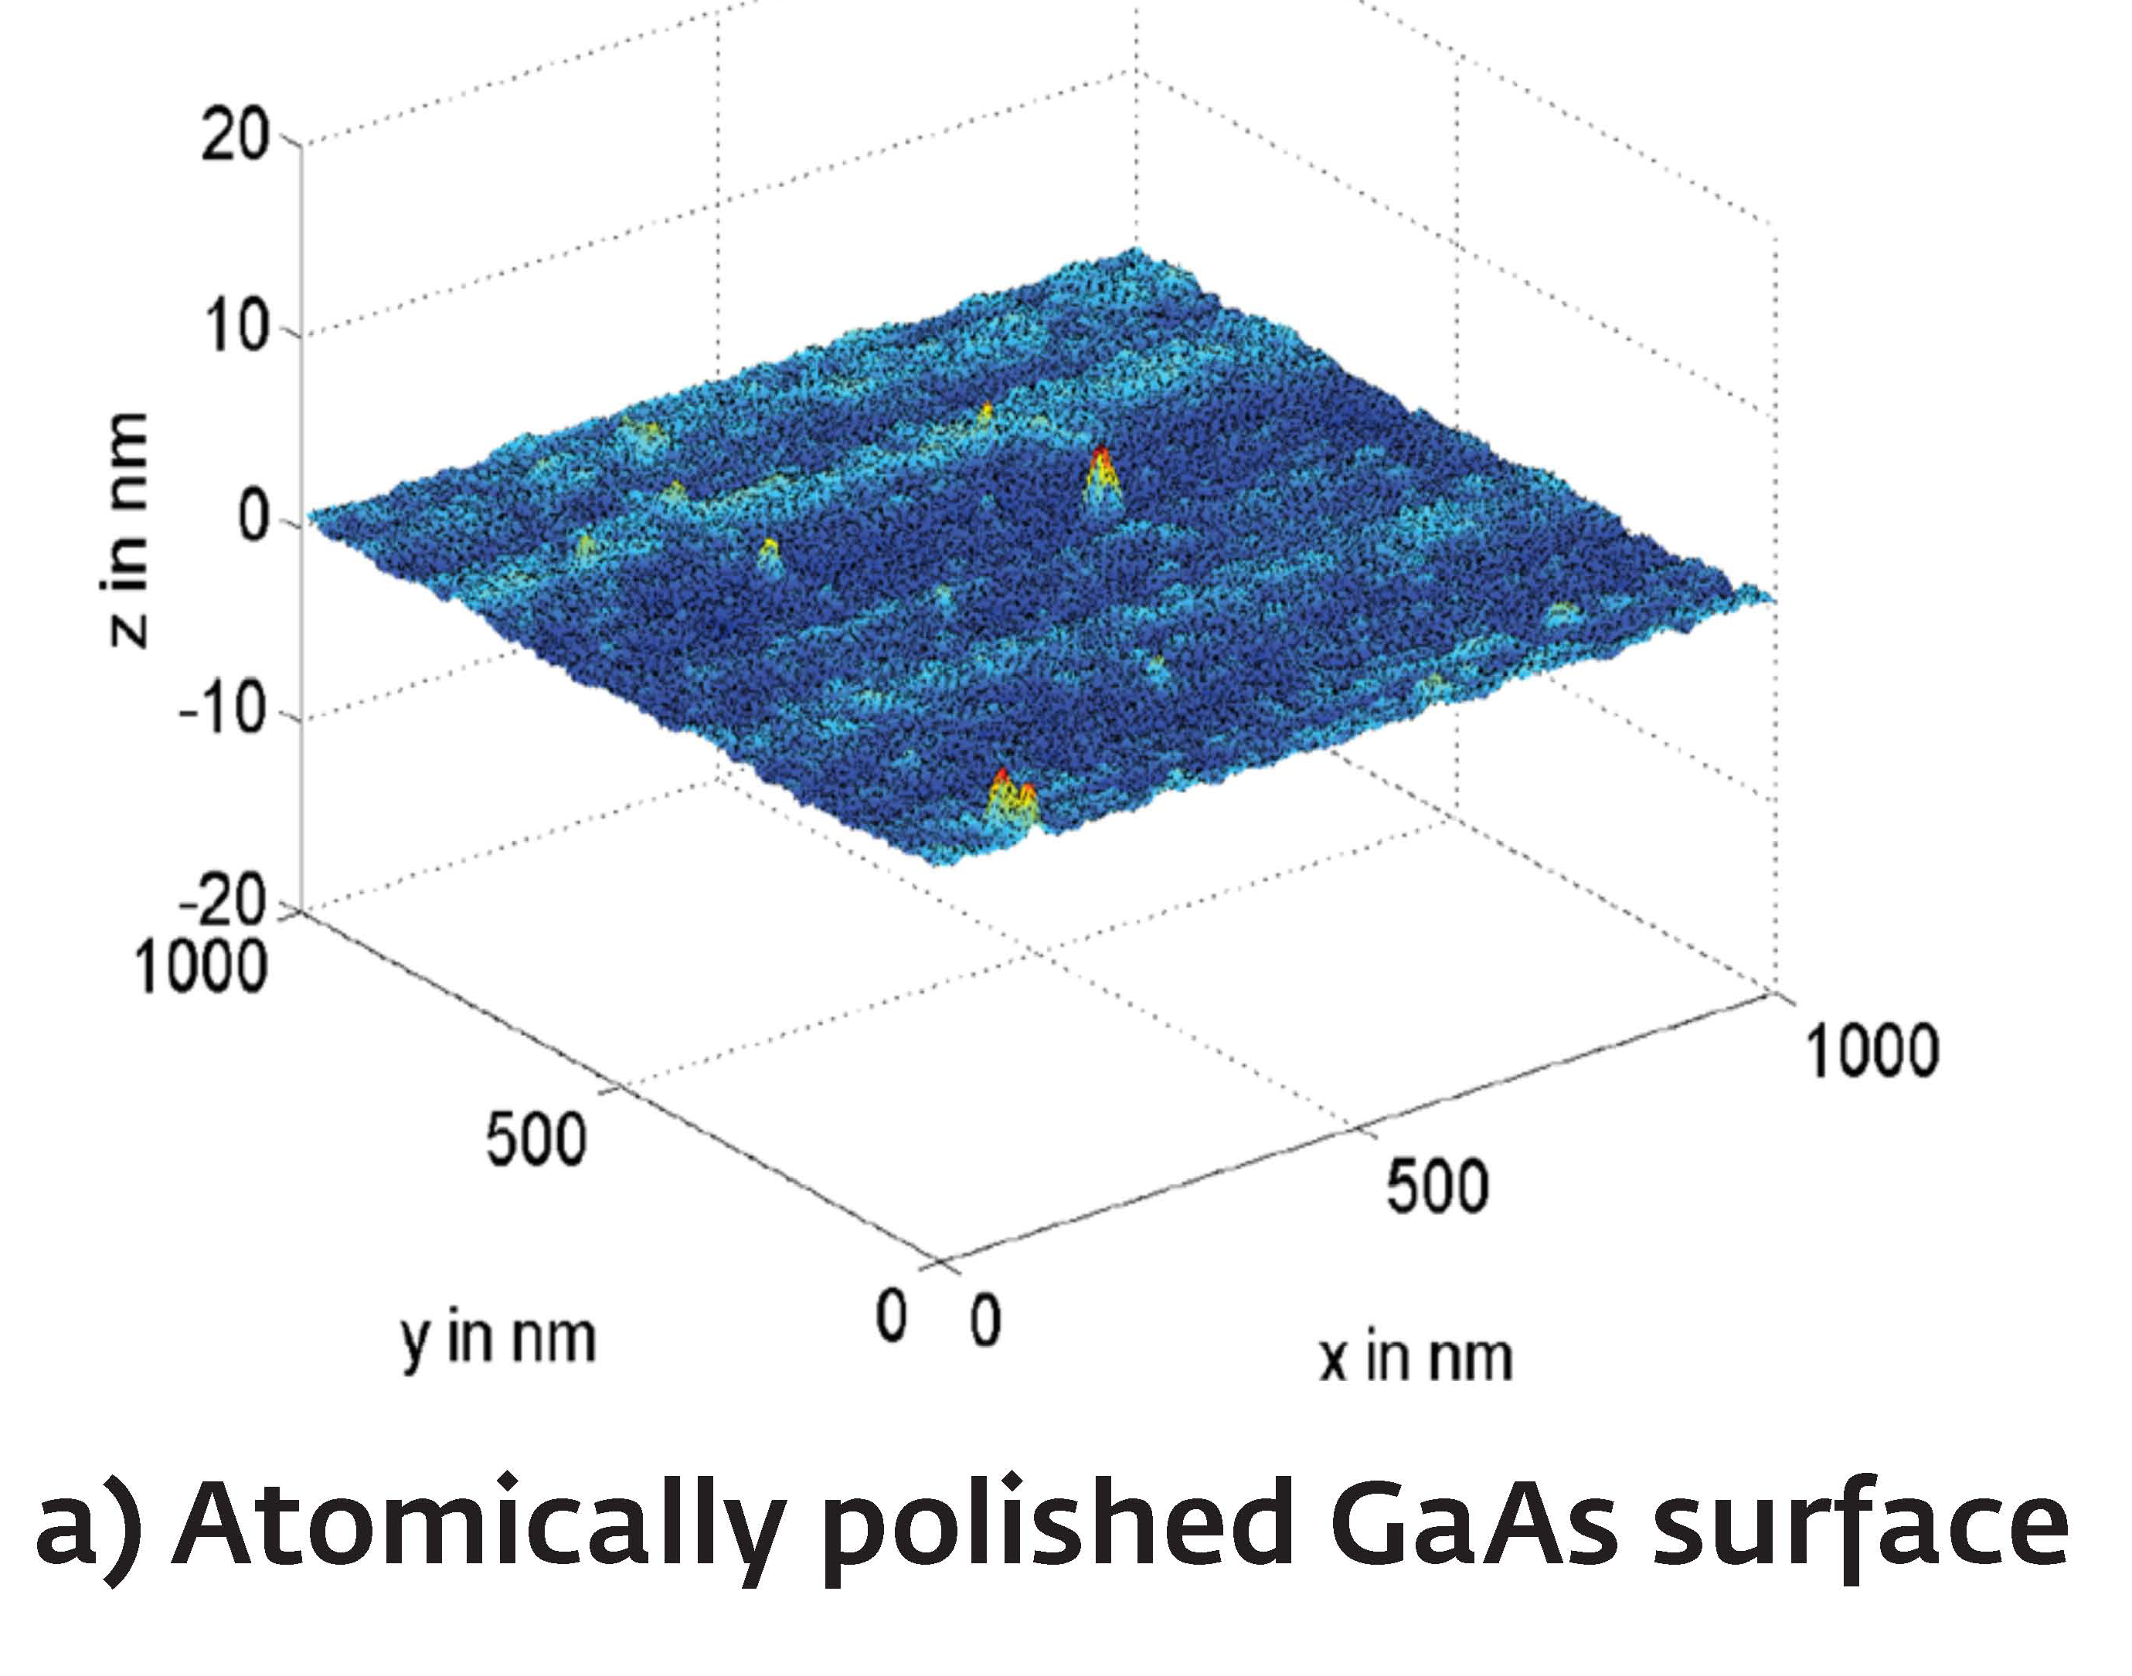
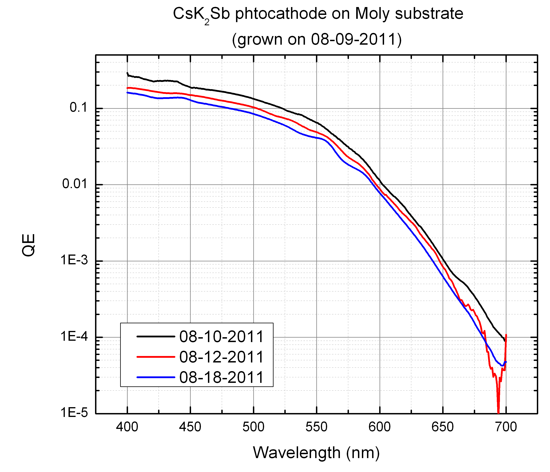
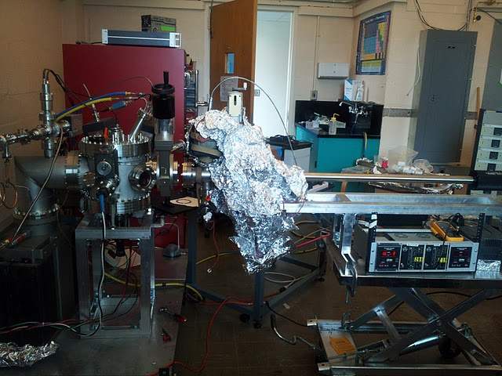
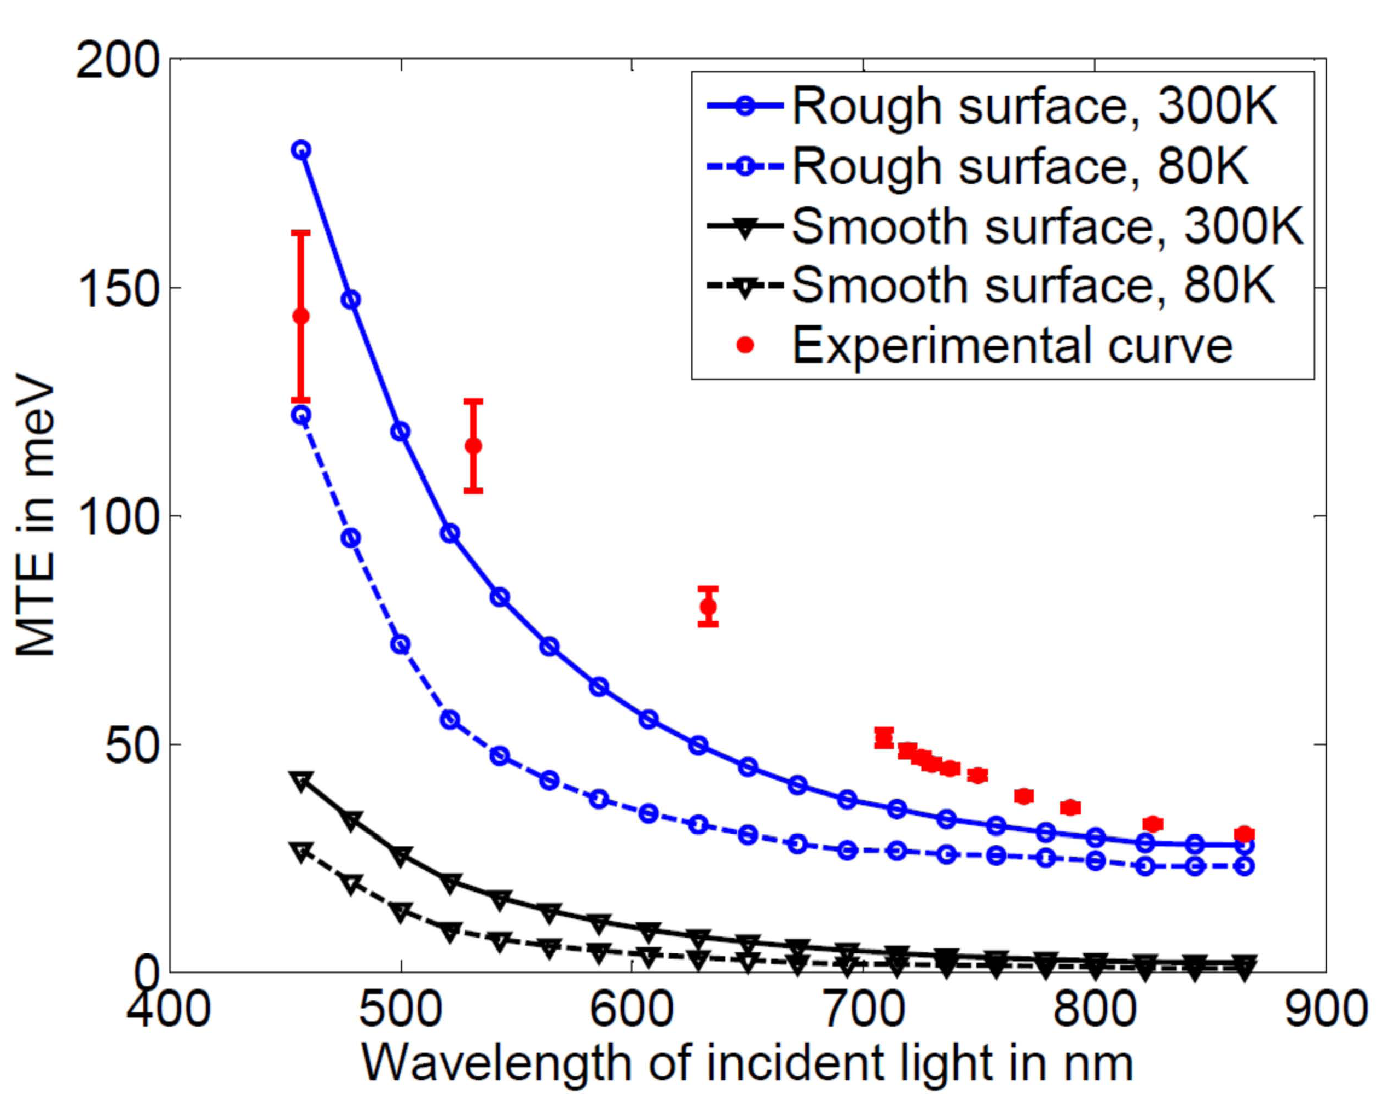
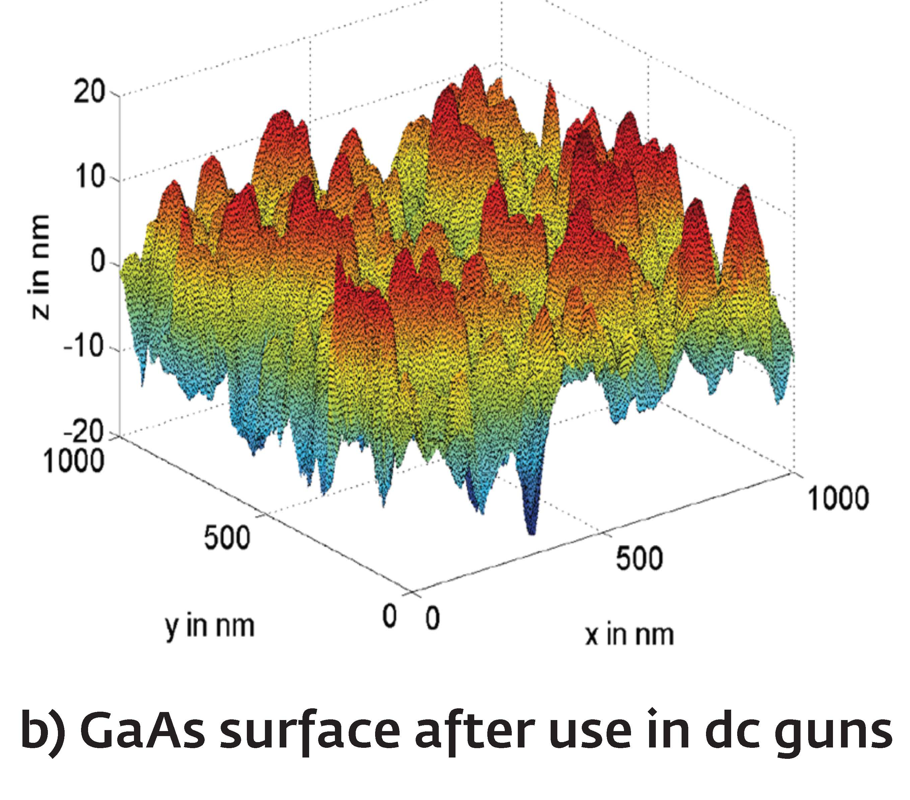
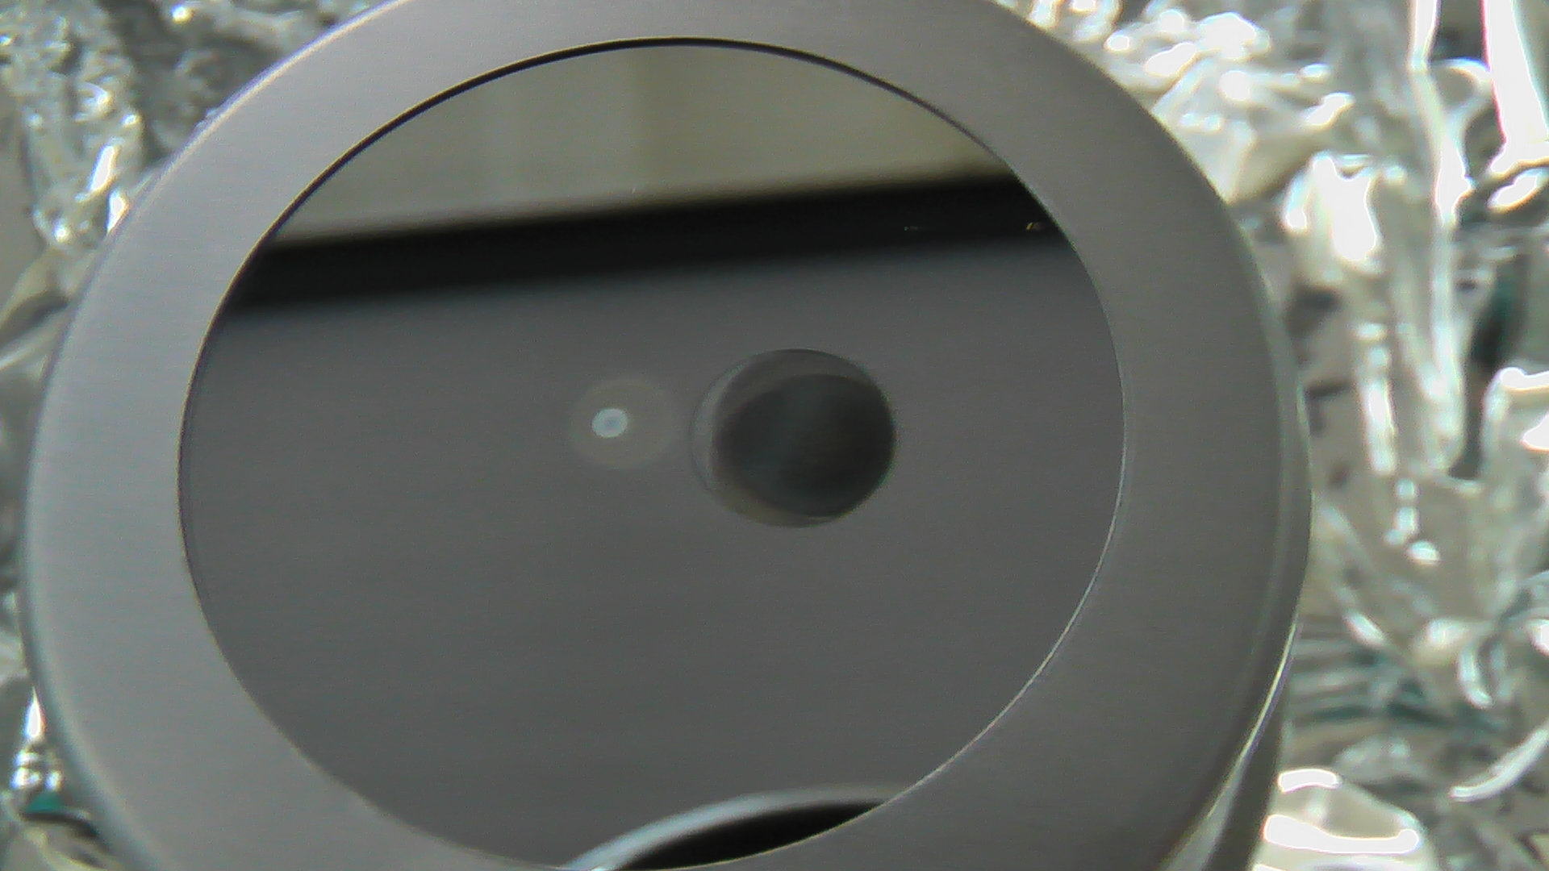
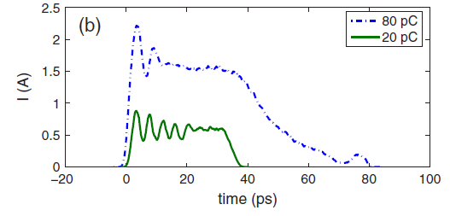
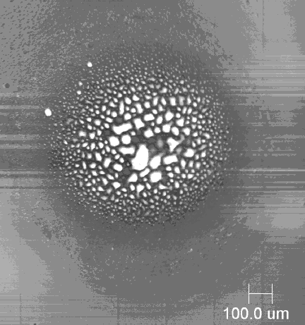
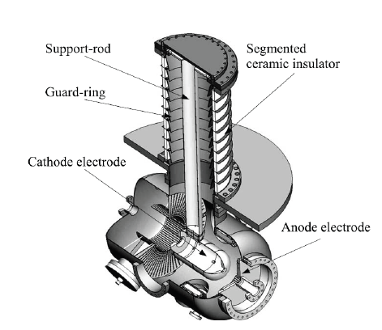
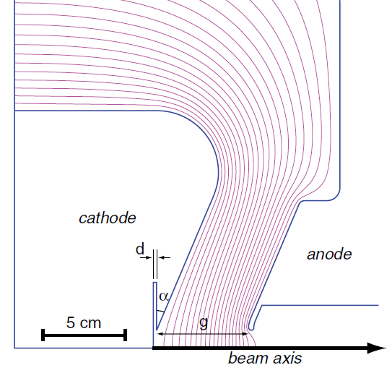
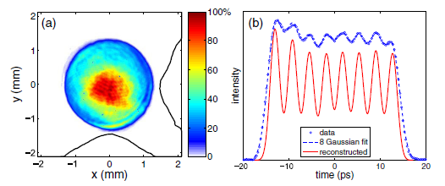
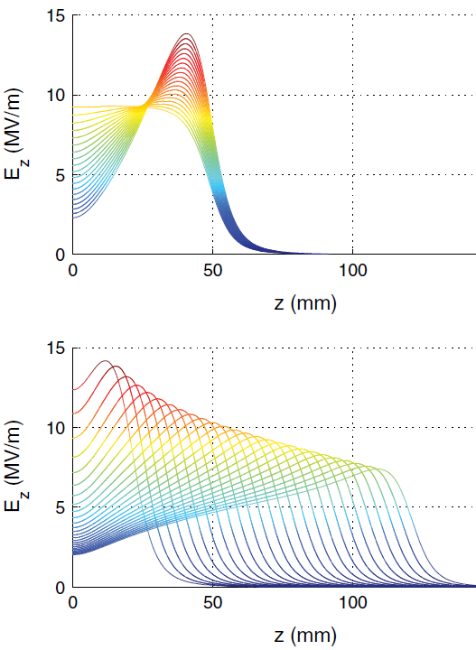
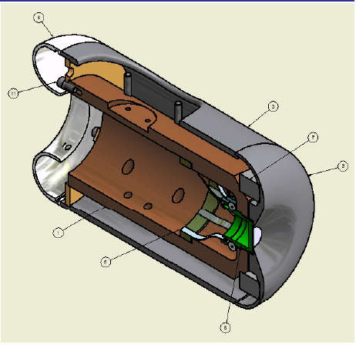
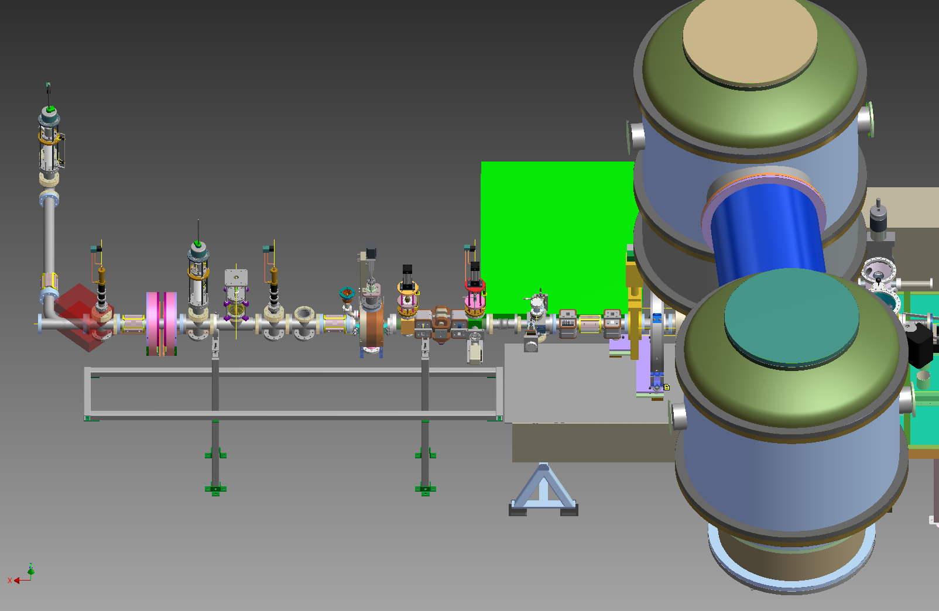
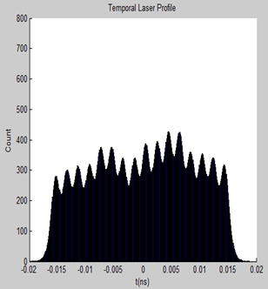
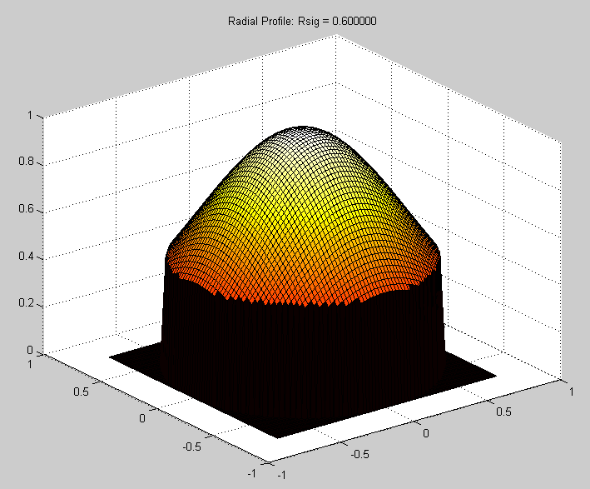
High Brightness Electron Source Development
I.V. Bazarov, L. Cultrera, S. Karkare, J. Maxson (for the ERL injector team)
Presented at DOE Contractors’ Mtg, Annapolis, MD, August 22-23, 2011
Photocathode development
Sub-thermal emittance from GaAs cathodes
CsK2Sb photocathode development
Multi-Alkali Cathode Prep-chamber with vacuum suitcase
20mA, 8hr run
Photocathode Diagnostics
Gun development
Crater Light gray
~1.5 mm diameter
Photocathode film
DIAGNOSTIC TECHNIQUES
PREPARATION CHAMBERS
Brightness Limiting Phenomena
Auger Spectroscopy
LEED
Photoreflectance
Electron Energy Analyzers
Response time measurements
Work function measurement
XRF
….
GaAs(Cs,F)
Alkali-Antimonide
In Vacuum Connection
In Vacuum Connection
Brown colored area
~4 mm diameter
~0.5 mm gap
ERL INJECTOR
DC GUN
Damage on Si substrate after 20mA run
In Vacuum Connection
Simulated bunch profile for 20pC and 80pC bunch charges from a realistic birefringent pulse-stacked laser profile.
The onset of the virtual cathode instability (VCI) is apparent in the bunch lengthening and breakup.
SEM image of central damaged area
In progress…
Achieving Optimal Brightness
MK II DC Gun: Pushing brightness limits
A new DC photogun is under construction @ Cornell. It will feature:
A segmented, shielded HV ceramic to reach higher voltage regimes.
Adjustable cathode-anode gap, to allow precision control of the photocathode field, on which the onset of the VCI depends.
A genetically optimized electrode profile to provide highest brightness, subject to empirical breakdown voltage constraints.
Use of Genetic Algorithms to optimize gun geometry
Genetically optimized 3D laser pulse profile to minimize space charge induced emittance growth.
Varying Pierce angle (0 to 45°)
The MK II Gun will employ adaptive 3D laser pulse shaping to allow online optimization of emittance.
Temporal shaping via birefringent crystal stacking
Transverse – via truncated Gaussian
Good light transmission, < 20% emittance change from the optimum
Varying gap (2 to 12 cm)
A 6-D phase space measurement beamline, transverse emittance measurement, and ps-resolution deflecting cavity.
Supported by DOE DE-SC0003965, NSF DMR-0807731

