Slide 1
Representation of synchrotron radiation in phase space
Ivan Bazarov

Slide 2
Outline
Motion in phase space: quantum picture
Wigner distribution and its connection to synchrotron radiation
Brightness definitions, transverse coherence
Synchrotron radiation in phase space
Adding many electrons
Accounting for polarization
Segmented undulators, etc.

Slide 3
Motivation
Compute brightness for partially coherent x-ray sources
Gaussian or non-Gaussian X-rays??
How to include non-Gaussian electron beams close to diffraction limit, energy spread??
How to account for different light polarization, segmented undulators with focusing in-between, etc.??

Slide 4
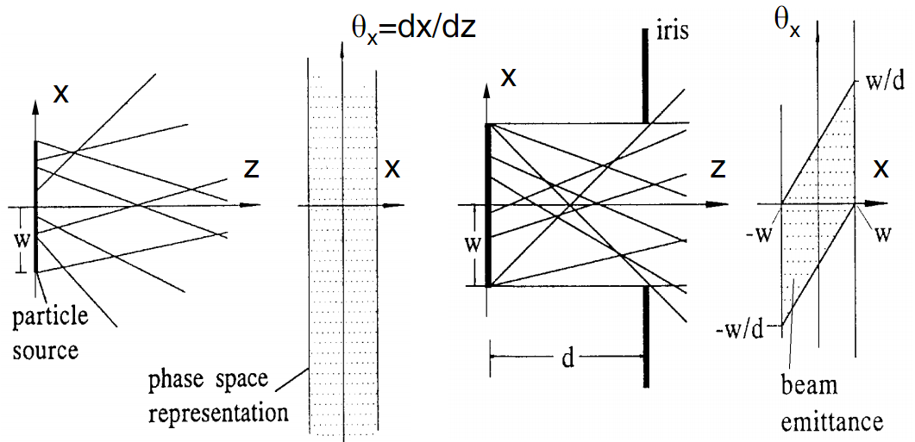
Brightness: geometrical optics
Rays moving in drifts and focusing elements
Brightness = particle density in phase space (2D, 4D, or 6D)

Slide 5
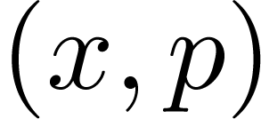
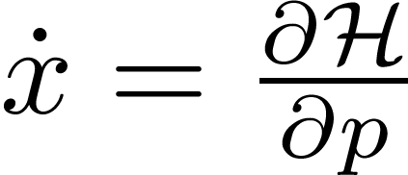
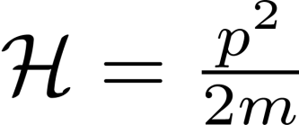
Phase space in classical mechanics
Classical: particle state
Evolves in time according to ,
E.g. drift: linear restoring force:
Liouville’s theorem: phase space density stays const along particle trajectories

Slide 6
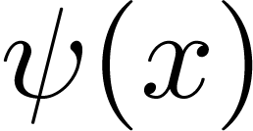
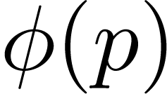
Phase space in quantum physics
Quantum state:
or
Position space momentum space
If either or is known – can compute anything. Can evolve state using time evolution operator:
- probability to measure a particle with
- probability to measure a particle with

Slide 7
Wigner distribution
– (quasi)probability of measuring quantum particle with and
Quasi-probability – because local values can be negative(!)

Slide 8
PHYS3317 movies

Slide 9
Same classical particle in phase space…

Slide 10
Going quantum in phase space…

Slide 11
Wigner distribution properties
Time evolution of is classical in absence of forces or with linear forces

Slide 12
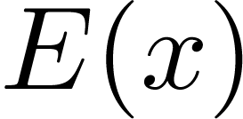
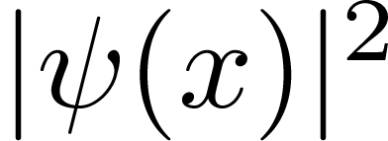
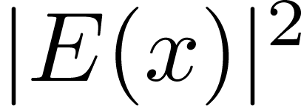
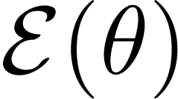
Connection to light
Quantum –
Linearly polarized light (1D) –
Measurable – charge density
Measurable – photon flux density
Quantum: momentum representation is FT of
Light: far field (angle) representation is FT of

Slide 13
Connection to classical picture
Quantum: , recover classical behavior
Light: , recover geometric optics
or – phase space density (=brightness) of a quantum particle or light
Wigner of a quantum state / light propagates classically in absence of forces or for linear forces!

Slide 14
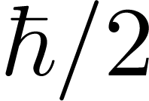
Diffraction limit
Heisenberg uncertainty principle: cannot squeeze the phase space to be less than
since ,
We call the diffraction limit

Slide 15
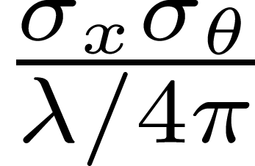
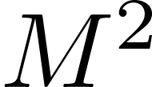
Coherence
Several definitions, but here is one
In optics this is known as value
measure of coherence or mode purity

Slide 16
Useful accelerator physics notations
-matrix
Twiss (equivalent ellipse) and emittance
with and or

Slide 17
Jargon
Easy to propagate Twiss ellipse for linear optics described by :
-function is Rayleigh range in optics
Mode purity

Slide 18
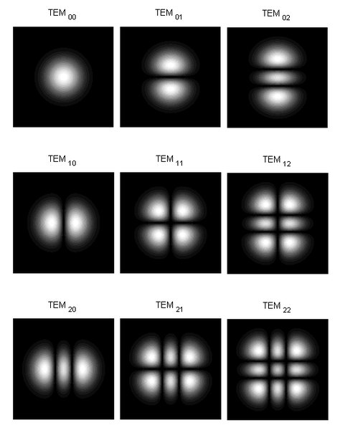
Hermite-Gaussian beam
, where are Hermite polynomial order in respective plane

Slide 19
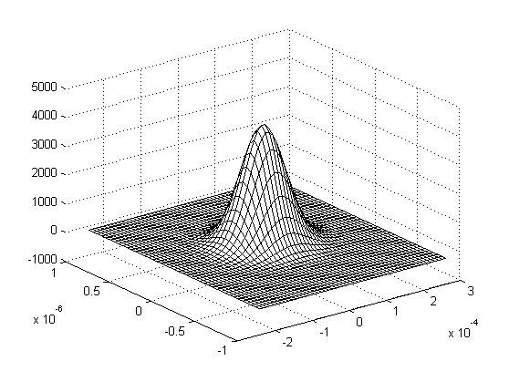
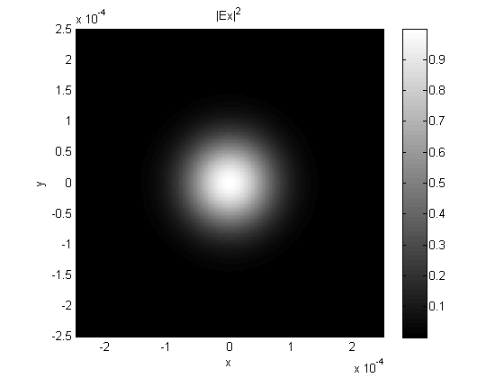
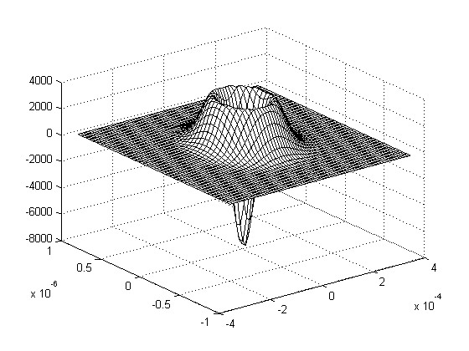
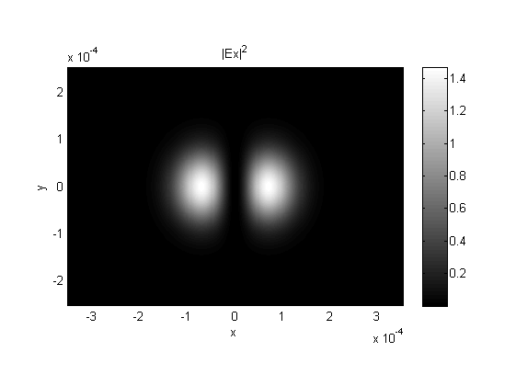
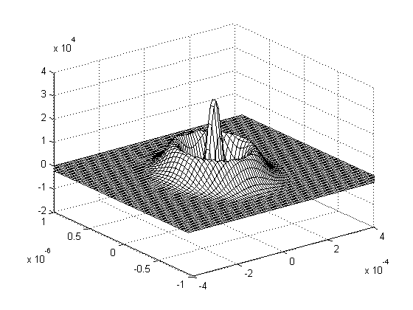
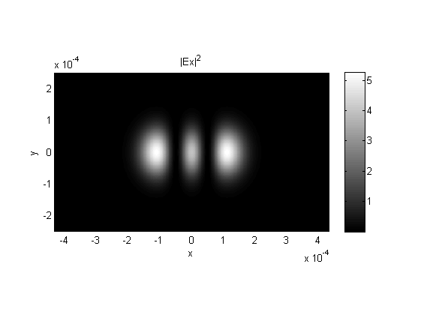
Hermite-Gaussian beam phase space
wigner
y
x
angle θ_{x}
position x
y
x
angle θ_{x}
position x
y
x
angle θ_{x}
position x

Slide 20
Wigner from 2 sources?
Wigner is a quadratic function, simple adding does not work
Q: will there an interference pattern from 2 different but same-make lasers?

Slide 21
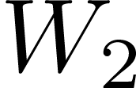
Wigner from 2 sources?
- first source, - second source, - interference term

Slide 22
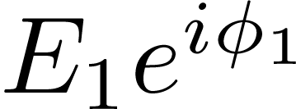
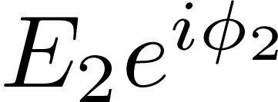
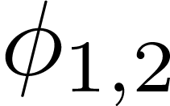
Interference term
Let each source have and , with random phases , then W_{c} = 0 as
This is the situation in ERL undulator: electron only interferes with itself
Simple addition of Wigner from all electrons is all we need

Slide 23
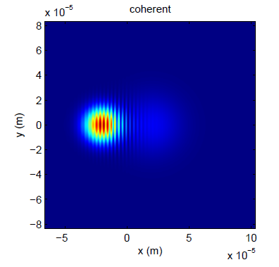
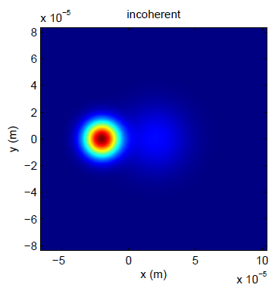
Example of combining sources
two Gaussian beams

Slide 24
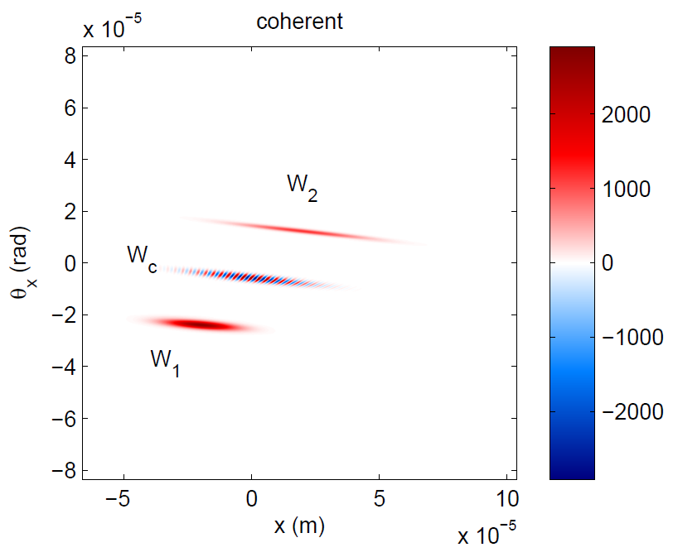
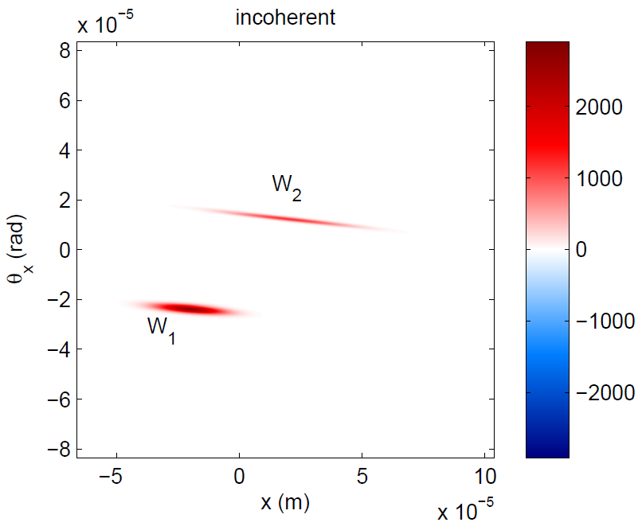
Same picture in the phase space
two Gaussian beams

Slide 25
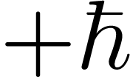
Wigner for polarized light
Photon helicity or right handed and left handed circularly polarized photons
Similar to a 1/2-spin particle – need two component state to describe light
Wigner taken analogous to stokes parameters

Slide 26
Generalized Stokes (or 4-Wigner)
Total intensity
Linearly polarized light
(+) x-polarized
(–) y-polarized
Linearly polarized light
(+) +45°-polarized
(–) -45°-polarized
Circularly polarized light
(+) right-hand
(–) left-hand

Slide 27
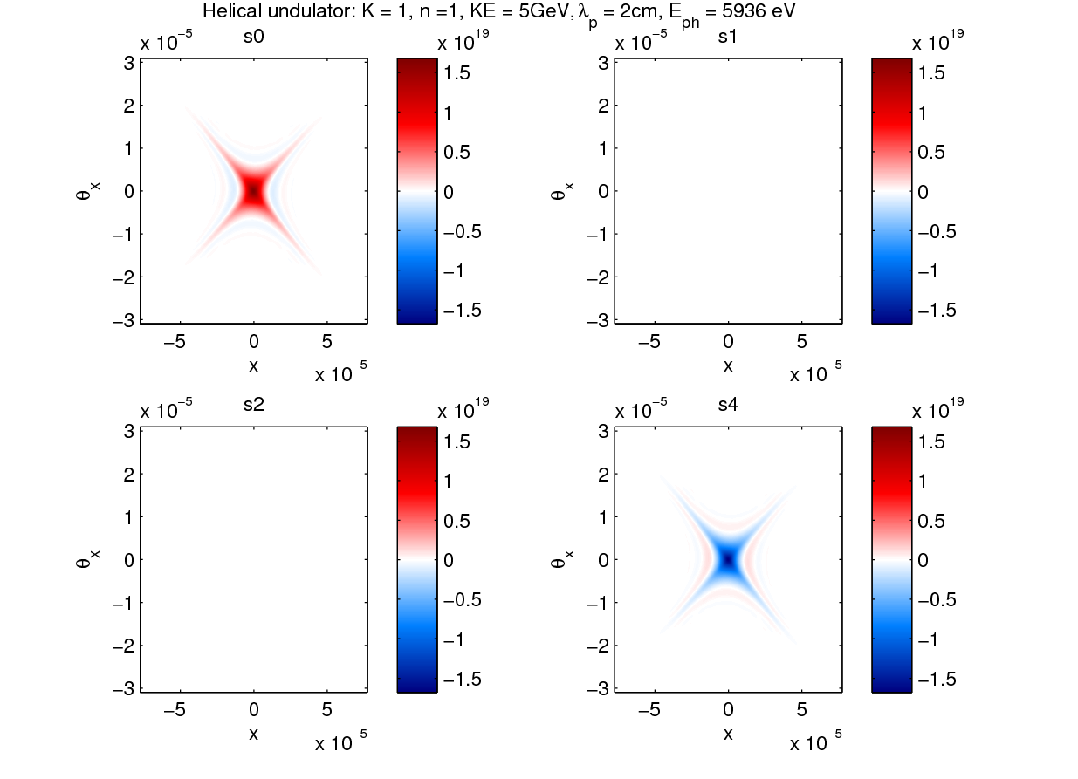
Example B_{x}(ph/s/0.1%BW/mm/mrad)
, N_{und} = 250

Slide 28
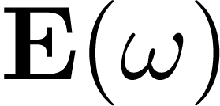
Synchrotron radiation
Potential from moving charge
with . Then find , then FT to get

Slide 29
Brightness definitions
Phase space density in 4D phase space = brightness . Same as Wigner, double integral gives spectral flux
– Units ph/s/0.1%BW/mm²/mrad²
– Nice but bulky, huge memory requirements.
Density in 2D phase space = 2D brightness are integrated away respectively. Easy to compute, modest memory reqs.
– Units ph/s/0.1%BW/mm/mrad

Slide 30
Brightness definitions
Can quote peak brightness or – but can be negative
E.g. one possible definition (Rhee, Luis)

Slide 31
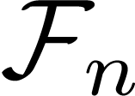
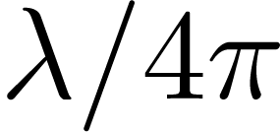
How is brightness computed now
Find flux in central cone
Spread it out in Gaussian phase space with light emittance in each plane
Convolve light emittance with electron emittance and quote on-axis brightness

Slide 32
Criticism
What about non-Gaussian electron beam?
Is synchrotron radiation phase space from a single electron Gaussian itself (central cone)?
(I) Is the case of ERL, while (II) is never the case for any undulator

Slide 33
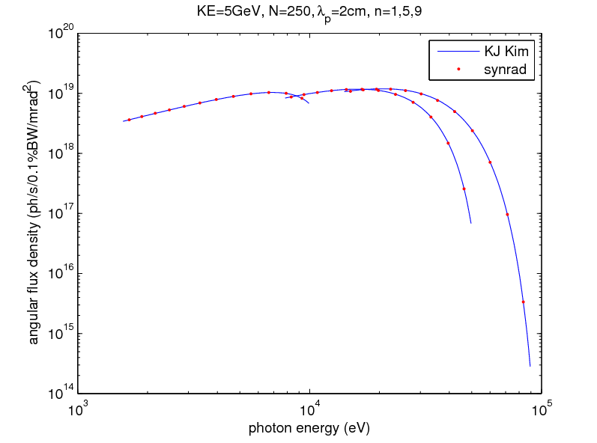
Some results of simulations with synrad
I = 100mA, zero emittance beam everywhere
Checking angular flux on-axis

Slide 34
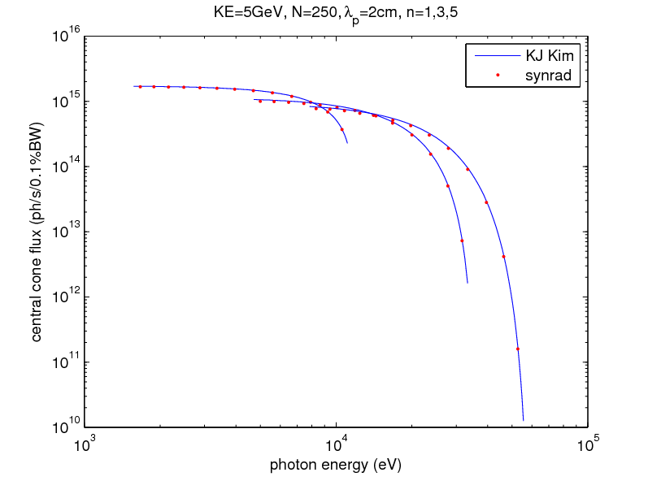
Total flux in central cone

Slide 35
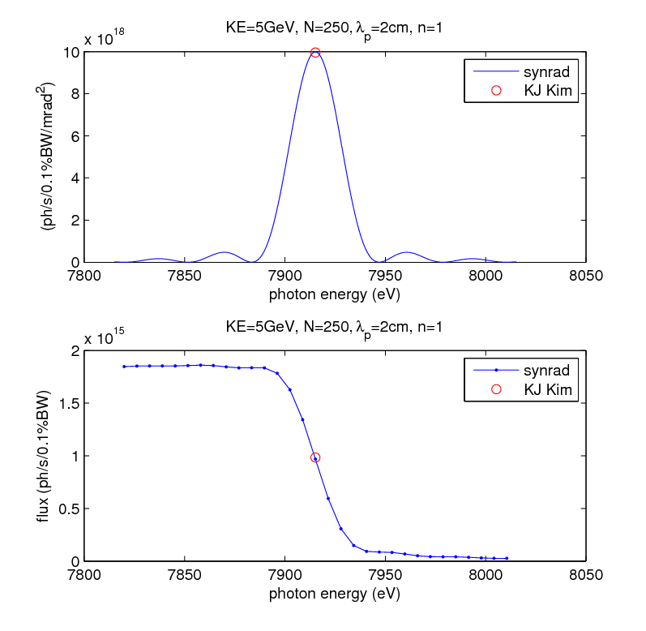
Scanning around resonance…
on-axis
total

Slide 36
Scanning around resonance…

Slide 37
Scanning around 2nd harmonic…

Slide 38
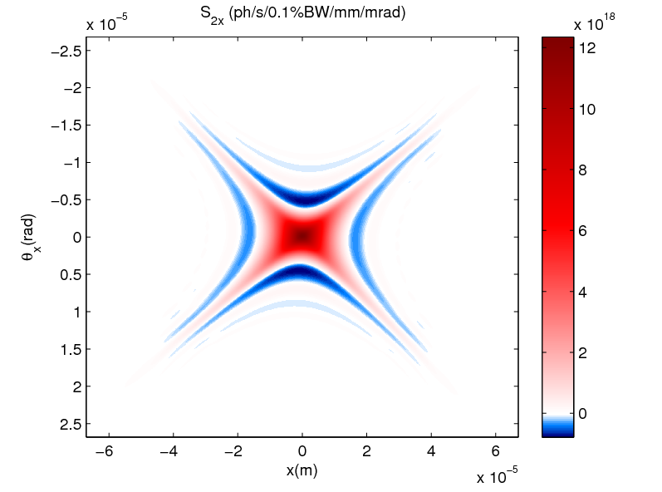
Synchrotron radiation in phase space, back-propagated to the undulator center

Slide 39
Key observations
Synchrotron radiation light:
Emittance ~ 3×diffraction limit
Ninja star pattern
Bright core (non-Gaussian)

Slide 40
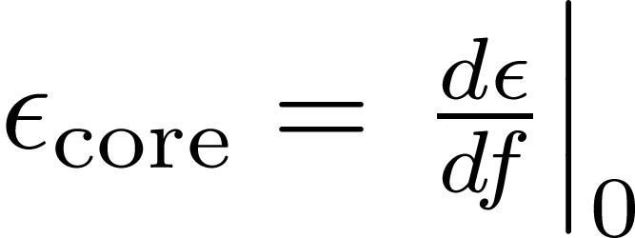
Emittance vs fraction
Ellipse cookie-cutter (adjustable), vary from 0 to infinity
Compute rms emittance inside
All beam
Core emittance
Core fraction

Slide 41
Examples
Uniform: ,
Gaussian: ,

Slide 42
What exactly is core emittance?
Together with total flux, it is a measure of max brightness in the beam

Slide 43
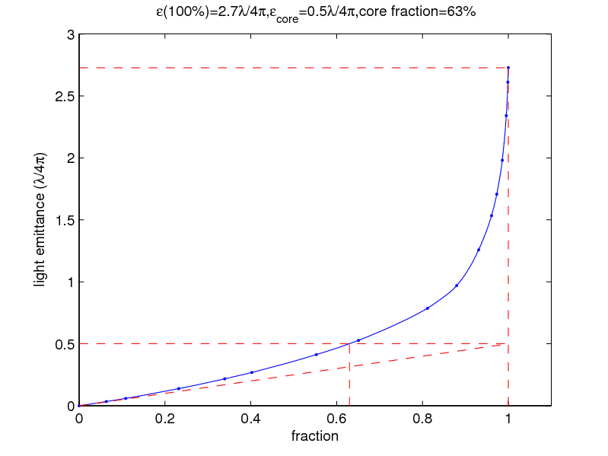
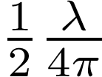
Light emittance vs fraction
core emittance is
(same as Guassian!), but
is much larger

Slide 44
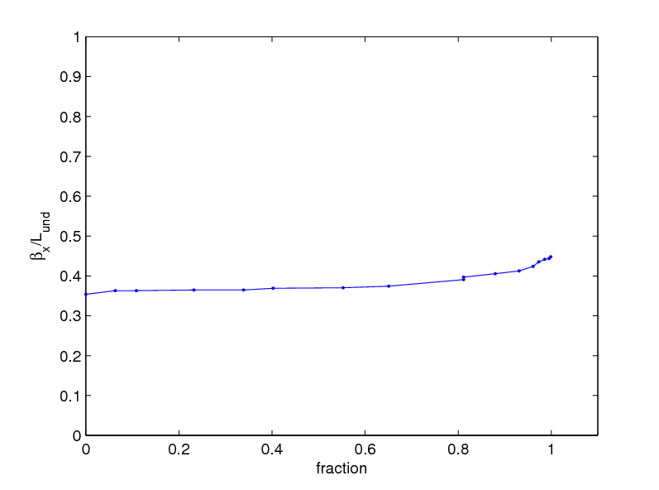
Optimal beta function

Slide 45
Light phase space around 1st harmonic

Slide 46
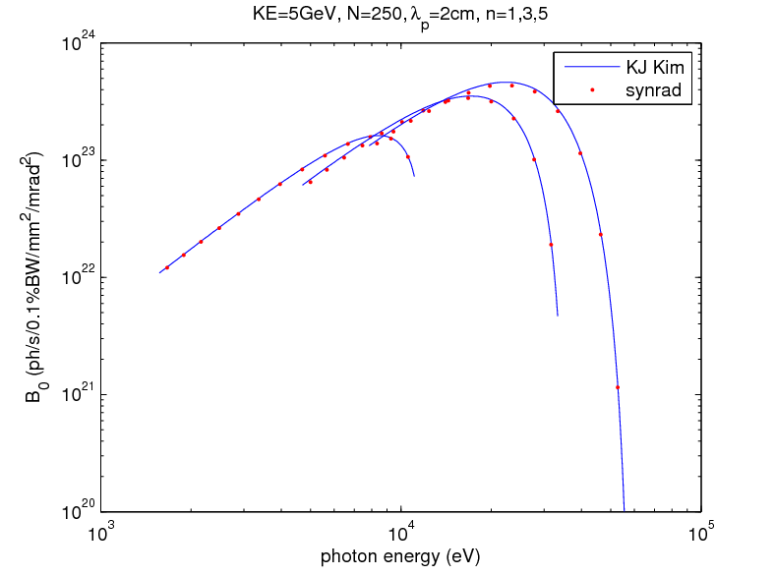
Checking on-axis 4D brightness

Slide 47
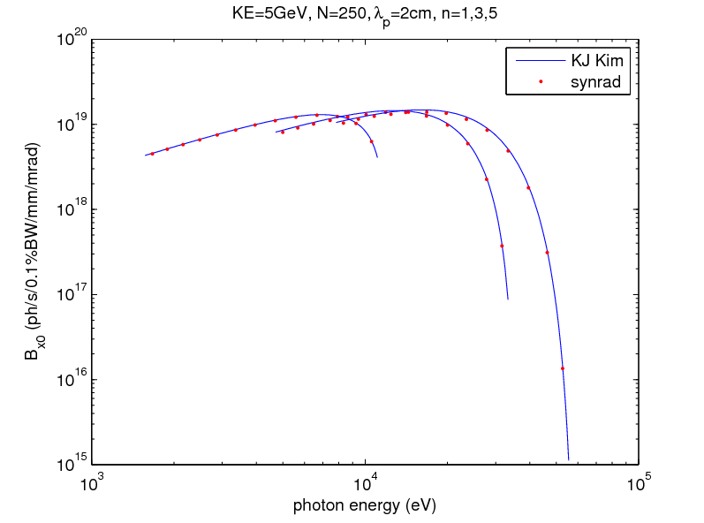
Checking on-axis 2D brightness

Slide 48
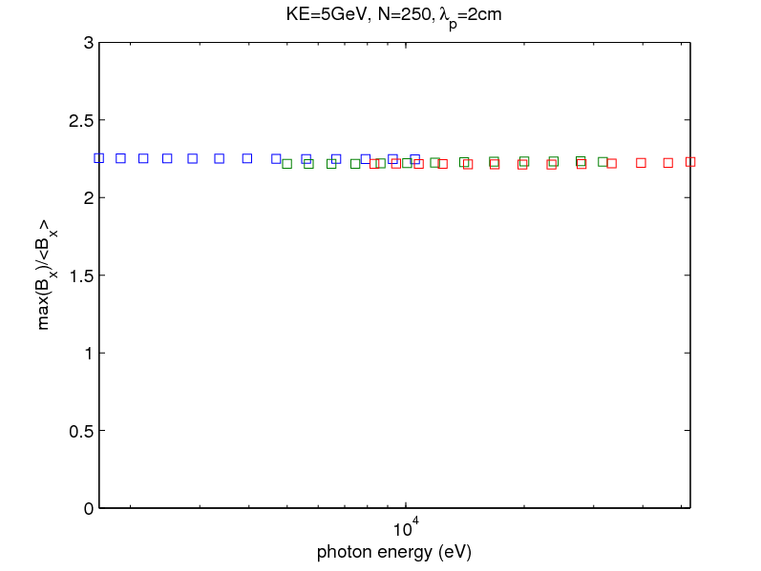
On-axis over average 2D brightness

Slide 49
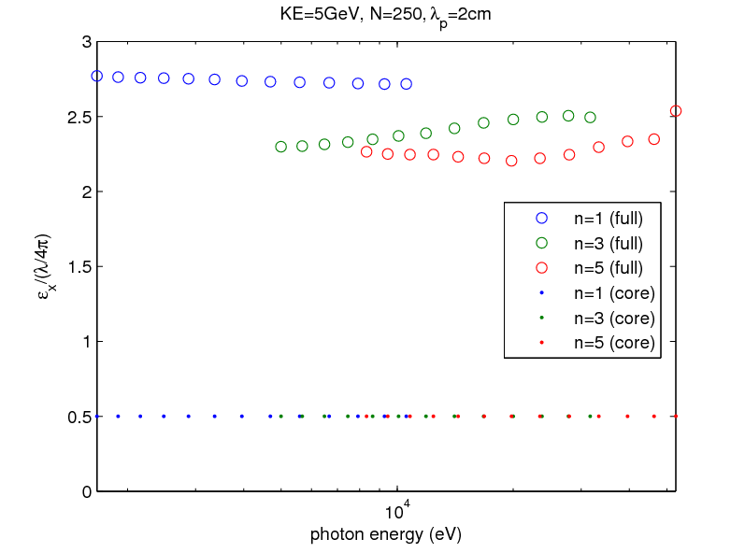
Light emittance

Slide 50
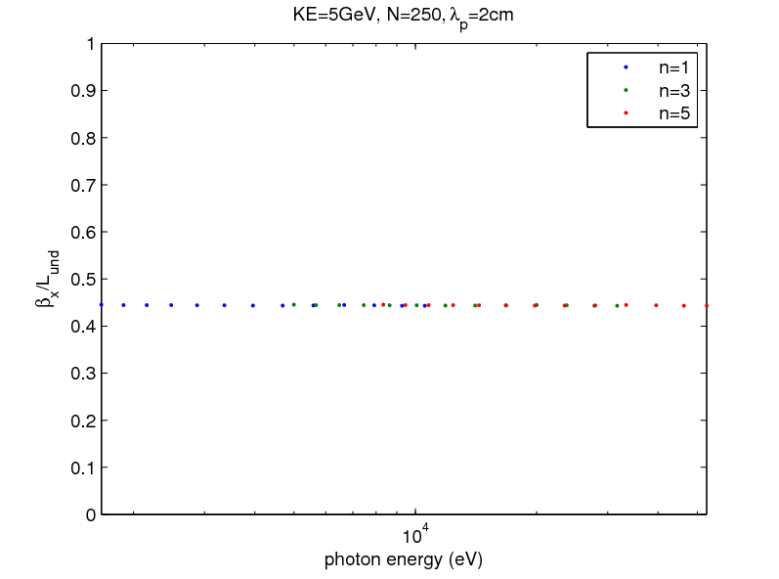
Optimal beta function

Slide 51
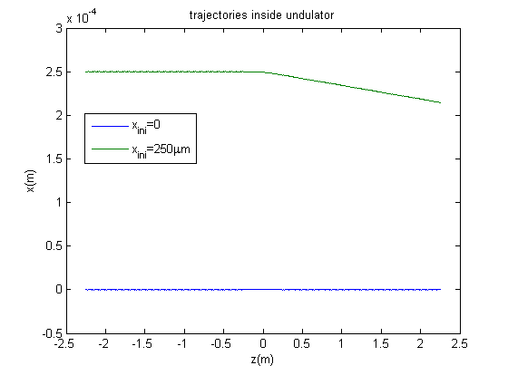
2 segments, N_{u}=100 each, 0.48m gap λ_{u}=2cm, B_{y} = 0.375T, E_{ph}= 9533eV 5GeV, quad 0.3m with 3.5T/m
quad
section 1
section 2

Slide 52
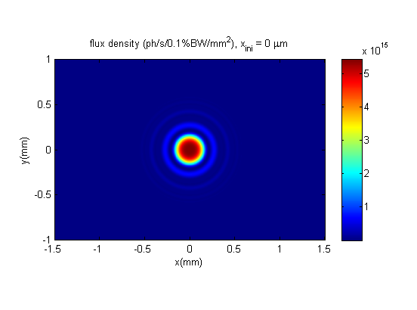
flux @ 50m

Slide 53
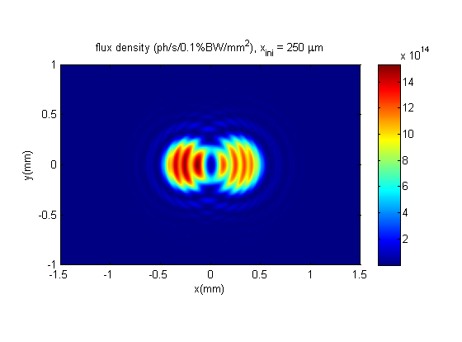
flux @ 50m

Slide 54
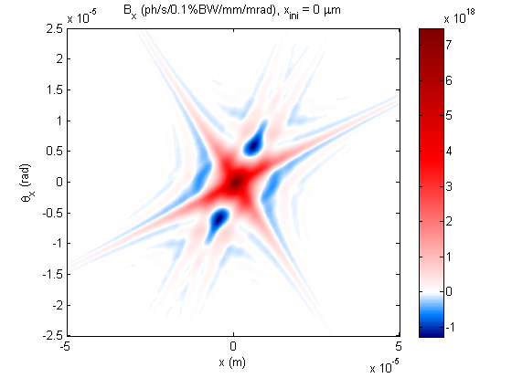

Slide 56
Conclusions
Wigner distribution is a complete way to characterize (any) partially coherent source
(Micro)brightness in wave optics is allowed to adopt local negative values
Brightness and emittance specs have not been identified correctly (for ERL) up to this point
The machinery in place can do segmented undulators, mismatched electron beam, etc.

Slide 57
Acknowledgements
Andrew Gasbarro
David Sagan

