Slide 1
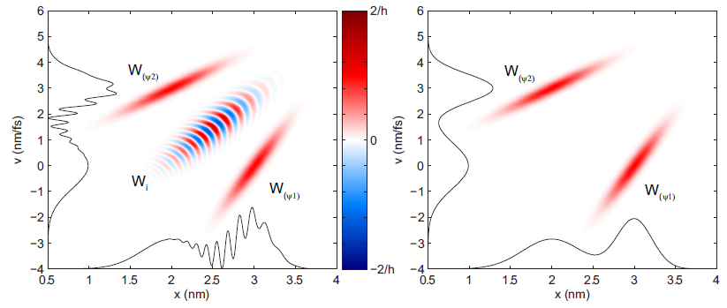
Cornell Laboratory for Accelerator-based ScienceS and Education (CLASSE)
On Maximum Brightness
from X-ray Light Sources
Ivan Bazarov
Cornell University
phase space of coherent (left) and incoherent (right) 2-state superposition

Slide 2
Some of today’s talk points
Partially coherent radiation in phase space: revisiting what brightness really is
Few words about rms emittance: introduction of a more appropriate metric (emittance vs. fraction)
My view on SR vs ERL comparison

Slide 3
Comparison metrics?
Cost (capital, operational)
Upgradeability
Time structure (pulse length, rep rate)
Brightness (maximize useful flux)
  Efficient use of undulators (low beam spread, flexible matching)
  Optics heat load (minimize total flux)

Slide 4
Comparison metrics?
Cost (capital, operational)
Upgradeability
Time structure (pulse length, rep rate)
Brightness (maximize useful flux)
  Efficient use of undulators (low beam spread, flexible matching)
  Optics heat load (minimize total flux)
Do we understand physics of x-ray brightness?
Is diffraction limit same as full transverse coherence?
How to account for non-Gaussian beams (both e– and γ)?

Slide 5
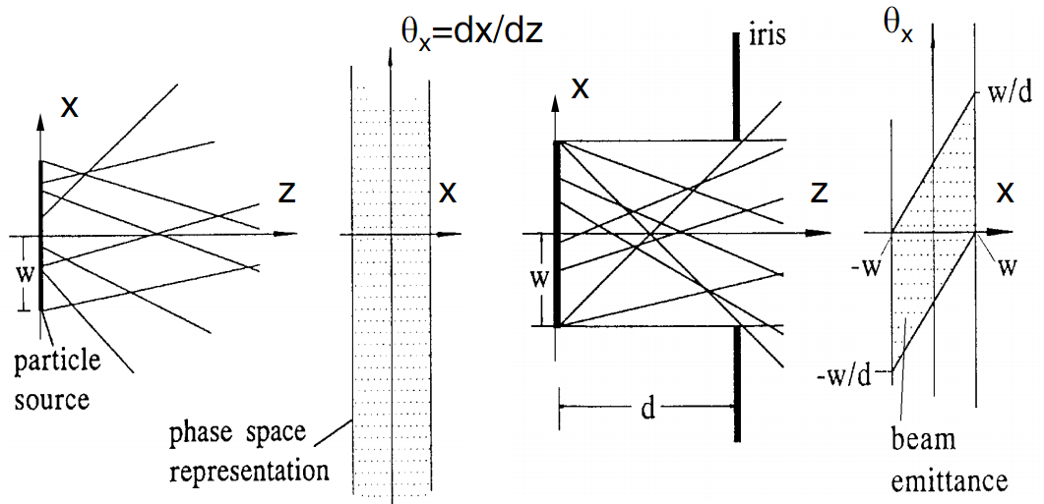
Brightness: geometric optics
Rays moving in drifts and focusing elements
Brightness = particle density in phase space (2D, 4D, or 6D)

Slide 6
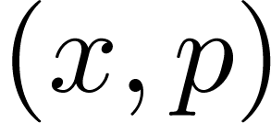
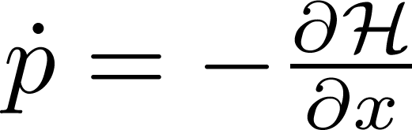
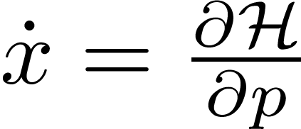
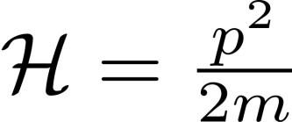
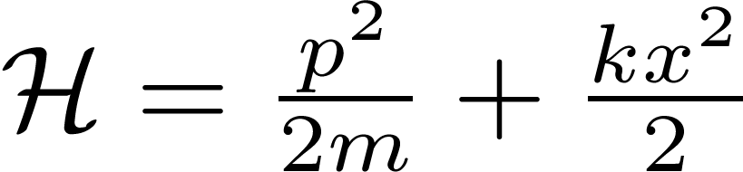
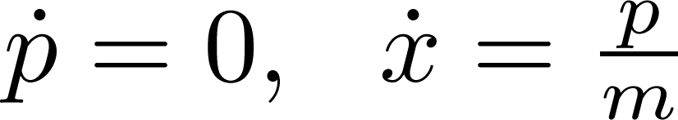
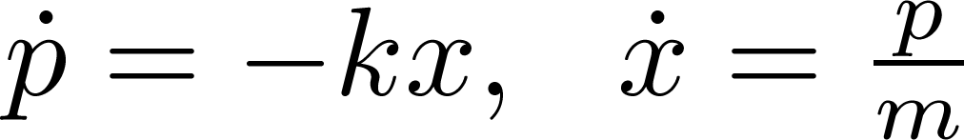
Phase space in classical mechanics
Classical: particle state
Evolves in time according to ,
E.g. drift: linear restoring force:
Liouville’s theorem: phase space density stays const along particle trajectories

Slide 7
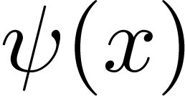
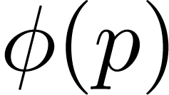
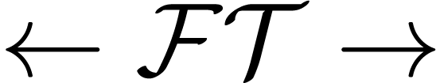
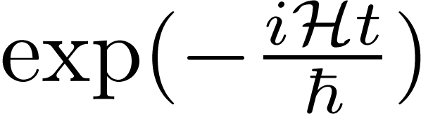
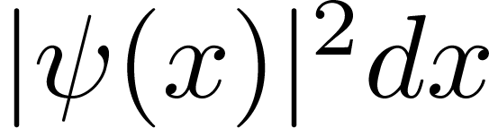
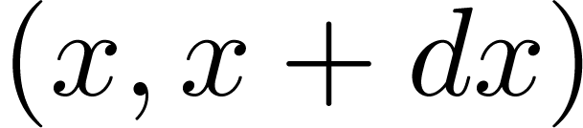
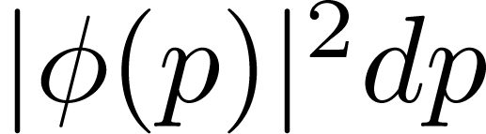
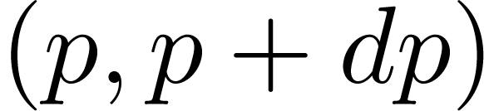
Phase space in quantum physics
Quantum state:
or
Position space momentum space
If either or is known – can compute anything. Can evolve state using time evolution operator:
- probability to measure a particle with
- probability to measure a particle with

Slide 8
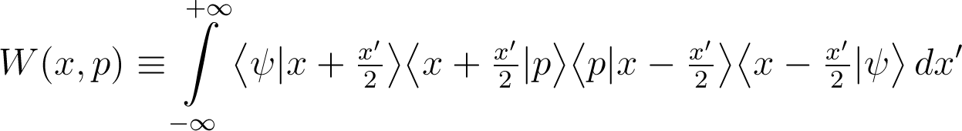
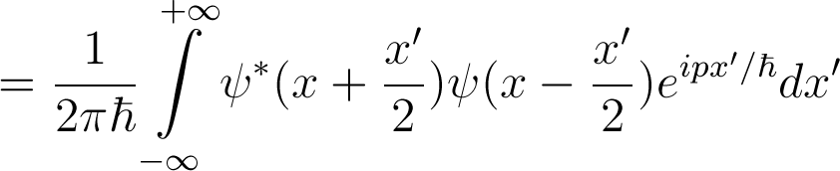
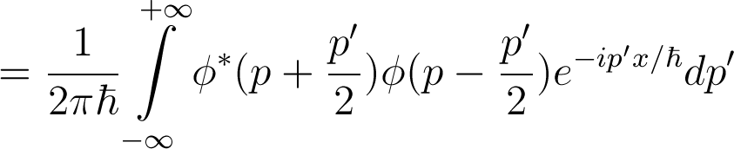



Wigner distribution
– (quasi)probability of measuring quantum particle with and

Slide 9
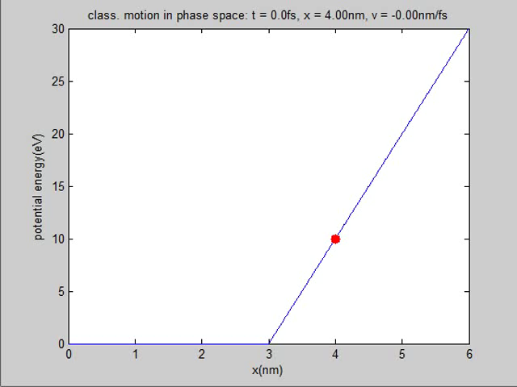
Classical electron motion in potential
Animation: click to play

Slide 10
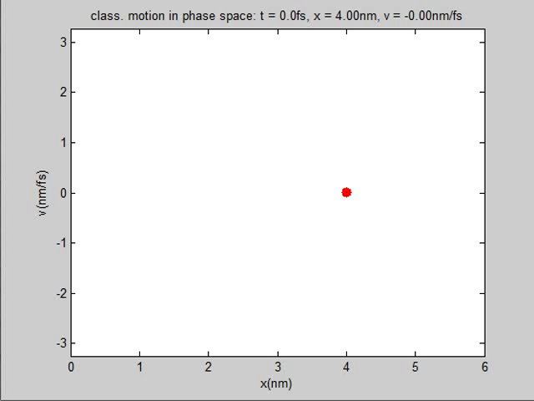
Same in phase space…
Animation: click to play

Slide 11
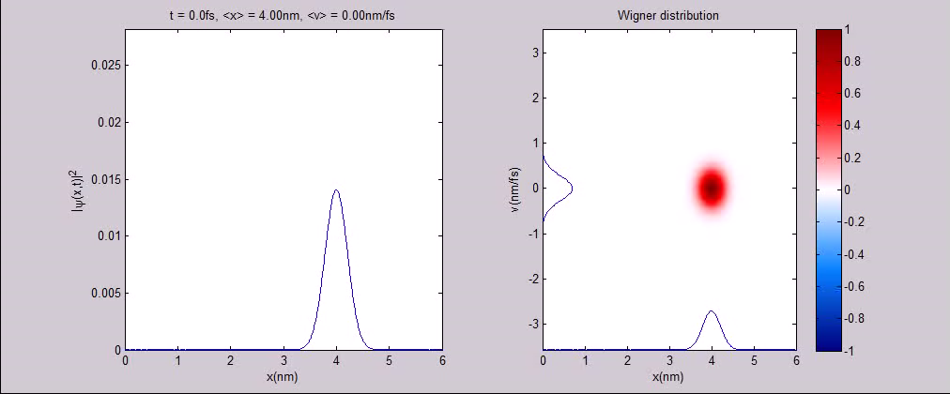
Going quantum in phase space…
Animation: click to play

Slide 12

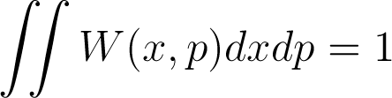
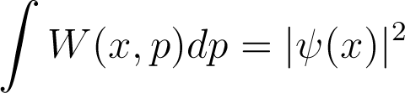
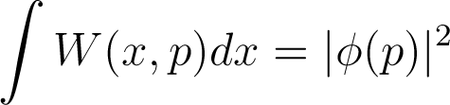

Some basic WDF properties
(can be negative)
Time evolution of is classical in absence of forces or with linear forces

Slide 13
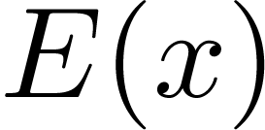
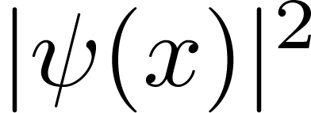
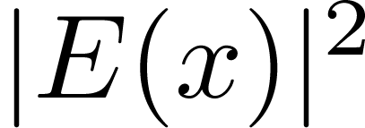
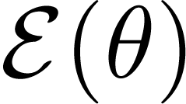
Connection to light
Quantum –
Linearly polarized light (1D) –
Measurable – charge density
Measurable – photon flux density
Quantum: momentum representation is FT of
Light: far field (angle) representation is FT of

Slide 14



Connection to classical picture
Quantum: , recover classical behavior
Light: , recover geometric optics
or – phase space density (=brightness) of a quantum particle or light
Wigner of a quantum state / light propagates classically in absence of forces or for linear forces
Wigner density function = brightness

Slide 15



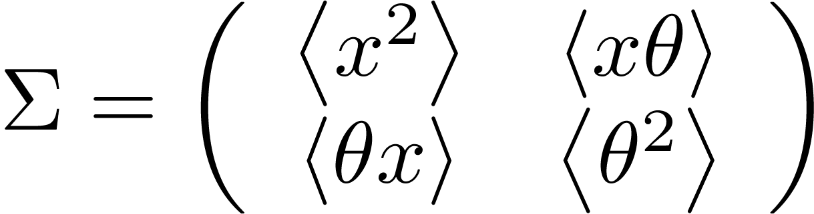
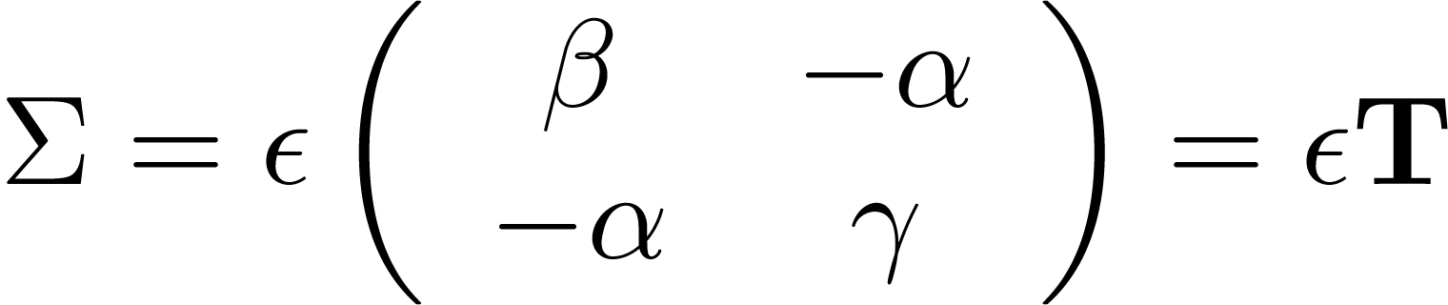
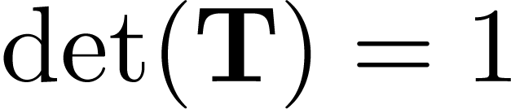
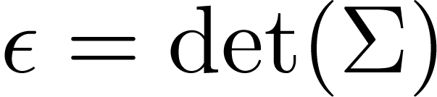
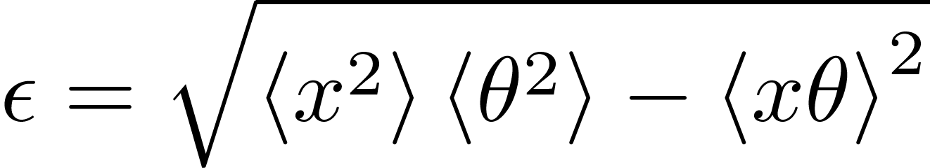
Extension of accelerator jargon to x-ray (wave) phase space
Wigner distribution
= x-ray phase space
-matrix
Twiss (equivalent ellipse) and emittance
with and or

Slide 16
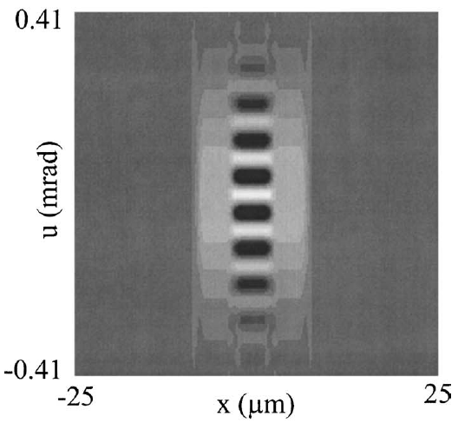
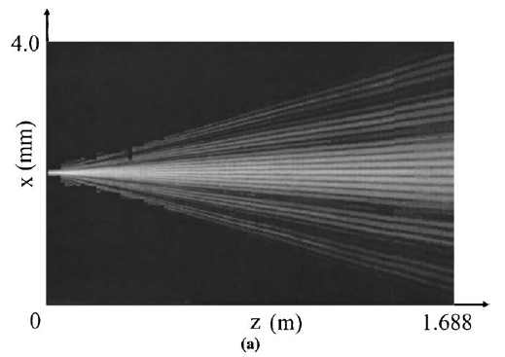
X-ray phase space can be measured using tomography
Same approach as phase space tomography in accelerators
Except the phase space is now allowed to be locally negative
x-ray phase space
detector placed at different positions
Tomography
negative
values
2μm
1.5 keV x-rays incident on a double-slit
10μm
C.Q. Tran et al., JOSA A 22 (2005) 1691

Slide 17

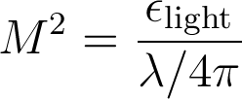
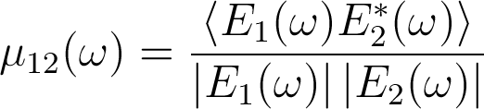
Diffraction limit vs. coherence
Diffraction limit (same as uncertainty principle)
  M² ≥ 1 (ability to focus to a small spot)
  a classical counterpart exists (= e-beam emittance)
Coherence (ability to form interference fringes)
  Related to visibility or spectral degree of coherence
  0 ≤ |μ₁₂| ≤ 1
  quantum mechanical in nature – no classical counterpart exists
Wigner distribution contains info about both!

Slide 18
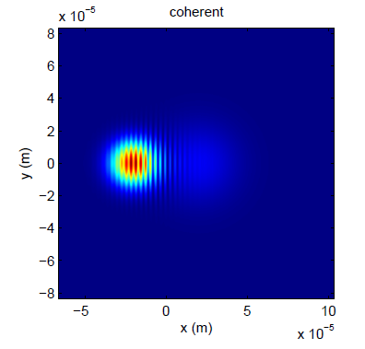
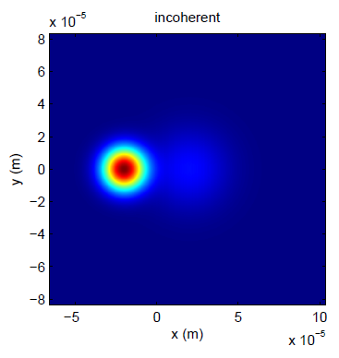
Example of combining sources
(coherent vs incoherent)
two laser Gaussian beams

Slide 19
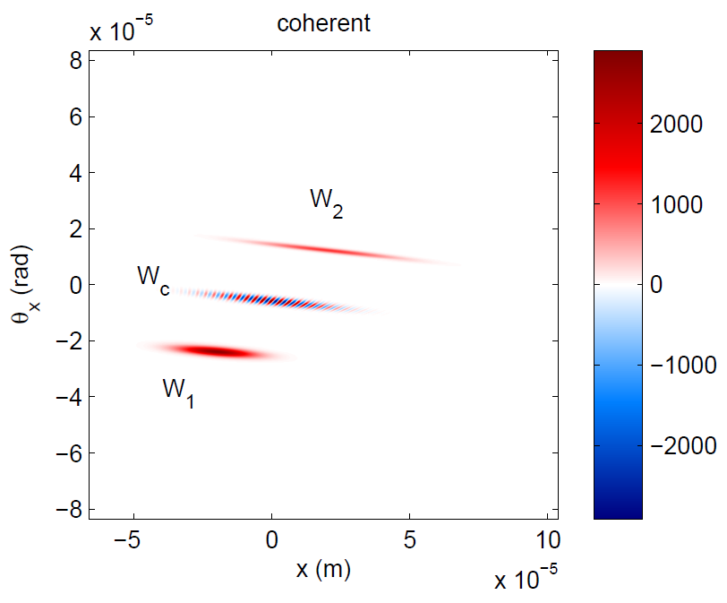
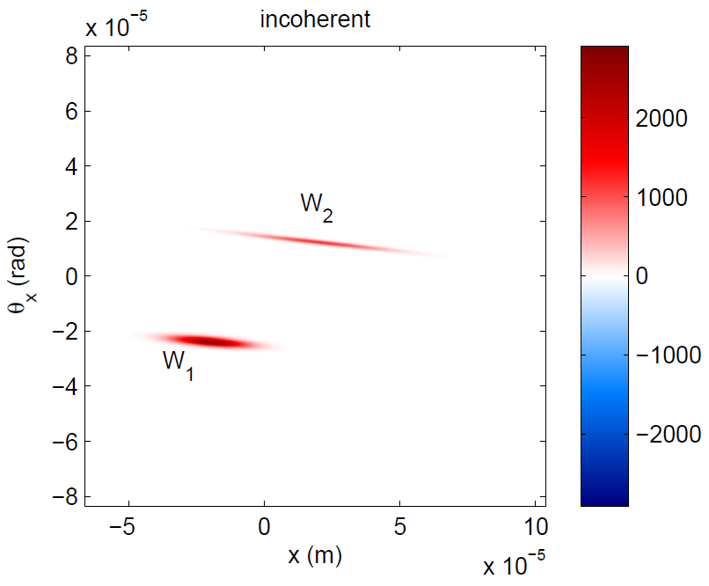
Same picture in the phase space
two laser Gaussian beams
μ² = 1
μ² < 1
M² > 1
M² > 1

Slide 20
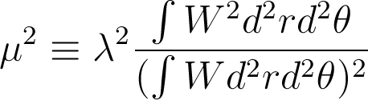
Facts of life
Undulator radiation (single electron) is fully coherent (μ² = 1)
But is not diffraction limited M² > 1
X-ray phase space of undulator’s central cone is not Gaussian
Old (Gaussian) metrics are not suitable for (almost) fully coherent sources
For more on the subject refer to
IVB, arXiV 1112.4047 (2011) (submitted to PRST-AB)

Slide 21
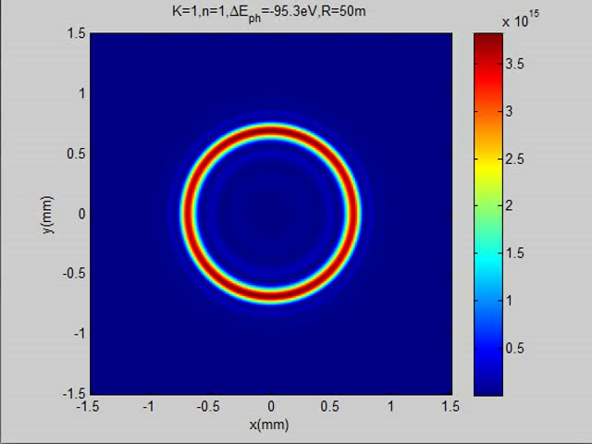
But the undulator radiation in central cone is Gaussian… or is it?
animation: scanning around 1st harm. ~6keV
(zero emittance)
Spectral flux (ph/s/0.1%BW/mm²) at 50m from undulator (5GeV, 100mA, λ_{p} = 2cm)
click to play

Slide 22
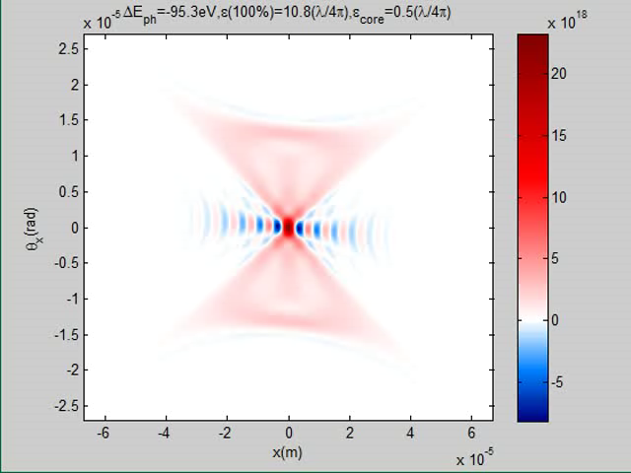
Light in phase space
animation: scanning around 1st harm. ~6keV
(zero emittance)
Phase space near middle of the undulator (5GeV, 100mA, λ_{p} = 2cm)
click to play

Slide 23
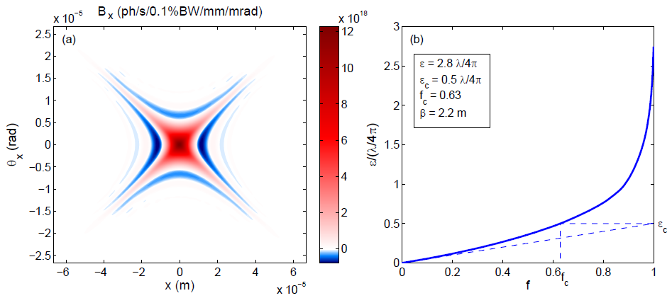
Emittance vs. fraction for light
Change clipping ellipse area from ∞ to 0, record emittance vs. beam fraction contained
Smallest M² ~ 3 of x-ray undulator cone (single electron), core much brighter

Slide 24
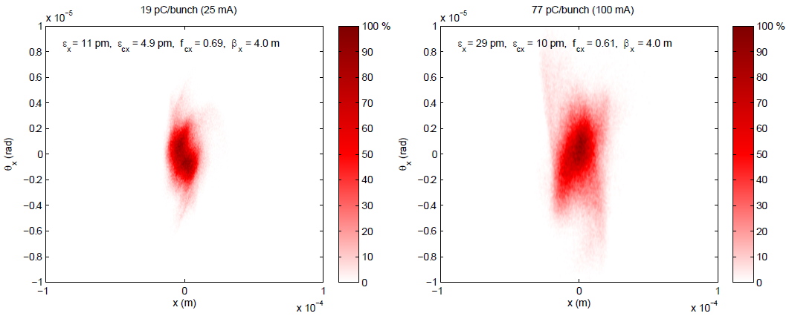
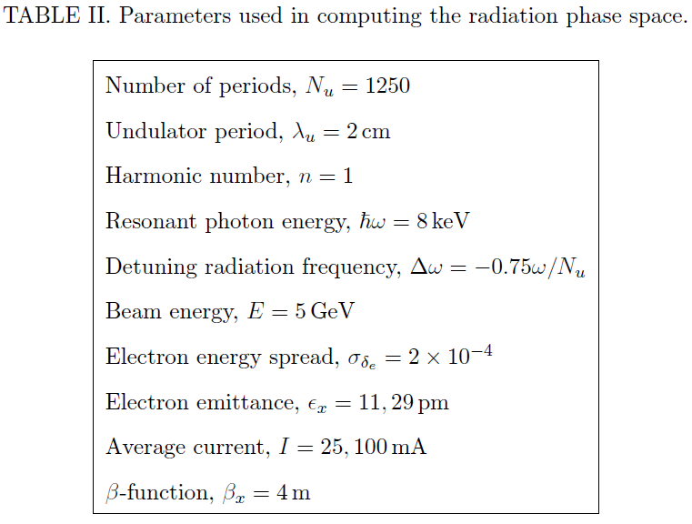
Exampe of accounting for realistic spreads in the electron beam
e-beam phase space at undulator 25mA
e-beam phase space at undulator 100 mA

Slide 25
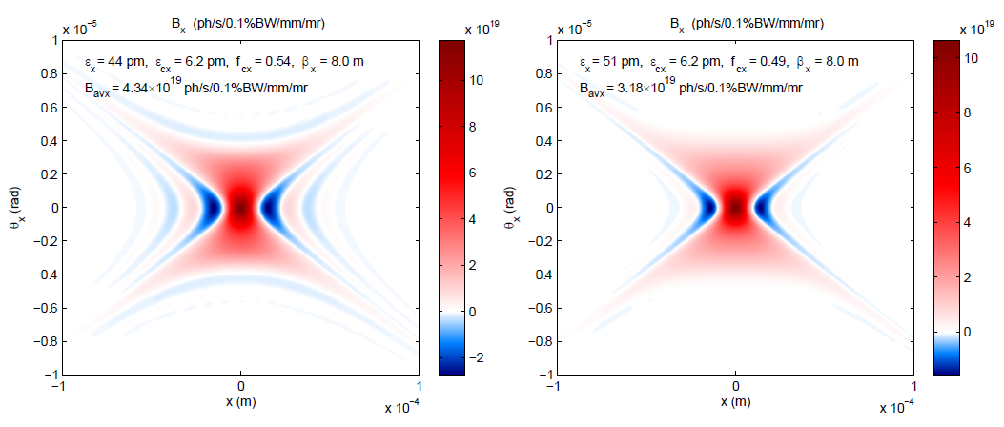
Accounting for energy spread
(phase space of x-rays)
zero emittance, zero energy spread
zero emittance, 2x10^{–4} energy spread

Slide 26

And finite emittance…
(phase space of x-rays)

Slide 27
Back to the comparison
TODAY: Cornell ERL photoinjector project has already achieved beam brightness that at 5 GeV would be equivalent to 100mA 0.5nm-rad × 0.005nm-rad storage ring Gaussian beam
TOMORROW: both technologies (SR and ERL) can reach diffraction limited emittances at 100mA
SR can easily do several 100’s mA (x-ray optics heat load??), ERLs not likely (less appealing for several reason)
ERL is better suited for very long undulators (small energy spread) and Free-Electron-Laser upgrades (using its CW linac)

Slide 28

Simultaneous short pulses and generic ERL running
Initial analysis to meet XFELO specs shows it’s doable using non-energy recovered beamline
Simultaneous operation of the two sources (100mA and 100μA appears feasible)
<0.5 MW dump
<100 μA source
BC1
BC2
100pC@1MHz
or less
500 MeV
5 GeV
80 m long undulator or ID farm
3rd harmonic linearizer
100 mA source

Slide 29
Conclusions
Few people do correct brightness calculations (there are a lot fewer Gaussians than one might be imagining); proper procedure discussed (more in arXiV 1112.4047)
Both technologies can deliver super-bright x-rays with a CW SRF linac of ERL having an edge for FEL techniques
Can a future source be made more affordable?? Cost of ~billion should be a hard cutoff in my opinion (including beamlines)

