Slide 1
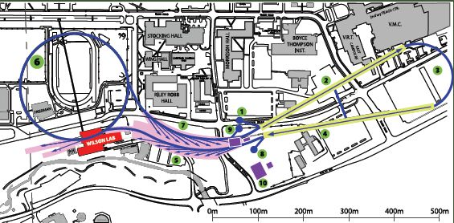
Cornell Laboratory for Accelerator-based ScienceS and Education (CLASSE)
ERL R&D Update
Ivan Bazarov
Cornell University
Significant milestones reached for an ERL based x-ray source
Photoelectron source
RF superconductivity

Slide 2
Cornell ERL team
D. H. Bilderback, M. G. Billing, J. D. Brock, B. W. Buckley, S. S. Chapman, E. P. Chojnacki, Z. A. Conway, J. A. Crittenden, D. Dale, J. A. Dobbins, B. M. Dunham, R. D. Ehrlich, M. P. Ehrlichman, K. D. Finkelstein, E. Fontes, M. J. Forster, S. W. Gray, S. Greenwald, S. M. Gruner, C. Gulliford, D. L. Hartill, R. G. Helmke, G. H. Hoffstaetter, A. Kazimirov, R. P. Kaplan, S. S. Karkare, V. O. Kostroun, F. A. Laham, Y. H. Lau, Y. Li, X. Liu, M. U. Liepe, F. Loehl, L. Cultrera, C. E. Mayes, J. M. Maxson, A. A. Mikhailichenko, D. Ouzounov, H. S. Padamsee, S. B. Peck, M. A. Pfeifer, S. E. Posen, P. G. Quigley, P. Revesz, D. H. Rice, D. C. Sagan, J. O. Sears, V. D. Shemelin, D. M. Smilgies, E. N. Smith, K. W. Smolenski, A. B. Temnykh, M. Tigner, N. R. A. Valles, V. G. Veshcherevich, Z. Wang, A. R. Woll, Y. Xie, Z. Zhao
+ collaborators from other institutions

Slide 3
Cornell ERL R&D effort
CHESS
X-ray science case (XDL’11 series of 6 workshops in Ithaca, NY for diffraction limited X-rays), undulator R&D, ERL facility planning
SRF group
Manufactured the first main linac 7-cell cavities, main linac cryomodule prototype
ERL photoinjector facility
Operating the world’s highest current and brightness CW photoinjector
Gun & cathode development lab
Laser lab, Mark-II gun under construction, material science & engineering of high efficiency photocathodes

Slide 4
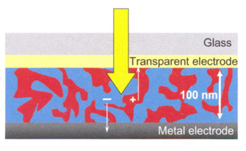
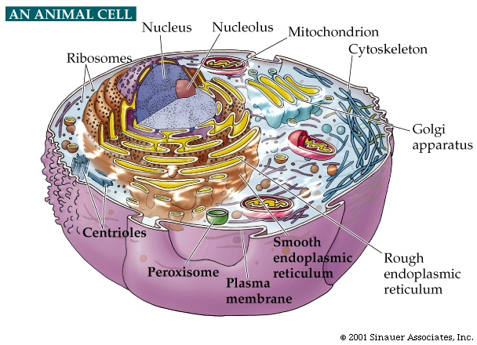
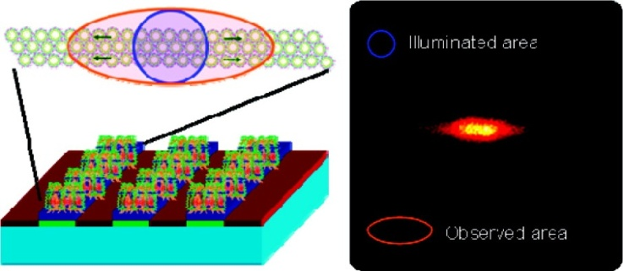
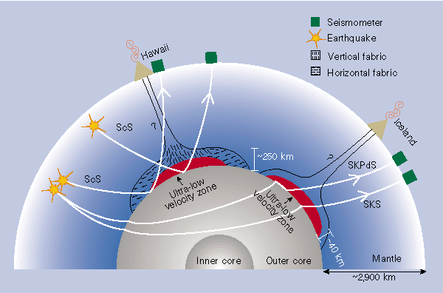
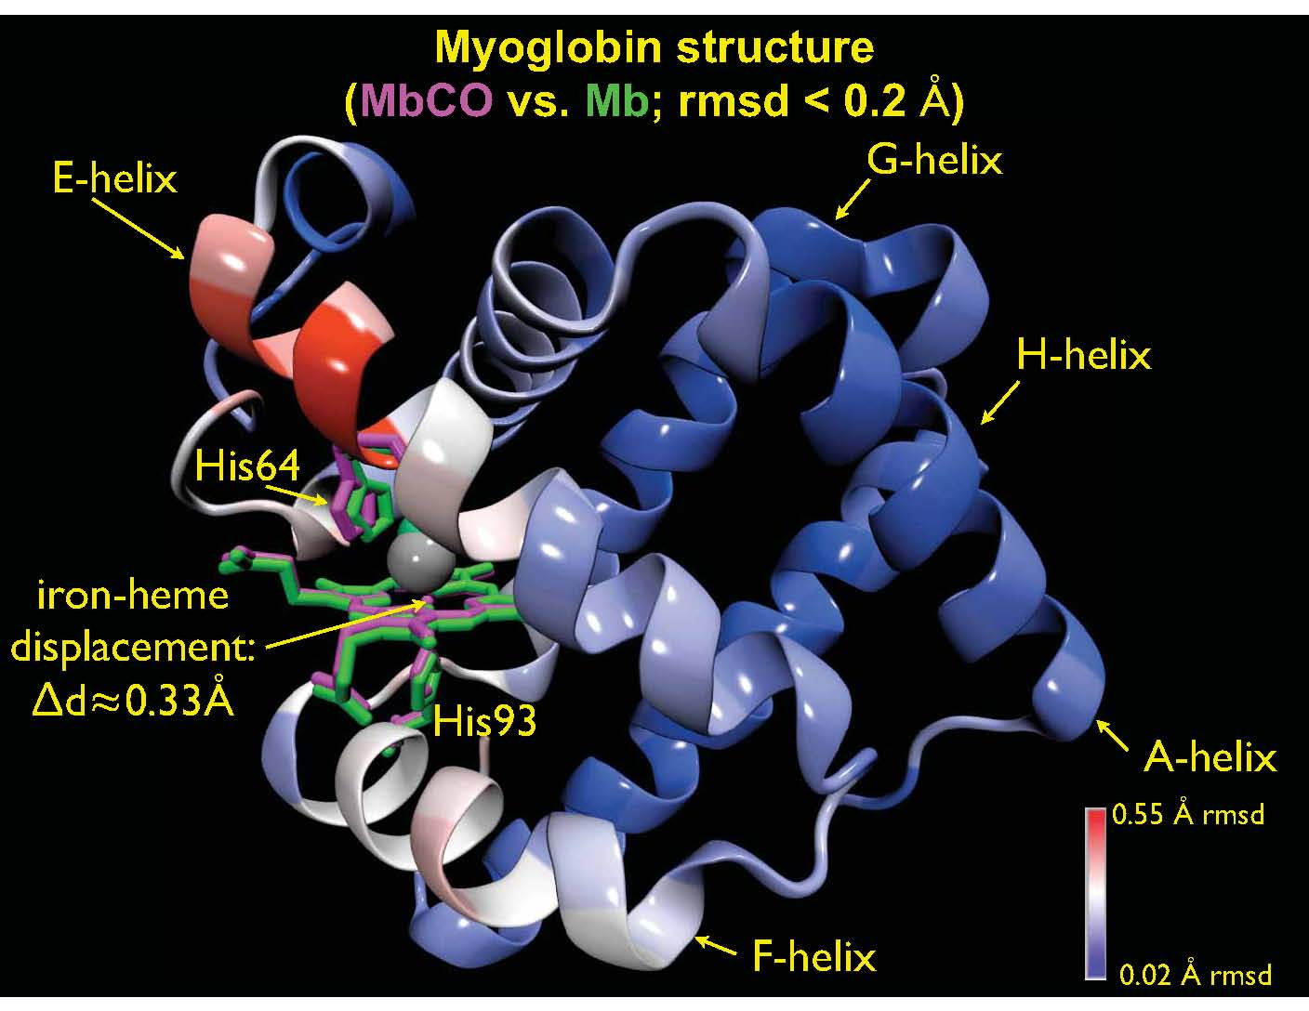
Progress in ERLs for Light Sources
XDL’11 workshops – exciting science enabled by X-ray ERLs
Beyond existing brightest x-ray sources
CDI
XDM
Tickle-Probe
SAXS/WAXS @ sub-ps
IXS

Slide 5
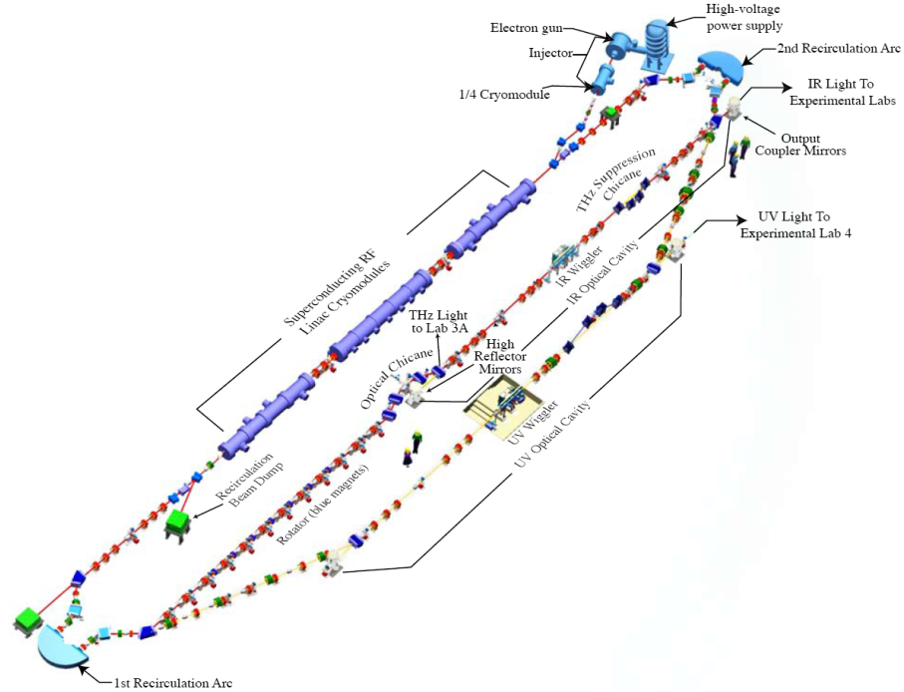
Progress in ERLs for Light Sources
Operations at JLAB

Slide 6
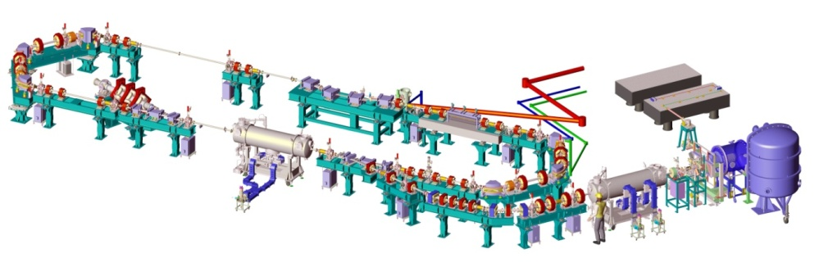
Progress in ERLs for Light Sources
Operations at JLAB, Daresbury,

Slide 7
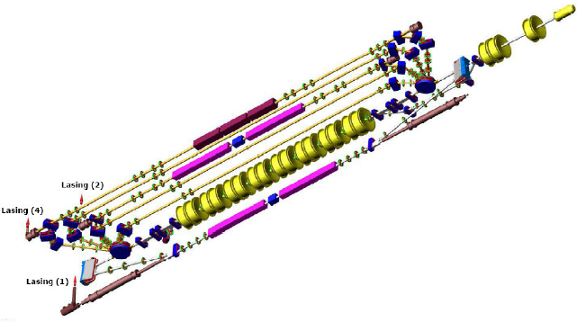
Progress in ERLs for Light Sources
Operations at JLAB, Daresbury, BINP

Slide 8
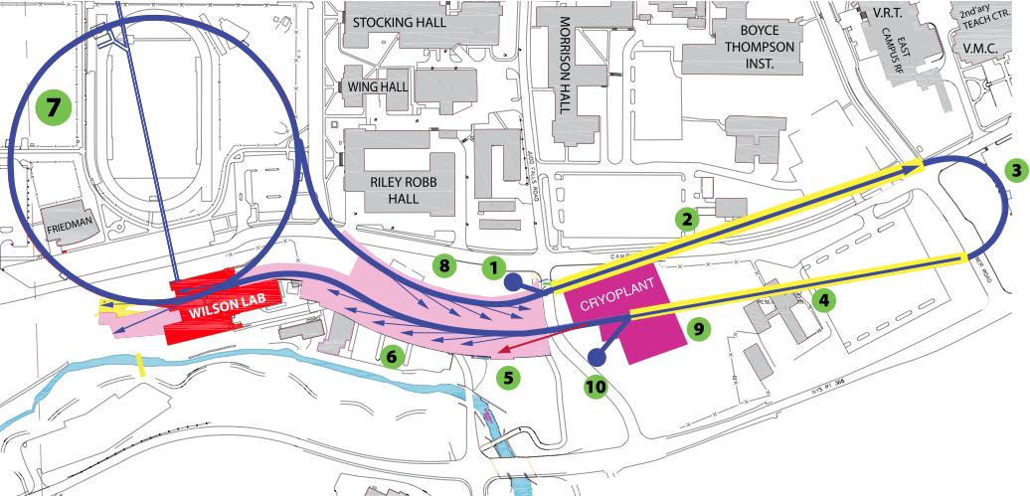
Progress in ERLs for Light Sources
Operations at JLAB, Daresbury, BINP
Designs at Cornell

Slide 9
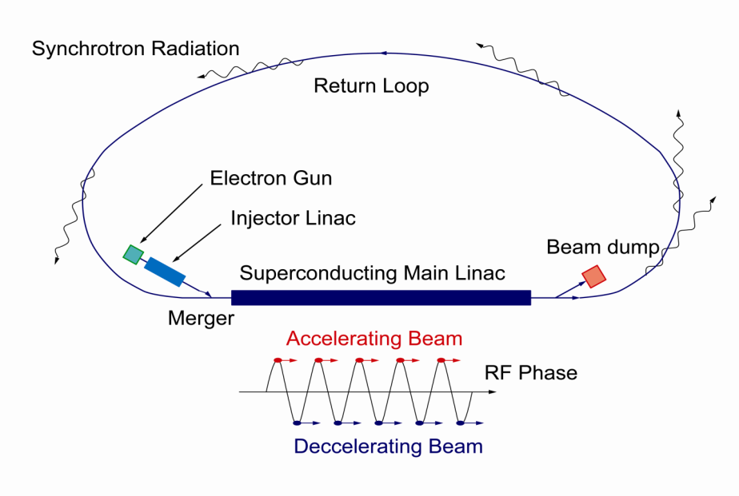
Progress in ERLs for Light Sources
Operations at JLAB, Daresbury, BINP
Designs at Cornell, KEK/JAEA
7GeV
Double Acc.
3GeV ERL
First Stage
XFEL-O Second Phase
9

Slide 10
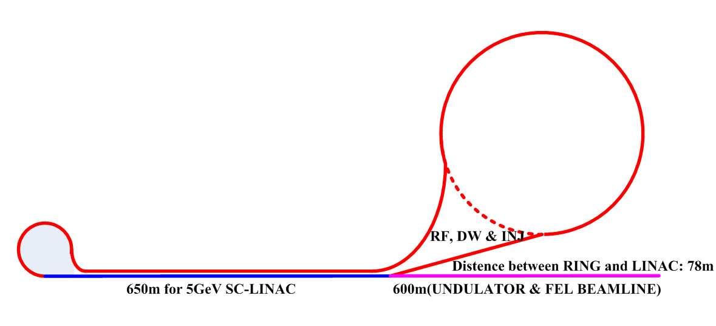
Progress in ERLs for Light Sources
Operations at JLAB, Daresbury, BINP
Designs at Cornell, KEK/JAEA, BAPS
7GeV
Double Acc.
3GeV ERL
First Stage
XFEL-O Second Phase
10
Notes:
BAPS = Beijing Advanced Photon Source

Slide 11
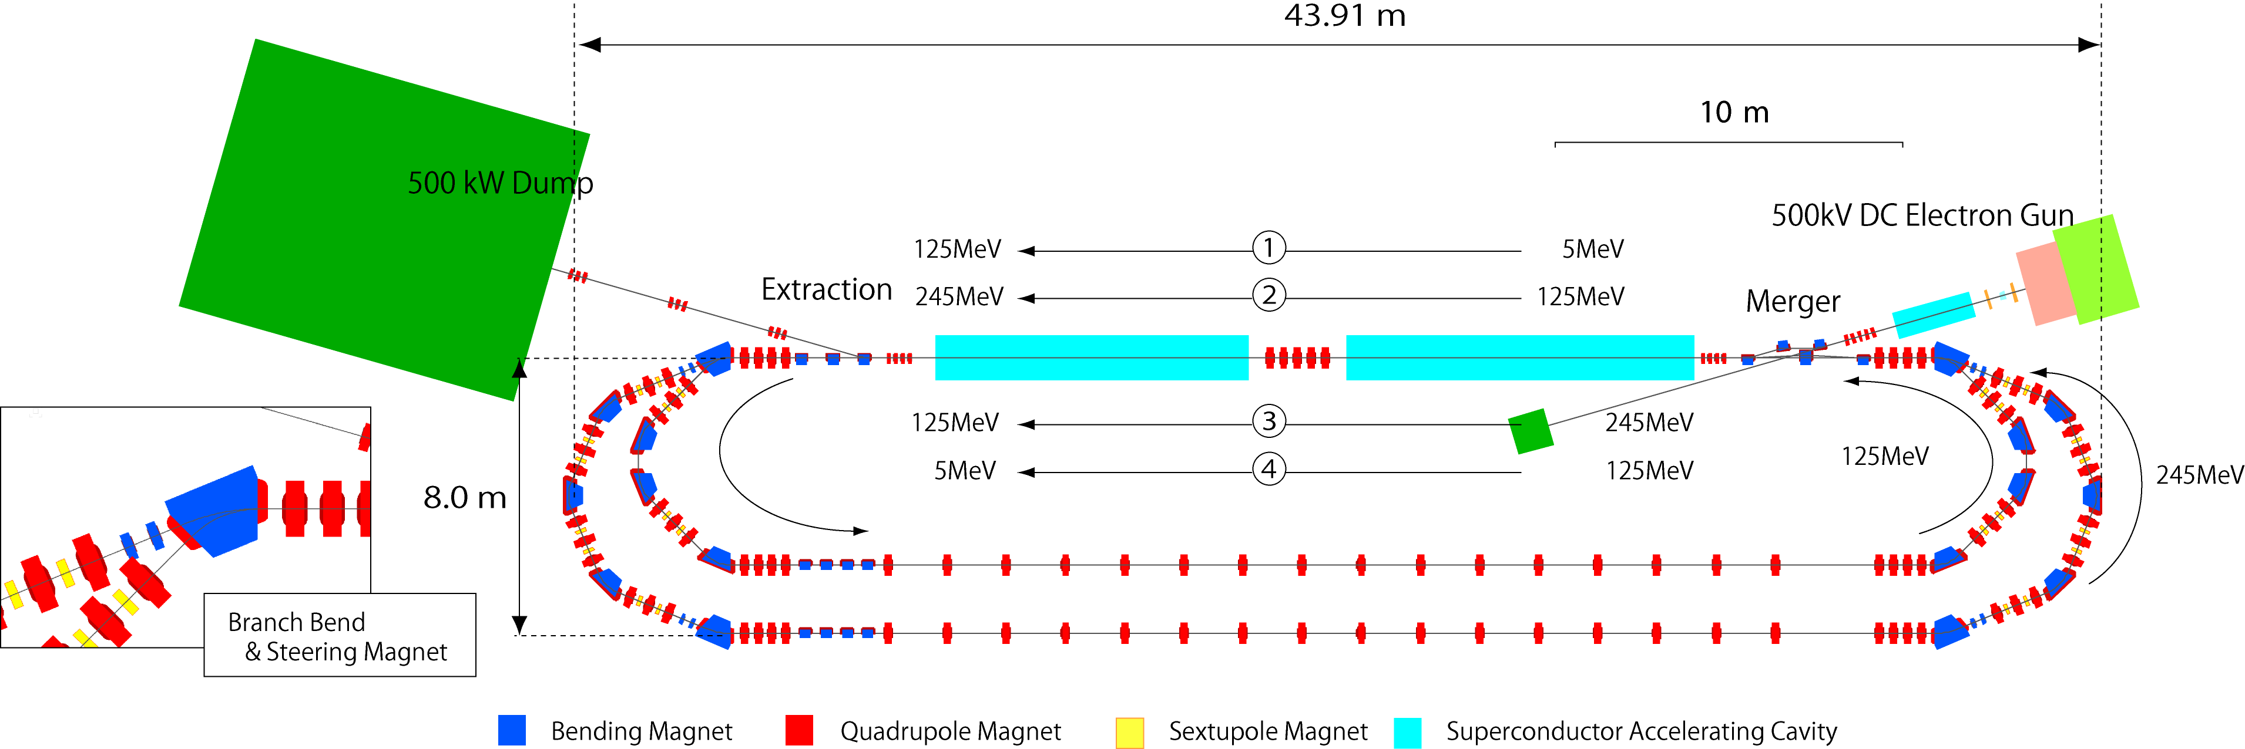
Progress in ERLs for Light Sources
Operations at JLAB, Daresbury, BINP
Designs at Cornell, KEK/JAEA, BAPS
Test loops at KEK
7GeV
Double Acc.
3GeV ERL
First Stage
XFEL-O Second Phase
11

Slide 12
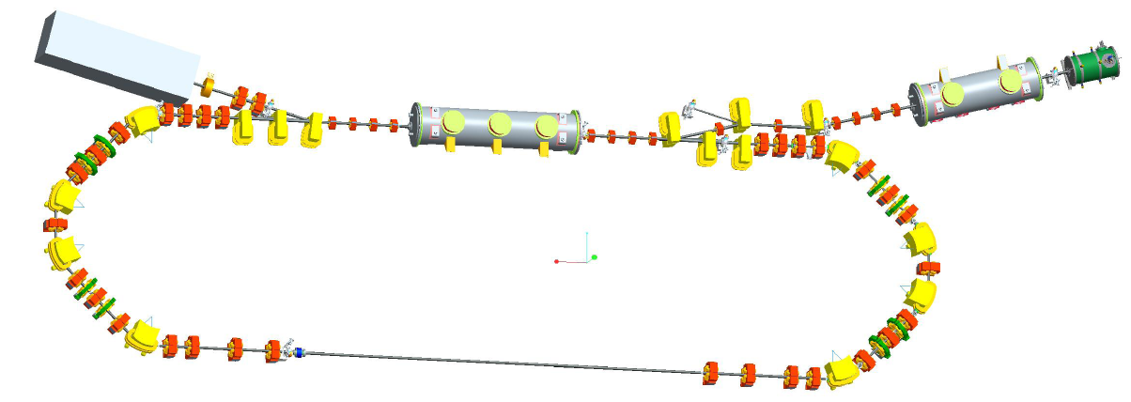
Progress in ERLs for Light Sources
Projects, projects, projects … progress
Envisioned, developed,
Operations at JLAB, Daresbury, BINP
Designs at Cornell, KEK/JAEA, BAPS
Test loops at KEK, HZB
7GeV
Double Acc.
3GeV ERL
First Stage
XFEL-O Second Phase
12

Slide 13
Progress in ERLs for Light Sources
Projects, projects, projects … progress
Envisioned, developed, operational
Operations at JLAB, Daresbury, BINP
Designs at Cornell, KEK/JAEA, BAPS
Test loops at KEK, HZB, IHEP
7GeV
Double Acc.
3GeV ERL
First Stage
XFEL-O Second Phase
13
Notes:
IHEP = Institute of High Energy Physics in China

Slide 14
ERL X-ray source R&D
Essentials
Superconducting RF (high Q₀ , Q_{L} for low operation cost; HOM damping for > 100mA; cost-efficient cryomodule design & fabrication)
Photoinjector (demonstrate high current, longevity, brightness)
Generic facility strawman (undulators, beamline, magnets, power budget, cryoplant)
And beyond
Multi-turn designs (depends on how cheap/efficient SRF can be made)
Marry XFEL solutions (simultaneous low rep rate beam operation with high current – e.g. KEK design)

Slide 15
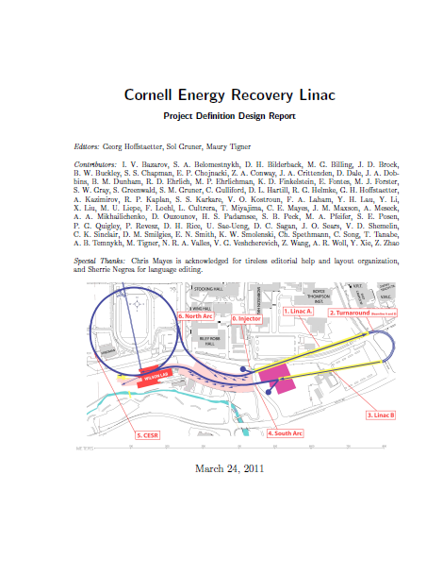
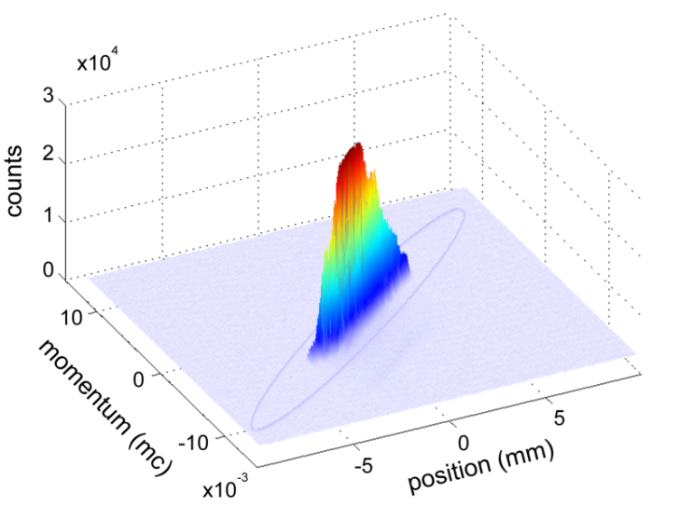
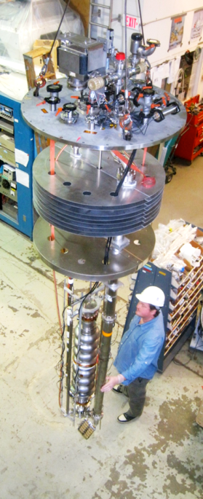
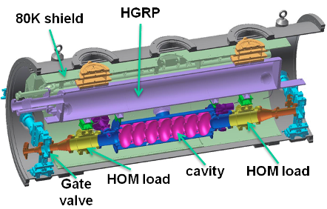
Milestones reached at Cornell in 2011/12
In all of the following:
Superconducting RF (high Q₀ , Q_{L} for low operation cost; HOM damping for > 100mA; cost-efficient cryomodule design & fabrication)
Photoinjector (demonstrate high current, longevity, brightness)
Generic facility strawman (undulators, beamline, magnets, power budget, cryoplant)
http://news.chess.cornell.edu/index.html

Slide 16
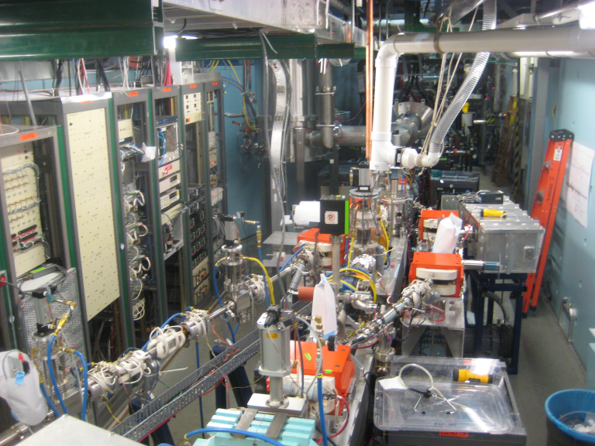
Frontier photoinjector work @ Cornell
Pushing the state-of-the-art: 10MeV photoinjector
Now world’s highest brightness and current photoelectron source
20m
world‘s highest brightness photoinjector

Slide 17
Cornell photoinjector highlights
Over the last year:
Maximum average current of 52 mA from a photoinjector demonstrated
Demonstrated feasibility of high current operation (> kiloCoulomb 1/e lifetime from the same laser spot)
measured beam brightness already would surpass any existing storage ring if 5 GeV energy recovery linac were to be built today
Clear path exists for further improvements
Better photocathodes will result in brighter beams
The photoinjector itself was built to be future-looking R&D machine with highly optimized performance (yet to be fully realized)

Slide 18
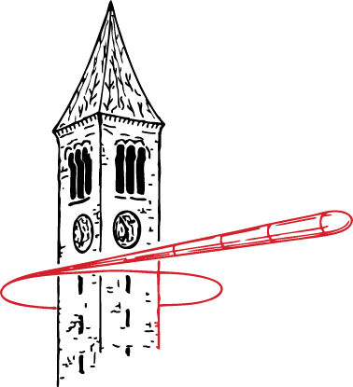
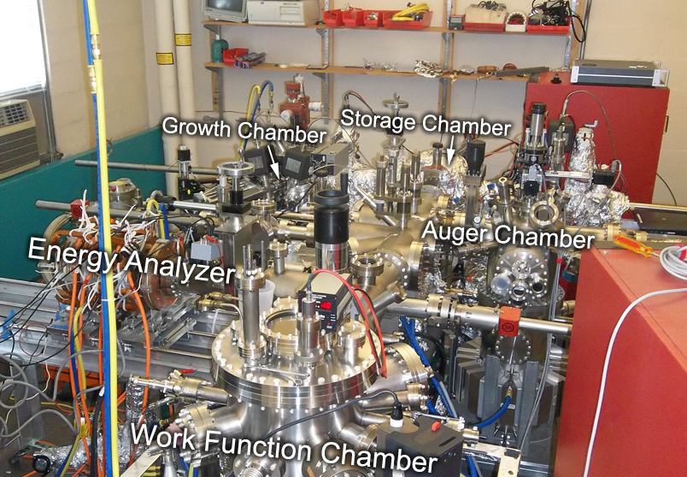
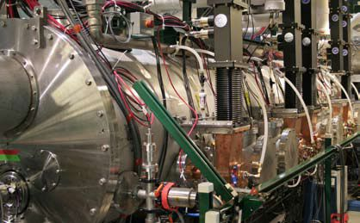
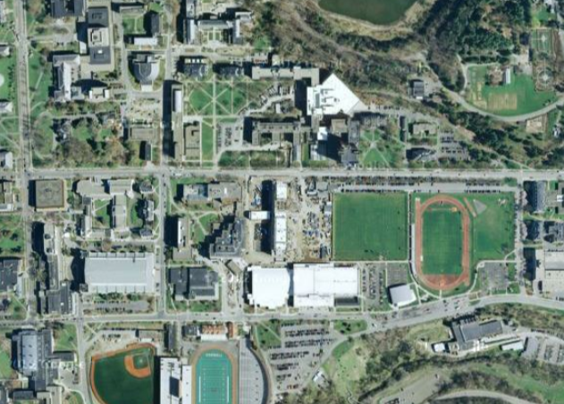
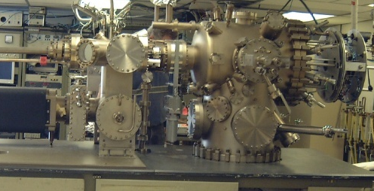
Developing advanced photocathodes for accelerators
over in Newman Lab
over in Wilson Lab
actual accelerator
antimonide growth & analysis chamber
over in Phillips Hall
Newman
Phillips
Wilson
dedicated MBE system

Slide 19
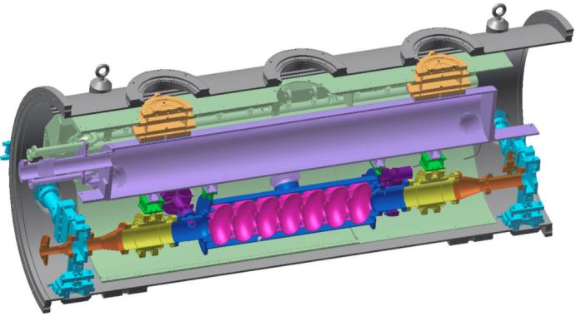
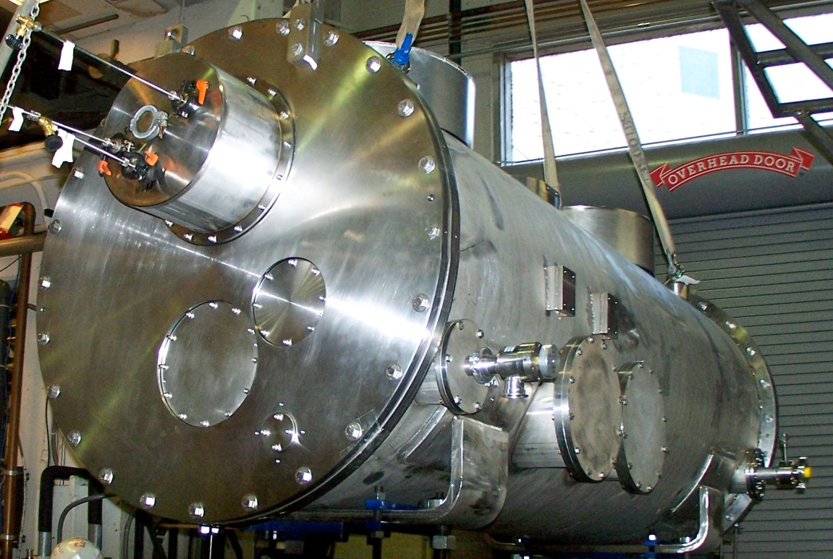
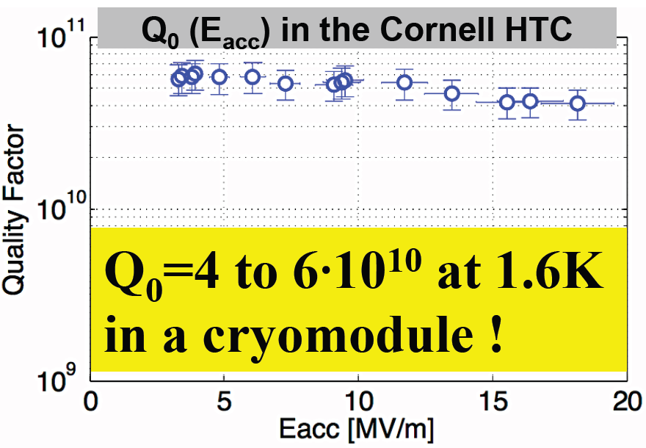
SRF milestone: high Q₀ for efficient operation of future high current accelerators!
80K shield
HGRP
Cornell Horizontal Test Cryomodule:
Dedicated to high Q₀ studies
Goal: show that (and how) high Q₀ can be maintained when cavity is installed in cryomodule
Reached Q₀ > 4x10¹⁰ in first test
>50% improved efficiency!
HOM load
cavity
HOM load
Gate valve
Operational goal for ERL: 2x10¹⁰

Slide 20
Conclusions
World-wide interest in super-bright ERL x-ray source and much R&D effort underway
Cornell team is significantly ahead of the competition
2011/12 was year of many major accomplishments
ERL being redefined from a great concept to ‘it will work’ category
Much remains to be done, but no showstoppers

Slide 21
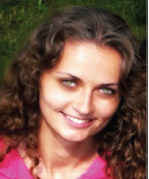
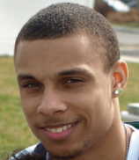
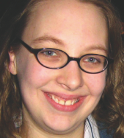
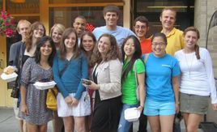
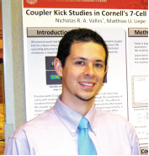
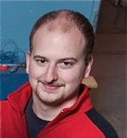
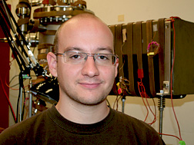
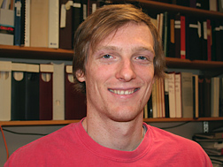
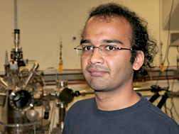
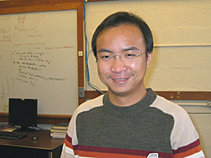
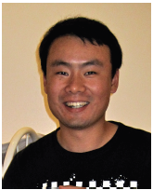
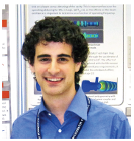
Preparing our future
2011 CLASSE summer students
PhD students
> 30 Cornell undergrads throughout academic year

