Slide 1
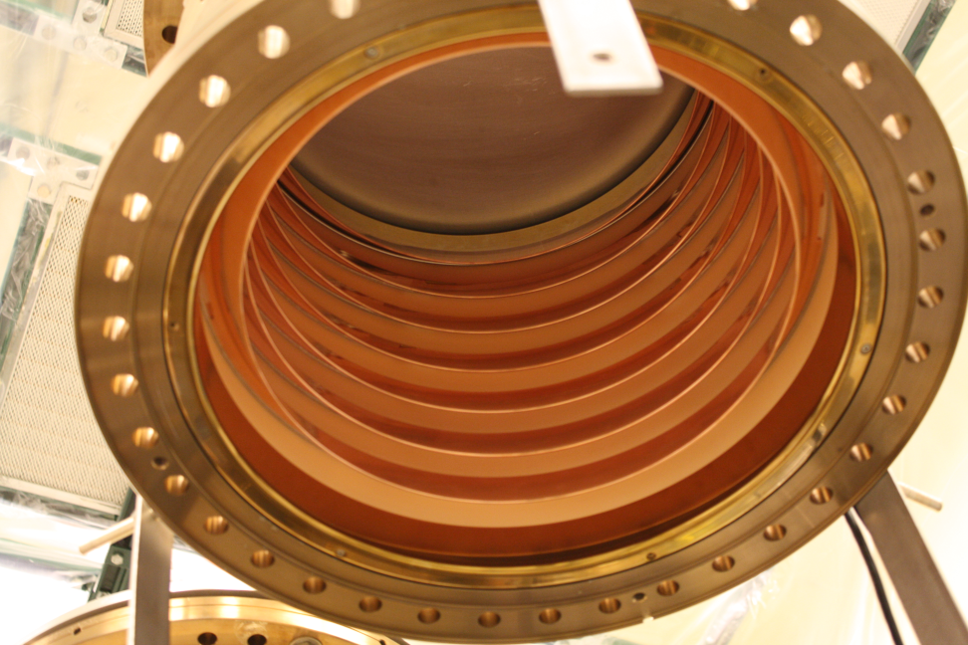
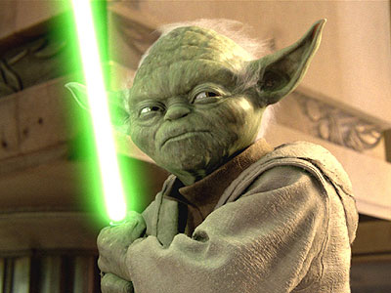

Cornell High Brightness Photoinjector: Beyond the “Star Wars”
Ivan Bazarov
Cornell University
segmented high-voltage ceramic
Notes:
In case you are wondering about the title, let me clarify right away which “Star Wars” I mean. Not the famous “in the galaxy far, far away”, but Strategic Defense Initiative also known as Star Wars.

Slide 2
Outline
Uses of high brightness beams
Physics of brightness
Photoinjectors: marriage of different fields
Cornell photoinjector for Energy Recovery Linac

Slide 3
Outline
Uses of high brightness beams
Physics of brightness
Photoinjectors: marriage of different fields
Cornell photoinjector for Energy Recovery Linac

Slide 4
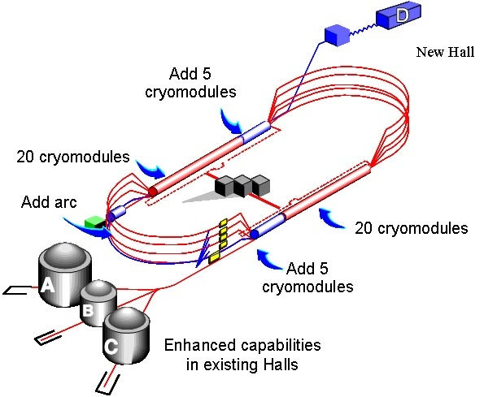
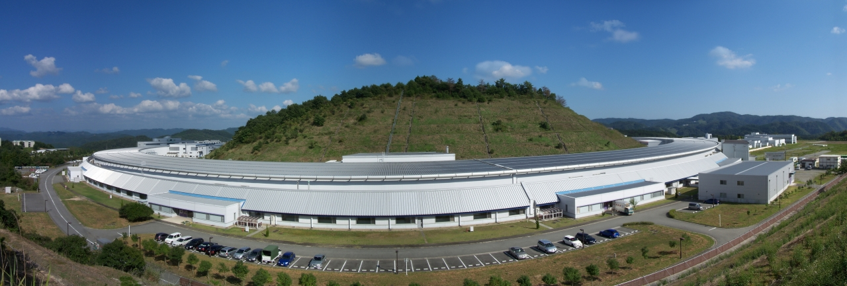
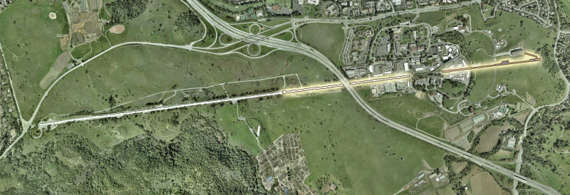
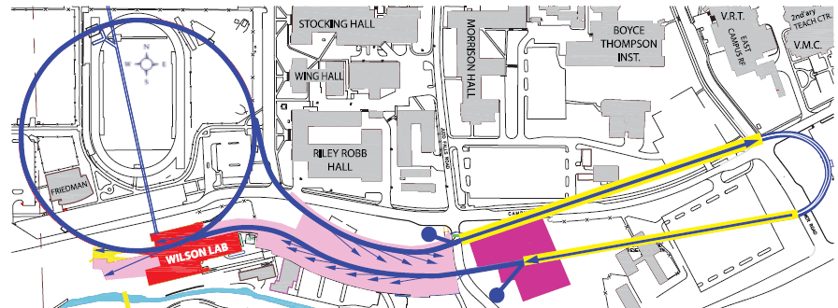
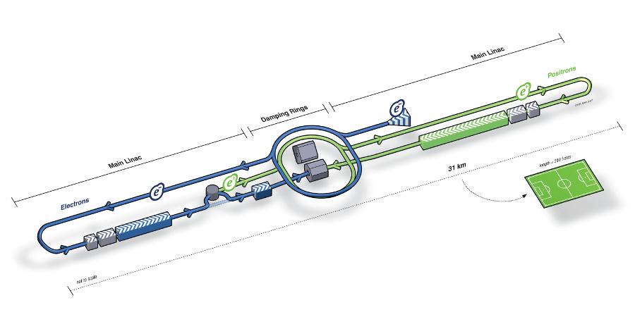
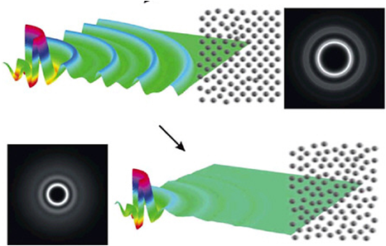
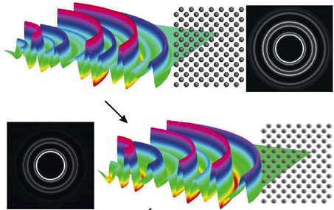
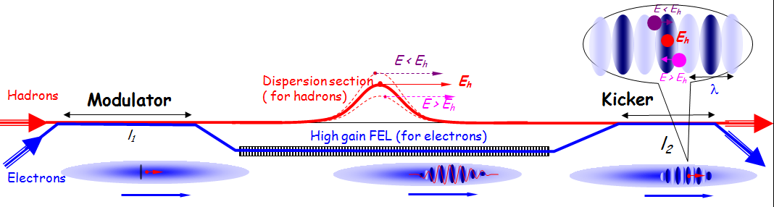
Need for high brightness beams
Powerful probes of matter
  Colliders, fixed target experiments
  Small lab scale probes (e.g. ultrafast electron diffraction)
Sources of secondary beams
  Synchrotron radiation sources: storage rings, free electron lasers, energy recovery linacs
Cooling of hadron beams
CEBAF 12 GeV
Spring-8
LCLS
Cornell ERL
ILC
coherent electron cooling scheme proposed at BNL
600 fs snapshots of Al melting, Dwayne Miller, U Toronto

Slide 5
Outline
Uses of high brightness beams
Physics of brightness
Photoinjectors: marriage of different fields
Cornell photoinjector for Energy Recovery Linac
Notes:
Now I will go through physics of brightness to give you some background and to show how my group has contributed to this important area.

Slide 6


What is brightness?
y
-z
6D phase space
  {x, p_{x}, y, p_{y}, E, t}
Connection to:
  Liouville theorem, beam temperature, entropy, coherence
x
Notes:
The main stage of accelerator physics is 6D phase space.

Slide 7
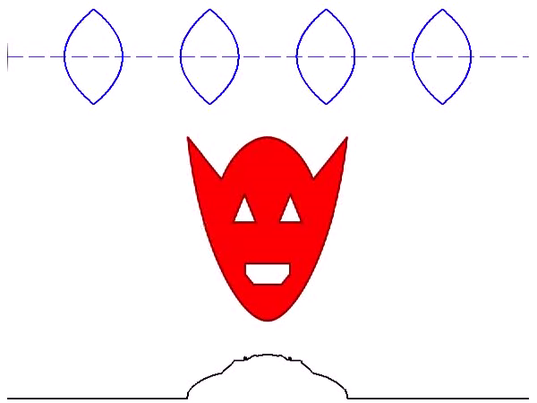
Example: linear optics beamline of non-interacting particles
position
transverse momentum
transverse position
Notes:
Whenever possible, it’s convenient to go to 2D phase space (x-px, y-py, or E-t).
B is constant!

Slide 8
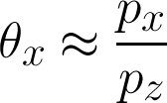

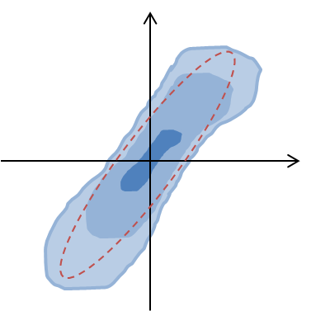





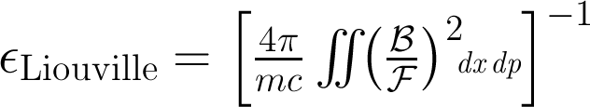
Some definitions
Micro-brightness:
  Flux:
Normalized emittance (phase space area):
  e.g. quantum limit for e–:
  geometric emittance:
Alternative definition of phase space area (volume)
  “Liouville’s emittance”:
Notes:
Liouville’s emittance is the inverse of average brightness – a measure of how diffuse the phase space is, regardless of shape.

Slide 9
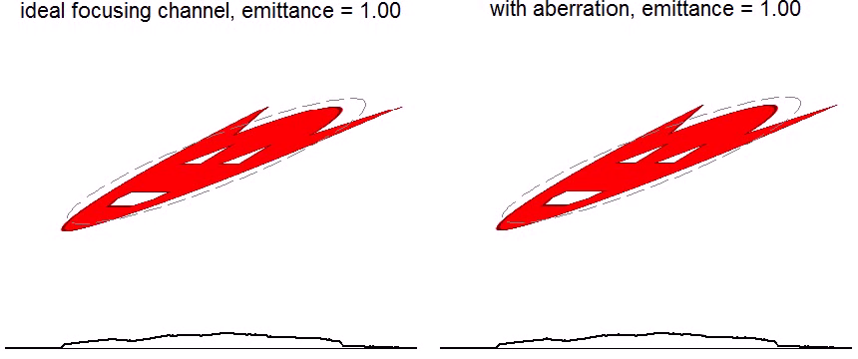
Linear and non-linear motion (continuous focusing channel)
momentum
position
position
Liouville’s emittance: const in both cases
Notes:
Note that focusing corresponds to rotation of the phase space. Using many projections (position profiles), one can reconstruct the phase space distribution or micro-brightness.

Slide 10
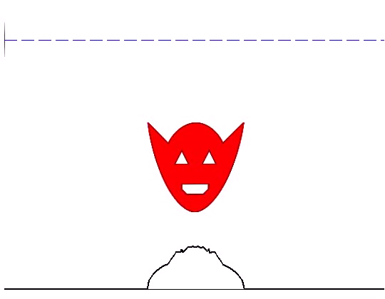
Space charge in a continuous focusing channel
position
momentum
transverse position

Slide 11
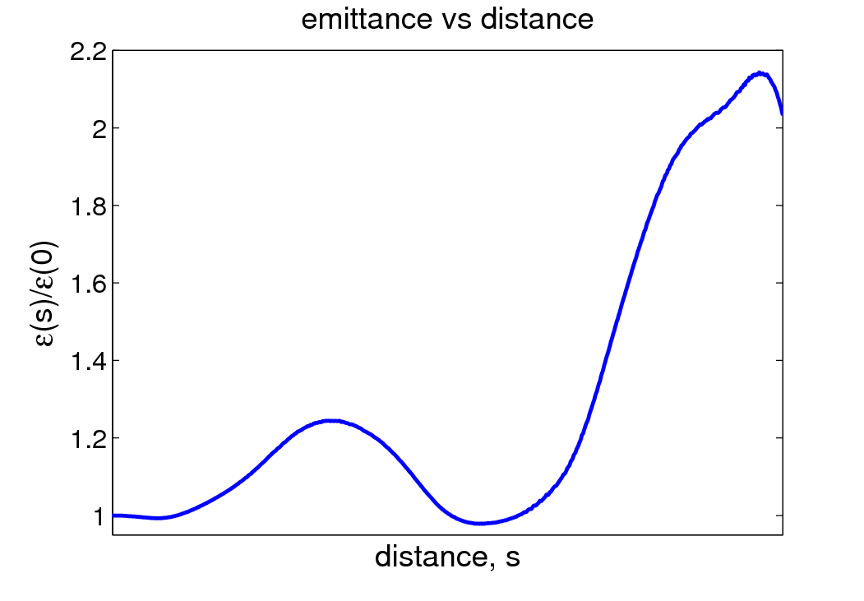
Space charge in a continuous focusing channel
But Liouville’s emittance stays const

Slide 12

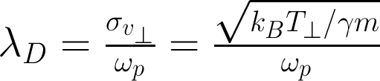

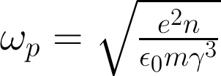

Tricky space charge
Beam as non-neutral plasma: 3 characteristic lengths
beam diameter; inter-particle distance; Debye length
single particle dynamics
YES
NO
collective forces matter
YES
“smooth force” 6D phase space volume conserved
NO
“grainy forces” must deal with 6N-D phase space
Notes:
Debye length – screening distance for a potential bump. Note that plasma frequency goes to 0 with increased energy (space charge disappears). In photoinjectors, the beam dynamics can undergo all three regimes.

Slide 13
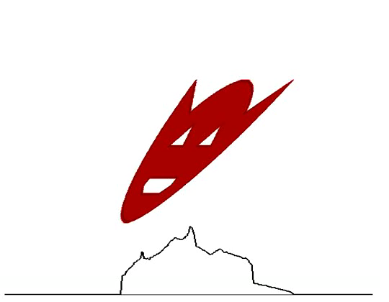
Information loss in phase space
momentum
position
Notes:
Both normal emittance and Liouville’s emittance increase. There can be several reasons for such washing out in the phase space such as “grainy” space charge and synchrotron radiation

Slide 14
Accelerator topologies
Linac Ring Recirculators
source
source
RF
beam dump

Slide 15
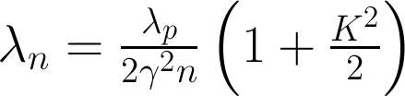

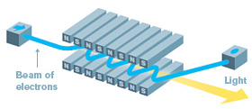
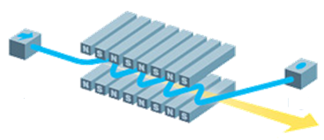
Synchrotron radiation sources
Some approaches to light production
Desired electron beam parameters
  Transverse phase space area (emittance) ~ wavelength
  Energy spread ~ 1/#periods
  Short pulses (~ picosecond and less)
  undulators (spontaneous emission) Free-electron-laser oscillator

Slide 16
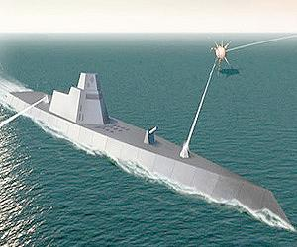
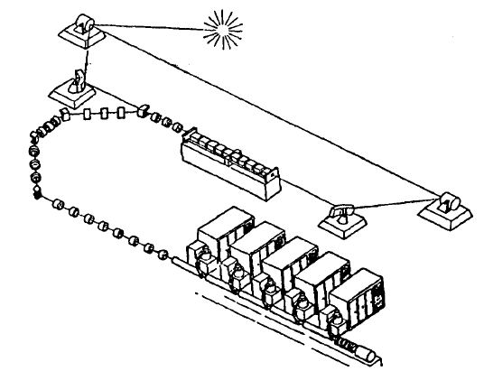
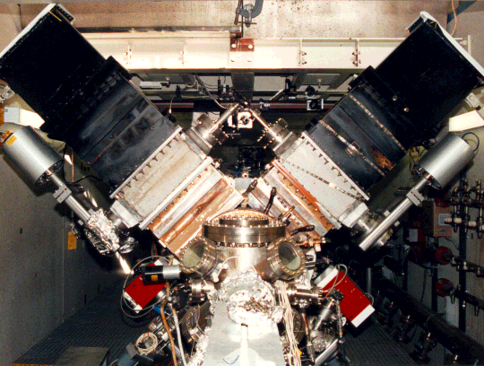
Strategic Defense Initiative
FEL oscillator pursued as an alternative to chemical lasers
Can provide megawatt beam in IR
  120 MeV × 100 mA × 8% ≈ 1 MW of IR power
Major technological challenges
  Electron source (emittance, current, longevity)
  High power mirrors
US Navy has since supported FEL R&D for ship defense
BOEING/LANL proposed demonstration facility for SDI
BOEING/LANL RF photogun
2.3 m
Notes:
Electron source parameters needed for 1MW were never reached within the SDI supported effort.

Slide 17
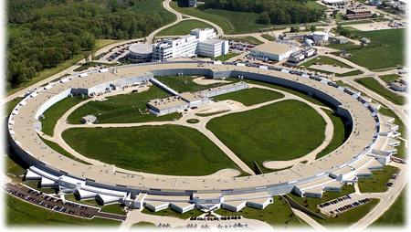
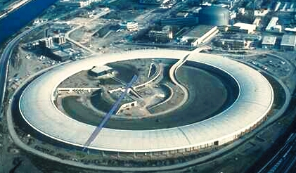
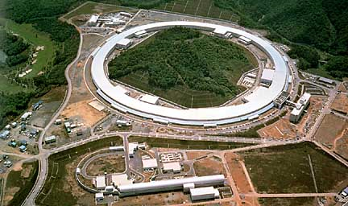

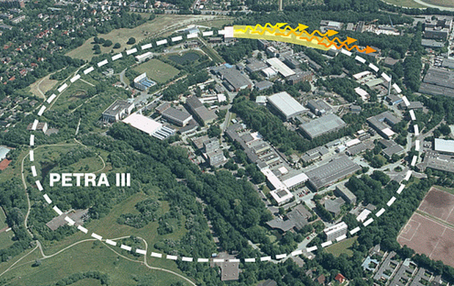
Storage rings for hard x-rays
APS: circumference 1.1 km, emittance 3 nm
ESRF: circumference 0.84 km, emittance 4 nm
For transverse coherence at 1Å require
Spring-8: circumference 1.4 km, emittance 3 nm
PETRAIII: circumference 2.3 km, emittance 1 nm

Slide 18


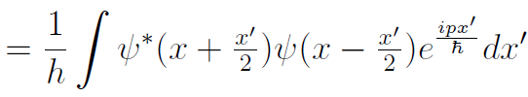
Brightness of waves?
Brightness as density of phase space = classical concept
Quantum mechanics “protects” simultaneous knowledge of position and momentum
  – or does it?
Notes:
At the time we started the ERL project it was unclear as to how to compute brightness of x-rays (waves not particles!). Everyone used Gaussian approximations for electron beams and x-rays. Turned out it was not good enough and one had to borrow concepts from quantum mechanics.

Slide 19
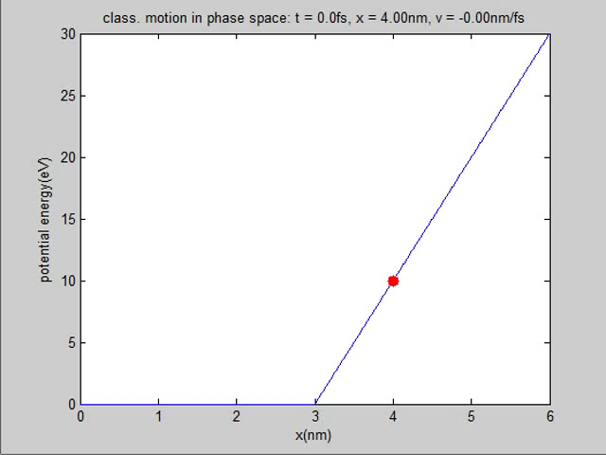
PHYS 3317 movies

Slide 20
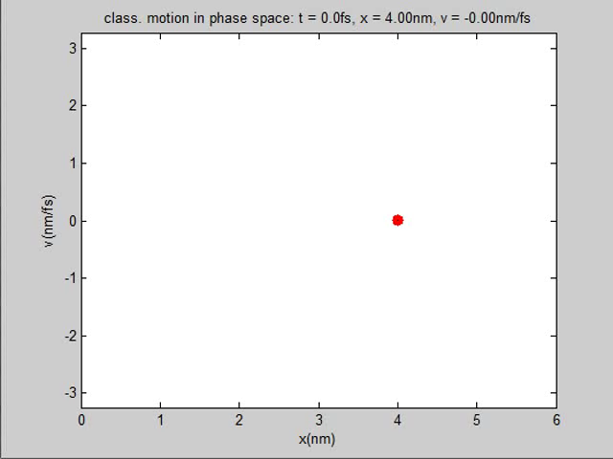
Same motion in phase space (classical)

Slide 21
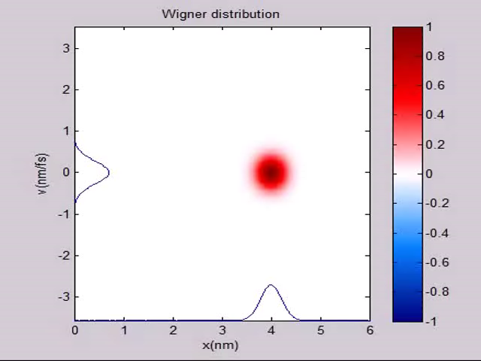
Same motion in phase space (quantum)
2/h
-2/h

Slide 22
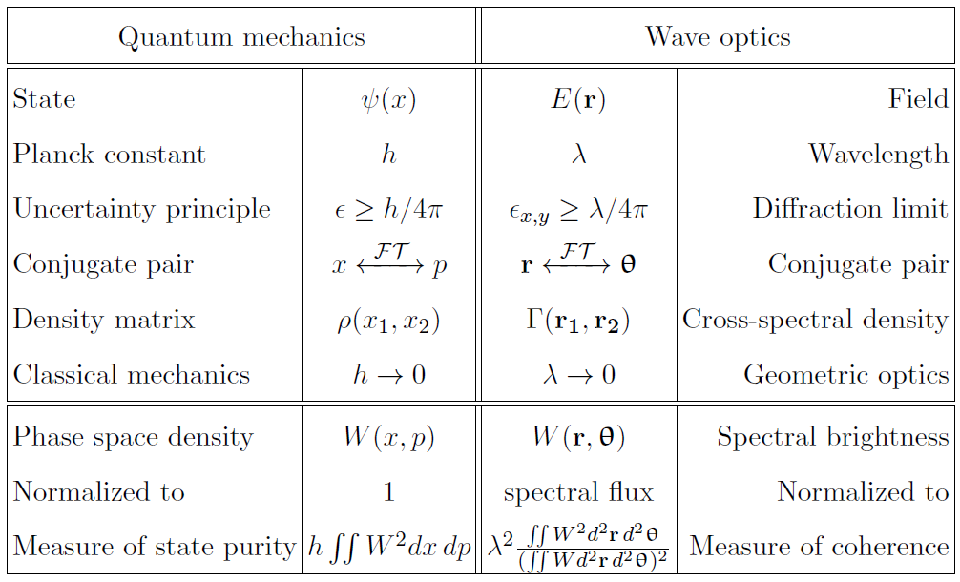
Quantum to wave optics correspondence
IVB, Phys Rev ST-AB 15 (2012) 050703
Notes:
This work came out in 2012, where we were able to put concepts of brightness for x-rays on a firm theoretical footing.

Slide 23



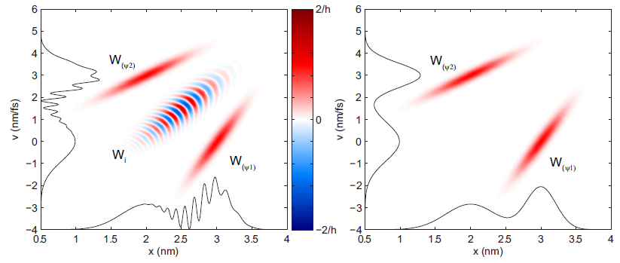


Partial coherence = mixed states
pure:
mixed:
always
IVB, Phys Rev ST-AB 15 (2012) 050703

Slide 24
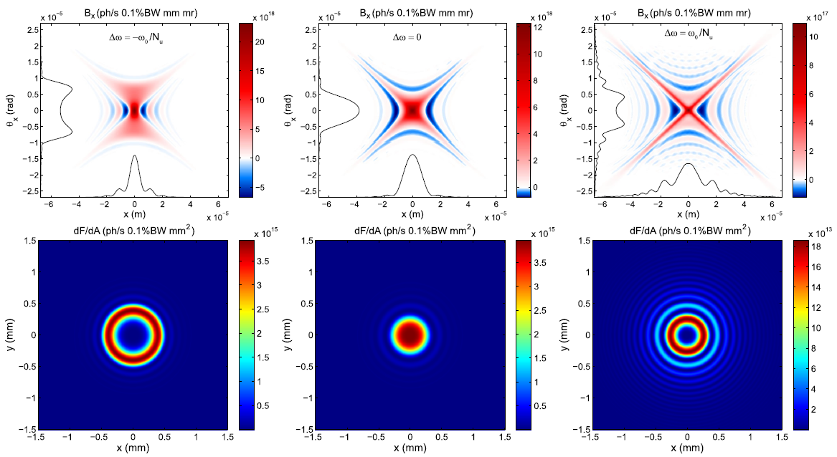
Example: undulator radiation
(zero emittance e-beam)
Radiation phase space at undulator center
Detector image 50 m from undulator
IVB, A. Gasbarro, IPAC’12, WEOBB03
IVB, Phys Rev ST-AB 15 (2012) 050703
Notes:
Andrew Gasbarro – undergraduate student working with me for the last 1.5 years.

Slide 25
Outline
Uses of high brightness beams
Physics of brightness
Photoinjectors: marriage of different fields
Cornell photoinjector for Energy Recovery Linac

Slide 26
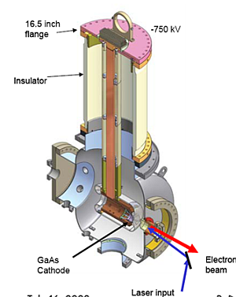
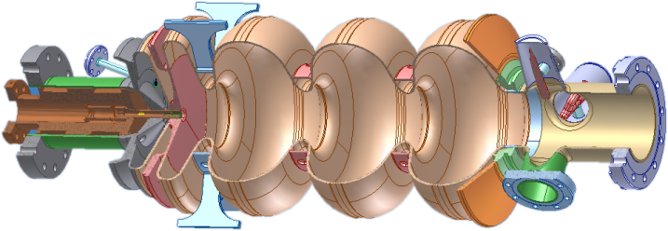
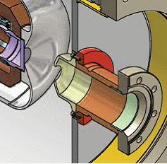
Photoinjectors = marriage of physics and technology
normal conducting RF gun
SRF gun
DC gun
plus variants…
CW operation: max cathode fields: (DC ≤10 MV/m), NCRF (≤ 20 MV/m), best promise for SRF (≤ 30 MV/m)
½ cell
Tuner
RF / HOM ports
Cathode
stock
Choke filter
3 full cells
LANL RF gun
ELBE SRF gun
Cornell gun
operating principle

Slide 27
Physics 101: basic limit to beam brightness from photoinjectors
Each electron bunch assumes a ‘pan-cake’ shape near the photocathode for short ( ≤ 10ps) laser pulses
Maximum charge density determined by the electric field:
dq/dA = ε₀ E_{cath}
Angular spread set by mean transverse energy (MTE) of photoelectrons
Δp⊥ ~ (m×MTE)^{1/2}
v
B_{n}
ε₀mc²
E_{cath}
3
MTE
=
∈_{n⊥}
=
q
f
2π
MTE
10πε₀mc²
E_{cath}
_{max}
IVB et al. PRL 102, 104801 (2009)

Slide 28
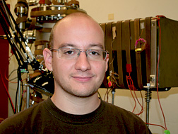
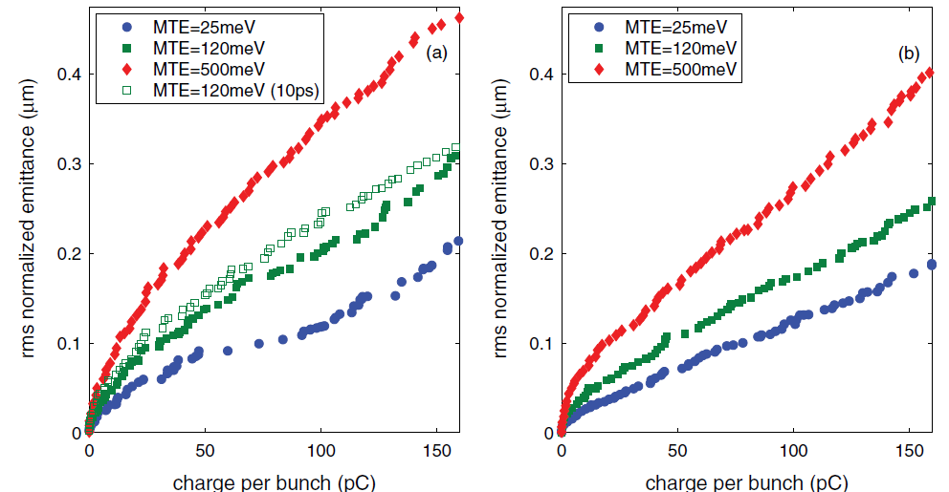
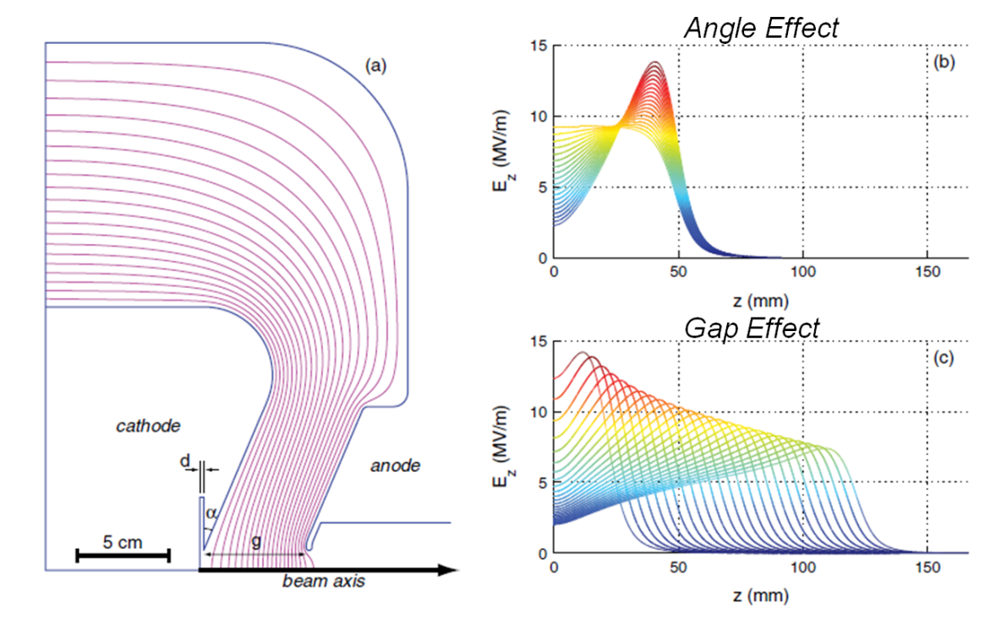
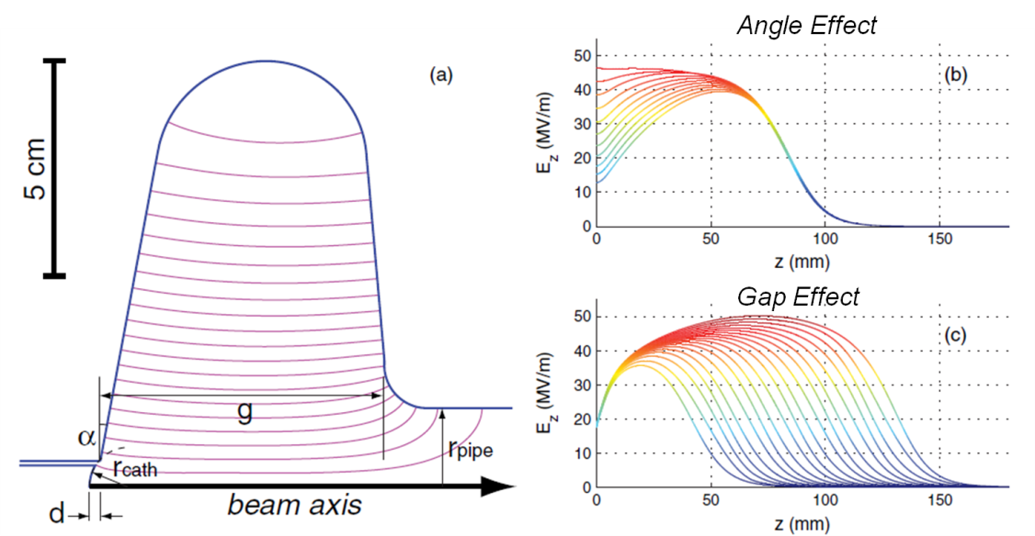
Optimization study: SRF vs DC guns
DC Gun
SRF Gun
Vary gun geometry while realistically constraining the voltages
Full beam dynamics with 3D space charge
Multiobjective parallel genetic optimization
DC gun, 3 geometry parameters: gap, cathode angle & recess
SRF gun, 4 parameters: gap, cath angle & recess, pipe dia
IVB, A. Kim, M. Lakshmanan, J. Maxson, Phys Rev ST-AB 14 (2011) 072001
Notes:
Mention undergrads.

Slide 29
Outline
Uses of high brightness beams
Physics of brightness
Photoinjectors: marriage of different fields
Cornell photoinjector for Energy Recovery Linac

Slide 30
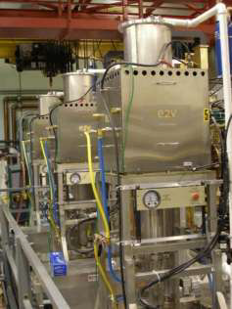
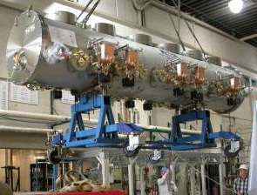
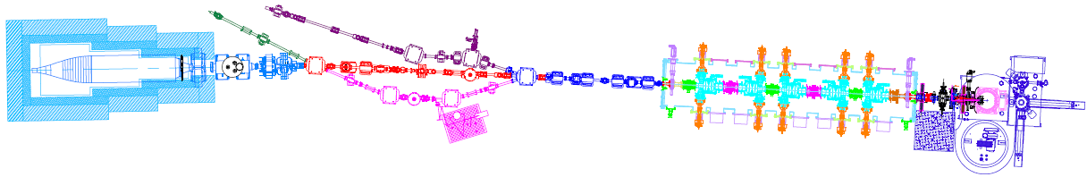
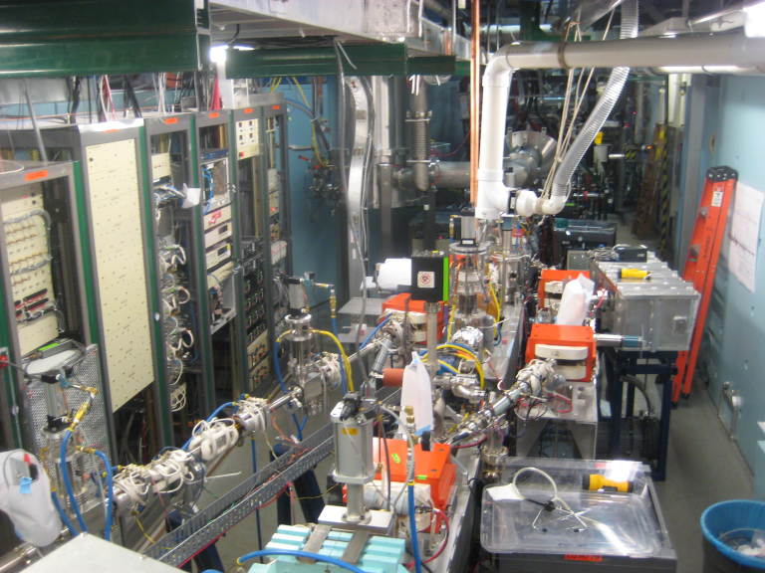
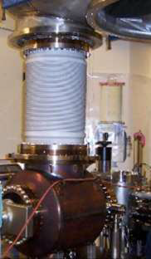
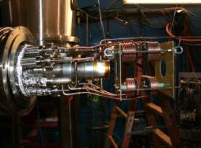

Cornell photoinjector
RF 135 kW klystrons
SRF cryomodule
photocathode
DC gun
cryomodule
buncher
NSF-supported accelerator R&D test-bed, operational starting 2009
  Main goals: ≤1 μm normalized rms emittance (to best storage rings)
  average current 33mA @ 15MeV & 100mA @ 5MeV
  2-3 ps bunch length
  demonstrate cathode longevity, RF controls, parameter stability & reliability
beam dump
diagnostics beam lines
5 m
world‘s brightest photoinjector!
HV DC gun
coldbox
laser system

Slide 31
Cornell photoinjector achievements (so far!)
Maximum average current of 52 mA achieved
  Previous record from LANL/BOEING RF gun 32 mA (pulsed), JLAB DC photoinjector 9 mA (CW);
Proved practicality of high current operation (~ kiloCoulomb extracted with no noticeable QE degradation at the laser spot)
  Best prior result was 400 Coulombs 1/e lifetime;
Original emittance spec achieved: 90% beam normalized emittance 0.5 μm at 80pC/bunch (= 100mA at 1.3GHz)
Would surpass best of existing storage rings if this quality beam were to be accelerated to 5 GeV (~5 better than PETRA3!)
  Beam brightness from previous high current photoinjectors improved by > 10²

Slide 32


















Photoinjector crew
and more …
Notes:
Here is one of the reasons why we achieved these results.

Slide 33



Key#1: space charge optics control & beam alignment
Example: require beam aligment to few 10μm within all key optics elements (gun, RF cavities, solenoids)
  perform orbit response measurements (either linear or non-linear) and fit data to model
aberrations
time slice-induced
RF quad due to input coupler
sol. alignment
accurate beam transfer maps:
C. Gulliford et al. Phys Rev ST-AB 14 (2011) 032002
C. Gulliford, IVB, Phys Rev ST-AB 15 (2012) 024002

Slide 34




Key#2: laser & shaping
with prof. Frank Wise
1.3GHz laser at 65W
Laser is primary, e-beam secondary
Control 3D shape to linearize space charge forces
  Numerically optimized laser shape
temporal – birefringent crystal pulse stacking
Temporal profile
Transverse profile
S. Zhou et al., Appl. Opt. 46 (2007) 8488
IVB et al., PRSTAB 11 (2008) 040702
H. Li et al., PRSTAB 14 (2011) 112802
Z. Zhao et al., Opt. Expr. 20 (2012) 4850

Slide 35





Key#3: beam diagnostics
‘Flying wire’: ~MW beam profile instrument
Emittance Measurement System
Time-domain diagnostics: 0.1 ps
Key beam instrumentation from Cornell accelerator group has been adopted at
LBNL, BNL, KEK, JLAB
IVB et al, PRSTAB 11 (2008) 100703
IVB et al, J. Appl. Phys.105 (2009) 083715
S. Belomestnykh et al, NIM A 614 (2010) 179
THz spectrometer for sub-mm bunch structure measurements
measured phase space
Notes:
imitation is the ultimate form of flattery

Slide 36





Key#4: photocathodes
over in Newman Lab
over in Wilson Lab
actual accelerator
antimonide growth & analysis chamber
with Dr. Schaff/ECE
over in Phillips Hall
Newman
Phillips
Wilson
dedicated MBE system

Slide 37



Key#4: photocathodes
Example: easiest x2 brightness increase after swapping a cathode with lower MTE (0.14 μm core norm. emittance at 75% core fraction for 20pC/bunch)
  – enormous potential for improvement!
phase space 20 pC/bunch
emittance vs. fraction
MBE grown GaAs
S. Karkare, IVB, APL 98 (2011) 094104
IVB et al, APL 98 (2011) 224101
L. Cultrera et al, APL 99 (2011) 152110

Slide 38






Key#5: don’t give up
setback #1 (the gun does not hold voltage above 250-280 kV)
setback #2 (charging ferrites)
corrector 2D scan
first beam (should be round!)
6 x HOM absorbers
SRF cold string
before SRF cavities
3 different tiles, 2 types charging up
⇒ Lab works in 3 shifts to rebuild the cryomodule
beam position after SRF (cavities are OFF!)

Slide 39




Key#5: don’t give up
setback #3 (dump meltdown)
repaired dump with 80 thermocouples added on the surface
Designed for 600 kW average power
We burned a hole in the aluminum dump at 25 mA. This was due to the incorrect setup of the raster/defocusing system, and one shorted magnet.
In this view, the water flows from the center (end of dump) to the outside (front of dump)
Notes:
A maxim: “you cannot collimate electrons, only make them angry”
These setbacks taught us many valuable lessons. Having overcome these setbacks we can now say: “Cornell photoinjector produces the world’s highest brightness relativistic beams”.

Slide 40

Outlook & future work
Cornell CLASSE lab has achieved a milestone in accelerator physics, now competing with ourselves;
Future work (happening now)
  All-new photoemission gun & low energy beamline; new diagnostics, improved laser shaping
  Photocathode research lab
    photoemission physics modeling
    material engineering
    real-life testing
~3m

Slide 41
Acknowledgements
The bigger ERL team: SRF group, CHESS & LEPP
  D. H. Bilderback, M. G. Billing, J. D. Brock, B. W. Buckley, S. S. Chapman, E. P. Chojnacki, Z. A. Conway, J. A. Crittenden, D. Dale, J. A. Dobbins, B. M. Dunham, R.G. Eichhorn, R. D. Ehrlich, M. P. Ehrlichman, K. D. Finkelstein, E. Fontes, M. J. Forster, S. W. Gray, S. Greenwald, S. M. Gruner, C. Gulliford, D. L. Hartill, R. G. Helmke, G. H. Hoffstaetter, A. Kazimirov, R. P. Kaplan, S. S. Karkare, V. O. Kostroun, F. A. Laham, Y. H. Lau, Y. Li, X. Liu, M. U. Liepe, F. Loehl, L. Cultrera, C. E. Mayes, J. M. Maxson, A. A. Mikhailichenko, D. Ouzounov, H. S. Padamsee, S. B. Peck, M. A. Pfeifer, S. E. Posen, P. G. Quigley, P. Revesz, D. H. Rice, D. C. Sagan, J. O. Sears, W. Schaff, V. D. Shemelin, D. M. Smilgies, E. N. Smith, K. W. Smolenski, A. B. Temnykh, M. Tigner, N. R. A. Valles, V. G. Veshcherevich, Z. Wang, A. R. Woll, Y. Xie, Z. Zhao
Wilson & Newman research support staff
Undergrads working with me this semester
  Eric Sawyer, Christian Ngueyn, Frank Gonzalez, Andrew Gasbarro, Jake Kiefer, Andrew Kim, Ben Lillard, Ben Pichler

Slide 42
Thank you!

