Slide 1
Cornell Laboratory for Accelerator-based ScienceS and Education (CLASSE)
Emittance and photocathodes
Ivan Bazarov
Cornell University
Where we are today
Injector performance
Ongoing work
Venues for improvements
Next generation gun
Achieving ultralow emittances
Photocathode research
Newman lab and Phillips Hall

Slide 2
Cornell ERL photoinjector highlights
Over the last year:
Maximum average current of 52 mA from a photoinjector demonstrated
Demonstrated feasibility of high current operation (~ kiloCoulomb extracted with no noticeable QE at the laser spot)
Original emittance spec achieved: now getting x1.6-1.8 the thermal emittance values (0.35 mm-mrad) at full 80pC charge (= 100mA at 1.3GHz)
Would surpass best of existing storage rings if this quality beam were to be accelerated to 5 GeV (~5 better than PETRA3 today!)

Slide 3
Emittance work
5 MeV operation
Initially limited to 5 MeV energy due to potential radiation hazards
Extensive studies of emittance in A4 section, getting 0.8 mm-mrad 100% rms emittance at 80 pC (simulated values 0.6 mm-mrad)
Longish bunch length 12 ps rms (simulated 8 ps rms)
Some issues with a non-round beam (cause of asymmetry is unclear, likely due to SRF cavities & alignment)
New diagnostics capabilities developed: slice emittance measurements (PhD thesis, Heng Li)

Slide 4
Ongoing emittance work
B1
C2
A3
A4
A5
C1
~8 MeV operation (merger studies)
Now cleared to run the injector up to 10 MeV
Rebuilt B1 section (merger) by adding RF deflecting cavity for slice emittance measurements
Finally commissioned THz interferometer (alternative bunch length diagnostics)
Now bunch length is 2-3 ps rms with 0.3 mm-mrad 70% core vertical emittance in the merger (matches simulations well)
Still discrepancy with the horizontal (x1.5-2 bigger)

Slide 5
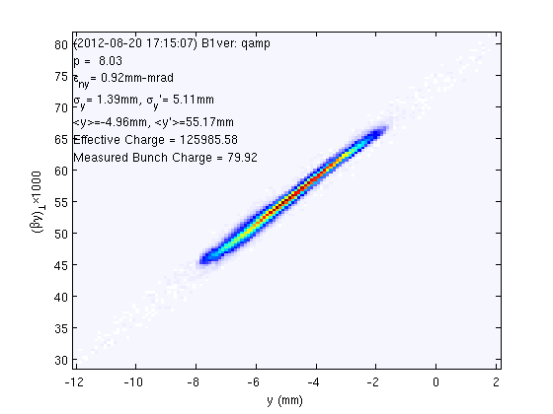
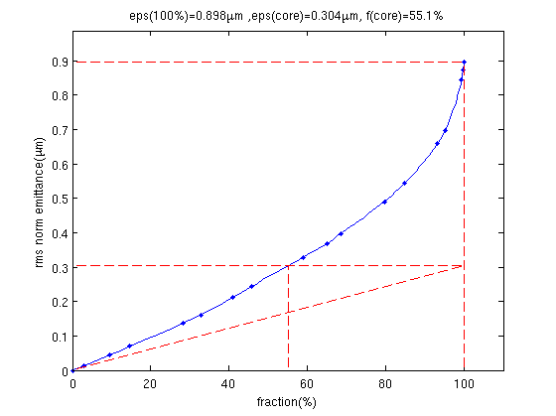
Measured merger phase space at 80 pC (bunch length 2.3 ps rms)
0.9 mm-mrad 100% vertical emittance, 0.3 mm-mrad core (60% fraction)
Simulated emittance is 0.8 mm-mrad 100% rms emittance
For proper description of beam brightness of non-Gaussian beams refer to
PSRTAB 15 (2012) 050703

Slide 6
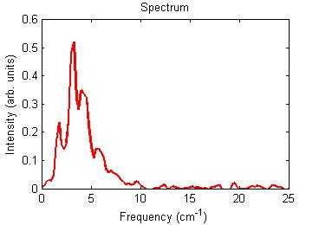
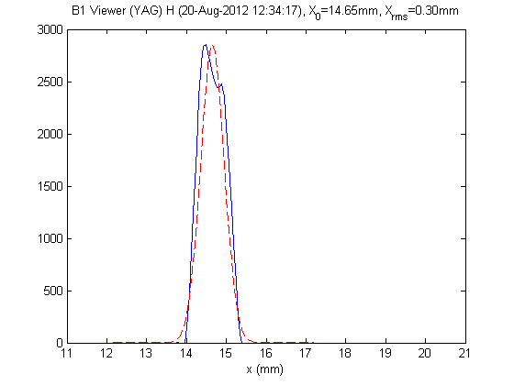
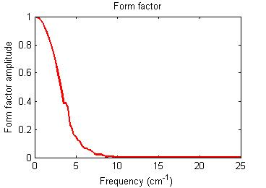
Good agreement between THz interferometer and RF deflector
THz diagnostics
RF deflector (central slice)
2 ps rms
2.6 ps rms

Slide 7
Linear optics characterization (response matrix measurements)
Horizontal emittance
Initial loading of optimized optics quite successful (agrees well)
Horizontal emittance is still larger (simulated values should be about the same)
Approach: make linear optics to agree
Characterize response matrices for optics by measuring M₁₁,₃₃ M₁₂,₃₄, coupling, and M₅₅,₅₆ along the beamline and check with detailed simulations (3D field maps)
Result so far:
Very good agreement of longitudinal elements M₅₅,₅₆ (bunch compression, energy); very good agreement of the transverse for static elements (solenoids, gun, quads, etc.); good agreement for M₁₁,₃₃ and M₁₂,₃₄ for first SRF cavity on and off-crest (last Fri!)

Slide 8
Emittance work plan & improvements
Finalize measurements of the low emittance in the merger and publish a detailed study
PhD student thesis (Colwyn Gulliford)
Planning to finish this or early next year (summer 2013 at the latest)
Smaller emittance improvement venues
Better cathodes
Better laser shape
Better gun

Slide 9
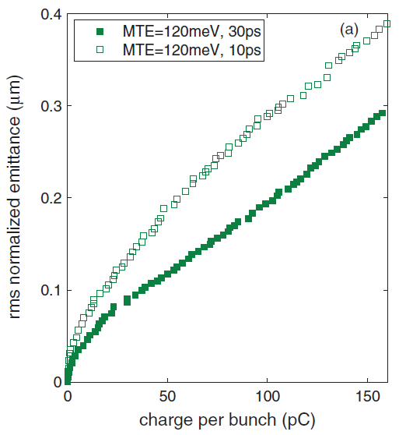
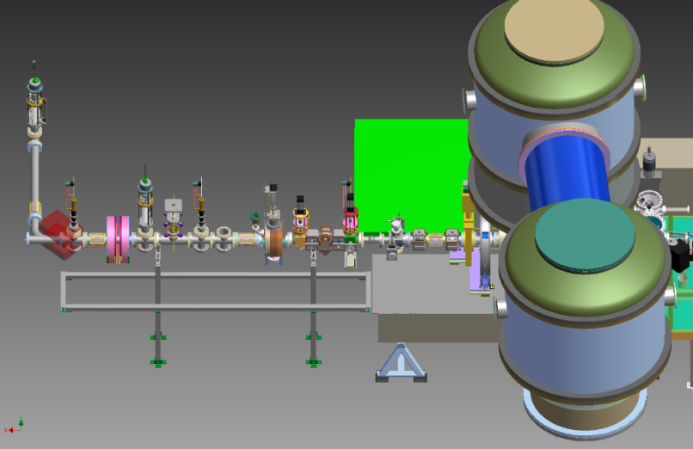
The new gun for ultralow emittances (coming online this year)
New gun & better laser shaping
Improved gun will give < 0.4 mm-mrad 100% 80pC emittance;
This will be first demonstrated in W128 (photogun devel. lab);
Adaptive laser shaping is acquired, the lab is being set up
K₂CsSb
~3m

Slide 10
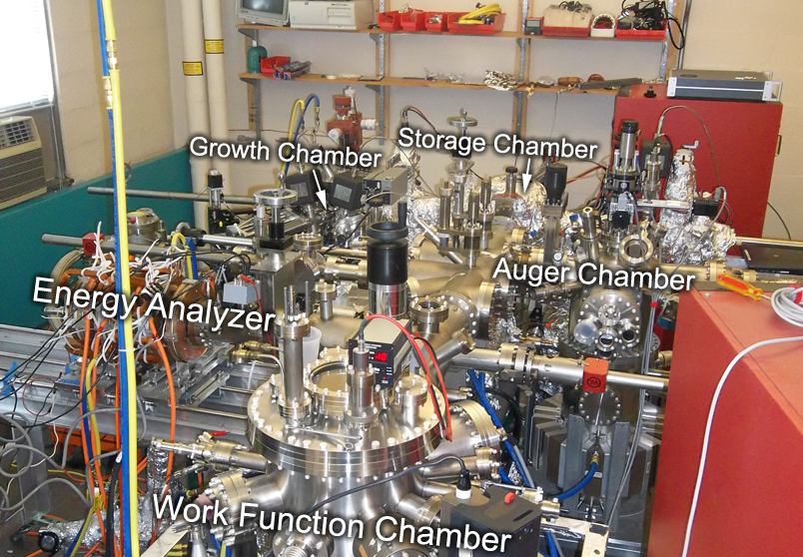
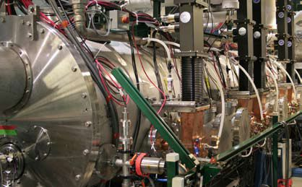
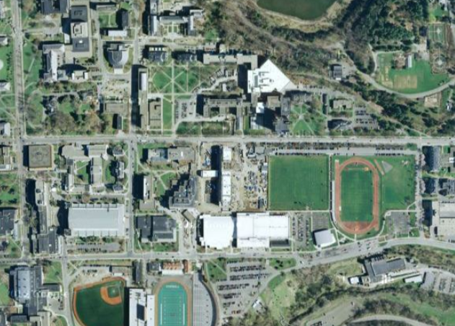
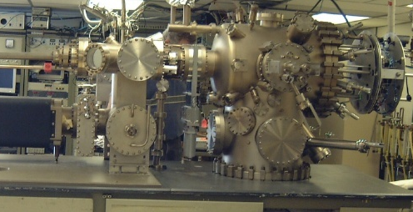
Developing advanced photocathodes for accelerators
over in Newman Lab
over in Wilson Lab
actual accelerator
antimonide growth & analysis chamber
over in Phillips Hall
Newman
Phillips
Wilson
dedicated MBE system

Slide 11
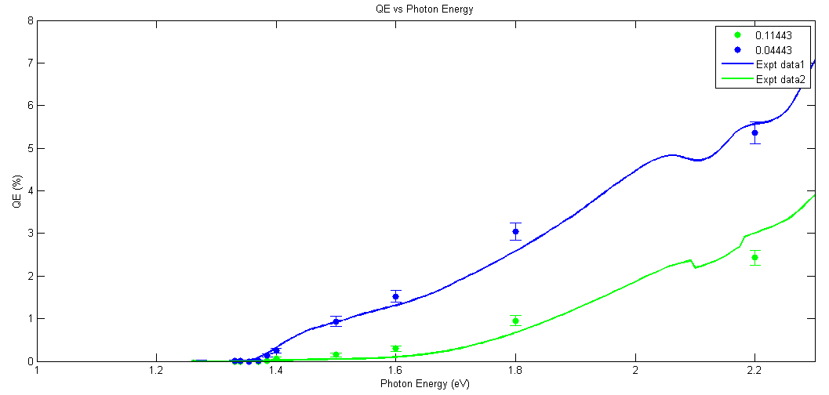
Photocathode research
Much progress over the last year
New photocathode lab set up in Newman lab (in-situ Auger/LEED, RHEED, spectral response, work-function measurements)
New MBE photocathodes grown and characterized
Now effort in modeling existing photocathodes to guide us in engineering of the new material
Theory vs experiment for GaAs spectral response
by S. Karkare

Slide 12
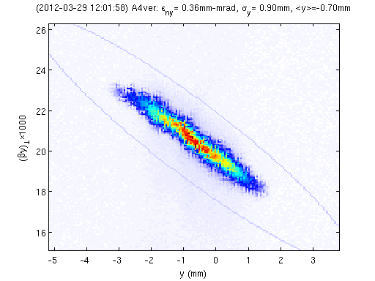
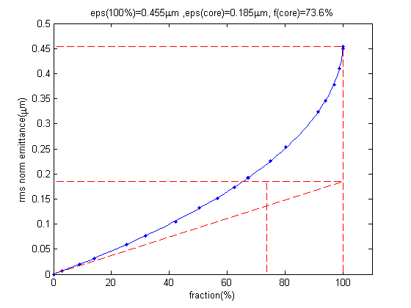
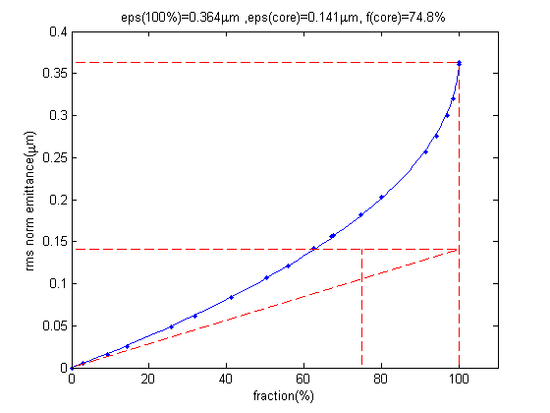
“Easiest” brightness improvement
phase space 20 pC/bunch
x2 brightness increase after swapping the cathodes (0.14 mm-mrad core emittance at 75% core fraction for 20pC/bunch)
emittance vs. fraction
emittance vs. fraction
K₂CsSb
MBE GaAs
Notes:
Add photocathode workshop

Slide 13
PPP workshop at Cornell (Ithaca, October 2012)
http://www.lepp.cornell.edu/Events/Photocathode2012/WebHome.html

Slide 14
Conclusions
Emittance performance today is in good agreement with simulations
Work underway to finalize emittance measurements for the present injector setup in L0
Further emittance improvements will be realized in a short beamline with the new photoemission gun & adaptive laser shaping
Novel photocathodes can improve emittance beyond what is achievable today; aggressive program underway

