Slide 1
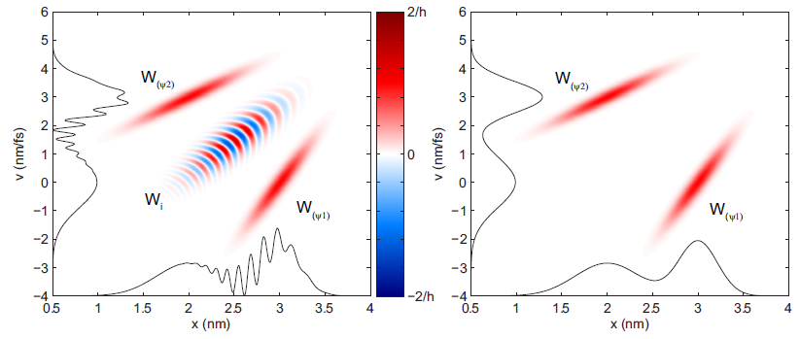
Cornell Laboratory for Accelerator-based ScienceS and Education (CLASSE)
Synchrotron Radiation Representation in Phase Space
Ivan Bazarov and Andrew Gasbarro
Cornell University
phase space of coherent (left) and incoherent (right) 2-state superposition

Slide 2
Motivation for this work
Do we understand physics of x-ray brightness?
Is diffraction limit same as full transverse coherence?
How to account for non-Gaussian beams (both e– and γ)?
This talk is a brief introduction, refer to
PRSTAB 15 (2012) 050703

Slide 3
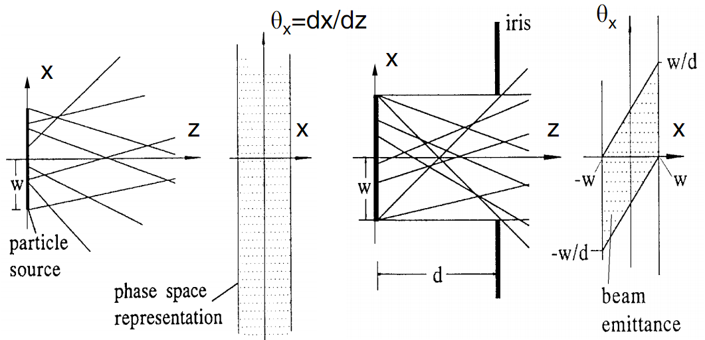
Brightness: geometric optics
Rays moving in drifts and focusing elements
Brightness = particle density in phase space (2D, 4D, or 6D)

Slide 4
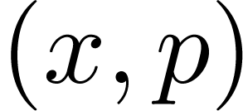
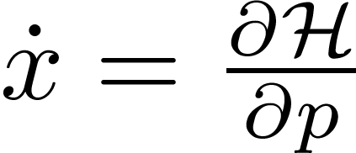
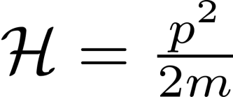
Phase space in classical mechanics
Classical: particle state
Evolves in time according to ,
E.g. drift: linear restoring force:
Liouville’s theorem: phase space density stays const along particle trajectories

Slide 5
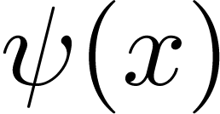
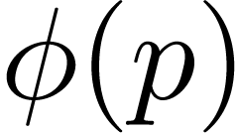
Phase space in quantum physics
Quantum state:
or
Position space momentum space
If either or is known – can compute anything. Can evolve state using time evolution operator:
- probability to measure a particle with
- probability to measure a particle with

Slide 6
Wigner distribution
– (quasi)probability of measuring quantum particle with and

Slide 7
Classical electron motion in potential

Slide 8
Same in phase space…

Slide 9
Going quantum in phase space…
+2/h
–2/h

Slide 10
Some basic WDF properties
(can be negative)
Time evolution of is classical in absence of forces or with linear forces

Slide 11
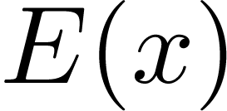
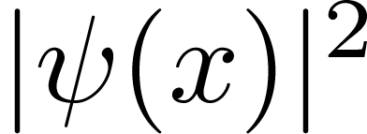
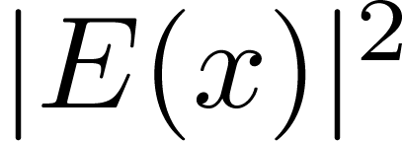
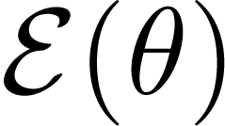
Connection to light
Quantum –
Linearly polarized light (1D) –
Measurable – charge density
Measurable – photon flux density
Quantum: momentum representation is FT of
Light: far field (angle) representation is FT of

Slide 12
Connection to classical picture
Quantum: , recover classical behavior
Light: , recover geometric optics
or – phase space density (=brightness) of a quantum particle or light
Wigner of a quantum state / light propagates classically in absence of forces or for linear forces
Wigner density function = brightness

Slide 13
Extension of accelerator jargon to x-ray (wave) phase space
Wigner distribution
= x-ray phase space
-matrix
Twiss (equivalent ellipse) and emittance
with and or
K.J. Kim, NIMA 246 (1986) 71

Slide 14
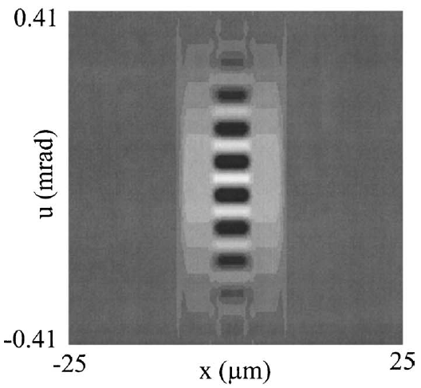
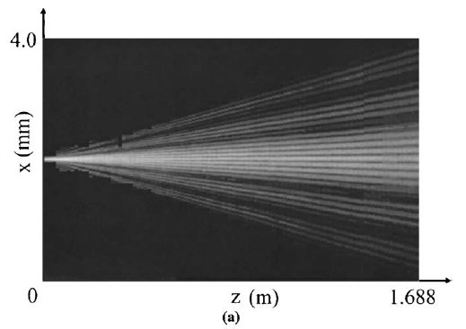
X-ray phase space can be measured using tomography
Same approach as phase space tomography in accelerators
Except the phase space is now allowed to be locally negative
x-ray phase space
detector placed at different positions
Tomography
negative
values
2μm
1.5 keV x-rays incident on a double-slit
10μm
C.Q. Tran et al., JOSA A 22 (2005) 1691

Slide 15
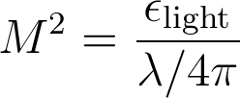
Diffraction limit vs. coherence
Diffraction limit (same as uncertainty principle)
M² ≥ 1 (ability to focus to a small spot)
a classical counterpart exists (= e-beam emittance)
Coherence (ability to form interference fringes)
Related to visibility or spectral degree of coherence
0 ≤ |μ₁₂| ≤ 1
quantum/wave in its nature – no classical counterpart exists
Wigner distribution contains info about both!

Slide 16
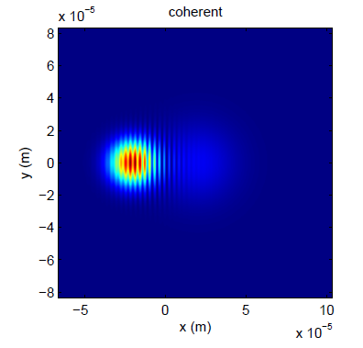
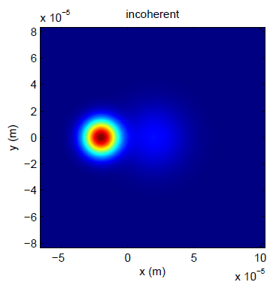
Example of combining sources (coherent vs incoherent)
two laser Gaussian beams

Slide 17
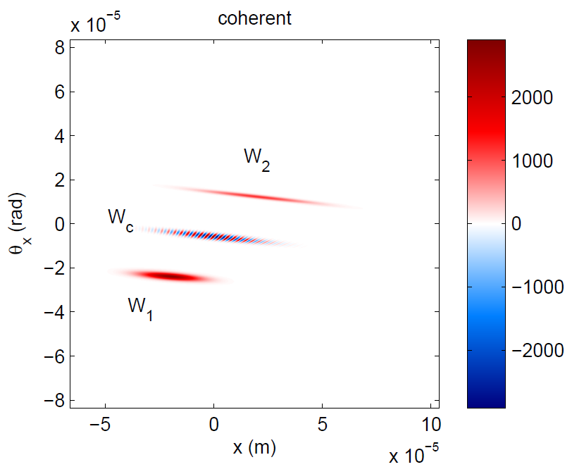
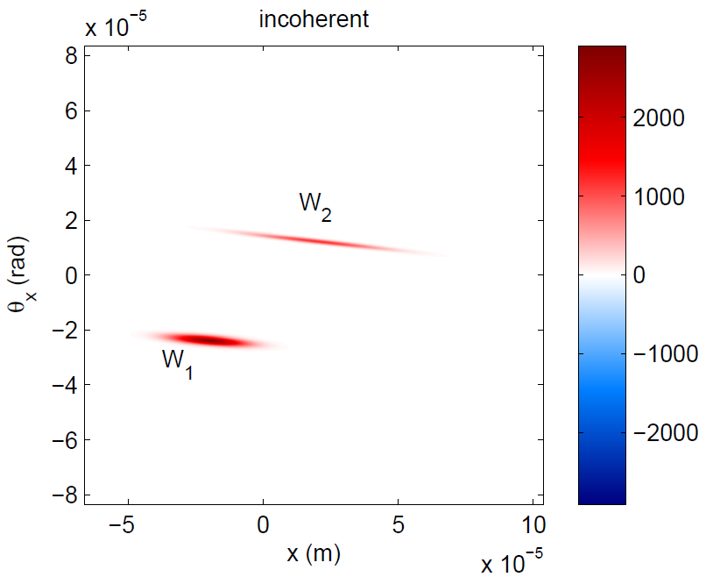
Same picture in the phase space
two laser Gaussian beams
μ² = 1
μ² < 1
M² > 1
M² > 1

Slide 18
Facts of life
Undulator radiation (single electron) is fully coherent (μ² = 1)
But is not diffraction limited M² > 1
X-ray phase space of undulator’s central cone is not Gaussian
Old (Gaussian) metrics are not suitable for (almost) fully coherent sources

Slide 19
But the undulator radiation in central cone is Gaussian… or is it?
animation: scanning around 1st harm. ~6keV
(zero emittance)
Spectral flux (ph/s/0.1%BW/mm²) at 50m from undulator (5GeV, 100mA, λ_{p} = 2cm)

Slide 20
Light in phase space
animation: scanning around 1st harm. ~6keV
(zero emittance)
Phase space near middle of the undulator (5GeV, 100mA, λ_{p} = 2cm)

Slide 21
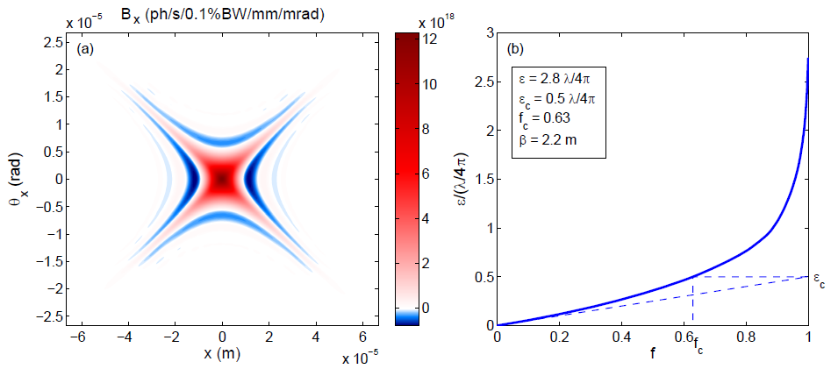
Emittance vs. fraction for light: 100% rms emittance, core emittance, and core fraction
Change clipping ellipse area from ∞ to 0, record emittance vs. beam fraction contained
Smallest M² ~ 3 of x-ray undulator cone (single electron)
Core emittance of any coherent symmetric mode is always λ/8π

Slide 22
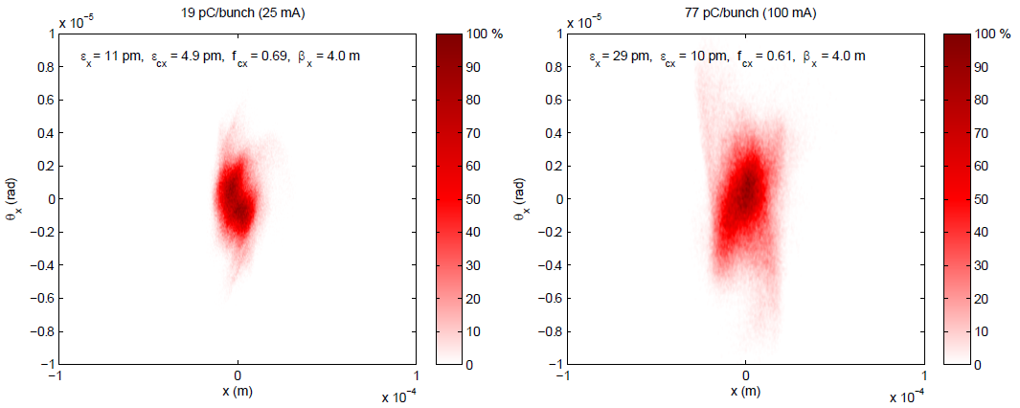
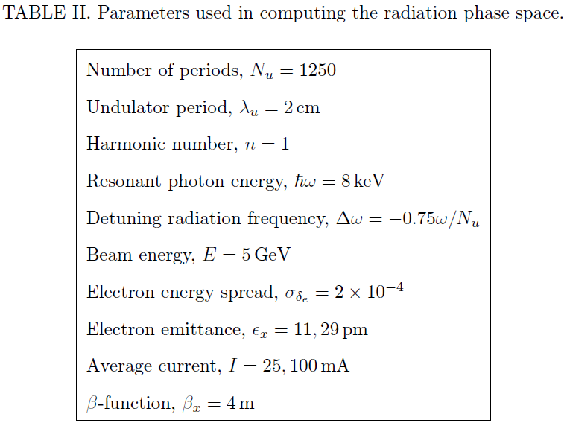
Example of accounting for realistic spreads in the electron beam (Cornell ERL)
e-beam phase space at undulator 25mA
e-beam phase space at undulator 100 mA

Slide 23
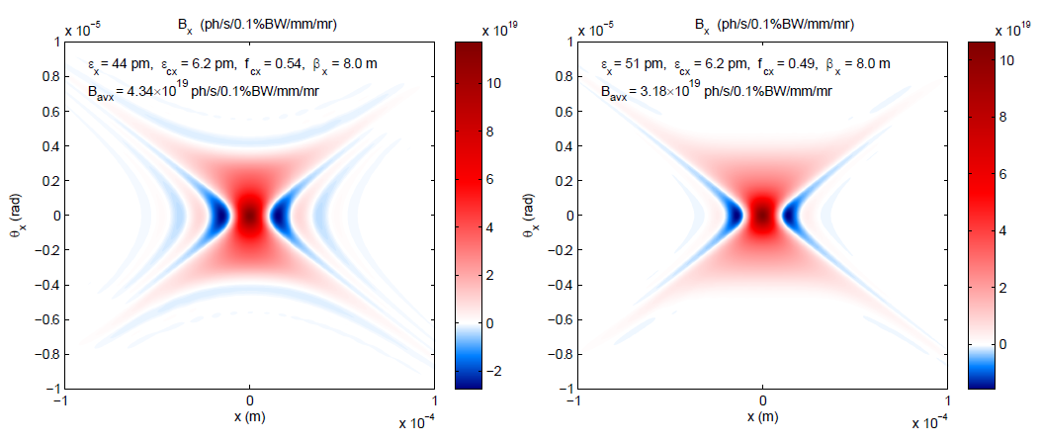
Accounting for energy spread (phase space of x-rays)
zero emittance, zero energy spread
zero emittance, 2x10^{–4} energy spread

Slide 24
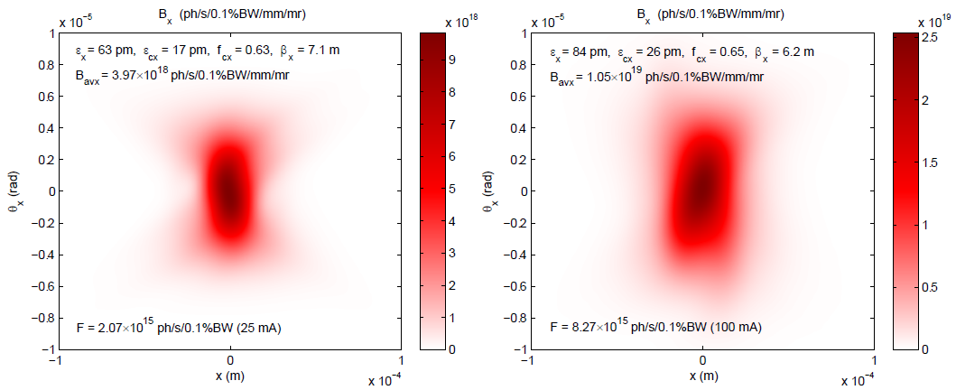
And finite emittance… (phase space of x-rays)

Slide 25
Summary
Wigner distribution function: natural framework for describing partially to fully coherent x-ray sources
Distinction between diffraction limit and coherence must be made
Fully coherent synchrotron radiation is not diffraction limited
Gaussian approximation does not work well when describing diffraction limited sources
Refined metrics must be used for comparison
There is much interconnection between classical wave optics in phase space and quantum mechanics waiting to be explored further

